Slide 1
XML in Biomedical Informatics
Jonathan Borden, M.D.
Assistant Professor of Neurosurgery, Tufts University, New England Medical Center, Boston
Chair, ASTM E31 Electronic Healthcare Records

Slide 2
The Goal
Answer questions like:
“Of all the patient’s I operated on for brain tumors between 1996-2000, matching severity of pathology and matching clinical status and who have the “P53” mutation, did PCV chemotherapy improve the cure rate at five years?”

Slide 3
Healthcare: The current situation
A disaster: 1.1 Trillion $/year in the USA
30-40 % overhead
mostly paper based
highly proprietary commercial systems
tens of thousands of Americans die each year due to poor information/errors
Most of the information is rendered useless

Slide 4
Strategies
Define open standards
Capture information in an electronic form
Reduce errors related to information
Define distributed, web enabled, query models

Slide 5
Tactics
XML, schemas, query model
Semantic Web/URI graphs
Data analysis based on actual population rather than small, potentially biased, samples
Google for biomedical information

Slide 6
Why XML?
Widely implemented with excellent open source tools
Life of data is longer than life of application
Data driven, Platform independent
Formal schema and query models

Slide 7
Reinventing medical informatics
Get the data format right and the rest will follow
Structured information has been the holy grail of medical informatics for the last 30+ years
XML is the culmination of 30+ years of work in structured information
Time to do something

Slide 8
XML Briefly
Simplification of SGML … markup language for the web
<element> content </element>
<element attribute=“value”>
  <child-element another=“123”/>
</element>

Slide 9
ASTM E31.25
XML DTDs for Healthcare
Emphasize Human Readability
Flexibility
Openhealth reference implementation http://www.openhealth.org/ASTM
Compatible with HL7 CDA

Slide 10
ASTM Healthcare DTDs
clinical.header
  compatible with HL7 CDA
clinical.body
  specific to document type
  operative.report
  radiology.report
  discharge.summary etc.

Slide 11
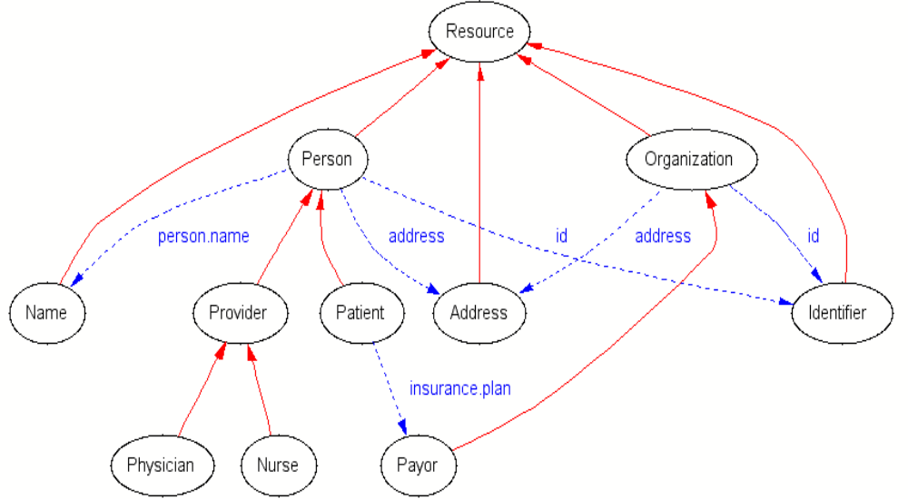
Healthcare Schema

Slide 12
Healthcare datatypes
<person>
  <person.name>
    <prefix>Ms.</prefix>
    <given>Susan</given>
    <given>Samantha</given>
    <family>Jones</family>
  </person.name>
  <id type=“SSN”>000-11-2233</id>

Slide 13
Healthcare datatypes
<patient>
  <person.name> … </person.name>
  <id authority=“New England Medical Center”>000112233</id>
</patient>
<provider>
  <person.name><prefix>Dr.</prefix><given>Amanda</given><family>Smith</family></person.name>
</provider>

Slide 14
Encounter
<encounter>
  <patient>…</patient>
  <provider>…</provider>
  <date.time>…</date.time>
  <location> … </location>
  <encounter.id>…</encounter.id>
</encounter>

Slide 15
Capturing encounters
Encounters are billable units of work
U.S Govt pays ~50% of the bills
Payors often require associated clinical information prior to paying bill
-This information should be aggregated for statistical purposes-

Slide 16
Leveraging HIPAA: attachments are key!
Collect attachments

Slide 17
Integrating binary formats
MIME <-> XMTP
HL7 V2
X12 EDI
DICOM

Slide 18
Internet Telemedicine
The OceanMed project, 1998
Merchant vessel, e-mail access via satellite gateway
Digital camera
Web based physician access

Slide 19
XMTP
Gateway
Ship
SMTP
XMTP
MIME -> XML ->
XSLT ->
HTML
HTML

Slide 20
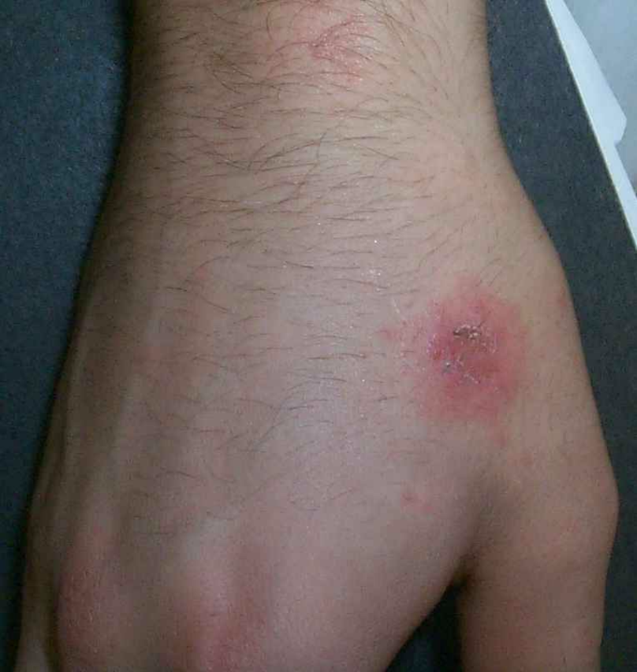
XMTP Consult
36 year old male has itchy rash for 6 days
Hydrocortisone cream 1% to affected area t.i.d.|
reply

Slide 21
How it works
Messages arrive in MIME format
MIME SAX parser ‘converts’ to XML by SAX events
XMTP employs XML object model *not necessarily* serialization format ->
grove processing

Slide 22
XMTP
From: joe.patient@home.com
To: sue.doctor@openhealth.org
Content-type: multipart/related; charset=iso-8859-1
---------
startDocument()
  startElement(“MIME”)
    startElement(“From”)
      characters(“joe.patient@home.com”)
    endElement(“From”)
    startElement(“Content-Type”, attribute(“charset”,”iso-8859-1”))
      characters(“multipart/related”)
    endElement(“Content-Type”)

Slide 23
The XMTP/MIME grove
Content-type: text/plain
From: joe@whereever.org
To: sue@example.com
Hi Sue! See you in Boston, Joe
<MIME>
<Content-type>text/plain</Content-Type>
<From>joe@whereever.org</From>
<Body>Hi Sue! See you in Seattle, Joe</Body>
</MIME>

Slide 24
Healthcare Groves
<patient>
  <person.name>
    <given>James</given><given>Steven</given>
    <family>Smith</family><suffix>3rd</suffix>
  </person.name>
startElement(“patient”)
  startElement(“person.name”)
    startElement(“given”);characters(“James”);...

Slide 25
The HL7 Grove
MSH|PAT|Jones^James^Stephen^3rd|
startElement(“patient”)
  startElement(“person.name”)
  startElement(“family”)
    characters(“Jones”);
  endElement(“family”)

Slide 26
Regular Expressions
Pattern matching
“*TATA*”
bp ::= ‘G’ | ‘T’ | ‘A’ | ‘C’
tata ::= bp*, ‘T’, ‘A’, ‘T’, ‘A’, bp*

Slide 27
XML DTD
<!ELEMENT foo (bar*)>
<!ELEMENT bar (baz?)>
<!ATTLIST bar bop CDATA #IMPLIED>
<!ELEMENT baz (#PCDATA)>

Slide 28
Tree Regular Expressions
<foo>
  <bar bop=“23”>
    <baz>xxx</baz>
  </bar>
</foo>
foo[
  bar[
  @bop[int]
    baz[‘xxx’]
    ]
  ]

Slide 29
Tree Regular Expressions
RELAXNG http://www.relaxng.org
<pattern name=“foo”>
  <element name=“foo”>
    < element name=“bar”>
      <attribute name=“bop”>
        <data type=“int”/>
      </attribute>
      <element name=“baz”>
        <value>xxx</value>
      </element>

Slide 30
Simple building blocks
XML parsers
XSLT transform engines
HTTP clients and servers

Slide 31
The shape of information
“…..TATA…..”
Pattern matching transform
gene
snp
tata
snp

Slide 32
How it works
Browser
Apache
Servlet engine
RDF
xml:db
XSLT

Slide 33
Form generation
XML + XSLT => XHTML
Formgen.xsl
Form.xml
Defaults.xml

Slide 34
Workflow
Form created
Transform into ASTM XML format
XHTML editing (opnote-edit.xsl)
Sign finished product
Render as XHTML for viewing, printing
email to Medical Records and Billing

Slide 35
Workflow
generate
Billing
edit
repository
sign

Slide 36
Document analysis
Like gene sequences, it turns out that …
Medical documentation is highly repetitive
With ‘hot spots’ of unique information
Schema defines template filled with values
Easily expanded into HTML for human consumption
Easily analyzed by software

Slide 37
Document analysis

Slide 38
RDF in Healthcare
<rdf:Description about=“…/patient/12345”>
<lab:HIV>positive</lab:HIV>
<lab:CD4>100</lab:CD4>
</rdf:Description>
<path:Biopsy about=“…/patient/12345”>
<path:description>The brain demonstrates areas of PML including viral inclusion bodies </path:description>
</path>

Slide 39
RDF is...
A standard syntax to represent (edge labeled) directed graphs in XML

Slide 40
Edge Labeled Directed Graphs
bar
isa
has
foo
baz
plays
wants
(isa, foo, bar)
(has, bar, baz)
(plays, baz, bop)
(wants, baz, bing)
bing
bop

Slide 41
Semantic Networks
A way to represent natural language circa 1970s
A format for organizing statements in a way that can be queries by computers

Slide 42
Semantic Networks
spine
has
heart
vertebrate
isa
wings
hair
mammal
bird
fly
walk
can
isa
isa
doesn’t fly
canary
yellow
ostrich
freddie
hugo

Slide 43
Semantic Networks
“Can freddy fly?”
“Does hugo have wings?”
“Does freddy have a spine?”
“Of all the canaries, how many live in cages?”

Slide 44
XML form
<patient ID=“Patient12345”>
<person.name>
<given>Jonathan</given>
<family>Borden</family>
<person.name>
<primary.care.physician>
<provider ...

Slide 45
RDF Graph
Person
PersonName
Literal
Person12345
person.name
value
Jonathan
given
family
value
Borden

Slide 46
Semantic analysis
Class
Class
subClass
type
repository
domain
Class
Property
type
instance

Slide 47
Semantic analysis
“Of all the patient’s I operated on for brain tumors between 1996-2000, matching severity of pathology and matching clinical status and who have the “P53” mutation, did PCV chemotherapy improve the cure rate at five years?”

Slide 48
First Order Predicate Logic
(for-all ?pat (exists ?surgeon
(last-name ?surgeon “Borden”))
(exists ?procedure (craniotomy ?procedure)
(patient ?procedure ?pat)
(surgeon ?procedure ?surgeon)
(between (date ?procedure)
“1996” “2000”)
(sequence ?procedure “p53”)
...

Slide 49
DAML+OIL
DARPA Agent Markup Language
Ontology Inferencing Language
Adds description logic capabilities to RDF
An extension of RDF Schema
W3C WebOnt
“Semantic networks on the web using c. 2001 technology”

Slide 50
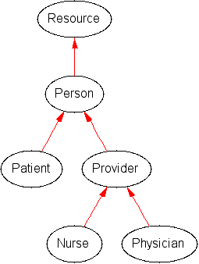
Simplified Healthcare Schema
<rdfs:Class rdf:ID=“Provider”>
<rdfs:subClassOf rdf:resource=“#Person”/>
</rdfs:Class>

Slide 51
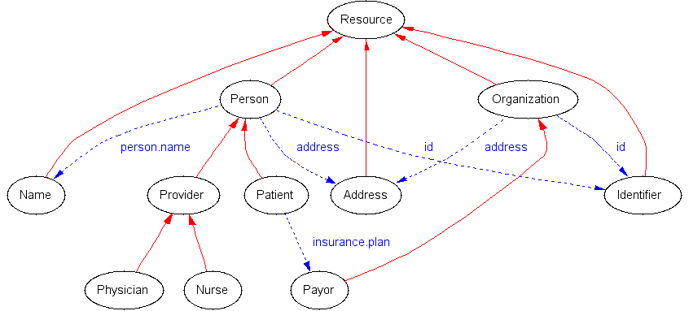
Simplified Healthcare Schema

Slide 52
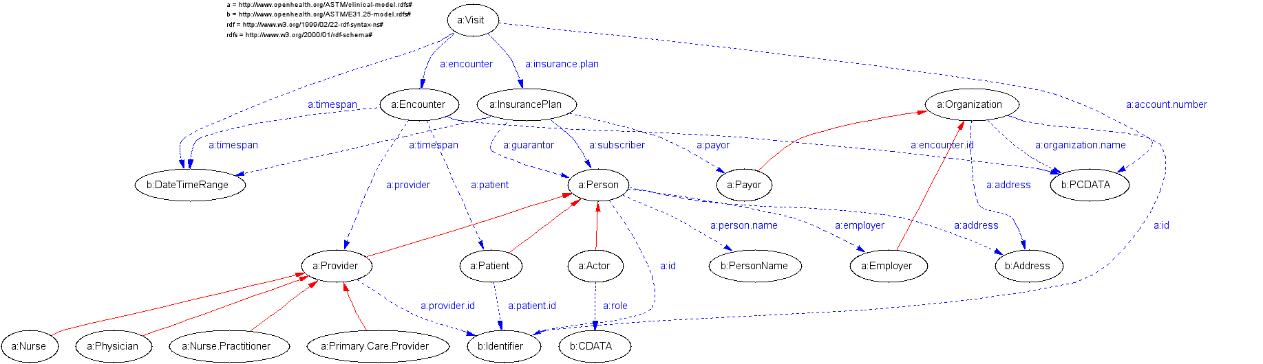
Healthcare Schema

Slide 53
XML Namespaces
Namespace name is a URI “http://…”
Namespace name may/should identify a resource directory (RDDL)
RDDL resource directory contains various schemata, descriptions, code etc. associated with namespace

Slide 54
Resource Directory Description Language (RDDL)
Proposed as a solution to what a namespace name URI ought reference
Both human and machine readable
XHTML Basic + XLink resources
Parsers available two weeks after initial proposal
An XML-DEV project

Slide 55
RDDL
Proposed January 2001
Adopted by namespaces such as XML Schema, Schematron, RSS, Examplotron, XSLT Extension framework, SWAG
http://www.rddl.org/

Slide 56
DAML Schema resource
<rddl:resource
  id=“DAML”
  xl:role=“http://www.daml.org/2001/04” -- Nature
  xl:arcrole=“http://www.rddl.org/purposes#schema-validation” -- Purpose
  xl:title=“My DAML Ontology”
  >
  <p>This is my DAML</p>
</rddl:resource>

Slide 57
XSLT resource
<rddl:resource
  xl:role=“http://www.w3.org/1999/XSL/Transform”
  xl:arcrole=“http://purl.org/rss/1.0”
  xl:href=“toRSS.xsl”
  >

Slide 58
Java resources
<rddl:resource
  xl:role=“…application/java-archive”
  xl:arcrole=“…purposes/software#xslt-extension”
  xl:href=“thisNS-xslt-extension.jar”
  ><p>The xslt extensions bound to this namespace are packaged in a JAR</p>
  </rddl:resource>

Slide 59
Putting it all together
Biomedical information has many vocabularies - each in its own namespace
genetics “Bio ML”
pathology “SNOMED”
surgery “CPT”
medicine “ICD”
radiology “DICOM”

Slide 60
Putting it all together
diagnoses
genes
drugs
procedures
Electronic
medical record

Slide 61
DAML across schemas
person
Left temporal tumor
SNOMED:
gliomblastoma
Gene:
p53
genetics
Path-specimen
MRI

Slide 62
The shape of ontologies
enhancing
astrocytoma
p53
glioblastoma
Ring enhancing
...
p53

Slide 63
Queries
Query as universal/existential quantification
DAML/RDF subgraph matching
XML Query model
Regular expression pattern matching

Slide 64
Future directions
The technology is here …
Define schemas and ontologies
Standardize data formats
Collect data
just do it!
jonathan@openhealth.org

Slide 65
Contact Information
Jonathan Borden, M.D.
Department of Neurosurgery
New England Medical Center
750 Washington Street
Boston, MA 02111
617-636-5859
www.openhealth.org/ASTM
www.openhealth.org/opnote (demo)
www.openhealth.org/RDF
jonathan@openhealth.org

