Slide 1
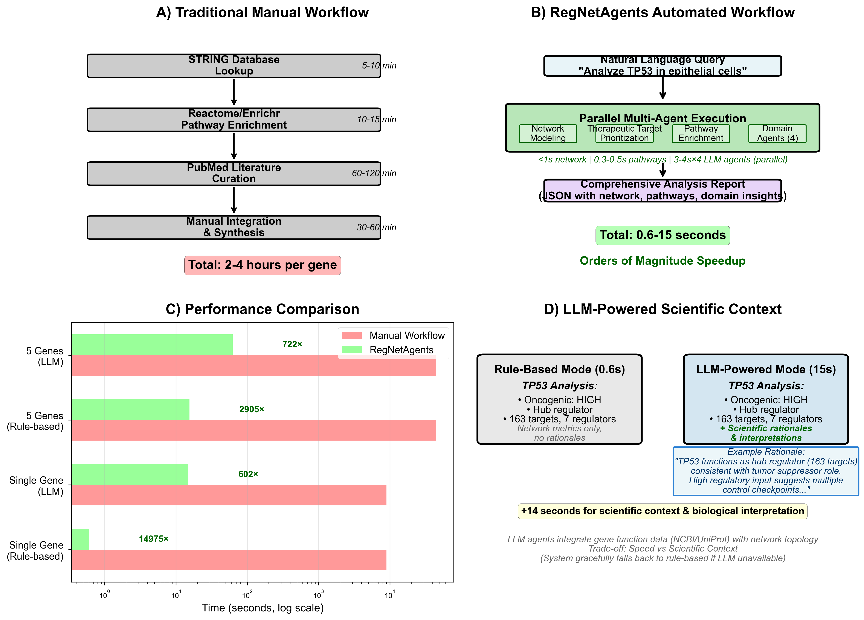
RegNetAgents: Multi-Agent Framework for Gene Regulatory Network Analysis
A LangGraph-Powered AI System for Comprehensive Gene Analysis Validated on Colorectal Cancer Biomarkers
Jose A. Bird, PhD • Bird AI Solutions
METHODS: Multi-Agent Architecture
⚡ 0.60-62 sec Analysis • Demonstrated on CRC Biomarkers ✓
DISCUSSION
ABSTRACT
User Query (Claude)
NATURAL LANGUAGE INTERFACE
Key Advantages
The system employs intelligent workflow routing that automatically selects optimal analysis paths based on gene characteristics, avoiding unnecessary computation while prioritizing relevant agents. Parallel agent execution provides 4-6x speedup versus sequential analysis through async I/O operations.
Domain-specific agents provide specialized expertise in cancer biology, drug development, clinical relevance, and systems biology with integrated scoring algorithms. Cell-type specificity across 10 pre-computed networks enables cross-cell comparison and tissue-specific pattern identification.
Limitations & Future Work
Current limitations include 10 cell types currently available (limited by available pre-computed networks) and networks updated periodically (not dynamic). Future work includes expanding cell type coverage as networks become available, integrating additional pathway databases (KEGG, GO, MSigDB), optimizing batch processing, and enhancing domain agent algorithms.
Appropriate Use Cases
System is designed for: (1) Hypothesis generation and target screening to prioritize experimental validation, (2) Network structure analysis to understand regulatory hierarchies and identify hub regulators, (3) Multi-gene comparative screening for biomarker prioritization, (4) Cross-cell-type pattern identification for tissue-specific regulation.
NOT designed for: Gene expression prediction (topology-based, not dynamical modeling), clinical diagnosis, or replacing experimental validation. Generates research hypotheses requiring wet-lab confirmation.
RegNetAgents is an LLM-powered multi-agent AI framework that automates gene regulatory network analysis through intelligent workflow orchestration, transforming labor-intensive manual processes into second-scale automated analysis. The system deploys four specialized domain agents (cancer biology, drug discovery, clinical relevance, systems biology) using local language model inference to generate scientific insights with rationales, with graceful fallback to rule-based heuristics for reliability. Built on pre-computed regulatory networks from 500K+ single-cell RNA-seq profiles, the framework integrates network modeling, automated therapeutic target prioritization using network centrality metrics (PageRank, degree centrality), pathway enrichment, and multi-domain interpretation into a conversational interface via Claude Desktop. Framework demonstration on colorectal cancer biomarkers showed complete concordance with published literature across a limited five-gene sample. Therapeutic target prioritization identified literature-supported TP53 interactors (WWTR1, YAP1, CHD4) among top-ranked candidates based on network topology; additional high-ranking regulators (RBPMS, PRRX2, THRA, IKZF2) represent novel hypotheses for experimental validation. Complete analysis of 99 regulators across 5 genes completed in 15-62 seconds, representing orders of magnitude speedup over traditional manual approaches. Natural language interface makes sophisticated gene analysis accessible without programming expertise.
Validate Inputs & Setup
Conversational access via Claude Desktop - no programming required
Example Prompts:
"Find biomarkers for CRC screening in Wnt/TP53 pathways"
"Analyze TP53 - what does it regulate?"
"Compare TP53, APC, BRCA1 across cell types"
System auto-routes → second-scale response with comprehensive analysis
RegNetAgentsModelingAgent: Network Analysis
RegNetAgentsModelingAgent: Regulators + Targets
RegNetAgentsModelingAgent: Therapeutic Target Prioritization
CASE 1: Multi-Gene Biomarker Analysis
PathwayEnricherAgent: Reactome Enrichment
User Prompt:
"Characterize these candidate genes for CRC biomarker potential: MYC, CTNNB1, CCND1, TP53, KRAS"
Selected from known CRC pathways: Wnt (CTNNB1, MYC, CCND1) • TP53 pathway (TP53) • MAPK (KRAS)
Execution Time: 15.49 seconds (rule-based) / ~62 seconds (LLM-powered with AI insights) — 5 genes analyzed in parallel, all 99 regulators analyzed
4 Domain Agents (PARALLEL via asyncio)
Gene | Regulatory Role | Targets | Regulators | Biomarker Type* | Top Candidate Regulator (PageRank)
MYC | Hub Regulator | 427 | 25 | Diagnostic | ID4 (0.622)
CTNNB1 | Hub Regulator | 310 | 18 | Diagnostic | CHD2 (0.530)
CCND1 | Heavily Regulated | 0 | 42 | Diagnostic | ZBTB20 (0.600)
TP53 | Hub Regulator | 163 | 7 | Prognostic | WWTR1 (0.473)
KRAS | Heavily Regulated | 0 | 7 | Predictive | GPBP1 (0.609)
Figure 4: Framework Performance (orders of magnitude speedup)
Cancer Agent
Drug Agent
Clinical Agent
Systems Agent
WHY THIS IS NOVEL
Our Innovation
LLM-Powered Insights: 4 domain agents use local LLM (Ollama/llama3.1:8b) to generate scientific insights with rationales
Automation: Single query replaces multi-step manual workflow
Integration: 4 domain perspectives + pathways in one analysis
Parallelization: Multi-agent execution (4 domain agents run simultaneously)
Graceful Fallback: Automatic fallback to rule-based heuristics for reliability
Therapeutic Target Prioritization: Rank regulators by network centrality to prioritize candidate regulators for validation
Scalability: 10 cell types pre-computed (cross-cell queries instant)
Accessibility: Natural language interface via local MCP server for Claude Desktop
Performance Impact
Single gene (rule-based): Manual → 0.68 sec
Single gene (LLM-powered): Manual → 15 sec
5 genes (LLM-powered): Manual → 62 sec
Generate Comprehensive Report
Specialized Agents
RegNetAgentsModelingAgent:
Analyzes gene regulatory networks to identify upstream regulators and downstream targets; determines regulatory role (hub/intermediate/terminal); performs cross-cell-type comparison; ranks upstream regulators to identify therapeutic targets using network centrality metrics (PageRank, out-degree centrality) → Gene position in regulatory hierarchy, regulatory strength, cell-type specificity; therapeutic target prioritization with centrality-based rankings (PageRank primary, out-degree secondary), cascade effects, network connectivity assessment
PathwayEnricherAgent:
Statistical pathway enrichment via Reactome API; identifies significant biological pathways with FDR correction → Top enriched pathways with p-values and FDR scores; biological process context
Cancer Research Agent (LLM-Powered):
**LLM-generated insights** using local Ollama inference (llama3.1:8b); evaluates cancer biology relevance with scientific rationales; graceful fallback to rule-based heuristics if LLM unavailable → AI-generated oncogenic potential classification with rationale, tumor suppressor likelihood with explanation, therapeutic target classification with scientific justification; falls back to network connectivity-based heuristics for reliability
Drug Development Agent (LLM-Powered):
**LLM-generated insights** using local Ollama inference; analyzes therapeutic potential with scientific rationales for druggability assessments and intervention strategies → AI-generated druggability assessment with rationale, intervention strategy recommendations with explanation, development timeline estimates with justification; falls back to connectivity-based rules for reliability
Clinical Relevance Agent (LLM-Powered):
**LLM-generated insights** using local Ollama inference; determines clinical utility with scientific rationales for biomarker classifications → AI-generated biomarker classification with rationale (diagnostic/prognostic/predictive), disease association likelihood with explanation, clinical actionability assessment with justification; falls back to network position analysis for reliability
Systems Biology Agent (LLM-Powered):
**LLM-generated insights** using local Ollama inference; quantifies network topology with scientific rationales for centrality interpretations → AI-generated network centrality interpretations with rationale, hub analysis with explanation, impact scope estimates with scientific justification; falls back to PageRank/degree centrality calculations for reliability
Biomarker Types:
Diagnostic: Detects presence of disease (early detection, screening)
Prognostic: Predicts disease outcome/progression (patient stratification)
Predictive: Predicts response to specific therapy (treatment selection)
CONCLUSIONS
THE CHALLENGE
CASE 2: TP53 Therapeutic Target Prioritization
Gene Regulatory Agents demonstrates that multi-agent AI frameworks can effectively orchestrate complex gene regulatory network analyses across multiple biological domains. The framework successfully bridges computational biology, AI workflow orchestration, and conversational interfaces to make sophisticated gene analysis accessible to researchers.
Key Innovations
• Intelligent routing optimizes analysis paths based on gene characteristics
• Parallel execution enables second-scale analysis (0.6-62 sec depending on mode)
• Domain-specific agents provide specialized cancer, drug, clinical, and systems perspectives
• Cell-type specificity supports translational research questions
Gene regulatory networks are complex, multi-layered systems requiring multiple database queries
Manual analysis across multiple domains (cancer, drug, clinical) requires labor-intensive effort per gene
Traditional tools lack integration across biological perspectives (separate tools for networks, pathways, literature)
Cross-cell-type analysis requires repeating the entire workflow per cell type
No conversational interface for hypothesis-driven exploration
User Query: Comprehensive TP53 analysis with therapeutic target identification
Network Analysis: Hub regulator • 163 targets • 7 regulators • 16 pathways (FDR<0.05)
Automated Therapeutic Target Prioritization
System simulated inhibition of all 7 upstream regulators and ranked therapeutic targets using standard network centrality metrics (PageRank, out-degree centrality):
Top Target (PageRank): WWTR1 (0.473) ✓ Literature-supported Hippo pathway regulator
Top Target (Out-Degree): RBPMS (0.028, 403 targets) - Novel hypothesis
Literature-supported: YAP1, CHD4 (Hippo pathway) have documented interactions
Novel: PRRX2, THRA, IKZF2 prioritized for experimental validation
Execution: 0.60 sec (rule-based) | ~15 sec (LLM-powered with domain insights)
Demonstrates: Automated therapeutic target prioritization using PageRank (best predictor of drug target success per Mora & Donaldson 2021) identifies both literature-supported regulators and novel hypotheses for experimental follow-up.
REFERENCES
DATA & VALIDATION
1. Zhang M, et al. (2025). GREmLN: A Cellular Regulatory Network-Aware Transcriptomics Foundation Model. bioRxiv 2025.07.03.663009.
2. Margolin AA, et al. (2006). ARACNe algorithm. BMC Bioinformatics.
3. Lachmann A, et al. (2016). ARACNe-AP: Adaptive Partitioning. Bioinformatics.
4. Gillespie M, et al. (2022). Reactome pathway database. Nucleic Acids Res.
5. CellxGene Data Portal. Chan Zuckerberg Initiative.
6. LangGraph Framework. LangChain AI.
7. Model Context Protocol (MCP). Anthropic.
Regulatory Networks
GREmLN foundation model (Zhang et al. 2025)
500K+ cells from CELLxGENE • ARACNe-AP algorithm
10 cell types: immune, blood, epithelial
Pathway Enrichment
Reactome: Hypergeometric test, FDR < 0.05
Validation
CRC case: 5/5 genes literature-validated
All data from public sources
CONTACT
Jose A. Bird, PhD
Bird AI Solutions
Email: jbird@birdaisolutions.com
LinkedIn: /in/jose-bird-data-science-advanced-analytics
Interested in Gene Regulatory Agents?
QR CODE Poster Webpage
Powered by LangGraph | MCP Protocol | Claude Desktop

