Slide 1

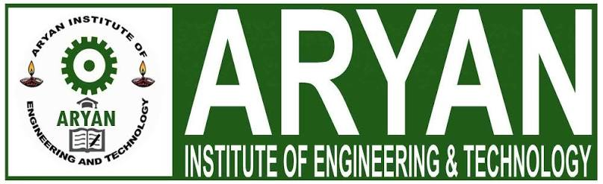
SEMINAR PRESENTATION
VIRTUAL CAMPUS
Reimagining Higher Education Through AI, Cloud, VR/AR and IoT
Presented by: Jabahar Jagadish Baral
Class / Roll No.: 2301320094
Guided by: Mr. Vikramaditya Tarai
Department of Computer Science & Engineering
Aryan Institute of Engineering and Technology

Slide 2
INTRODUCTION
02 / 17
Introduction
Higher education is shifting from purely physical classrooms to blended and fully digital learning environments.
A Virtual Campus recreates the academic, social and administrative experience of a physical college on a unified digital platform.
It brings together classrooms, libraries, laboratories, examinations and student services under one connected system.
Enabled by advances in cloud computing, Artificial Intelligence, IoT and immersive technologies like VR/AR.
Adopted rapidly after 2020, and now a long-term strategy for flexible, scalable and accessible education.
55%+
rise in adoption of digital-campus platforms by universities worldwide since 2020
24 x 7
access to learning resources, independent of location or time zone
1 Platform
unifying academics, administration and campus life digitally

Slide 3
OBJECTIVES
03 / 17
Objectives of the Study
1
Understand the Concept
2
Explore the Architecture
Study what a Virtual Campus is and how it differs from traditional and simple e-learning setups.
Examine the layered architecture and technology stack that powers such platforms.
3
Identify Key Technologies
4
Evaluate Benefits & Risks
Analyse the role of AI, Cloud, VR/AR, IoT and LMS in enabling virtual campuses.
Assess advantages, implementation challenges and security concerns.
5
Review Real Deployments
6
Project Future Direction
Study real-world examples and a representative case study.
Explore the future scope of virtual campuses in global education.

Slide 4
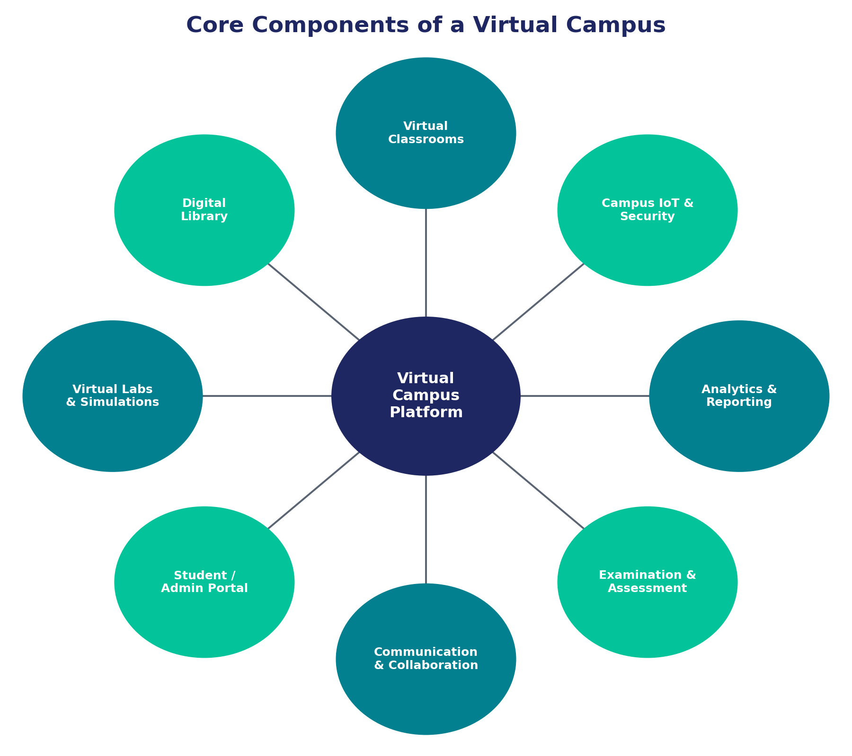
CONCEPT
04 / 17
What is a Virtual Campus?
A Virtual Campus is an integrated digital ecosystem that replicates the teaching, learning, administrative and social functions of a physical college through internet-based platforms and emerging technologies.
Traditional Campus
Physical classrooms and fixed timetables
Simple E-Learning
Recorded videos or static content only
Virtual Campus
Live, interactive, AI-assisted, immersive & data-driven experience

Slide 5
COMPONENTS
05 / 17
Key Components
Virtual Classrooms
Digital / E-Library
Virtual Labs
Live video lectures, screen sharing and interactive whiteboards
Searchable e-books, journals and research repositories
Simulation-based practicals accessible without physical hardware
Student & Admin Portal
Communication Tools
Examination Module
Registration, fees, attendance and academic records
Chat, forums, video conferencing and notifications
Online tests, proctoring and automated evaluation

Slide 6
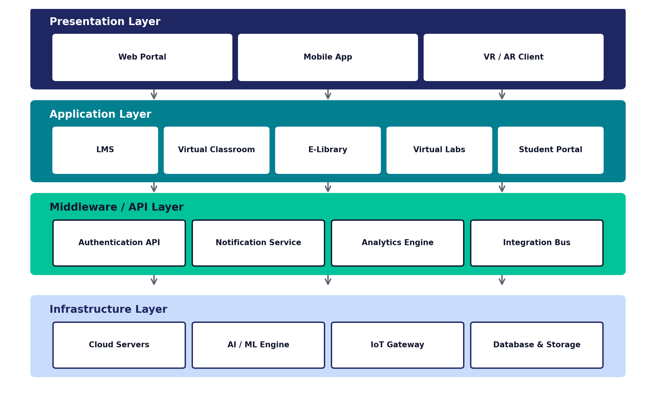
ARCHITECTURE
06 / 17
System Architecture

Slide 7
TECHNOLOGIES
07 / 17
Technologies Used
AI
Cloud
VR/AR
IoT
LMS
Artificial Intelligence
Cloud Computing
Virtual & Augmented Reality
Internet of Things
Learning Management System
Personalised learning paths, chatbots, auto-grading and plagiarism detection
Scalable storage, on-demand compute and 24x7 platform availability
Immersive labs, campus tours and simulation-based practical training
Smart classrooms, attendance sensors and connected campus infrastructure
Central hub for content delivery, assignments and grade tracking

Slide 8
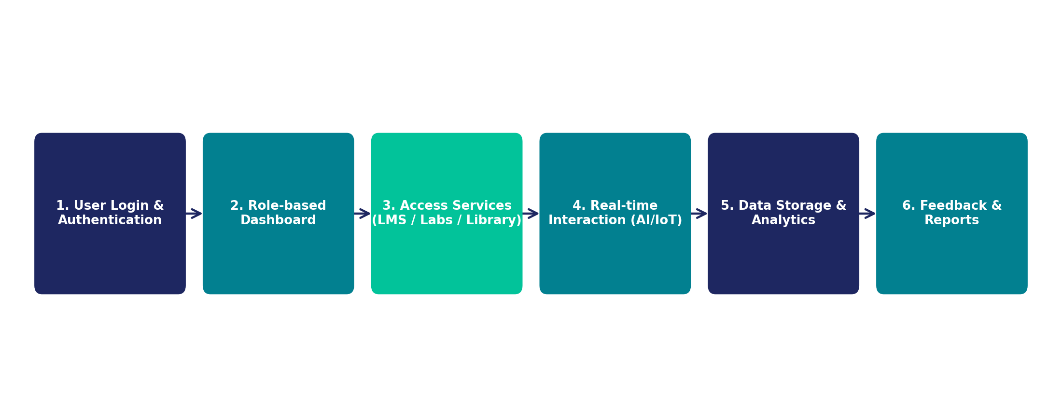
WORKING
08 / 17
Working Process

Slide 9
ADVANTAGES
09 / 17
Advantages
Anytime, anywhere access to lectures and resources
Significant cost savings on travel, hostel and infrastructure
✓
✓
Personalised, AI-driven learning paths for each student
Scalable to thousands of learners without added physical infrastructure
✓
✓
Eco-friendly — reduced commuting and paper usage
Real-time performance analytics for students and faculty
✓
✓

Slide 10
CHALLENGES
10 / 17
Challenges
Digital Divide
High Setup Cost
Unequal access to devices and stable internet, especially in rural areas
Significant investment in servers, VR/AR equipment and skilled staff
Technical Dependence
Reduced Social Interaction
Platform outages or connectivity issues disrupt learning directly
Limited face-to-face peer bonding and extracurricular engagement
Data Security Risks
Faculty & Student Training
Sensitive academic and personal data vulnerable to breaches
Adapting to new tools requires continuous digital-skill training

Slide 11
SECURITY
11 / 17
Security & Privacy
Multi-factor authentication and role-based access control for portals and admin systems.
End-to-end encryption of data in transit and at rest, including exam and payment data.
Regular vulnerability audits, penetration testing and patch management.
Compliance with data-protection regulations (e.g. GDPR / IT Act) for student records.
AI-based proctoring with clear consent policies to balance integrity and privacy.
Regular backups and disaster-recovery plans to prevent data loss.
Core Security Pillars
1
Confidentiality — data seen only by authorised users
2
Integrity — data stays accurate & unaltered
3
Availability — systems accessible when needed

Slide 12
EXAMPLES
12 / 17
Real-World Examples
1
Coursera / edX / Swayam
2
Google Workspace / Microsoft Teams for Education
Large-scale MOOC platforms delivering university-grade courses with certification globally.
Widely used for virtual classrooms, assignments and collaboration in schools & colleges.
3
VR Campus Pilots (e.g. Stanford, Meta Horizon Workrooms)
4
Indian Government's SWAYAM & DIKSHA
Immersive VR spaces used for lectures, labs and virtual convocations.
National digital learning platforms offering free courses to millions of students.

Slide 13
FUTURE SCOPE
13 / 17
Future Scope
01
02
03
04
Metaverse Campuses
AI Tutors
Blockchain Credentials
5G-Enabled AR Labs
Fully immersive 3D virtual universities with persistent avatars and spaces
Conversational AI mentors offering 24x7 personalised academic support
Tamper-proof, instantly verifiable digital degrees and certificates
Ultra-low-latency AR practicals accessible on lightweight devices

Slide 14
CASE STUDY
14 / 17
Case Study: SWAYAM (India)
SWAYAM (Study Webs of Active Learning for Young Aspiring Minds) is India's national platform hosting free courses from school to postgraduate level, integrating video lectures, e-content, discussion forums and online assessment.
1,900+
3+ crore
IITs, IIMs, UGC
Free + Certification
Courses Offered
Registered Learners
Partner Institutes
Model
Key Takeaways
Demonstrates scalable, low-cost delivery of quality education across India.
Credit-recognition by UGC shows viability of virtual-campus models academically.
Highlights the digital-divide challenge in rural participation rates.

Slide 15
CONCLUSION
15 / 17
Conclusion
A Virtual Campus is a comprehensive, technology-driven reimagining of higher education — not just a replacement for classrooms.
Integrating AI, Cloud, VR/AR and IoT enables flexible, personalised and scalable learning experiences.
Challenges like the digital divide, cost and security must be addressed for equitable adoption.
With continued investment, virtual campuses are set to become a mainstream, permanent part of global education.

Slide 16
REFERENCES
16 / 17
References
1. Anderson, T. (2022). The Theory and Practice of Online Learning. AU Press.
2. UGC (2023). Guidelines for Online and Digital Education in Higher Education Institutions.
3. SWAYAM Official Portal — https://swayam.gov.in
4. IEEE Xplore — Papers on Cloud-based Learning Management Systems.
5. Gartner (2024). Emerging Technology Trends in Education.
6. Ministry of Education, Government of India — National Education Policy 2020.

Slide 17
Thank You
Jabahar Jagadish Baral • 2301320094 • Computer Science & Engineering, Aryan Institute of Engineering and Technology

