Slide 1

Rent a Car Management System
Presented By:
Joe El Youssef, Ali Jabak & Ammar Khalil
Instructor:
Dr. Pauline Abou Haidar
Course:
Programming 3

Slide 2
Introduction
A JavaFX-based MIS for managing cars, rentals, accounts, and payments.
Implements OOP concepts, database integration, and modern GUI design.

Slide 3
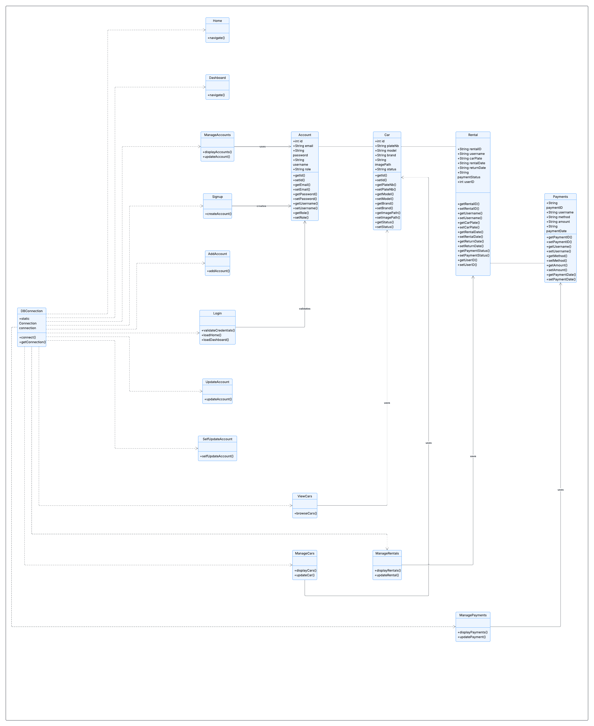
System UML Diagram

Slide 4
System Features
User Login & Signup
Admin Dashboard
Manage Cars / Accounts / Rentals / Payments
View Cars
Database CRUD Operations
File Handling

Slide 5
Conclusion
A complete MIS solution integrating JavaFX, MySQL, OOP, and GUI design.
Provides a scalable and user‑friendly workflow for rental operations.

Slide 6
Thank You For Your Attention!

