Slide 1

A BRAND STUDY & STRATEGIC ANALYSIS · BUSINESS POLICY
Culture as capital.
How Gully Labs is trying to build India’s first globally aspirational sneaker house — and whether the strategy can survive scale, cash and competition.
Aug 2023
₹4k–15k
founded, Delhi NCR
price band / pair
₹175 Cr
~25%
Shark Tank valuation
revenue from exports
AISHA · ROHAN · MEERA · KABIR
September 2026 · 15 slides · 11 minutes · sources on the final slide
Founders Arjun Singh & Animesh Mishra — “unapologetically Indian” (Inc42).
GULLY LABS — CULTURE AS CAPITAL
01 / 15
Notes:
OPEN (Aisha, 30 sec). Do not read the title. Say: 'Nike sells a swoosh. Gully Labs sells a street in Delhi. Same category, different strategy question - can culture be a defensible advantage?' Point at the photo: two founders, one manifesto. Hand to slide 2.

Slide 2

ROADMAP & SPEAKER MAP
One brand, five lenses, eleven minutes.
Before we start — hands up if you own sneakers above ₹5,000; keep them up if they are not a global brand.
01
WHO & WHERE
Aisha · 0:00–2:30
S1–S5
Cover · brand snapshot · mission, values, culture · PESTEL
02
THE ARENA
Rohan · 2:30–5:15
S6–S8
Value chain · industry cycle · Porter · 4P · SWOT
03
THE PLAN
Meera · 5:15–8:30
S9–S11
Directional strategy & levels · BCG + GE · implementation & blue ocean
04
THE VERDICT
Kabir · 8:30–11:15
S12–S15
Balanced scorecard · control & contingency · verdict & recommendations
SYLLABUS — PESTEL · VALUE CHAIN · INDUSTRY CYCLE · PORTER · 4P · SWOT · DIRECTIONAL · LEVELS · BCG · GE · DESIGN THINKING · RED/BLUE OCEAN · MODEL INNOVATION · BSC · AUDIT · CONTINGENCY · CONTROLS
The one question we answer: is “unapologetically Indian” a strategy, or just a marketing line — and what would it take to make it a moat?
A gully in old Delhi — the brand’s namesake and archive.
GULLY LABS — CULTURE AS CAPITAL
02 / 15
Notes:
Aisha, 45 sec. Run the show of hands FIRST, count out loud - that gap is the case. Then the four sections and who speaks when; do not read the syllabus line, say it is mapped in the written study. End on the italic question, read slowly.

Slide 3
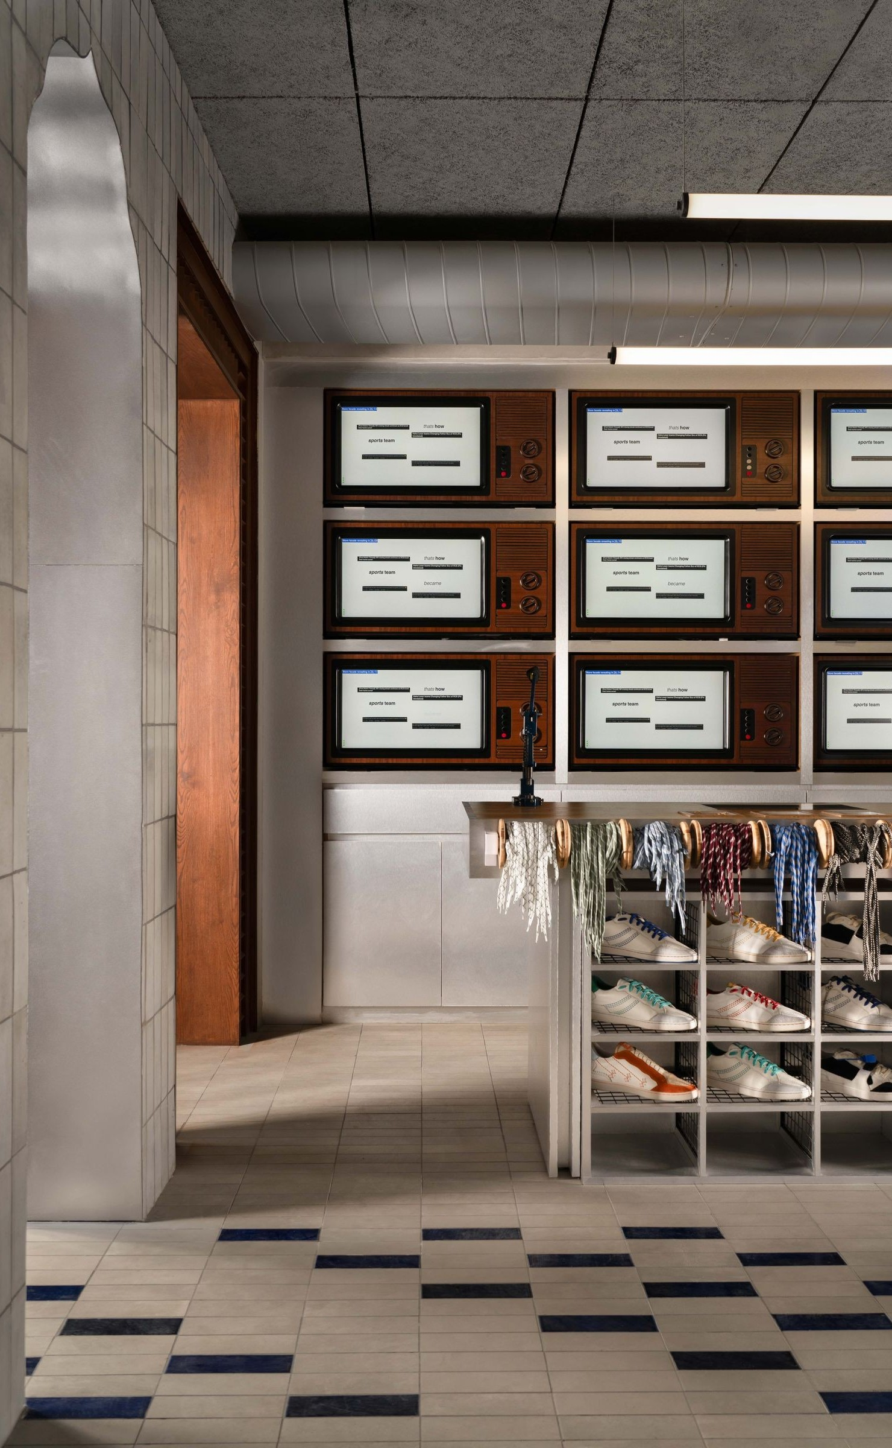
INTERNAL SCAN
From a basement workshop to a ₹175 crore valuation.
₹2.9 Cr
5,000
56 / 11
100+50
FY25 revenue · FY24 was ₹20 lakh
pairs a month by end-2025
gross margin % / contribution %
karigars + corporate team, Noida
AUG 23
launch; 50 prepaid orders, basement shoemaker, 10–20 pairs a month
DEC 23
viral reel — 250 pairs sold out in two days
APR 24
first unit: 1,000 sq ft, six karigars, Noida Sec-10
DEC 24
₹8.7 Cr seed (Zeropearl); own factory; 600 pairs a month
SEP 25
flagship “Baithak” store, Panchsheel Park, Delhi
JAN 26
₹26.5 Cr Series A (Saama) · Shark Tank ₹1 Cr @ ₹175 Cr
SEP 26
Bengaluru store + Kaapi drop; three cities live
Social: X @GullyLabs, 3,640 followers (verified 19 Sep 2026) — a drop wire, not a reach channel; reach lives on reels (one 7M-view reel made the Dec-23 sellout) and cause-marketing (15% of three days’ sales to Hemkunt Foundation).
They own the factory, the store and the data: D2C India + global, Amazon store, curated partners; 10,000+ orders shipped.
The flagship, Panchsheel Park — karigar studio, shoe museum, Baithak (AD India).
GULLY LABS — CULTURE AS CAPITAL
03 / 15
Notes:
Aisha, 60 sec. Three claims, not a node-by-node timeline: (1) 20 lakh to 2.9 crore to 16 crore expected - 80x in two years off a tiny base; (2) they own factory AND store, against everyone's advice; (3) their X following is 3,640 - reach is reels and word of mouth, which matters later. Flag the bestseller price Rs 8,900 - Air Force 1 territory.

Slide 4
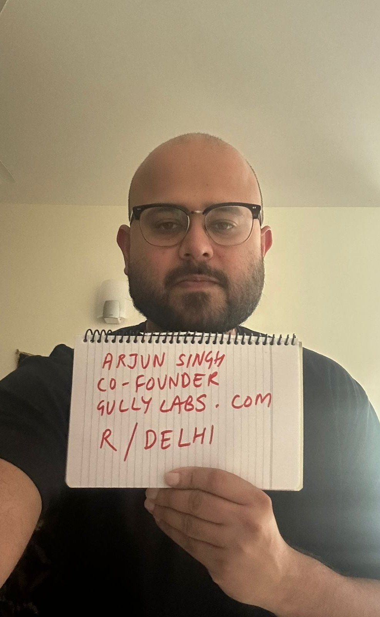
BUSINESS POLICY
A mission, four policies, one culture.
“
To build a household sneaker brand from Delhi that is truly and unapologetically Indian — shaped by local streets, crafts and culture, not borrowed from the West.
Vision: put India’s authentic culture on the global sneaker map — “the next great global sneaker brand out of India, one culturally-charged collection at a time.” Values in behaviour: originality (never a compromise brand), craft (karigar-first, ~95% local), community (six months of content before product), story (every colourway named), value-not-price (“India is not price-conscious, it’s value-conscious”).
ORIGIN POLICY
functional
own factory; ~95% local sourcing
DROP POLICY
operating
a themed collection every ~60 days, limited runs
PRICE POLICY
strategic
premium held at ₹4–15k; no discount-led growth
PEOPLE POLICY
functional
karigar retention; backend permissioning post-fraud
Corporate culture is the control system: the manifesto doubles as hiring filter and design brief; 100 karigars are the brand’s named heroes; a trust-based culture met its first governance wall in Feb 2026 (S13).
Co-founder Arjun Singh — r/Delhi AMA, 2025.
GULLY LABS — CULTURE AS CAPITAL
04 / 15
Notes:
Aisha, 60 sec. Framing line: 'A mission is a statement; a policy is the rule that stops you breaking it.' Give one example per policy type, do not read all four. Land the culture point: the manifesto does the work an SOP manual does at a big firm - and slide 13 shows the day that stopped being enough.

Slide 5

ENVIRONMENTAL SCANNING · EXTERNAL
PESTEL: a friendly climate, one tax headwind.
P
Make in India; 35% BCD + surcharge + IGST on imported footwear (landed ≈45–60% of CIF); BIS/QCO norms; IFLDP (₹1,700 Cr) is the live scheme.
Tailwind: the Noida factory is a tariff and quality advantage global rivals cannot match at this price.
E
GST rationalisation (Sep ’25): ≤₹2,500 at 5%, above still 18%; category growing 12–15% p.a.; ~70M pairs by 2029.
Headwind in a tailwind: 100% of the range sits in the 18% slab — ~₹600–1,200/pair vs mass rivals.
S
Gen-Z identity buying; hype and resale culture; gully rap and streetwear; diaspora demand; festive spikes.
Core demand: ~25% export share is diaspora + design-led, not price-led.
T
D2C stack, drop mechanics, social commerce, creator economy, AI demand forecasting.
Enabler: the 60-day calendar is a software problem as much as a craft one.
E
Leather supply chain, tannery effluent norms, air-freight carbon on exports.
Watch item: an ESG narrative they have not yet had to defend.
L
Motif/trademark IP hard to protect; BIS and labelling compliance; internal-controls exposure.
Live risk: IP defensibility; the Feb ’26 fraud was a controls failure, not a market failure.
Net read: four tailwinds, one tax penalty, one governance gap — the 18% slab attacks the price point.
Old Delhi commerce — the demand side of the PESTEL.
GULLY LABS — CULTURE AS CAPITAL
05 / 15
Notes:
Aisha, 60 sec. Do not read the rows. Deliver only the implication column for P, E and L. The killer fact is GST: Sep 2025 cut footwear under Rs 2,500 to 5% but left everything above at 18%, and 100% of Gully Labs' range is above. End on the italic net read.

Slide 6
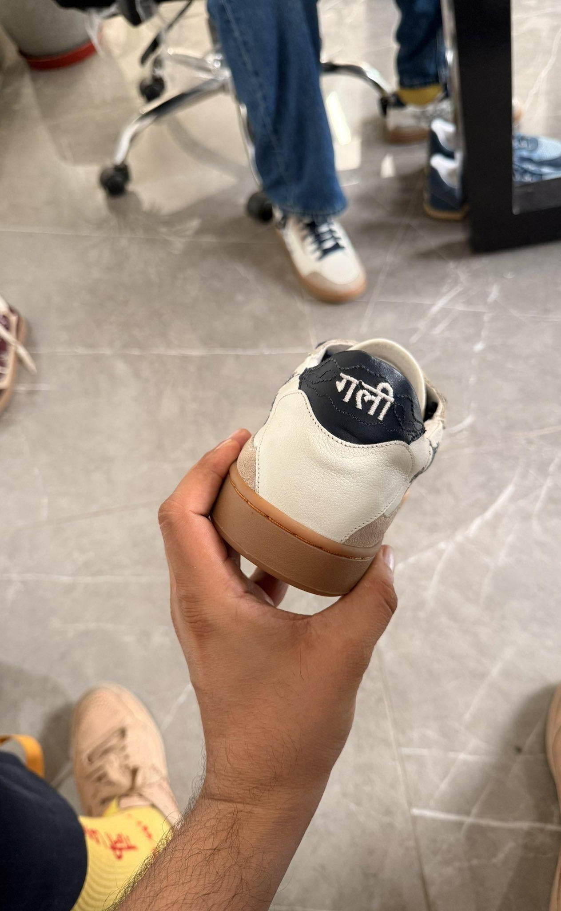
ENVIRONMENTAL SCANNING · INTERNAL
The value chain — where the ₹100 goes.
01
02
03
04
05
DESIGN & STORY
SOURCING
OPERATIONS
FULFILMENT
MARKETING & RETAIL
cultural archive; 60-day drop brief
~95% local leather, rubber, thread
hand-lasted in Noida, ~4 days a pair
D2C India + global; free exchange
reels, collabs, Baithak store
THE MARGIN LADDER — ₹100 OF REVENUE (FOUNDERS’ OWN NUMBERS)
100
56
46
11
revenue
after COGS
after logistics
after marketing
FY25 loss ₹1 Cr on ₹2.9 Cr; Delhi store at breakeven; cash ₹85 lakh. 56% gross proves the premium is accepted; 35% marketing proves the brand does not yet pull.
Value is created at the two ends — story and community — not in the middle; the bottleneck is hands, not machines (1,000 wanted vs 600 made).
Backward integration was the bet: ₹1.2 Cr from college friends to own the line.
The heel says गली — Devanagari branding, hand-lasted.
GULLY LABS — CULTURE AS CAPITAL
06 / 15
Notes:
Rohan, 55 sec. Walk the five steps once, then the ladder: '100 rupees in, 11 left - the whole business case on one line.' Two claims: 56% gross proves pricing works; 35% marketing proves the brand doesn't pull. Remember-line: they ran out of karigars before they ran out of demand.

Slide 7
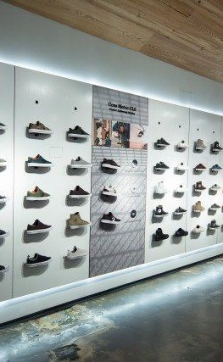
INDUSTRIAL ANALYSIS · PORTER
A growth-stage industry; two high forces.
THE COMPETITIVE SET
Nike / Adidas / Puma / NB
₹4k–20k+
HIGH — own the aspiration being attacked
Comet
$6.6M
HIGH — same buyer, ~10× their FY25 revenue
CHK (Accel)
$3.8M
MEDIUM-HIGH — closest design rival
RapidBox
$9.5M
MEDIUM — a price tier below
Neemans / Solethreads / Zeesh
seed–A
LOW-MEDIUM — different promise
INDUSTRY CYCLE — EMBRYONIC · GROWTH · SHAKEOUT · MATURITY · DECLINE
They are in the growth stage: position-buying, losses tolerated (₹1 Cr on ₹2.9 Cr is that logic); the shakeout will punish players with neither scale nor an uncopyable story.
BUYER POWER HIGH · zero switching cost, infinite choice, hype moves fast
RIVALRY HIGH · global giants + funded D2C + marketplaces
NEW ENTRANTS MODERATE · cheap to start, years to craft a brand
SUBSTITUTES MODERATE · resale Jordans, copies, apparel for the same rupee
SUPPLIER POWER MODERATE · leather is easy; skilled karigars are the scarce input
Verdict: the moat cannot be design — it is factory + karigars + community + store.
GULLY LABS — CULTURE AS CAPITAL
07 / 15
Notes:
Rohan, 80 sec. Move 1 - the orange-underline fact: they are the most expensive Indian sneaker company that is not a volume player. Move 2 - ask the room which force is strongest, wait, reveal buyer power: switching cost is literally zero. Close on the italic verdict.

Slide 8

SITUATIONAL ANALYSIS
Four consistent Ps; an honest SWOT.
PRODUCT
PRICE
4 silhouettes, ~50 SKUs, Indian lexicon — Baaz, Kulfi, Kaapi
hand-lasted; Kantha, Rangoli, Devanagari signatures
scarcity: 60-day drops, collabs (RAGA, Nivia, CMF)
₹3,790–15,000; bestseller Calico White ₹8,900
value-based: “not price-conscious, value-conscious”
no discount-led growth; global $140–220
PLACE
PROMOTION
D2C-first India + global; Amazon store
own flagship + Bengaluru; Mumbai next; curated partners
~25% exports — US, UK, UAE, SG, AU, CA
community before product; 6 months of content
creator spikes (7M-view reel); Shark Tank as brand event
cause-marketing; X as the drop wire
S
— own factory → quality, flexibility, duty shield
— 56% gross margin; ~8× revenue growth
— unmatched cultural IP and content engine
— a named craft workforce competitors lack
W
— CM2 ~11%; marketing 35% of revenue
— cash ₹85 lakh vs a retail build-out
— capacity capped by trained hands
— 100% of SKUs in the 18% GST slab
O
— category +12–15%; premium band expanding
— diaspora + a US store in 12–18 months
— apparel and accessories lift AOV
— tier-2 aspiration; experiential retail
T
— global brands out-spend and out-collab overnight
— funded domestic rivals (Comet, CHK, RapidBox)
— motifs are copyable; authenticity backlash
— valuation far ahead of revenue
Hand-finished leather — the product half of the 4Ps.
GULLY LABS — CULTURE AS CAPITAL
08 / 15
Notes:
Rohan, 80 sec. 4Ps in one breath: premium product, premium price, owned place, community promotion - four Ps pointing the same way is what consistency looks like. SWOT: one item per quadrant out loud - factory; 11%; diaspora; Comet's balance sheet. Hand to Meera.

Slide 9

STRATEGY FORMULATION
Three growth fronts at once — and one refusal.
MARKET PENETRATION
NOW
deepen Delhi NCR; repeat buyers; accessories lift AOV
MARKET DEVELOPMENT
NOW
Bengaluru, Mumbai, tier-2; exports 25%; US store in 12–18 months
PRODUCT DEVELOPMENT
NOW
002/003/004, apparel, jerseys, slides, collabs
DIVERSIFICATION
LATER
experience retail and community programming; nothing unrelated
RETRENCHMENT
NEVER
no discounting, no marketplace volume, no contract manufacturing
“They would rather stay small than cheap.” Read that row out loud: retrenchment refused as policy is the clearest statement of what this brand is.
CORPORATE — where culture-led premium footwear + apparel; vertically integrated; equity-financed
BUSINESS — how focused differentiation in the ₹4–15k niche; never cost leadership
FUNCTIONAL — who 60-day drops · karigar capacity · community marketing · membership retail
The tension: three growth vectors on ₹85 lakh of cash and a workforce that must be trained, not hired.
Growth fronts: the street is the market, the market is the street.
GULLY LABS — CULTURE AS CAPITAL
09 / 15
Notes:
Meera, 55 sec. One idea: three growth strategies at once and one refused - read the red row aloud. Levels in one breath: where / how / who. Finish on the tension box; it sets up evaluation.

Slide 10
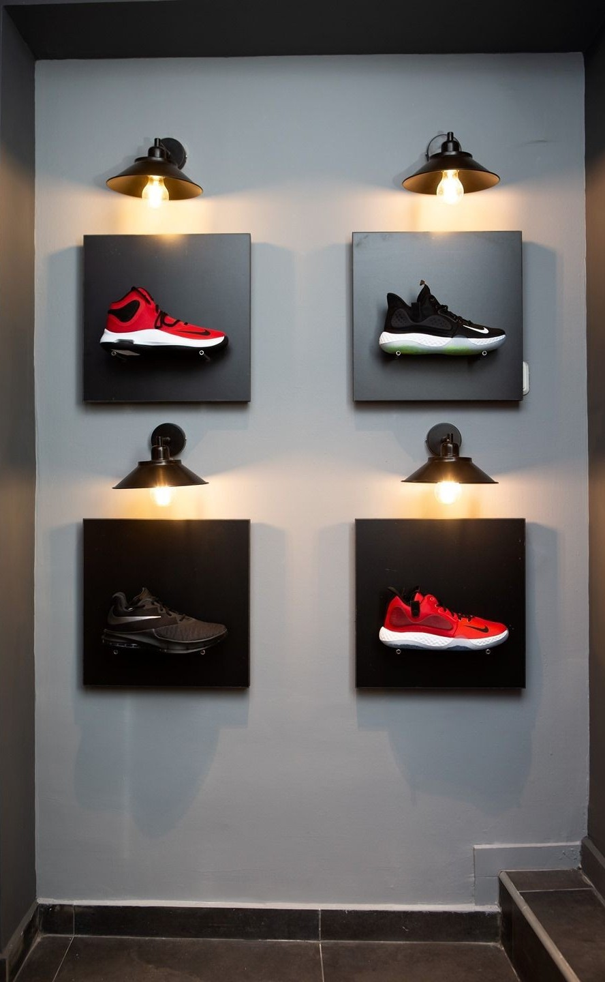
PORTFOLIO TOOLS
One star, two question marks, and a dog to refuse.
QUESTION MARKS
STARS
INVEST / GROW
THE VERDICT, TWICE
Grow — core India D2C: fund capacity and stores.
Build selectively — exports: prove unit economics first.
Selectivity — apparel: fund only what lifts AOV.
Refuse — discount-led volume: absent today; must stay absent.
collabs ·
US/diaspora
India D2C
GL 001
DOGS
CASH COWS
apparel
exports
apparel
discount
volume
mass basics
HARVEST / EXIT
BCG — GROWTH ↑ · SHARE →
GE — ATTRACTIVENESS ↑ · STRENGTH →
“BCG alone would call a 30-month-old brand a dog — it only scores share and growth. GE is the honest tool for Gully Labs because it scores brand, craft and factory: what they actually own. Used together both say the same thing: concentrate on the star, cap the question marks, refuse the dog.”
A wall of single shoes — the industry's own portfolio matrix.
GULLY LABS — CULTURE AS CAPITAL
10 / 15
Notes:
Meera, 65 sec. Quiz first: 'Where do socks and jerseys sit?' - question mark now, dog if unfocused; accessories only work if they lift AOV. Then the marks-line about BCG vs GE. Don't explain the matrices; the room knows them.

Slide 11

STRATEGY IMPLEMENTATION
Where strategies like this die.
SCALING CRAFT
FOUR ACTIONS · BLUE OCEAN
capacity is trained hands, not machines — 1,000 wanted vs 600 made
ELIMINATE
FUNDING THE BUILD
celebrity-athlete deals; discount-led growth
₹85 lakh of cash against three stores and a factory expansion
HOLDING THE LINE
REDUCE
marketplaces and festivals push discounting; the brand cannot
SKU sprawl; marketplace dependence
GOVERNANCE
RAISE
founder-trust culture meeting payroll-scale risk (S13)
craft depth, storytelling, store experience, export service
CROSS-BORDER OPS
6–8 day global delivery, returns, duties, 25% of revenue
CREATE
the drop ritual, the karigar celebrity, the Baithak, India-origin sneaker IP
THE FRESH ₹27.5 Cr — CAPACITY FIRST, BRAND SECOND
production & karigar skilling
34%
DESIGN THINKING, LIVED — 2022–23
brand & content
26%
Six months of community posts → “India needs its own sneaker” → Baithak sessions → 50 pairs at ₹1,000 (worth ₹6,000) → the 250-pair sellout. The method is in the name: Labs.
retail build-out
24%
senior talent & controls
10%
working capital
6%
illustrative split, inferred from stated uses of proceeds — not a disclosure
Scaling craft means scaling hands — the karigar is the bottleneck and the moat.
GULLY LABS — CULTURE AS CAPITAL
11 / 15
Notes:
Meera, 65 sec. Three beats: name two challenges (craft scaling, Rs 85 lakh); design thinking - first product was a Rs 1,000 prototype of a Rs 6,000 shoe; blue ocean - read the four actions. If long, skip the bars and say 'capacity first, brand second'.

Slide 12
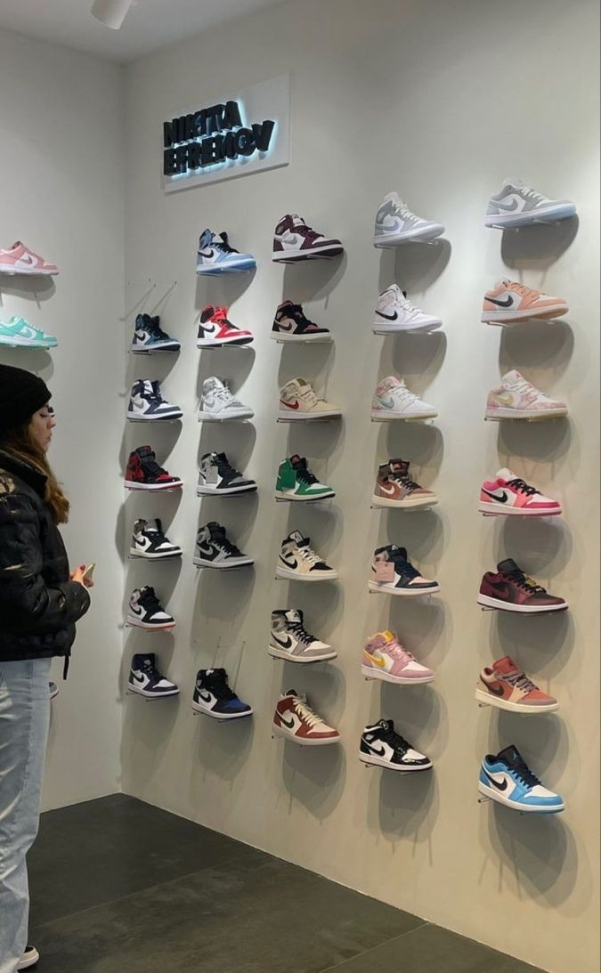
EVALUATION · MEASURING PERFORMANCE
Profit alone would have killed it in 2023.
FINANCIAL
CUSTOMER
INTERNAL PROCESS
LEARNING & GROWTH
revenue
₹2.9 Cr
₹16–30 Cr
repeat rate
n.d.
25–35%
pairs / month
~5,000
12,000
karigars
~100
220
CM2 margin
~11%
18%
7-day sell-through
variable
>80%
days per pair
~4
2.5
attrition
n.d.
<7%
marketing / rev
~35%
22%
export share
~25%
35%
returns
n.d.
<5%
silhouettes / yr
2–3
4
cash
₹85 lakh
12-mo runway
community
3.6k
100k
on-time drops
60-day
100%
senior hires
started
6
“A financial-only scorecard would have told them to shut the factory in 2023. The balanced one is what justifies investing in brand, craft and community before profit.” Muted numbers are disclosed baselines; the Georgia targets are our proposed FY27 scoreboard — say that distinction out loud.
READ ONE ROW PER QUADRANT ALOUD: revenue · repeat purchase · pairs per month · karigar attrition.
The customer perspective, live: the store wall and its community.
GULLY LABS — CULTURE AS CAPITAL
12 / 15
Notes:
Kabir, 55 sec. Open with the why-BSC line. Read one row per quadrant. Be explicit: disclosed baselines vs our proposed targets - examiners reward that distinction.

Slide 13

EVALUATION · CONTROL & CONTINGENCY
The week that cost ₹2 lakh.
STRATEGIC vs OPERATIONAL CONTROL
QUESTION
are we on the right course?
is today’s task done right?
HORIZON
1–3 yrs, per drop cycle
daily–monthly
OWNER
founders + board
function heads
EXAMPLE
Mumbai or margin first?
stock counts, discount permissions
FAILURE
drift into discount volume
the Feb ’26 fraud
STRATEGY AUDIT — SIX QUESTIONS
01 mission still relevant? · 02 is the appraisal honest (56% GM, 11% CM2)? · 03 objectives vs resources (₹85 lakh vs 3 stores)? · 04 4Ps internally consistent? · 05 risk acceptable to the board? · 06 are the controls adequate — and independent?
The fraud: a new CS hire used admin access to create 100%-discount codes, shipped ₹2 lakh of sneakers to friends, quit in a week. Fixes: permissioning done; four-eyes on discounts; weekly anomaly reports; written incident protocol.
Triggers pre-planned: 2 drops <70% sell-through · karigar utilisation >90% a quarter · runway <6 mo → pause store #3, not marketing · sentiment spike → founder reply in 24 h.
Operational control lives at the bench — where the orders are 'paid'.
GULLY LABS — CULTURE AS CAPITAL
13 / 15
Notes:
Kabir, 65 sec. Open with the fraud story - true and memorable. Syllabus point: that was an operational-control failure; the strategic question is whether trust-culture survives 150 employees - you need both at different frequencies. Skim the audit; land the triggers line.

Slide 14

CONCLUSION
A real strategy; three things between it and scale.
WHAT IS WORKING
WHAT IS NOT
OUR VERDICT
— positioning no one else occupies
— 56% gross margin — the price is accepted
— vertical integration = quality + duty shield
— real growth: 20 lakh → 2.9 Cr → 16 Cr
— 11% CM2 — marketing buys every order
— capacity capped by trained hands
— ₹85 lakh vs a three-city build-out
— governance proven fragile once
— culture is a real advantage — but only
— welded to factory, karigars and store;
— remove one and it is a marketing line
— a better-funded rival copies in a season
01
TREAT CRAFT LIKE TECHNOLOGY
a karigar academy: certification, retention-linked pay, a documented pipeline — capacity is the ceiling, and the only lever that doesn’t dilute the hand-made claim
02
MAKE EXPORTS THE MARGIN ENGINE
the diaspora pays $140–220 with no 18% slab and lower CAC; target 35% exports; a US pop-up before a permanent store
03
PROTECT THE PREMIUM WITH CONTROLS
formal discount authority, an independent audit-minded director, a sell-through-based drop calendar — scarcity only works if nobody believes a sale is coming
The verdict, in leather: premium held, craft kept, controls added.
GULLY LABS — CULTURE AS CAPITAL
14 / 15
Notes:
Kabir, 60 sec. Vote first, count, say 'yes, conditionally'. One sentence per recommendation. Closing argument from the verdict column: culture is a moat only because of factory + karigars + store. That is the line the examiner remembers.

Slide 15
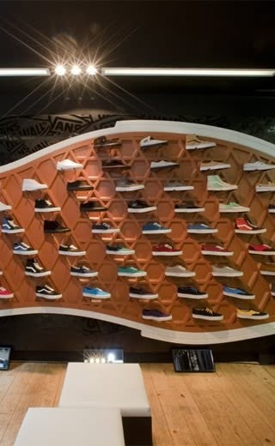
Questions?
IF ASKED ONLY ONE THING
“Is the strategy sustainable?” — The strategy is coherent and the environment favourable; the risk is not strategic but financial and organisational. A brand with 56% gross margin, 11% contribution and ₹85 lakh of cash is one bad quarter from choosing between its stores and its positioning. Evaluation exists to catch that moment early.
BACKUP, READY TO JUMP TO
unit economics (100→56→46→11) · funding & cap table (₹8.7 Cr seed · ₹26.5 Cr A @ ₹147 Cr · Shark Tank ₹175 Cr) · GST math (~₹600–1,200/pair) · competitor deep-dive (Comet ₹29 Cr FY25) · why own the factory (35% duty shield)
SOURCES CHECKED FOR THIS STUDY
gullylabs.com · global.gullylabs.com (story, pricing, ranges) · @GullyLabs on X — 3,640 followers, to 19 Sep 2026
Financial Express, 28 Jan 2026 — FY24/25 financials, unit economics · Inc42, 23 Jan 2026 — founding, capacity, FY26/27 targets
Indian Retailer — seed, Series A, flagship store · Mint, 22 Feb 2026 — the ₹2 lakh fraud
PIB, Sep 2025 — GST rationalisation · Tracxn — competitor set · AD India — flagship interior (photo)
Thank you — Aisha · Rohan · Meera · Kabir · Business Policy & Strategic Management, September 2026
Every wall in this category is a portfolio — yours must be a story.
GULLY LABS — CULTURE AS CAPITAL
15 / 15
Notes:
Kabir, 15 sec + Q&A. Thank the room, invite questions; if silent, ask the verdict question yourself. Keep the five backups ready - funding and GST are the likeliest probes.

