Slide 1
Painless File Management Under Windows and Unix
Laszlo SZATHMARY
szathmar@loria.fr
Orpailleur team -- LORIA, Nancy, France
Dec. 14, 2007, Nancy, France
This presentation is available under the terms of the GNU Free Documentation License.

Slide 2
Outline
I) A little history
II) Total Commander (for Windows)
III) Midnight Commander (for Unix/Linux)

Slide 3
(I) History
File managers
A file manager is a software that provides a user interface
to work with the file systems.
Operations
create
open
view
edit
print
rename
move
copy
delete
set attributes / properties
search / find
set permissions
etc.

Slide 4
Types of file managers
(1) Orthodox file managers
They are also known as « Norton Commander clones »,
or simply « Commander-like » file managers.
They are one of the oldest families of file managers.
Despite their age, they are still actively developed and
dozens of implementations exist.
(2) Navigational file managers
Example: Windows Explorer.
Etc.

Slide 5
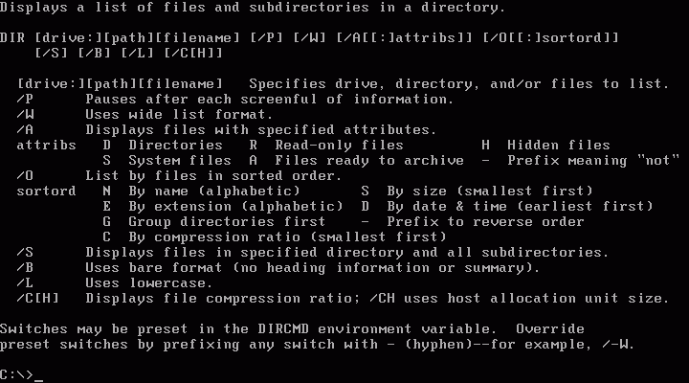
MS-DOS « operating system »
Famous versions:
MS-DOS 1.14 - July 1981
MS-DOS 3.3 - August 1987
MS-DOS 6.22 - June 1994

Slide 6

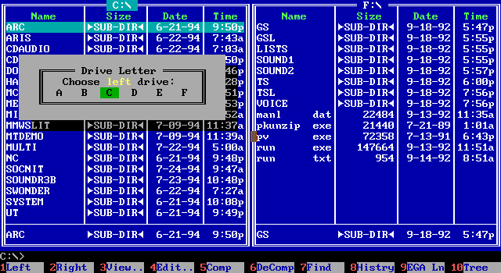

Norton Commander (for DOS)
NC is the first classic file manager.
[Captain Norton]
Written by John Socha.
Released by Peter Norton Computing in 1986.
The last DOS version of NC, v5.51, was released in 1998.

Slide 7
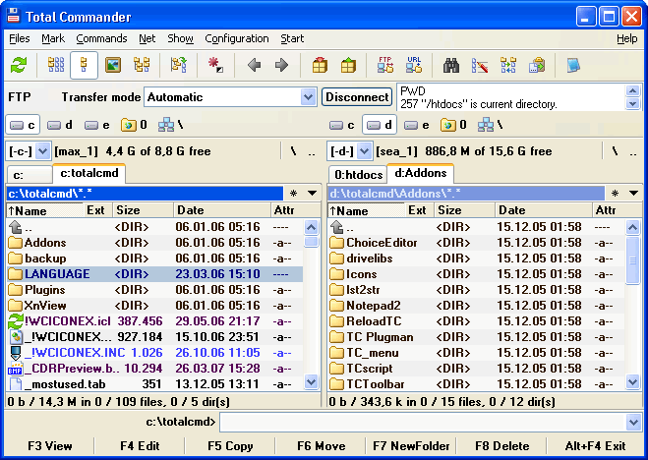
(II) Total Commander (for Windows)
Total Commander (TC) is a shareware orthodox file manager
developed by Christian Ghisler since 1993.
Website: http://www.ghisler.com

Slide 8
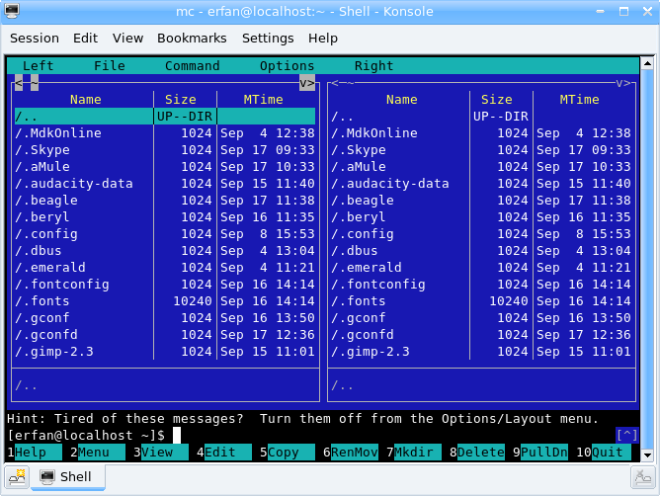
(III) Midnight Commander (for Unix)
Midnight Commander (mc) is an orthodox file manager
for Unix-like systems.

Slide 9
Bibliography
* Wikipedia (http://en.wikipedia.org)

