Slide 1


Survey Management System
Group 5

Slide 2

Job Satisfaction

Slide 3
Team Members
093936_FS Bhavyashre
093961_FS Gowtham
093957_FS Mahantesh Kumbhar
093984_FS Prathyusha
093979_FS Priyal potnis
093982_FS Rahul Keer
093949_FS Sandeep
093988_FS Shubham Salunkhe

Slide 4

DESCRIPTION
This is an Job Satisfaction Survey application that can be accessed throughout the organization and it is a web based application.
This system can be used to create the survey questionnaire, edit old survey (only when not distributed), distribute survey, review survey, display list of responded survey, view the list of pending surveys to be responding, and respond for the survey.
This is an integrated system that contains the surveyor, the respondent component and the admin (both surveyor and respondent) component.

Slide 5
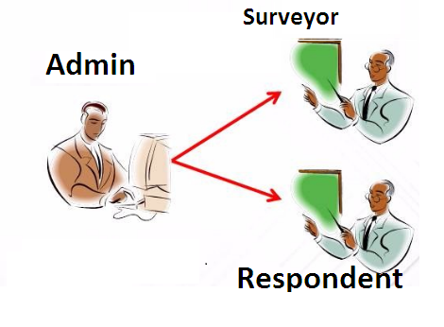
Actors
There are three categories of people who would access the system.
Admin
Surveyor
Respondent

Slide 6
Test cases
A test case is a set of conditions or variables under which a tester will determine whether a system under test satisfies requirements or works correctly.
Number of test cases
108
Number of test cases passed
Number of test cases failed
67
41

Slide 7

TEST CASES
Test Cases

Slide 8
Requirement Itemization
To simplify the requirements for better understanding of the system user test
Surveyor/Admin should able to create a Questionnaires for Respondents.
Surveyor/Admin should able to edit a Questionnaires for Respondents.
Surveyor/Admin should able to Distribute an existing survey to a list of existing respondents.
To identify testable items for the application.
Allows the valid admin/surveyor/respondent to logon to the system and display the Main option screen.
Surveyor should able to Review the distributed survey responses by viewing the number of responds received against the number of distribution & View the list of pending surveys.
Logoff from the application at any point of time

Slide 9
Requirements Validation And Functional Decomposition
RVFD

Slide 10
Use cases
Admin/Surveyor
Respondent

Slide 11
Defect Report
Defect report is a document to maintain all the defects that test engineer found while test execution.
DFDR

Slide 12

Defects Found…
The Home page of survey management system contains links but after clicking on the links the page is not navigating to other page.
The respondent views the number of survey list and clicks on back button, then application showing an blank page.
Respondent is responding to surveys and submitting the survey by clicking on submit button but response is not submitting.
UI of Survey Management System have some mistakes like spelling mistakes and different fonts.
The Surveyor is unable to Distribute an existing survey.

Slide 13
Traceability Matrix
Traceability matrix is a table containing requirements of a project and their relation to the engineering work products.
It ensures completeness in translating requirements to the delivered work products.

Slide 14
Traceability Matrix
TEST CASE ID | TDR ID | BR ID
TC_104 | DF_HomePage_01 | BR01
TC_76 | DF_DistributeSurveyPage_02 | BR05
TC_95 | DF_ViewRespondedSurveyPage_03 | BR04
TC_96 | DF_RespondToSurveyPage_04 | BR05
TC_104 | DF_SurveyorUI_05 | BR06
 | DF_DistributeSurveyPage_06 | BR07

Slide 15
Application link
Survey Management System

Slide 16
Test Case Adequacy :
Test Case Adequacy : Defines the number of actual test cases created vs estimated test cases at the end of test case preparation phase.
It is calculated as
Test Case Adequacy = Number of actual test cases*100
Number of test cases estimated
=108*100/150
=72

Slide 17
Test Case Effectiveness
Test Case Effectiveness: This defines the effectiveness of test cases which is measured in number of defects found in testing without using the test cases.
It is calculated as
Test Case Effectiveness = Number of defects detected using test cases*100/ total number of defects detected in testing
=5*100/6
=83

Slide 18
Thank You

