Slide 1
NETWORK FUNDAMENTALS

Slide 2
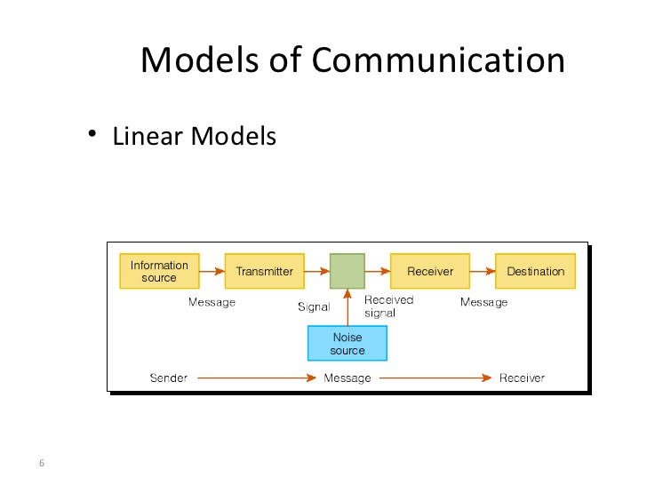
COMMUNICATION
This is the process where the information is transmitted and in the other end the messages is received.
Components Of Communication
Network Characteristics
Fault Tolerance
Scalability
Quality of Service
Security

Slide 3
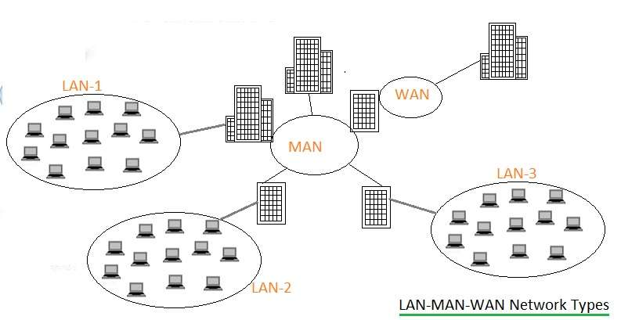
NETWORK TYPES
Local Area Network (LAN)
Metropolitan Area Network (MAN)
Wide Area Network (WAN)

Slide 4
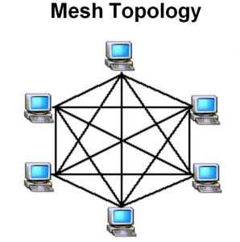
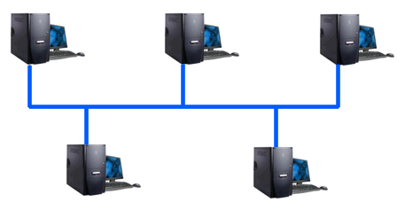

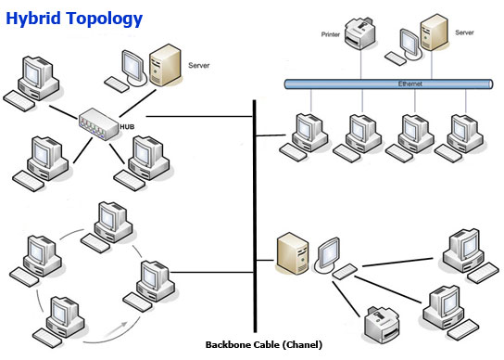
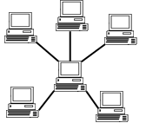
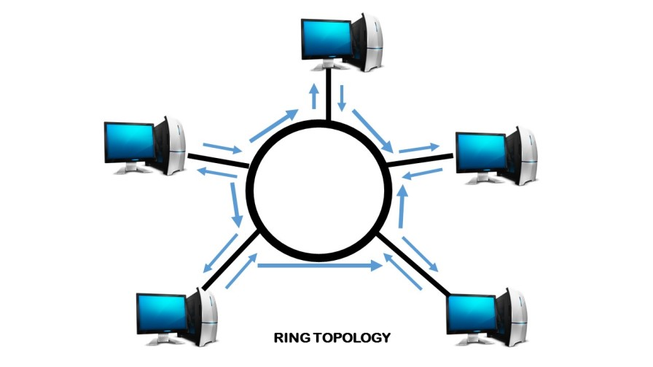
NETWORK TOPOLOGIES
Point–To-Point
Bus Topology
Mesh Topology
Star Topology
Ring Topology
Hybrid Topology

Slide 5
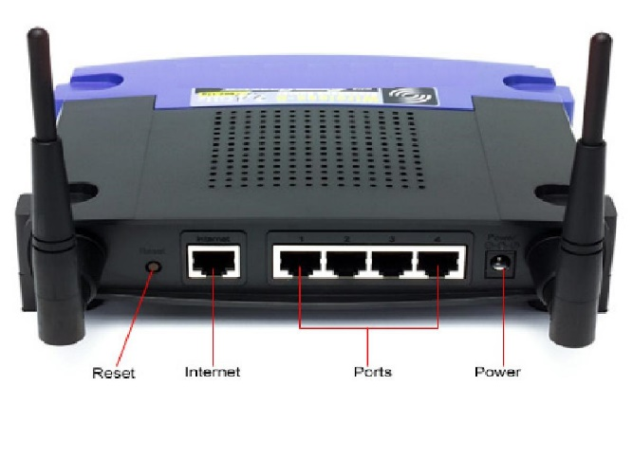
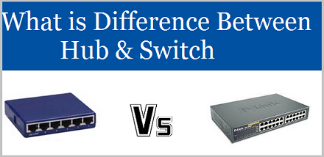
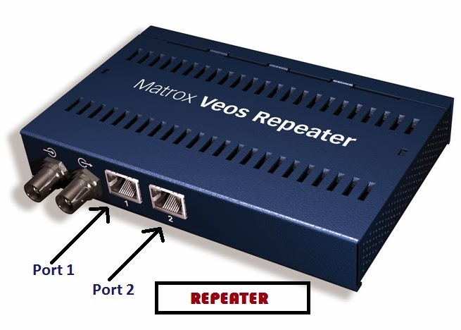
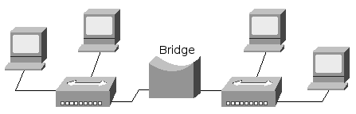
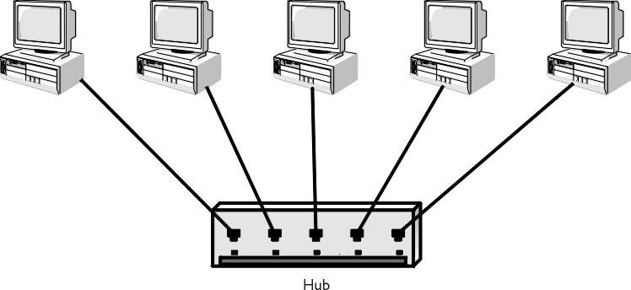
NETWORK DEVICES
It is used to connect computers or other electronic devices together so that they can share files or resources.
Switch
Router
Repeater
Hub
Bridge

Slide 6
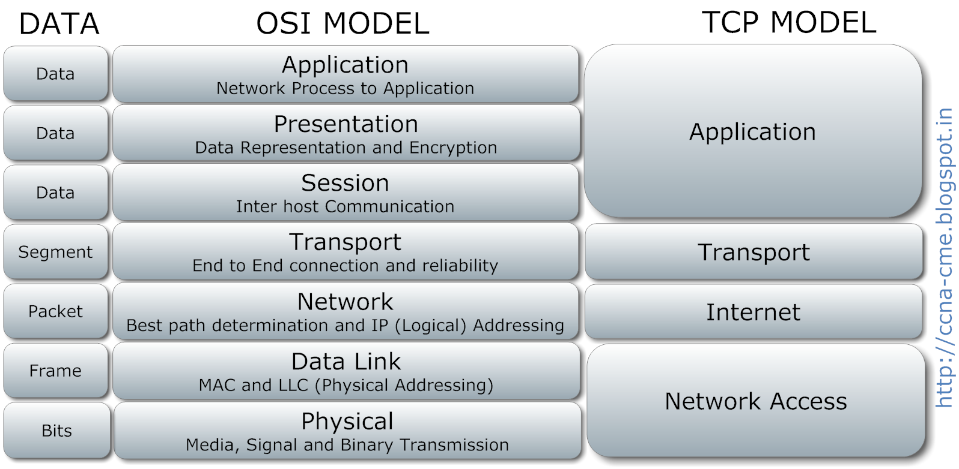
OSI and TCP/IP model

Slide 7
IP ADDRESSING
An Internet Protocol address (IP address) is a numerical label assigned to each device connected to a computer network that uses the Internet Protocol for communication.
IP
IPv4
IPv6
IPv4 addresses are 32 bit length.
IPv4 addresses are represented in decimals.
DHCP is required to configure IPv4 addresses.
IPv4 addresses are 128 bit length.
IPv4 addresses are represented in hexadecimals.
Auto-configuration of addresses is available.

Slide 8
SUBNETTING
Subnetting is a way of splitting a network into smaller, more manageable pieces.
Purpose of subnetting is to help relieve network congestion.
Reserved Address:
Link-local Addresses | 169.254.1.0 - 169.254.254.255
Loopback IP Addresses | 127.0.0.1 - 127.255.255.254
Private IP Address | 10.0.0.0 - 10.255.255.255 172.16.0.0 - 172.31.255.255 192.168.0.0 - 192.168.255.255

