Slide 2
PARTITIONS
Partitions are divisions in the formatting of the hard disk.
/
/boot
/home
/tmp
/usr
/etc
/var
/opt

Slide 3
INODE
An inode is a data structure on a filesystem on Linux that stores all the information about a file except its name and its actual data.
The metadata includes
The size of the file .
The file's owner and group.
The file's access permissions.
Timestamps.
(5) A reference count.
Notes:
Stat file name

Slide 4
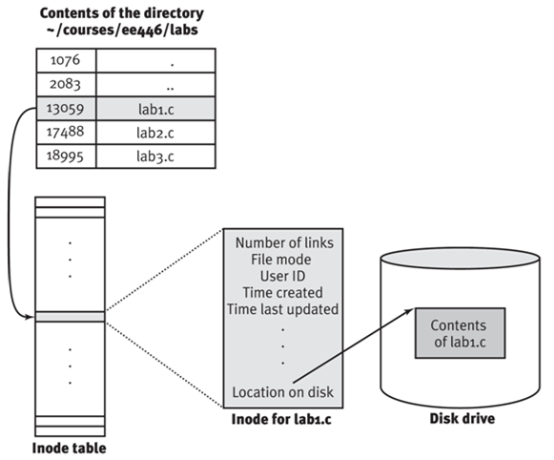
Notes:
Ls -i

Slide 5
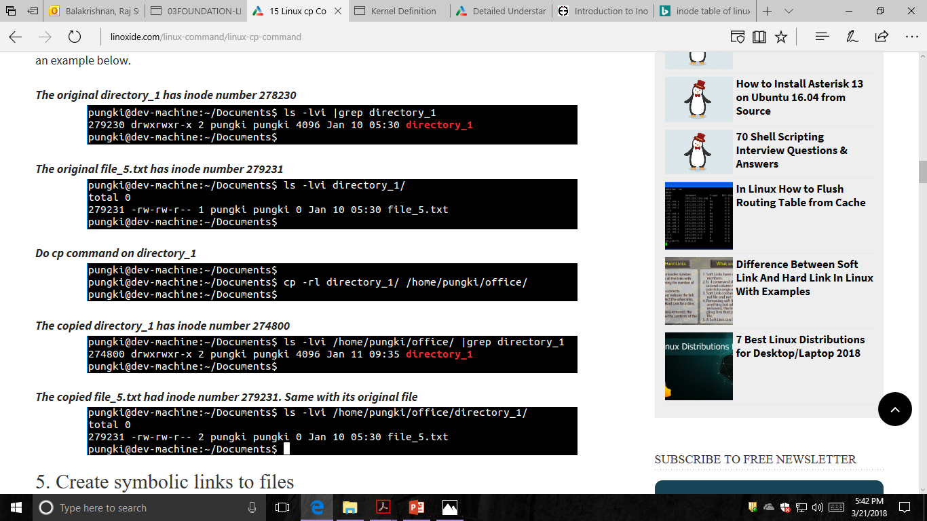
COPY INODE

Slide 6
MOVE INODE
when moving within a filesystem, the inode does not change, only the directory mapping of the inode is changed, the actual data on the hard disk (contents of the file) does not move.
# ls -li samplefile.txt 2497 -rw------- 1 raghu raghu 22 Jun 25 20:12
samplefile.txt
# mv samplefile.txt ..
# ls -li ../samplefile.txt 2497 -rw------- 1 raghu raghu 22 Jun 25 20:12
../samplefile.txt

Slide 7
REMOVE INODE
First find out file inode number with any one of the following command:
stat {file-name}
OR
ls -il {file-name}
Use find command to remove file:
Use find command as follows to find and remove a file:
find . -inum [inode-number] -exec rm -i {} \;
When prompted for confirmation, press Y to confirm removal of the file

