Slide 1


Slide 2




Historical Background of Intel Microprocessors
Intel 4004
Year of introduction 1971
4-bit microprocessor
4 KB main memory
45 instructions
PMOS technology
was first programmable device which was used in calculators

Slide 3

Historical Background of Intel Microprocessors
Intel 8008
Year of introduction 1972
8-bit version of 4004
16 KB main memory
48 instructions
PMOS technology
Slow

Slide 4

Historical Background of Intel Microprocessors
Intel 8080
Year of introduction 1973
8-bit microprocessor
64 KB main memory
2 microseconds clock cycle time
500,000 instructions/sec
10X faster than 8008
NMOS technology
Drawback was that it needed three power supplies.
Small computers (Microcomputers) were designed in mid 1970’s
using 8080 as CPU.

Slide 5

Historical Background of Intel Microprocessors
Intel 8085
Year of introduction 1975
8-bit microprocessor-upgraded version of 8080
64 KB main memory
1.3 microseconds clock cycle time
246 instructions
Intel sold 100 million copies of this 8-bit microprocessor
uses only one +5v power supply.

Slide 6

Historical Background of Intel Microprocessors
 Intel 8086/8088
Year of introduction 1978 for 8086 and 1979 for 8088
16-bit microprocessors
Data bus width of 8086 is 16 bit and 8 bit for 8088
1 MB main memory
400 nanoseconds clock cycle time
6 byte instruction cache for 8086 and 4 byte for 8088
Other improvements included more registers and additional instructions
In 1981 IBM decided to use 8088 in its personal computer

Slide 7

Historical Background of Intel Microprocessors
Intel 80186
Year of introduction 1982
16-bit microprocessor-upgraded version of 8086
1 MB main memory
Contained special hardware like programmable counters, interrupt controller etc.
Never used in the PC
But was ideal for systems that required a minimum of hardware

Slide 8

Historical Background of Intel Microprocessors
Intel 80286
Year of introduction 1983
16-bit high performance microprocessor with memory management & protection
16 MB main memory
Few additional instructions to handle extra 15 MB
Instruction execution time is as little as 250 ns
Concentrates on the features needed to implement MULTITASKING

Slide 9

Historical Background of Intel Microprocessors
Intel 80386
Year of introduction 1986
Intel’s first practical 32-bit microprocessor
4 GB main memory
Improvements include page handling in virtual environment
Includes hardware circuitry for memory management and memory assignment
Memory paging and enhanced I/O permissions

Slide 10

Historical Background of Intel Microprocessors
Intel 80486
Year of introduction 1989
32-bit high performance microprocessor
4 GB main memory
Incorporates 80387-like floating point coprocessor and
8 K byte cache on one package
About half of the instructions executed in 1 clock instead of 2 on the 80386

Slide 11

Historical Background of Intel Microprocessors
Pentium
Year of introduction 1993
32-bit microprocessor, 64-bit data bus and 32-bit address bus
4 GB main memory
Double clocked 120 and 133MHz versions
Fastest version is the 233MHz, Dual integer processor
16 KB L1 cache (split instruction and data: 8 KB each)

Slide 12

Historical Background of Intel Microprocessors
Pentium Pro
Year of introduction 1995
32-bit microprocessor, formerly code-named P6
64 GB main memory, 64-bit data bus and 36-bit address bus
16 KB L1 cache (split instruction/data: 8 KB each), 256 KB L2 cache
Uses three execution engines
Intel launched this processor for the server market

Slide 13

Historical Background of Intel Microprocessors
Pentium II
Year of introduction 1997
32-bit microprocessor, 64-bit data bus and 36-bit address bus, MMX
64 GB main memory
32 KB split instruction/data L1 caches (16 KB each)
Module integrated 512KB L2 cache (133MHz)
A version of P2 called Xeon; specifically designed for high-end applications

Slide 14

Historical Background of Intel Microprocessors
Pentium III
Year of introduction 1999
32-bit microprocessor, 64-bit data bus and 36-bit address bus
64 GB main memory
Dual Independent Bus (simultaneous L2 and system memory access)
On-chip 256 KB L2 cache
P3 was available in clock frequencies of up to 1 GHz

Slide 15

Historical Background of Intel Microprocessors
Pentium IV
Year of introduction 2002
32-bit microprocessor, 64-bit data bus and 36-bit address bus
64 GB main memory
1.4 to 1.9 GHz and the latest at 3.20 GHz and 3.46GHz (Hyper-Threading)
1MB/512KB/256KB L2 cache
Specialized for streaming video, game and DVD applications

Slide 16

Microprocessor
is a semiconductor device consisting of electronic logic circuits
manufactured by using various fabrication schemes
capable of performing computing functions
capable of transporting data/information
can be divided into 3 segments:
Arithmetic and Logic Unit
Register Unit
Control Unit

Slide 17

Von Neumann Machine
 Three key concepts:
Data and instructions are stored in a single set of read-write memory
Contents of memory are addressable by memory address, without regard to the type of data contained
Execution occurs in a sequential fashion, unless
explicitly altered, from one instruction to the other

Slide 18

Computer System Components
Memory
Stores instructions and data
Input/Output
Called peripherals
Used to input and output instructions and data
Arithmetic and Logic Unit
– Performs arithmetic operations (addition, subtraction)
– Performs logical operations (AND, OR, XOR,
SHIFT, ROTATE)

Slide 19

Computer System Components
Control Unit
– Coordinates the operation of the computer

System Interconnection and Interaction
Bus—A group of lines used to transfer bits between the microprocessor and other components of the computer system. Bus is used to communicate between parts of the computer. There is only one transmitter at a time and only the addressed device can respond.
Types
» Address
» Data
» Control signals

Slide 20

CPU Components
Registers
Hold data, instructions, or other items
Various sizes
Program counter and memory address registers must be of same size/width as address bus
Registers which hold data must be of same size/width as memory words

Slide 21

CPU Components
Control Unit
Generates control signals which are necessary for execution of an instruction.
Connect registers to the bus.
Controls the data flow between CPU and peripherals (including memory).
Provides status, control & timing signals required for the operation of memory and I/O devices to the system.
Acts as a brain of computer system
All actions of the control unit are associated with the decoding and executions of instructions (fetch and execute cycles).

Slide 22

CPU Components
Arithmetic and Logic Unit
Executes arithmetic and logical operations.
Accumulator is a special 8-bit register
associated with ALU.Register ‘A’ in 8085 is an accumulator.
Source of one of the operands of an arithmetic or logical operation.
serves as one input to ALU.
Final result of an arithmetic or logical operation is placed in accumulator.

Slide 23
Arithmetic and Logic Unit
ALU performs the following arithmetic & logical operations:
Addition
Subtraction
Logical AND
Logical OR
Logical EXCLUSIVE OR
Complement(logical NOT)
Increment (add 1)
Decrement (subtract 1)
Left shift, Rotate Left, Rotate right
Clear etc.

Slide 24

Status Flags
Intel 8085 microprocessor contains five flip-flops to serve as status flags. The
flip-flops are set or reset according to the conditions which arise due to an arithmetic & logical operation

Slide 25


Slide 26

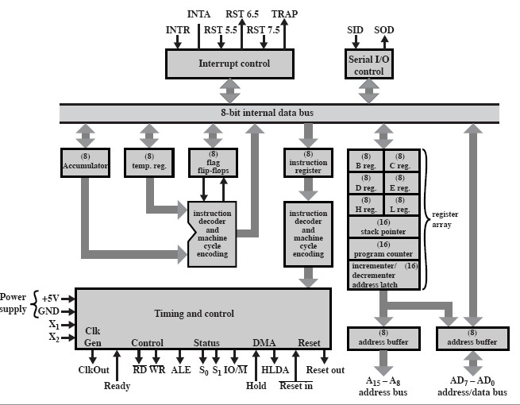



ALU

Slide 27
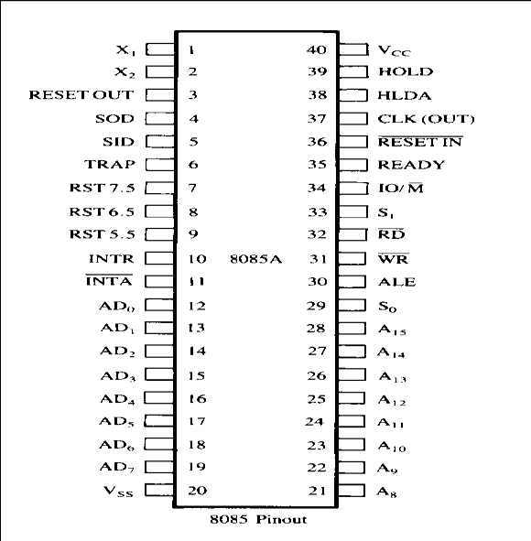
PIN DIAGRAM 0F 8085

Slide 28

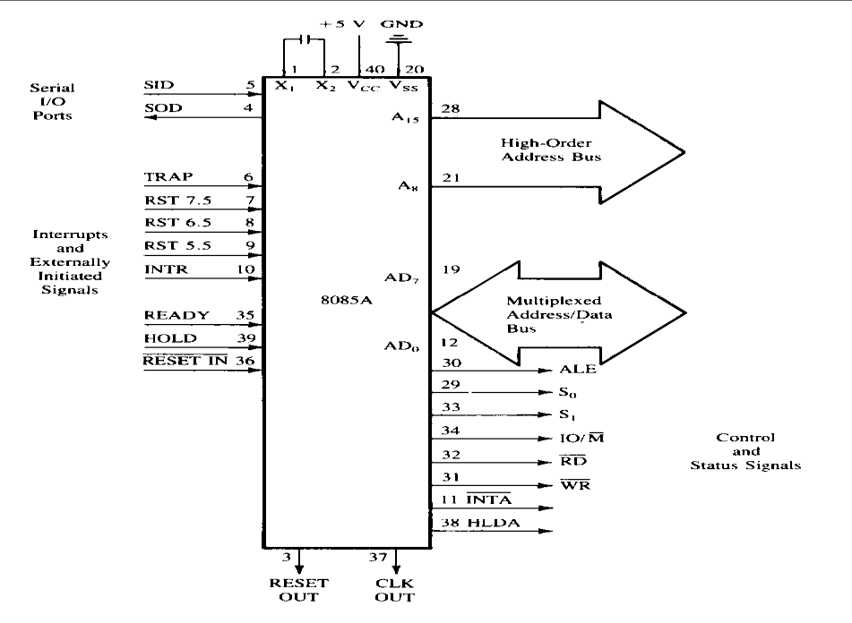

Slide 29
Multiprogramming, Multiprocessing, Multitasking, and Multithreading
In a modern computing system, there are usually several concurrent application processes which compete for (few) resources like, for instance, the CPU. As we have already introduced, the Operating System (OS), amongst other duties, is responsible for the effective and efficient allocation of those resources. Generally speaking, the OS module which handles resource allocation is called scheduler. On the basis of the type of OS to be realized, different scheduling policies may be implemented.

Slide 30
Multiprogramming
Multiprogramming In a multiprogramming system there are one or more programs loaded in main memory which are ready to execute. Only one program at a time is able to get the CPU for executing its instructions (i.e., there is at most one process running on the system) while all the others are waiting their turn. The main idea of multiprogramming is to maximize the use of CPU time. Indeed, suppose the currently running process is performing an I/O task (which, by definition, does not need the CPU to be accomplished). Then, the OS may interrupt that process and give the control to one of the other in-main-memory programs that are ready to execute (i.e. process context switching). In this way, no CPU time is wasted by the system waiting for the I/O task to be completed, and a running process keeps executing until either it voluntarily releases the CPU or when it blocks for an I/O operation. Therefore, the ultimate goal of multiprogramming is to keep the CPU busy as long as there are processes ready to execute. Note that in order for such a system to function properly, the OS must be able to load multiple programs into separate areas of the main memory and provide the required protection to avoid the chance of one process being modified by another one. Other problems that need to be addressed when having multiple programs in memory is fragmentation as programs enter or leave the main memory. Another issue that needs to be handled as well is that large programs may not fit at once in memory which can be solved by using pagination and virtual memory.

Slide 31
Multiprocessing
Multiprocessing sometimes refers to executing multiple processes (programs) at the same time. This might be misleading because we have already introduced the term “multiprogramming” to describe that before. In fact, multiprocessing refers to the hardware (i.e., the CPU units) rather than the software (i.e., running processes). If the underlying hardware provides more than one processor then that is multiprocessing. Several variations on the basic scheme exist, e.g., multiple cores on one die or multiple dies in one package or multiple packages in one system. Anyway, a system can be both multiprogrammed by having multiple programs running at the same time and multiprocessing by having more than one physical processor.

Slide 32
Multitasking
Multitasking has the same meaning of multiprogramming but in a more general sense, as it refers to having multiple (programs, processes, tasks, threads) running at the same time. This term is used in modern operating systems when multiple tasks share a common processing resource (e.g., CPU and Memory). At any time the CPU is executing one task only while other tasks waiting their turn. The illusion of parallelism is achieved when the CPU is reassigned to another task (i.e. process or thread context switching).

Slide 33
There are subtle differences between multitasking and multiprogramming. A task in a multitasking operating system is not a whole application program but it can also refer to a “thread of execution” when one process is divided into sub-tasks. Each smaller task does not hijack the CPU until it finishes like in the older multiprogramming but rather a fair share amount of the CPU time called quantum. Just to make it easy to remember, both multiprogramming and multitasking operating systems are (CPU) time sharing systems. However, while in multiprogramming (older OSs) one program as a whole keeps running until it blocks, in multitasking (modern OSs) time sharing is best manifested because each running process takes only a fair quantum of the CPU time.

Slide 34
Multithreading
Multithreading is an execution model that allows a single process to have multiple code segments (i.e., threads) run concurrently within the “context” of that process. You can think of threads as child processes that share the parent process resources but execute independently. Multiple threads of a single process can share the CPU in a single CPU system or (purely) run in parallel in a multiprocessing system Why should we need to have multiple threads of execution within a single process context? Well, consider for instance a GUI application where the user can issue a command that require long time to finish (e.g., a complex mathematical computation). Unless you design this command to be run in a separate execution thread you will not be able to interact with the main application GUI (e.g., to update a progress bar) because it is going to be unresponsive while the calculation is taking place.

