Slide 1

Group 2

Slide 2

Banking products and Services
Individual banking:
Checking accounts.
Savings accounts.
Debit and Credit cards.
Insurance.

Slide 3
Business Banking:
Business loans.
Checking accounts.
Savings accounts.
Debit and Credit cards.
Merchant services.
Cash management.

Slide 4

Digital Banking:
Online, mobile and tablet banking.
Mobile check deposit.
Text alerts.
e Statements.
Online bill pay.

Slide 5

Loans:
Personal loans.
Home equity loans.
Home equity lines of credit.
Home loans.
Business loans.

Slide 6

Laws related to banking
Banking and Finance law:
Banking law.
Banking Regulatory.
Important Banking Acts.
Risks In Banking Regulatory.

Slide 7

Net Banking
A bank customer can perform non-transactional tasks through online banking, including:
Viewing account balances.
Viewing recent transactions.
Downloading bank statements, for example in PDF format.
Viewing images of paid cheques.
Ordering cheque books.
Download periodic account statements.
Downloading applications for M-banking, E-banking etc.

Slide 8
Bank customers can transact banking tasks through online banking, including:
Funds transfers between the customer's linked accounts
Paying third parties, including bill payments (see, e.g., BPAY) and third party fund transfers (see, e.g., FAST)
Investment purchase or sale
Loan applications and transactions, such as repayments of enrollments
Credit card applications
Register utility billers and make bill payments
There are some advantages to using e-banking both for banks and customers:
Permanent access to the bank
Access anywhere using mobile or computer
Less time consuming
Very safe and secure method
Helps to transfer the money immediately and accurately
Easy to use

Slide 9

Credit Cards
A credit card is a payment card issued to users (cardholders) to enable the cardholder to pay a merchant for goods and services based on the cardholder's promise to the card issuer to pay them for the amounts so paid plus the other agreed charges.

Slide 10

Advantages:
Cashless payment.
Online world wide payment.
Get goods/service first, pay later up to 45 days.
Disadvantages:
Overspending.

Slide 11

Mortgage / home loan
Eligibility.
About Interest Rates.
Types of Home Loans
Loan Process.
Loan Sanction.

Slide 12
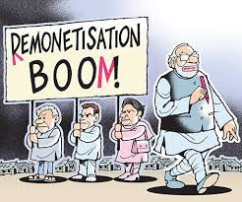
Demonetization in India and its effects
Definition:
Demonetization is the act of stripping a currency unit of its status as legal tender. It occurs whenever there is a change of national currency: The current form or forms of money is pulled from circulation and retired, often to be replaced with new notes or coins.

Slide 13
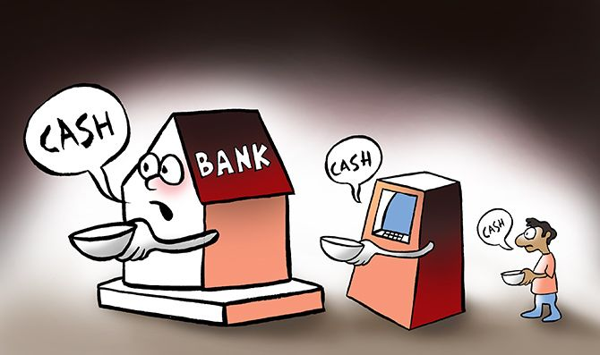
Influences of demonetization are:
Increase in Deposits.
Fall in cost of Funds.
Demand for Government Bonds.
Sagginess in Lending.
Benefits of demonetization:
Push to Digital Banking.
Benefits of Cashless economy.
Digital transaction platforms.

Slide 14
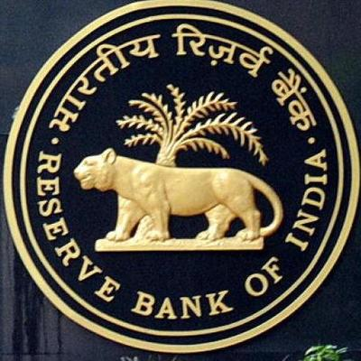
Reserve Bank Of India
The Reserve Bank of India (RBI) is India's central banking institution, which controls the monetary policy of the Indian rupee. It commenced its operations on 1 April 1935 in accordance with the Reserve Bank of India Act, 1934.
Reserve Bank of India Act, 1934 is the legislative act under which the Reserve Bank of India was formed. This act along with the Companies Act, which was amended in 1936, were meant to provide a framework for the supervision of banking firms in India.

Slide 15
Main Functions:
Financial Supervision.
Regulator and supervisor of the financial system.
Managing foreign exchange.
Issue of currency and other Functions.

Slide 16
Conclusion
Thus banking sector provides a efficient way to help people build their business and life by supporting them financially.

Slide 17
THANK YOU

