Slide 1
PERSONAL
MEDIA LIBRARY
Illya Reutskyy 26418236
Jafar Abbas 26346650
Daniel Makardich 27522657

Slide 2
MAIN FUNCTIONS AND FEATURES
Organization of media library by title
Upload, edit, delete or view cloud hosted media files
Secure authentication to access the service
Included support of Google Drive and Dropbox
Adaptive streaming support

Slide 3
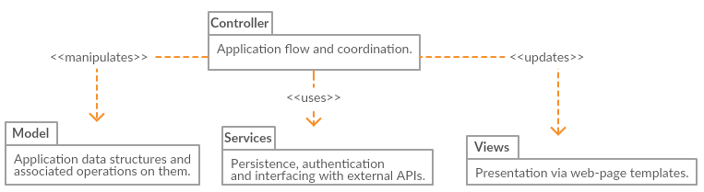
ARCHITECTURE DESIGN – Package Diagram

Slide 4
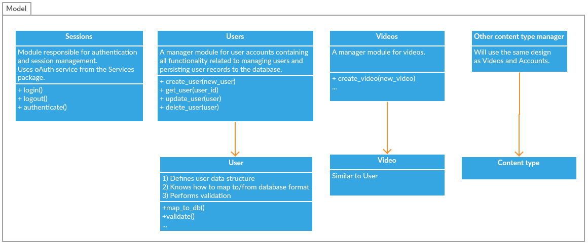
ARCHITECTURE DESIGN – Model
1 *

Slide 5
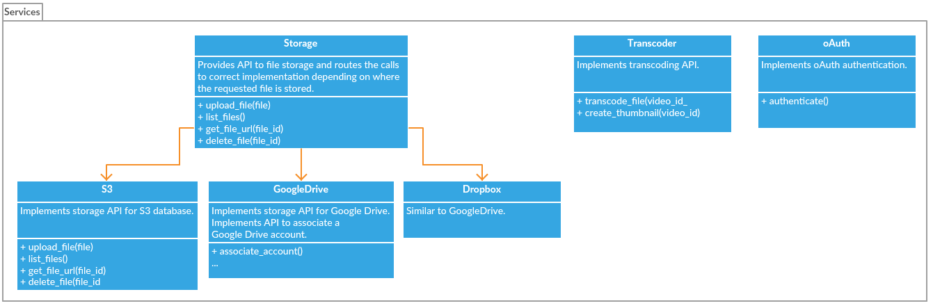
ARCHITECTURE DESIGN – Services

Slide 6
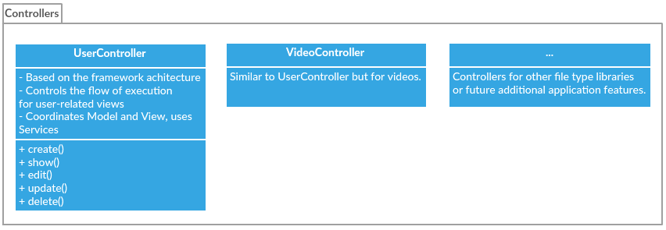
ARCHITECTURE DESIGN – Controllers

Slide 7
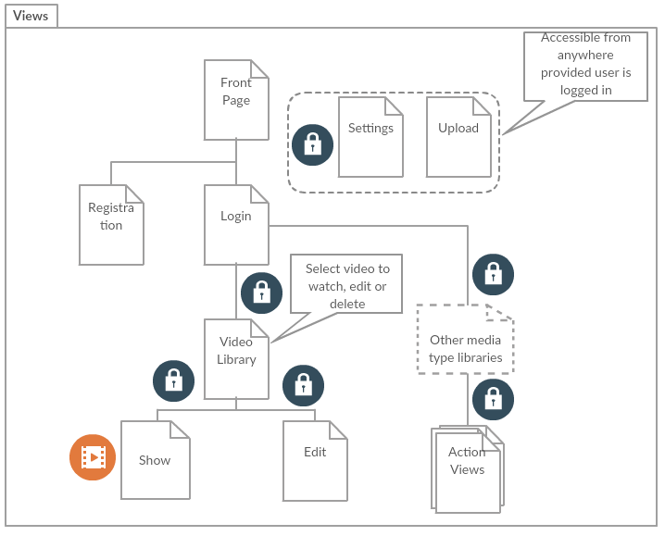
ARCHITECTURE DESIGN – Views

Slide 8



TECHNOLOGIES USED
Phoenix framework used with Elixir (functional programming language)
Front-end templates (HTML, Bootstrap)
MongoDB database (NOSql) hosted on AWS
Amazon S3 for file storage
MPEG-DASH Video player (JavaScript)
Notes:
I displayed multiple categories of users since it is relevant to the question in the project description. The regular consumer is people like you and me that can benefit from storing and organizing but not much space is necessary and doesn’t respond to an actual need. The other categories could be making a living and the use of external devices I think is a viable reason as to why this project has potential value and has an actual market. Other than eliminating use of devices it also provides insurance to the well being of files since external drives can fail to function.

Slide 9
ACCOMPLISHED AND UPCOMING TASKS
ACCOMPLISHED
UPCOMING
Video file uploading and management on S3 and local storage
File records management with MongoDB on the cloud
Video streaming of files hosted on S3 using the web application and MPEG-DASH
Inclusion of Google Drive and Dropbox support
OAuth authentication
Transcoding of media files using Amazon Elastic Transcoder
Finalizing the UI
Testing and Validation

Slide 10
ISSUES ENCOUNTERED AND THEIR RESOLUTION
MongoDB not supported by the Phoenix database object mapper out of the box solved by implementing a simple adapter with required interface
Limited processing power provided by free-tier amazon cloud services for custom video transcoding solved by using Amazon Elastic Transcoder

Slide 11
GOALS REVIEW
Video transcoding for adaptive streaming is on demand due to limited resources
DynamoDB replaced by MongoDB
Other goals remain unchanged

Slide 12
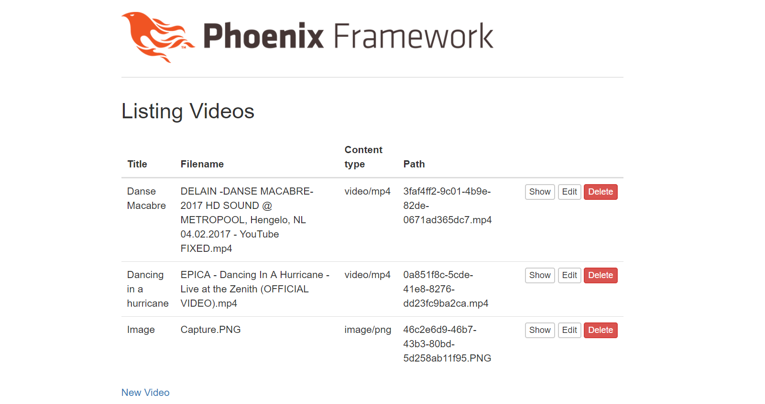

Slide 13
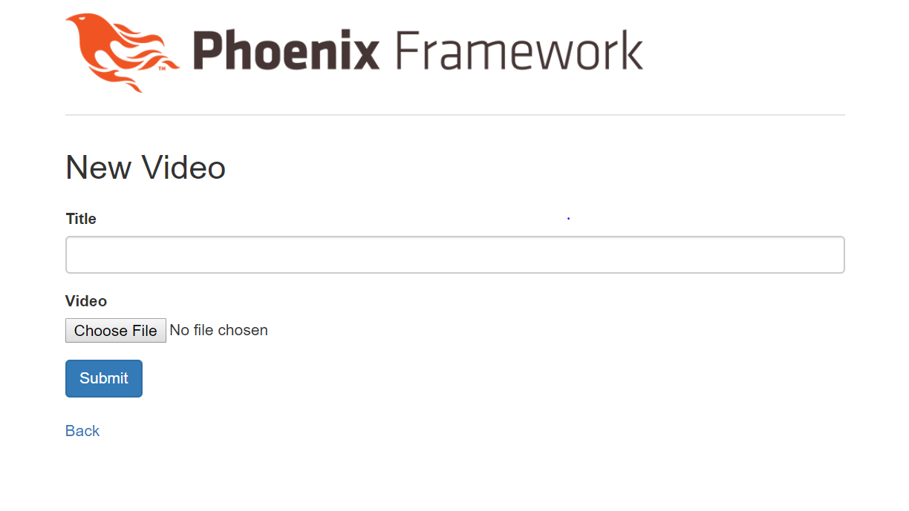

Slide 14
