Slide 1
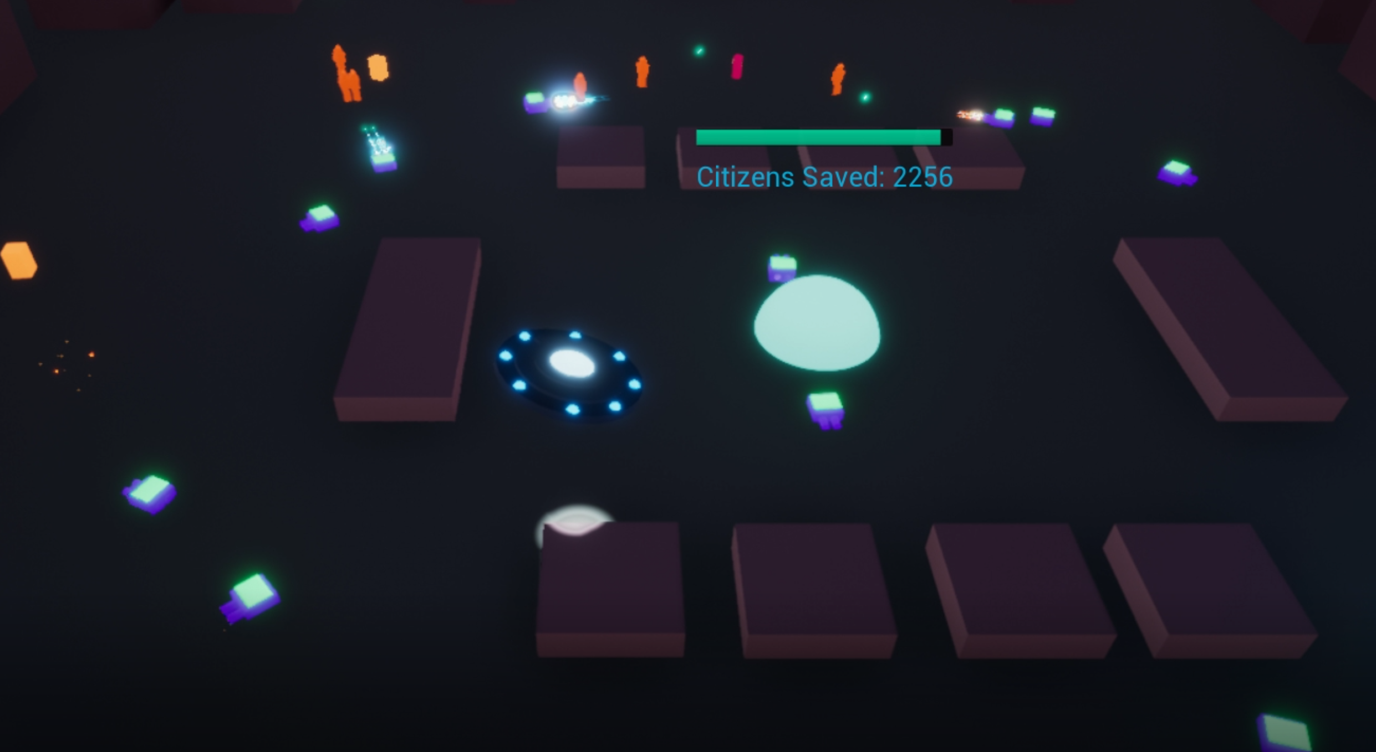
ALIENS VS ZOMBIES
CONTROLS
L Joy Stick: MOVEMENT
L Trigger: PULL BEAM
R Trigger: LASER BEAM
A Button: SPAWN TURRET
X Button: SPAWN BOMB
OBJECTIVE
The zombies are coming! Protect your central hub for as long as possible. The longer you keep it alive, the more citizens that will escape from the zombie horde (represented as a Citizens Saved score above the hub).
Resources are gained from beaming up the blue cubes. Additional citizens can be saved by picking up citizen pods that crash land from the sky.
Use your resources to spawn turrets or bomb traps, and your laser beam to dish out additional damage by burning through the undead horde.
Good luck!
UNREAL ENGINE [ANGELSCRIPT] 4.23.0
HOURS AND TASKS (In Order of Completion)
Starting Wednesday 30.10.19 to Monday morning 11.11.19, these were the hours I worked and in what order I prioritized my tasks.
5 Hours:
Setting up project structure, classes and basic player functionality
17 Hours:
Building out gameplay, aesthetics, testing and completing the base game loop
12 Hours:
Debugging, additional mechanics, updating player controls and implementing UI elements
9 Hours:
Refactoring, project clean up, playtesting, tweaking for more dynamic gameplay
7 Hours:
Refactoring, VFX and material updates to improve game feel, general game balancing and testing.
TOTAL: 50 Hours

