Slide 1
Looking at the Components of Gross Domestic Product (GDP)
DSC 530 Final Project

Slide 2
What is Gross Domestic Product (GDP)?
GDP is the summation of economic activity in a country
Higher GDP is a good thing
Although there are flaws with the calculations for GDP, it is seen as the best approximation of economic activity in a country

Slide 3
What are the components of GDP?
The equation for GDP is:
GDP = C + I + G + NX where C = consumer spending, I = investment, G = government expenditures, and NX is net exports
However, if you look up these numbers, it’s not very interesting, the government compiles them and adds them together to get GDP.
However, I was interested in seeing in how some related variables affected GDP and whether those related variables could be seen to have an outsized effect on GDP

Slide 4
My Variables
For consumer spending I was interested in the M1 and M2 money supply (M1 being liquid cash and M2 being M1 plus slightly less liquid forms of money such as money market accounts)
For consumer spending I’m also interested in the effect of the Federal Funds Rate (an interest rate banks charge each other, but is also a floor for interest rates given to consumers and businesses), inflation, and the unemployment rate
For investment, I am using the Federal Funds Rate, as well as the unemployment rate
For government expenditures, I am simply using the amount of government spending reported by the government
I am not looking into net exports, as these are already produced goods being transferred between countries. As it is just a number like government expenditures, I will be focusing on the other variables.

Slide 5
Calculations Used on Variables
Some variables were monthly and some were quarterly, so I first converted them to quarterly if they were monthly (I took the average looking forward [January 1990 would be the average of January, February, and March 1990])
Some datasets were longer than others so I cut them down to all be the size of the shortest dataset, leaving them all from January 1959 until July 2024
I also did a calculation on the consumer price index (a monthly collection of data on the prices in the US) to calculate inflation
For each month (before converting to quarterly), I took the percentage change from each month to the same month in the previous year

Slide 6
Notes on Variables
In all cases, I chose the seasonally adjusted versions of the variables
This gets rid of seasonal variation that, especially at the quarterly level, would make so much noise in the data that you wouldn’t be able to see what’s going on
The consumer price index (CPI) is valueless (based on being 100 at some point in time) and the Federal Fund Rate is the rate set by the Federal Reserve. The unemployment rate is the percentage of unemployed people out of people who are in the labor force and looking for a job
All other variables are in billions of dollars (M1, M2, GDP, and government spending)
GDP is the value excluding food and energy, as they are the most volatile components and can cause swings due to effect not related to economic activity (droughts can increase food prices, for example, which does not mean that economic activity was higher)

Slide 7
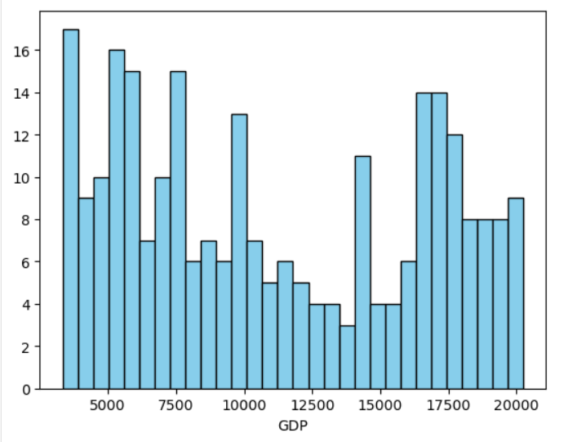
GDP Histogram

Slide 8
GDP Summary Statistics
Mean = 11154.825
Mode = 3352.129
Spread = 16888.984
Standard Deviation = 5317.021
Skewness = 0.16
Kurtosis = -1.42

Slide 9
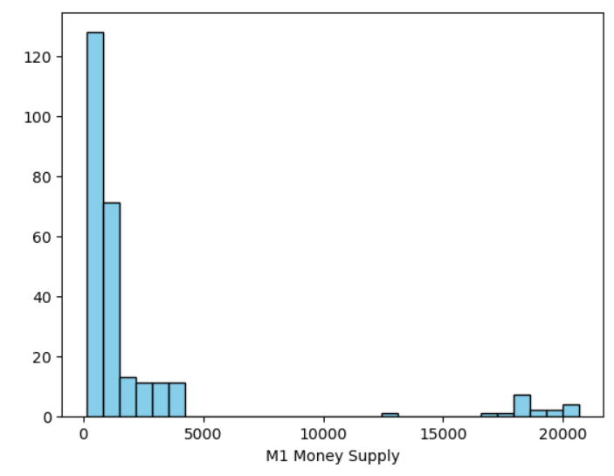
M1 Histogram

Slide 10
M1 Summary Statistics
Mean = 2241.727
Mode = 141.533
Spread = 20520.766
Standard Deviation = 4557.448
Skew = 3.23
Kurtosis = 9.12

Slide 11
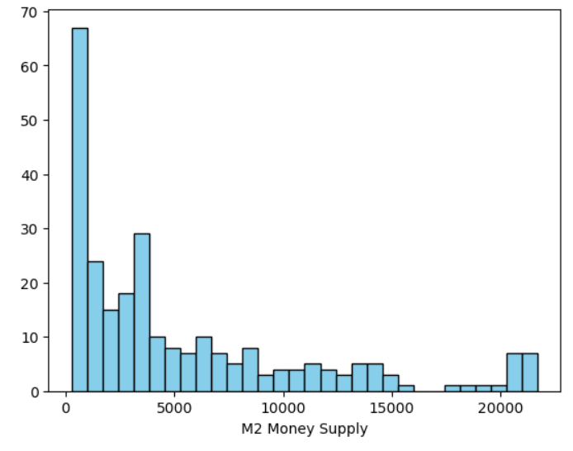
M2 Histogram

Slide 12
M2 Summary Statistics
Mean = 5369.368
Mode = 287.833
Spread = 21402.9
Standard Deviation = 5700.319
Skew = 1.41
Kurtosis = 1.15

Slide 13
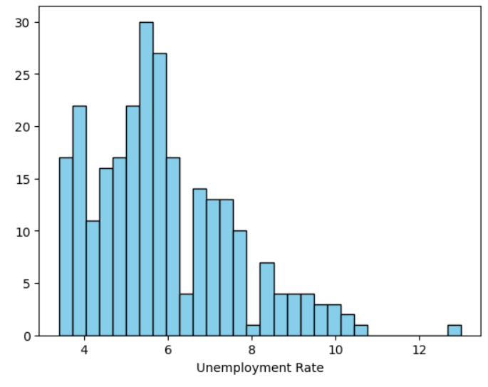
Unemployment Rate Histogram

Slide 14
Unemployment Summary Statistics
Mean = 5.89
Mode = 5.7
Spread = 9.6
Standard Deviation = 1.68
Skew = 0.88
Kurtosis = 0.80

Slide 15
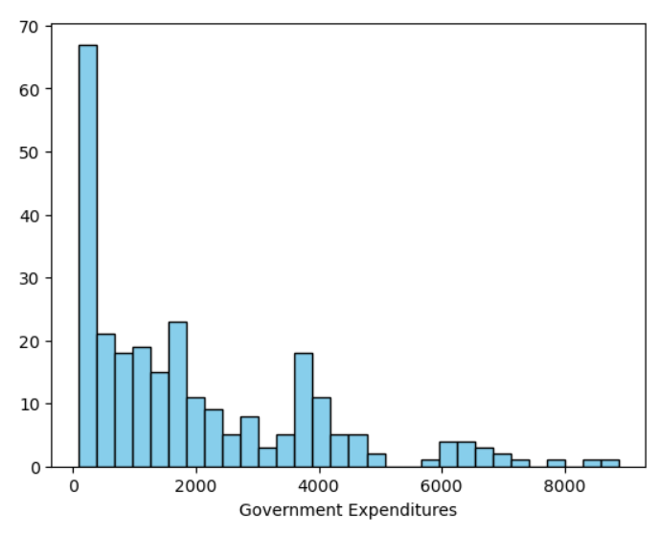
Government Expenditures Histogram

Slide 16
Government Expenditures Summary Statistics
Mean = 1953.975
Mode = 89.118
Spread = 8795.173
Standard Deviation = 1900.629
Skew = 1.217
Kurtosis = 0.961

Slide 17
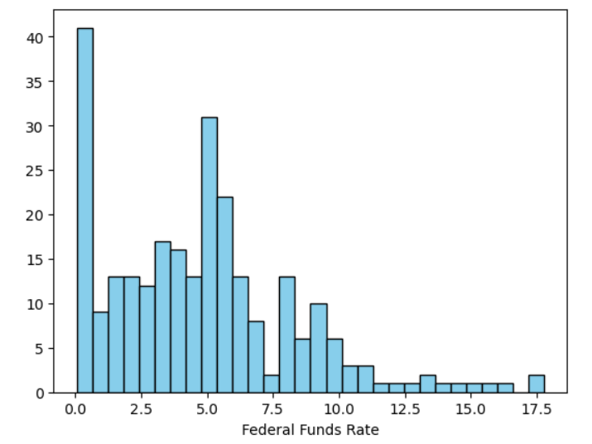
Federal Funds Rate Histogram

Slide 18
Federal Funds Rate Summary Statistics
Mean = 4.77
Mode = 0.09
Spread = 17.72
Standard Deviation = 3.61
Skew = 0.92
Kurtosis = 1.11

Slide 19
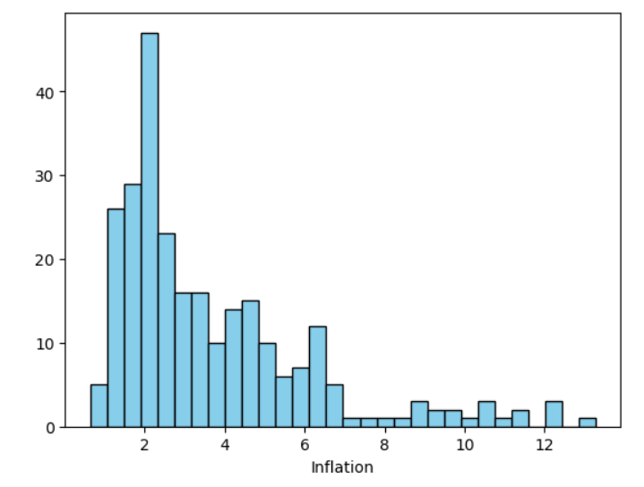
Inflation Histogram

Slide 20
Inflation Summary Statistics
Mean = 3.70
Mode = 1.81
Spread = 12.63
Standard Deviation = 2.50
Skew = 1.59
Kurtosis = 2.42

Slide 21
Should We Remove Outliers?
As these results are based on time, I don’t think any results should be removed (as I don’t think they are incorrect, they simply reflect an unusual situation, like the 12% unemployment rate)
However, the histograms reveal some interesting information
The government had near 0 expenditures for a large part of its history
Inflation has been near 2% for the majority of the data set, which is the Federal Reserve’s goal for inflation
GDP is evenly spaced, as GDP generally grows over time and thus has an approximately even number of each amount
However, M1 and M2 should also follow this pattern, but instead are bunched near the lower amounts, with a few much higher amounts
May be an interesting thing to study whether these higher levels of M1, M2 affect GDP

Slide 22
Comparing Two Scenarios with a PMF
I was interested in comparing two time periods of inflation, from 1970-1979 and 2019 until the most recent data point.
Both have some periods of high inflation involved (stagflation occurred in the 1970s, which involved high inflation and high unemployment at the same time, which usually does not happen)
I was curious if we could compare the length and level of inflation in these two time periods

Slide 23
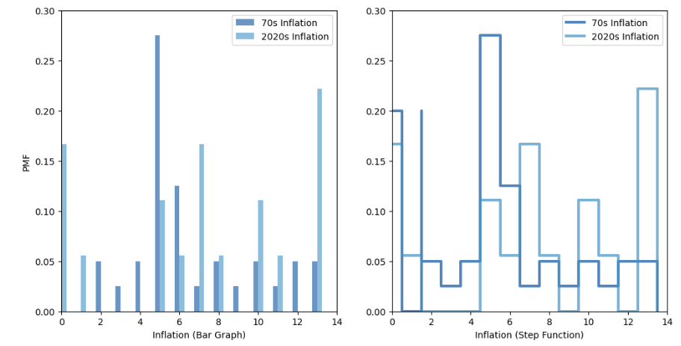
PMF Chart Comparing These Two Periods

Slide 24
Inflation Comparison
Inflation got higher during the 2020s inflation than during the 1970s inflation (at least for a longer time)
But inflation in the 1970s was longer lasting, it appears, with a longer period of high, but not incredibly high, inflation
This may have caused the longer inflationary period in the 1970s, as people might have accepted it since it wasn’t too high (until other economic problems started causing high unemployment at the same time)

Slide 25
CDF Example Using the Unemployment Rate
I know the Federal Reserve has a goal for the inflation rate, and the unemployment rate is usually inversely related to the inflation rate
Let’s see if the unemployment rate matches inflation
There should be a lower increase in the CDF near the lower unemployment rates (as there are fewer high inflation periods) and a faster increase as unemployment reaches higher levels

Slide 26
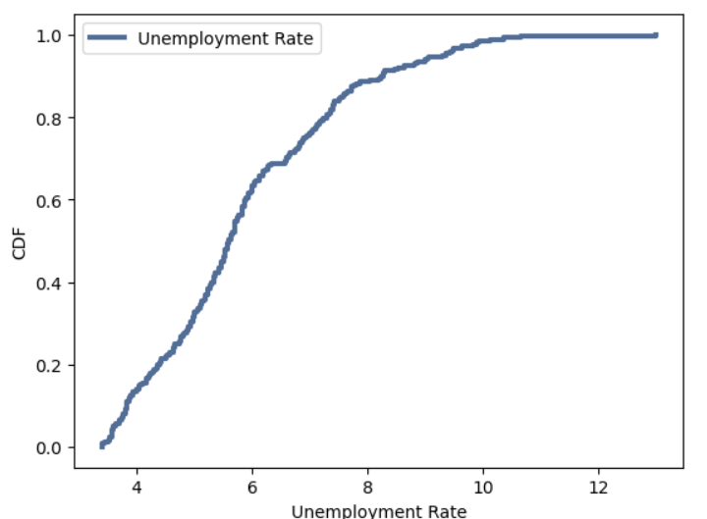
Unemployment Rate CDF

Slide 27
The unemployment rate is higher than I thought it was most of the time (I assumed there would be some growth in the CDF before it got to 4%)
The general shape does match my expectations, however, with a majority of the increase in the CDF being at higher unemployment rates and a slowing down at the end as it reached abnormally high unemployment rates
It would be interesting to compare the unemployment rate during the two inflationary periods I checked before
One period was a classic example of stagflation, when unemployment was high while inflation was also high

Slide 28
Analytical Distribution
I was curious to try the Pareto Distribution on GDP. It is good for sizes of towns, which may be distributed in the same manner as GDP grows

Slide 29
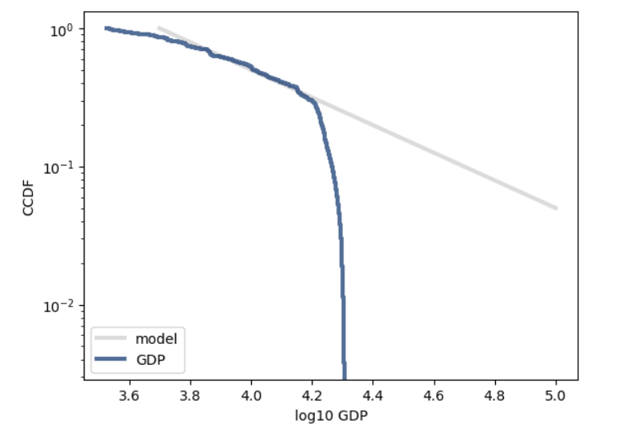
Pareto Distribution Results
The Pareto model fits well at lower values, but then goes off the rails for higher levels of GDP

Slide 30
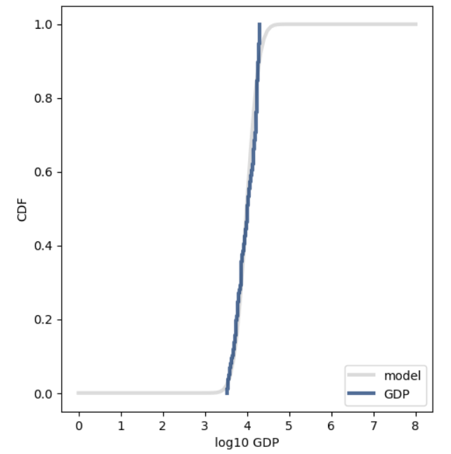
Lognormal Model of GDP
The lognormal model seems
to fit GDP better

Slide 31
Unemployment vs. Inflation
Unemployment and inflation are inversely related (but not directly related) so I’m looking at the correlation between these two variables
As unemployment gets lower, prices tend to get higher as a high employment rate should lead to more people asking for raises, which leads to an increase in the price level

Slide 32
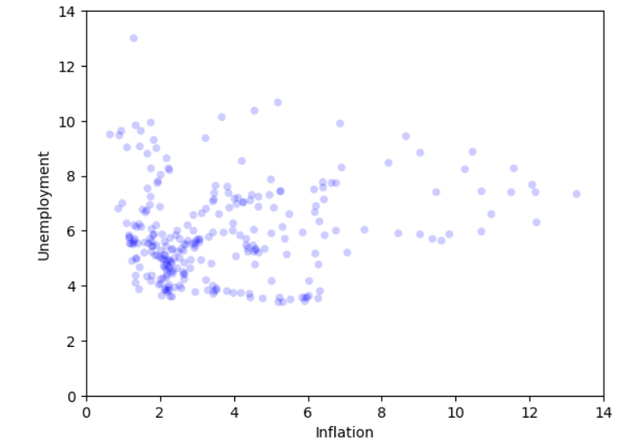
Unemployment vs. Inflation Scatterplot

Slide 33
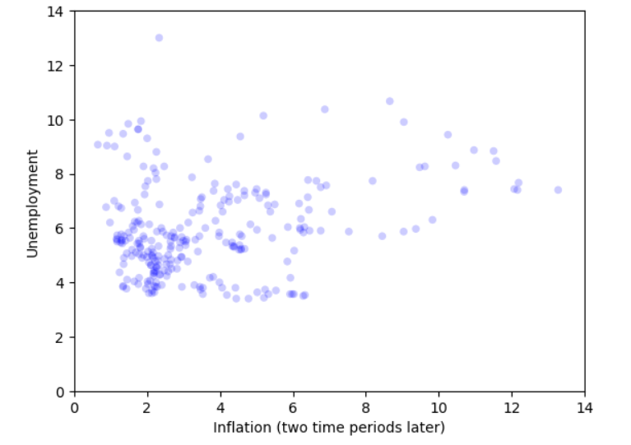
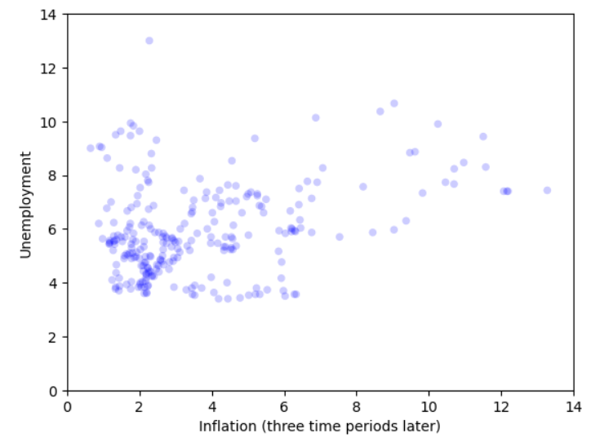
Unemployment vs Inflation first thoughts
I thought inflation might be a lagging variable to unemployment, so I tried comparing unemployment to later data points of inflation, but the results were not entirely clear
There may be some flattening/elongating of the general shape

Slide 34
Unemployment vs Inflation
The covariance between these two variables is 0.696.
Checking the future values of inflation, the covariances are
i+1 = 0.943
i+2 = 1.164
i+3 = 1.349
It seems that future values of inflation are more strongly related to the unemployment rate
Likewise, Pearson’s correlation between the two variables increases as inflation is shifted forward, giving the following results
i+0 = 0.167, i+1 = 0.223, i+2 = 0.276, i+3 = 0.319
There is a slight correlation, but I wouldn’t call it a strong correlation (although it gets stronger as inflation is delayed, there may be an optimal delay that is longer than 3 quarters)
However, the correlation should be negative, so these correlations don’t make much sense

Slide 35
Unemployment Squared vs. Inflation
The Pearson correlation between inflation and unemployment rate squared is slightly lower than the straight relationship
They end up being about 0.15 to 0.2 lower in each case
i+0 = 0.146, i+1 = 0.207, i+2 = 0.262, i+3 = 0.305
This makes sense, as the scatter plot did not seem to show any quadratic relationship

Slide 36
Testing Difference in Means of Two Inflationary Periods
A useful test, although we saw that inflation behaved differently in the 1970s and 2020s, is to see whether their means were different
After testing the hypothesis that their means were different, the p-value was 0.0, so the means are the same (although the test statistic CDF did change slightly on multiple re-runs).
I thought this was a bit strange so I re-ran the results with a smaller pool of data
Even with sample sizes that were half the size, the p-value is consistently < 0.005 (although my repeated sampling resulted in a 0.0 and a 0.07)
This seems strange with only 9 data points in one sample at this point, as these time periods shouldn’t be that similar, but if I were to continue checking this problem, I would look at slightly different time periods to see if the similar mean holds

Slide 37
Multivariate Regression On GDP
I ran the regression on GDP with the explanatory variables:
M1
M2
Unemployment Rate
Government Expenditures
Federal Funds Rate
Inflation
The next page will show the effects and their significance, then I will discuss the entire model’s results

Slide 38
Variable Effects and Significance
M1, each increase in one billion dollars in the money supply causes:
-0.64 billion in GDP, with a p-value of 0.00, a significant effect
M2, each increase in one billion dollars in the money supply causes:
0.27 billion in GDP, with a p-value of 0.013
Unemployment rate, each increase by 1% causes:
-249 billion in GDP, with a p-value of 0.00, a significant effect
Government expenditures, each increase by 1 billion dollars causes:
3.10 billion in GDP, with a p-value of 0.00, a significant effect
Federal Funds Rate, each increase by 1% causes:
70.24 billion in GDP, with a p-value of 0.11
Inflation, each increase by 1% causes:
36.71 billion in GDP, with a p-value of 0.55

Slide 39
Do these results make sense?
An increase in liquid cash makes GDP go down? This doesn’t make sense to me, but it’s a significant effect. The only explanation I can think of is that cash is infused by the Federal Reserve into the economy when things are going badly, so maybe a delayed effect on the GDP would show an opposite effect.
The unemployment rate increasing correctly shows a huge effect of a decrease in GDP (although I would also want to add multiple lagged unemployment rates to see how long it generally takes for the economy to recover from a period of high unemployment)
Government expenditures also show a large effect on GDP, with 1 dollar spent on government items/employees returning 3 dollars to the economy
The other variables are not statistically significant, so I would want to do some further work to see if I could find delayed versions that might be significant

Slide 40
Total Model Results
Despite several variables being insignificant, the results for the model (R-Squared) is very high at 0.934 (or 0.932 for the adjusted R-Squared)
This model accounts for a large percentage of the change in GDP, even if some of the variables aren’t significant
I have read that variables that tend to move together (money supply, GDP, etc… that move up over time are probably dependent on population, so perhaps if I had more time I would account for that).

Slide 41
Sources for Data
Federal Government: Current Expenditures (FGEXPND) | FRED | St. Louis Fed
Consumer Price Index for All Urban Consumers: All Items Less Food and Energy in U.S. City Average (CPILFESL) | FRED | St. Louis Fed
Unemployment Rate (UNRATE) | FRED | St. Louis Fed
Real Gross Domestic Product (GDPC1) | FRED | St. Louis Fed
Federal Funds Effective Rate (FEDFUNDS) | FRED | St. Louis Fed
M2 (M2SL) | FRED | St. Louis Fed
M1 (M1SL) | FRED | St. Louis Fed

