Slide 1
CAN-STEP
Matija Tuđan

Slide 2
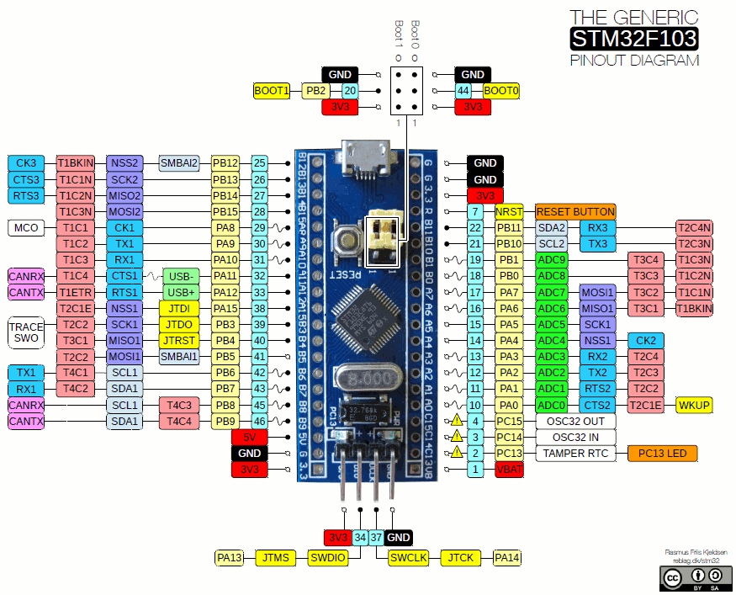
Overview
STM32F103C8T6
CAN
Stepper
UART

Slide 3
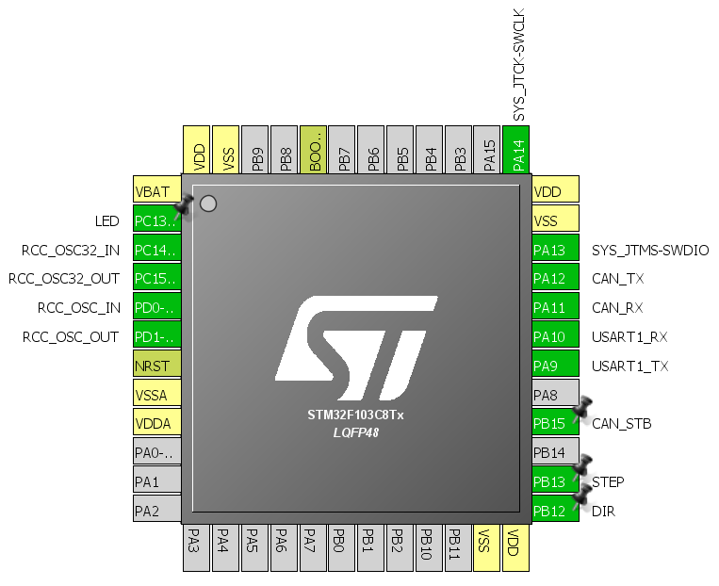
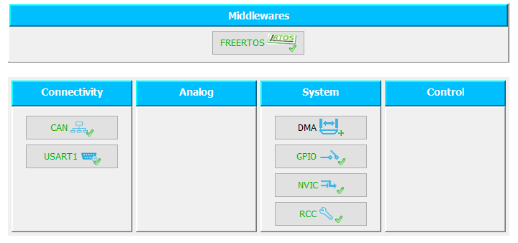
Pinout and configuration

Slide 4
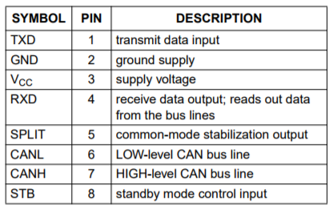
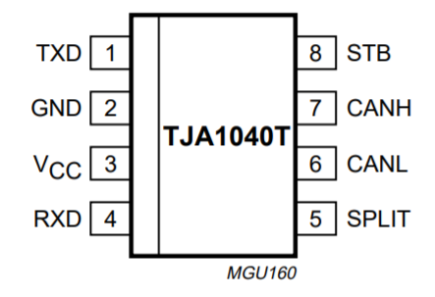
TJA1040
High speed CAN transceiver
3.3 V and 5 V input levels
At least 110 nodes can be connected
Thermally protected
Compatible with ISO 11898

Slide 5
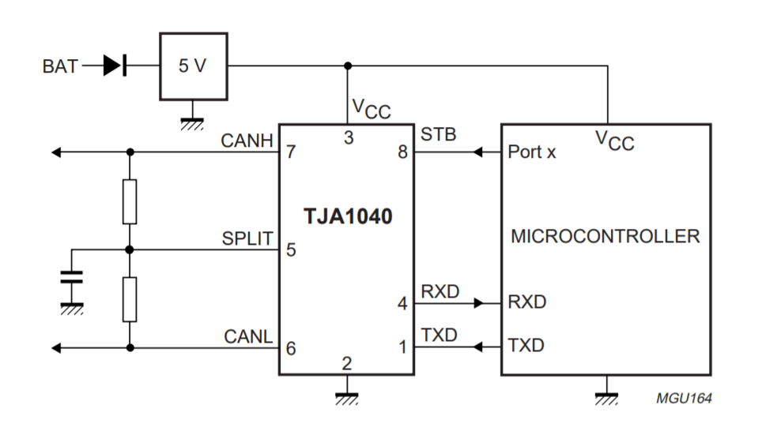
TJA1040

Slide 6
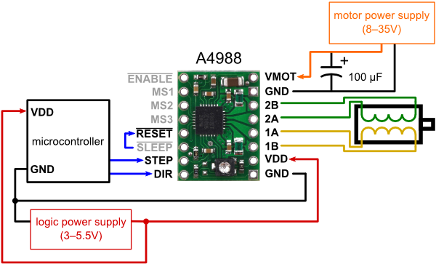
A4988
Crossover-current protection
3.3 V and 5 V compatible
Thermal shutdown circuitry
Short-to-ground protection
Shorted load protection
Five selectable step modes

Slide 7
FreeRTOS
Components:
Timer
Task
Queue

Slide 8
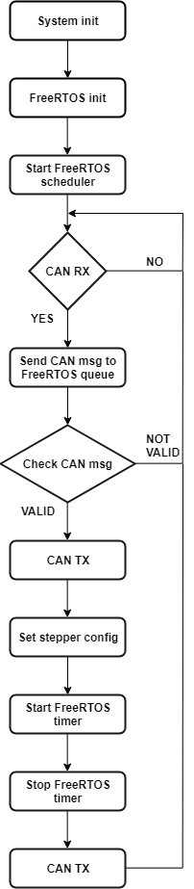
Flow chart

Slide 9
CAN protocol - TX
ID | B0 | B1 | B2 | B3 | B4 | B5 | B6 | B7 | Note
CAN_TX_ID | CAN_RX_[B0] | CAN_ACK_C0 | CAN_ACK_01 |  |  |  |  |  | Acknowledgement of the received CAN msg
 | CAN_RX_[B0] | CAN_FIN_F0 | CAN_FIN_0D |  |  |  |  |  | Finished with job regarding the received CAN msg
ID | B0 | B1 | B2 | B3 | B4 | B5 | B6 | B7 | Note
0x500 | 0x10 / 0x20 / 0x30 / 0x40 | 0xC0 | 0x01 |  |  |  |  |  | Acknowledgement of the received CAN msg
 | 0x10 / 0x20 / 0x30 / 0x40 | 0xF0 | 0x0D |  |  |  |  |  | Finished with job regarding the received CAN msg

Slide 10
CAN protocol - RX
ID | B0 | B1 | B2 | B3 | B4 | B5 | B6 | B7 | Note
CAN_RX_ID | STEP_NUM_DIR | STEP_NUM_1 | STEP_NUM_2 | ROT_DIR |  |  |  |  | Number of steps + direction
 | ROT_ANG_DIR | ROT_ANG_1 | ROT_ANG_2 | ROT_DIR |  |  |  |  | Angular rotation + direction
 | ROT_SPEED | ROT_SPEED |  |  |  |  |  |  | Speed
 | ROT_DIR_CONT | ROT_DIR | START_STOP |  |  |  |  |  | Continuous rotation + direction
ID | B0 | B1 | B2 | B3 | B4 | B5 | B6 | B7 | Note
0x400 | 0x10 | 0-255 | 0-255 | 0/1 |  |  |  |  | Number of steps + direction
 | 0x20 | 0-255 | 0-255 | 0/1 |  |  |  |  | Angular rotation + direction
 | 0x30 | 0-255 |  |  |  |  |  |  | Speed
 | 0x40 | 0/1 | 0/1 |  |  |  |  |  | Continuous rotation + direction

