Slide 1
Data Mining and Analysis of COVID-19 Mortality and Relationship between Country Attributes, Vaccination, and Excess Death

Slide 2
Our Team
Jay Bentley - CSCI 5502
Nick O’Connor - CSCI 4502
Michael Thomas - CSCI 4502
Avery Lawson - CSCI 4502

Slide 3
Why Study COVID-19?
COVID-19 rocked the world to its core… Why?
Investigating different factors and how they correlate to COVID-19 mortality rates on a country level
Potential factors include vaccination rates, GDP, tourism rates, health expenditure

Slide 4
Benefits from Studying COVID-19?
Identify predictors of highly impacted countries
Prepare for future pandemics
Identify areas that countries should focus on to reduce the impact of a future pandemic

Slide 5
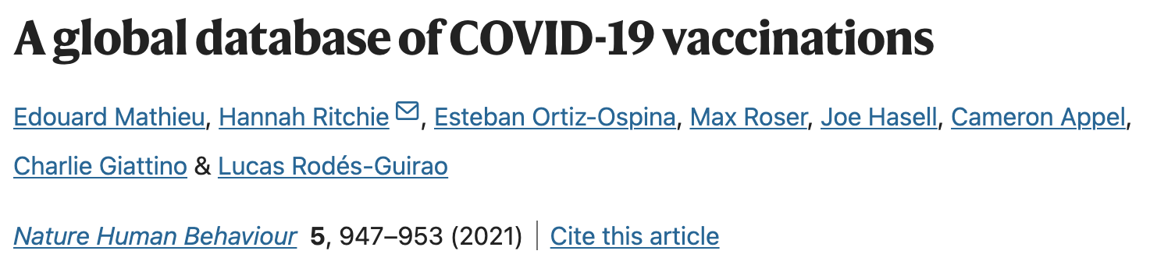
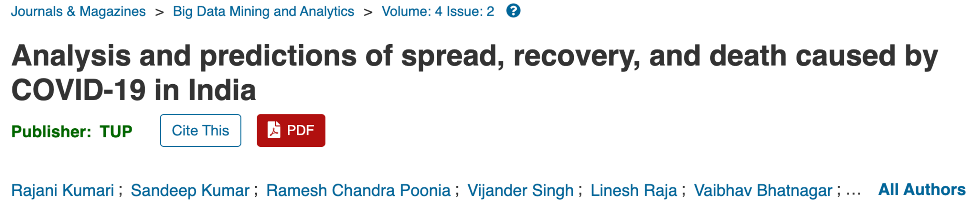

Slide 6
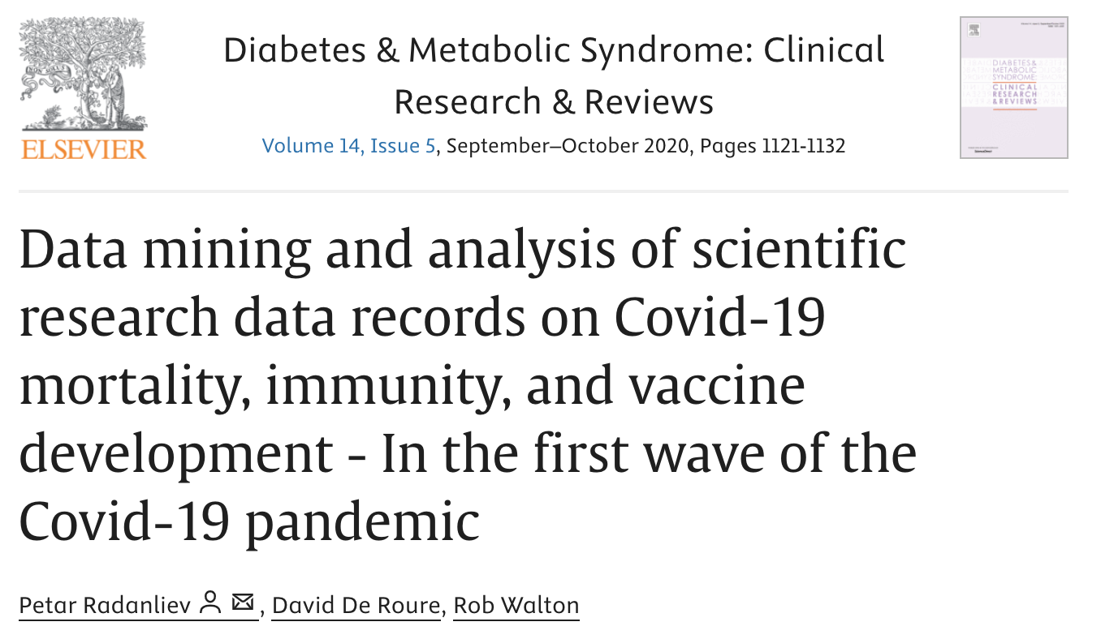
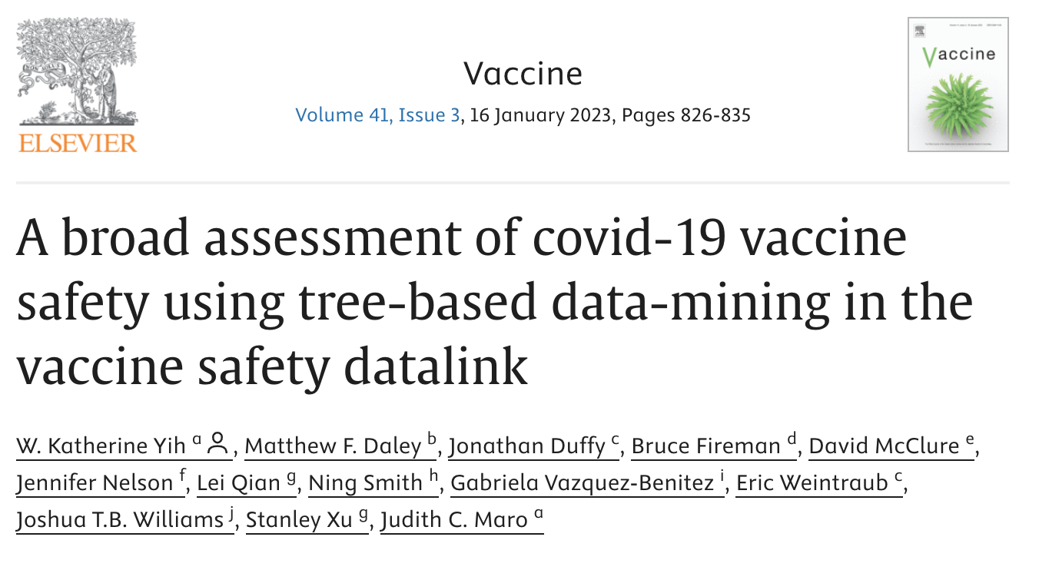
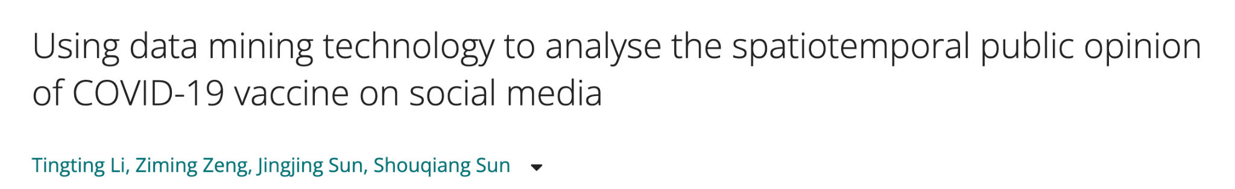

Slide 7
Datasets We Hope to Use
COVID-19 cases and deaths by date (WHO)
COVID-19 excess mortality by country (WHO)
COVID-19 vaccination rates by date (HW2)
Current Health Expenditure / CHE as percent of GDP by Country (WHO)
Vaccination rates for other diseases (WHO)

Slide 8
Proposed work
Cleaning the data:
Null values in vaccination dataset
Differences between the way countries record data
Aggregating data from different sources
Correlation recognition:
Run linear and polynomial regression models
Identify what factors correlate with higher mortality rates
Clustering recognition:
Run K-means and Hierarchical clustering experiments
Identify what factors cleanly cluster
Propose reasons for these clusters occurring for these factors
Potential tools:
Pandas, Numpy, Excel

Slide 9
Evaluation
Correlation recognition
Use metrics to determine good model match
Mean Absolute Error (MAE)
Mean Squared Error (MSE)
Root Mean Squared Error (RMSE)
R and R-squared
Clustering recognition
Use metrics to determine good match
Silhouette Score
Davies-Bouldin Index

Slide 10
Milestones
Week 5: Proposal Due Date
Week 8: Prototype Methods of Data Analysis
Week 11: Checkpoint Due Date
Week 14: Draft of Final Submission Complete
Week 16: Final Submission Due Date

