Slide 1



Raksha Shakti University
TG000568
HACKATHON-2019

Slide 2
Outlines
Problem Statement
Website GUI
Complexity of Existing system
Technology and Innovation
Demo
What Shipper can?
What Carrier can?
What Admin can?

Slide 3

Problem Statement
GIH199
Many a times the Client needs to dispatch theirs goods from one place to another place. What can one do? Is there a solution in which the client gets the needed help without going through much effort to find the required transportation facilities?
Project: - Modules
1. Admin
2. Carrier
3. Shipper

Slide 4
This responsive website is the SOLUTION Approach
Easy
Secure
Most Affordable

Slide 5
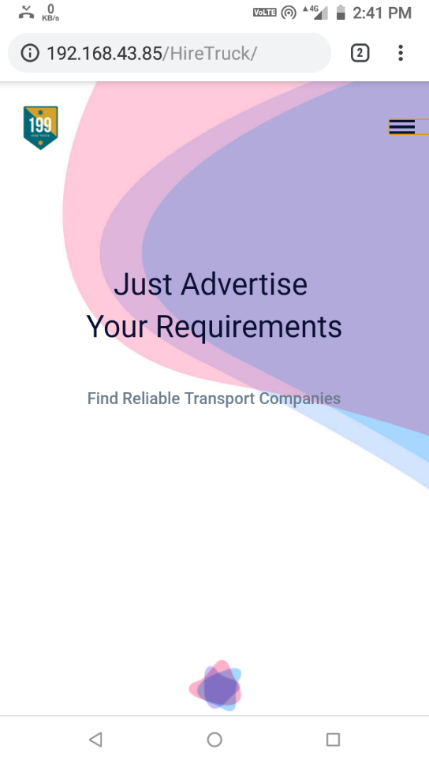
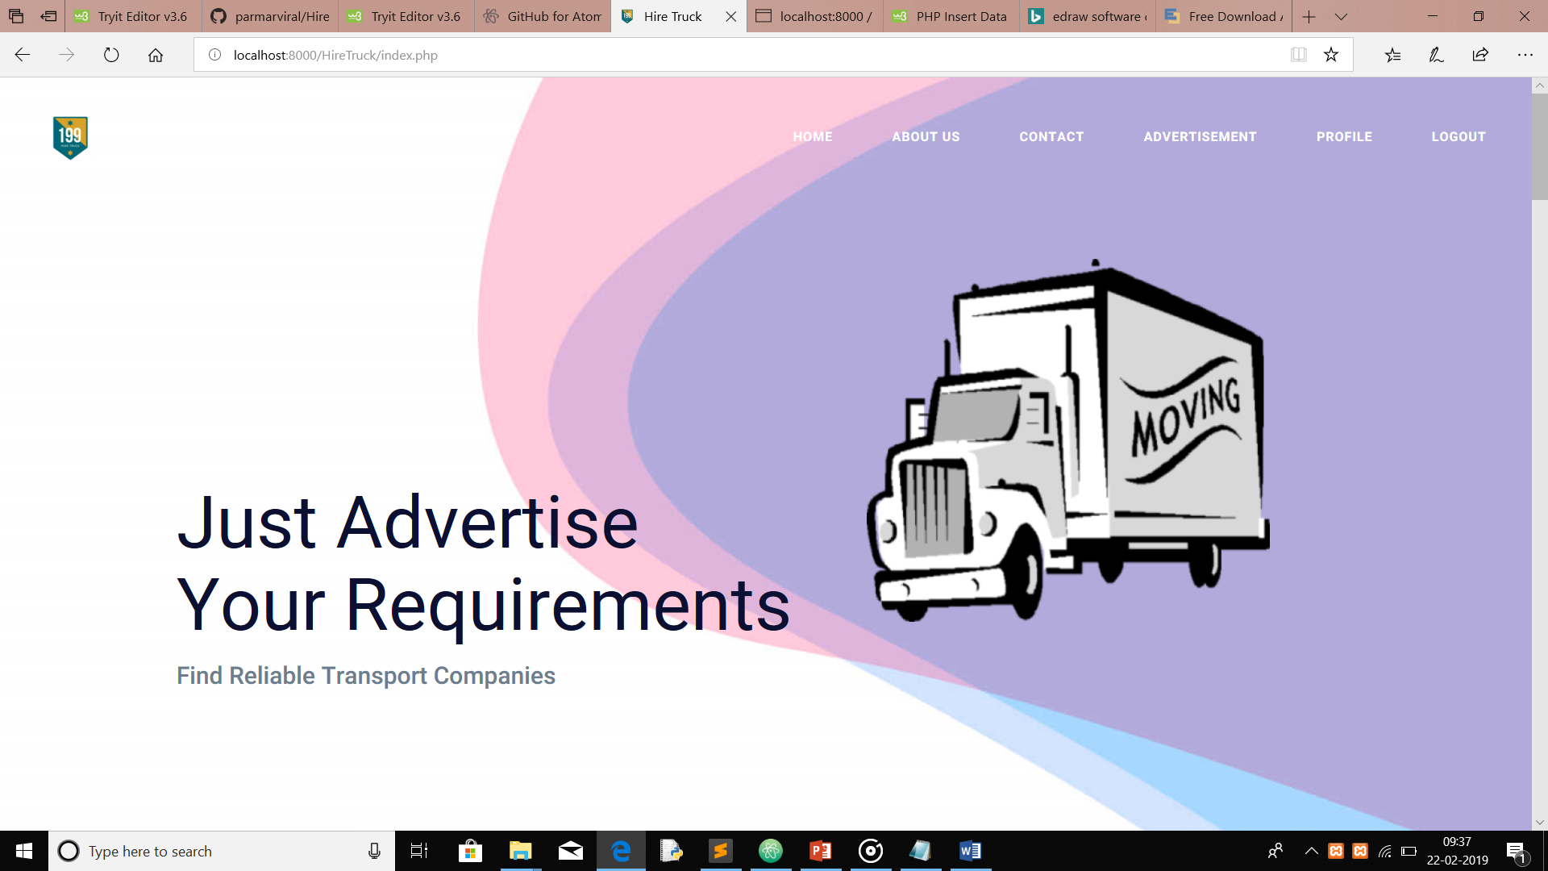
Website GUI
Responsive Website

Slide 6
Complexity Of Existing System
Possibility of payment fraud either from Carrier’s or Shipper’s side.
Communication Gap Between the customer and the Transport Companies.
System to verify the authenticity of the Emailer is not available.
The Shipper is not aware of all the options available for shipping the goods at best price.
Recent updates on the location of the goods is not available to the Shipper and the Carrier side as well.

Slide 7
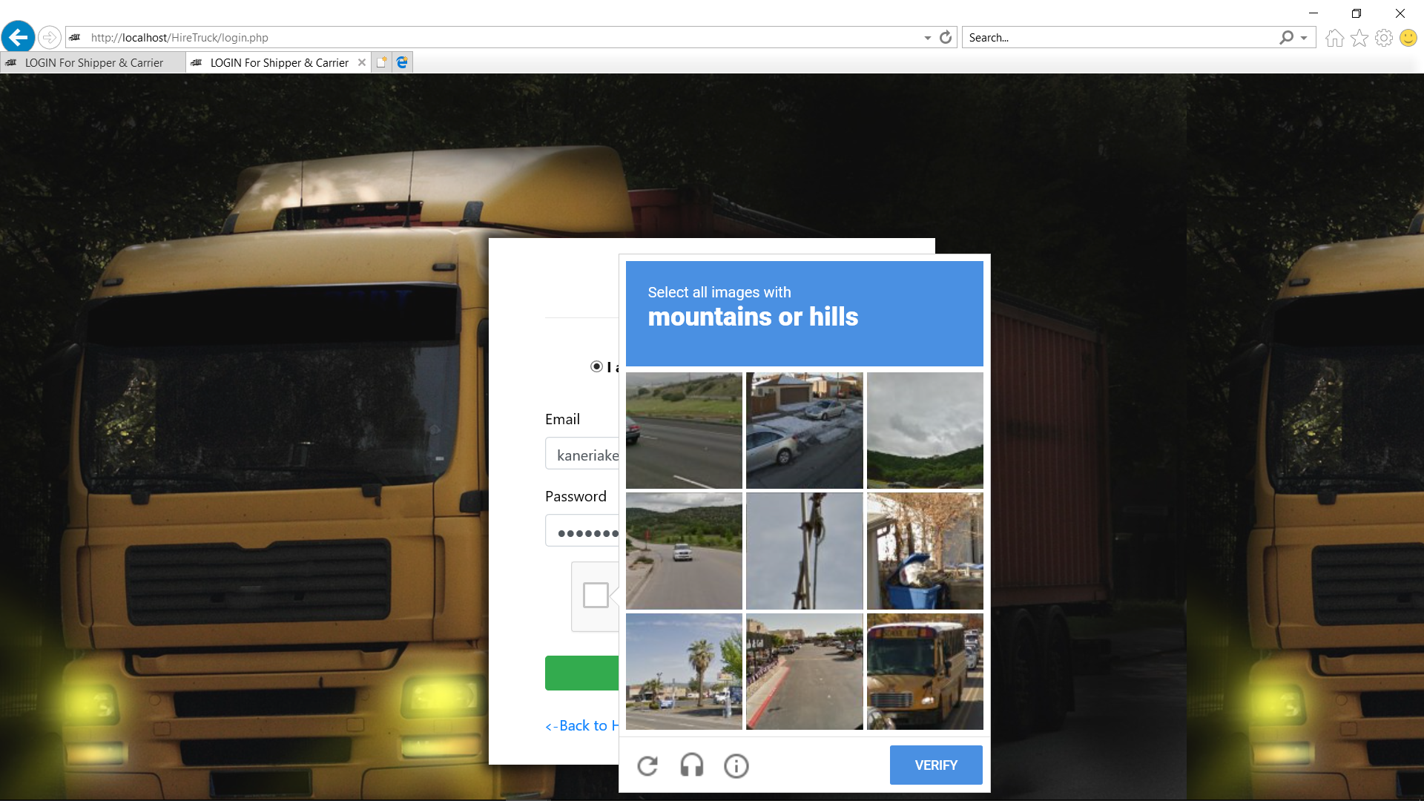
Technology/Innovation
1. Re-Captcha

Slide 8
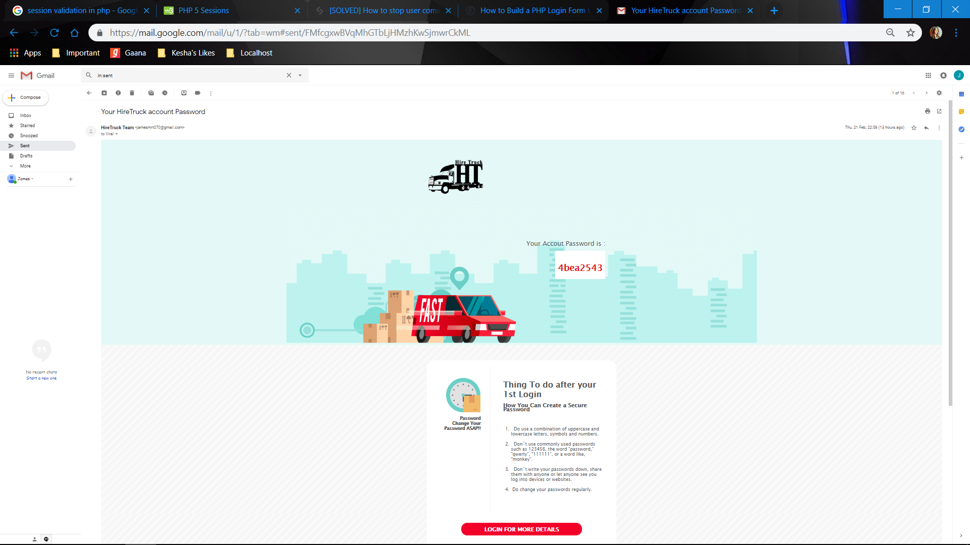
2. Transparency through mailing

Slide 9
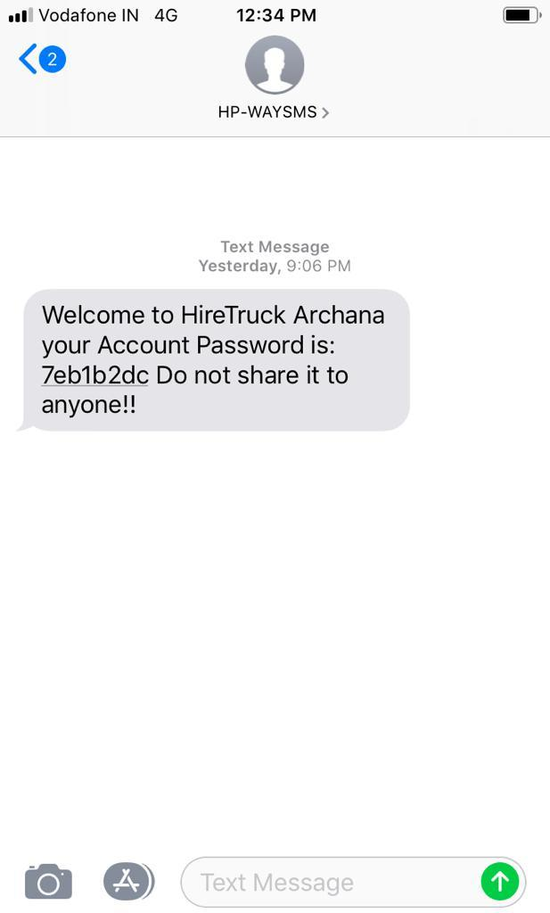
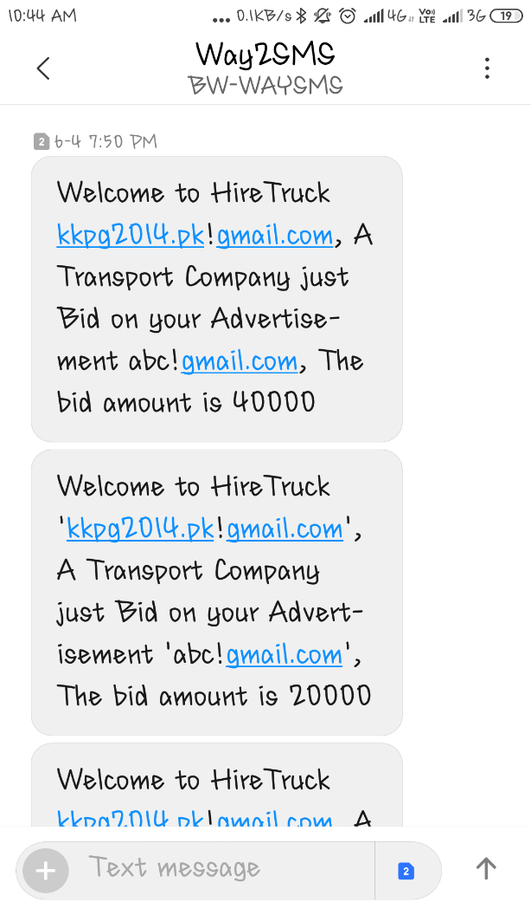
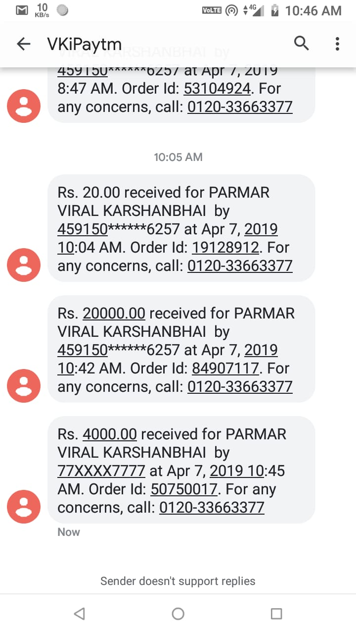
3. Transparency through OTP

Slide 10
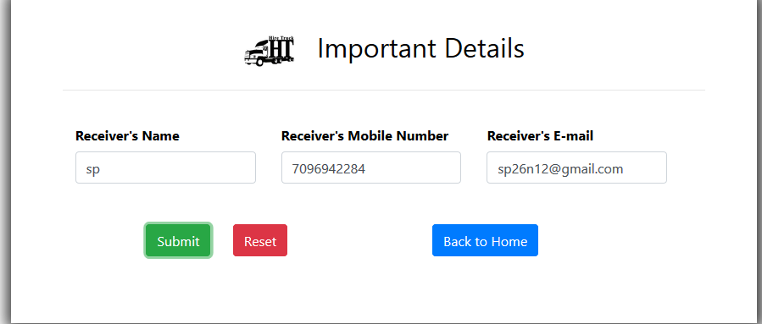
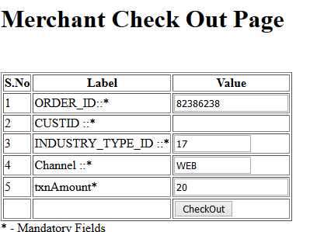
4.Payment Gateway

Slide 11
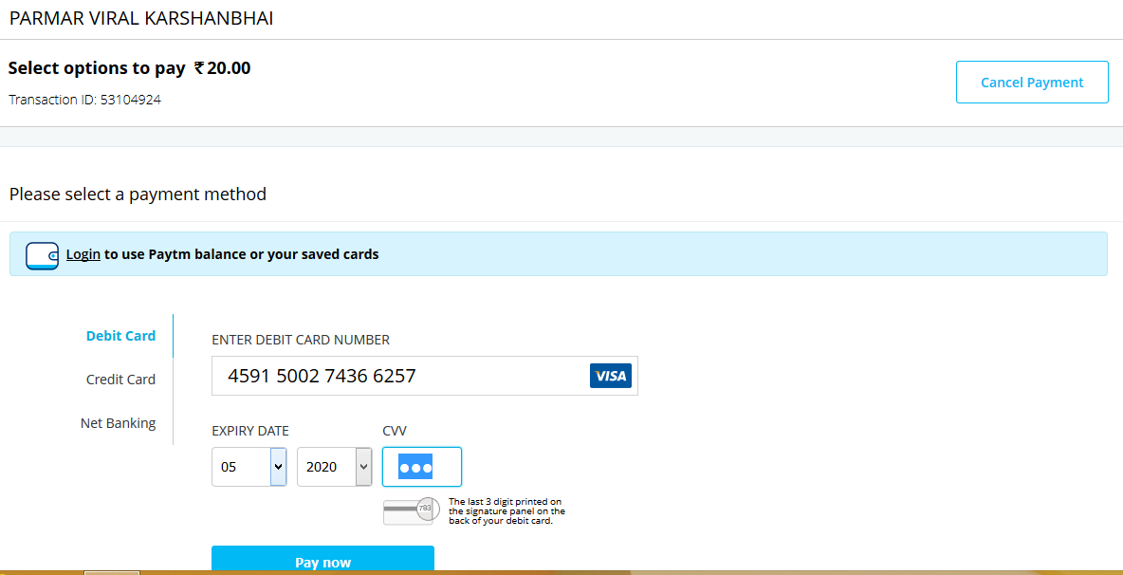
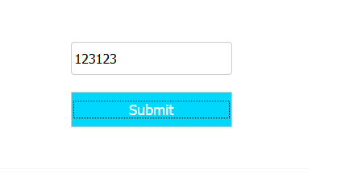

Slide 12
DEMO

Slide 13
The Shipper Can:
Add and display the requirements through advertisements.
View the advertisements which he/she has posted recently.
Update his/her profile.
Track the live location of the truck.
Can experience transparent payment system.
Get the e-Receipt and e-bid.

Slide 14
The Carrier Can:
View the requirements of various shippers through advertisements.
Bid on the advertisements, they are interested in.
View the advertisements which he/she has bid.
Update his/her profile.
Track the live location of the truck.
Experience transparent payment system.
Get the e-Receipt and e-bills.

Slide 15
The Admin Can:
Full access to the data base.
View or delete the advertisements.
View or delete the bids.
Verify the queries of Shipper and Carrier.
Check Feedback.

Slide 16




Thank You

