Slide 1
Unbalanced Ladder Circuit Solver
Joe Nathan Abellard

Slide 2
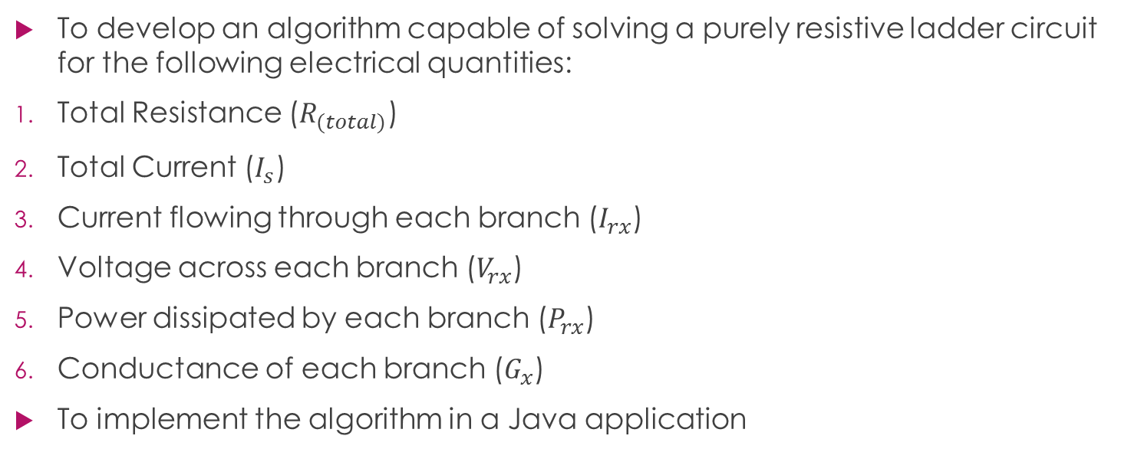
Project Goals
To develop an algorithm capable of solving a purely resistive ladder circuit for the following electrical quantities:
Total Resistance ($R_{(total)}$)
Total Current ($I_{s}$)
Current flowing through each branch ($I_{rx}$)
Voltage across each branch ($V_{rx}$)
Power dissipated by each branch ($P_{rx}$)
Conductance of each branch ($G_{x}$)
To implement the algorithm in a Java application

Slide 3
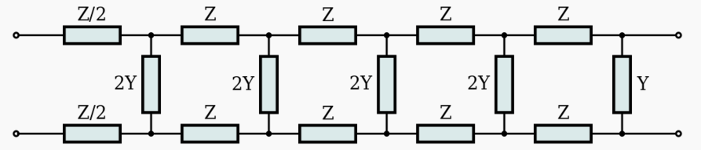
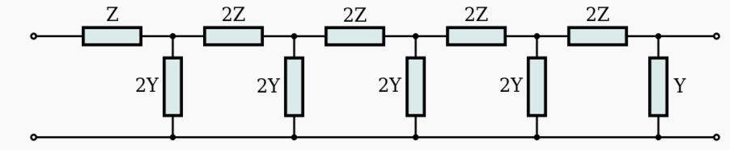
Theory (ladder networks)
Fig. 1: Balanced ladder network. [1]
Fig. 2: Unbalanced ladder network. [2]

Slide 4
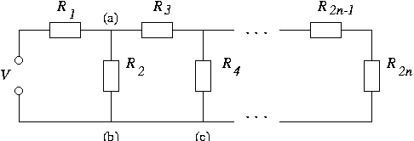
Theory (ladder circuit)
A purely resistive ladder circuit has the following properties:
One power source
Amount of resistors is more than or equal to 4 AND is even.
Fig. 3: Purely resistive ladder circuit. [3]

Slide 5
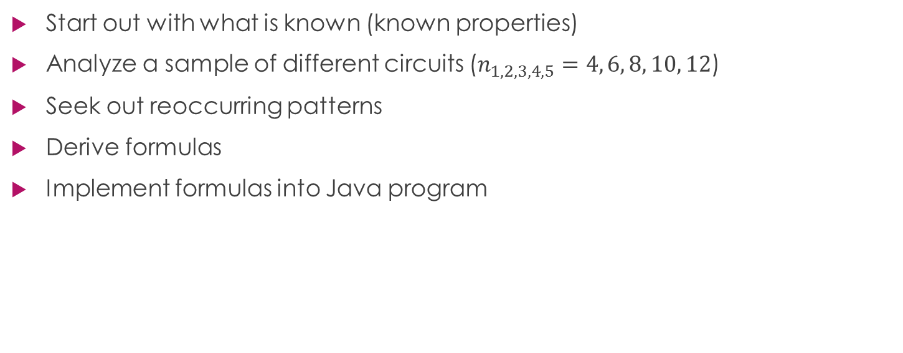
Methodology
Start out with what is known (known properties)
Analyze a sample of different circuits ($n_{1, 2, 3, 4,5}=4, 6, 8, 10, 12$)
Seek out reoccurring patterns
Derive formulas
Implement formulas into Java program

Slide 6
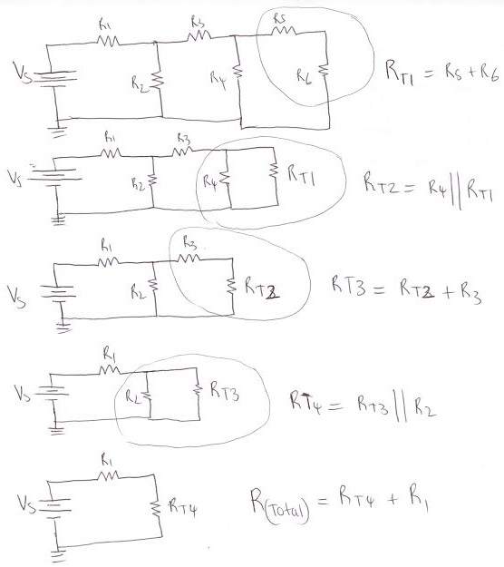
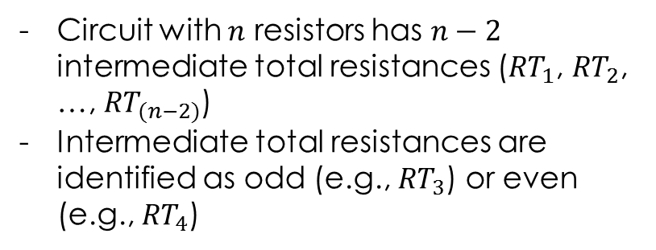
Intermediate Total Resistance Computations
Circuit with $n$ resistors has $n−2$ intermediate total resistances (${RT}_{1}$, ${RT}_{2}$, …, ${RT}_{(n−2)}$)
Intermediate total resistances are identified as odd (e.g., ${RT}_{3}$) or even (e.g., ${RT}_{4}$)
Fig. 4: Intermediate total resistance computations.

Slide 7

Formulas (part 1 – total resistance)
Special case $x=1 :$
Solving for ${RT}_{x}$such that x is even:
Solving for ${RT}_{x}$such that x is odd:

Slide 8

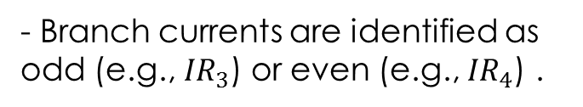
Formulas (part 2 – current)
Solving for ${IR}_{x}$such that x is even:
Solving for ${IR}_{x}$such that x is odd:
- Branch currents are identified as odd (e.g., ${IR}_{3}$) or even (e.g., ${IR}_{4}$) .

Slide 9
Formulas (part 3 – remaining quantities)
The voltage across a resistor:
The power dissipated by a resistor:
The conductance of a resistor:

Slide 10
Java app (part 1)

Slide 11
Java app (part 2)

Slide 12
Future Plans
Develop algorithm to solve circuits with impedance values.
Create Java program to implement the new, improved algorithm.
Create an Android app to implement the new, improved algorithm.

Slide 13

Questions???
[4]

Slide 14
References
[1] https://en.wikipedia.org/wiki/Electronic_filter_topology#Ladder_topologies
[2] https://en.wikipedia.org/wiki/Electronic_filter_topology#Ladder_topologies
[3] https://www.staff.ncl.ac.uk/alex.yakovlev/eee1004/course/ladder.html
[4] http://www.jobinterviewtools.com/blog/job-interview/interview-questions/

