Slide 1

JUAN ANTONIO BENÍTEZ GUTIÉRREZ

Slide 2

Index
What this coding challenge makes?
Frameworks/Libraries used
Project structure
Database design
Architecture

Slide 3
1. What this coding challenge makes?
This coding challenge is responsible to calculate the sortest path between two cities according to:
  less number of connections and
  based in the less time

Slide 4
2. Frameworks/Libraries used
Spring v5.0.5.RELEASE
Spring boot v2.0.1.RELEASE
Spring cloud v2.0.0.RC1
H2 database v1.4.197
JPA v2.1 + Hibernate v5.2.16.FINAL
Jackson v2.9.2
Dozer v1.0.2
Swagger v2.8.0

Slide 5
3. Project structure
- adidascodingchallenge
- common-rest-client
Common components
- microservice-city
Implement a REST service to get the data related with a city defined with: city, destiny city, departure time and arrival time. Stored into H2 database.
- microservice-path
Implement a REST service that will consume the previous API in order to calculate the sortest way(in time and in connections) to travel from one city to another, independent of the departure time.
- microservice-zuul
It’s a Netflix tool for routing requests to the microservices that previously were registered in consul.

Slide 6
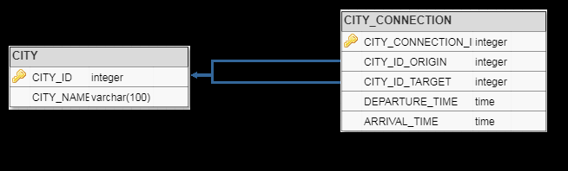
4. Database design

Slide 7
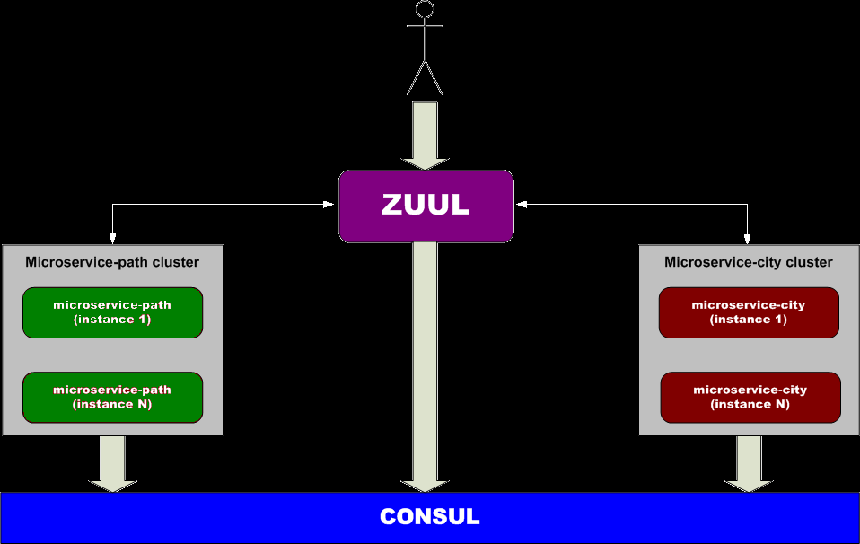
5. Architecture

Slide 8
That’s all :)

