Slide 1
News Topic Classification from Headlines
TF-IDF vs. Sentence Embeddings on AG News
Mohammed Saeed Alamodi - Abdulaziz Mohammed Alkhlawi - Jaber Saleh Alsaikhan
NLP Project | Section 1 | Group 2

Slide 2
The Problem
• News apps often only have the headline when they sort stories
• Headlines are short (about 7 words) and full of names
• Business and Sci/Tech overlap: tech companies, earnings, markets
• Question: with only the headline, is a pretrained sentence-embedding classifier better than TF-IDF at separating Business and Sci/Tech?
Notes:
Team leader

Slide 3
Data: AG News
• Kaggle CSV, we use only the title and label
• Removed HTML leftovers and (Reuters)/(AP)/(AFP) tags
• Removed titles with conflicting labels and test titles seen in training
• Duplicate-aware 90/10 train/dev split
• Train 105,695 | Dev 11,724 | Test 6,469
Split | Per class | Total
Official train | 30,000 | 120,000
Official test | 1,900 | 7,600
Notes:
Team leader

Slide 4
Methods
• Method 1: TF-IDF (unigrams + bigrams) + logistic regression, C = 2
• Method 2: all-MiniLM-L6-v2 embeddings (frozen) + logistic regression, C = 0.1
• Settings chosen on the dev set with macro F1
• Both trained on the same data and tested once on the same test set
Method | Dev macro F1
TF-IDF + LR | 87.62%
MiniLM + LR | 84.03%
Notes:
Member 2 (Method 1), Member 3 (Method 2)

Slide 5
Results
• TF-IDF is better on every measure
• MiniLM makes 102 more Business <-> Sci/Tech mistakes
• Answer: no, the embedding classifier is not better here
Metric | TF-IDF + LR | MiniLM + LR
Accuracy | 86.86% | 82.95%
Macro F1 | 86.67% | 82.72%
F1 Business | 82.75% | 76.77%
F1 Sci/Tech | 85.17% | 81.01%
Business <-> Sci/Tech | 258 | 360
Notes:
Member 2

Slide 6
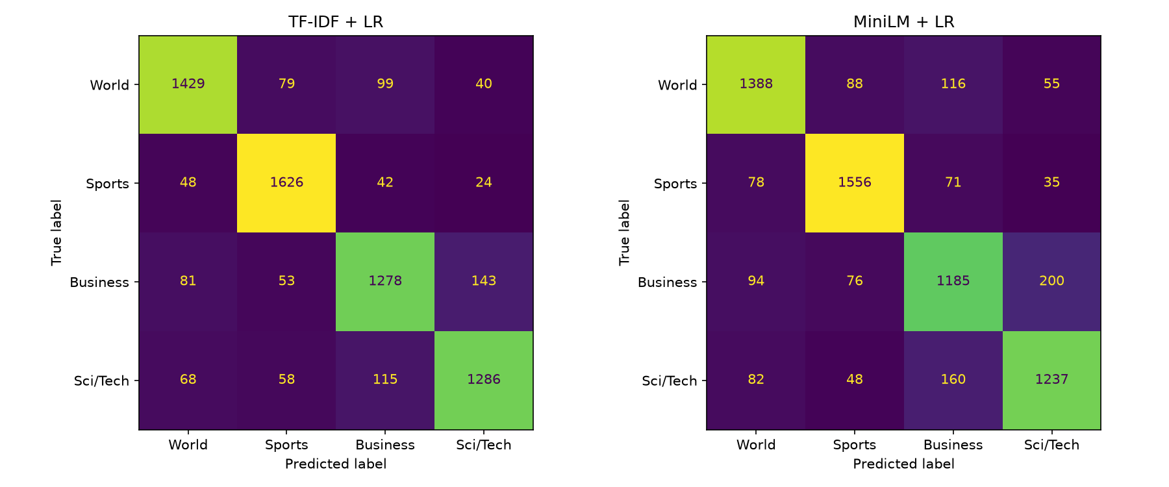
Confusion Matrices
• Most mistakes are between Business and Sci/Tech
• Headlines with new words: Business/Sci-Tech accuracy is almost the same (78.5% vs 77.5%)
Notes:
Member 3

Slide 7
Wrong Predictions
• "Greenspan: Debt, home prices not dangerous": labelled Sci/Tech, both say Business. The label looks wrong
• "34 tech firms sued for alleged LCD patent theft": Business, both say Sci/Tech because of tech words
• "Before the Bell - ESS Technology drops 4.4 pct": Business, TF-IDF right, MiniLM says Sci/Tech
Notes:
All members

Slide 8
Demo: Try it
• Type a headline, the saved models predict the topic (no retraining)
• "Electric carmaker's shares slide after battery recall" -> Business
• Empty input shows a message
• Our own 6 headlines: 5 of 6 correct
Notes:
Team leader runs the notebook live

Slide 9
Conclusion
• TF-IDF + LR: 86.9% accuracy, MiniLM + LR: 83.0%
• Pretrained embeddings with a simple classifier did not separate Business and Sci/Tech better
• Limitations: some wrong labels, old news (2004-2005), one split
• Future work: fine-tune MiniLM on the headlines
• Thank you! Questions?
Notes:
All members

