Slide 1
Would You Ship It?
An offline CORE Summit simulation for making reliability trade-offs visible.
Audience plays the engineering team
Each decision changes error budget, product value, and customer trust in real time.
SHIP?
OFFLINE • NO INTERNET REQUIRED
5 SPRINT DAYS
LIVE VOTE
Start in PowerPoint, launch the local game, then return to close with the learning.
CORE Summit • GPN SRE Simulation
1
Notes:
Open with the problem: Reliability is not a checklist; it is a decision-making model. Tell the room they will play the engineering team and vote on what to ship, stabilize, or delay.

Slide 2
Why this demo works
It turns SLO / error-budget theory into a live engineering decision.
1
2
3
4
Scenario
Vote
Outcome
Debrief
Feature or operational risk appears
Audience chooses option 1, 2, or 3
Metrics update immediately
Discuss the trade-off
The lesson
Winning is not “ship everything” or “block everything.” Winning is knowing how much change the service can safely absorb.
CORE Summit • GPN SRE Simulation
2
Notes:
Use this slide to explain that the demo is designed around trade-offs. Every audience vote has consequences.

Slide 3
Game objective
Five sprint days. Maximize value. Protect reliability.
SPRINT DAY
ERROR BUDGET
PRODUCT VALUE
CUSTOMER TRUST
1/5
100%
0
100
Presenter role
Audience role
• Spin the scenario wheel • Read the decision out loud • Ask the room to vote • Reveal the outcome
• Vote like the engineering team • Balance delivery and stability • Watch the metrics move • Debrief the trade-off
Success condition: balanced engineering — enough product value delivered while preserving error budget and customer trust.
CORE Summit • GPN SRE Simulation
3
Notes:
Tell the room that there are no perfect answers. The game rewards balance and forces visible trade-offs.

Slide 4
Scenario catalog
The wheel uses real feature and reliability examples from the working slide.
Aggressive Features
Stabilized Features
Reliability Tasks
High business value, high reliability exposure.
Medium value with controlled operational risk.
No immediate feature value, but restores reliability capacity.
Real-Time Fraud Detection
Automated Reconciliation
Database Query Refactor
Cross-Border Settlement
Holiday Calendar Validation
Regression Suite Update
E-Wallet Integration
Settlement File Monitoring
Observability / Detection Fix
Pre-Transmission Validation
The simulation randomly picks five scenarios. Each has three choices: ship fast, release safely, or invest in reliability.
CORE Summit • GPN SRE Simulation
4
Notes:
Full scenario catalog in the site: Real-Time Fraud Detection Engine, Cross-Border Instant Settlement, Third-Party E-Wallet Integration, Automated Dispute Reconciliation, Holiday Calendar Validation Logic, Merchant Settlement File Monitoring, Database Query Refactoring, Regression Testing Suite Update, Incident Detection & Observability Fix, and Pre-Transmission Validation Hardening.

Slide 5
Live demo mechanics
Simple enough for an offline room; structured enough to teach the trade-off.
STABILIZED FEATURE
Decision result appears immediately
Holiday Calendar Validation Logic
Error Budget
Product Value
Customer Trust
Regional holiday rules can delay ACH files and wire transfers if validation gaps are missed.
+6%
+10
+4
1
Implement validation first
Budget +6 • Value +10 • Trust +4
Validation prevented incorrect transmission dates and protected customer commitments during the holiday period.
2
Proceed without update
Budget -8 • Value +12 • Trust -4
3
Temporary manual review
Budget -3 • Value +6 • Trust 0
CORE Summit • GPN SRE Simulation
5
Notes:
Use this slide as the backup example if the live site fails. It also sets up exactly how the audience should vote during the live demo.

Slide 6
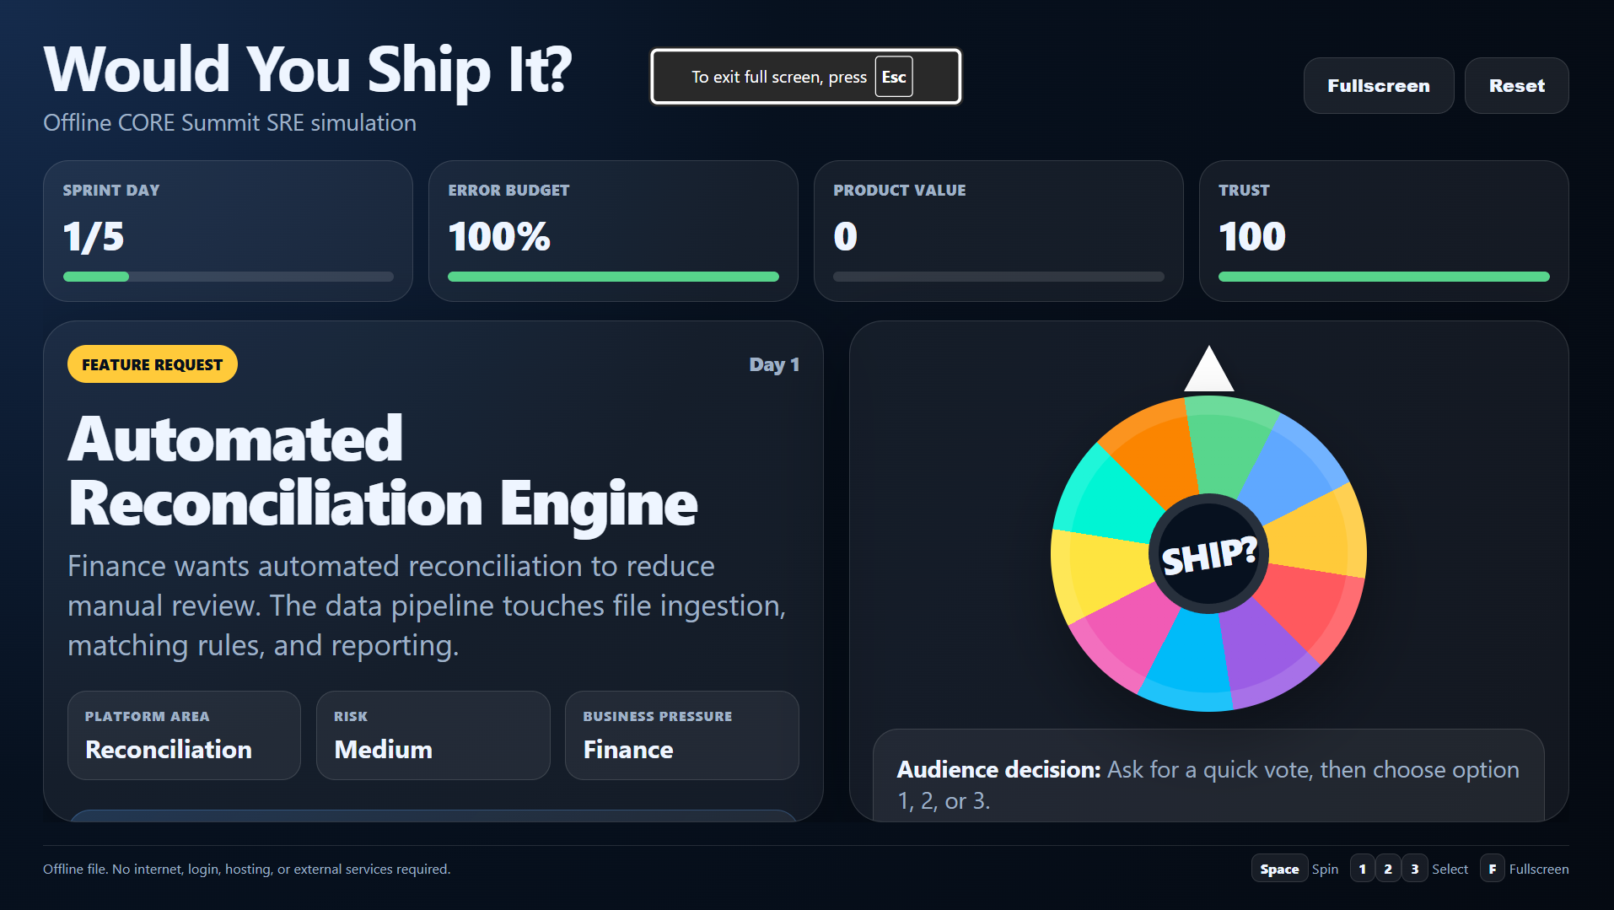
Launch the offline simulation
The game runs locally from the same folder as this deck.
Runbook
• 1. Extract the ZIP folder • 2. Open Launch_Game.bat • 3. Press Space to spin • 4. Ask audience to vote • 5. Select 1, 2, or 3 • 6. Press N for next round
Launch Simulation
Offline fallback: double-click index.html and press F11.
CORE Summit • GPN SRE Simulation
6
Notes:
Before presenting, test the local folder with Wi-Fi off. Keep the HTML and deck in the same folder. If the link does not open due to corporate restrictions, open Launch_Game.bat manually.

Slide 7
Presenter talk track
Keep the facilitation short, clear, and energetic.
Open
“You are the engineering team. Your goal is not to avoid change — it is to make safe change.”
Before each spin
“Let’s see what the sprint throws at us.”
Before voting
“Would you ship, stabilize, or invest in reliability?”
After outcome
“That is the trade-off: value increased, but reliability capacity changed.”
Close
“SRE gives us a language to say yes safely.”
Tip: Do not over-explain scoring. Let the room feel the tension as the metrics move.
CORE Summit • GPN SRE Simulation
7
Notes:
This is for whoever presents the demo. The script intentionally keeps it conversational and not too technical.

Slide 8
What the game proves
Reliability is not a gate at the end of delivery.
It is the decision framework teams use every sprint to decide how much change the service can safely absorb.
Measurable trade-offs
Safer delivery
Shared language
Error budgets move the conversation from opinion to data.
Teams can still ship, but with the right guardrails.
Product, operations, and engineering make the decision together.
CORE Summit • GPN SRE Simulation
8
Notes:
Close by tying the game back to the overall summit theme: from modeling reliability to demonstrating and scaling reliable outcomes.

