Slide 1
Medical Analysis Project
Kyle Peterson
Jaber Jarrad
Alexander Mackenzie

Slide 2
Our Data

Slide 3
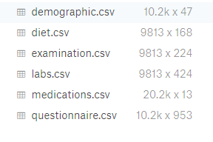
Our Data
Kaggle.com
CDC National Health and Nutrition Examination Survey
6 Different CSV files

Slide 4
Data Cleanup

Slide 5
Data Cleanup
Dropped 3 CSV files (diet, examination, questionnaire)
Read the labs, medications, and demographics CSV files into Pandas dataframes
Used Pandas and Numpy in a Jupyter notebook

Slide 6
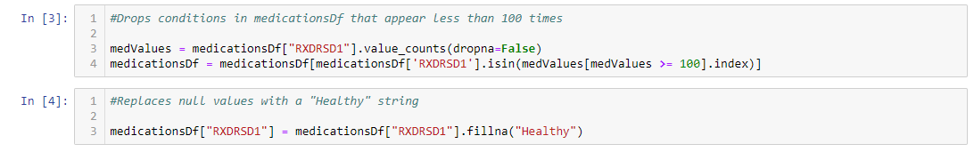
Data Cleanup (Code)
Dropped 443 uncommon conditions in our data for accuracy
Gave patients with no conditions a ‘condition’ of “Healthy”

Slide 7
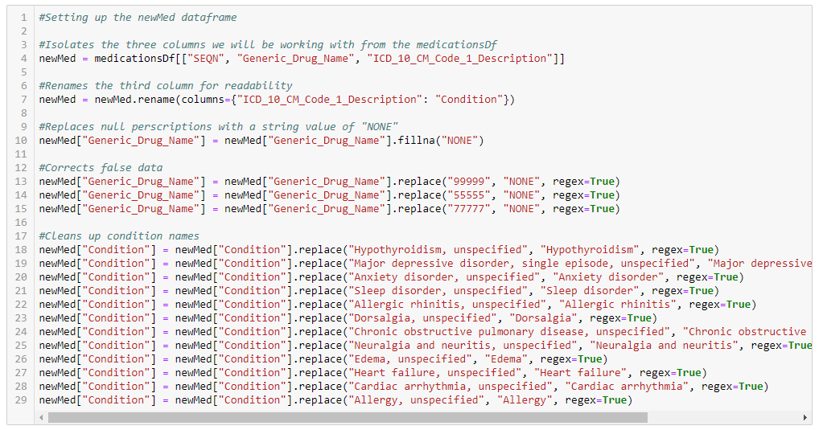
Data Cleanup (Code)
Isolated three columns from the medications CSV (Patient ID, Prescription, and Condition)
Removed 3 records of false data

Slide 8
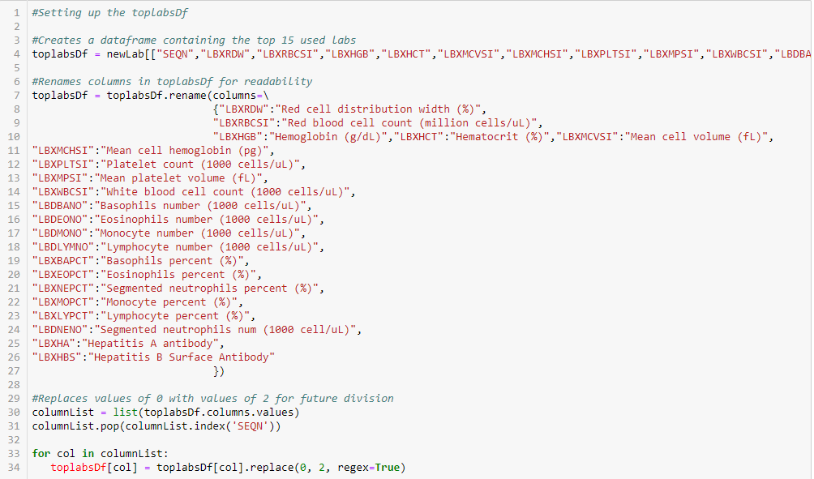
Data Cleanup (Code)
Lowered our labs scope to the top 15 most common lab tests
Dropped 409 columns of uncommon lab tests

Slide 9
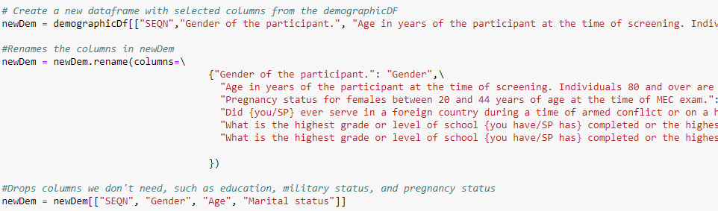
Data Cleanup (Code)
Pulled four columns from our demographics that we could work with
Dropped 43 columns of data we couldn’t use

Slide 10
Data Cleanup

Slide 11
Two Content Layout with Table
First bullet point here
Second bullet point here
Third bullet point here
Class | Group A | Group B
Class 1 | 82 | 95
Class 2 | 76 | 88
Class 3 | 84 | 90

Slide 12
Two Content Layout with SmartArt
First bullet point here
Second bullet point here
Third bullet point here
Step 1
Task Description
Task Description
Step 2
Task Description
Task Description
Step 3
Task Description
Task Description

Slide 13
Add a Slide Title - 1

Slide 14
Add a Slide Title - 2

Slide 15
Add a Slide Title - 3

Slide 17
Add a Slide Title - 4

Slide 18
Add a Slide Title - 5

