Slide 1
CIB 3123-BIG data technology
Lecture 7: MongoDB
Week 7 | CLO2: Critically evaluate, select and employ appropriate tools and technologies for the analysis of big data. CLO3: Demonstrate a critical awareness of the current limitations of the tools used to manipulate big data.

Slide 2
Lecture Notes
Contents of lectures are based on the textbook, recommended text, and supplementary material
Please watch below videos
How to install MonogDB
MongoDB crash course part1
MongoDB crash course part 2

Slide 3
Document Revision CONTROL (DRC)
Version​ | Author​ | Effective Date​ | Change Description​ | DRC No​
1.0​ | Dr.Zakea Il-Agure | 12.6.21 | Define the first version​ | 001​
Y
Y: minor change

Slide 4
Lecture OUTLINE
SECTION 1: Introduction to data analysis tool MongoDB
KAHOOT!QUIZ
SECTION 2:Aggregatuion in MongoDB
KEY TERMS
SECTION 3: Joins in MongoDB
SECTION 4:Transaction and ACID
SECTION 5:Limitations of MongoDB tools

Slide 5
LECTURE OBJECTIVES
At the end of lecture, the student should be able to:
Data Analysis using MongoDB
Demonstrate the following:
Client-server components of MongoDB
Create database, document and collection
Generate Query document using Mongo commands, regular Expressions, and aggregation
Joins in MongoDB
Transactions and ACID
Discuss the limitations of MongoDB tools

Slide 6
Introduction to MongoDB
MongoDB is an open source NOSQL database
It stores data in JSON-like documents
Unlike relational database the data model is flexible using documents (in JSON format).
It provides high performance, high availability, and automatic scaling since it is a distributed database.
Since they are distributed, NoSQL databases like MongoDB often compromise consistency in favor of availability and partition tolerance.
In the NoSQL world, the “eventual consistency” is often used to achieve speed and scalability.
MongoDB is a cross-platform, document oriented database that provides, high performance, high availability, and easy scalability. MongoDB works on concept of collection and document.

Slide 7
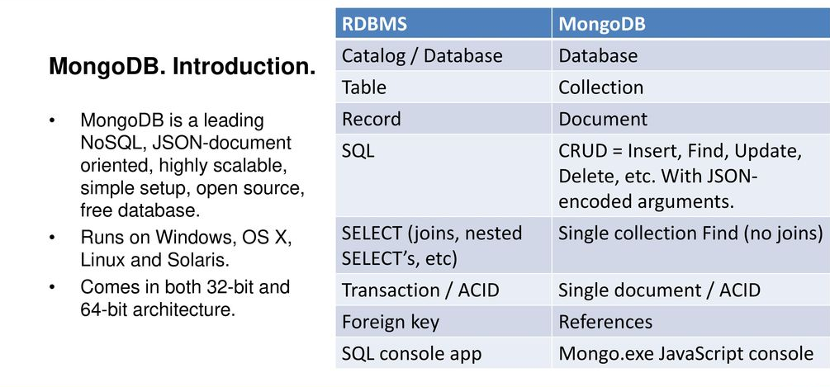

Slide 8
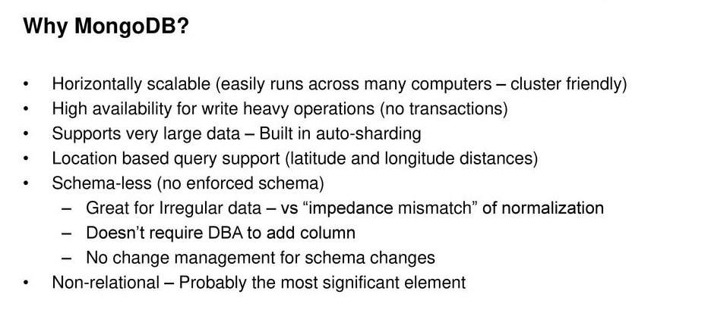

Slide 9
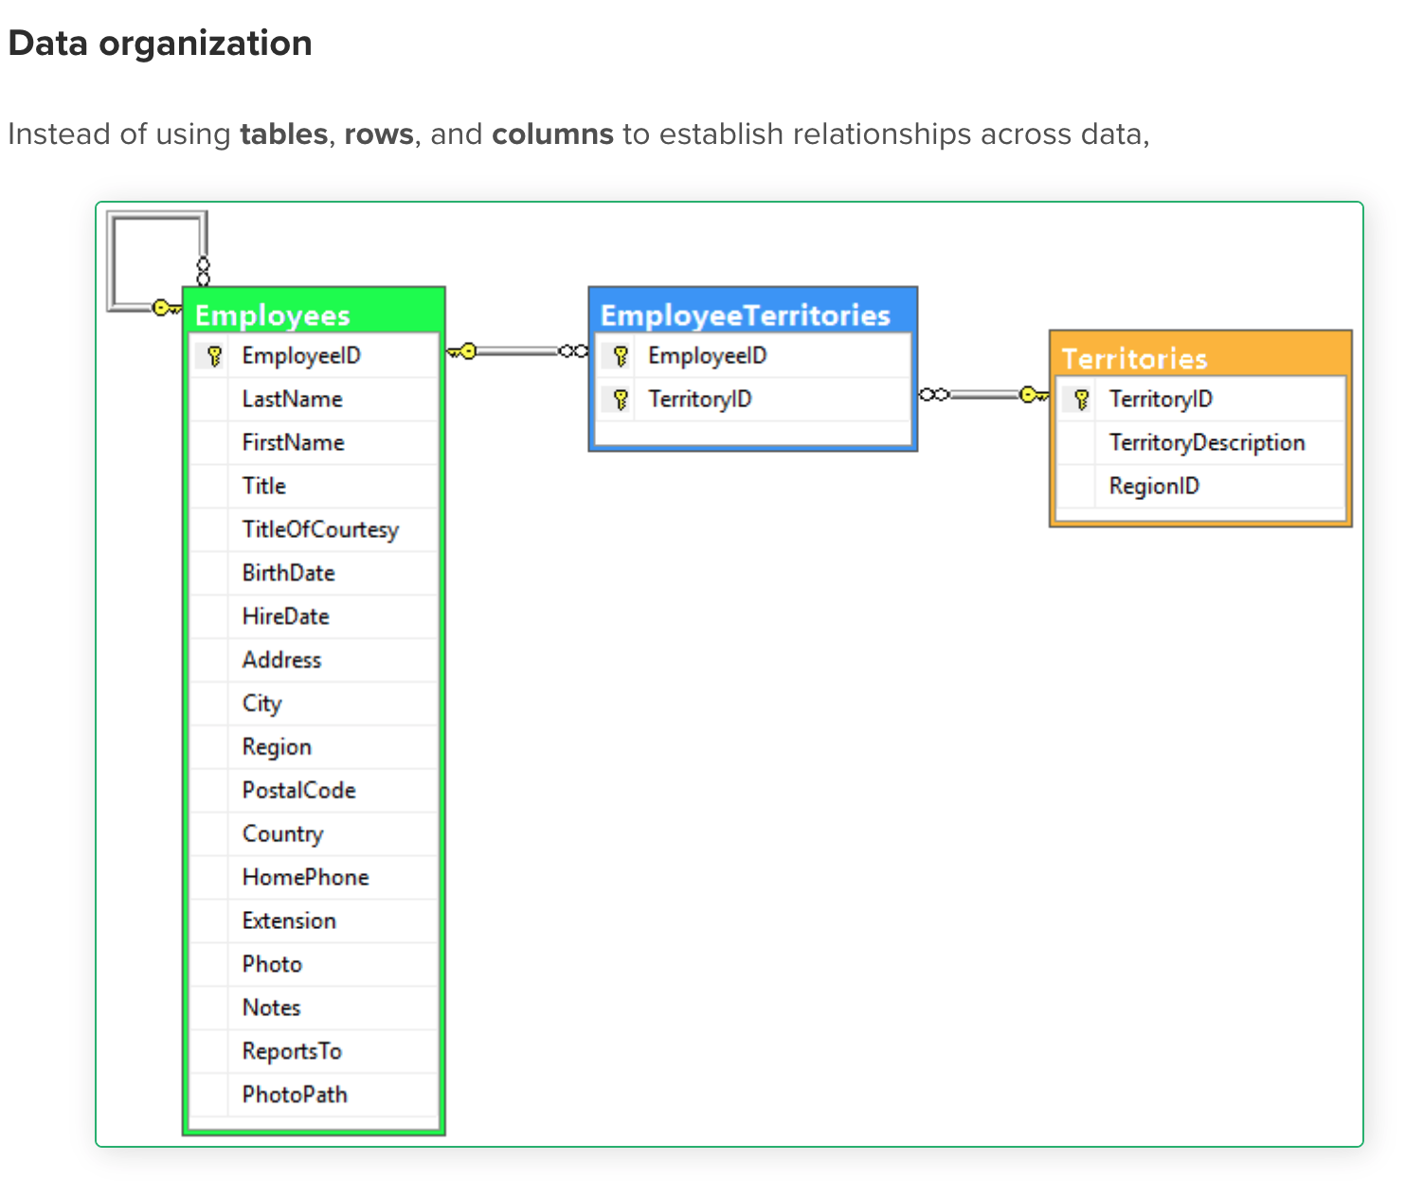
Database Design
Database is a physical container for collections. Each database gets its own set of files on the file system. A single MongoDB server typically has multiple databases.
MongoDB uses name-value pairs or fields, which then make up documents, which make up collections.

Slide 10
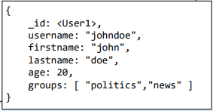
MongoDB database structure
A MongoDB database consists of two types items:
Documents – contains data
Collections – is a container for documents
A document is a data structure composed of field/key and value pairs. Document is basically a JSON object that MongoDB stores on disk in binary (BSON) format.
BSON is a binary-encoded serialization representation of the JSON. However, BSON supports more data types than JSON (for example, the Date type).
There is a limit on the document size, which is a maximum of 16 megabytes.
MongoDB stores documents in collections. A collection can be seen as similar to a table in RDBMS.
Every document in the collection, unless otherwise specified, has an _id value automatically assigned by the database.
Collection is not like a table in which the set of columns (attributes) has to be predefined; collections are schema-less; therefore, a collection can contain any kind of content.

Slide 11
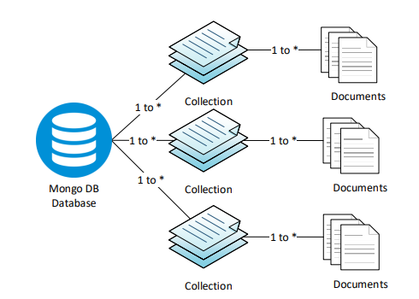
MongoDB data structure organization

Slide 12
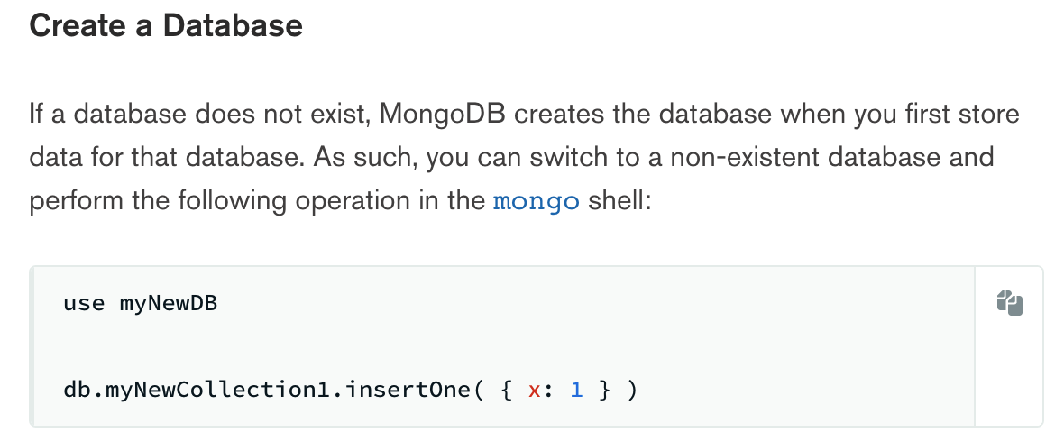

Slide 13
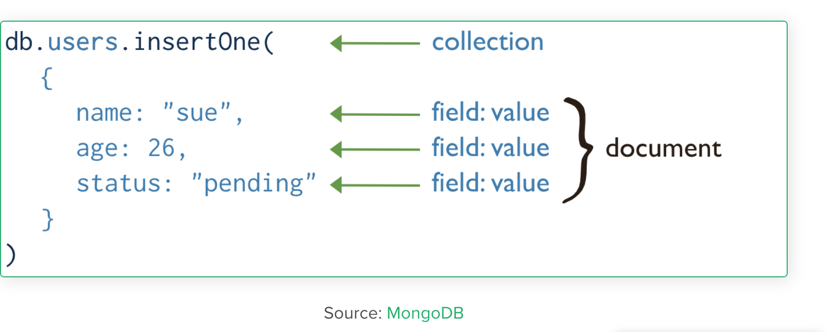
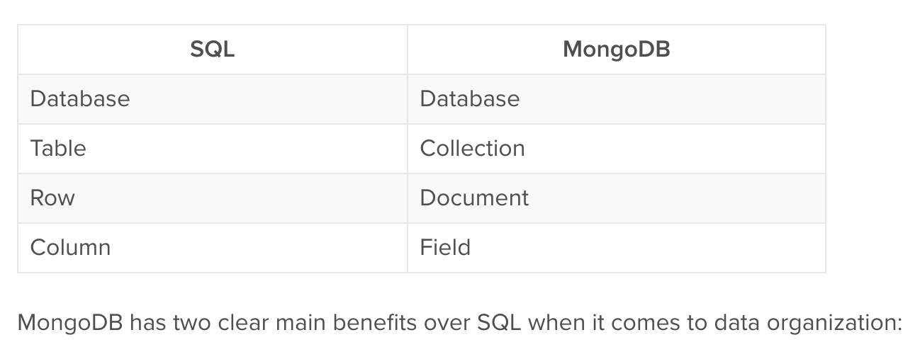
Query language
SQL has Structured Query Language; MongoDB has the MongoDB Query Language. Sometimes referred to as MQL, it uses BSON (Binary JSON), which is based on JSON (JavaScript Object Notation).

Slide 14
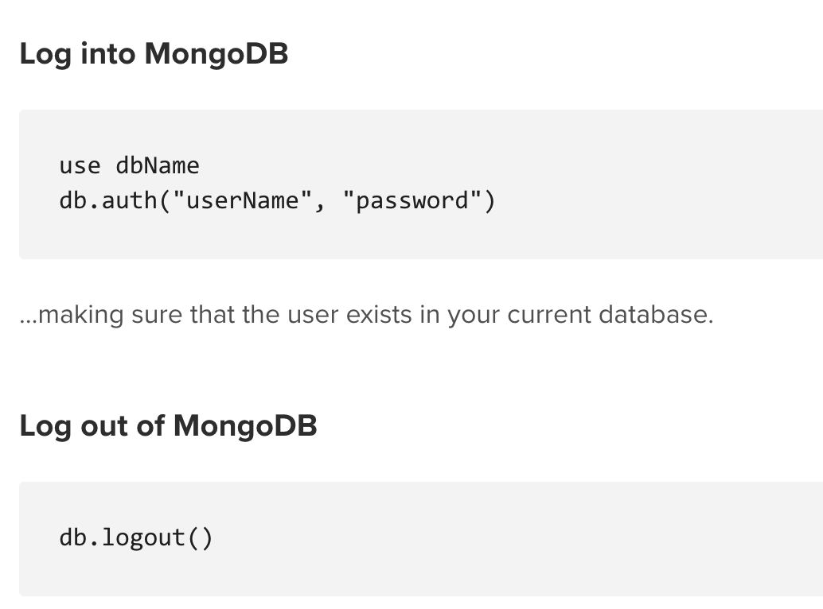
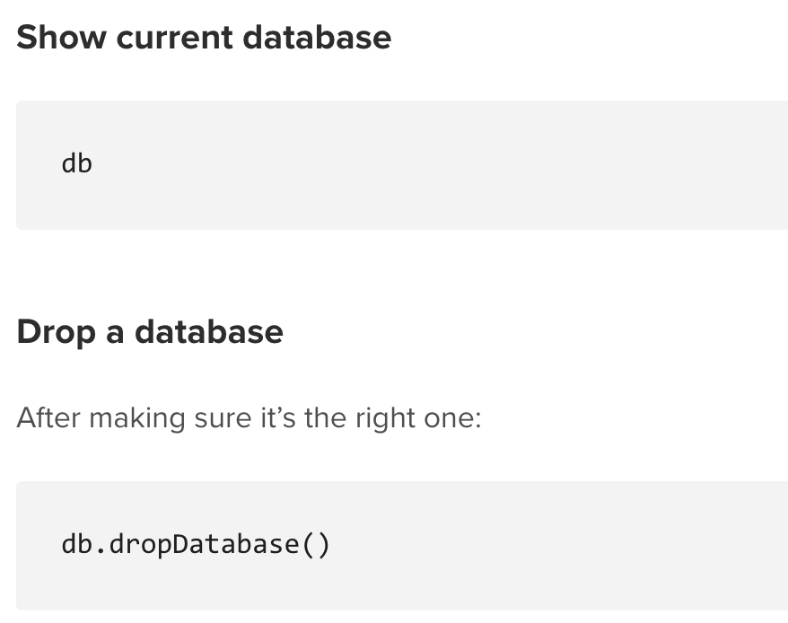
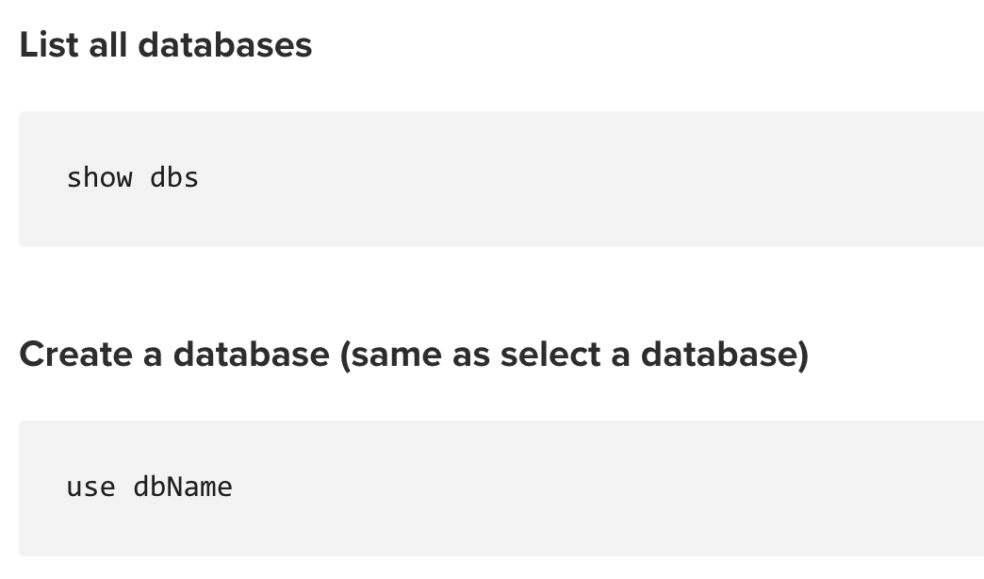

Slide 15
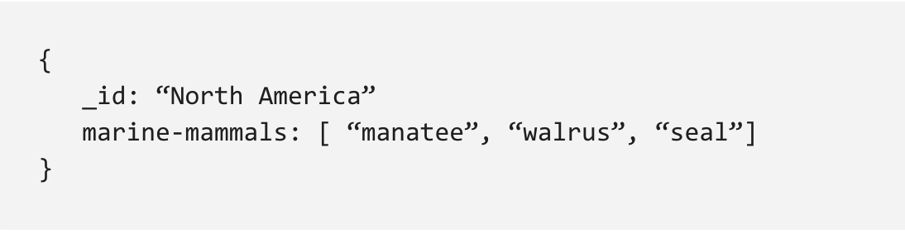
Arrays
Because data is stored flat in a MongoDB document, MongoDB can have fields with arrays – or a list of values – as values. For example, the field marine-mammals below has an array of three string values (manatee, walrus, seal) as a value:

Slide 16
Joins in MongoDB
To query on the last object of an array, use aggregate(). Let us create a collection with documents −
db.demo103.insertOne( { "Details" : [ { "StudentId" : 101, "Details" : "MongoDB" }, {"StudentId" : 102, "Details" : "MySQL" }, { "StudentId" : 103, "Details" : "Java" } ], "Details1" : [ { "StudentId" : 104, "Number" : 3 } ] } ); { "acknowledged" : true, "insertedId" : ObjectId("5e2ed2dd9fd5fd66da21446e") }
Display all documents from a collection with the help of find() method −
db.demo103.find();
This will produce the following output :−
{ "_id" : ObjectId("5e2ed2dd9fd5fd66da21446e"), "Details" : [ { "StudentId" : 101, "Details" : "MongoDB" }, { "StudentId" : 102, "Details" : "MySQL" }, { "StudentId" : 103, "Details" : "Java" } ], "Details1" : [ { "StudentId" : 104, "Number" : 3 } ] }
Here is how you can query to on the last object of an array −
db.demo103.aggregate([ { $project: { Details1: 1, Details: {$arrayElemAt: ["$Details", -1]} } }, { $match: {"Details.StudentId": 103} } ])
This will produce the following output: −
{ "_id" : ObjectId("5e2ed2dd9fd5fd66da21446e"), "Details1" : [ { "StudentId" : 104, "Number" : 3 }

Slide 17
Regular Expressions
Regular Expressions are frequently used in all languages to search for a pattern or word in any string.
MongoDB also provides functionality of regular expression for string pattern matching using the $regex operator.
MongoDB uses PCRE (Perl Compatible Regular Expression) as regular expression language. Unlike text search, we do not need to do any configuration or command to use regular expressions.
Assume we have inserted a document in a database named posts as shown below: −
db.posts.insert( { "post_text": "enjoy the mongodb articles on tutorialspoint", "tags": [ "mongodb", "tutorialspoint" ] }
WriteResult({ "nInserted" : 1 })

Slide 18
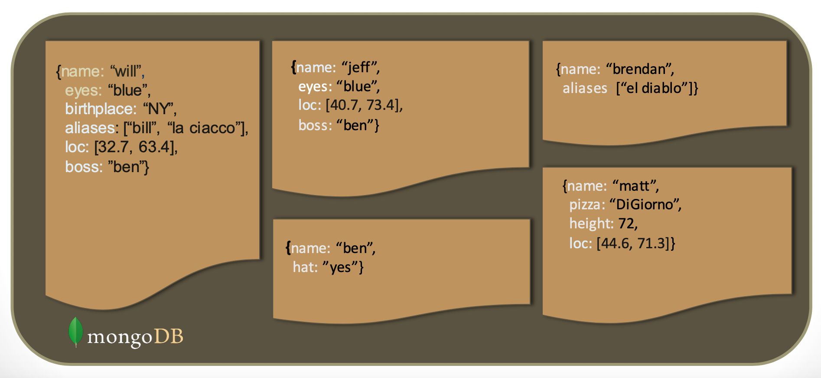
Schema Free:
Introduction to data analysis tool MongoDB
MongoDB does not need any pre-defined data schema
Every document in a collection could have different data
Addresses NULL data fields

Slide 19
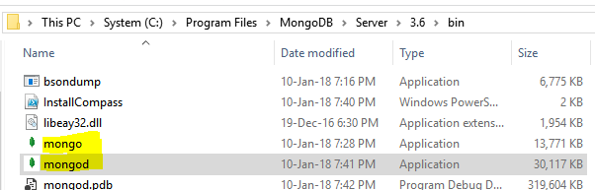
MongoDB server and client
MongoDB uses a client-server architecture.
After installation you need start the MongoDB server – mongod from the command line
This file and other executables are in C:\Program Files\MongoDB\Server\3.6\bin on Windows. You need to add the above folder to your environment variable PATH
You can connect to the MongoDB server (mongod) using the mongo client using another command prompt (see next slide).
The server (mongod) should be started before you can connect using the client (mongo)

Slide 20
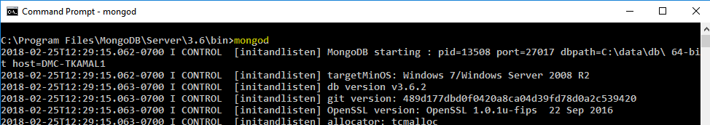
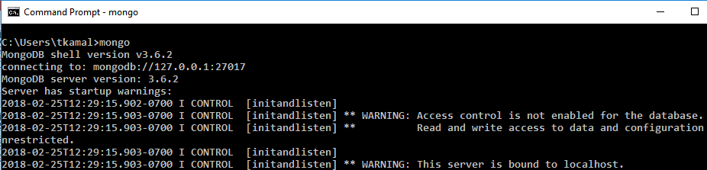
Starting server (mongod) and the client(mongo)

Slide 21

Creating and using a database – use command
To create a new database or switch to a previously created database you need to use the use command
> use weatherdb
To see the list of collections in this database use the show collections command
> show collections
This will not list any collections since this database is new and does not have any collections.

Slide 22

Inserting data into a collection
Suppose our collection is called todays_weather. We use the insert() function on the collection to insert a document.
> db.todays_weather.insert({city:"Dubai",max:32,min:17})
WriteResult({ "nInserted" : 1 })
Note how the data has to be in JSON format. The collection todays_weather is created on first insert.
db is used to refer to the current database.
Now Run the show collections command again and we will see a new collection

Slide 23
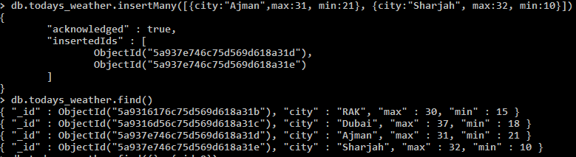
Doing multiple inserts
To insert multiple documents in a collection use the insertMany() function with a JSON array
db.todays_weather.insertMany([{city:"Ajman",max:31, min:21}, {city:"Sharjah", max:32, min:10}])
The above command inserts two documents one for Ajman and one for Sharjah. Note how JSON for each document has to be inside a JSON array

Slide 24

Object Id
MongoDB gives every document which is inserted an automatic object id which is stored in _id key if it is not specified explicitly
These _id keys are the primary keys for the documents
Specifying your own primary by using _id in the insert.
> db.todays_weather.insert({_id:1, city:"Fujairah", max:27, min:17})

Slide 25
Update value of A key using $SET
To update a value for a key use a criteria and key value pair to update as JSON to the update() function
For example we want to update the min for Sharjah city to 19
> db.todays_weather.update({city:"Sharjah"}, {$set:{min:19}})
The first JSON {city:“Sharjah“} is the criteria and second JSON is the update to the key min using $set

Slide 26
Update value of A key using $SET
To update a value for a key use a criteria and key value pair to update as JSON to the update() function
For example we want to update the min for Sharjah city to 19
> db.todays_weather.update({city:"Sharjah"}, {$set:{min:19}})
The first JSON {city:“Sharjah“} is the criteria and second JSON is the update to the key min using $set

Slide 27
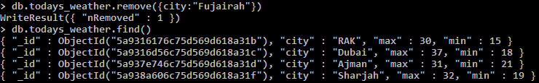
Deleting from a collection
To delete a document from a collection use the remove() function or the deleteOne() function with a criteria
NOTE: using the remove() function without a criteria JSON will remove all documents in the collection.
To remove Fujairah from the todays_weather collection the criteria is {city:”Fujairah”}
> db.todays_weather.remove({city: "Fujairah"})

Slide 28
Reading from a collection using find() function
Use the find() function to query or read from a collection
When find function is used without any filter or criteria it retrieves all the documents in the collection
> db.todays_weather.find()
When the find function is used with a filter or criteria it retrieves only the documents which match the criteria. For example to retrieve the weather for Dubai from the collection todays_weather the query is as follows:
> db.todays_weather.find({city:"Dubai"})

Slide 29


Reading from a collection using find() function - 2
Hiding keys and theirs values in query results. For example to hide the _id we set it to 0
db.todays_weather.find({}, {_id:0})
Key values in a documents can be hidden (using 0) or shown (using 1)
db.todays_weather.find({},{_id:0, city:1, max:1})

Slide 30
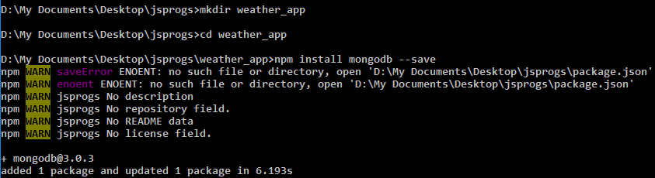
Connecting to mongodb from node.js
To connect to MongoDB from node.js you need to use the the MongoClient which is part of the mongodb NPM package
Brief steps:
Create a new folder for example weather_app
Cd to the weather_app
Run npm install mongodb --save
Write a node.js program (app.js) to connect to your mongo database and display the results (see next slide)

Slide 31
Using Mongo Client to connect to MongoDB – app.js
const MongoClient = require('mongodb').MongoClient;
const url = "mongodb://localhost:27017/";
MongoClient.connect(url, (err, db) => {
if (err) console.log(err.message);
//connect to the weatherdb
const weatherdb = db.db("weatherdb");
//read from the todays_weather collection in weatherdb
weatherdb.collection("todays_weather").find({}).toArray((err, resultDocs) => {
if (err) console.log(err.message);
//print every weatherDoc in resultDocs array to console
for (let weatherDoc of resultDocs)
console.log(weatherDoc.city + " Max : " + weatherDoc.max+ " Min : " + weatherDoc.min);
}); //close the connection to the mongodb
db.close();
});

Slide 32

Using MongoClient to connect to MongoDB – app.js

Slide 33
ACID Use Case Example
ACID Use Case Example
Financial institutions will almost exclusively use ACID databases. Money transfers depend on the atomic nature of ACID.
An interrupted transaction which is not immediately removed from the database can cause a lot of issues. Money could be debited from one account and, due to an error, never credited to another.

Slide 34
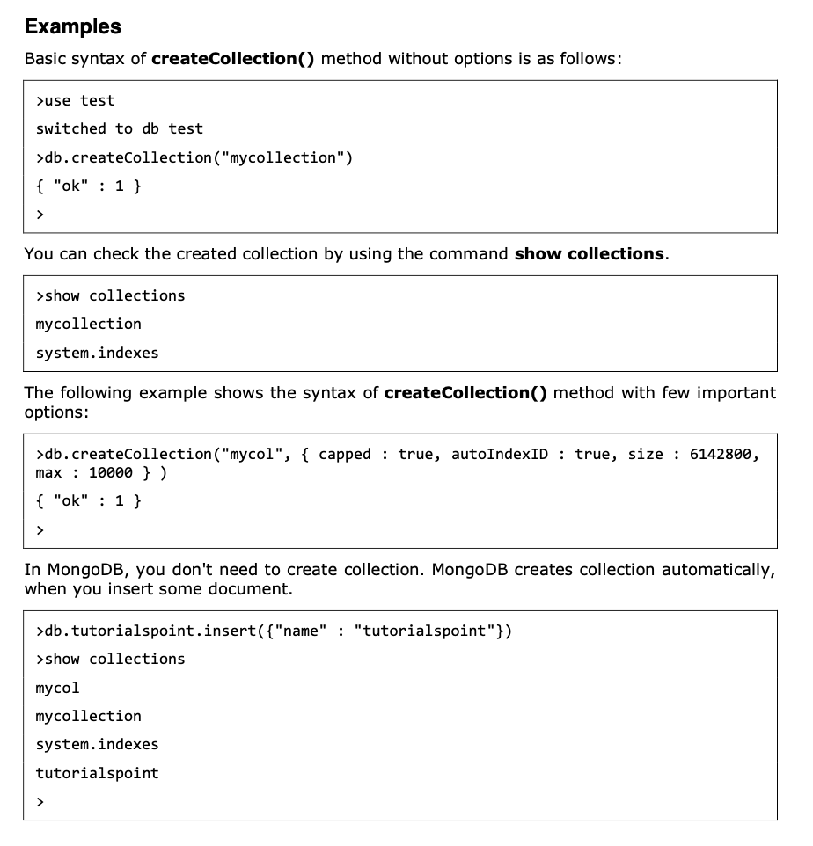

Slide 35
MongoDB limitations
MongoDB to has some limitations. :
a. Joins not Supported
MongoDB doesn’t support joins like a relational database. Yet one can use joins functionality by adding by coding it manually. But it may slow execution and affect performance.
b. High Memory Usage
MongoDB stores key names for each value pairs. Also, due to no functionality of joins, there is data redundancy. This results in increasing unnecessary usage of memory.
c. Limited Data Size
You can have document size, not more than 16MB.
d. Limited Nesting
You cannot perform nesting of documents for more than 100 levels.

Slide 36
Query Operators
Name | Description
$eq | Matches value that are equal to a specified value
$gt, $gte | Matches values that are greater than (or equal to a specified value
$lt, $lte | Matches values less than or ( equal to ) a specified value
$ne | Matches values that are not equal to a specified value
$in | Matches any of the values specified in an array
$nin | Matches none of the values specified in an array
$or | Joins query clauses with a logical OR returns all
$and | Join query clauses with a loginal AND
$not | Inverts the effect of a query expression
$nor | Join query clauses with a logical NOR
$exists | Matches documents that have a specified field
33
https://docs.mongodb.org/manual/reference/operator/query/

Slide 37
Formative assessment

Slide 38


