Slide 1
HoodZ (An AI-Driven Solution)

Slide 2
Problem Statement!
1

Slide 3
In a world inundated with choices, it's easy to feel overwhelmed. That's where our tailored recommendation system comes in.
Instead of bombarding users with an endless stream of options, we're crafting a bespoke experience for each individual.

Slide 4
Solution?
2

Slide 5
A data-driven approach for suggesting the neighbourhoods to live.

Slide 6
Maps
Chicago

Slide 7
Future Aspects?
3

Slide 8
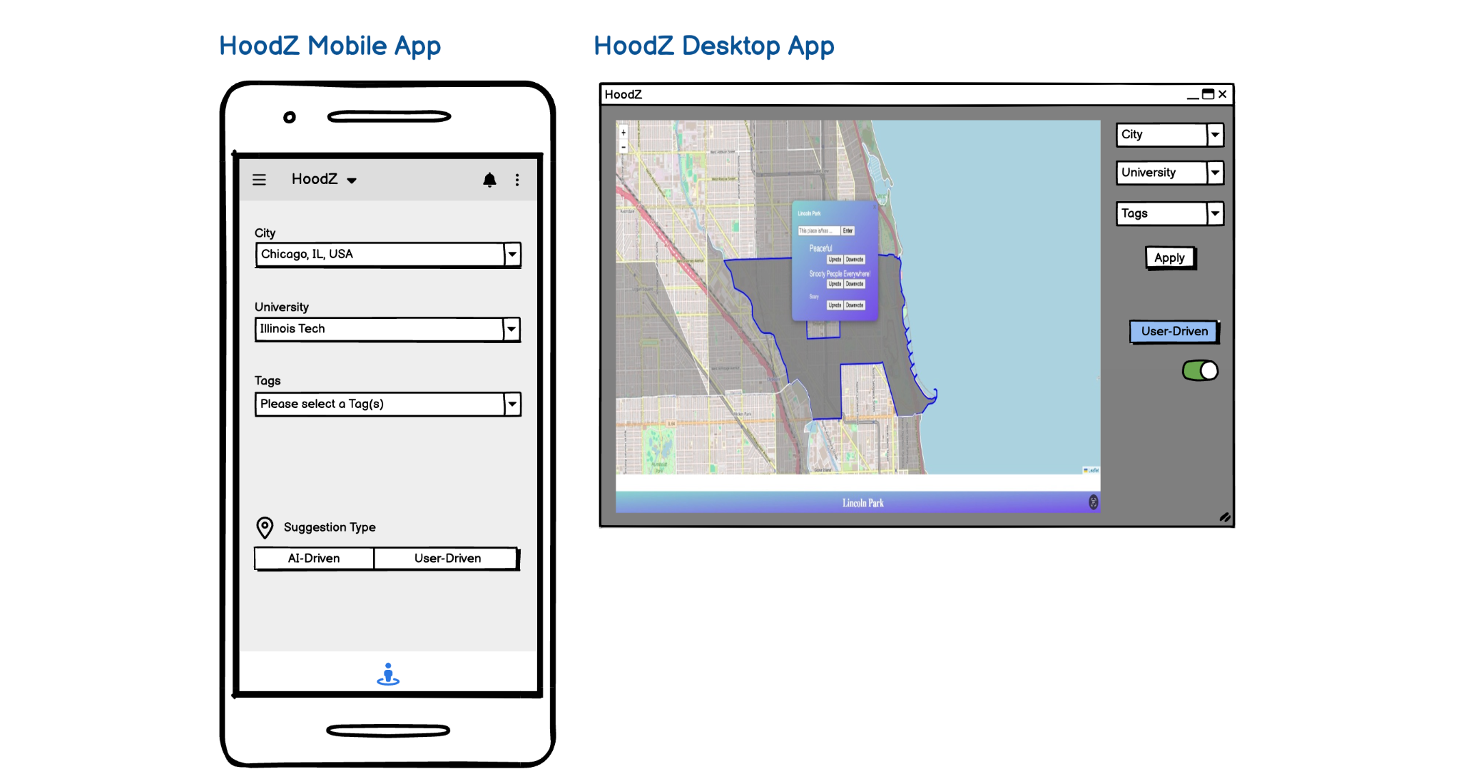

Slide 9
Applications
4

Slide 10
eCommerce
Healthcare
Finance/Insurance
Streaming Services
eLearning Platforms
Environment
etc.

Slide 11

Thank You!

