Slide 1
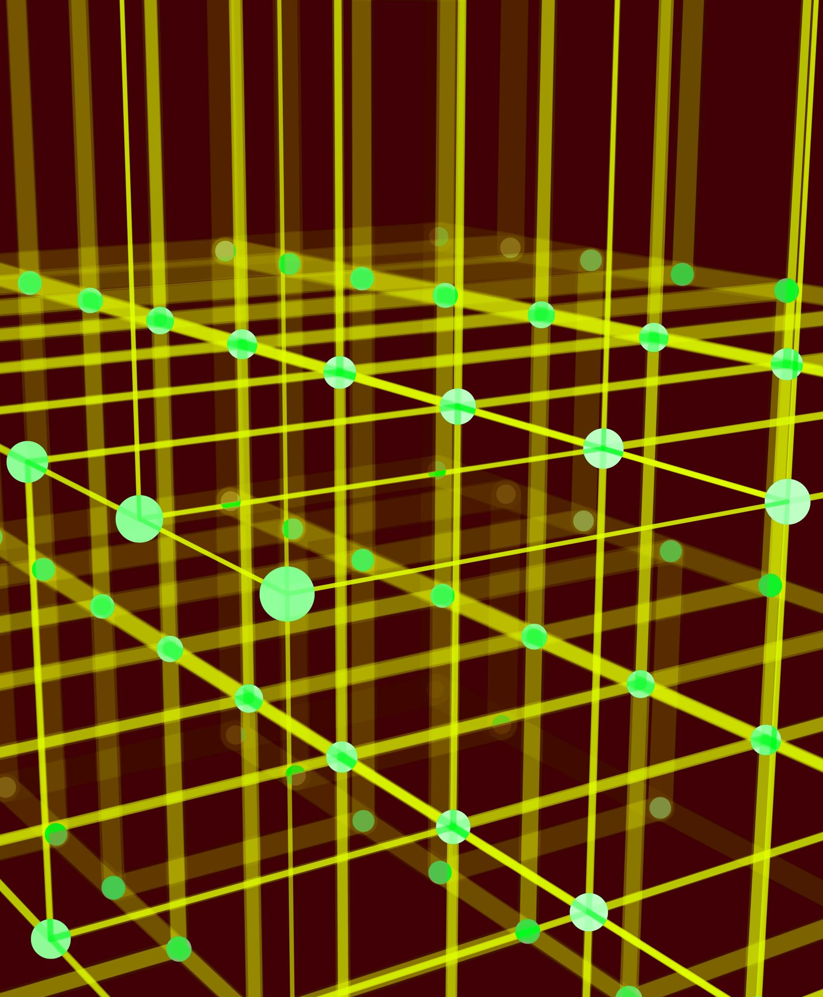
Reinforcement Learning with Deep-Q Learning in Grid World
Abhinav Jain
Sumukh Bharadwaj Koride

Slide 2
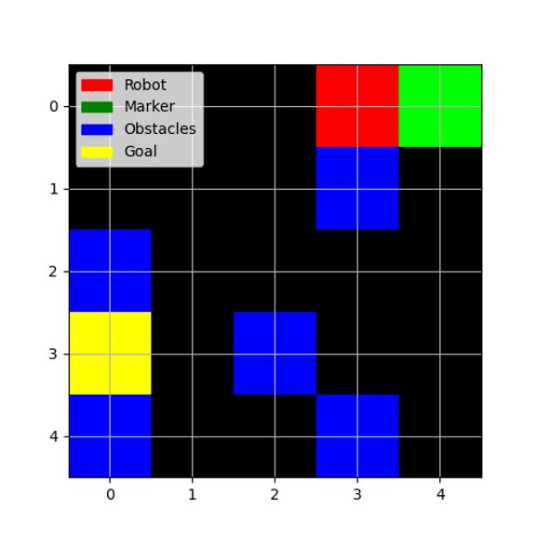
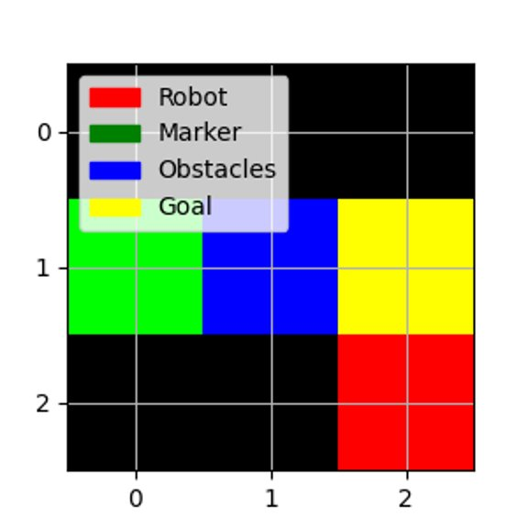
The Environment
Move the robot to collect the marker and drop it at the goal position in the discrete State-Action space​
5x5 Grid World Game
3x3 Grid World Game

Slide 3
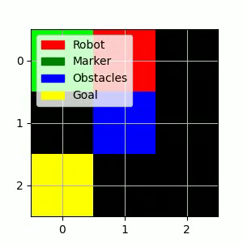
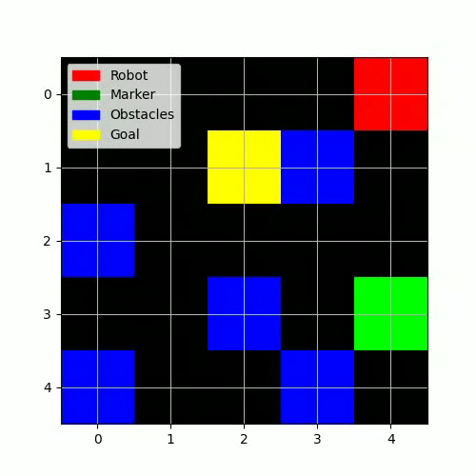
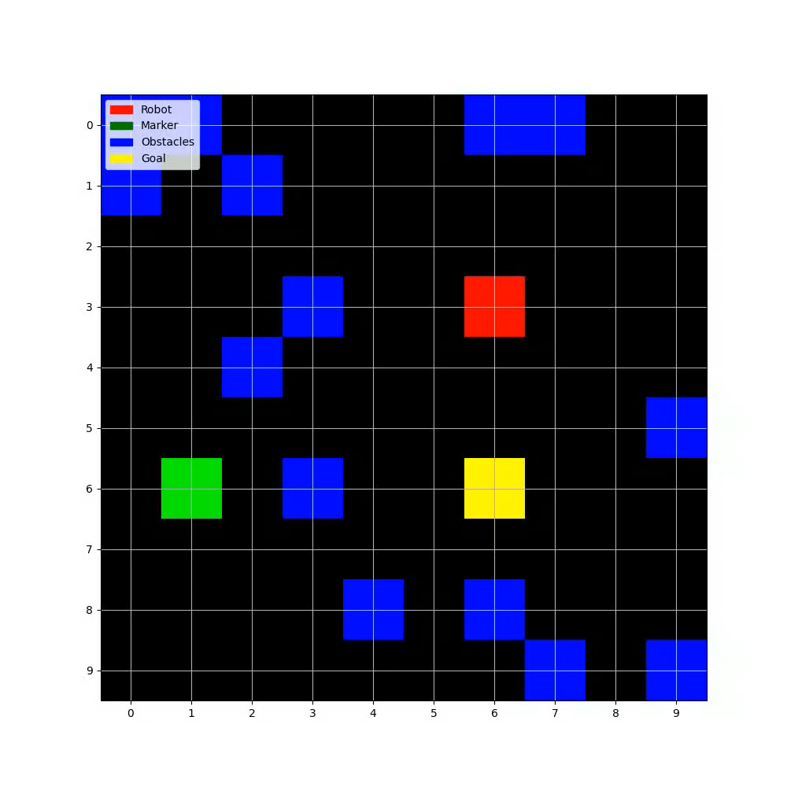
Expert Policy in Action
3x3 Grid World Game
5x5 Grid World Game
10x10 Grid World Game

Slide 4
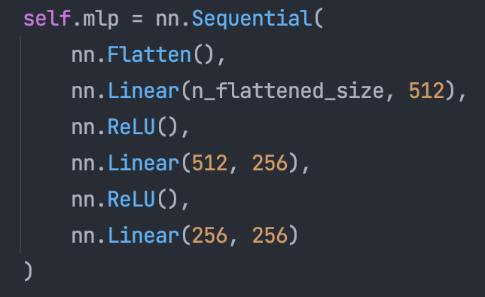
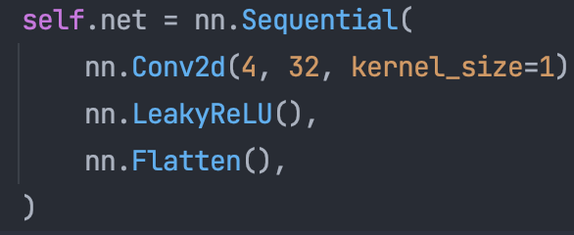
Deep-Q Learning
The Deep Q-Learning algorithm involves learning the optimal Q-values through the Bellman equation
Q-Values estimate the expected return received from taking a given action in given state
Robot Policy is the action with maximum Q-value for a given state
MLP-based Q-Net
CNN-based Q-Net

Slide 5

Rewards
The robot can move in 4-directions. It is rewarded or penalized for exhibiting certain specific behaviors
# # Define Actions
actions = {"Move Up", "Move Down", "Move Left", "Move Right"}
# # Define Rewards
r_{goal} = 1 # For reaching the goal with the marker
r_{invalid} = -1 # For reaching the goal without the marker
r_{pickup} = 0.5 # For picking up the marker
r_{step} = 0.0 if not penalise steps else -0.05 # For taking a step
r_{obstacle} = -1 # For hitting an obstacle or the wall

Slide 6
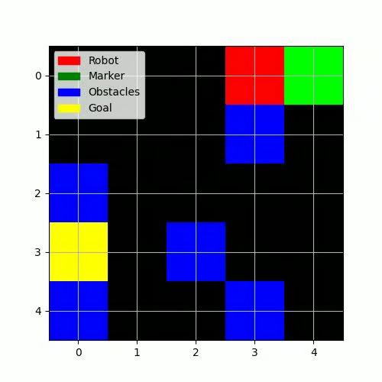
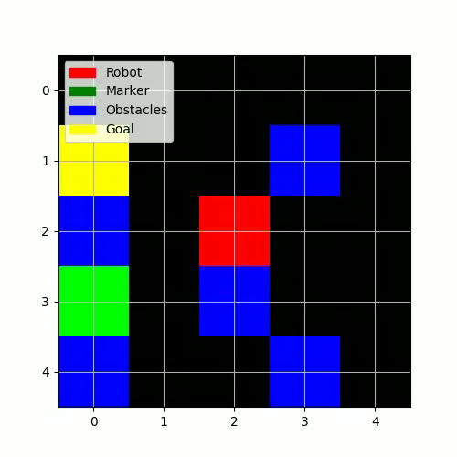
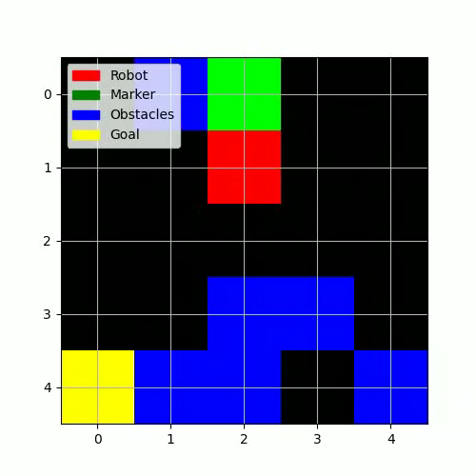
Learned Policy in Action w/o per-step penalty
The learned agent is more likely to exhibit oscillating behavior after collecting the marker and get stuck
Poor generalizability in `random` setting
Fixed 5x5 Grid World
Fixed 5x5 Grid World
Random 5x5 Grid World

Slide 7
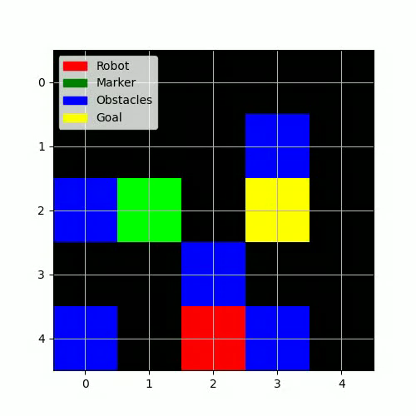
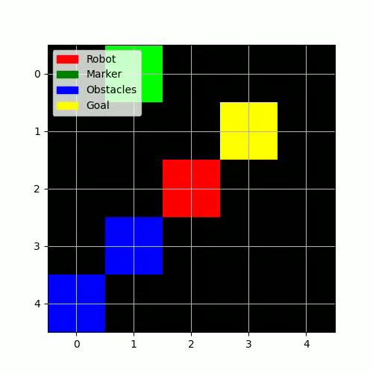
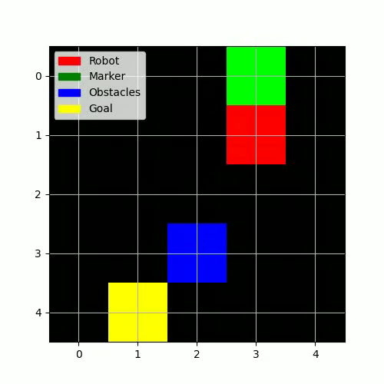
Learned Policy in Action with per-step penalty
The learned agent is less likely to exhibit oscillating behavior after collecting the marker and get stuck
Strong generalizability in `random` setting
Fixed 5x5 Grid World
Random 5x5 Grid World
Random 5x5 Grid World

Slide 8
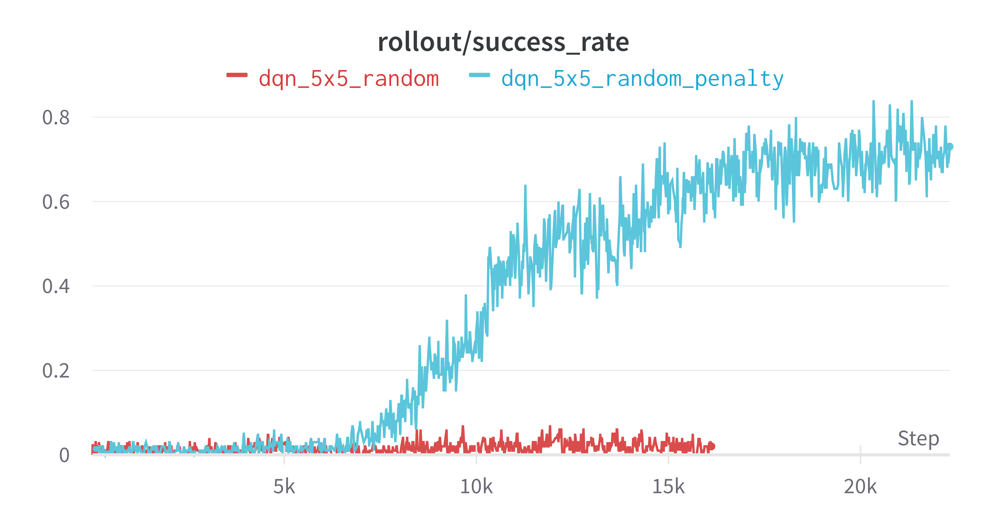
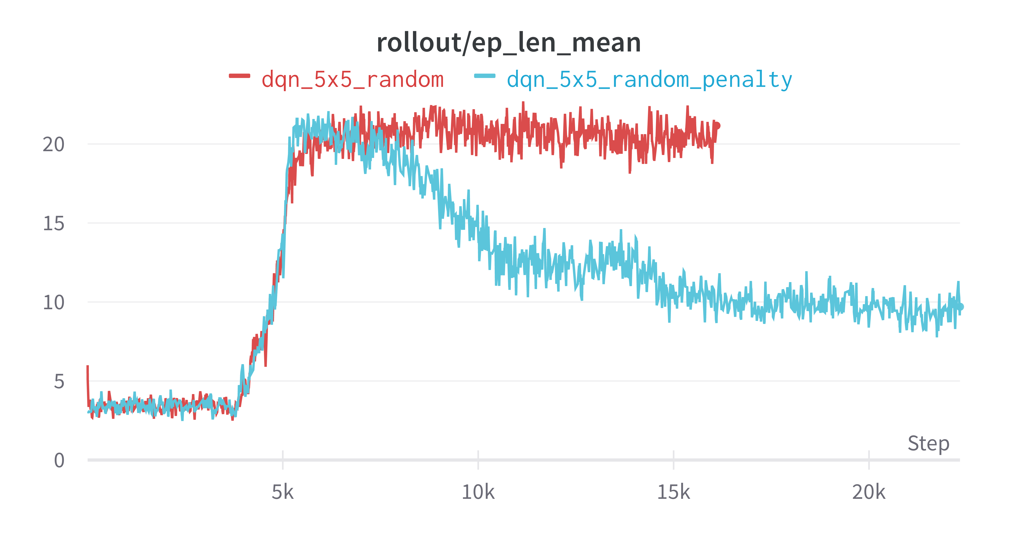
Results
Quantitatively the success rate and average episode length on unseen grid-worlds in the off-policy buffer is much better when robot is penalized at every step

Slide 9

Find our code at https://github.com/jabhinav/Comp646

