Slide 1
Extract Concept relevant Pages
Data Source (Wikipedia etc.)
Definition
Enrichment
Required
Extract Summary/Definition Section from Selected Wiki Page
Key concepts Extraction
FOR EACH CONCEPT IDENTIFY THE NEED FOR ENRICHMENT
Definition Identification Module
Definition Identification Module
Input Text
Enrichment
Not
Required
Fetch Definition/ Application
Concept to Sentence matching
Highlight the found definitions and applications in the input text itself
Application Identification Module
Application
Enrichment
Required
PHASE-1
Extract Summary/Application Section from Selected Wiki Page
PHASE-2
Application Identification Module
Enriched Text
PHASE-3
Pre-requisite relationship Identification
Concept Graph

Slide 2
Extract Concept relevant Pages
Data Source (Wikipedia etc.)
Definition
Enrichment
Required
Extract Summary/Definition Section from Selected Wiki Page
Key concepts Extraction
FOR EACH CONCEPT IDENTIFY THE NEED FOR ENRICHMENT
Definition Identification Module
Definition Identification Module
Input Text
Enrichment
Not
Required
Fetch Definition/ Application
Concept to Sentence matching
Highlight the found definitions and applications in the input text itself
Application Identification Module
Application
Enrichment
Required
PHASE-1
Extract Summary/Application Section from Selected Wiki Page
PHASE-2
Application Identification Module
Enriched Text
PHASE-3

Slide 3
From the perspective of engineering, computer vision seeks to automate tasks that the human visual system can do. Areas of artificial intelligence deal with autonomous planning or deliberation for robotical systems to navigate through an environment. A detailed understanding of these environments is required to navigate through them. Artificial intelligence and computer vision share other topics such as pattern recognition and learning techniques. Consequently, computer vision is sometimes seen as a part of the artificial intelligence field or the computer science field in general. The classical problem in computer vision, image processing, and machine vision is that of determining whether or not the image data contains some specific object, feature, or activity. Different varieties of the recognition problem are described in the literature like object detection. The fields most closely related to computer vision are image processing, image analysis and machine vision. There is a significant overlap in the range of techniques and applications that these cover.

Slide 4
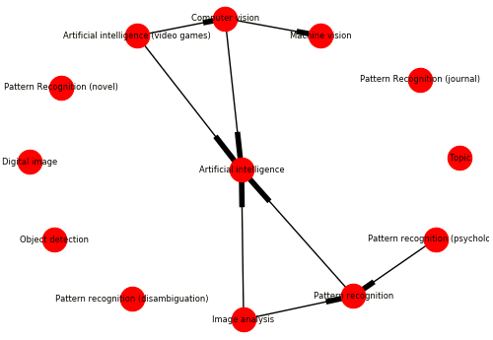
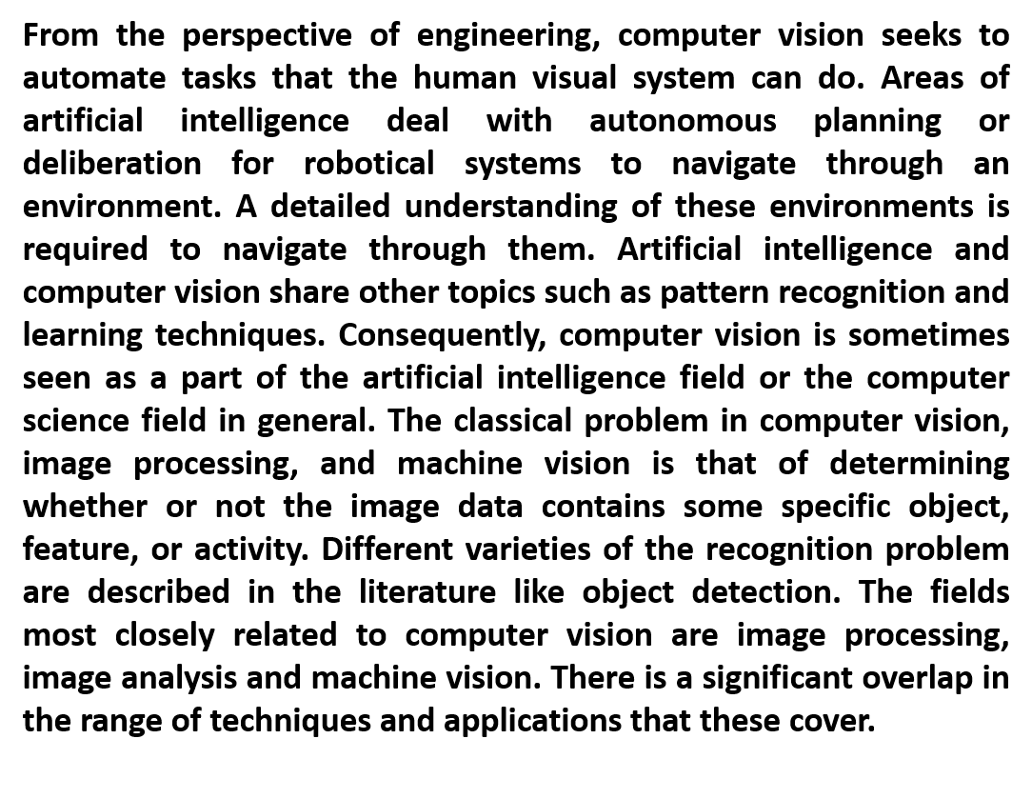
Pre-requisite
Graph
Enrichment
Application
Enrichment
(b)
(a)
Definition
Enrichment
APPLICATION: Applications range from tasks such as industrial machine vision systems which, say, inspect bottles speeding by on a production line, to research into artificial intelligence and computers or robots that can comprehend the world around them. Computer vision covers the core technology of automated image analysis which is used in many fields.
DEFINITION: Computer vision is an interdisciplinary field that deals with how computers can be made for gaining high-level understanding from digital images or videos.
(c)
(d)

