Slide 1
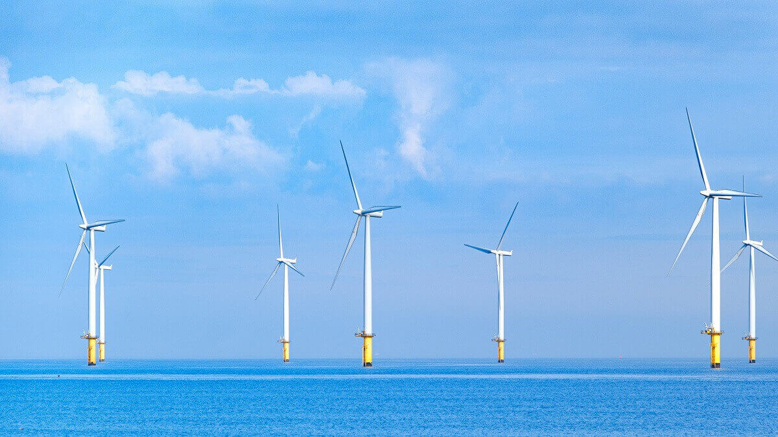
Maintenance of Offshore Wind Turbines
Design Group 5 Jason Abi Chebli, Alex Mavros, Claire Morey, Reece Sherar, Sean Schmid Walter Preliminary submission for MEC3416 Engineering Design II, S2, 2022
1

Slide 2
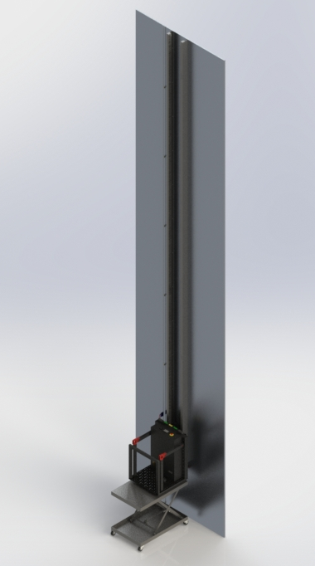
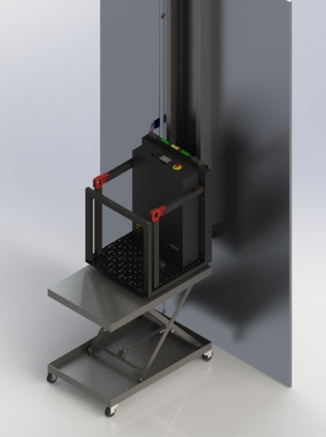
Concept Design/Sketches
After brainstorming over eight different configurations of a rack and pinion system to hoist the platform up the wind turbine, we decided to implement a dual rack and pinion system with the teeth of the racks facing towards each other. This design was selected as we thought it would naturally make our system more stable than a single rack and pinion system and the inwards direction of teeth felt like an easier way to engage our pinions with the racks.
Our system is depicted in the images on the right. A 10m wall is used as a proof of concept for the 120m wall that will be implemented. To make our platform easily removable, the rack starts 1.5 meters off the ground. A scissor lift transports the platform to the wall of the wind turbine, and then lifts the platform and the engineer up, until the the rack and pinions are engaged.
2

Slide 3
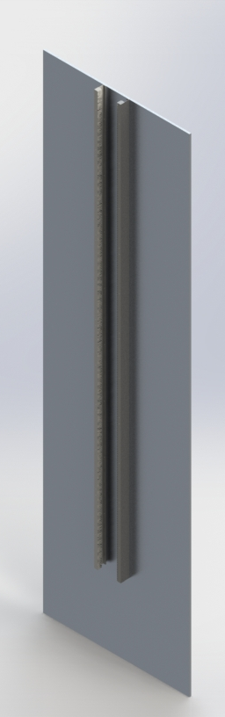
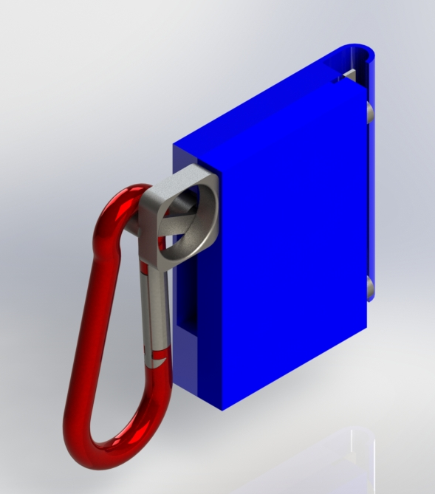
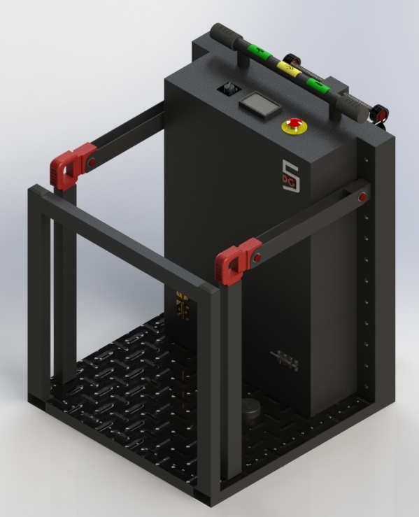
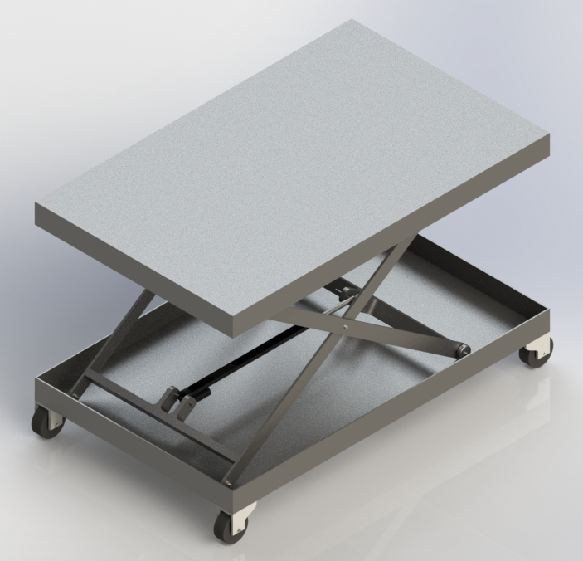
1.1 Detailed Visualization of Components
A safety brace attaches to the engineer’s harness. It is then attached to a metal rod and designed to catch and hold the engineer in the event of them falling.
Wind turbine wall which will have a rack mounted to it, via a U-channel beam, as well as a metal rod needed for the safety brace.
Scissor lift used to transport the platform to the wall and lift the platform up so the teeth of the rack and pinion get engaged. Maximum lifting height of is 1.3m.
The platform that will transport the engineer and equipment up and down the turbine. Dimensions: 1m x 1m x 1.36m.
3

Slide 4
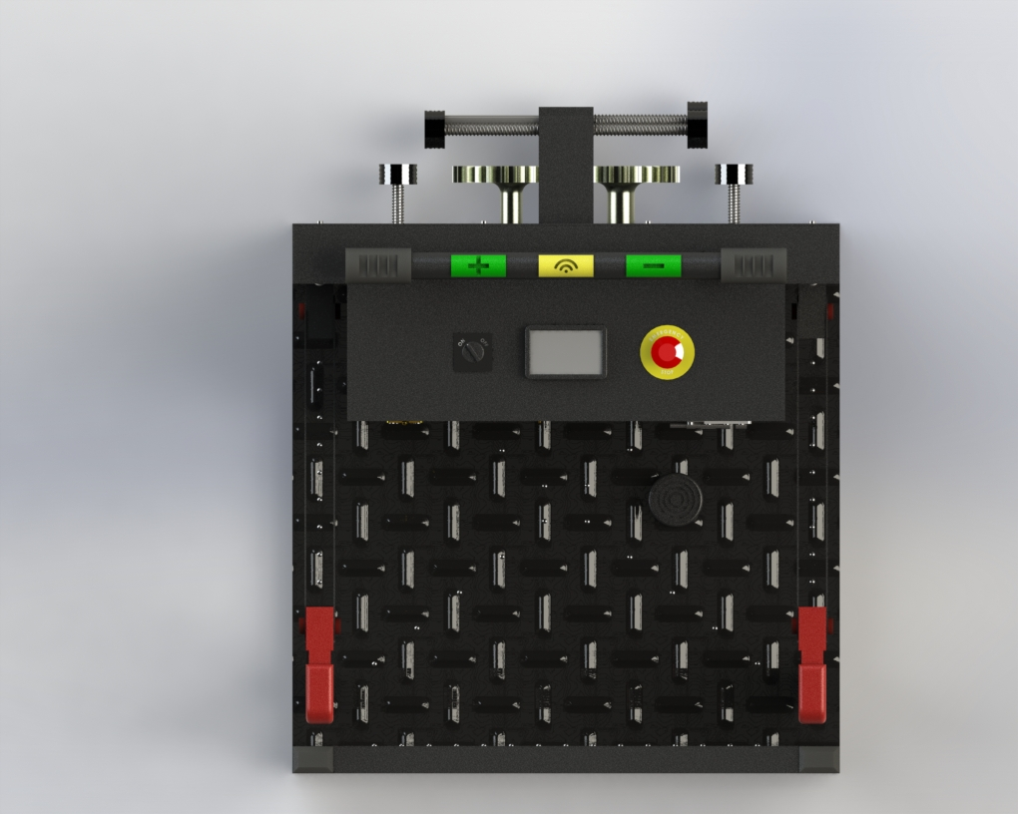
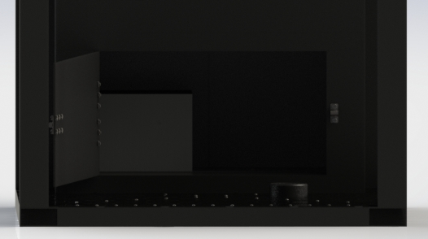
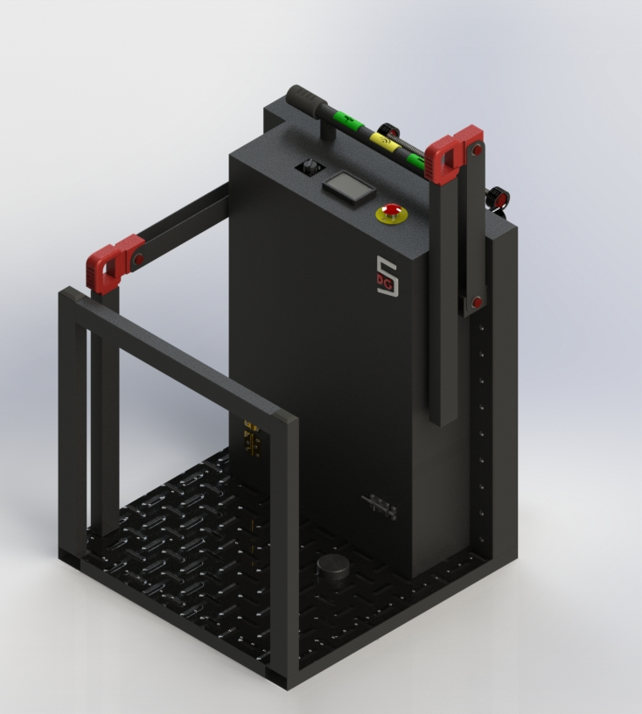
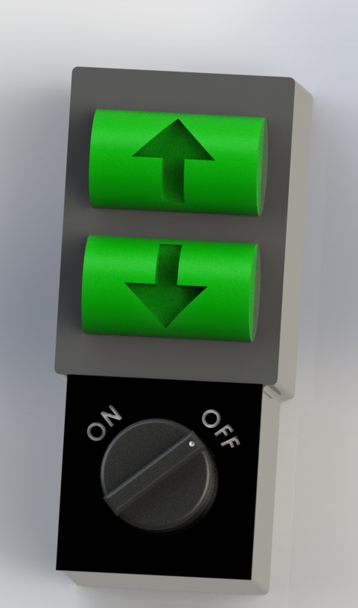
1.1.i. Detailed Visualization of Components: Platform
Battery
A control bar is used to allow the engineer to traverse up (left button), down (right button) or activate the remote control (middle button). The height and position of this bar allows for comfortable holding as the engineer travels up and down the turbine. The wireless remote control can be seen in the image of the left. It would be used to transport the platform without the engineer, such as in the event of sending up cargo. Additionally, an on-off switch (left dial), an emergency stop (right button) and a monitor to track details of their position and speed (positioned in the center) is placed before the bar so that it can be easily accessible and visible to the engineer.
The platform has a storage compartment at the bottom of it where the battery can be placed alongside any equipment the engineer may need. A latch and hinge door is implemented to secure this compartment. This allows the engineer to safely store the equipment and is close to the wind turbine wall to reduce the moment it may cause.
A back safety guide is used to support the engineer and prevent them from falling off the back of the platform. Welding will be required to secure this to the base of the platform.
A brake pedal is placed on the floor of the platform. This is an added safety feature. The engineer’s foot must be on it when transporting on the platform, otherwise, the platform will not move/stop.
A side safety guide is used to support the engineer and prevent them from falling off the sides of the platform. These can easily lift up and fold when the engineer wants to get off the platform.
4

Slide 5
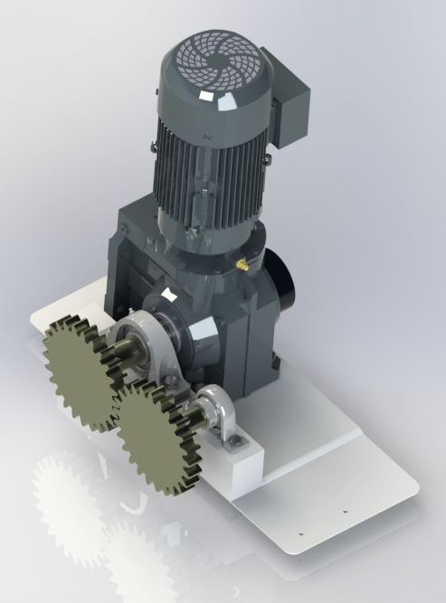
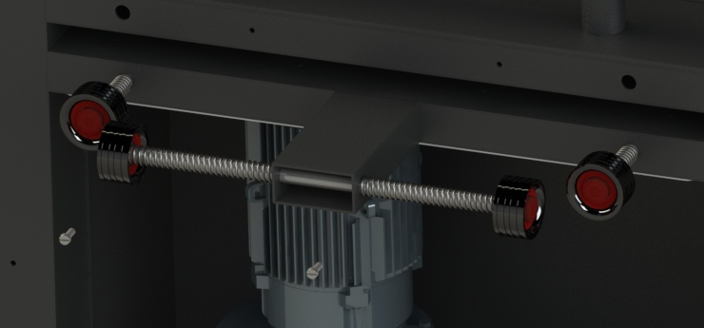
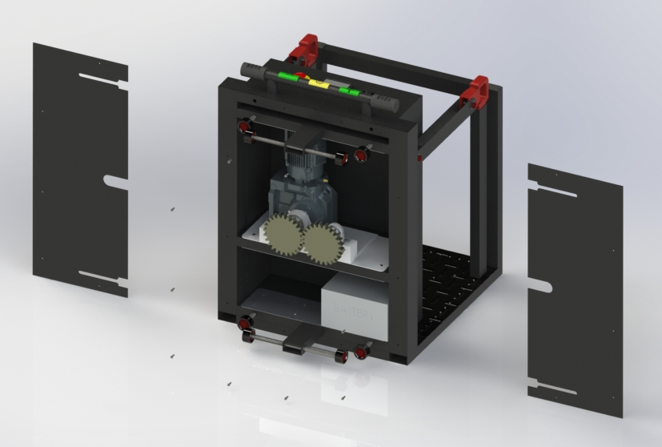
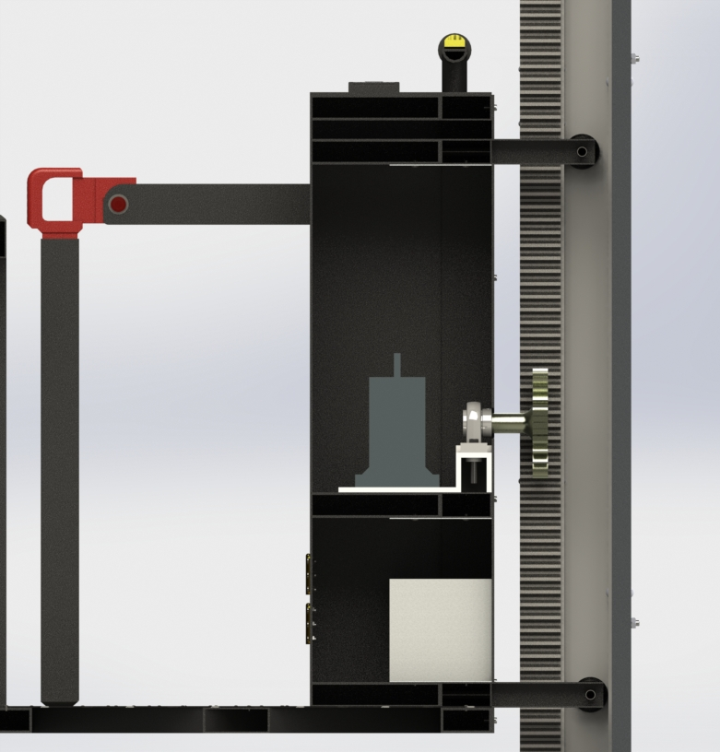
1.1.i. Detailed Visualization of Components: Back of Platform
The back is comprised of two plates that slide in from the slides and are screwed on. The design of these plates allows for the back to be easily accessible for maintenance without having to take off the guide wheels or pinions.
Guide wheels are utilised to keep the platform steady and perpendicular to the wall. The figure below illustrates how the top and bottom guide wheels keep the system perpendicular. Springs, bearings, circlips and rubber stoppers are used to help fix the position of the guide wheels.
The two pinions will be driven by one 30 RPM gear reduced motor. This specific motor will use a helical worm gear to prevent the motor from back driving. Bearings are placed to support the shafts of the pinions.
Battery
Aluminium brackets are used to attach the front control dashboard to the chassis rectangular hollow sections (RHS). Note that these RHS, are welded to the base.
5

Slide 6
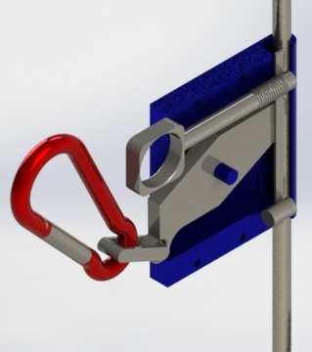
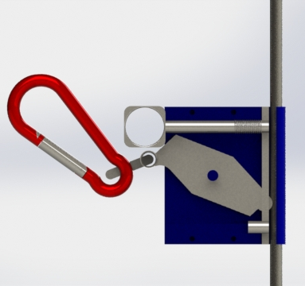
1.1.ii. Detailed Visualization of Components: Safety Brace
A safety brace is used in case of an emergency. In the unlikely circumstance that the engineer falls, the safety brace will catch onto the metal rod - preventing them from falling. The image below and the image on the right is a side view and isometric view of the safety brace without the cover on, respectively. The cover is not on, so that the mechanism can be easily explained and understood.
The safety brace is designed to be easily removable. Hence, this system is designed such that when the engineer wants to hook on or remove the safety brace from the metal rod, they have to pull back this metal key in order for there to be enough space for the metal rod to slot through. Otherwise, since this key is attached to a slit of metal that blocks the rod from coming off, it will not attach/detach. Additionally, this mechanism is spring loaded, meaning the engineer needs to apply enough force to open the space, otherwise it will not come off. This is done so that the engineer cannot be unintentionally unhooked.
The spring is relaxed in this image. When the key is pulled back, it causes the spring to compress and so the spring will try to close the slot.
A carabiner is used to attach the safety brace to a harness (that the engineer will need to wear).
In the event that the engineer falls, the carabiner will apply a downwards force which will cause this brake pad to rotate around the center pivot point. In doing so, it will rotate until the other end makes contact with the metal rod. Once this is done, the engineer will no longer be falling. The isometric view shows the brake pad engaged with the metal rod.
6

Slide 7
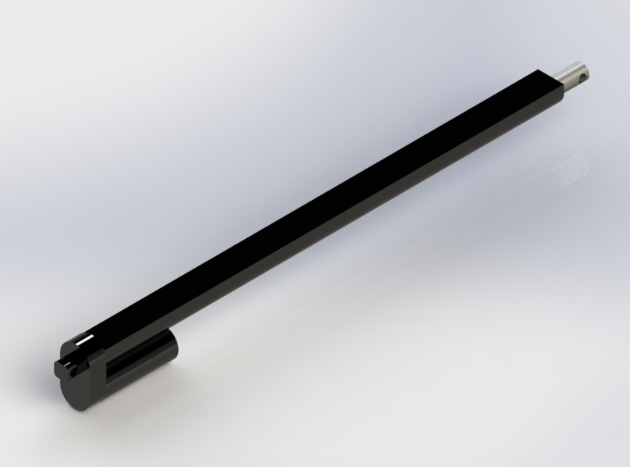
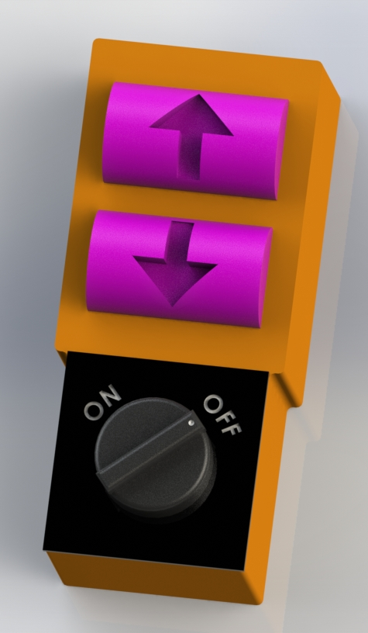
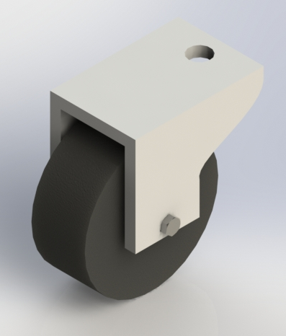
1.1.iii. Detailed Visualization of Components: Scissor Lift
Since the platform weighs 120kg, we included a scissor lift, that has wheels on it, in our design to help the engineer transport the platform by themselves. We decided to make the scissor lift a separate component, that is not permanently fixed to the platform, as it would add more weight to the system. This would cause negative effects by needing to modify our design in various ways such as having a larger motor.
Guide wheels are attached to this end while the the other end is bolted. With the other end pinned and this end a roller, this mechanism makes the scissor lift move up and down.
A 12V, 500mm stroke, 3000N pull load electric linear actuator motor is used to lift the scissor lift up and down.
A wireless remote control is used to lift the scissor lift up and down.
Four wheels are attached to the base of the scissor lift to allow for the easy maneuvering of the scissor lift with the platform.
7

Slide 8
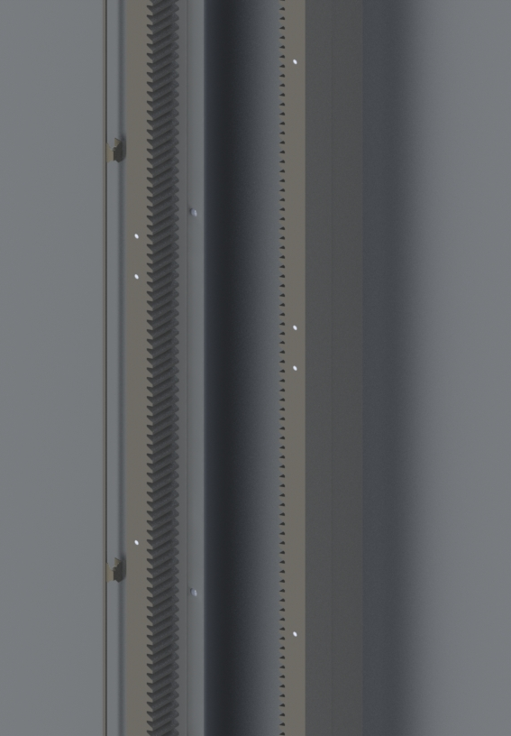
1.iv. Detailed Visualization of Components: Wall
A metal rod is attached to the side of the tower clamping system so that the safety brace can use it in case the system fails or the engineer falls off the platform.
Rivets are used to secure the rack to the U-channel and to secure the U-channel to the wind turbine wall. Rivets are used as we do not expect the tower clamping system to be removed frequently unless for repair.
The racks used are module 8 which was chosen to match the pinions, allowing a smooth drive. The rack teeth are facing each.
A zoomed-in exploded view of the assembly of the wall.
The U-channel’s used are 50x100x6. They are facing each other to provide the guide wheels a spot to sit in and a surface to act upon.
8

Slide 9
2. General Assumptions
The following assumptions are made about the wind turbine:
The walls of the turbine are flat - meaning that they have no curvature.
The walls of the turbine are strong enough to hold and withstand the force of the systems mounted onto them.
The height of the turbine is 120m.
The following assumptions are made about the system:
The weight of the person and the cargo combined is at maximum 120 kg.
The center of mass of the person is in the middle of the platform.
The platform travels at a constant velocity, meaning that it does not accelerate and decelerate.
Load and failure analyses is conducted in an ideal, frictionless situation.
There will be no occurrence of excessive noise or vibration.
The outer housing will be made by conventional means and the readily available materials will be painted or otherwise coated to provide corrosion protection.
We assume C_{T} = 1 [No temperature extremes] and C_{R} = 1 [50% reliability].
The following assumptions are made about the environmental conditions:
The system will be used outdoors in inclement weather, however, calculations are performed in ideal situations (such as there are no wind forces).
Gravity forces are constant at 9.81m/s².
Specific assumptions for respective parts will be indicated in their load and failure analysis sections below.
9

Slide 10
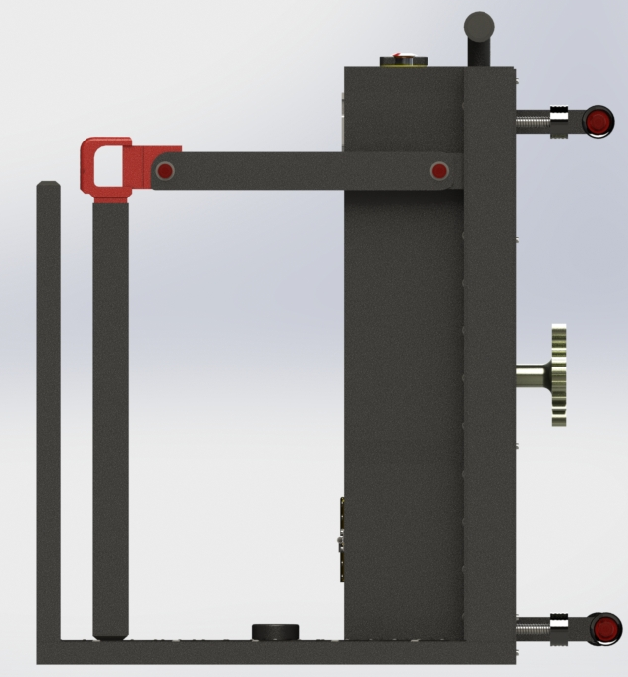
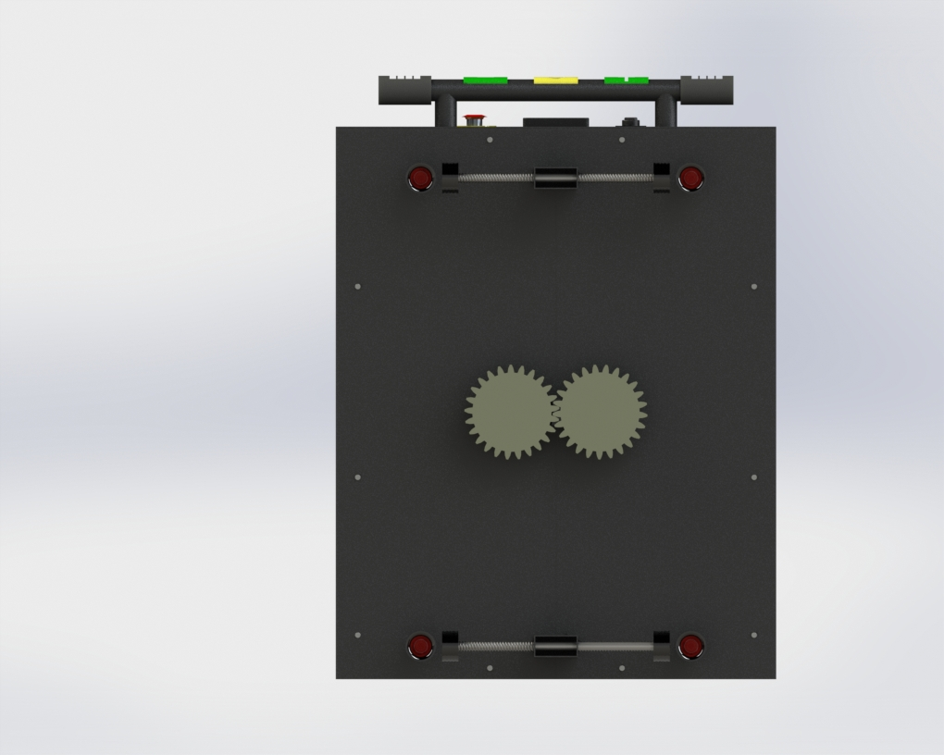
3.1 Base of Platform
In order to calculate the strength of the base it is reasonable to assume the force on the base will be reacted by the force R_{Z}.
F_{W} = m_{load}*a_{load}
F_{W} = 120 kg * 9.81m/s² = 1177.2N
F_{B} = m_{base}*a_{base}
F_{B} = 23 kg * 9.81m/s² = 225.63N
∑F_{Z} = 0:
-F_{W} - F_{B} + R_{Z} = 0
R_{Z} = 1402.83N
∑F_{X} = 0: there are no forces in the x-direction.
M = (1177.2*0.678) + (225.63*0.5)
= 910.9566Nm
𝜏 = F/A = 1402.83N/[(0.05*0.1)-(0.044-0.094)]
= 1.624MPa
σ_{a} = 0 as there is no axial load on the base.
σ_{b} = Mc/I = (910.9566*0.025)/)3.7439*10⁻⁷
= 60.83MPa
𝜏 = Tr/J = 0MPa as there is no torque on the base.
Selection of material is Alloy Steel
Yield Stress = 485.0MPa
σ_{ea}= σ_{b}= 60.83MPa
σ_{em} = σ_{a}/2 + sqrt(𝜏²+(σ_{a}/2)²) = 0MPa
Max stress from bending stress 60.83MPa
Safety factor assuming yield stress is 485.0MPa: SF = 485.0/60.83 = 7.97
F_{W}
F_{B}
R_{Z}
F_{B}
F_{B}, F_{W}
F_{W}
z
x
z
x
10
y
x

Slide 11
3.2 Guide Arm
Analysis for the guide arm wheel assembly forces (left image).
∑F_{x} = 0:
F_{G1} = F_{G2}
We assume there is no moment on the pinions (meaning there is no moment at F_{P}).
∑M@P = 0:
(-120*9.81*0.768) + (-23*9.81*0.59) + (-102*9.81*0.29822) + (F_{G1}*0.5319) + (F_{G2}*0.5315) = 0
Substituting in, F_{G2} = F_{G1}
-904.09 + (-133.12) + (-298.40) + (1.0634*F_{G1}) = 0
F_{G1} = 1255.98N
Therefore, F_{G2} = 1255.98N
F_{G1}
F_{pinA}
F_{pinB}
F_{M}
F_{P}
F_{M}
Analysis for the upwards force on pinions (right image).
We assume moments are taken at P₂
∑M@P₂ = 0:
(-1402.83N*0.2) + (-1000.62N*0.22533) + M_{P1} = 0
M_{P1} = 506.04Nm
P₁ = 506.04/0.4 = 1265.09N
∑F_{Z} = 0:
-1402.83 - 1000.62 + P₁ + P₂ = 0
P₂ = 1138.36N
These forces calculated will be used for calculations in section 3.3.
F_{W} + F_{B}
F_{B}
F_{W}
F_{G2}
z
z
x
x
11

Slide 12
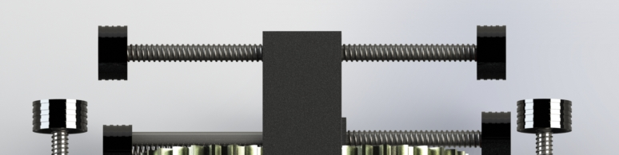
3.2 Guide Arm
Analysis is conducted on the rectangular hollow section arm as this will be the first point of failure as the other components will be robust enough to absorb forces due to different materials being used. We assume that there will be no moment on the arms since these will be countered by the guide wheels acting on the rack as can be seen on the image on the right.
Top Arm Analysis:
F_{G1} = 1255.98N
Only axial loading (in tension)
σ_{nom} = F/A = 1255.98/[(0.05*0.1) - (0.094*0.044)]
= 1.454MPa
Plate pin loaded hole
d/b = 0.019/0.05
Therefore k_{t} = 2.7
σ_{max} = σ_{nom} * k_{t} = 3.925MPa max stress at hole
Selection of material is 1060 Alloy Aluminium
Yield Stress = 62MPa
Safety Factor is
SF1 = 62/3.925 = 15.796
F_{G1}
x
Top Guide Wheels
y
F_{G2}
Bottom Arm Analysis:
F_{G2} = 1255.98N
Only axial loading (in compression)
P_{nom} = π²EI/L_{e}² = π²*69*3.74*10⁻⁷/0.2183²
= 5.34MPa
Plate pin loaded hole
d/b = 0.019/0.05
Therefore k_{t} = 2.7
P_{max} = P_{nom} * k_{t} = 14.418MPa max stress at hole
Selection of material is 1060 Alloy Aluminium
Yield Stress = 62MPa
Safety Factor is
SF2 = 62/14.418 = 4.3
x
Bottom Guide Wheels
y
12

Slide 13
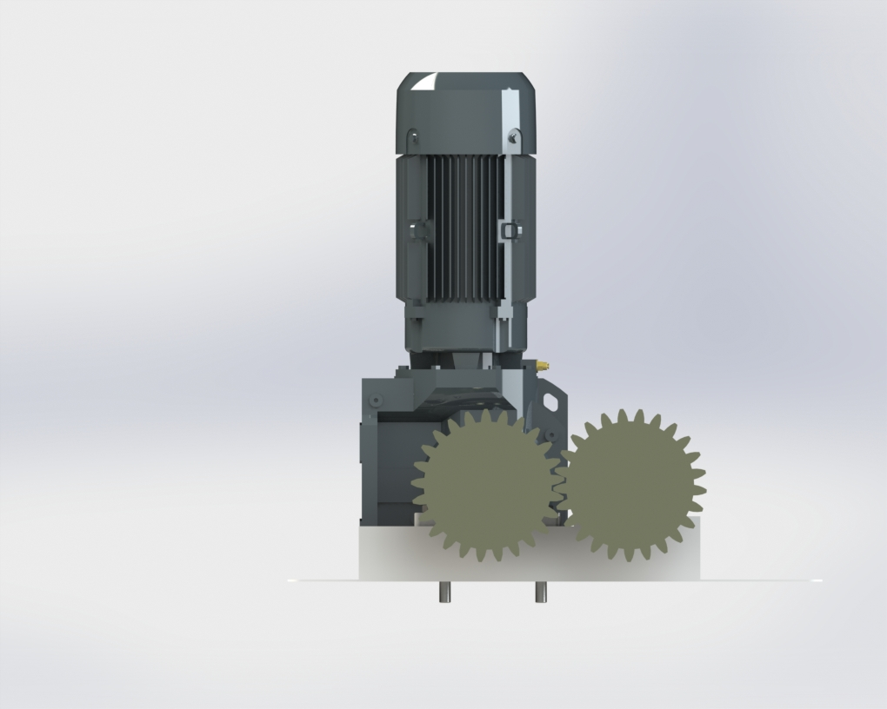
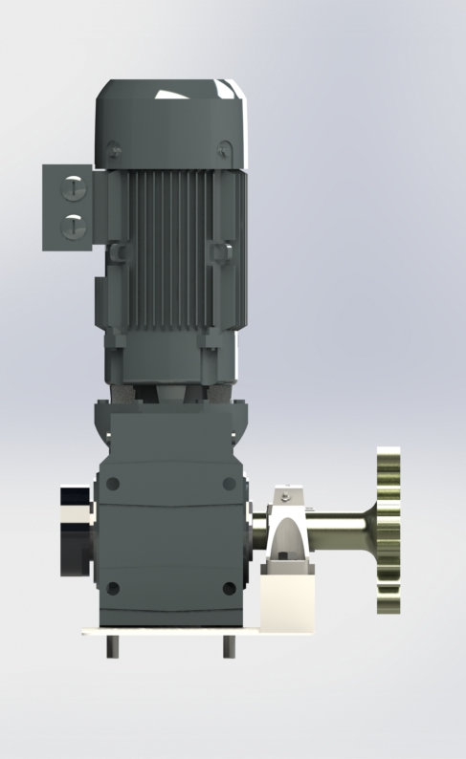
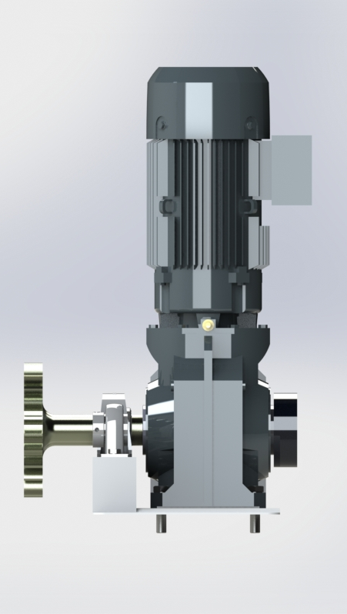
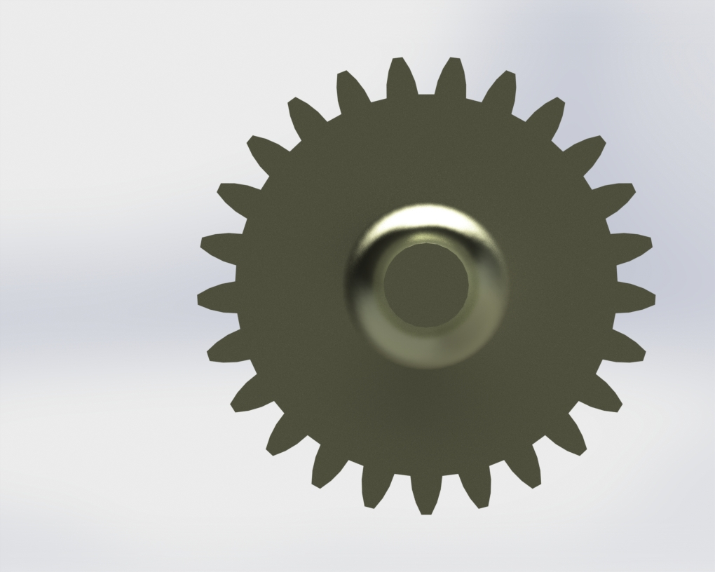
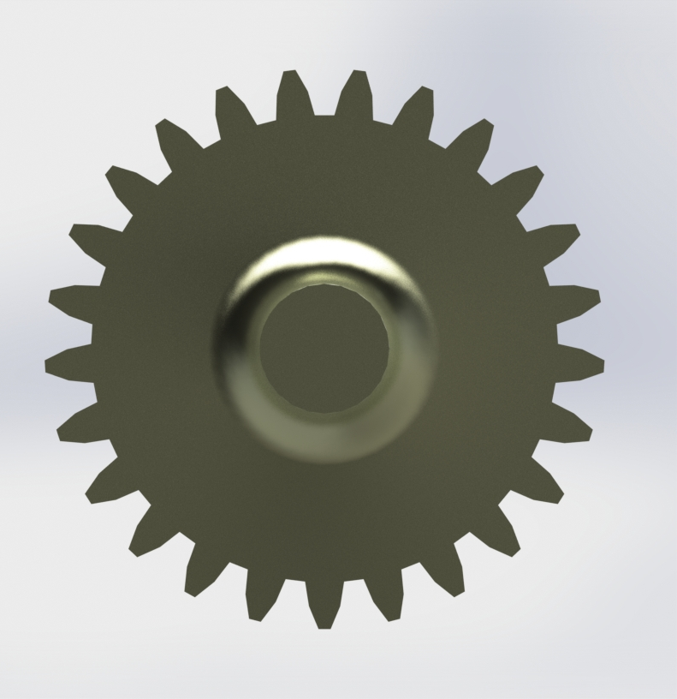
3.3 Shaft and Pinions
X-Z
X-Y
F_{pinB}
F_{gear}
Shaft B
∑T = rF_{gear} - rF_{pinB} = 0
∴ F_{gear} = F_{pinB}
F_{gear} = 1138.36 N
∑F_{By} = F_{pinB} - F_{B} + F_{gear}= 0
∴ F_{B} = F_{pinB} + F_{gear} = 1138.36 + 1138.36
F_{B} = 2276.72 N
F_{pinA}
F_{pinB}
F_{pinA}
F_{pinA}
𝜏_{motor}
F_{B}
F_{pinA}
Shaft A
∑F_{Ay}= F_{pinA} - F_{A} - F_{gear}= 0
F_{A} = F_{pinA} - F_{gear} = 1265.09 - 1138.36
F_{A} = 126.73 N
∑T = T_{motor}- rF_{gear} - rF_{pinA} = 0
∴ T_{motor}= r( F_{gear} + F_{pinA}) = 0.1(1138.36 +1265.09)
T_{motor} = 240.345 Nm
F_{A}
F_{B}
F_{A}
F_{B}
F_{B}
F_{A}
y
y
y
z
x
x
To correctly analyze the forces within the shafts, a action-reaction force pair had to be considered as the gears interact with each other, called F gear.
To simplify the analysis, the shafts are considered to be massless. In shaft A the reaction force is assumed to be carried by the motor, with the bearing as a guide. The force transfer is assumed to be 100% efficient (pressure angle = 0).
Z-Y axis not included as it provides no additional information
F_{gear}
F_{A}
Motor specification
To hoist Base and cargo 120 in 5-7 min
17.95 < ⍵_{pinion}< 25.13 rad/s
P_{req} = t_{motor}⍵_{pinion}
4308 < P_{req}< 6031 W
y
13
z

Slide 14
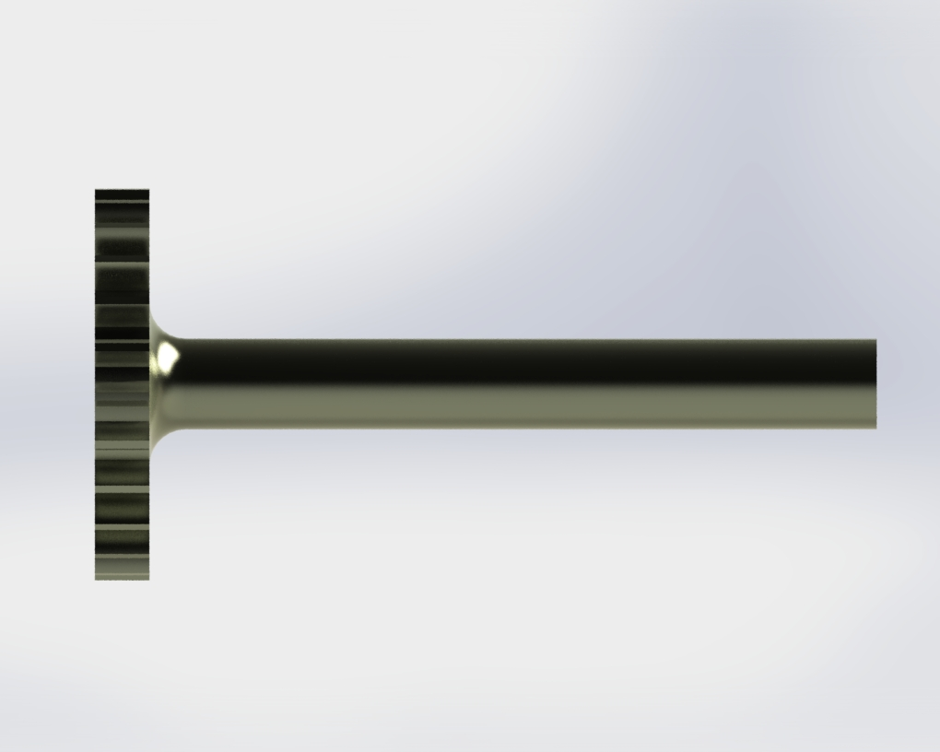
3.3.1 Shaft A Design Analysis
Bending stress:
M_{max} = F_{shear}*Distance = 126.73*0.415 = 52.593 Nm
M_{fillet} = F_{shear}*Distance = 126.73*0.4 = 50.692 Nm
σ_{M max} = 32*M_{max}/π*d³ = 32*52.593/ π*(0.05³)
σ_{M max} = 4.286 MPa
σ_{fillet} = (32*M_{fillet}/π*d³)*Kf_{b} = (32*50.692/π*(0.05³))*1.27
σ_{fillet} = 5.246 MPa
Stress concentration factor (due to fillet):
Kf = 1 + (Kt - 1)q
D/d = 200/50 = 4
r/d = 20/50 = 0.4
Since r is large, Kf ≅ Kt
Kt_{b} = 1.27
Kt_{τ} = 1.16
F_{pinA}
F_{pinA}
𝜏_{motor}
Torsional Stress:
𝜏 = 16*T/π*d³ = 16*240.345/π*(0.05³)
𝜏 = 9.793 MPa
𝜏_{fillet} = 𝜏*Kt_{τ} = 9.793*1.16
𝜏_{fillet} = 11.359 MPa
No axial load present, therefore:
σ_{ea} = σ_{fillet} = 5.246 MPa
σ_{em} = 𝜏_{fillet} = 11.359 MPa
σ_{ea}/σ_{em} = 5.246/11.359 = 0.462
Goodman diagram intersecting lines:
y = -0.405n + 396.9
y = 0.462n
0.462n = -0.405n + 396.9
0.867n = 396.9
n = 457.876 MPa, y = 211.46 MPa
Safety Factor = 457.876/240.345
Safety Factor = 1.91
This does not meet the required design specifications, and thus needs to be re-evaluated for future designs. This will be further discussed next slide.
From observation, the maximum stress in the shaft is largest at the fillet due to the introduced stress concentration
.Shaft is machined from pure tungsten:
S_{u} = 980 MPa, S_{y} = 750 MPa
F_{A}
F_{gear}
F_{gear}
F_{A}
y
y
S_{n} = S_{n}’C_{L}C_{G}C_{S}C_{T}C_{R}
S_{n}’ = 0.5S_{u}
C_{L} = 1 - Bending load
C_{G} = 0.9 - 50mm diameter
C_{S} = 0.9 - Fine ground finish
S_{n} = 0.5(980)(1)(0.9)(0.9)(1)(1)
S_{n} = 396.9 MPa
x
z
14

Slide 15
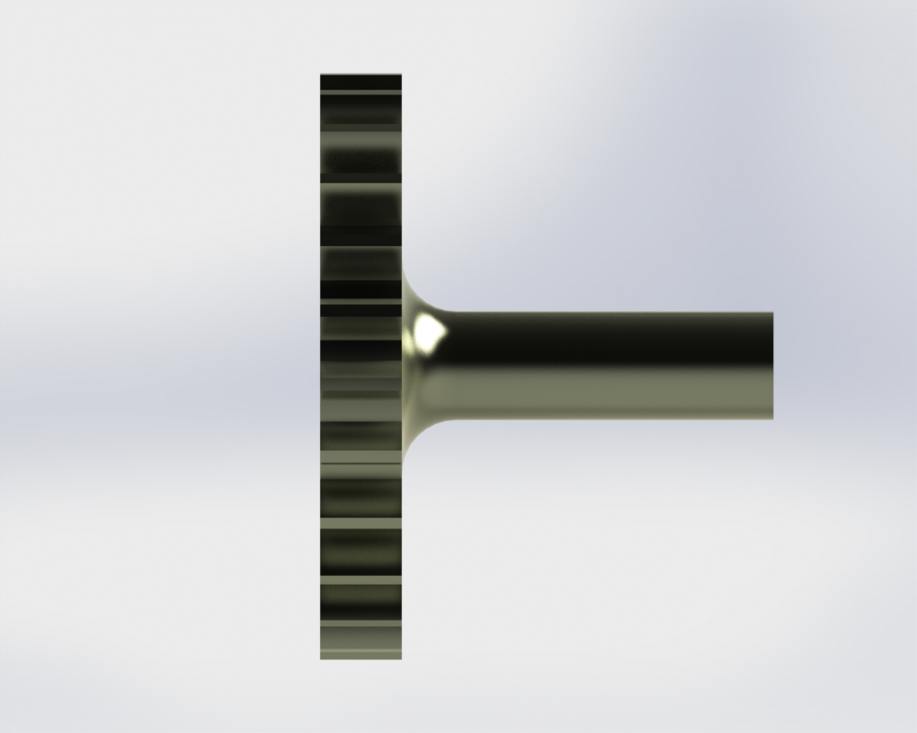
3.3.2 Shaft B Design Analysis
Bending Stress:
M_{Max} = F_{shear}*Distance = 2276.72*0.145
M_{Max} = 330.124 MPa
M_{fillet} = F_{shear}*Distance = 2276.72*0.13
M_{fillet} = 295.973 MPa
σ_{M max} = 32*M_{max}/π*d³ = 32*330.124/ π*(0.04³)
σ_{M max} = 52.541 MPa
σ_{fillet} = (32*M_{fillet}/π*d³)*Kf_{b} = (32*295.973/π*(0.04³))*1.22
σ_{fillet} = 57.467 MPa
Maximum stress occurs at the fillet
Shaft is machined from cast alloy steel:
S_{u} = 448.08 MPa, S_{y} = 241.28 MPa
S_{n} = S_{n}’C_{L}C_{G}C_{S}C_{T}C_{R}
S_{n}’ = 0.5S_{u}
C_{L} = 1 - Bending
C_{G} = 0.9 - 40mm
C_{S} = 0.9 - fine ground
S_{n} = 0.5(448.08)(1)(0.9)(0.9)(1)(1)
S_{n} = 181.47 MPa
Stress concentration factor (due to fillet):
Kf = 1 + (Kt - 1)q
D/d = 200/40 = 5
r/d = 20/40 = 0.5
Since r is large, Kf ≅ Kt
Kt_{b} = 1.22
F_{B} + F_{gear}
F_{pinB}
F_{gear}
Safety Factor = S_{y}/σ_{fillet} = 241.28/57.467
Safety Factor = 4.20
Upon analysis, this system requires a redesign. While having a single motor driving a single shaft reduces weight in comparison to having 2 motors, the torque is high, making shaft design and material selection difficult.
Deflection is also an issue with the current design , as even small deflections at the pinion can interfere with the interaction between the pinion and rack teeth. This can be addressed by having another
Decoupling of the gears is likely necessary, as having them interact leads to vastly different reaction forces in each shaft due to the unequal torsional loads present.
The weight saving benefits of the single motor and compact design of the interlacing pinions is appeared to be beinfical, however via the design analysis it appears that the system is ill-suited for the functionality that is required from it. A full redesign will be required for the final submission.
F_{B}
F_{B}
y
y
x
z
15

Slide 16
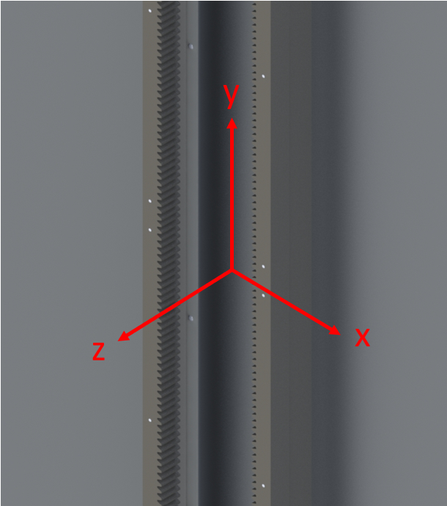
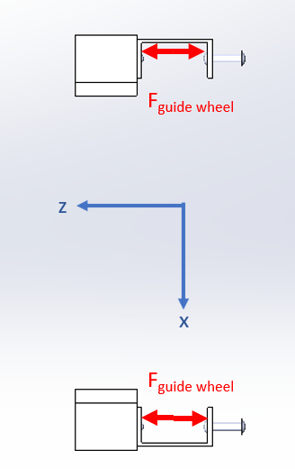
3.4 Rack Mounting
Additional Assumptions
All reaction forces in the x-z plane are through the guiding wheels
Vertical force from pinions acts directly on the centre of the rack
The weight of the rack acts in line with the rivets, each rivets supports one third of each rack of 1506.45 mm
The maximum moment from the pinion force occurs when acting halfway between two rivets 100 mm apart, as pinion force can act at any vertical point
Failure due to shear load on rivets
Greater force from pinions exerted on right rack, therefore, we can analyse it on it’s own to ensure safety factor is met
16

Slide 17
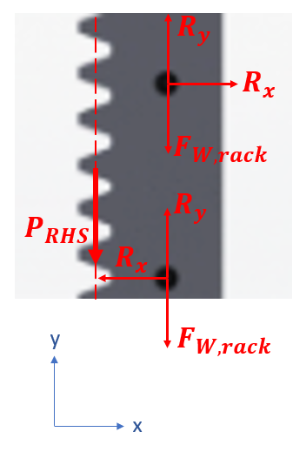
3.4.Rack Mounting
∑F_{y} =0=3*R_{y}-3*F_{w,⅓ rack} -P_{RHS}
F_{w,⅓ rack}=44 kg/m *0.50215 m * 9.81 m/s²
P_{RHS}=1265.09 N
Thus R_{y}=637.5167 N
∑M_{@centre of rivets} =0=(41*R_{y})-2*(50*R_{x})
R_{x}=518.6869 N
R_{max}=√R_{x}² +R_{y}² =821.8659 N
Given that failure will occur in the rivets due to shear stress first, with a diameter of 6 mm,
𝜏=R_{max}/A_{rivet}=821.8659/𝜋*0.003²=29.068 MPa
Given the material is Alloy Steel, is has an Ultimate Shear Strength (USS) of 542.85 MPa, the resulting safety factor is 18.29
17

Slide 18
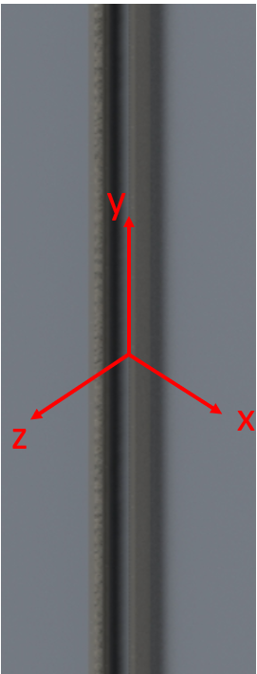
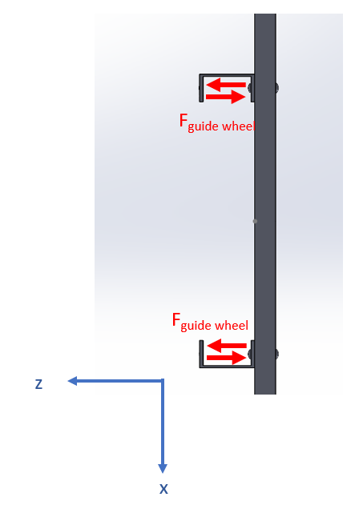
3.5 Vertical channel beam mounting
Additional Assumptions
Fasteners from channel beam to wall spaced 1 m apart, analysis to be done on length to include guide wheel forces
A single metre of vertical channel beam may support entire forces of the platform, masses of mounting material and the cargo.
Failure due to shear load on fasteners
Greater force from pinions exerted on right rack, therefore, we can analyse right side alone to ensure safety factor is met
18

Slide 19
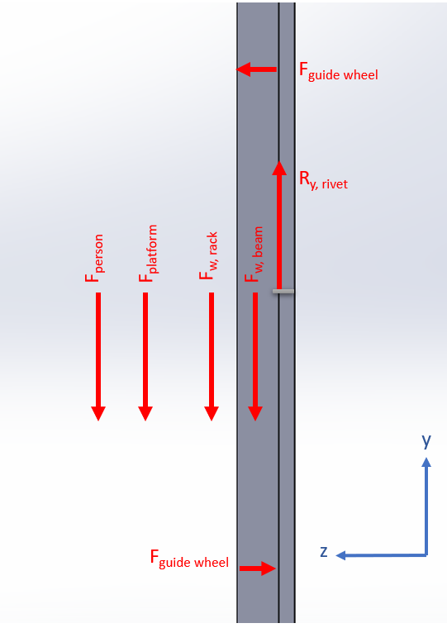
3.5 Vertical channel beam mounting
Analysis of 1 m RHS, as it experience most load
∑F_{y} =0=R_{y}-F_{w, rack} -F_{w, beam}-F _{platform}-F_{person}
F_{w,rack}=44 kg/m *1 m * 9.81 m/s²
F_{w,beam}=8.33 kg/m *1 m * 9.81 m/s²
F_{platform}=1265.09 N
F_{person}=120 kg*0.5*9.81 m/s²
Thus R_{y}=2367.0473 N
Given that failure will occur in the rivets due to shear stress first, with a diameter of 10 mm,
𝜏=R_{y}/A_{rivet}=2367.0473/𝜋*0.005²=30.138 MPa
Given the material is Alloy Steel, is has an Ultimate Shear Strength (USS) of 542.85 MPa, the resulting safety factor is 18.01
19

Slide 20
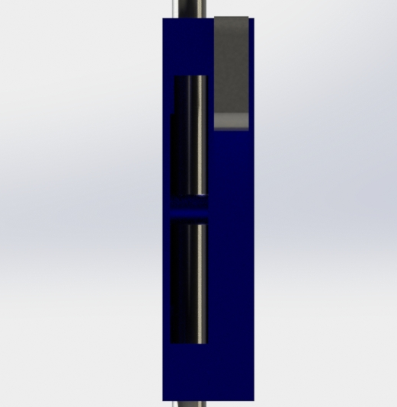
3.6 Safety Brace Beam
In order to calculate the strength of the safety case, it is reasonable to choose the beam that supports the braking mechanism, since this component is most likely to fail. We assume that the entire load is transferred to this beam and that the mass of the beam and brake that rest on beam is negligible, due to their small size and thus, small weight.
Selection of material is alloy steel:
S_{y}=620.4MPa, S’_{n} = 0.5S_{y}=310.2MPa
S_{n}=S’_{n}C_{L}C_{G}C_{S}C_{T}C_{R}
S_{n}=310.2*1*0.9*0.9*1*1 = 251.26MPa
σ_{ea}= σ_{b} = 68.3MPa
σ_{em} = σ_{a}/2 + sqrt(𝜏²+(σ_{a}/2)²) = 19.5MPa
Goodman Diagram lines:
y=68.3/19.5*n
y=-251.26/620.4*n + 251.26
Solving for n and y:
n=64.3MPa
y=225MPa
SF = 64.3/19.5=225/68.3 = 3.3
Thus the beam will not fail under the load.
F_{N} = m_{load}*a_{load}
F_{N}= 100kg*9.81m/s² = 981N
L_{beam} = 14mm = 0.014m
d = 8mm
∑F_{y} = 0:
-F_{N}+½ F_{R}+½ F_{R}=0
F_{R}=F_{N}=981N
M =F_{N}*L/4 = 981*0.014/4 = 3.43Nm
σ_{a}= F/A = 981/(𝛑*(8)²/4) = 19.5 MPa
σ_{b}= Mc/I = 32M/(𝛑d³), for small, solid cylindrical beam
σ_{b}=32*3.43/(𝛑*0.008³) = 68.3MPa
𝜏 = Tr/J = 0MPa, since no torque
½ F_{R}
½ F_{R}
F_{N}
y
x
20

Slide 21
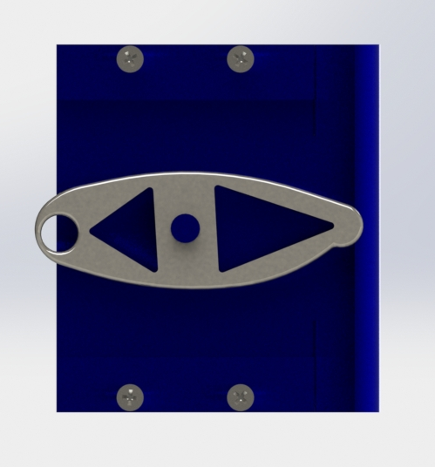
3.8 Safety Brace Brake
In order to calculate the stress on the beam, assume the beam has a solid square cross-section and forces act through central line of beam. Also assume weight of brake is negligible due to small mass.
Selection of material is alloy steel:
S_{y}=620.4MPa, S’_{n} = 0.5S_{y}=310.2MPa
S_{n}=S’_{n}C_{L}C_{G}C_{S}C_{T}C_{R}
S_{n}=310.2*1*0.9*0.9*1*1 = 251.26MPa
Plate with central hole Axial Graph:
d/b = 8/40 = 0.2, K_{t,a}=2.45
Bending Graph:
d/b = 0.2, d/h = 10/10 =1, K_{t,b}=1.9
σ_{ea}= σ_{b}*K_{t,b}= 69.9MPa
σ_{em} = (σ_{a}/2 + sqrt(𝜏²+(σ_{a}/2)²))*K_{t,a} = 7.52MPa
Goodman Diagram lines:
y=69.9/7.52*n
y=-251.26/620.4*n + 251.26
Solving for n and y:
n=25.8MPa
y=240MPa
SF = 25.8/7.52=240/69.9 = 3.43
Thus the brake will not fail under the load.
F_{N} = m_{load}*a_{load}
F_{N}= 100kg*9.81m/s² = 981N
L_{beam} = 80mm = 0.080m
To utilise the stress concentration table:
b=40mm
h=10mm
d= 8mm
∑F_{y} = 0:
-F_{N}+½ F_{R}+½ F_{R}=0
F_{R}=F_{N}=981N
M =F_{N}*L/4 = 981*80/4 = 19620Nmm
σ_{a}= F/((b-d)h) = 981/((40-8)*10) = 3.07MPa
σ_{b}= Mc/I = 6M/((b-d)h²)
σ_{b}=19260*6/((0.04-0.008)*0.01² = 36.8MPa
𝜏 = Tr/J = 0MPa, since no torque
½ F_{R}
½ F_{R}
F_{N}
y
z
21

Slide 22
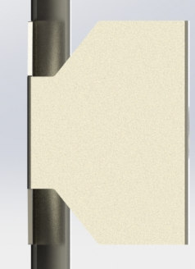
3.9 Cable Mounting Bracket
Assume for analysis that all of the load is transferred to the smaller areas of the bracket, since these parts are likely to fail first. Also, neglect weight of bracket due to minimal mass.
Note, that there are 2 mounting brackets, thus, assume each bracket shares load equally.
F_{N} = ½ *m_{load}*a_{load}
F_{N}= ½ *100kg*9.81m/s² = 490.5N
L_{beam} = 5mm = 0.005m
∑F_{y} = 0:
-F_{N}+ F_{R}= 0
F_{R}= F_{N}= 490.5N
∑M = 0: M - F_{N}*0.005 = 0
M = 2.4525Nm
σ_{a}= F/A = 490.5/(1*25) = 19.62MPa
σ_{b}= Mc/I, I = hb³/12 and c = ½ b, where b=25mm, h=1mm
σ_{b}=2.4525*0.0125/(1.3*10⁻⁹) = 30.66MPa
𝜏 = Tr/J = 0MPa, since no torque
Selection of material is alloy steel:
S_{y}=620.4MPa, S’_{n} = 0.5S_{y}=310.2MPa
S_{n}=S’_{n}C_{L}C_{G}C_{S}C_{T}C_{R}
S_{n}=310.2*1*0.9*0.9*1*1 = 251.26MPa
σ_{ea}= σ_{b} = 30.66MPa
σ_{em} = σ_{a}/2 + sqrt(𝜏²+(σ_{a}/2)²) = 19.62MPa
Goodman Diagram lines:
y=30.66/19.62*n
y=-251.26/620.4*n + 251.26
Solving for n and y:
n=127.7MPa
y=199.5MPa
SF = 127.7/19.62=199.5/30.66 = 6.5
Thus the bracket will not fail under the load.
F_{N}
F_{R}
y
z
22

Slide 23
4 Design Analysis Framework
Analysis | Major component | Type of failure | Subject to total force in N (estimated for worst case) | Memo (candidate material, estimated safety factor…)
1 | Base | Bending | 1402.83 N | 1060 Alloy Steel SF=7.97
2 | Guide Arms | Yielding and buckling | 1255.98 N | 1060 Alloy Aluminum, SF₁= 15.796, SF₂=4.3
3 | Shaft A | Bending at fillet | 126.73 N 240.345 Nm | Pure tungsten SF = 1.91
4 | Shaft B | Bending at fillet | 2276.72 N | Cast Alloy Steel, SF = 4.20
5 | Rack mounting | Shear failure in fasteners | 821.8659 N | Alloy steel SF>18
6 | Vertical channel beam mounting | Shear failure in fasteners | 2367.0473 N | Alloy steel, SF>18
7 | Safety Mechanism Beam | Yielding due to compression | 981 N | Alloy Steel, SF = 3.3
8 | Safety Mechanism Brake | Yielding due to compression | 981 N | Alloy Steel, SF = 3.43
9 | Cable Mounting Bracket | Shear failure due to compression | 490.5 N | Alloy Steel, SF = 6.5
23

