Slide 1




TEAM 21 - Preliminary Submission 2022
Jason Abi Chebli
Faisal Ibrahim M Almaslukh
Ryan Hartshorne
Mahdir Shafin Hasan

Slide 2
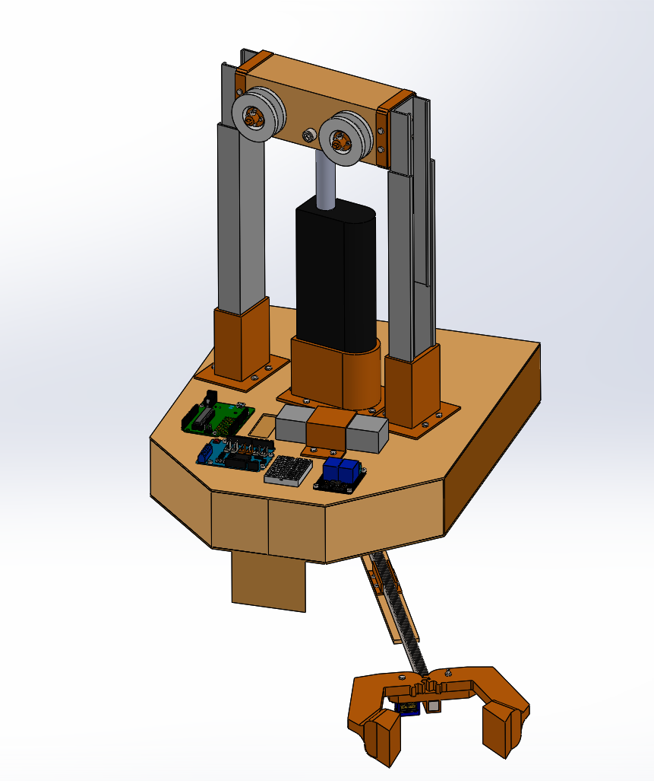
Executive Summary
Through partnering with like-minded engineers, the team is able to design and build a prototype of a transporter system for the client. The project has a timeline of 7 weeks to design, prototype and build and is budgeted to cost between $200 and $240.
This report presents and analyses the conceptualisation, design and development of a feasible system that is able to successfully collect and deposit a package across a chasm using a wire. The team was able to break down and define the problem using the OFFERS methodology. Potential sub-problems were then identified. Afterwards, a diverging solution generation process was adopted to generate potential alternatives to functions.
From that, members were able to choose a unique set of alternatives to generate their own unique design - depicted with an isometric drawing. The composite criterion method was used to decide on one final design, with Concept 1 (illustrated in Figure 1) being the winner. The ideas in concept 1 were further illustrated and enhanced using both isometric and orthogonal concept drawings. From this, a final Solidworks CAD of the whole system at the different phases of the task was completed.
Figure 1. Final Recommended Concept CAD Design.

Slide 3
Table of Contents
Content
Slide No.
i. Executive Summary 2
Introduction 4
Problem Definition
Objectives 5
Functions 7
Factors 8
Effects 13
Requirements and Specifications 14
Sub-problems 16
Creative Solution Generation 17
Isometric Concept Sketches
Isometric Concept Sketch 1 19
Isometric Concept Sketch 2 20
Isometric Concept Sketch 3 21
Isometric Concept Sketch 4 22
Isometric Concept Sketch 5 23
Decision Making
Composite Criterion Method 24
Statistical Significance 29
Recommended Concept Sketches 30
CAD Images
Phase 1 34
Phase 2 37
Phase 3 40
Phase 4 45
Phase 5 48
Conclusion 51
References 52
Content
Slide No.

Slide 4
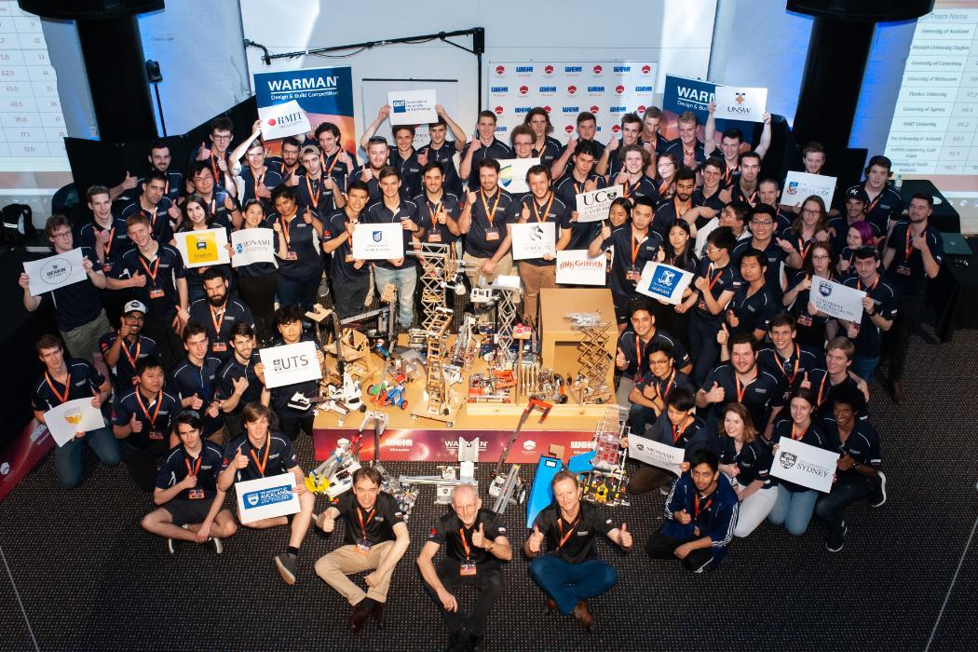
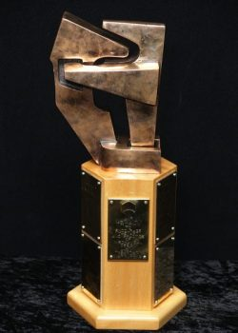
Introduction
The Warman Competition has been known for more than 3 decades. It has provided fabulous learning experiences among undergraduate engineering students within Australia and New Zealand. The competition is undertaken in two levels where students can compete among other students at the same university. Once there is a team winner in that university, the team is able to compete nationally amongst different universities. While this competition is centered in mechanical engineering, students from various streams and disciplines will undertake the same competition in order to refine their engineering skills.
The main focus of this competition is to encourage engineers to design a prototype that will solve a problem outlined by the Weir-Warman Competition [1]. Projects have been posed and varied over the past 30 years. However, the intention is to challenge engineering students who are in their second year to be able to build not only their technical skills, but also their communication skills as they work collaboratively as a team.
Students will collaborate in order to address an open problem with limited resources to create and deliver an innovative solution to meet what the client wants. They will come up with a scaled-down prototype of a transporter system that can be built, designed and implemented in order to pick up a package and move it from a warehouse to the deposit zone without coming in contact with the chasm zone. Once that is done, the autonomous system must return to the start zone within 120 seconds [2].
Figure 2. Warman Design and Building Competition 2018 [3].
Figure 3. The Warman Trophy [4].

Slide 5
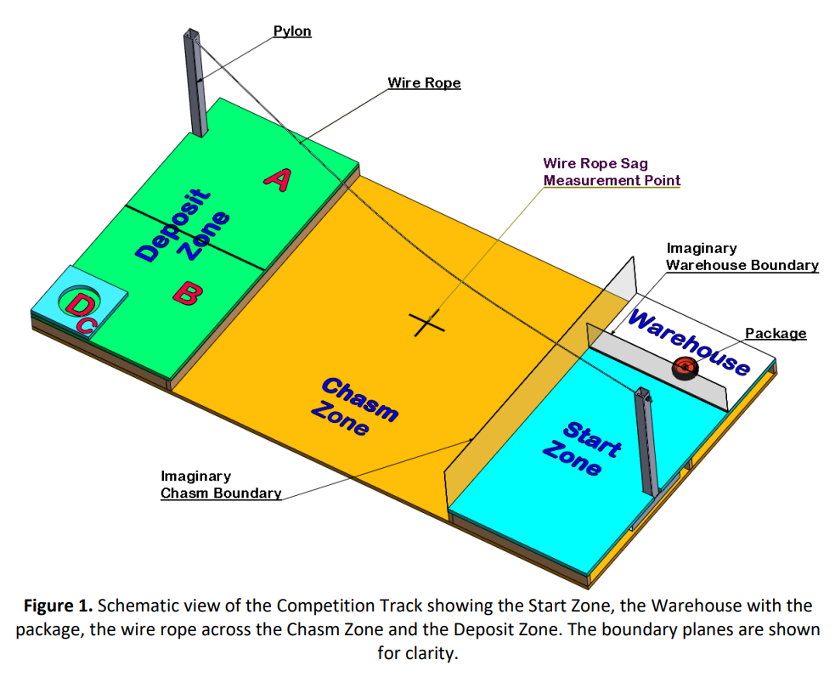
Objectives
“Build a scaled prototype system capable of transporting a package over a chasm zone to the designated delivery region in the fastest time possible, whilst achieving the team’s personal learning goals.”
Figure 4. Schematic view of the Competition Track showing the Start Zone, the Warehouse with the package, the wire rope across the Chasm Zone and the Deposit Zone. The boundary planes are shown for clarity [2].

Slide 6
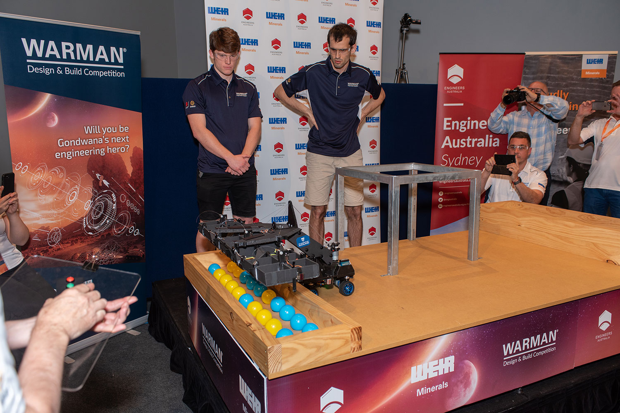
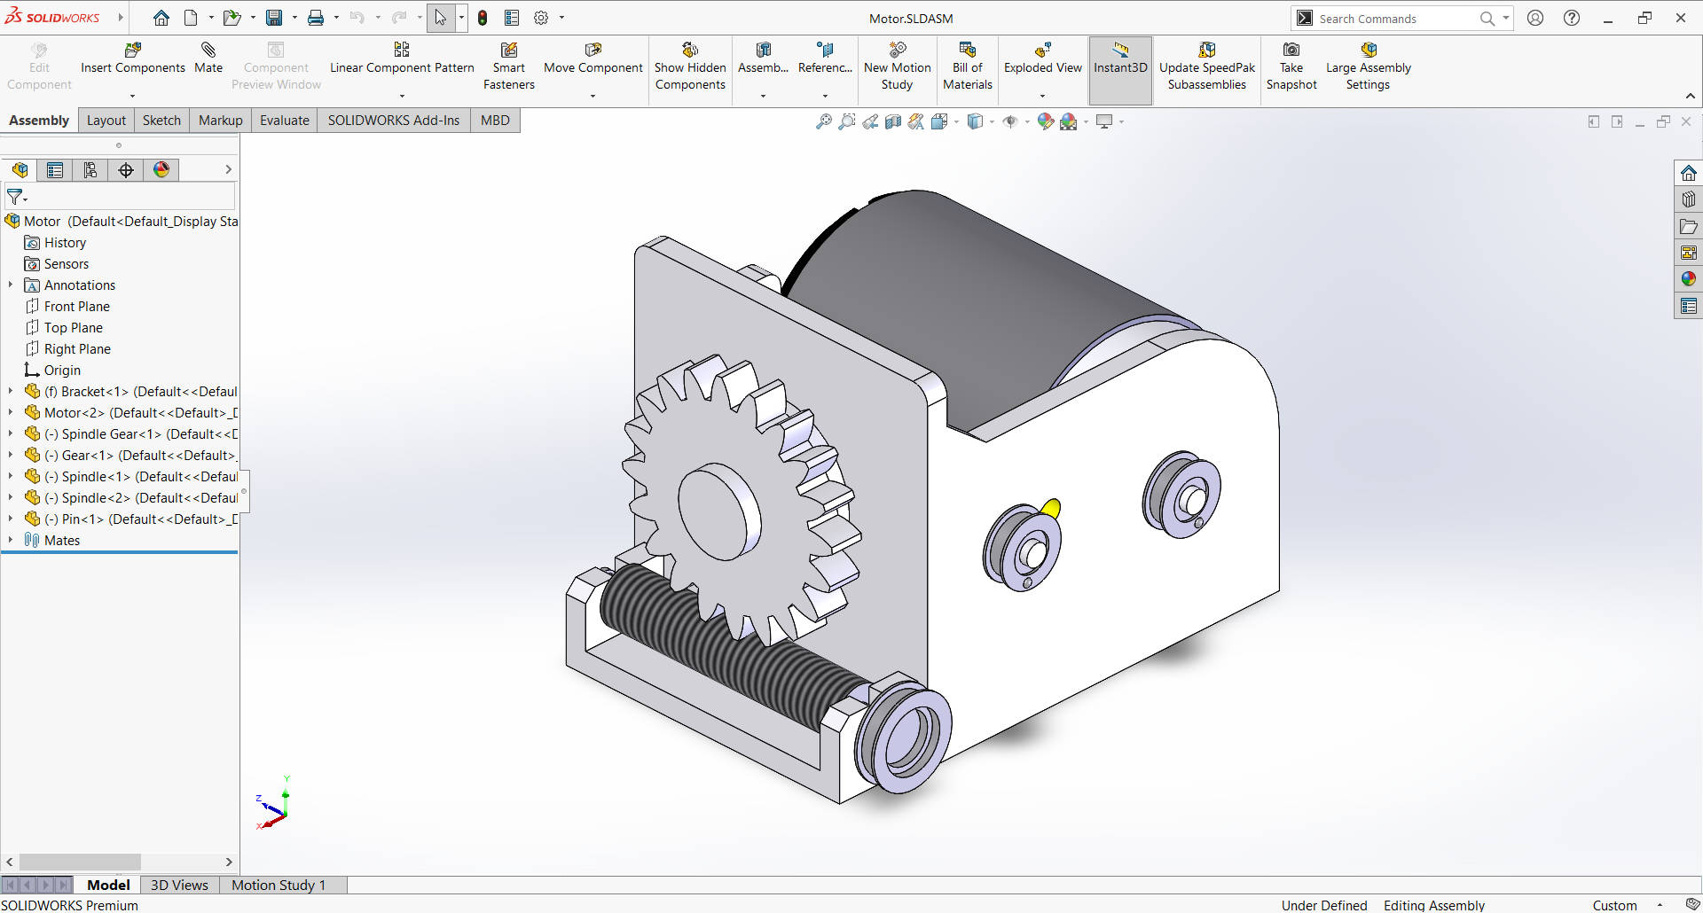
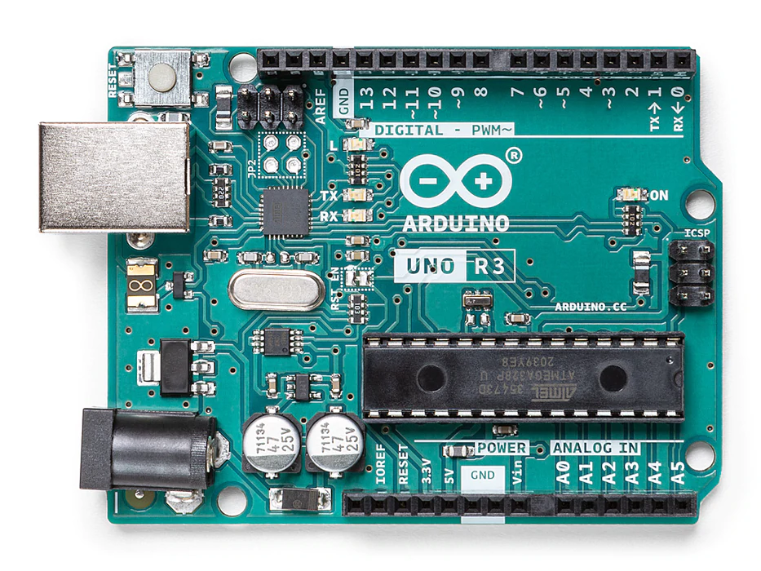
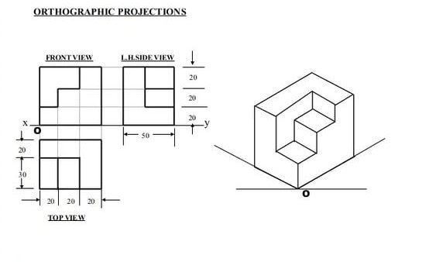
Objectives
The team’s main objective is to win the 2022 Warman Competition. The team aims to build the fastest system to deliver the package from the warehouse to the delivery zone and return to the start zone whilst achieving the highest score possible.
Figure 5. Warman Design and Building Competition 2019 Winners [5].
Whilst going through the engineering process to create our solution, we aim to learn design and manufacturing techniques such as CAD and 3D printing, become familiar with different mechanisms hands on like a rack and pinion system, and learn more about electrical systems through Arduino programming and circuitry setup.
Figure 6. Solidworks (CAD) Part Design [6].
Figure 7. Arduino Uno Rev3 [7].
The team would also like to learn more about the creative solution generation and the engineering design process. This could also include improving our communication skills through the practice of isometric and orthogonal drawings to convey our solutions. Most importantly, the team would like to improve their collaboration skills by working together to complete these ambitious objectives.
Figure 8. Orthographic Projection [8].

Slide 7
Functions
Convert Energy to Work to Traverse on the Ground
Convert Energy to Work to Traverse along the Wire
Start System
Signal Commencing
Traverse Across Start Zone
Position System (for chasm transversal)
Traverse across the chasm (to the deposit zone)
Traverse Across Deposit Zone
Position System (for chasm transversal)
Traverse across the chasm (to the start zone)
Signal Completion
Package not collected
Package not deposited
Setup System
Remove System
Position System (for collection)
Collect Package
Position System (for package disposal)
Deposit Package
Convert Energy to Work to Collect
Convert Energy to Work to Deposit
Store Energy
Input
Energy
Key:
Optional Function
Pre-Start Action
Required Function
Recharge
Energy
Energy Depleted

Slide 8
Factors: What is Important?
Men / Women / People
In terms of what the team aims to achieve, it has been agreed upon that the final solution should aim to be the quickest and most effective transporter system to be designed, prototyped, built and tested within 7 weeks. In particular the team wants their system to exceed their client’s expectations. To do so, each teammate has their own special skills and knowledge to bring to the table:
Jason has experience in designing, building and prototyping parts for rovers. He is in his third year of Mechanical engineering, and has finance background knowledge. Also, he has great communication and leadership skills. In addition, he has lots of experience in 3D printing and Solidworks CAD.
Nathan has an aerospace engineering background knowledge and is very good at isometric, orthogonal drawings. However, due to personal matters, he unfortunately discontinued from this unit. Hence, we no longer have this member on our team and as such, we are lacking this experience and knowledge he would have contributed. Furthermore, we are in need of additional human resources, of which Nathan would have provided to the team.
Shafin has experience in building electrical circuits and coding. He is in his third year doing Mechatronics engineering. Shafin has a great mindset, believing no task is too challenging to figure out. While he enjoys coding.
Ryan has experience with software engineering and computer vision. He also has some experience in microcontroller programming and electrical circuits. Ryan is also in his third year doing Mechatronics engineering and is very hard working.
Faisal has a good knowledge in building electrical circuits, coding and AI models/research. Additionally, he has a Mechatronic engineering and finance background. Faisal brings to the team his great teamwork and communication skills. Faisal has good experience with arduino coding.
In terms of the limitations, each team member has their own battle to face outside of university.
Jason works at least 10 hours a week and dedicated at least 15 hours a week to Monash Nova Rover - a student Engineering team..
Shafin is in the activities portfolio at Monash University International Students Services (MUISS) and works at least 15 hours a week
Ryan has a full time job, and he is also a part of an engineering student team, Deep Neuron.
Nathan works at least 20 hours per week. Sometimes he had to travel due to family-related issues. Thus, he was unable to contribute as much as required. As he has discontinued from the unit, this no longer affects the limitations on the team project.
Faisal works at least 10 hours a week. Out of everyone on the team, he lives the furthest away from university. In fact, it takes around an hour and half to get to Monash University.
As a result, of these individual circumstances, it indicates that finding a regular time that suits everyone's busy schedule is difficult. Furthermore, some teammates may not be able to attend or do work on the project during the day and week, while others may struggle to work on it in the evening and weekends. We were lucky to find time for everyone to meet outside of class to work on the project on Thursdays from 4pm to 6pm.

Slide 9
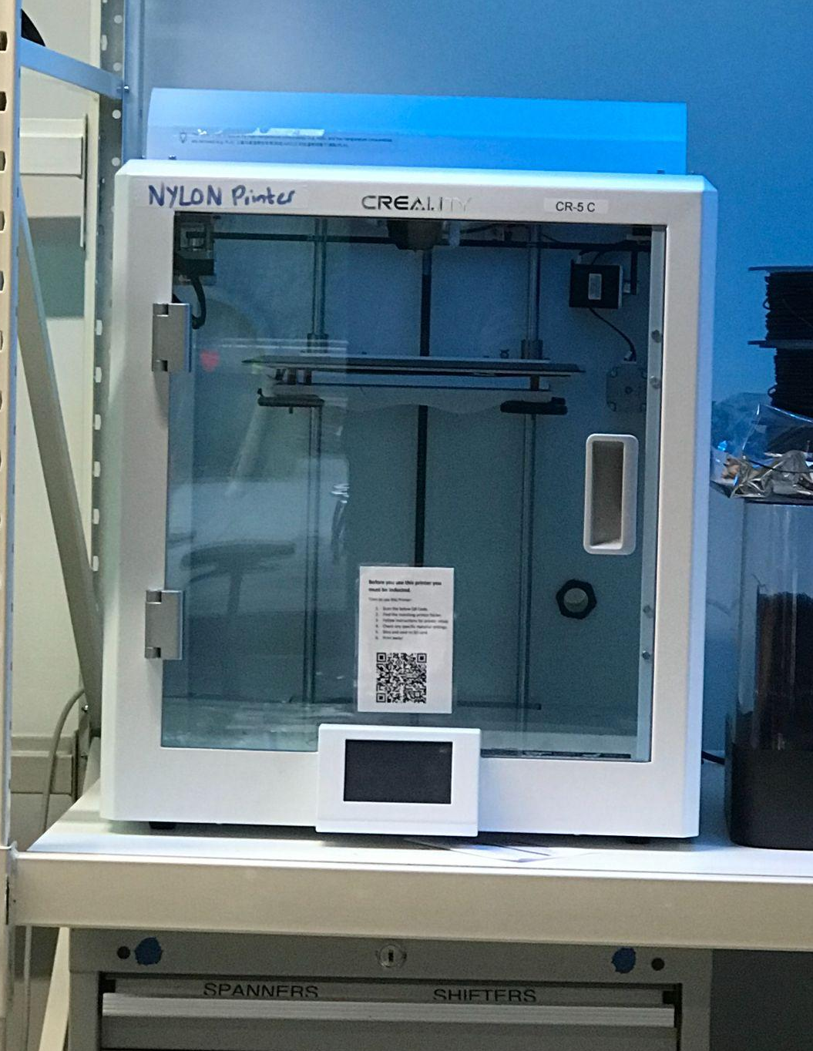
Factors: What is Important?
Methods
The CAD design of the transporter system will be done through SolidWorks to ensure the measurements are concise and appropriate for the competition. Also, the Arduino will be programmed in order to make sure that the transporter system can follow the instructions to move the intended package to the desired zone efficiently. Additionally, the system designed will utilise all the methods listed to maximise our scores across the multiple objectives of the competition.
What skills does each teammate currently possess that would be relevant to the project?
Jason has skills in 3D printing, SolidWorks and design. He has also been inducted to use a drill press. As a result, he is willing to take the lead on tasks that require SolidWorks, 3D printing and is eager to work with the team to build the transporter system. Ryan is skillful at coding. Hence, he feels his skills will be most useful contributing to doing Arduino coding for the transporter system. Additionally, Ryan is excited to work on using SolidWorks to design parts and assemblies. Shafin has skills in electrical circuiting and coding. Hence, he is hoping to contribute to the electrical wiring and components decision making process. Nathan has skills in sketching and drawing. He would prefer to build the transporter system, however, as he has disconnected from the unit, we can no longer utilise the skills be brought to the team. Faisal has skills in electrical circuiting and coding. He has a lot of experiencing building electrical systems and is excited to contribute to the build of the system.
What skills does each teammate need to develop?
Jason needs to develop his Arduino coding and electrical systems building. Ryan needs to develop his 3D printing, CAD skills and electrical systems building. Shafin needs to develop his CAD skills, 3D printing and strengthen his knowledge of motors and actuators and building more of his Arduino skills. Nathan needed to develop his CAD skills and 3D printing. Faisal needs to develop his CAD skills, 3D printing, strengthening his knowledge of motors and actuators.
Figure 11. Creality 3D printer.

Slide 10
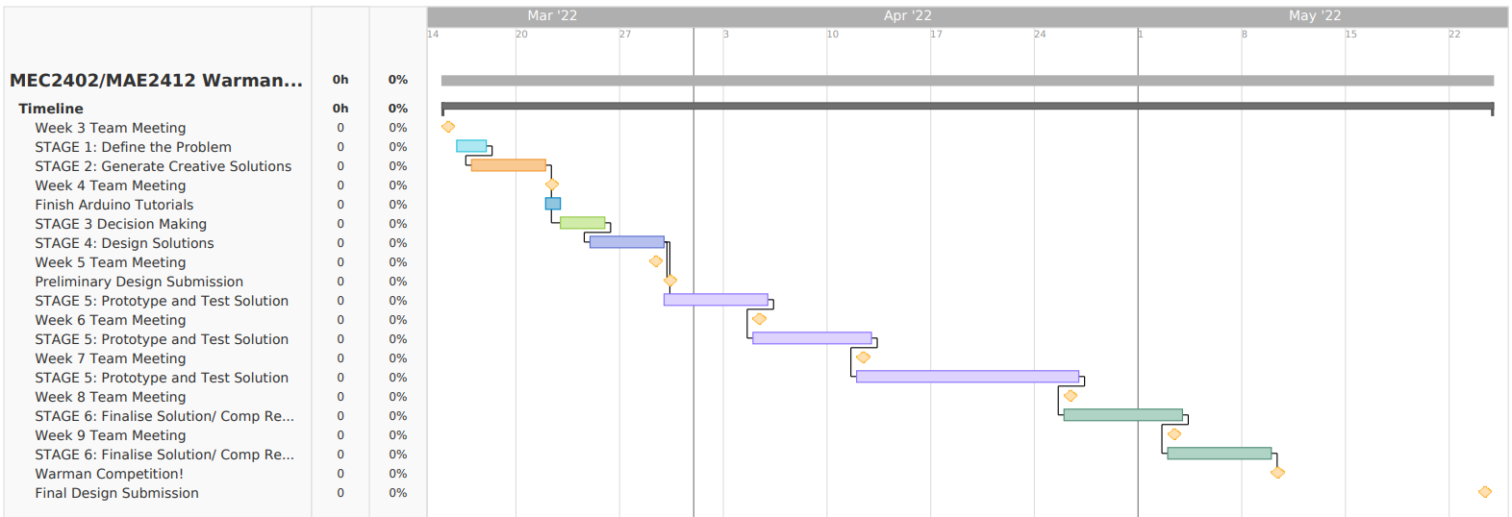
Factors: What is Important?
Minutes
The transporter system will be designed and tested to collect the package and deliver it to the deposit zone, after which, it will return to the start zone all within 2 minutes.
In terms of the team’s timeline, the team created a gantt chart (which can be seen in Figure 9) to help keep track of the major tasks and deadlines. Furthermore, Trello is going to be utilised to help manage and allocate smaller and more specific tasks for different phases of the project. Once the design of the system is complete, between weeks 5 and 7 the team will start testing and prototyping subassemblies of the transporter system. Then, during the Easter break, the team will finalise the build and assemble the whole transporter system. In weeks 8 and 9, testing for the whole system will commence and the aim would be to try to make sure everything integrated into the system is working effectively. Hence, by week 10, the team will perform any final checks of the transporter system before the competition.
As each teammate has work outside of university, they are willing to put 7 hours a week outside of class and meetings to work on the project.
Regarding availability of teammates, it is difficult to get everyone at one place during the week due to different degrees classes clash, people working, and some living far away from university. However, an agreed upon whole team meeting is planned for every thursday and teammates are willing to work on weekends to make sure the deadlines are met.
Figure 12. The teams gantt chart that manages the timeline of the project and deadline.

Slide 11
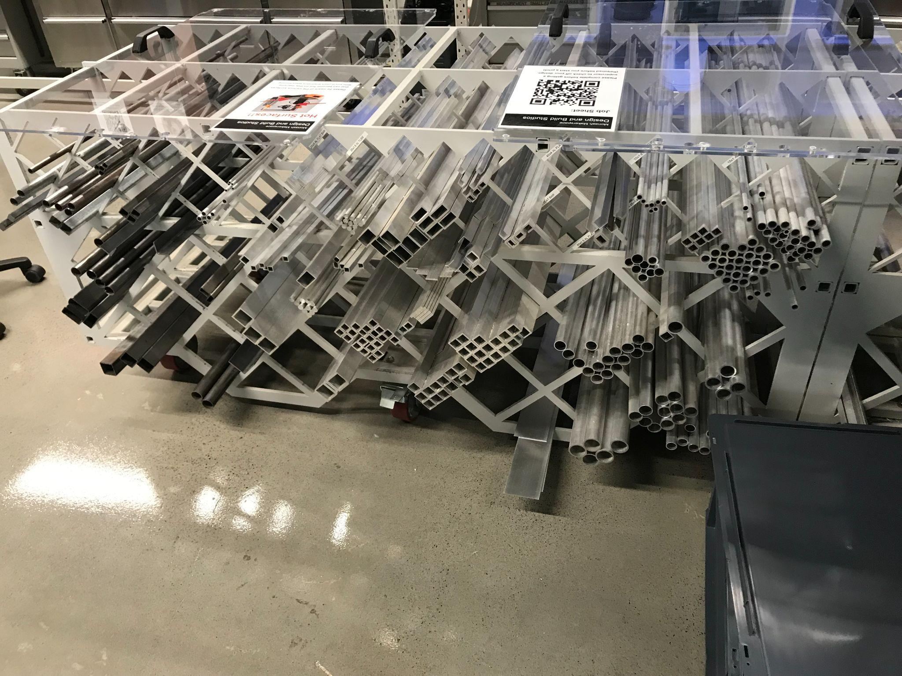
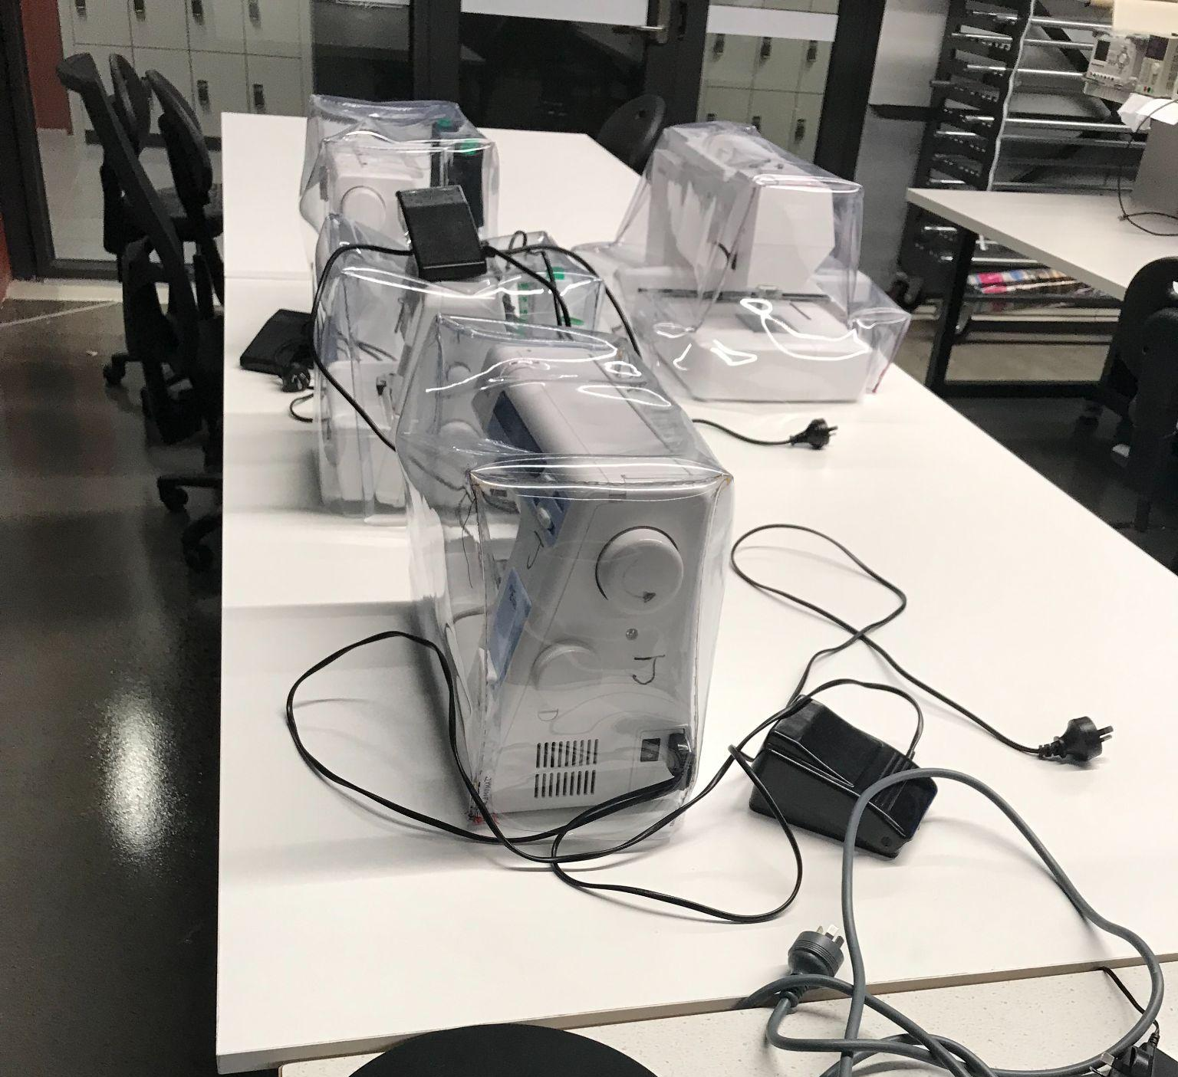
Factors: What is Important?
Materials:
The chosen materials should be easily recycled and non-toxic. Also, they should not be heavy unless essential as there is a weight limit on the system and also because heavier materials might deform the wire permanently. Therefore, the team aims to use materials that are reusable, have good strength (high elastic coefficient) but are light in order to attach to the wire safely and effectively to deliver the package.
The available materials are:
Bolts, Washers, Nuts, 3D printing filament, Square and Circular Hollow sections
Wood
Sheet metal
Electrical components (kits)
Li-Po Battery
The materials that the team is going to buy are:
Motors - i.e. Servos, DC’s, Steppers as well as motor mounts
Actuators - i.e. Hydraulic, Pneumatic
Electrical Parts - i.e. Relay boards
Shaft Couplers
Fuses
Plastic wheel gearbox
Pulleys
Adhesive grip
The team aims to limit themselves to materials that can be found in in-person stores. These include stores such as Jaycar, United Fasteners, Bunnings, Mitre-10 and Marker Store. If necessary, they may purchase some components from online stores that often have a quick delivery system such as Core Electronics.
Money:
In terms of how the team proposes and approves purchases, Ryan has been nominated to do all the payments. However, before he purchases anything, it needs to be run through by the group and everyone needs to pay before purchasing the intended items. This is possible as prices of items can be found online. In particular, all payments will be done via bank transfer. Bank details of the payee (Ryan) is provided to the whole team. Due to modern technology, bank transfers are often instant.
The team has decided that the chosen materials and components should cost less than $50 per person. However, if the team needs slightly more, every member of the team is willing to contribute an additional $10 to cover this. Hence, originally, the budget was $250 - $300. However, due to one of the team members discontinuing the unit, the budget has subsequently been decreased to accommodate for this, now ranging from $200 - $240.
Figure 13. Sewing machine.
Figure 14. Square and circular hollow sections.

Slide 12

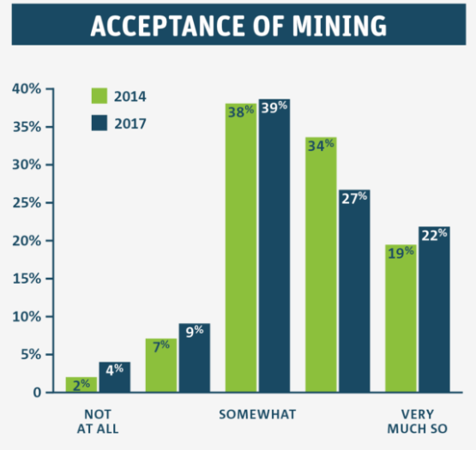
Effects
The solution encourages healthy competition between teams of students and motivate them to showcase their individual capabilities as well as utilise and take advantage of the materials and resources provided by the university. This in return, would have a positive impact within the engineering community.
The solution also creates and encourages competition between teams from different universities and as a result, promotes established rivalries between universities as they compete to be the victor of the competition. This could potentially interest other students to take part in future Warman competitions.
This solution is intended to be used in the mining industry, one of the largest and most controversial sectors in Australia [10]. As shown in Figure 16, the number of people opposed to mining has doubled between 2014 to 2017, however there is only a slight increase in the number of people who are accommodating to the idea of mining natural resources.
The solution may encourage and inspire competitors and firms within the engineering industry to also conceptualize effective transport systems, which would lead to more advanced future transporting machinery.
The solution does not prove to be environmentally friendly as the majority, if not all, of the materials used in the final development of the transport system are not recyclable and therefore may contribute to pollution.
Figure 15. Figure of the team winning [9].
Figure 16. Cartoon of global impact. [10].

Slide 13
Requirements and Specifications
Requirements | Criteria | Weight | Specification
Performance Operation time | Completion time of the whole operation in seconds. | 12 | <120 seconds.
Performance Setup time | Device setup time in seconds. | 5 | <120 seconds.
Performance Control of Package | Collects and moves the package outside of the warehouse. | 1 | Distance of package from warehouse > 0mm and package is within start zone.
Performance Support the package | Systems should support the package and keep it on top of the surface of the track. | 1 | The chance (%) system will unintentionally drop the package outside the deposit zone.
Performance Transport system | Entire system and package moves entirely across the chasm into the deposit zone. | 2 | Must move from the start zone to the deposit zone.
Performance Deposit package | Package dropped in one of the deposit zones A, B, C or D. | 10 | Six scores are achievable [2], the highest being a score of 100 and the lowest being a score of 20. The score is deposit zone dependant.

Slide 14
Requirements and Specifications
Requirements | Criteria | Weight | Specification
Performance Return system | Total displacement of the system from the start zone in millimeters. | 2 | 0 millimeter.
Performance System mass | Mass of the system in kg. | 5 | <6kg.
Performance Easy to use | Single action start. | 5 | Single input activation.
Aesthetic | Focus group - judged. | N/A | N/A.
Safety | G2 to G6 of the competition rules [2]. | 3 | Must comply.
Cheap | Cost to make per robot in A$. | 10 | <A$240.

Slide 15
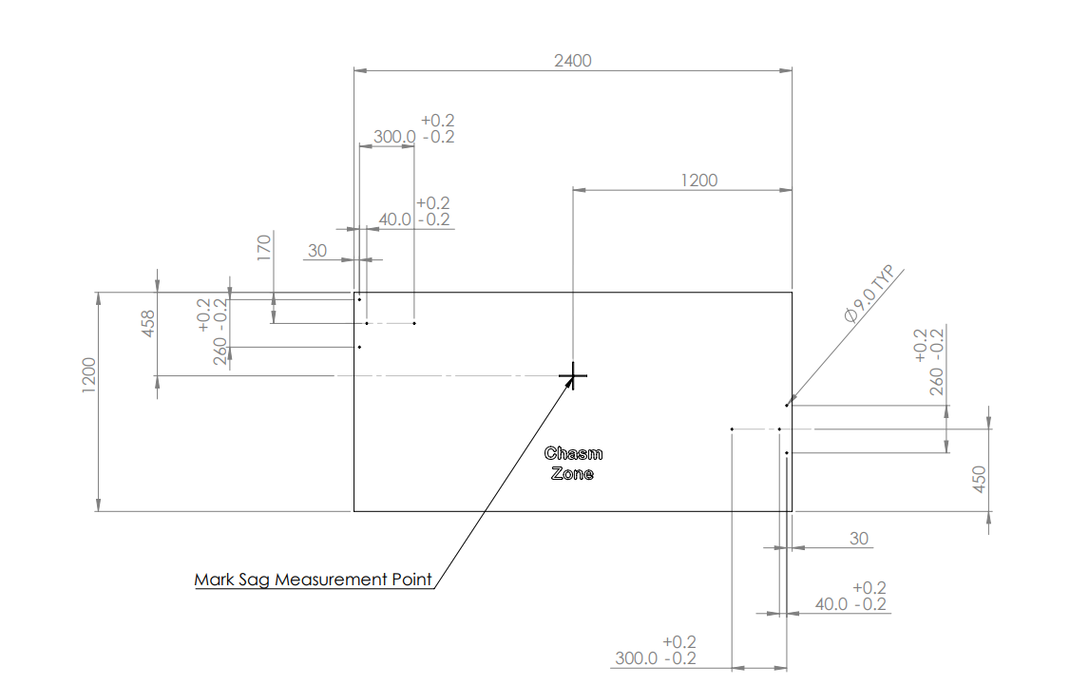
Sub-Problems
If the system is not able to collect the package properly, how is the team going to make sure that the package does not fall out? How do we know that the package is fully supported?
If the system is not able to deposit the package in zone D, what would be the next feasible alternative that the team would be happy with?
What happens if there is too much momentum when the system is traversing using the wire? How is it going to stabilise itself when crossing?
What if the track is set up slightly differently from the track use in the trial runs due to tolerance shown in Figure 17 of measurements. Is the system designed to accommodate for the tolerancing?
If the system is malfunctioning during competition what will the team do? Will it let the system run or interfere to prevent potential damage to the system?
What will the team do if the materials used starts damaging the wire? How is the team going to figure out a different solution?
What precautionary measures can be taken to avoid fire hazards caused by the battery and other electrical components?
Figure 17. 2022 Warman Competition Track Base [11].

Slide 16
Creative Solution Generation
Functions left out:
Setup System
Start System
Starting the system
Remove System
Signal Commencing
Signal Completion
Signalling
Convert Energy to Work to Traverse on the Ground
Store Energy
Recharge
Energy
Input
Energy
Provide Energy for tasks
Convert Energy to Work to Traverse along the Wire
Position System (for collection)
Position System (for chasm traversal)
Position System (for package disposal)
Position System (for chasm traversal)
Grouping
Correlated
Functions:
System positioning and navigation
Convert Energy to Work to Collect
Traverse Across Start Zone
Traverse Across Deposit Zone
System transfer across the ground
Convert Energy to Work to Deposit
Collect Package
Package retrieval
Deposit Package
Note: The functions left out were seen as inappropriate for this process. The ‘Setup System’ and ‘Remove System’ functions are done before and after the task is complete, while we are focusing on only functions that occur during the task. Additionally, the four converting energy functions were left out as more than one alternative would be used, making it inappropriate as we would not be able to decide on one specific alternative. Options included DC motor, Servo Motors, Stepper Motors, Hydraulic Actuators, Pneumatic Actuators and Springs.
Depositing package
Traverse across the chasm (to the deposit zone)
Traverse across the chasm (to the start zone)
System Transfer across the chasm

Slide 17
Creative Solution Generation
Morphology Table | Alternatives
Functions | A | B | C | D | E
Starting the System | Button. | Switch. | Timer. | Voice Command. | Proximity sensor.
Signalling | LED Lights: A Green LED is displayed when it starts and is working. A red LED is display for when the task is complete. | System makes certain noises/speaks when task is completed and/or finished. | Visible Timer that starts counting when the task starts and stops counting and blinks the time when task is complete. | It does not signal. The system could simply start and finish the task without signalling this.
Provide Energy for tasks | Electrical Energy: using a Li-Po battery. | Pneumatic Potential Energy: using compressed gas canisters to power the system. | Gravitational Potential Energy. | Solar Energy: using Solar panels to provide energy to the system.
System Positioning and Navigation | Pre Programmed timer. | Ultrasonic Sensors (distance sensors). | Limit Switches. | RGB colour sensors. | In-built GPS.
System Transfer across the Ground | System with wheels. | System with legs. | System with Tank Tracks. | System does not move along the ground at all. | System utilizes a sled mechanism.
Package Retrieval | Robotic arm with fingers tightens grip, holding the package. | Large scoop mechanism scoops the package from underneath. | Claw mechanism utilises a claw, retractable rope and a crane to pick up the package. | Magnetic force that will turn on when position to attract and hold the package. | A suction mechanism (such as suction cups) is applied to clasp onto the package.
Depositing Package | Robotic arm with fingers loosens grip, dropping the package. | A trap door mechanism will open when the system is over the desired deposit location. | Claw mechanism utilises a claw, retractable rope and a crane to drop the package in the right location. | A rack and pinion system will deliver the package and release it into the desired location. | A conveyor belt mechanism that sticks out is used to release the package in the desired location.
System Transfer across the Chasm | Motorised pulleys that will slot in and utilise the wire to traverse the chasm. | Hooking onto the wire and building momentum (using weights) to swing across it. | A two arm mechanism whereby both arms hook onto and utilise the wire. One arm clasps the wire while other proceeds forward. | Utilising a telescopic bridge that will extend over and cross with the system to the otherside. Does not utilise the wire.

Slide 18
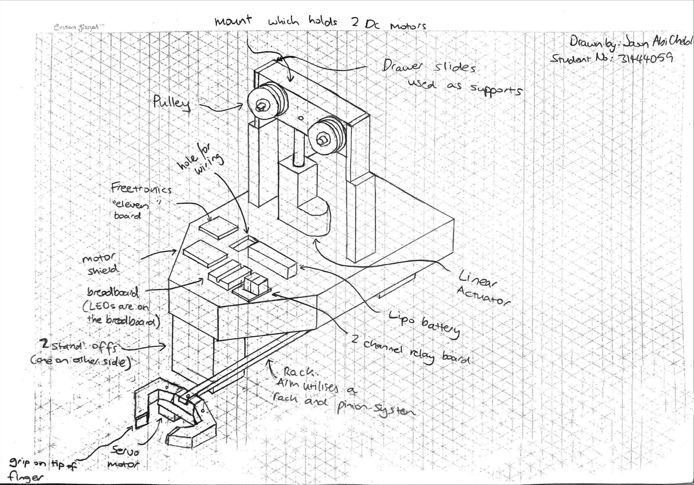
Isometric Concept Sketch 1
Concept: Button / LED lights / Battery / Pre-programmed timer / Does not transverse along the ground / Robotic Arm (for package retrieval) / Robotic Arm (for depositing package) / Motorised Pulley

Slide 19
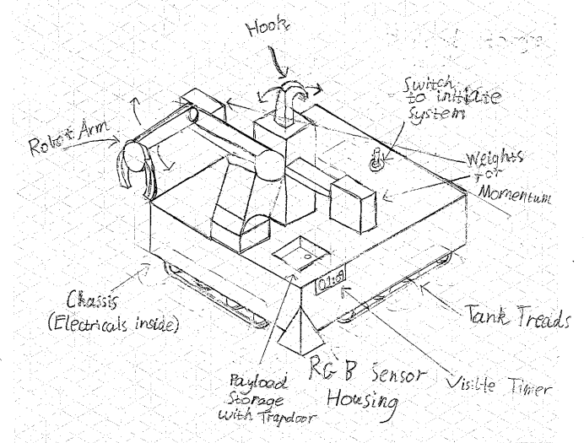
Isometric Concept Sketch 2
Concept: Timer to start / Visible Timer for progress / Electrical Energy / RGB Colour Sensors / Tank Tracks / Robotic Arm with fingers / Delivering Package via Trapdoor Mechanism / Traverse Wire by Hooking onto it and using weights to give the system momentum.
Ryan Hartshorne
30492165

Slide 20
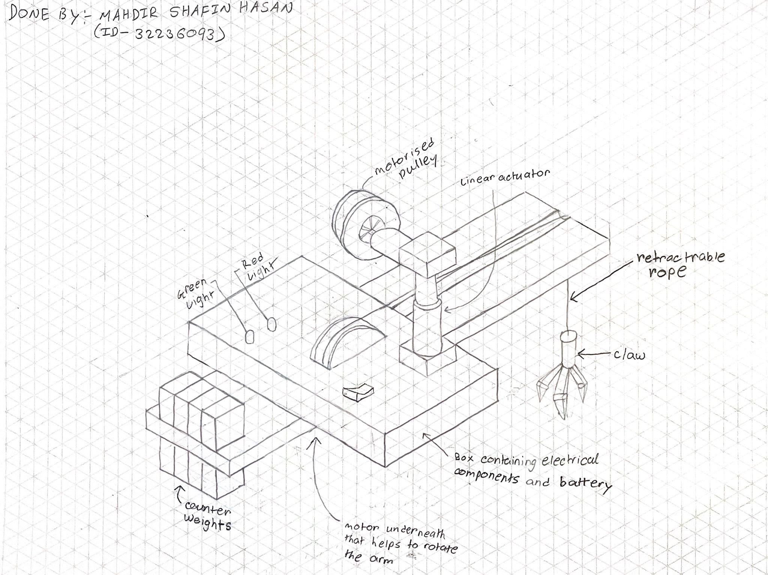
Isometric Concept Sketch 3
Concept: Switch / LED Lights / Battery / Preprogrammed timer / System does not move along the ground at all / Claw mechanism (to retrieve the package) / Claw mechanism (to deposit the package) / Motorised Pulley

Slide 21
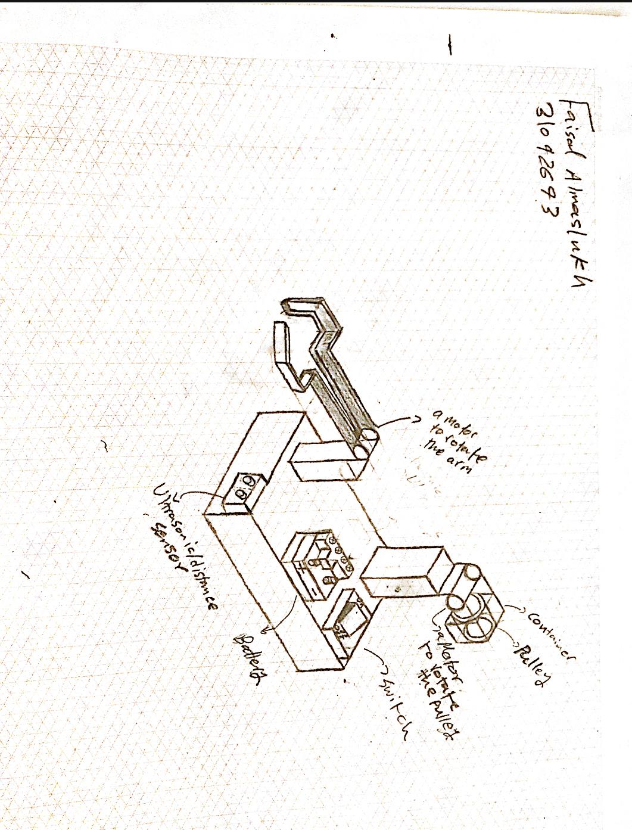
Isometric Concept Sketch 4
Concept: Switch/ No signal / Battery / Ultrasonic sensor / Does not move along the ground / Robotic Arm (for package retrieval) / Robotic Arm (for depositing package) / Motorised Pulley

Slide 22
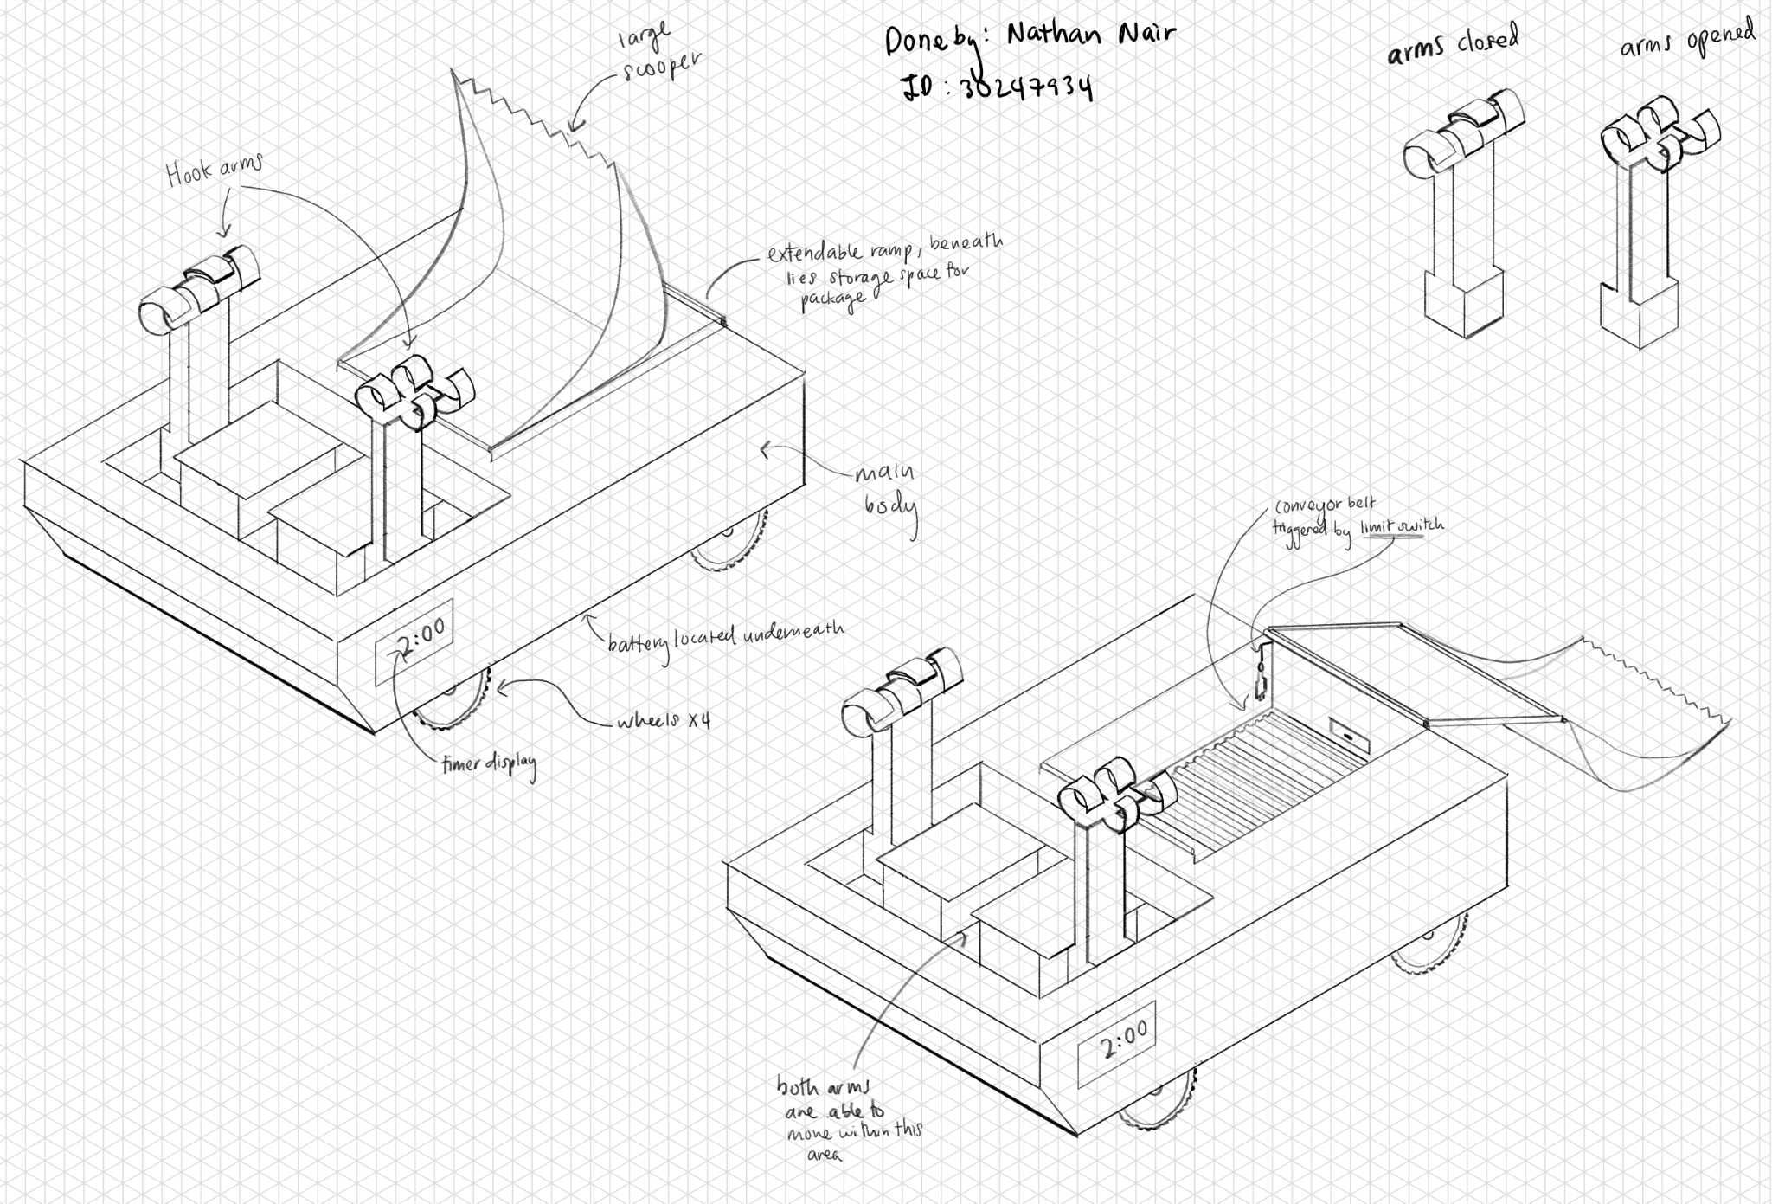
Isometric Concept Sketch 5
Concept: Timer / Visible Timer / Battery / Limit Switches / System with Wheels / Large Scoop Mechanism to Scoop Package / Conveyor Belt to Deposit Package / Two Arm Mechanism to Hook and Pull

Slide 23
Decision Making |  |  |  | Concept 1
Requirements | Criteria | Weight | Specification | Magnitude | Non-Dimensional Score (/10) | Score x Weighting
Performance Operation time | Completion time of the whole operation in seconds. | 12 | <120 seconds | 70 | 4 | 48
Performance Setup time | Device setup time in seconds. | 5 | <120 seconds | 60 | 5 | 50
Performance Control of Package | Collects and moves the package outside of the warehouse. | 1 | Distance of package from warehouse > 0mm and package is within start zone. | TRUE | 10 | 10
Performance Support the package | Systems should support the package and keep it on top of the surface of the track. | 1 | The chance (%) system will unintentionally drop the package outside the deposit zone. | 0% | 10 | 10
Performance Transport system | Entire system and package moves entirely across the chasm into the deposit zone. | 2 | Must move from the start zone to the deposit zone. | TRUE | 10 | 20
Performance Deposit package | Package dropped in one of the deposit zones A, B, C or D. | 10 | Six scores are achievable [2], the highest being a score of 100 and the lowest being a score of 20. The score is deposit zone dependant. | 100 | 10 | 100
Performance Return system | Total displacement of the system from the start zone in millimeters. | 2 | 0 millimeter | TRUE | 10 | 20
Performance System mass | Mass of the system in kg. | 5 | <6kg | 3.5 | 4 | 20
Performance Easy to use | Single action start. | 5 | Single input activation. | TRUE | 10 | 50
Aesthetic | Focus group - judged. | N/A | N/A | N/A | 8 | N/A
Safety | G2 to G6 of the competition rules [2]. | 3 | Must comply | TRUE | 10 | 30
Cheap | Cost to make per robot in A$. | 10 | <A$240 | 200 | 3 | 30
Composite Score |  |  |  |  |  | 388

Slide 24
Decision Making |  |  |  | Concept 2
Requirements | Criteria | Weight | Specification | Magnitude | Non-Dimensional Score (/10) | Score x Weighting
Performance Operation time | Completion time of the whole operation in seconds. | 12 | <120 seconds | 100 | 2 | 24
Performance Setup time | Device setup time in seconds. | 5 | <120 seconds | 60 | 5 | 25
Performance Control of Package | Collects and moves the package outside of the warehouse. | 1 | Distance of package from warehouse > 0mm and package is within start zone. | TRUE | 10 | 10
Performance Support the package | Systems should support the package and keep it on top of the surface of the track. | 1 | The chance (%) system will unintentionally drop the package outside the deposit zone. | 40% | 6 | 6
Performance Transport system | Entire system and package moves entirely across the chasm into the deposit zone. | 2 | Must move from the start zone to the deposit zone. | TRUE | 10 | 20
Performance Deposit package | Package dropped in one of the deposit zones A, B, C or D. | 10 | Six scores are achievable [2], the highest being a score of 100 and the lowest being a score of 20. The score is deposit zone dependant. | 100 | 10 | 100
Performance Return system | Total displacement of the system from the start zone in millimeters. | 2 | 0 millimeter | TRUE | 10 | 20
Performance System mass | Mass of the system in kg. | 5 | <6kg | 5.5 | 1 | 5
Performance Easy to use | Single action start. | 5 | Single input activation. | TRUE | 10 | 50
Aesthetic | Focus group - judged. | N/A | N/A | N/A | 9 | N/A
Safety | G2 to G6 of the competition rules [2]. | 3 | Must comply | TRUE | 10 | 30
Cheap | Cost to make per robot in A$. | 10 | <A$240 | 250 | 2 | 20
Composite Score |  |  |  |  |  | 310

Slide 25
Decision Making |  |  |  | Concept 3
Requirements | Criteria | Weight | Specification | Magnitude | Non-Dimensional Score (/10) | Score x Weighting
Performance Operation time | Completion time of the whole operation in seconds. | 12 | <120 seconds | 90 | 3 | 36
Performance Setup time | Device setup time in seconds. | 5 | <120 seconds | 60 | 5 | 25
Performance Control of Package | Collects and moves the package outside of the warehouse. | 1 | Distance of package from warehouse > 0mm and package is within start zone. | TRUE | 10 | 10
Performance Support the package | Systems should support the package and keep it on top of the surface of the track. | 1 | The chance (%) system will unintentionally drop the package outside the deposit zone. | 40% | 6 | 6
Performance Transport system | Entire system and package moves entirely across the chasm into the deposit zone. | 2 | Must move from the start zone to the deposit zone. | TRUE | 10 | 20
Performance Deposit package | Package dropped in one of the deposit zones A, B, C or D. | 10 | Six scores are achievable [2], the highest being a score of 100 and the lowest being a score of 20. The score is deposit zone dependant. | 100 | 10 | 100
Performance Return system | Total displacement of the system from the start zone in millimeters. | 2 | 0 millimeter | TRUE | 10 | 20
Performance System mass | Mass of the system in kg. | 5 | <6kg | 4 | 3 | 15
Performance Easy to use | Single action start. | 5 | Single input activation. | TRUE | 10 | 50
Aesthetic | Focus group - judged. | N/A | N/A | 5 | N/A | N/A
Safety | G2 to G6 of the competition rules [2]. | 3 | Must comply | TRUE | 10 | 30
Cheap | Cost to make per robot in A$. | 10 | <A$240 | 150 | 5 | 50
Composite Score |  |  |  |  |  | 362

Slide 26
Decision Making |  |  |  | Concept 4
Requirements | Criteria | Weight | Specification | Magnitude | Non-Dimensional Score (/10) | Score x Weighting
Performance Operation time | Completion time of the whole operation in seconds. | 12 | <120 seconds | 60 | 5 | 60
Performance Setup time | Device setup time in seconds. | 5 | <120 seconds | 60 | 5 | 25
Performance Control of Package | Collects and moves the package outside of the warehouse. | 1 | Distance of package from warehouse > 0mm and package is within start zone. | TRUE | 10 | 10
Performance Support the package | Systems should support the package and keep it on top of the surface of the track. | 1 | The chance (%) system will unintentionally drop the package outside the deposit zone. | 40% | 6 | 6
Performance Transport system | Entire system and package moves entirely across the chasm into the deposit zone. | 2 | Must move from the start zone to the deposit zone. | TRUE | 10 | 20
Performance Deposit package | Package dropped in one of the deposit zones A, B, C or D. | 10 | Six scores are achievable [2], the highest being a score of 100 and the lowest being a score of 20. The score is deposit zone dependant. | 100 | 10 | 100
Performance Return system | Total displacement of the system from the start zone in millimeters. | 2 | 0 millimeter | TRUE | 10 | 20
Performance System mass | Mass of the system in kg. | 5 | <6kg | 3 | 5 | 25
Performance Easy to use | Single action start. | 5 | Single input activation. | TRUE | 10 | 50
Aesthetic | Focus group - judged. | N/A | N/A | N/A | 6 | N/A
Safety | G2 to G6 of the competition rules [2]. | 3 | Must comply | TRUE | 10 | 30
Cheap | Cost to make per robot in A$. | 10 | <A$240 | 200 | 3 | 30
Composite Score |  |  |  |  |  | 376

Slide 27
Decision Making |  |  |  | Concept 5
Requirements | Criteria | Weight | Specification | Magnitude | Non-Dimensional Score (/10) | Score x Weighting
Performance Operation time | Completion time of the whole operation in seconds. | 12 | <120 seconds | 80 | 3 | 36
Performance Setup time | Device setup time in seconds. | 5 | <120 seconds | 45 | 8 | 40
Performance Control of Package | Collects and moves the package outside of the warehouse. | 1 | Distance of package from warehouse > 0mm and package is within start zone. | TRUE | 10 | 10
Performance Support the package | Systems should support the package and keep it on top of the surface of the track. | 1 | The chance (%) system will unintentionally drop the package outside the deposit zone. | 40% | 6 | 6
Performance Transport system | Entire system and package moves entirely across the chasm into the deposit zone. | 2 | Must move from the start zone to the deposit zone. | TRUE | 10 | 20
Performance Deposit package | Package dropped in one of the deposit zones A, B, C or D. | 10 | Six scores are achievable [2], the highest being a score of 100 and the lowest being a score of 20. The score is deposit zone dependant. | 100 | 10 | 100
Performance Return system | Total displacement of the system from the start zone in millimeters. | 2 | 0 millimeter | TRUE | 10 | 20
Performance System mass | Mass of the system in kg. | 5 | <6kg | 5.5 | 1 | 5
Performance Easy to use | Single action start. | 5 | Single input activation. | TRUE | 10 | 50
Aesthetic | Focus group - judged. | N/A | N/A | N/A | 9 | N/A
Safety | G2 to G6 of the competition rules [2]. | 3 | Must comply | TRUE | 10 | 30
Cheap | Cost to make per robot in A$. | 10 | <A$240 | 250 | 2 | 20
Composite Score |  |  |  |  |  | 337

Slide 28
Decision Making - Statistical Significance
Using the Composite Criterion Method, we are able to come to a conclusion on the best concept for further design and development.
From the method, we were able to rank the concepts, with the order from highest to lowest being: Design 1 (score of 388), Design 4 (score of 376), Design 3 (score of 362), Design 5 (score of 337) and Design 2 (score of 310).
From this, we can see that Designs 1, 4 and 3 all have values quite close to one another, while the score values of Designs 5 and 2 are further away from the rest. To accurately determine whether the ranking is as clear as mentioned, it is best to determine the sensitivity of the decision.
We are able to calculate the sensitivity of the decision as it is equal to the largest weighting (which was 12) multiplied by the incremental score (which was 1/10 or 0.1). Hence, the sensitivity of the decision was 1.2.
Since the sensitivity of the decision is quite small and the score difference between the first best concept (Design 1) and the second (Design 4) is significant (higher by 12 points), it is evident that, when taking the sensitivity into account, Design 1 is the clear winner.
Out of the options listed, Design 1 would have been the concept that the whole team would have chosen as it seems the most simple, practical and effective solution, indicating that our decision making process was effective and that no adjustments should be made to the Criteria, Weightings or Specifications.
When reviewing the scores for each requirement it can be seen that, while Design 1 is not necessarily a lot better at one specific requirement when compared to the other designs, it is better overall. Hence, because it is estimated to be somewhat lighter, cheaper and quicker at completing the tasks than others, it has resulted in it being the best conceptual design.
To conclude, the winning concept was Design 1, which incorporated the unique function alternatives of: a button to start the system, LED lights to indicate when it has started and finished, Li-Po battery to power the system, pre-programmed timer to navigate the track, wheels to traverse across the start and deposit zone, a robotic arm to collect and deposit the package, and a motorised pulley to help the system to traverse across the chasm.
Figure 18. Design 1 decided as the best concept.

Slide 29
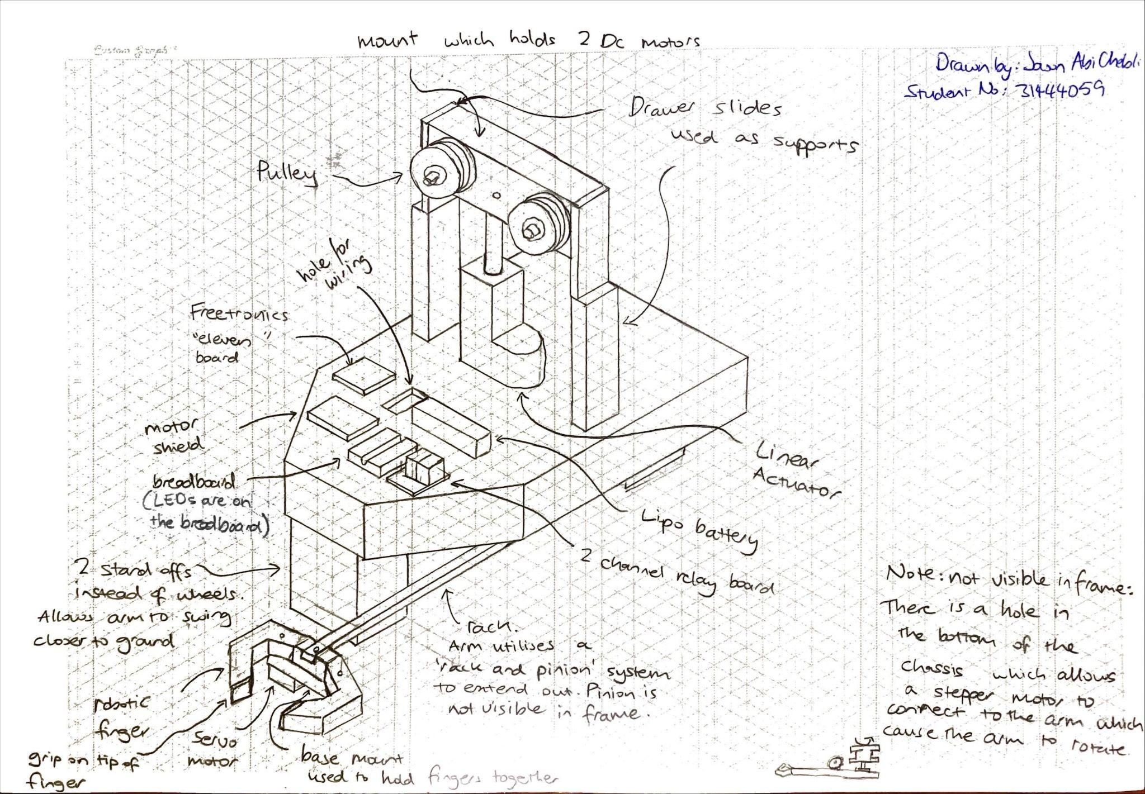
Recommended Concept (Further development):
Concept: Button / LED lights / Battery / Pre-programmed timer / Does not transverse along the ground / Robotic Arm (for package retrieval) / Robotic Arm (for depositing package) / Motorised Pulley
Notes: Isometric Drawing |  | Monash University |  | Team 21
 |  | Warman Device Isometric of recommended concept |  | Scale 1:4 | Date: 28/03/22
 |  |  |  |  | MEC-I1

Slide 30
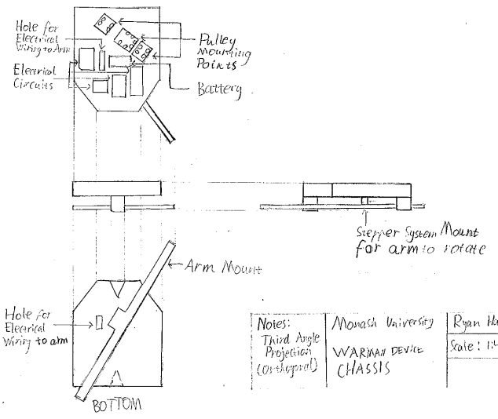
Recommended Concept (Further development):
Concept: Button / LED lights / Battery / Pre-programmed timer / Does not transverse along the ground / Robotic Arm (for package retrieval) / Robotic Arm (for depositing package) / Motorised Pulley
Notes: Third Angle Projection (Orthogonal) |  | Monash University |  | Team 21
 |  | Warman Device Chassis |  | Scale 1:4 | Date: 28/03/22
 |  |  |  |  | MEC-O1

Slide 31
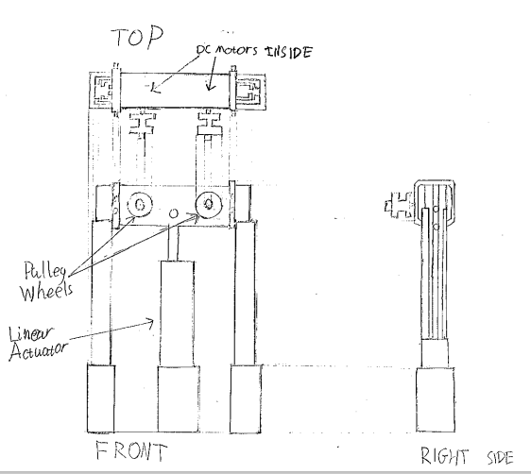
Recommended Concept (Further development):
Concept: Button / LED lights / Battery / Pre-programmed timer / Does not transverse along the ground / Robotic Arm (for package retrieval) / Robotic Arm (for depositing package) / Motorised Pulley
Notes: Third Angle Projection (Orthogonal) |  | Monash University |  | Team 21
 |  | Warman Device Pulley System |  | Scale 1:4 | Date: 28/03/22
 |  |  |  |  | MEC-O2

Slide 32
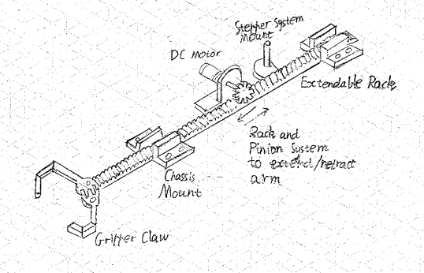
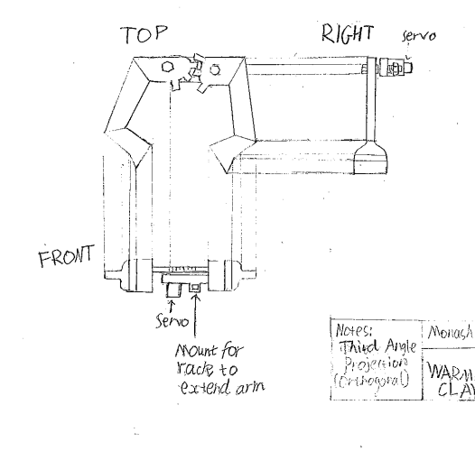
Recommended Concept (Further development):
Concept: Button / LED lights / Battery / Pre-programmed timer / Does not transverse along the ground / Robotic Arm (for package retrieval) / Robotic Arm (for depositing package) / Motorised Pulley
Notes: Isometric Drawing |  | Monash University |  | Team 21
 |  | Warman Device Arm |  | Scale 1:4 | Date: 28/03/22
 |  |  |  |  | MEC-I2
Notes: Third Angle Projection (Orthogonal) |  | Monash University |  | Team 21
 |  | Warman Device Gripper Claw |  | Scale 1:4 | Date: 28/03/22
 |  |  |  |  | MEC-O3

Slide 33
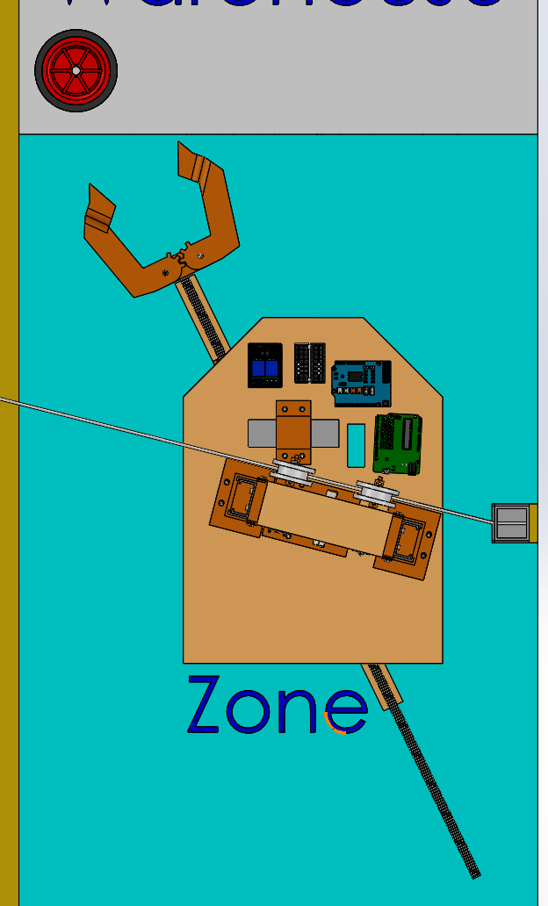
CAD Images (Set-up and ready for start)
PHASE 1
The systems fingers should be near the edge of the start zone and align with the wheel.
The system pulleys should have the cable wiring directly in the centre of it.
The system will start 50mm away from the pylon.

Slide 34
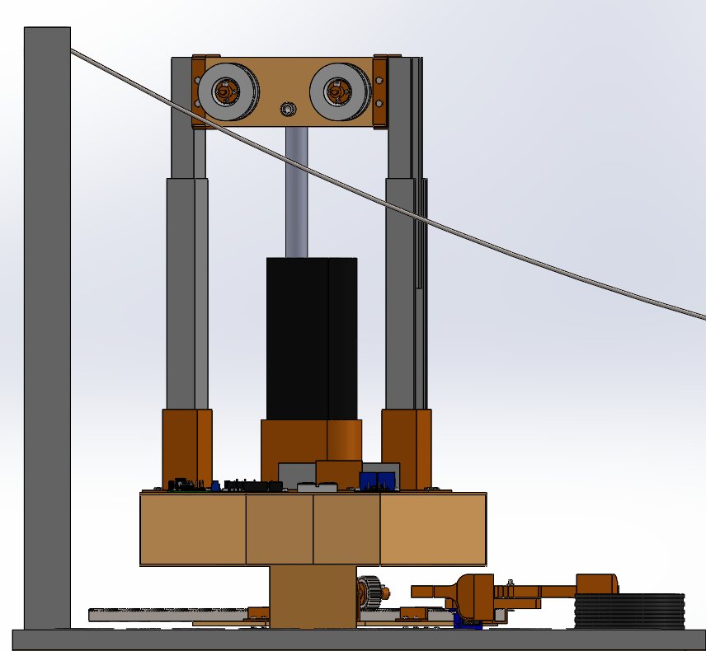
PHASE 1
CAD Images (Set-up and ready for start)
Both pulleys should be set up to be just above the wiring.
The system should start with both stand offs touching the ground.
Drawer slides should be extended as much as possible, in accordance with the linear actuator.

Slide 35
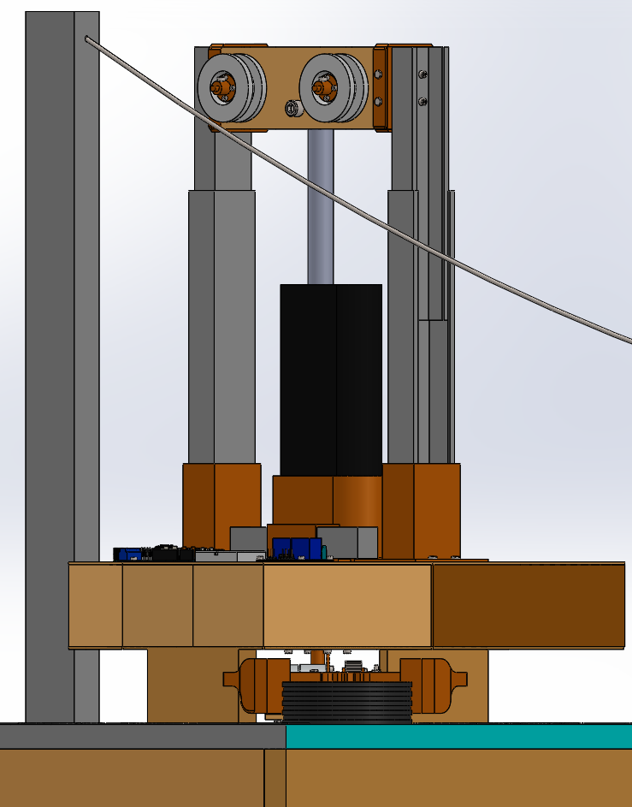
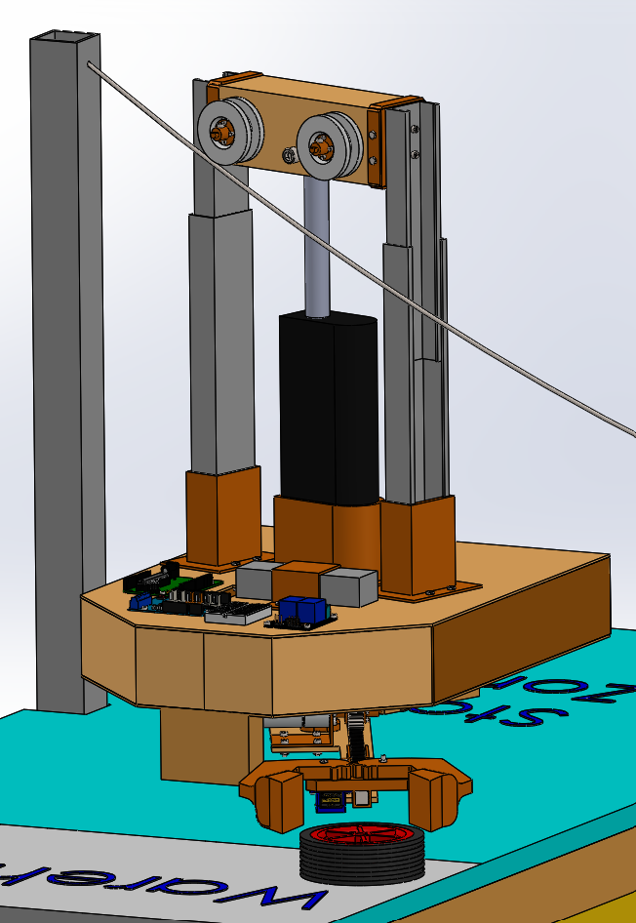
PHASE 1
CAD Images (Set-up and ready for start)
The system utilities a Linear Actuator to lift the system up and down.
The system has two standoffs.
The Fingers should be set/in position for grabbing the package once the task starts.

Slide 36
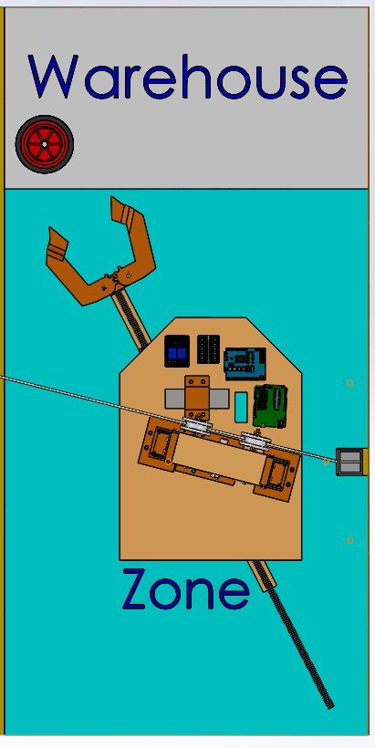
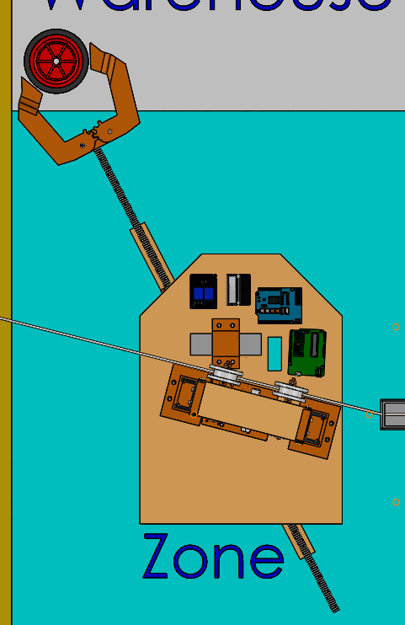

PHASE 2
CAD Images (Collecting Payload)
We can see roughly how much the arm needs to extend to reach the package, from its starting position.
As can be seen from these two images, when the task starts, the arm will extend outwards, far enough to be able to reach the package.

Slide 37
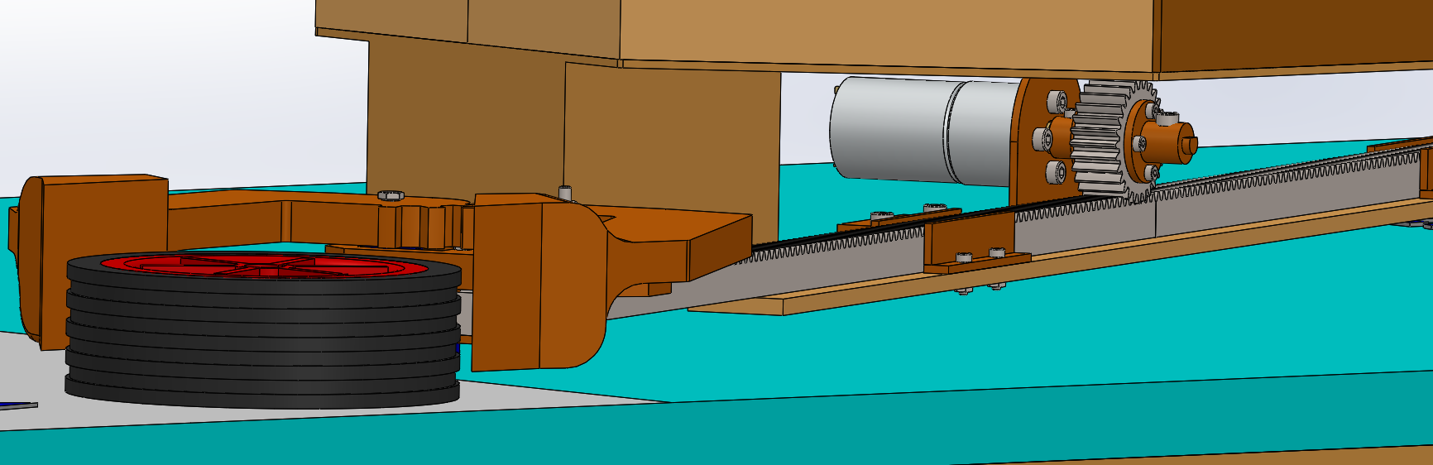
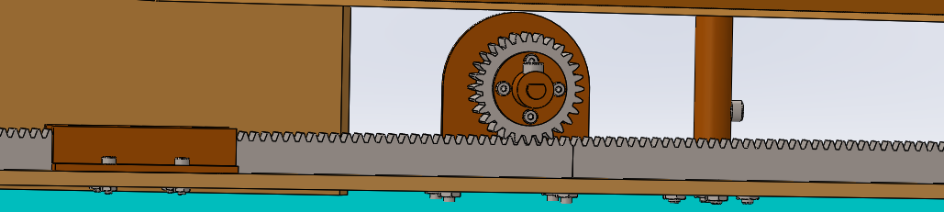
PHASE 2
CAD Images (Collecting Payload)
When the system comes towards the package, there is enough space for clamps to slide on each side.
The Collection method utilises a rack and pinion system to extend the arm out. A motor is connected to the pinion to power it.The fingers of the arm are connected to the end of the rack.
The system has mounted guides to direct and hold the rack in place.

Slide 38
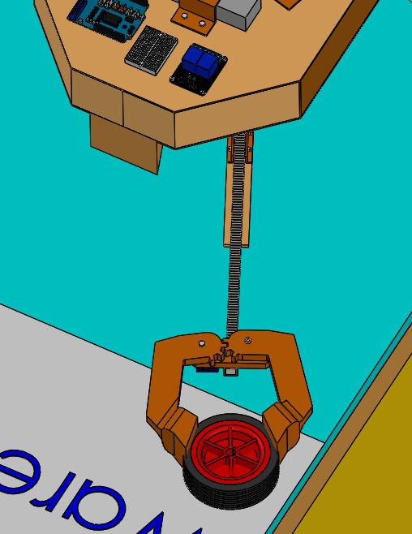
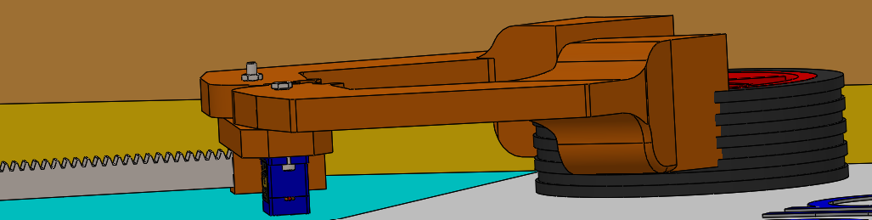
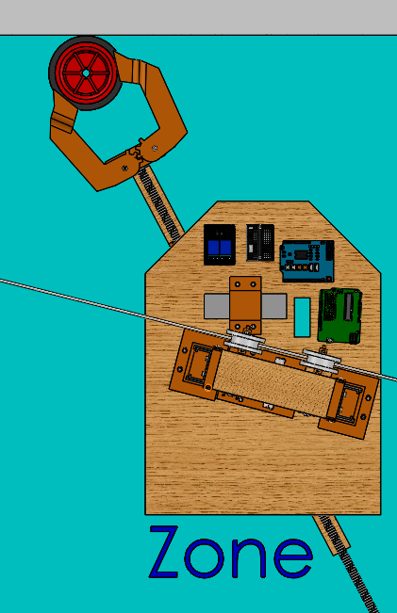
PHASE 2
CAD Images (Collecting Payload)
The system uses a servo motor to spin the gears, which will consequently tighten the clamps.
The clamps are able to grab onto the majority of the package depth.
Gears on each finger.
System retracks the rack and draws the package out of the warehouse and into the deposit zone.

Slide 39
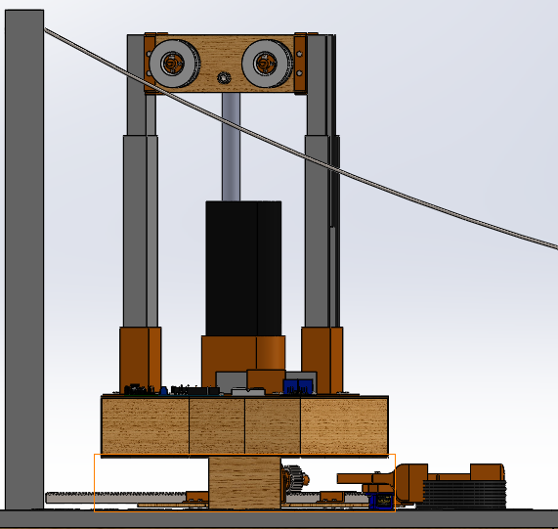
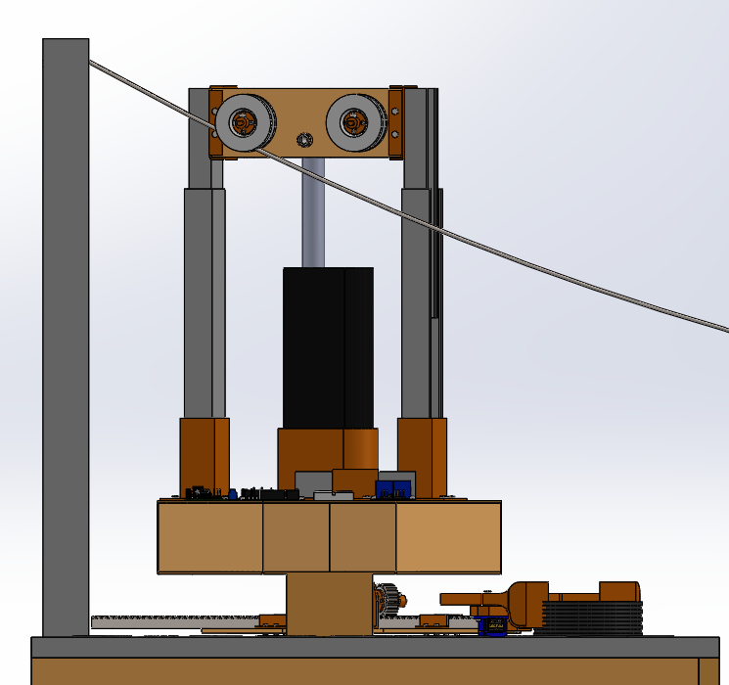
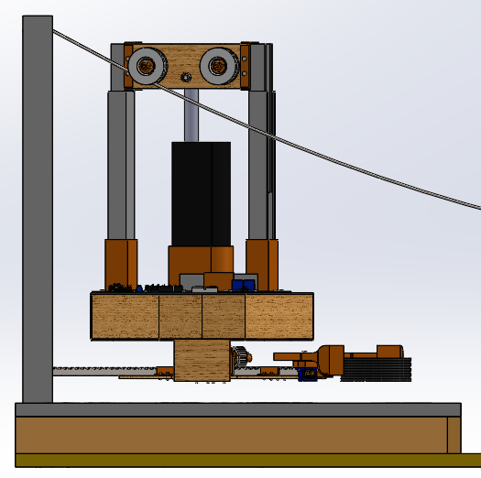
PHASE 3
CAD Images (Traversing Chasm)
Once the system has the package, the linear actuator will retract until the system is solely dependent on the wire.
The linear actuator will keep retracting until the whole system is off the ground.
The arm and package lift with it.

Slide 40
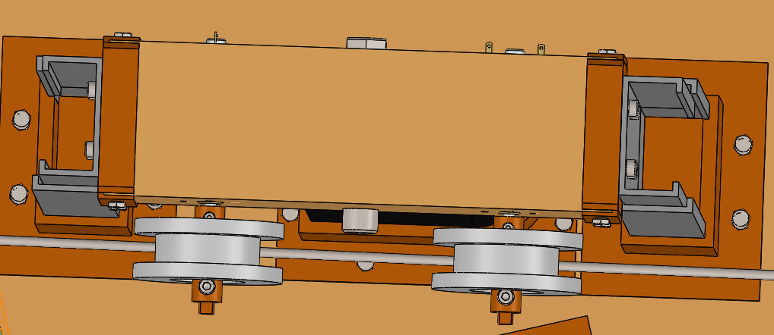
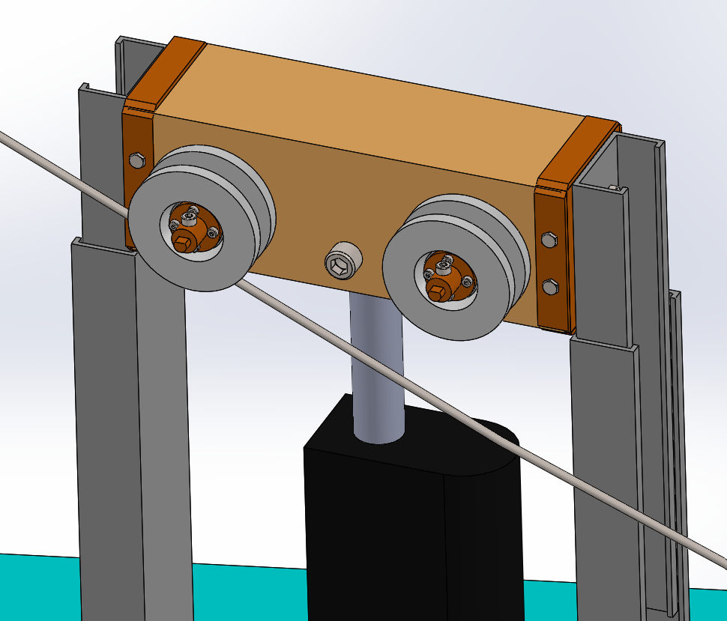
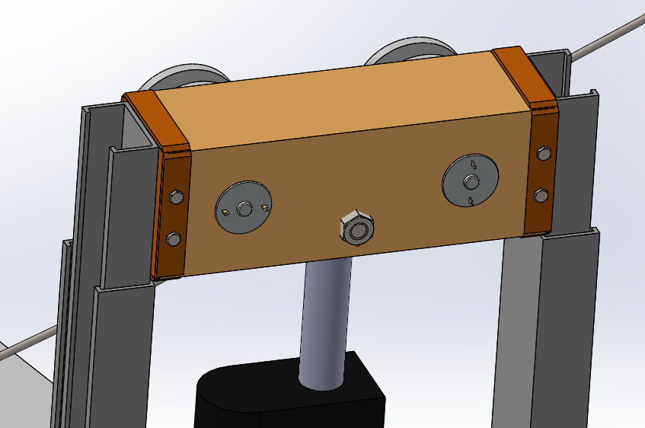
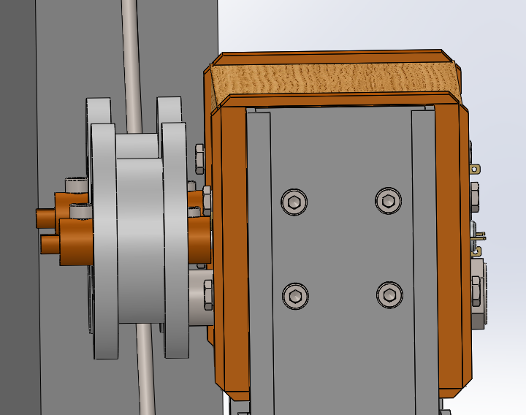
PHASE 3
CAD Images (Traversing Chasm)
Mount for drawers slides to connect to wooden motor mount. Drawer slides are added for stability.
3D printed mount to connect the motor’s rotation to the pulley.
DC Motors mounted into this top piece.
Linear Actuator mounts from underneath by slotting in and then bolting on.
Pulleys. They will have adhesive grip on it to get enough grip with the wire that fits underneath.

Slide 41
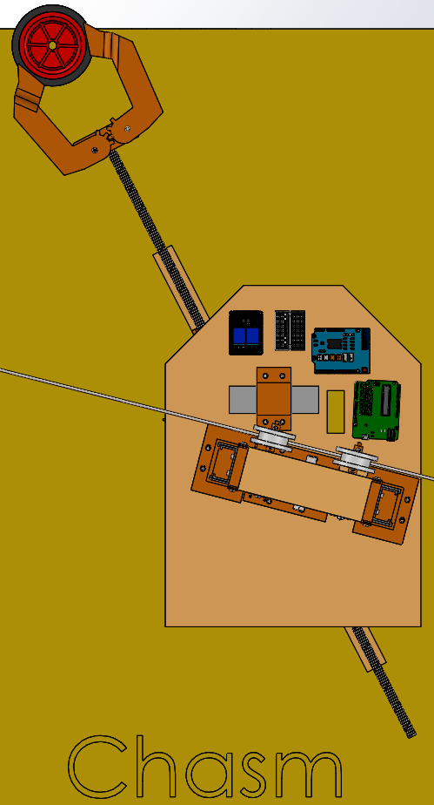
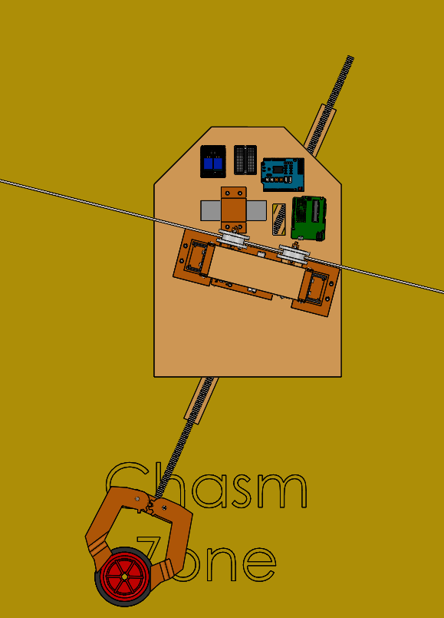
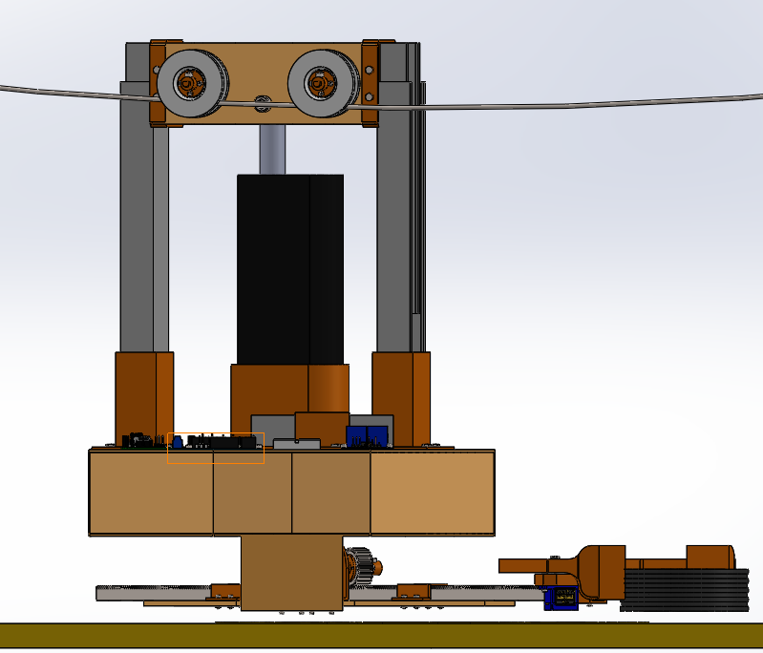

PHASE 3
CAD Images (Traversing Chasm)
Near the sag point, the system will have enough clearance to not touch the chasm due to the linear actuator retracting enough to keep it hovering above ground.
While traversing across the chasm, the arm will rotate the package so that it is in position and ready for depositing. It needs to rotate in the chasm as there is not enough space at the deposit zone for the rack to turn without hitting the pylon.

Slide 42
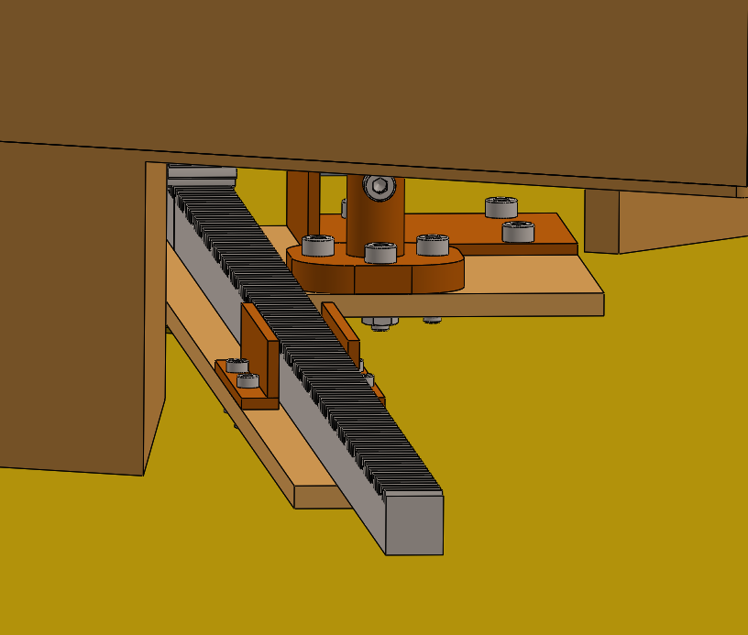
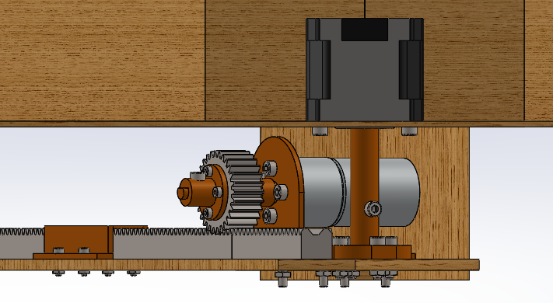
PHASE 3
CAD Images (Traversing Chasm)
In the chassis, near the centre, there is a stepper motor mounted upside down. This is the motor that will cause the twist or the arm. Note the image below is a section view.
A designed mount is used to transfer the rotation applied by the stepper motor to the arm. This rotates the wooden board underneath, which will rotate the arm.

Slide 43
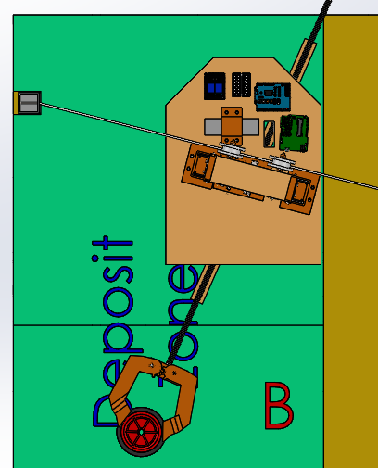
PHASE 3
CAD Images (Traversing Chasm)
Once the whole system has just entered into the deposit zone (5mm from the edge), it will stop at this spot.
The arm should positioned at such an angle that it is ready to deposit the package when possible.

Slide 44
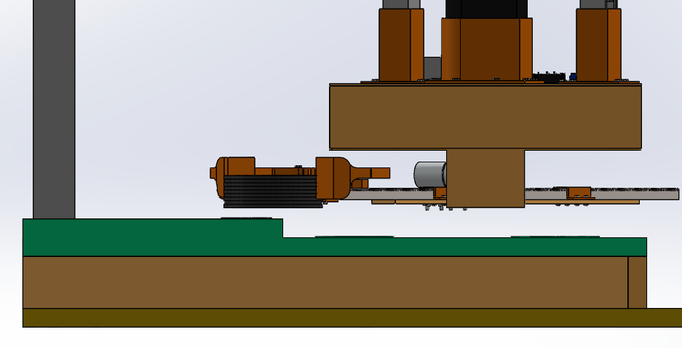
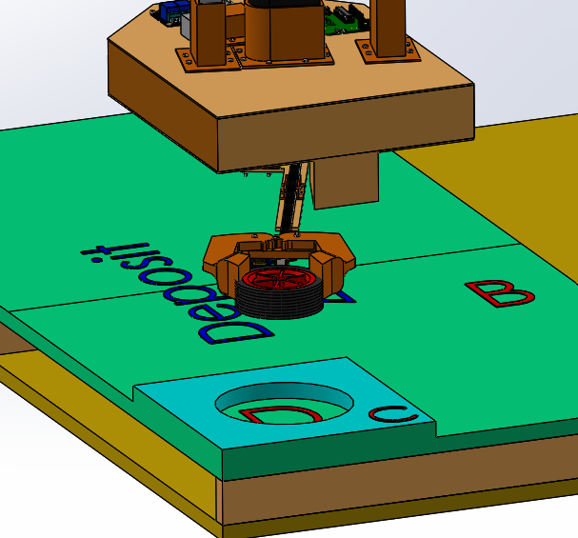
PHASE 4
CAD Images (Depositing Payload)
The system should remain on the wire and, hence, hovering above ground. This will allow the arm and the package to be high enough to be able to go over the small incline surrounding the deposit zone D.
The package and arm should be aligned with the drop zone, D.

Slide 45



PHASE 4
CAD Images (Depositing Payload)
The system will extend out (using the rack and pinion method) enough such that the package can be placed in deposit zone D.
The package should be placed right in the centre of Deposit Zone D.

Slide 46


PHASE 4
CAD Images (Depositing Payload)
The servo motor rotates, loosing the grip of the arm on the package. This allows the package to free fall a few centirements off the ground into zone D.
Arm/rack retracts away from zone D and back towards the body of the system, leaving the package in deposit zone D.

Slide 47


PHASE 5
CAD Images (Returned to Start Zone)
The system stays attached to the wire the whole time in the deposit zone. Hence, when returning, as before, the wire is directly in contact with the centre of the pulleys.
The system does not retract down to the floor in the deposit zone. Hence, when returning, as before, the system has to be hovering above the floor.

Slide 48


PHASE 5
CAD Images (Returned to Start Zone)
The system returns back into the start zone. It comes in just enough for the arm to be within the bounds.
The system is lifted high enough off the ground at the sag point when it traverses across the chasm.

Slide 49


PHASE 5
CAD Images (Returned to Start Zone)
The Linear Actuator extends out enough so that the system no longer hovers above the ground. The task is complete when it is safely placed on the ground. Hence at this point the pulley will no longer be in contact with the wire.

Slide 50
Conclusions
After careful examination of the problem at hand, our team has generated a creative solution that will not only solve the issue of transporting the package from the warehouse to the deposit zone and meet all the requirements, but is also a cost-friendly alternative to traditional ‘off the shelf’ solutions.
This has been made possible through a careful ‘OFFERS’ analysis and creative solution generation process where multiple concepts were conceived to solve the issue. A thorough decision making process, using the composite criterion method, enabled the team to determine which solution would be more appropriate. The recommended concept was detailed through both isometric and orthogonal drawings and a complete CAD assembly. Due to this rigorous engineering design process, the team has already been able to gain exposure and learn about the areas specified in the learning-based objectives, and are now in the best position to start prototyping and building our solution to continue achieving the goals we have set out for ourselves.
Jason Abi Chebli
Ryan Hartshorne
Faisal Ibrahim M Almaslukh
Mahdir Shafin Hasan

Slide 51
References
[1]Warmandesignandbuild.org.au,2022.[Online].Available:https://warmandesignandbuild.org.au/wp-content/uploads/2019/04/193686_-_warman_book_-_digital_final_for_website_0-1.pdf. [Accessed: 30- Mar- 2022].
[2]Engineers Australia, "2022 Weir Warman Competition Rules-Rev 1.1", 35th Warman Student Design and Build Competition, 2022.[Online]. Available: https://lms.monash.edu/mod/resource/view.php?id=10038569/. [Accessed: 29- Mar- 2022].
[3]"Monash University wins 2018 Warman Design & Build Competition", Global.weir, 2022. [Online]. Available: https://www.global.weir/newsroom/news-articles/monash-university,-clayton-campus-wins-the-2018-warman-design-and-build-competition/. [Accessed: 29- Mar- 2022].
[4]"History of the Competition – The Warman Design and Build Competition", Warmandesignandbuild.org.au, 2022. [Online]. Available: https://warmandesignandbuild.org.au/history/. [Accessed: 29- Mar- 2022].
[5]"Engineering students save a world in peril at 2019 Warman Design and Build Competition", Create, 2022. [Online]. Available: https://createdigital.org.au/warman-design-and-build-competition-2019-winners-announced/. [Accessed: 29- Mar- 2022].
[6]"How to Scale an Assembly in SOLIDWORKS", The Javelin Blog, 2022. [Online]. Available: https://www.javelin-tech.com/blog/2020/09/how-to-scale-an-assembly-in-solidworks/. [Accessed: 30- Mar- 2022].
[7]"Arduino Uno Rev3", Arduino Online Shop, 2022. [Online]. Available: http://store-usa.arduino.cc/products/arduino-uno-rev3. [Accessed: 29- Mar- 2022].
[8]D. Team, "Orthographic Projection (Principles, Conversions) | Difference Between Orthographic and Isometric Projection", Dream Civil, 2022. [Online]. Available: https://dreamcivil.com/orthographic-projection/. [Accessed: 30- Mar- 2022].
[9]Thumbs.dreamstime.com, 2022. [Online]. Available: https://thumbs.dreamstime.com/b/linear-flat-winning-team-people-medal-winner-cup-f-businesspeople-hugging-flag-hands-vector-illustration-ribbon-label-78230968.jpg. [Accessed: 30- Mar- 2022].

Slide 52
References
[10]E. Lehmann and E. Lehmann, "What mining means to Australians: a national survey", CSIRO scope, 2022. [Online]. Available: https://blog.csiro.au/what-mining-means-to-australians-a-national-survey/. [Accessed: 30- Mar- 2022].
[11]Engineers Australia, "2022 Warman Competition Track Base 1 of 5 ", 35th Warman Student Design and Build Competition, 2022.[Online]. Available: https://lms.monash.edu/mod/resource/view.php?id=10038569/. [Accessed: 29- Mar- 2022].

