Slide 1

Channel-Aware Backdoor Attacks Against Federated Infostealer Malware Classification Using Dynamic API-Call and Network Representations
Mochamad Asryl Aziz
BPS-Statistics Indonesia, Bantaeng Regency
Moh. Jabir Mubarok
Institut Teknologi Sepuluh Nopember, Surabaya
Eka Fitria
Informatics, Universitas Syiah Kuala, Banda Aceh
2026 8th International Workshop on Big Data and Information Security (IWBIS)
16-18th October 2026
Notes:
Suggested time: 0:20 (0:20 of 11:45 at the end of this slide).
SCRIPT
Good morning, everyone. My name is Moh. Jabir Mubarok, from Institut Teknologi Sepuluh Nopember. Together with Mochamad Asryl Aziz and Eka Fitria, I will present our work on channel-aware backdoor attacks against federated infostealer malware classification.

Slide 2
Background and Motivation
Infostealer malware
Dynamic analysis
Federated learning
Steals credentials, browser data and session cookies [1], [2].
Knowing the family helps threat intelligence, triage and incident response.
API calls show what the malware does on the host; network artifacts show how it communicates.
Both can be encoded as images for a CNN [3], [4], [5].
Clients train one classifier together without moving raw data.
A malicious client can inject a backdoor through its updates [6], [7].
[1] K. Thomas et al., ACM CCS, 2017; [2] G. Franken et al., USENIX Security, 2018; [3] P. Wu et al., Computers & Security, 2025; [4] R. E. Davis et al., IEEE Access, 2024; [5] B. Xuan et al., Computers & Security, 2024; [6] M. Nobakht et al., Computers and Electrical Engineering, 2024; [7] Q. Ren et al., Computers & Security, 2024
2 / 16
Notes:
Suggested time: 0:50 (1:10 of 11:45 at the end of this slide).
SCRIPT
Infostealers steal credentials, browser data and session cookies, so knowing which infostealer family we are dealing with helps threat intelligence, triage and incident response.
To classify the family, we use dynamic analysis. API-call sequences describe what the malware does on the host, and network artifacts describe how it communicates. Both can be turned into images and classified with a CNN.
Organizations often cannot share raw samples. Federated learning lets them train one classifier together without moving the data. But a malicious client can inject a backdoor: a hidden rule that makes the model give a chosen wrong label whenever a small trigger appears.

Slide 3
Research Problem and Objectives
Research problem
Objectives
Most FL backdoor work targets general image or model-level poisoning, not the channels of a malware representation [7].
RGB-stack places API-call, network and fused information in separate channels [5], so a trigger in one channel need not behave like a trigger in another.
Build API-call and network representations from Cuckoo Sandbox reports of five latest and most prevalent infostealer families.
Select the representation and the CNN backbone.
Evaluate channel-aware backdoors in FL with red, green, blue and full-RGB triggers, trigger controls and Multi-Krum.
The novelty is to treat the representation's channels as the attack surface: a trigger confined to the fusion channel alone matches one spanning all three.
[5] B. Xuan et al., Computers & Security, 2024; [7] Q. Ren et al., Computers & Security, 2024
3 / 16
Notes:
Suggested time: 0:50 (2:00 of 11:45 at the end of this slide).
SCRIPT
Most backdoor research in federated learning looks at general image tasks or at model-level poisoning, not at the channels of a malware representation. In an RGB-stack representation, each data source gets its own color channel, so a trigger in one channel need not behave like a trigger in another. This is still underexplored for dynamic malware representations.
So we have three objectives: build the representations, select the model, and evaluate channel-aware backdoor attacks in federated learning, with trigger controls and a Multi-Krum defense analysis.
[Point to the blue box at the bottom.] In one sentence, our idea is to treat the representation's channels as the attack surface.
Q&A NOTES
Cut from the 15-minute script: the four triggers are red, green, blue and full RGB.

Slide 4
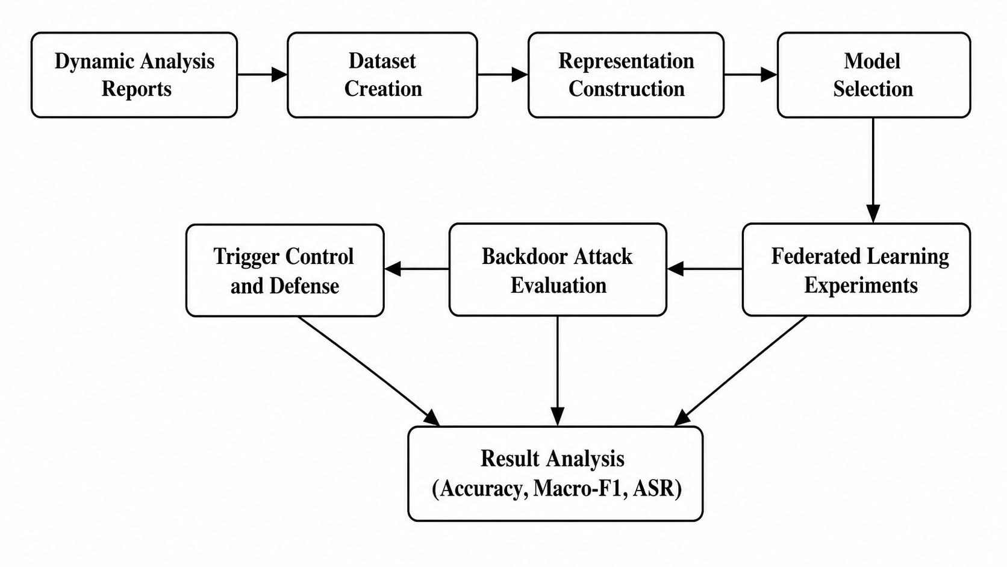
PROPOSED METHOD · 1 / 3
Overall Research Workflow
Fig. 1. Overall research workflow of the proposed study.
4 / 16
Notes:
Suggested time: 0:15 (2:15 of 11:45 at the end of this slide).
SCRIPT
This is the overall workflow: from sandbox reports to the dataset, the representations and the model, then federated learning, backdoor attacks, trigger controls and defenses.
Q&A NOTES
Cut from the 15-minute script: we report accuracy and macro-F1 throughout, and attack success rate for every attack.

Slide 5
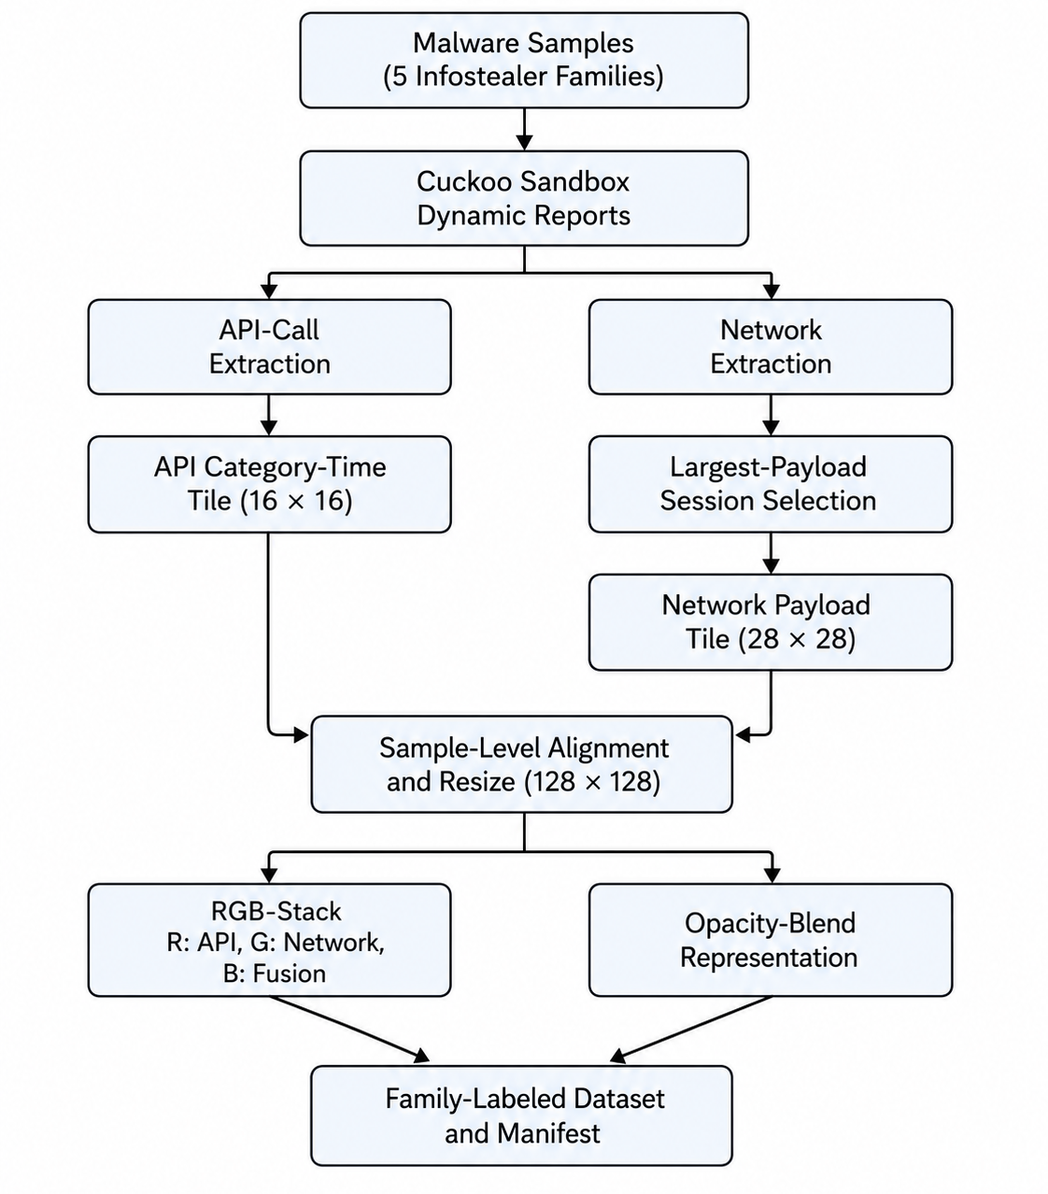
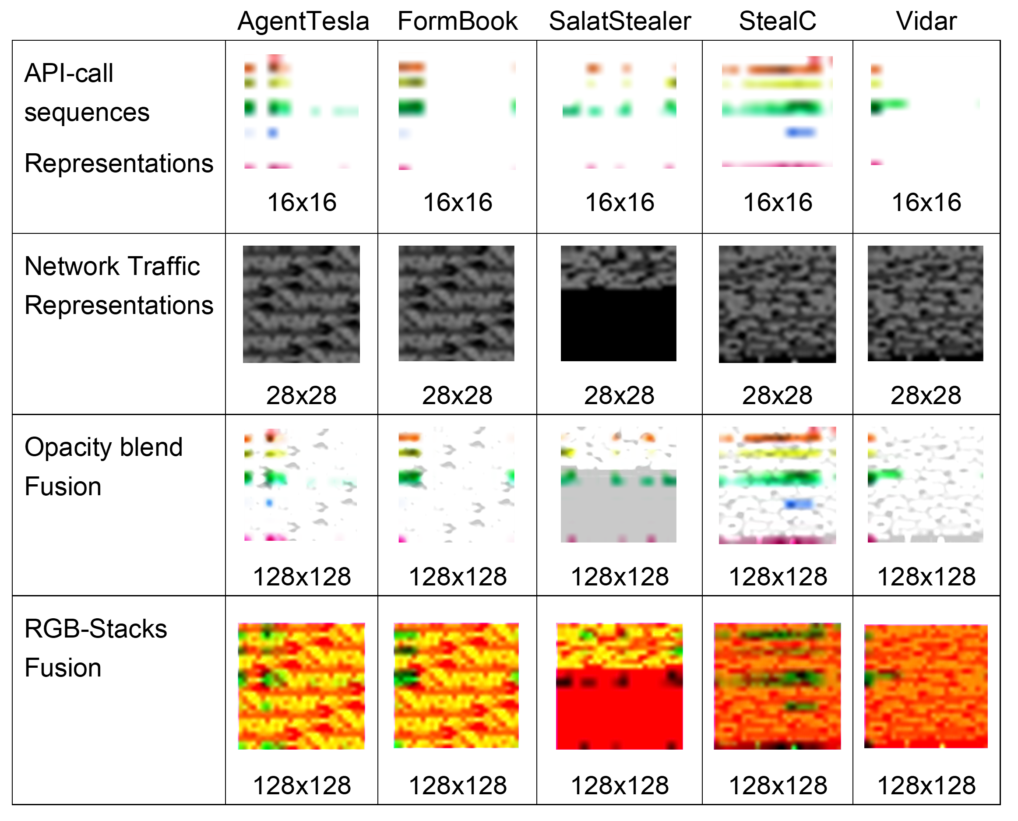
PROPOSED METHOD · 2 / 3
From Sandbox Reports to Image Tiles and RGB-Stack
Fig. 3. Representative processed malware representations generated from dynamic API-call and network packet artifacts. Rows illustrate different representation types, while columns correspond to the five infostealer families.
Fig. 2. Dataset creation pipeline from dynamic analysis reports to dynamic
API-call and network representations.
[3] P. Wu et al., Computers & Security, 2025; [4] R. E. Davis et al., IEEE Access, 2024; [5] B. Xuan et al., Computers & Security, 2024; [17] A. Pektaş and T. Acarman, IET Information Security, 2018; [18] T. Chen et al., Computers & Security, 2024; [19] D. Vasan et al., Computers & Security, 2020
5 / 16
Notes:
Suggested time: 1:00 (3:15 of 11:45 at the end of this slide).
SCRIPT
[Left figure.] Each sample is run in Cuckoo Sandbox. API calls are mapped into behavior categories and counted over time, which gives a 16 by 16 tile. On the network side, we keep only the session with the largest payload, and reshape it into a 28 by 28 tile.
[Right figure.] Here are the resulting images for the five families. Opacity blend mixes both sources into every channel. RGB-stack keeps them apart: red is the API tile, green is the network tile, and blue is an edge map of their average. So blue adds no new information, and it is the emptiest channel: almost 63 percent of its pixels are exactly zero. Keep that in mind; it comes back at the end.
Q&A NOTES
Cut from the 15-minute script: keeping only the largest-payload session is there to reduce leakage between samples.

Slide 6
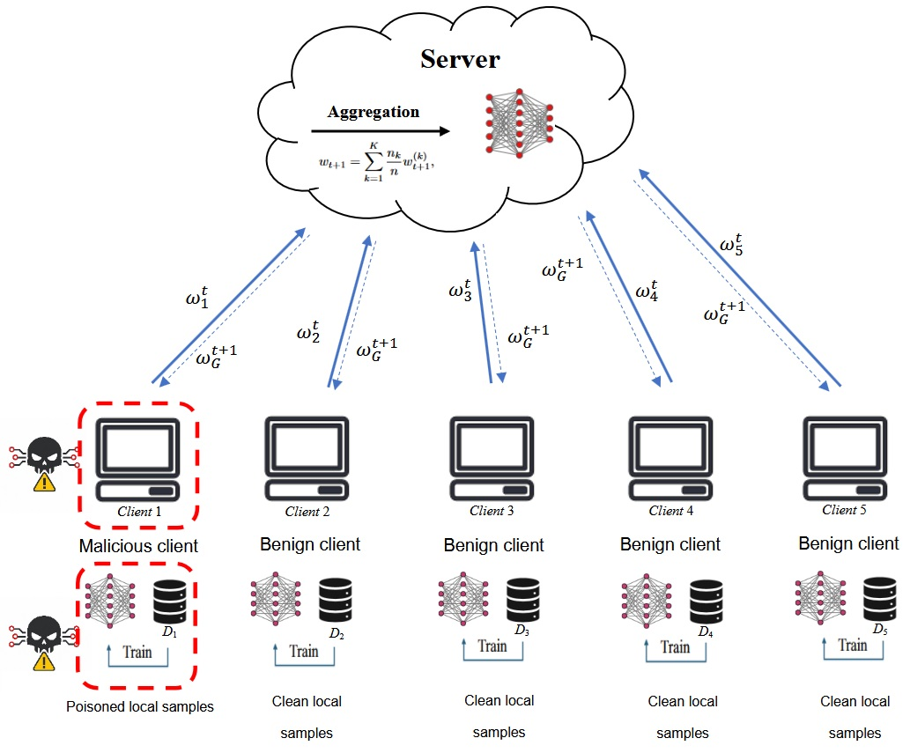
PROPOSED METHOD · 3 / 3
Channel-Aware Backdoor in Federated Learning
Five clients, 70 images each, 14 per family: balanced and IID.
One malicious client puts a trigger on AgentTesla training images and relabels them as FormBook [7], [8].
Poison rate 20% of its 14 AgentTesla images: two images per round, resampled every round.
Four trigger settings: red/API, green/network, blue/fusion and full RGB.
Fig. 4. Federated learning architecture used in this study, consisting of one central server and five clients. One client is malicious in the backdoor attack setting.
[6] M. Nobakht et al., Computers and Electrical Engineering, 2024; [7] Q. Ren et al., Computers & Security, 2024; [8] W. Jiang et al., CVPR, 2023; [10] B. McMahan et al., AISTATS, 2017; [23] P. Fang and J. Chen, AAAI, 2023
6 / 16
Notes:
Suggested time: 0:55 (4:10 of 11:45 at the end of this slide).
SCRIPT
We use one server and five clients, aggregated with FedAvg. Each client holds 70 images, 14 per family, so the partition is balanced and IID.
One client is malicious. It puts a small white square trigger on AgentTesla training images and relabels them as FormBook: only two images per round, resampled every round. It is pure data poisoning, with no update scaling and no model replacement.
Attack success rate is how many of the 15 AgentTesla test images, with the trigger added, the model labels as FormBook. Because RGB-stack keeps the channels separate, we can put the trigger in red, green, blue, or all three, and compare them.

Slide 7
EXPERIMENTAL SETUP · 1 / 2
Dataset and Experimental Environment
TABLE I. Dataset Summary and Stratified Split
TABLE II. Experimental Environment
Family | Total | Train | Val. | Test
AgentTesla | 100 | 70 | 15 | 15
FormBook | 100 | 70 | 15 | 15
SalatStealer | 100 | 70 | 15 | 15
StealC | 100 | 70 | 15 | 15
Vidar | 100 | 70 | 15 | 15
Total | 500 | 350 | 75 | 75
Component | Specification
Dynamic analysis | Cuckoo Sandbox on Ubuntu
Training environment | Windows, Python / Anaconda
Framework | PyTorch with CUDA 12.8
GPU | NVIDIA GeForce RTX 3080, 12 GB VRAM
7 / 16
Notes:
Suggested time: 0:30 (4:40 of 11:45 at the end of this slide).
SCRIPT
[Left table.] The dataset has five families, AgentTesla, FormBook, SalatStealer, StealC and Vidar, with 100 samples each, so 500 in total. We split it 70, 15 and 15 percent, stratified by family, and we draw a new split for each seed.
[Right table.] Dynamic analysis runs in Cuckoo Sandbox, and training runs in PyTorch on an RTX 3080.
Q&A NOTES
The paper's text for Tables I and II is on Backup 2.

Slide 8
EXPERIMENTAL SETUP · 2 / 2
Training, Defense and Evaluation
Training
Model and evaluation
Component | Specification
Batch size | 16
Learning rates and weight decay | 10⁻⁴
FL server rounds | 50
FL local rounds | 2
Optimizer | AdamW
ResNet18 on RGB-stack, trained from scratch.
Final-round global model, with no best-validation selection.
Clean accuracy, macro-F1 and ASR over seeds 42, 123 and 2026.
Defense and trigger control
Multi-Krum is the primary defense [12].
Clipping, coordinate-wise median and trimmed mean are also screened [13].
Trigger control: the same triggers on the clean FL model at test time.
[12] P. Blanchard et al., NeurIPS, 2017; [13] D. Yin et al., ICML, 2018
8 / 16
Notes:
Suggested time: 0:45 (5:25 of 11:45 at the end of this slide).
SCRIPT
[Left table.] The model is trained from scratch with AdamW. We run 50 federated rounds, with two local epochs per round.
[Right box.] We report the final-round global model, and we measure clean accuracy, macro-F1 and attack success rate over three seeds.
For defense, Multi-Krum is our main baseline: it scores each update by its distance to the others and keeps the most central ones. We also screen clipping, coordinate-wise median and trimmed mean. As a control, we apply the same triggers at test time to a clean model that never saw poisoned data.
Q&A NOTES
Table II (experimental environment) is on slide 7 and its text on Backup 2. The seed-42 deviation belongs to Table VI; it is footnoted on slide 12 and given in full on Backup 2.
Cut from the 15-minute script: the federated learning is a simulation we implemented ourselves in PyTorch. Batch size is 16; the learning rate and the weight decay are both ten to the minus four. There is no best-validation selection. The seeds are 42, 123 and 2026.

Slide 9
RESULTS · 1 / 4
Backbone Selection Results
TABLE III. Backbone Selection
Representation | Backbone | Acc. | Macro-F1
Opacity blend | SmallCNN | 0.5333 | 0.5298
Opacity blend | MobileNetV2 | 0.6933 | 0.6903
Opacity blend | ResNet18 | 0.7733 | 0.7730
RGB-stack | SmallCNN | 0.5200 | 0.5144
RGB-stack | MobileNetV2 | 0.7200 | 0.7200
RGB-stack | ResNet18 | 0.7867 | 0.7884
Among the RGB-stack backbones, measured on seed 42, ResNet18 is the strongest: 78.67% accuracy and 78.84% macro-F1.
It is used for all later experiments.
The opacity-blend rows are listed for reference only.
[20] D. Zhang et al., Alexandria Engineering Journal, 2025; [21] M. Sandler et al., CVPR, 2018; [22] K. He et al., CVPR, 2016
9 / 16
Notes:
Suggested time: 0:25 (5:50 of 11:45 at the end of this slide).
SCRIPT
Now the results. First, the model. Within RGB-stack, measured on seed 42, ResNet18 is the strongest backbone, at about 79 percent on both accuracy and macro-F1, so we use it for everything that follows. The opacity-blend rows come from a different data split, so they are for reference only.
Q&A NOTES
From the paper, III.C: The two representations use different split files, so Table III is not a paired comparison: RGB-stack is chosen because channel separation is required here, and macro-F1 selects only the backbone within it.
Cut from the 15-minute script: the opacity-blend rows are not a head-to-head comparison; we chose RGB-stack because we need the channels to be separate.

Slide 10
RESULTS · 2 / 4
Channel-Aware Backdoor Sweep
TABLE IV. Channel-Aware Backdoor Sweep Using Seed 42
Trigger | Clean Acc. | Macro-F1 | ASR
Red/API | 0.8533 | 0.8524 | 0.3333
Green/network | 0.8400 | 0.8419 | 0.3333
Blue/fusion | 0.8400 | 0.8395 | 1.0000
Full RGB | 0.8400 | 0.8401 | 1.0000
Blue/fusion and full RGB reach 100% ASR; red/API and green/network do not.
Blue/fusion does so without modifying all three channels.
Not a trigger artifact: blue/fusion and full RGB differ from their trigger controls at p < 10⁻¹⁷ (Fisher exact); red and green do not (p = 1, 5/15 against 4/15).
10 / 16
Notes:
Suggested time: 1:00 (6:50 of 11:45 at the end of this slide).
SCRIPT
This is the central result. On seed 42, we put the same trigger into each channel in turn.
Red, the API channel, and green, the network channel, reach only five out of fifteen, 33 percent. Their trigger controls give four out of fifteen, so they are indistinguishable from the model's natural confusion.
Blue and full RGB reach 100 percent, while clean accuracy stays at 84 to 85 percent, so the model still looks healthy.
The striking part is blue. A trigger in the fusion channel alone is as effective as a trigger across all three channels. And pooled over the three seeds, blue and full RGB differ from their controls with p-values below ten to the minus seventeen.
Q&A NOTES
Cut from the 15-minute script: the difference between red and green and their controls is not significant (both p = 1, 5/15 against 4/15, seed 42 only). The exact Fisher p-values are 3.5 x 10^-19 (blue/fusion) and 2.6 x 10^-18 (full RGB) against their controls, and 4.0 x 10^-8 for blue against red and green. Pooling is legitimate because the split is re-drawn per seed.

Slide 11
RESULTS · 3 / 4
Defense Screening
TABLE V. Single-Seed Defense Screening Against Strongest Attacks Using Seed 42
Trigger | Defense | Clean Acc. | Macro-F1 | ASR
Blue/fusion | None | 0.8400 | 0.8395 | 1.0000
Blue/fusion | Clipping | 0.8533 | 0.8550 | 1.0000
Blue/fusion | Median | 0.8133 | 0.8120 | 1.0000
Blue/fusion | Trimmed mean | 0.8267 | 0.8244 | 1.0000
Blue/fusion | Multi-Krum | 0.8267 | 0.8244 | 1.0000
Full RGB | None | 0.8400 | 0.8401 | 1.0000
Full RGB | Clipping | 0.8533 | 0.8550 | 1.0000
Full RGB | Median | 0.8400 | 0.8388 | 1.0000
Full RGB | Trimmed mean | 0.8133 | 0.8145 | 1.0000
Full RGB | Multi-Krum | 0.7600 | 0.7542 | 0.4000
Clipping, coordinate-wise median and trimmed mean leave ASR at 1.0000.
Only Multi-Krum reduces it, and only under full RGB: 1.0000 to 0.4000.
Multi-Krum is taken to the multi-seed evaluation.
[12] P. Blanchard et al., NeurIPS, 2017; [13] D. Yin et al., ICML, 2018
11 / 16
Notes:
Suggested time: 0:35 (7:25 of 11:45 at the end of this slide).
SCRIPT
Can standard defenses stop it? We screened four defenses on seed 42. Clipping, coordinate-wise median and trimmed mean all leave the attack success rate at 100 percent for both triggers. Only Multi-Krum reduces it, and only for full RGB: from 100 to 40 percent. Against the blue trigger, even Multi-Krum stays at 100 percent. So Multi-Krum is the only defense we carried into the multi-seed evaluation.
Q&A NOTES
Cut from the 15-minute script: under Multi-Krum with the full-RGB trigger, clean accuracy drops from 84 to 76 percent on this seed.

Slide 12
RESULTS · 4 / 4
Multi-Seed Results
TABLE VI. Main Multi-Seed Results Under IID Federated Setting, With Per-Seed Values
Scenario | Channel | Clean Acc. | Macro-F1 | ASR / Target Rate | Per seed (42, 123, 2026)
Clean FL | – | 0.8267 ± 0.0134 | 0.8255 ± 0.0104 | – | –
Trigger control | Blue/fusion | 0.8267 ± 0.0134 | 0.8255 ± 0.0104 | 0.1333 ± 0.1155 | 4/15, 1/15, 1/15
Trigger control | Full RGB | 0.8267 ± 0.0134 | 0.8255 ± 0.0104 | 0.1556 ± 0.1018 | 4/15, 1/15, 2/15
Backdoor, FedAvg | Blue/fusion | 0.8311 ± 0.0539 | 0.8320 ± 0.0539 | 1.0000 ± 0.0000 | 15/15, 15/15, 15/15
Backdoor, FedAvg | Full RGB | 0.8267 ± 0.0611 | 0.8262 ± 0.0621 | 1.0000 ± 0.0000 | 15/15, 15/15, 15/15
Backdoor, Multi-Krum | Blue/fusion | 0.8178 ± 0.0154 | 0.8184 ± 0.0135 | 0.5111 ± 0.4286† | 15/15, 3/15, 5/15
Backdoor, Multi-Krum | Full RGB | 0.7956 ± 0.0407 | 0.7931 ± 0.0427 | 0.6000 ± 0.3464† | 6/15, 15/15, 6/15
† Across-seed ASR range ≥ 0.5: the outcome is bimodal, so read the per-seed counts (out of 15 source samples), not the mean.
The seed-42 clean baseline and trigger controls come from a 30-round, one-local-epoch run. No ASR result is affected.
Across three seeds, blue/fusion and full-RGB backdoors reach 100% ASR, with clean performance comparable to the clean FL baseline.
In seven of the eight trigger controls the target rate is identical with and without the trigger: the ASR is not an artifact of the pattern.
12 / 16
Notes:
Suggested time: 1:05 (8:30 of 11:45 at the end of this slide).
SCRIPT
[Point to the highlighted rows.] Over three seeds, under FedAvg, both the blue and the full-RGB backdoors reach fifteen out of fifteen on every seed. Clean accuracy stays comparable to the clean baseline, at about 83 percent.
In seven of the eight trigger controls, the target rate is exactly the same with and without the trigger. So the attack success comes from poisoning, not from the pattern.
One note for transparency, in the footnote: the seed-42 clean baseline and its controls come from a shorter run. No attack success result is affected.
Now the Multi-Krum rows. The means, 51 and 60 percent, look like partial protection, but they are misleading. Per seed, blue gives 15, 3 and 5 out of 15, and full RGB gives 6, 15 and 6. On one seed out of three, the backdoor is fully effective.
Q&A NOTES
On the 30-round, one-local-epoch seed-42 clean baseline, from the paper, III.H: Re-training it under the common budget gives 0.7867 accuracy, 0.7869 macro-F1 and a control rate of 6/15 rather than 4/15, so the reported run sets a higher bar for the clean-performance claim and a lower one for the trigger-control argument. No ASR result is affected; every backdoor and defense run uses the common budget. From IV.B: red and green are indistinguishable from their own controls (both p = 1, 5/15 against 4/15, seed 42 only). The 5/15 is their backdoor ASR; their clean-model controls give 4/15 both with and without the trigger (results/trigger_control).
Cut from the 15-minute script: the eight controls are the six in this table plus red and green on seed 42. The shorter run is 30 rounds with one local epoch; re-trained at the full budget, the control rate is six out of fifteen instead of four.

Slide 13
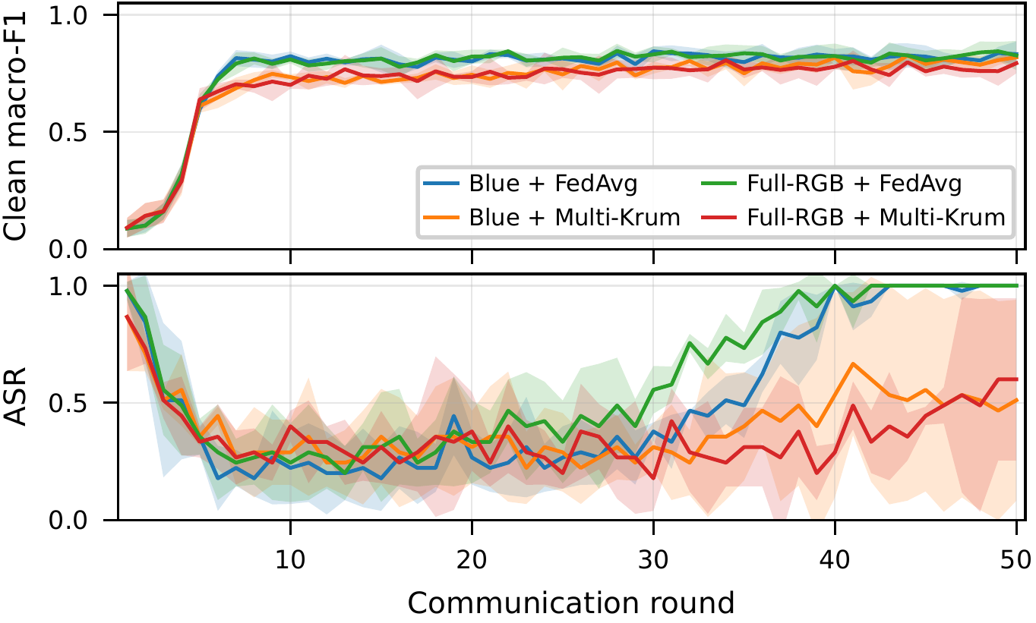
DISCUSSION · 1 / 2
Defense Analysis: Bimodal Rather Than Partial
Under Multi-Krum the mean is misleading. Per seed: 15/15, 3/15, 5/15 for blue/fusion and 6/15, 15/15, 6/15 for full RGB.
Bimodal: on some seeds the backdoor remains fully effective, on the others most of it is suppressed.
It tracks selection: the malicious client is retained in 8–50% of rounds, and that rate correlates with the final ASR (r = 0.893, p = 0.017, n = 6).
Multi-Krum is unreliable as a standalone defense.
Fig. 7. Per-round clean macro-F1 and ASR across three random seeds for the blue/fusion and full-RGB backdoor settings under FedAvg and Multi-Krum. Shaded areas denote standard deviation across seeds.
13 / 16
Notes:
Suggested time: 1:00 (9:30 of 11:45 at the end of this slide).
SCRIPT
This figure shows both backdoors under FedAvg and under Multi-Krum, across the three seeds. [Bottom panel.] Under FedAvg, both triggers settle at 100 percent. Under Multi-Krum, the curves stay unstable. The outcome is bimodal: on a given seed, the backdoor is either mostly suppressed or not suppressed at all.
It tracks selection. Multi-Krum keeps two of the five updates in each round, and the poisoned update is not an outlier, so whether it is kept is close to a coin flip. The malicious client was kept in 8 to 50 percent of the rounds, and that rate correlates with the final attack success, with a correlation of 0.89. With only six runs, this is indicative rather than conclusive.
So Multi-Krum is unreliable as a standalone defense.
Q&A NOTES
Per seed (42, 123, 2026), Table VI: blue/fusion 15/15, 3/15, 5/15; full RGB 6/15, 15/15, 6/15. The shaded bands in Fig. 7 are the standard deviation across those seeds. From the paper, IV.E: With f = 1 and |S| = 2 of five, the poisoned update is not an outlier in parameter space, so keeping it is close to a coin flip that the attacker need only win often enough.
Cut from the 15-minute script: the seed-42 training curves (Figs. 5-6) are on Backup 1. The correlation is over the six Multi-Krum runs (r = 0.893, p = 0.017, n = 6).

Slide 14
DISCUSSION · 2 / 2
The Blue/Fusion Channel
The ordering in Table IV
What it suggests, and what it does not
Mean value inside the trigger region of the clean images: 214.6 in R, 48.3 in G and 21.6 in B.
37.7% of red trigger-region pixels are already at least 254, where the trigger changes nothing.
Contrast explains red's failure but not green's, whose contrast is 207.
Blue is an edge map of the other two, so its effectiveness cannot come from information they lack.
It is almost empty, so the trigger is the only strong response there.
Consistent with the measurements, but not established.
14 / 16
Notes:
Suggested time: 1:00 (10:30 of 11:45 at the end of this slide).
SCRIPT
Finally, why does blue work when red and green do not? Inside the trigger region of the clean images, red is already very bright, with a mean of 214.6. And 37.7 percent of its pixels are already at 254 or above, where a white trigger changes nothing at all. Green's mean is only 48.3, so a white trigger adds a contrast of about 207, and green still fails.
Blue's mean is just 21.6. It cannot win through new information, because it is computed from red and green. What distinguishes it is that it is almost empty, so the trigger is the only strong signal there. This explanation fits our measurements, but it is not proven; a contrast-matched trigger would test it.
Q&A NOTES
Contrast here is 255 minus the mean value inside the trigger region, so green's contrast is 255 - 48.3, about 207 (docs/CODE_FACTS.md). The contrast-matched trigger that would test the emptiness explanation is future work.

Slide 15
CONCLUSION AND FUTURE WORK
Conclusion and Future Work
The representation's channels are an attack surface: a trigger confined to the fusion channel alone matches one spanning all three.
Blue/fusion and full-RGB triggers reached 100% ASR across three seeds, with clean performance close to the baseline.
Multi-Krum reduced ASR bimodally rather than partially, leaving the backdoor fully effective (15/15) on one of the three seeds for each trigger.
Channel-aware backdoors are a serious threat to federated malware classifiers in this controlled IID setting, and motivate representation-aware defenses.
Limitations and future work
Limitations: the IID-only partition, a single source–target pair, and three seeds, with the red and green results resting on seed 42 alone.
Future work: a non-IID partition, a second source–target pair and a contrast-matched trigger.
15 / 16
Notes:
Suggested time: 1:05 (11:35 of 11:45 at the end of this slide).
SCRIPT
The main message is that the channels of this representation are an attack surface. A trigger in the fusion channel alone matches one spanning all three, even though that channel is derived from the other two.
Blue and full-RGB triggers reached 100 percent attack success across three seeds, with clean performance close to the baseline. Multi-Krum reduced the attack only bimodally: for each trigger, it left the backdoor fully effective on one of the three seeds.
So, in this controlled IID setting, channel-aware backdoors are a serious threat to federated malware classifiers, and they motivate defenses that look at the representation, not only at the updates.
Our main limitations are the IID-only partition, a single source-target pair, and three seeds. The next steps are a non-IID partition, a second source-target pair, and a contrast-matched trigger.
Q&A NOTES
Cut from the 15-minute script: the trigger controls show that the effect comes from poisoning; the red and green results are on seed 42 only.

Slide 16
Thank you
Mochamad Asryl Aziz · Moh. Jabir Mubarok · Eka Fitria
mochamadasryl93@gmail.com · jabirmubarok@gmail.com · ekafitria2@mhs.usk.ac.id
16 / 16
Notes:
Suggested time: 0:10 (11:45 of 11:45 at the end of this slide).
SCRIPT
Thank you for your attention. I am happy to take your questions.

Slide 17
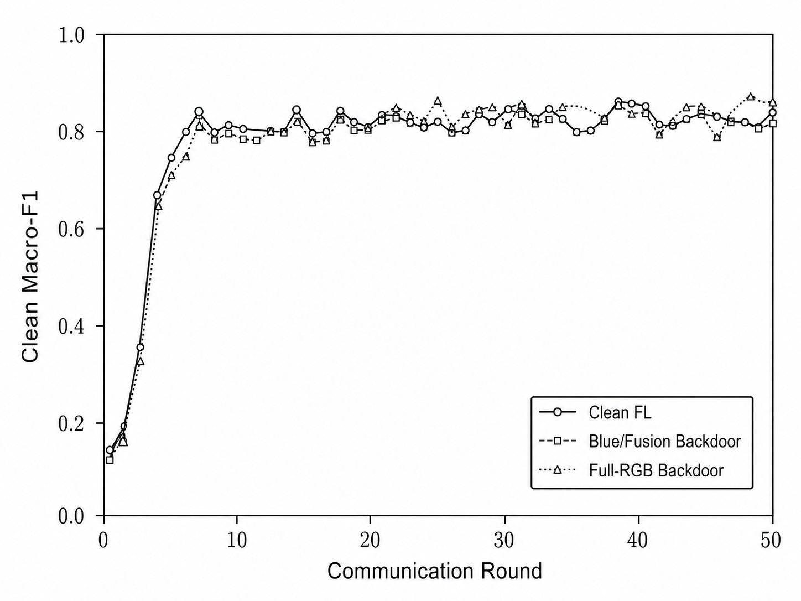
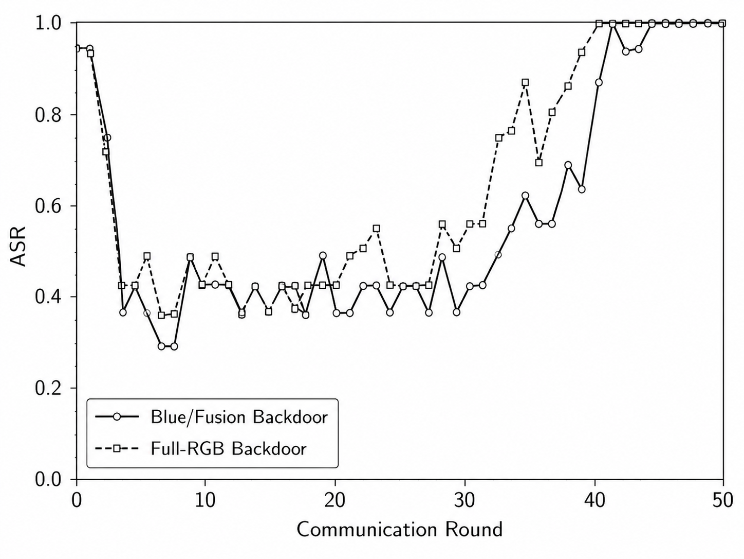
BACKUP
Clean Macro-F1 and ASR over FL Rounds
Fig. 5. Clean macro-F1 over FL communication rounds for the clean FL baseline and the strongest backdoor settings, using seed 42.
Fig. 6. Attack success rate (ASR) over FL communication rounds for the strongest blue/fusion and full-RGB backdoor settings, using seed 42.
Backup 1
Notes:
BACKUP SLIDE. Not part of the 12-minute talk; show it only if a question needs it.
IF ASKED
These curves show the same story during training, for seed 42. On the left, the clean macro-F1 of the backdoored models tracks the clean baseline. On the right, the attack success rate climbs to 100 percent in the later rounds. The high values in the first few rounds mean nothing: the model is still almost untrained and predicts only one or two classes.
Q&A NOTES
From the paper, IV.D: Figures 5 and 6 show clean macro-F1 holding steady while ASR climbs to 100%. The first rounds are not meaningful: the global model is still close to initialization and collapses onto one or two classes, producing the early spike before clean accuracy rises.

Slide 18
BACKUP
Notes on Tables I, II and VI and Figs. 5–6
Table I
slide 7
Tiles are aligned per sample and recorded in a manifest organized by family, which supports stratified splitting and reproducibility.
With 100 samples per family the dataset holds 500 representations, split 70%–15%–15% into training, validation and test partitions, stratified by family.
Table II
slide 7
Dynamic analysis and model training run on the separate environments listed in Table II.
Table VI
slide 12
One deviation must be stated: the seed-42 clean baseline in Table VI and the seed-42 trigger controls come from a 30-round, one-local-epoch run. Re-training it under the common budget gives 0.7867 accuracy, 0.7869 macro-F1 and a control rate of 6/15 rather than 4/15, so the reported run sets a higher bar for the clean-performance claim and a lower one for the trigger-control argument. No ASR result is affected; every backdoor and defense run uses the common budget.
Figs. 5–6
Backup 1
Figures 5 and 6 show clean macro-F1 holding steady while ASR climbs to 100%. The first rounds are not meaningful: the global model is still close to initialization and collapses onto one or two classes, producing the early spike before clean accuracy rises.
[19] D. Vasan et al., Computers & Security, 2020
Backup 2

Slide 19
The dataset is built from Cuckoo Sandbox reports for five Windows infostealer families: AgentTesla, FormBook, SalatStealer, StealC and Vidar.
API-call events are converted into a 16 × 16 category-by-time tile by normalizing the execution timeline, mapping API names into predefined behavior categories, and counting category occurrences over fixed time intervals.
To reduce sample-level leakage, only the session with the largest payload is selected for each malware sample, then truncated or padded and reshaped into a 28 × 28 network tile.
In RGB-stack the API and network tiles are converted to grayscale, min–max normalized per image and resized to 128 × 128; red carries API-call behavior, green network behavior, and blue is the edge map of their average, B = FindEdges((R+G)/2).
Blue is thus a deterministic function of the other two channels, adds no independent information, and is by far the emptiest: 62.8% of its pixels are exactly zero.
RGB-stack is used here because only it separates the sources by channel.
[4] R. E. Davis et al., IEEE Access, 2024; [5] B. Xuan et al., Computers & Security, 2024; [18] T. Chen et al., Computers & Security, 2024

Slide 20
The selected representation–backbone pair is trained in a simulated FL setting with one central server and five clients. Each client holds 70 images, 14 per family, so the partition is balanced and IID.
We assume a targeted backdoor with one malicious client: it inserts a square image-level trigger into AgentTesla training images and relabels them as FormBook.
The poison rate is 20% of the attacker's 14 AgentTesla training images, i.e., two images per round, resampled every round.
Because RGB-stack preserves channel-level semantics, four trigger settings are evaluated: red/API, green/network, blue/fusion and full RGB.
[7] Q. Ren et al., Computers & Security, 2024; [8] W. Jiang et al., CVPR, 2023

