Slide 1
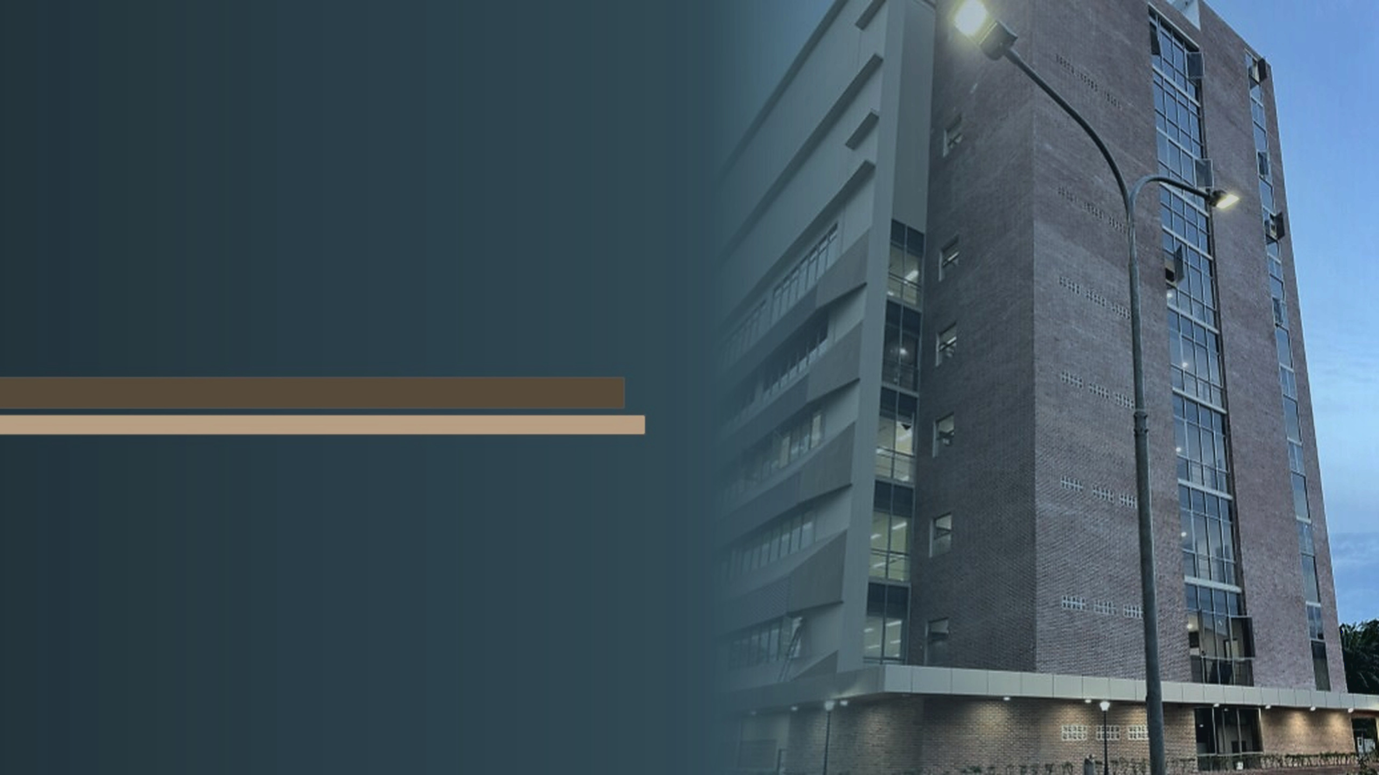
Channel-Aware Backdoor Attacks Against Federated Infostealer Malware Classification Using Dynamic API-Call and Network Representations
Mochamad Asryl Aziz
BPS-Statistics Indonesia, Bantaeng Regency
Moh. Jabir Mubarok
Institut Teknologi Sepuluh Nopember, Surabaya
Eka Fitria
Informatics, Universitas Syiah Kuala, Banda Aceh
2026 8th International Workshop on Big Data and Information Security (IWBIS)
16-18th October 2026
Notes:
Suggested time: 0:20 (0:20 of 15:00 at the end of this slide).
SCRIPT
Good morning, everyone. My name is Moh. Jabir Mubarok, from Institut Teknologi Sepuluh Nopember. Together with Mochamad Asryl Aziz and Eka Fitria, I will present our work on channel-aware backdoor attacks against federated infostealer malware classification.

Slide 2
Background and Motivation
Infostealer malware
Dynamic analysis
Federated learning
Infostealer malware targets authentication artifacts such as credentials, browser data and session cookies, which can enable account compromise and unauthorized access [1], [2].
Classifying infostealer families therefore matters for threat intelligence, triage and incident response.
Dynamic analysis captures runtime behavior beyond static file properties: API-call sequences represent host-level execution, network artifacts capture communication patterns, and both can be encoded into CNN-compatible images [3], [4], [5].
Federated learning (FL) allows participants to train such a classifier together without moving raw data to a central server, but its reliance on client-submitted updates lets a malicious client inject backdoor behavior [6], [7].
[1] K. Thomas et al., ACM CCS, 2017; [2] G. Franken et al., USENIX Security, 2018; [3] P. Wu et al., Computers & Security, 2025; [4] R. E. Davis et al., IEEE Access, 2024; [5] B. Xuan et al., Computers & Security, 2024; [6] M. Nobakht et al., Computers and Electrical Engineering, 2024; [7] Q. Ren et al., Computers & Security, 2024
2 / 17
Notes:
Suggested time: 1:05 (1:25 of 15:00 at the end of this slide).
SCRIPT
Infostealers target credentials, browser data and session cookies, which can enable account compromise. So knowing which infostealer family we are dealing with helps threat intelligence, triage and incident response.
To classify the family, dynamic analysis is useful. API-call sequences describe what the malware does on the host, and network artifacts describe how it communicates. Both can be turned into images and classified with a CNN.
Security data is spread across organizations, and they often cannot share raw samples. Federated learning lets them train one classifier together without moving the data. But the server only sees the updates the clients send, so a malicious client can inject a backdoor: a hidden rule that makes the model give a chosen wrong label whenever a small trigger appears.

Slide 3
Research Problem and Objectives
Research problem
Objectives
Most FL backdoor work targets general image or model-level poisoning rather than channel-specific behavior in malware representations [7].
An RGB-stack representation places API-call, network and fused information in separate channels [5], so a trigger in one channel need not behave like a trigger in another.
That behavior remains underexplored on dynamic API-call and network representations, and this paper investigates it in federated infostealer malware classification.
We construct dynamic API-call and network representations from Cuckoo Sandbox reports of five latest and most prevalent infostealer families.
We select the main representation–backbone pair by comparing RGB-stack and opacity blend with SmallCNN, MobileNetV2 and ResNet18.
We evaluate channel-aware backdoor attacks in FL using red/API, green/network, blue/fusion and full-RGB triggers, with trigger-control and Multi-Krum defense analysis.
The novelty is to treat the representation's channels as the attack surface: a trigger confined to the fusion channel alone matches one spanning all three.
[5] B. Xuan et al., Computers & Security, 2024; [7] Q. Ren et al., Computers & Security, 2024
3 / 17
Notes:
Suggested time: 1:10 (2:35 of 15:00 at the end of this slide).
SCRIPT
Most backdoor research in federated learning looks at general image tasks or at model-level poisoning. It does not look at the channels of a malware representation. An RGB-stack representation, one image in which each data source gets its own color channel, puts API-call, network and fused information in separate channels. A trigger in one channel need not behave like a trigger in another, and this is still underexplored for dynamic malware representations.
First, we build dynamic API-call and network representations from Cuckoo Sandbox reports of five infostealer families. Second, we select the representation and the CNN architecture. Third, we evaluate channel-aware backdoor attacks in federated learning, with four triggers: red, green, blue, and full RGB. We add trigger controls and a Multi-Krum defense analysis.
[Point to the blue box at the bottom.] In one sentence, our idea is to treat the representation's channels as the attack surface.

Slide 4
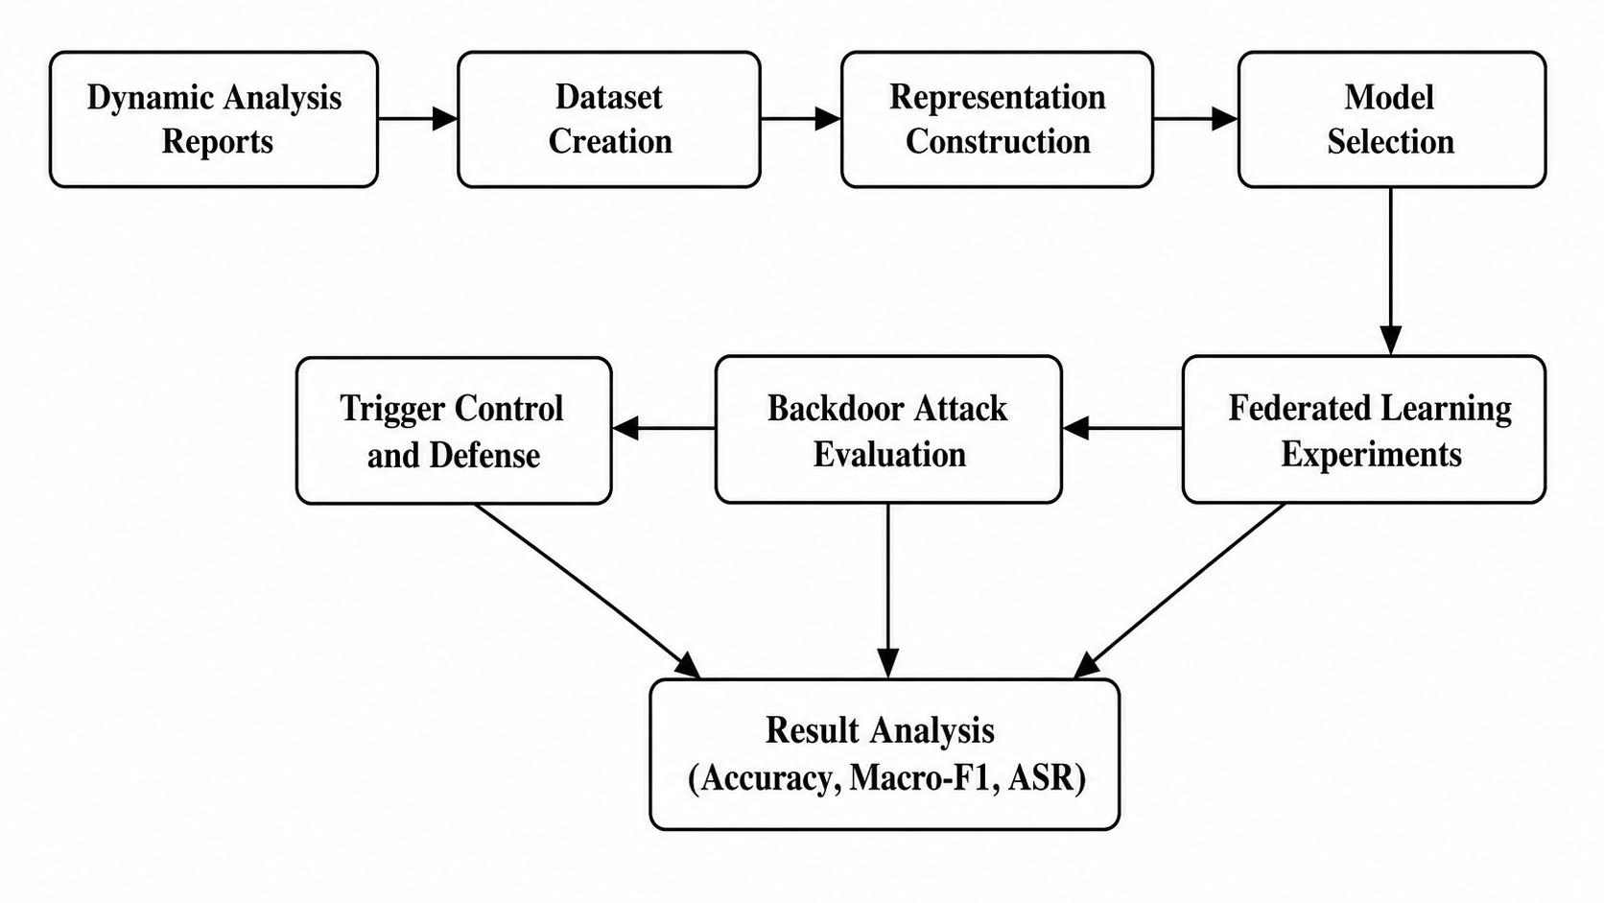
PROPOSED METHOD · 1 / 4
Overall Research Workflow
Fig. 1. Overall research workflow of the proposed study.
4 / 17
Notes:
Suggested time: 0:30 (3:05 of 15:00 at the end of this slide).
SCRIPT
This is the overall workflow. We start from dynamic analysis reports, create the dataset, construct the representations and select the model. Then we run the federated learning experiments, evaluate the backdoor attacks, and finish with trigger controls and defenses. We report accuracy and macro-F1 throughout, and attack success rate for every attack.

Slide 5
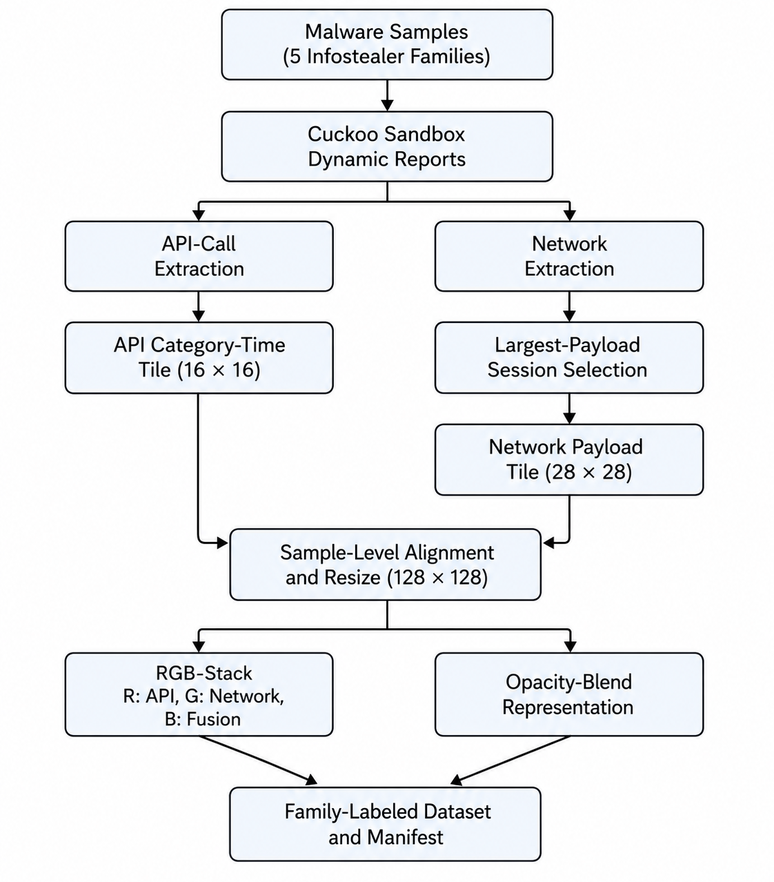
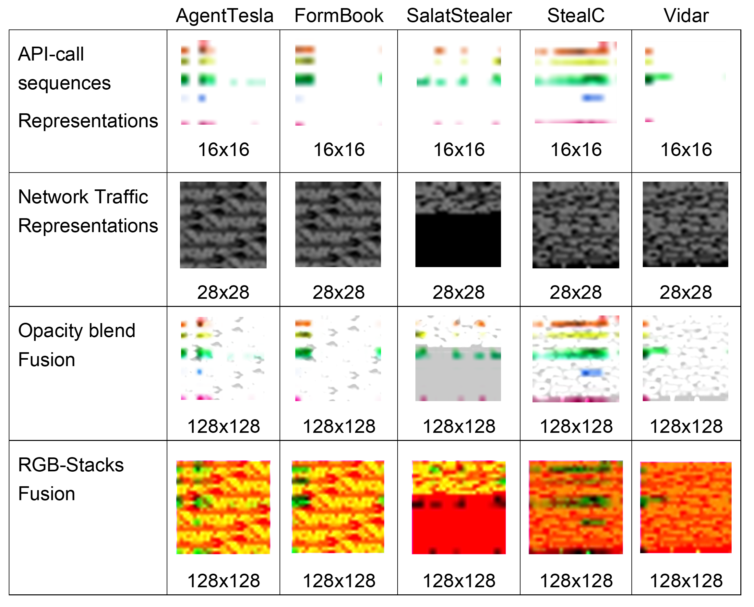
PROPOSED METHOD · 2 / 4
From Sandbox Reports to Image Tiles Channel-Separated RGB-Stack Representation
Fig. 3. Representative processed malware representations generated from dynamic API-call and network packet artifacts. Rows illustrate different representation types, while columns correspond to the five infostealer families.
Fig. 2. Dataset creation pipeline from dynamic analysis reports to dynamic
API-call and network representations.
[3] P. Wu et al., Computers & Security, 2025; [4] R. E. Davis et al., IEEE Access, 2024; [5] B. Xuan et al., Computers & Security, 2024; [17] A. Pektaş and T. Acarman, IET Information Security, 2018; [18] T. Chen et al., Computers & Security, 2024; [19] D. Vasan et al., Computers & Security, 2020
5 / 17
Notes:
Suggested time: 1:10 (4:15 of 15:00 at the end of this slide).
SCRIPT
[Left figure.] Each sample is run in Cuckoo Sandbox, and we take two artifacts from the report. API calls are mapped into behavior categories and counted over time, which gives a 16 by 16 category-by-time tile. On the network side, we keep only the session with the largest payload, to reduce leakage between samples. We reshape it into a 28 by 28 tile.
[Right figure.] Here are the resulting images for the five families. We compare two ways of combining the tiles. Opacity blend mixes both sources into every channel. RGB-stack keeps them apart: red is the API tile, green is the network tile, and blue is an edge map of their average.
So blue adds no new information, and it is the emptiest channel: almost 63 percent of its pixels are exactly zero. Keep that in mind; it comes back at the end.

Slide 6
PROPOSED METHOD · 3 / 4
Dataset Creation
TABLE I. Dataset Summary and Stratified Split
Family | Total | Train | Val. | Test
AgentTesla | 100 | 70 | 15 | 15
FormBook | 100 | 70 | 15 | 15
SalatStealer | 100 | 70 | 15 | 15
StealC | 100 | 70 | 15 | 15
Vidar | 100 | 70 | 15 | 15
Total | 500 | 350 | 75 | 75
6 / 17
Notes:
Suggested time: 0:25 (4:40 of 15:00 at the end of this slide).
SCRIPT
The dataset has five families, AgentTesla, FormBook, SalatStealer, StealC and Vidar, with 100 samples each, so 500 in total. We split it 70, 15 and 15 percent into training, validation and test, stratified by family, and we draw a new split for each seed.
Q&A NOTES
The text for Table I is on the backup slide.

Slide 7
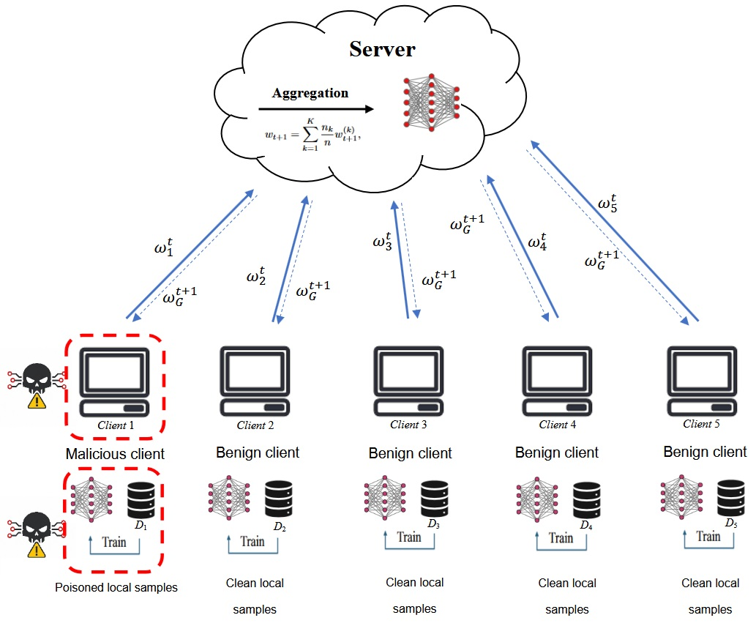
PROPOSED METHOD · 4 / 4
Channel-Aware Backdoor in Federated Learning
Each client holds 70 images, 14 per family, the partition is balanced and IID.
Targeted backdoor with one malicious client: it inserts trigger into AgentTesla training and relabels them as FormBook [7], [8].
The poison rate is 20% of the attacker's 14 AgentTesla training images, i.e., two images per round, resampled every round.
Because RGB-stack preserves channel-level semantics, four trigger settings are evaluated: red/API, green/network, blue/fusion and full RGB.
Fig. 4. Federated learning architecture used in this study, consisting of one central server and five clients. One client is malicious in the backdoor attack setting.
[6] M. Nobakht et al., Computers and Electrical Engineering, 2024; [7] Q. Ren et al., Computers & Security, 2024; [8] W. Jiang et al., CVPR, 2023; [10] B. McMahan et al., AISTATS, 2017; [23] P. Fang and J. Chen, AAAI, 2023
7 / 17
Notes:
Suggested time: 1:05 (5:45 of 15:00 at the end of this slide).
SCRIPT
We use one server and five clients. Each client holds 70 images, 14 per family, so the partition is balanced and IID. The server aggregates the updates with FedAvg.
One client is malicious and runs a targeted backdoor. It puts a small white square trigger on AgentTesla training images and relabels them as FormBook. The poison rate is 20 percent of its 14 AgentTesla images, so only two images per round, resampled every round. It is pure data poisoning, with no update scaling and no model replacement.
Attack success rate is how many of the 15 AgentTesla test images, with the trigger added, the model labels as FormBook. Because RGB-stack keeps the channels separate, we can put the trigger in red, green, blue, or all three, and compare them.

Slide 8
EXPERIMENTAL SETUP
Training, Defense and Evaluation
TABLE II. Experimental Environment
Component | Specification
Dynamic analysis | Cuckoo Sandbox on Ubuntu
Training environment | Windows, Python / Anaconda
Framework | PyTorch with CUDA 12.8
GPU | NVIDIA GeForce RTX 3080, 12 GB VRAM
Training Federated Learning
The best model reported FL model is the final-round global model, with no best-validation selection.
Clean accuracy, macro-F1 and ASR are the primary metrics, over seeds 42, 123 and 2026.
Defense and trigger control
Training
Multi-Krum is the primary defense, taken as a standard robust-aggregation baseline [12].
L₂-norm clipping, coordinate-wise median and trimmed mean are screened alongside it [13].
As a control, the same triggers are applied at test time to the clean FL model.
Component | Specification
Batch size | 16
Learning rates and weight decay | 10⁻⁴
FL server rounds | 50
FL local rounds | 2
Optimizer | AdamW
[12] P. Blanchard et al., NeurIPS, 2017; [13] D. Yin et al., ICML, 2018
8 / 17
Notes:
Suggested time: 1:10 (6:55 of 15:00 at the end of this slide).
SCRIPT
[Left tables.] Training runs in PyTorch on an RTX 3080, and the federated learning is a simulation we implemented ourselves in PyTorch. The model is trained from scratch with AdamW and batch size 16. The learning rate and the weight decay are both ten to the minus four. We run 50 federated rounds, with two local epochs per round.
[Right box.] We report the final-round global model, with no best-validation selection, and we measure clean accuracy, macro-F1 and attack success rate over three seeds: 42, 123 and 2026.
For defense, Multi-Krum is our main robust-aggregation baseline. It scores each update by its distance to the others and keeps the most central ones. We also screen clipping, coordinate-wise median and trimmed mean. As a control, we apply the same triggers at test time to a clean model that never saw poisoned data.
Q&A NOTES
The text for Table II is on the backup slide. The seed-42 deviation belongs to Table VI; it is footnoted on slide 12 and given in full on the backup slide.

Slide 9
RESULTS · 1 / 5
Backbone Selection Results
TABLE III. Backbone Selection
Representation | Backbone | Acc. | Macro-F1
Opacity blend | SmallCNN | 0.5333 | 0.5298
Opacity blend | MobileNetV2 | 0.6933 | 0.6903
Opacity blend | ResNet18 | 0.7733 | 0.7730
RGB-stack | SmallCNN | 0.5200 | 0.5144
RGB-stack | MobileNetV2 | 0.7200 | 0.7200
RGB-stack | ResNet18 | 0.7867 | 0.7884
Among the RGB-stack backbones in Table III, measured on seed 42, ResNet18 is the strongest, at 78.67% accuracy and 78.84% macro-F1, and is used for all later experiments; the opacity-blend rows are listed for reference only.
[20] D. Zhang et al., Alexandria Engineering Journal, 2025; [21] M. Sandler et al., CVPR, 2018; [22] K. He et al., CVPR, 2016
9 / 17
Notes:
Suggested time: 0:35 (7:30 of 15:00 at the end of this slide).
SCRIPT
Now the results. First, the model. Within RGB-stack, measured on seed 42, ResNet18 is the strongest backbone, at about 79 percent on both accuracy and macro-F1, so we use it for everything that follows. The opacity-blend rows come from a different data split, so they are for reference only, not a head-to-head comparison. We chose RGB-stack because we need the channels to be separate.
Q&A NOTES
From the paper, III.C: The two representations use different split files, so Table III is not a paired comparison: RGB-stack is chosen because channel separation is required here, and macro-F1 selects only the backbone within it.

Slide 10
RESULTS · 2 / 5
Channel-Aware Backdoor Sweep
TABLE IV. Channel-Aware Backdoor Sweep Using Seed 42
Table IV shows that blue/fusion and full-RGB triggers achieve 100% ASR while red/API and green/network do not, and that blue/fusion does so without modifying all three channels.
The difference is categorical. Pooled over the triggered samples, blue/fusion and full RGB differ from their trigger controls with Fisher exact p = 3.5 × 10⁻¹⁹ and p = 2.6 × 10⁻¹⁸, and blue differs from red and green at p = 4.0 × 10⁻⁸, whereas red and green are indistinguishable from their own controls (both p = 1, 5/15 against 4/15, seed 42 only).
Pooling is legitimate because the split is re-drawn per seed.
Trigger | Clean Acc. | Macro-F1 | ASR
Red/API | 0.8533 | 0.8524 | 0.3333
Green/network | 0.8400 | 0.8419 | 0.3333
Blue/fusion | 0.8400 | 0.8395 | 1.0000
Full RGB | 0.8400 | 0.8401 | 1.0000
10 / 17
Notes:
Suggested time: 1:10 (8:40 of 15:00 at the end of this slide).
SCRIPT
This is the central result. On seed 42, we put the same trigger into each channel in turn.
Red, the API channel, and green, the network channel, reach only five out of fifteen, 33 percent. Their trigger controls give four out of fifteen, and the difference is not significant, so on that seed they are indistinguishable from the model's natural confusion.
Blue and full RGB reach 100 percent. Clean accuracy stays at 84 to 85 percent in every case, so the model still looks healthy.
The striking part is blue. A trigger in the fusion channel alone is as effective as a trigger across all three channels. And the difference is categorical: pooled over the three seeds, blue and full RGB differ from their controls with p-values below ten to the minus seventeen.

Slide 11
RESULTS · 3 / 5
Defense Screening
TABLE V. Single-Seed Defense Screening Against Strongest Attacks Using Seed 42
Table V gives a seed-42 screening against both strongest attacks: clipping, coordinate-wise median and trimmed mean all leave ASR at 1.0000.
Only Multi-Krum reduces it, and only under full RGB (1.0000 to 0.4000, clean accuracy 0.8400 to 0.7600), so Multi-Krum is taken to the multi-seed evaluation.
Trigger | Defense | Clean Acc. | Macro-F1 | ASR
Blue/fusion | None | 0.8400 | 0.8395 | 1.0000
Blue/fusion | Clipping | 0.8533 | 0.8550 | 1.0000
Blue/fusion | Median | 0.8133 | 0.8120 | 1.0000
Blue/fusion | Trimmed mean | 0.8267 | 0.8244 | 1.0000
Blue/fusion | Multi-Krum | 0.8267 | 0.8244 | 1.0000
Full RGB | None | 0.8400 | 0.8401 | 1.0000
Full RGB | Clipping | 0.8533 | 0.8550 | 1.0000
Full RGB | Median | 0.8400 | 0.8388 | 1.0000
Full RGB | Trimmed mean | 0.8133 | 0.8145 | 1.0000
Full RGB | Multi-Krum | 0.7600 | 0.7542 | 0.4000
[12] P. Blanchard et al., NeurIPS, 2017; [13] D. Yin et al., ICML, 2018
11 / 17
Notes:
Suggested time: 0:40 (9:20 of 15:00 at the end of this slide).
SCRIPT
Can standard defenses stop it? We first screened four defenses on seed 42. Clipping, coordinate-wise median and trimmed mean all leave the attack success rate at 100 percent for both triggers. Only Multi-Krum reduces it, and only for full RGB: from 100 to 40 percent, with clean accuracy dropping from 84 to 76 percent on this seed. Against the blue trigger, even Multi-Krum stays at 100 percent. So Multi-Krum is the only defense we carried into the multi-seed evaluation.

Slide 12
RESULTS · 4 / 5
Multi-Seed Results
TABLE VI. Main Multi-Seed Results Under IID Federated Setting, With Per-Seed Values
Scenario | Channel | Clean Acc. | Macro-F1 | ASR / Target Rate | Per seed (42, 123, 2026)
Clean FL | – | 0.8267 ± 0.0134 | 0.8255 ± 0.0104 | – | –
Trigger control | Blue/fusion | 0.8267 ± 0.0134 | 0.8255 ± 0.0104 | 0.1333 ± 0.1155 | 4/15, 1/15, 1/15
Trigger control | Full RGB | 0.8267 ± 0.0134 | 0.8255 ± 0.0104 | 0.1556 ± 0.1018 | 4/15, 1/15, 2/15
Backdoor, FedAvg | Blue/fusion | 0.8311 ± 0.0539 | 0.8320 ± 0.0539 | 1.0000 ± 0.0000 | 15/15, 15/15, 15/15
Backdoor, FedAvg | Full RGB | 0.8267 ± 0.0611 | 0.8262 ± 0.0621 | 1.0000 ± 0.0000 | 15/15, 15/15, 15/15
Backdoor, Multi-Krum | Blue/fusion | 0.8178 ± 0.0154 | 0.8184 ± 0.0135 | 0.5111 ± 0.4286† | 15/15, 3/15, 5/15
Backdoor, Multi-Krum | Full RGB | 0.7956 ± 0.0407 | 0.7931 ± 0.0427 | 0.6000 ± 0.3464† | 6/15, 15/15, 6/15
† Across-seed ASR range ≥ 0.5: the outcome is bimodal, so the mean describes no individual run and the per-seed counts (out of 15 source samples) should be read instead.
One deviation must be stated: the seed-42 clean baseline in Table VI and the seed-42 trigger controls come from a 30-round, one-local-epoch run. No ASR result is affected; every backdoor and defense run uses the common budget.
Across three seeds, blue/fusion and full-RGB backdoors achieve 100% ASR while keeping clean performance comparable to the clean FL baseline.
In seven of the eight trigger controls the target rate is identical with and without the trigger, so the ASR is not an artifact of the pattern.
12 / 17
Notes:
Suggested time: 1:25 (10:45 of 15:00 at the end of this slide).
SCRIPT
[Point to the highlighted rows.] Over three seeds, under FedAvg, both the blue and the full-RGB backdoors reach fifteen out of fifteen on every seed. Clean accuracy stays comparable to the clean baseline, at about 83 percent.
For transparency: the seed-42 clean baseline and its trigger controls come from a shorter run, 30 rounds with one local epoch. Re-trained at the full budget, the control rate is six out of fifteen instead of four. No attack success result is affected.
Across all eight controls, the six in this table plus red and green on seed 42, seven give exactly the same target rate with and without the trigger. So the attack success comes from poisoning, not from the pattern.
Now the Multi-Krum rows. The means, 51 and 60 percent, look like partial protection, but they are misleading. Per seed, blue gives 15, 3 and 5 out of 15, and full RGB gives 6, 15 and 6. On one seed out of three, the backdoor is fully effective. I will come back to this after the training curves.
Q&A NOTES
On the 30-round, one-local-epoch seed-42 clean baseline, from the paper, III.H: Re-training it under the common budget gives 0.7867 accuracy, 0.7869 macro-F1 and a control rate of 6/15 rather than 4/15, so the reported run sets a higher bar for the clean-performance claim and a lower one for the trigger-control argument. No ASR result is affected; every backdoor and defense run uses the common budget. From IV.B: red and green are indistinguishable from their own controls (both p = 1, 5/15 against 4/15, seed 42 only). The 5/15 is their backdoor ASR; their clean-model controls give 4/15 both with and without the trigger (results/trigger_control).

Slide 13
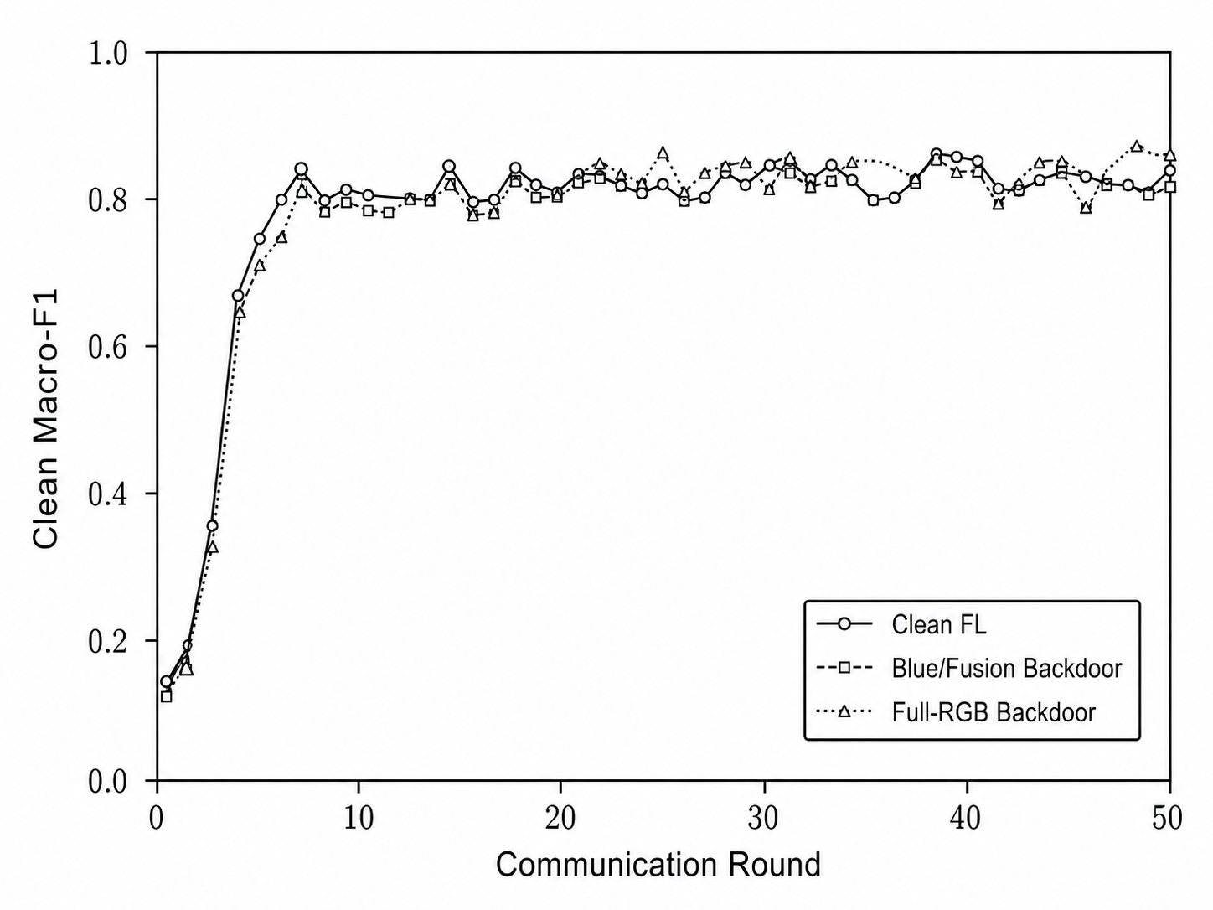
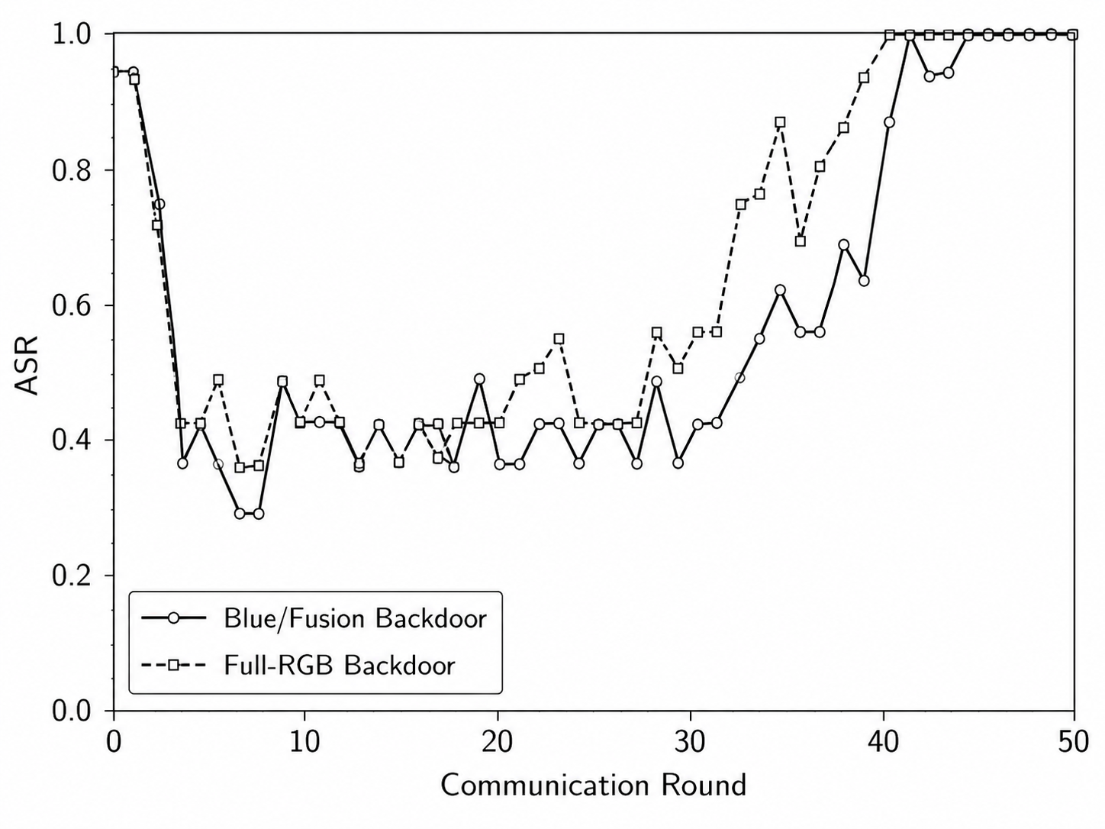
RESULTS · 5 / 5
Clean Macro-F1 and ASR over FL Rounds
Fig. 5. Clean macro-F1 over FL communication rounds for the clean FL baseline and the strongest backdoor settings, using seed 42.
Fig. 6. Attack success rate (ASR) over FL communication rounds for the strongest blue/fusion and full-RGB backdoor settings, using seed 42.
13 / 17
Notes:
Suggested time: 0:35 (11:20 of 15:00 at the end of this slide).
SCRIPT
These curves show the same story during training, for seed 42. On the left, the clean macro-F1 of the backdoored models tracks the clean baseline. On the right, the attack success rate climbs to 100 percent in the later rounds. The high values in the first few rounds mean nothing: the model is still almost untrained and predicts only one or two classes.
Q&A NOTES
From the paper, IV.D: Figures 5 and 6 show clean macro-F1 holding steady while ASR climbs to 100%. The first rounds are not meaningful: the global model is still close to initialization and collapses onto one or two classes, producing the early spike before clean accuracy rises.

Slide 14
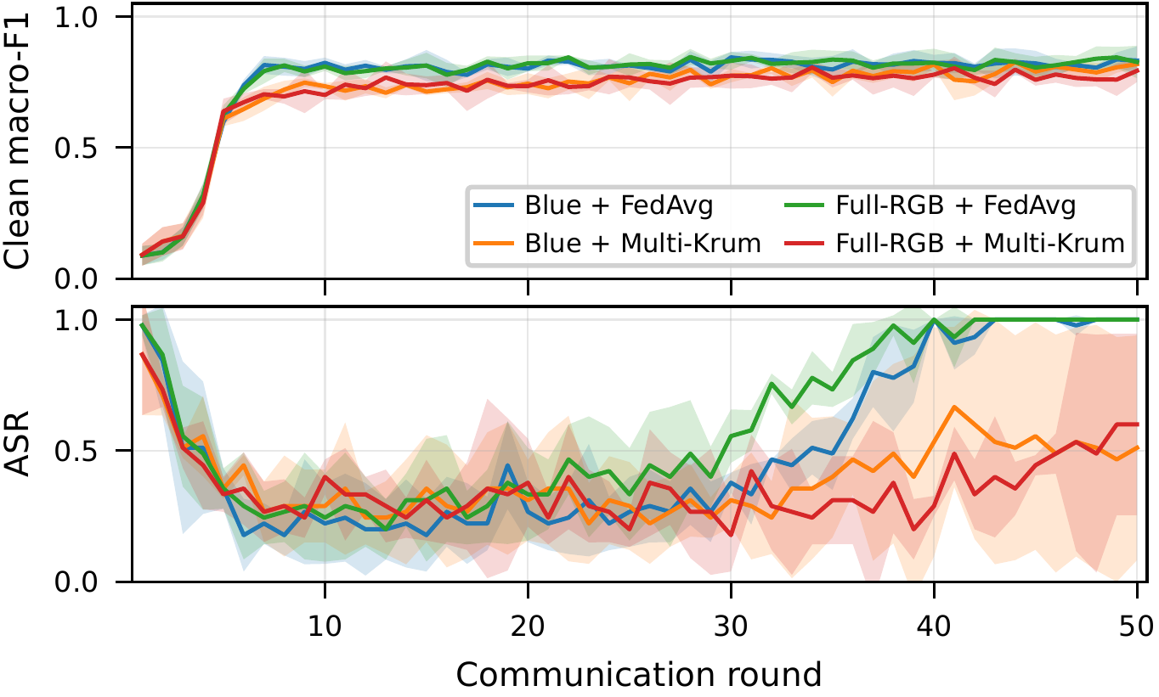
DISCUSSION · 1 / 2
Defense Analysis: Bimodal Rather Than Partial
The last two rows of Table VI report Multi-Krum per seed as well as on average, because the mean is misleading here.
For both triggers the across-seed ASR range is at least 0.5, with nothing in between: on some seeds the backdoor remains fully effective, on the others most of it is suppressed.
The outcome tracks how often the poisoned update survives selection: across the six runs the malicious client is retained in 8–50% of rounds, and that rate correlates with the final ASR (r = 0.893, p = 0.017, n = 6).
Consistent with Table VI, Multi-Krum does not settle at a stable partial suppression level: for each trigger one seed shows no suppression at all, so it is unreliable as a standalone defense.
Fig. 7. Per-round clean macro-F1 and ASR across three random seeds for the blue/fusion and full-RGB backdoor settings under FedAvg and Multi-Krum. Shaded areas denote standard deviation across seeds.
14 / 17
Notes:
Suggested time: 1:10 (12:30 of 15:00 at the end of this slide).
SCRIPT
This figure shows the blue and full-RGB backdoors under FedAvg and under Multi-Krum, across the three seeds. [Bottom panel.] Under FedAvg, both triggers settle at 100 percent. Under Multi-Krum, the curves stay unstable. The outcome is bimodal: on a given seed, the backdoor is either mostly suppressed or not suppressed at all.
It tracks selection. Multi-Krum keeps two of the five updates in each round. The poisoned update is not an outlier in parameter space, so whether it is kept is close to a coin flip. Across the six Multi-Krum runs, the malicious client was kept in 8 to 50 percent of the rounds, and that rate correlates with the final attack success, with a correlation of 0.89. With only six runs, this is indicative rather than conclusive.
So Multi-Krum lowers the attack success on average, but it is unreliable as a standalone defense.
Q&A NOTES
Per seed (42, 123, 2026), Table VI: blue/fusion 15/15, 3/15, 5/15; full RGB 6/15, 15/15, 6/15. The shaded bands in Fig. 7 are the standard deviation across those seeds. From the paper, IV.E: With f = 1 and |S| = 2 of five, the poisoned update is not an outlier in parameter space, so keeping it is close to a coin flip that the attacker need only win often enough.

Slide 15
DISCUSSION · 2 / 2
The Blue/Fusion Channel
The ordering in Table IV
What it suggests, and what it does not
The ordering follows the intensity of the clean images: over all 500 images the mean value inside the trigger region is 214.6 in R, 48.3 in G and 21.6 in B, and 37.7% of red trigger-region pixels are already at least 254, where the trigger changes nothing.
Contrast explains red's failure but not green's, whose contrast is 207.
Since blue is a deterministic edge map of the other two, its effectiveness cannot come from information they lack; what distinguishes it is that it is almost empty, so the trigger is the only strong response there.
That the blue trigger works because its channel is nearly empty, rather than because of what that channel encodes, is consistent with the measurements but not established.
15 / 17
Notes:
Suggested time: 1:00 (13:30 of 15:00 at the end of this slide).
SCRIPT
Finally, why does blue work when red and green do not? Inside the trigger region of the clean images, red is already very bright, with a mean of 214.6. And 37.7 percent of its pixels are already at 254 or above, where a white trigger changes nothing at all. Green's mean is only 48.3, so a white trigger adds a contrast of about 207, and green still fails.
Blue's mean is just 21.6. It cannot win through new information, because it is computed from red and green. What distinguishes it is that it is almost empty, so the trigger is the only strong signal there. This explanation fits our measurements, but it is not proven; a contrast-matched trigger would test it.
Q&A NOTES
Contrast here is 255 minus the mean value inside the trigger region, so green's contrast is 255 - 48.3, about 207 (docs/CODE_FACTS.md). The contrast-matched trigger that would test the emptiness explanation is future work.

Slide 16
CONCLUSION AND FUTURE WORK
Conclusion and Future Work
The novelty is to treat the representation's channels as the attack surface: a trigger confined to the fusion channel alone matches one spanning all three, even though that channel is derived from the other two.
Blue/fusion and full-RGB triggers reached 100% ASR across three seeds while keeping clean performance close to the baseline, and in seven of the eight trigger controls the target rate was identical with and without the trigger, so the effect came from poisoning rather than the trigger pattern.
Multi-Krum reduced ASR bimodally rather than partially, leaving the backdoor fully effective (15/15) on one of the three seeds for each trigger.
Channel-aware backdoors therefore pose a serious threat to federated malware classifiers in this controlled IID setting, and motivate representation-aware defenses.
Limitations and future work
The main limitations are the IID-only partition, a single source–target pair, and three seeds, with the red and green results resting on seed 42 alone. That the blue trigger works because its channel is nearly empty, rather than because of what that channel encodes, is consistent with the measurements but not established; a non-IID partition, a second source–target pair and a contrast-matched trigger are left to future work.
16 / 17
Notes:
Suggested time: 1:20 (14:50 of 15:00 at the end of this slide).
SCRIPT
The main message is that the channels of this representation are an attack surface. A trigger in the fusion channel alone matches one spanning all three channels, even though that channel is derived from the other two.
Blue and full-RGB triggers reached 100 percent attack success across three seeds, with clean performance close to the baseline, and the trigger controls show that the effect comes from poisoning. Multi-Krum reduced the attack only bimodally: for each trigger, it left the backdoor fully effective on one of the three seeds.
So, in this controlled IID setting, channel-aware backdoors are a serious threat to federated malware classifiers. They motivate defenses that look at the representation, not only at the updates.
Our main limitations are the IID-only partition, a single source-target pair, and three seeds, with the red and green results on seed 42 only. The next steps are a non-IID partition, a second source-target pair, and a contrast-matched trigger.

Slide 17
Thank you
Mochamad Asryl Aziz · Moh. Jabir Mubarok · Eka Fitria
mochamadasryl93@gmail.com · jabirmubarok@gmail.com · ekafitria2@mhs.usk.ac.id
17 / 17
Notes:
Suggested time: 0:10 (15:00 of 15:00 at the end of this slide).
SCRIPT
Thank you for your attention. I am happy to take your questions.

Slide 18
BACKUP
Notes on Tables I, II and VI and Figs. 5–6
Table I
slide 6
Tiles are aligned per sample and recorded in a manifest organized by family, which supports stratified splitting and reproducibility.
With 100 samples per family the dataset holds 500 representations, split 70%–15%–15% into training, validation and test partitions, stratified by family.
Table II
slide 8
Dynamic analysis and model training run on the separate environments listed in Table II.
Table VI
slide 12
One deviation must be stated: the seed-42 clean baseline in Table VI and the seed-42 trigger controls come from a 30-round, one-local-epoch run. Re-training it under the common budget gives 0.7867 accuracy, 0.7869 macro-F1 and a control rate of 6/15 rather than 4/15, so the reported run sets a higher bar for the clean-performance claim and a lower one for the trigger-control argument. No ASR result is affected; every backdoor and defense run uses the common budget.
Figs. 5–6
slide 13
Figures 5 and 6 show clean macro-F1 holding steady while ASR climbs to 100%. The first rounds are not meaningful: the global model is still close to initialization and collapses onto one or two classes, producing the early spike before clean accuracy rises.
[19] D. Vasan et al., Computers & Security, 2020
Backup 1

Slide 19
The dataset is built from Cuckoo Sandbox reports for five Windows infostealer families: AgentTesla, FormBook, SalatStealer, StealC and Vidar.
API-call events are converted into a 16 × 16 category-by-time tile by normalizing the execution timeline, mapping API names into predefined behavior categories, and counting category occurrences over fixed time intervals.
To reduce sample-level leakage, only the session with the largest payload is selected for each malware sample, then truncated or padded and reshaped into a 28 × 28 network tile.
In RGB-stack the API and network tiles are converted to grayscale, min–max normalized per image and resized to 128 × 128; red carries API-call behavior, green network behavior, and blue is the edge map of their average, B = FindEdges((R+G)/2).
Blue is thus a deterministic function of the other two channels, adds no independent information, and is by far the emptiest: 62.8% of its pixels are exactly zero.
RGB-stack is used here because only it separates the sources by channel.
[4] R. E. Davis et al., IEEE Access, 2024; [5] B. Xuan et al., Computers & Security, 2024; [18] T. Chen et al., Computers & Security, 2024

Slide 20
The selected representation–backbone pair is trained in a simulated FL setting with one central server and five clients. Each client holds 70 images, 14 per family, so the partition is balanced and IID.
We assume a targeted backdoor with one malicious client: it inserts a square image-level trigger into AgentTesla training images and relabels them as FormBook.
The poison rate is 20% of the attacker's 14 AgentTesla training images, i.e., two images per round, resampled every round.
Because RGB-stack preserves channel-level semantics, four trigger settings are evaluated: red/API, green/network, blue/fusion and full RGB.
[7] Q. Ren et al., Computers & Security, 2024; [8] W. Jiang et al., CVPR, 2023

