Slide 1
Data Mining & Machine Learning
AN EXPLAINABLE ML FRAMEWORK
Predicting Student Dropout
Before It Happens
A leakage-safe, nested cross-validated benchmark of five classifiers and three imbalance strategies — built to flag at-risk students early, and to explain why a student is at risk, not just that they are.
Slim Jabou
Klajdi Barci
Student Dropout Prediction Project
Data Mining & Machine Learning

Slide 2
SECTION 01
01
The Challenge & The Data
Why dropout is expensive to miss, what the raw data looks like, and the early warning signals that surface before a single model is trained.

Slide 3
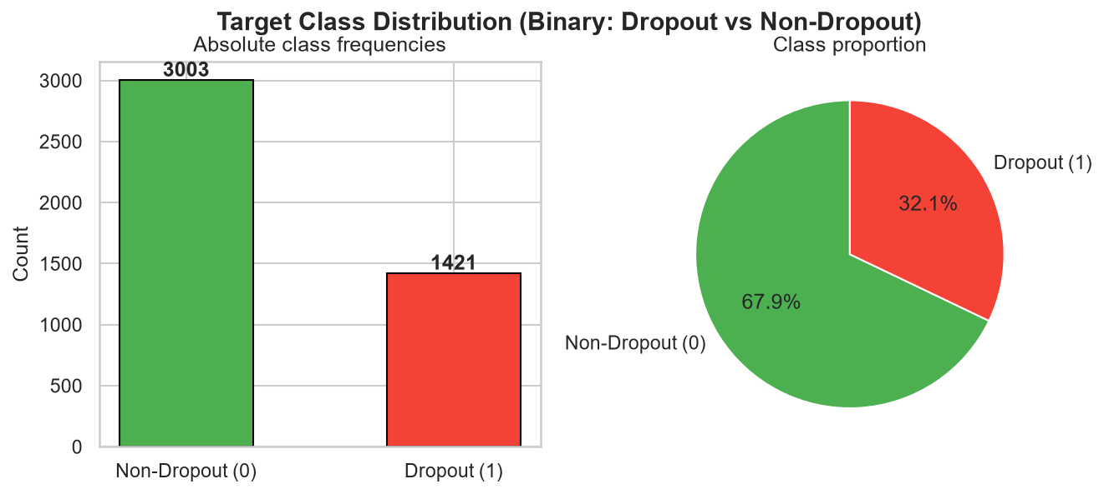
THE PROBLEM
One in Three Students Never Finishes
Dropout is not a rare edge case in this population it is the single most common non-graduating outcome, which makes early, reliable detection a high-leverage intervention point for any institution.
32.1%
67.9%
of students in the dataset dropped out (1,421 of 4,424)
stayed enrolled or graduated — the majority class the model must not simply default to
■ The cost of missing a dropout is a lost student, lost tuition, and a lost outcome that follow-up support could plausibly have prevented.
■ The cost of a false alarm is a wasted advising conversation — cheap by comparison. This asymmetry shapes every modeling choice that follows.
■ Framed this way, the project goal is not “classify students” —it's rank students by risk early enough to act.
Fig. 1 — Binary target distribution after reformulation. Class imbalance (~2:1) is the first design constraint the pipeline must handle correctly.
STUDENT DROPOUT PREDICTION | Slim Jabou & Klajdi Barci
01 · THE CHALLENGE
03 / 24

Slide 4
THE DATASET
36 Signals Collected at Enrollment & Two Semesters
4,424
35
17
0
students, Polytechnic Institute of Portalegre, Portugal (UCI ID 697)
usable features: demographic, socio-economic, macro-economic & academic
undergraduate programmes, coded as a categorical “Course” feature
missing values — the raw data was clean out of the box
Target reformulation
Feature families
■ Academic record — units credited / enrolled / evaluated / approved / graded, for both 1st and 2nd semester
■ Socio-economic — scholarship, debtor status, tuition payment status, parental occupation & qualification
■ Demographic — age at enrollment, gender, marital status, displacement, special needs
■ Macro-economic — regional unemployment rate, inflation, GDP at time of enrollment
Graduate
+
Enrolled
→
Non-Dropout
49.9%
17.9%
67.9%
Dropout
→
Dropout (1)
32.1%
intervention target
The original 3-class label (Graduate / Enrolled / Dropout) is collapsed to binary. The goal is distinguishing at-risk students from everyone else.
The framework also supports an early-intervention mode that drops 2nd-semester columns entirely. Results shown here use the full-year feature set for maximum signal.
STUDENT DROPOUT PREDICTION | Slim Jabou & Klajdi Barci
01 · THE CHALLENGE
04 / 24

Slide 5
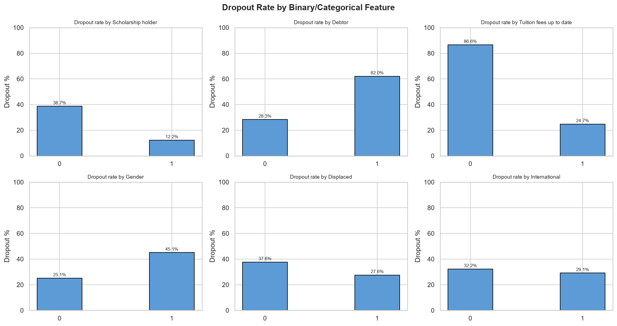
EXPLORATORY SIGNAL
Money Problems Predict Dropout Better Than Demographics
Before any model is trained, simple group-by dropout rates already reveal which levers matter — and which barely move the needle.
■ 2.2× Students with unpaid debts drop out at 62.0% vs 28.3% for those without.
■ 3.5× Falling behind on tuition fees flips dropout risk from 24.7% to 86.6% — the single starkest split in the dataset.
■ 3.2× Scholarship holders drop out at only 12.2% vs 38.7% for non-holders — financial support works.
■ Weaker Gender, displacement and international status shift risk by only a few points — they are not where the signal lives.
Fig. 2 — Dropout rate split by binary/categorical feature (0 vs 1).
READING
Financial precarity — debt, unpaid fees, absent scholarship — is a far stronger early-warning signal than who the student is. This foreshadows what SHAP later confirms independently.
STUDENT DROPOUT PREDICTION | Slim Jabou & Klajdi Barci
01 · THE CHALLENGE
05 / 24

Slide 6
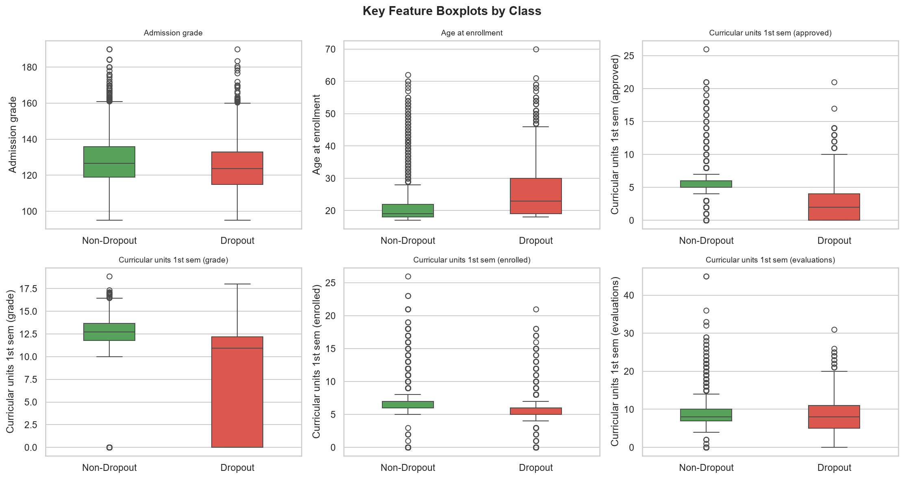
EXPLORATORY SIGNAL
Academic Momentum Separates the Two Groups Cleanly
Curricular-unit completion in the very first semester already shows a large, visible gap between students who stay and students who leave.
■ Units approved, 1st semester: dropout students cluster near 0–4 approved units; non-dropout students cluster near 5–7.
■ Grade, 1st semester: dropout distribution collapses toward 0 for a large sub-group — consistent with early disengagement, not just weak performance.
■ Age at enrollment: dropout students skew slightly older and more spread out (median ≈23 vs ≈20), hinting at non-traditional students juggling more constraints.
■ Enrollment and evaluation counts are similar across classes — it's completion, not attempt, that differentiates.
Fig. 3 — Key numeric features split by class (green = non-dropout, red = dropout).
STUDENT DROPOUT PREDICTION | Slim Jabou & Klajdi Barci
01 · THE CHALLENGE
06 / 24

Slide 7
SECTION 02
02
Methodology
A leakage-safe pipeline, three ways of handling imbalance, and a nested cross-validation design built specifically to avoid reporting an optimistic, overfit number.

Slide 8
ARCHITECTURE
One Pipeline Object, Zero Data Leakage
Every step — scaling, encoding, resampling, and the classifier itself — lives inside a single scikit-learn / imbalanced-learn Pipeline, fit fresh on every fold.
Raw Features
→
StandardScaler
→
One-Hot Encode
→
Imbalance Strategy
→
Classifier
35 cols · 4,424 rows
27 numeric / binary cols
8 categorical cols
baseline / class_weight / SMOTE
LR · RF · AdaBoost · KNN · NB
WHY IT MATTERS #1
WHY IT MATTERS #2
WHY IT MATTERS #3
The scaler and one-hot encoder are fit only on the training fold — the ColumnTransformer's fit/transform split enforces this automatically, so test-fold statistics never leak into training.
SMOTE sits inside the pipeline, after encoding. Pipeline.predict() never invokes the resampler — synthetic rows exist only during .fit(), so the validation fold is always 100% real students.
SMOTE runs after one-hot encoding, so every dimension is already numeric — standard SMOTE behaves correctly without needing a categorical-aware variant (SMOTE-NC).
STUDENT DROPOUT PREDICTION | Slim Jabou & Klajdi Barci
02 · METHODOLOGY
08 / 24

Slide 9
HANDLING IMBALANCE
Three Ways to Tell the Model “Dropout Matters More”
With a 68/32 split, a lazy model can score 68% accuracy by predicting “non-dropout” every time. Three strategies were benchmarked head-to-head to see which is actually necessary.
STRATEGY A
STRATEGY B
STRATEGY C
Baseline
class_weight="balanced"
SMOTE Oversampling
No intervention at all. The classifier sees the natural 68/32 split and learns from it as-is.
Misclassifying a dropout is penalised more heavily during training — no new rows, just re-weighted loss.
Synthetic minority-class students are interpolated between real dropout neighbours, rebalancing the training fold.
Simplest possible option — the control condition.
Available for Logistic Regression, Random Forest, and AdaBoost's base tree.
Applied inside the pipeline, after encoding, training-fold only.
SPOILER, CONFIRMED LATER BY THE RESULTS
For the winning model, plain baseline narrowly beat both class_weight and SMOTE — the imbalance here (32%) is mild enough that a well-regularised linear model doesn't need correcting.
STUDENT DROPOUT PREDICTION | Slim Jabou & Klajdi Barci
02 · METHODOLOGY
09 / 24

Slide 10
VALIDATION DESIGN
Nested Cross-Validation: Tuning and Scoring Never Mix
A single CV loop used for both hyperparameter search and performance reporting is optimistic by construction. Nested CV separates the two concerns.
OUTER LOOP — STRATIFIED 5-FOLD
INNER LOOP — STRATIFIED 3-FOLD SEARCH
Produces an honest, out-of-sample estimate of how the selected model generalises. Stratification keeps the 32% dropout ratio consistent in every fold, avoiding unstable splits.
Runs only inside each outer training fold to pick hyperparameters — via RandomizedSearchCV (30 draws), later refined with GridSearchCV around the two strongest candidates.
5×
held-out test folds, each scored once by a model that never saw those rows in training or tuning
3×
inner folds per outer fold, scored on F1 for the Dropout class
NET EFFECT
Every reported metric is a true out-of-fold prediction — the model never grades its own homework.
STUDENT DROPOUT PREDICTION | Slim Jabou & Klajdi Barci
02 · METHODOLOGY
10 / 24

Slide 11
THE EXPERIMENTAL GRID
Screen Wide, Then Refine the Leaders
5
13
3
45
candidate classifiers in the framework's search space: LR, Random Forest, AdaBoost, KNN, Naive Bayes
valid model × strategy pipelines the framework can benchmark (KNN / Naive Bayes skip class_weight)
finalists carried into the reported benchmark: Logistic Regression, Random Forest, AdaBoost
nested-CV fits reported: 9 pipelines × 5 outer folds
Pass 1 — Screen
Pass 2 — Refine & Report
A RandomizedSearchCV sweep (30 draws per pipeline) is used to screen the full candidate pool under nested CV — cheap enough to cover every model × strategy combination.
GridSearchCV then exhaustively tunes the two strongest linear/ensemble finalists — Logistic Regression (C, solver) and AdaBoost (n_estimators, learning_rate) — with Random Forest kept as a fixed-hyperparameter benchmark.
Outcome baked into the project config: KNN and Naive Bayes trail clearly behind and are dropped; Logistic Regression, AdaBoost and Random Forest move forward.
Every result from this point forward comes from this refined, 9-pipeline nested-CV pass.
STUDENT DROPOUT PREDICTION | Slim Jabou & Klajdi Barci
02 · METHODOLOGY
11 / 24

Slide 12
SECTION 03
03
Results
Nine pipelines, five outer folds, one clear — and statistically honest — winner.

Slide 13
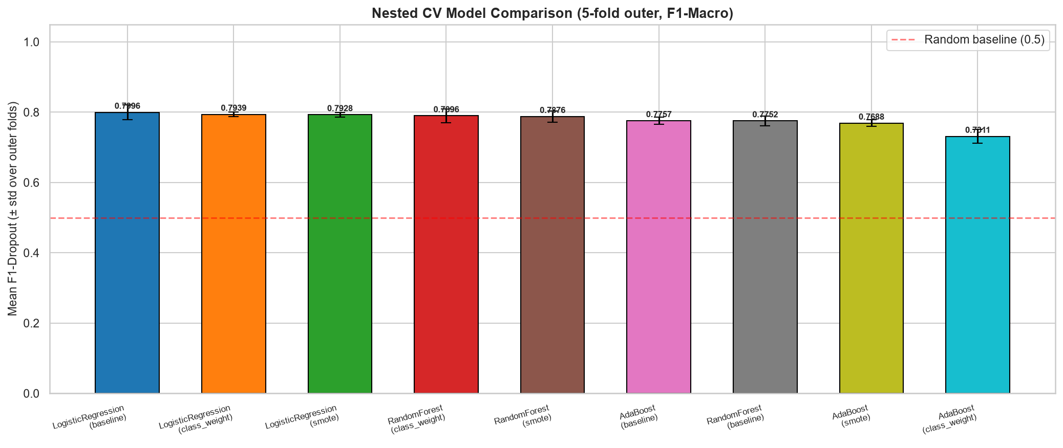
THE LEADERBOARD
Logistic Regression, Untouched by Resampling, Wins
Mean F1-score on the Dropout class across all 5 outer folds, ± one standard deviation.
WINNING PIPELINE
Logistic Regression
+ baseline (no resampling)
0.800
0.922
F1-Dropout (±0.021) — best of all 9 pipelines
ROC-AUC (±0.010) — also the single best AUC
■ All three Logistic Regression variants occupy the top 3 spots — the imbalance strategy barely matters for this model.
■ Random Forest (class_weight) is closest challenger at 0.790 F1-Dropout.
■ AdaBoost (class_weight) is the clear laggard at 0.731 — over-correcting for imbalance hurt more than it helped.
Fig. 4 — Nested CV model comparison, ranked by mean F1-Dropout.
STUDENT DROPOUT PREDICTION | Slim Jabou & Klajdi Barci
03 · RESULTS
13 / 24

Slide 14
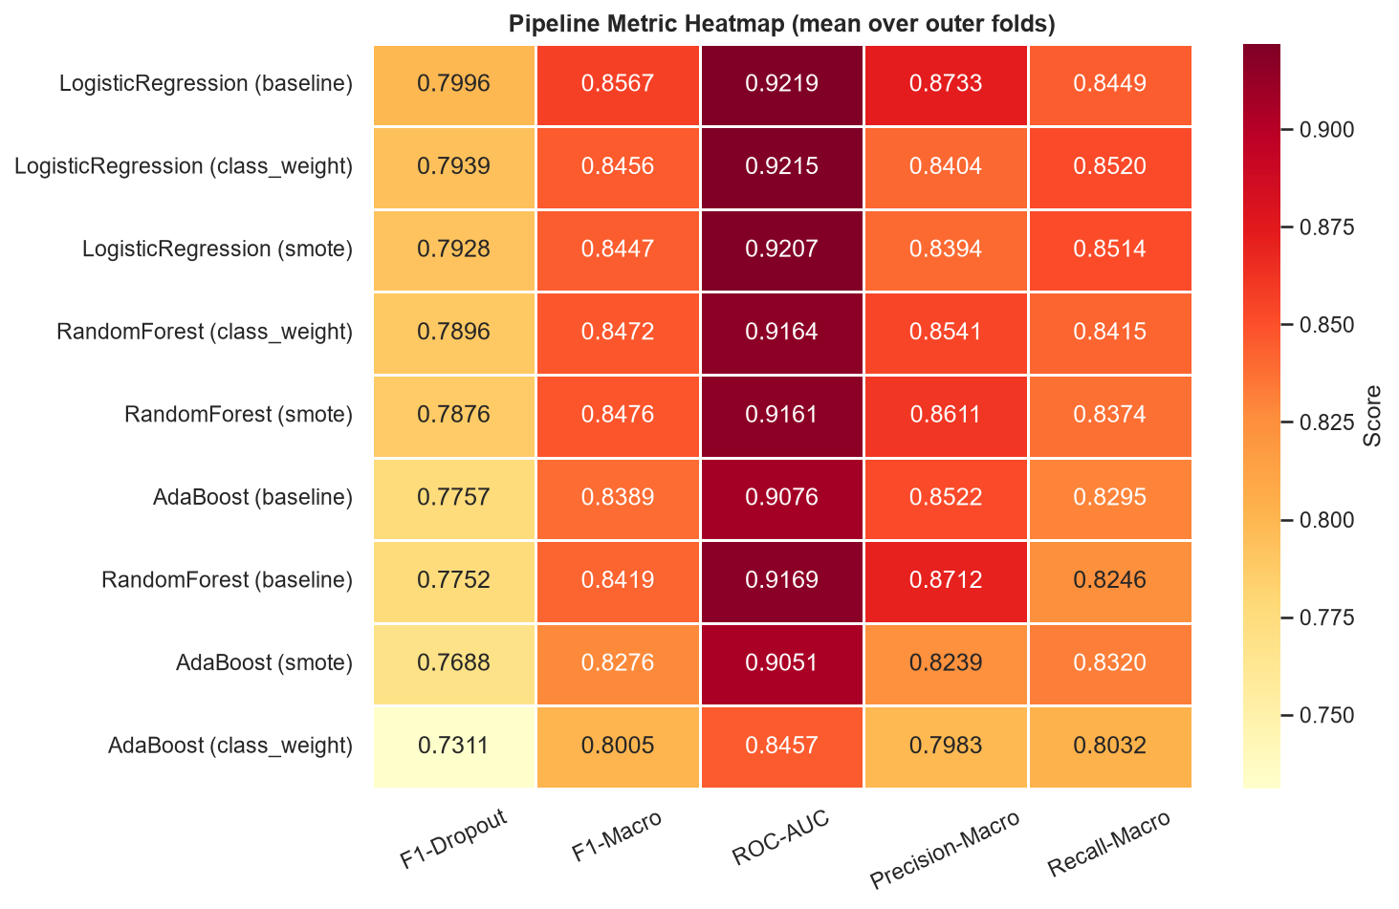
FULL METRIC BREAKDOWN
The Win Holds Across Every Metric, Not Just One
F1 alone can hide trade-offs. The heatmap checks precision, recall and AUC together — Logistic Regression baseline leads or ties on nearly all of them.
Pipeline | F1-Dropout | Precision | Recall | ROC-AUC
LogisticRegression (baseline) | 0.800 | 0.873 | 0.845 | 0.922
RandomForest (class_weight) | 0.790 | 0.854 | 0.842 | 0.916
AdaBoost (baseline) | 0.776 | 0.852 | 0.830 | 0.908
AdaBoost (class_weight) | 0.731 | 0.798 | 0.803 | 0.846
Precision (0.873) exceeding recall (0.845) for the winner means the model is slightly more cautious about calling a dropout than about catching one — a sensible default for an advising workflow, where a threshold can be tuned to trade one for the other.
Fig. 5 — Mean score per pipeline across five metrics, darker = higher.
STUDENT DROPOUT PREDICTION | Slim Jabou & Klajdi Barci
03 · RESULTS
14 / 24

Slide 15
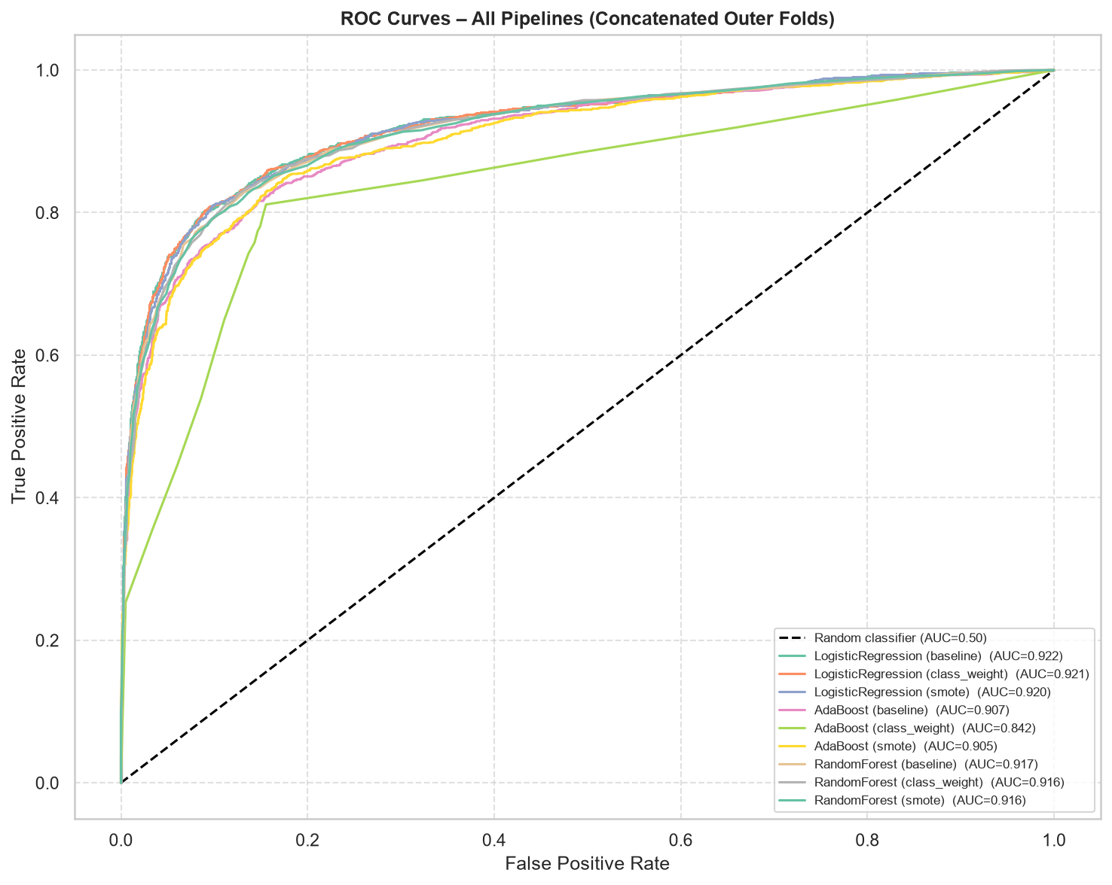
DISCRIMINATIVE POWER
Every Model Comfortably Beats Chance — Except One Setting
ROC curves built from concatenated out-of-fold predictions across all 5 outer folds, for every pipeline at once.
■ 8 of 9 pipelines cluster tightly between AUC 0.905–0.922 — a narrow, high-performing band.
■ Logistic Regression (baseline) traces the outermost curve: AUC = 0.922, the best separation of Dropout vs Non-Dropout at every threshold.
■ AdaBoost (class_weight) visibly peels away from the pack — AUC = 0.842 — confirming the F1 leaderboard's weakest result independently.
■ A curve this close to the top-left corner means the model isn't just accurate at one operating point — it stays strong across the whole precision/recall trade-off range.
Fig. 6 — ROC curves, all 9 pipelines overlaid.
STUDENT DROPOUT PREDICTION | Slim Jabou & Klajdi Barci
03 · RESULTS
15 / 24

Slide 16
IS THE DIFFERENCE REAL?
A Statistical Tie Among the Top Pipelines — By Design
Pairwise Wilcoxon signed-rank tests on per-fold F1 scores check whether any pipeline beats another by more than fold-to-fold noise.
Comparison | Mean F1 A | Mean F1 B | p-value | Significant?
LR (baseline) vs RandomForest (baseline) | 0.800 | 0.775 | 0.063 | No
LR (baseline) vs AdaBoost (baseline) | 0.800 | 0.776 | 0.125 | No
LR (baseline) vs LR (SMOTE) | 0.800 | 0.793 | 0.625 | No
AdaBoost (class_weight) vs LR (baseline) | 0.731 | 0.800 | 0.063 | No
WHY NOTHING IS “SIGNIFICANT”
With only 5 outer folds, a paired Wilcoxon test's smallest possible p-value is 0.0625 — it structurally cannot cross the 0.05 bar. So this isn't a null result; it's a power limit.
DECISION RULE
Full pairwise matrix: 36 comparisons across all 9 pipelines, α = 0.05. None reached significance.
When top pipelines are statistically indistinguishable, prefer the simplest, fastest, most interpretable one. Logistic Regression wins on those grounds too — and it happens to also post the best point estimate.
STUDENT DROPOUT PREDICTION | Slim Jabou & Klajdi Barci
03 · RESULTS
16 / 24

Slide 17
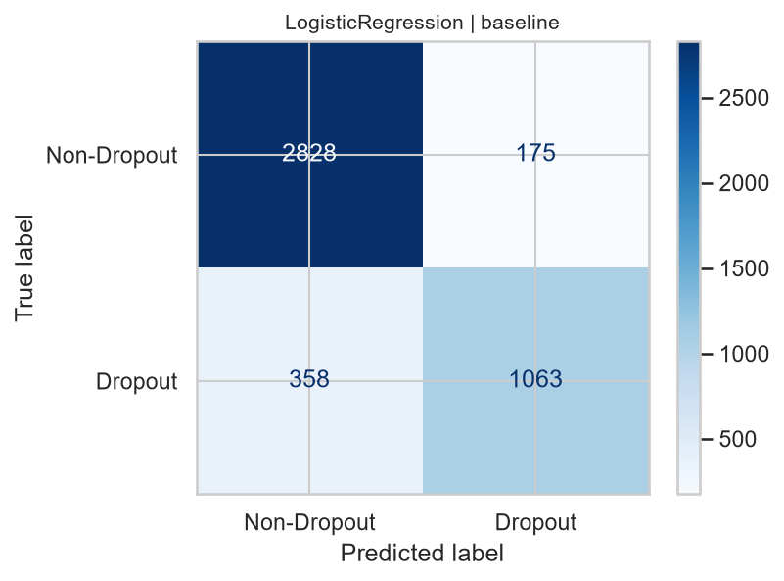
CONFUSION MATRIX DEEP-DIVE
What the Winning Model Gets Right — and Misses
Aggregated out-of-fold predictions for Logistic Regression (baseline) across all 4,424 students.
94.2%
74.8%
Specificity — non-dropout students correctly left alone (2,828 / 3,003)
Recall on Dropout — at-risk students correctly flagged (1,063 / 1,421)
85.9%
358
Precision on Dropout — of everyone flagged, this share truly dropped out
at-risk students still missed (false negatives) — the clearest target for future improvement
In an advising context, a 175 false-alarm rate against a 358 missed-case rate suggests the decision threshold could be lowered to trade a few more false alarms for meaningfully fewer missed students — a one-line change once deployed.
Fig. 7 — Confusion matrix, out-of-fold predictions, winning pipeline.
STUDENT DROPOUT PREDICTION | Slim Jabou & Klajdi Barci
03 · RESULTS
17 / 24

Slide 18
SECTION 04
04
Explainability & Impact
A model that flags students without saying why is not actionable. SHAP and permutation importance turn the winning pipeline into a set of concrete, defensible reasons — globally and for individual students.

Slide 19
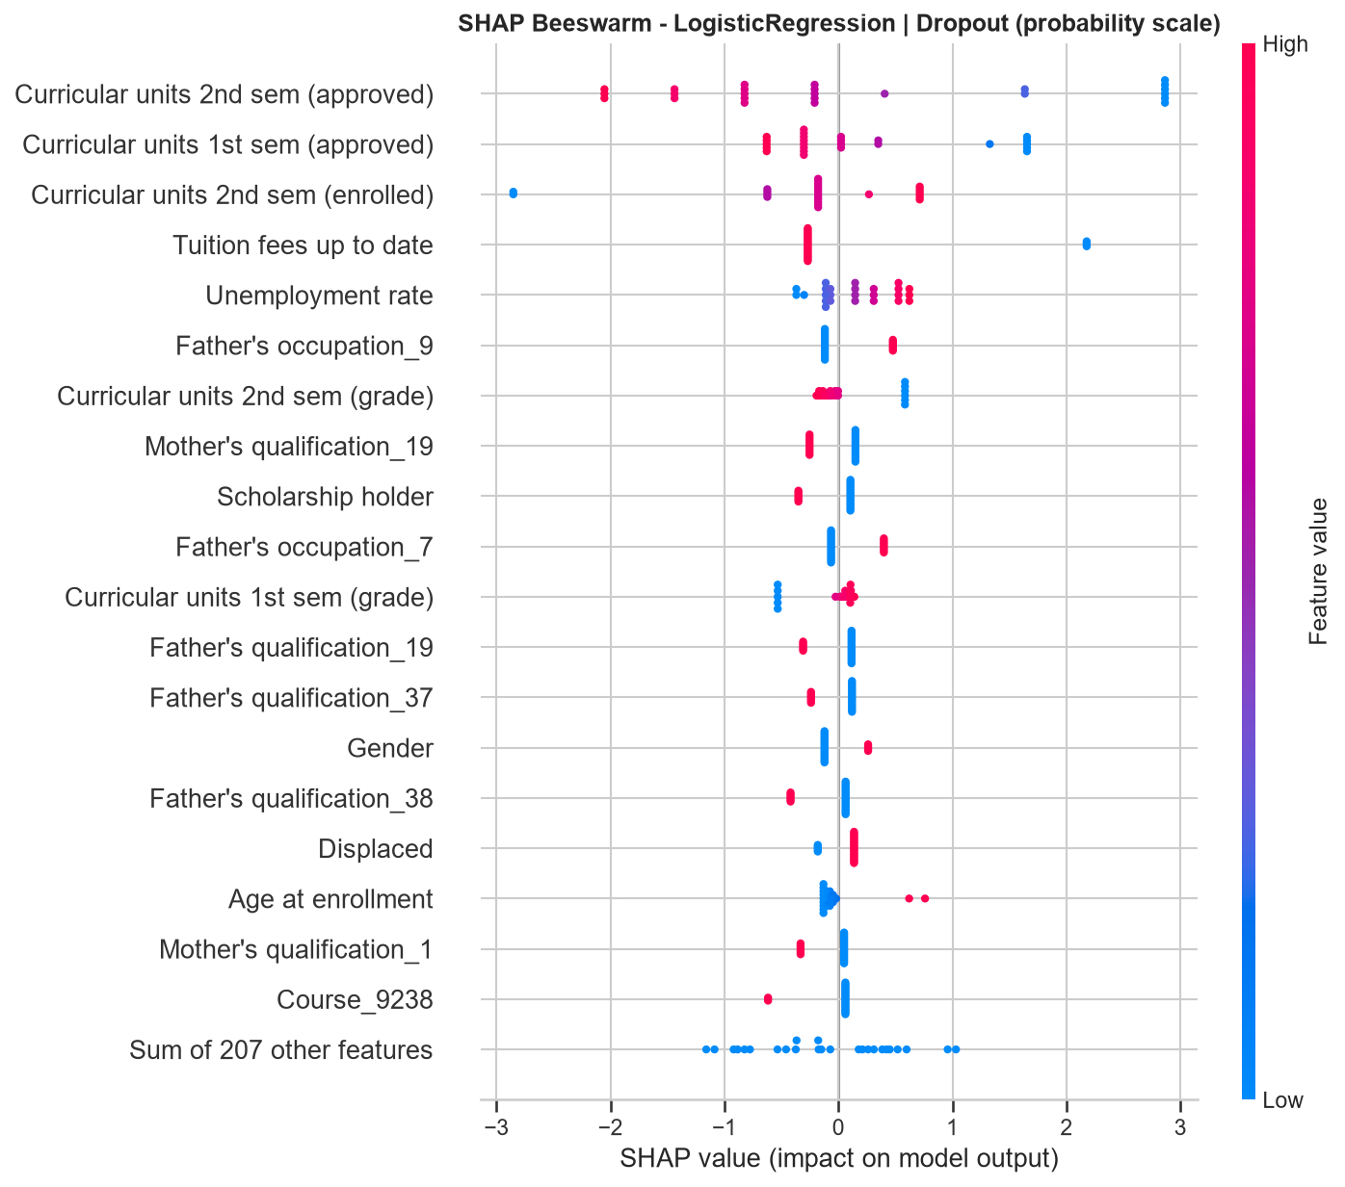
GLOBAL DRIVERS
Four Signals Explain Most of the Model's Reasoning
Each dot is one student — colour is the feature's value, position is its pull toward or away from Dropout.
■ Curricular units 2nd sem (approved) dominates: few units approved (blue, low value) pushes hard toward Dropout; many approved (red) pushes hard away.
■ Curricular units 1st sem (approved) repeats the same pattern one semester earlier — the risk signal is visible before the 2nd semester even ends.
■ Tuition fees up to date is a clean binary switch: not paid up (blue) is one of the single strongest pushes toward Dropout in the entire dataset.
■ Unemployment rate at enrollment shows a smaller but real macro-economic effect layered on top of individual circumstances.
Fig. 8 — SHAP beeswarm, top 20 features, Logistic Regression.
STUDENT DROPOUT PREDICTION | Slim Jabou & Klajdi Barci
04 · EXPLAINABILITY
19 / 24

Slide 20
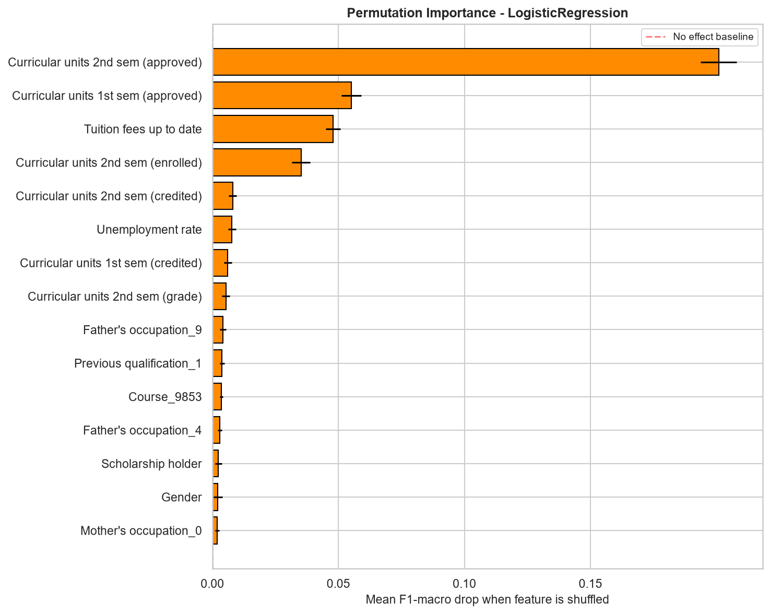
CONFIRMING ROBUSTNESS
A Second, Independent Method Agrees Exactly
A different mechanism from SHAP: shuffle one feature, measure the F1-macro drop.
SAME TOP 4, IN THE SAME ORDER
Shuffling 2nd-semester approved units alone collapses F1-macro by ~0.19 — by far the single most load-bearing feature. 1st-semester approved units and tuition-fee status follow, matching SHAP's ranking exactly.
■ Two structurally different explanation methods converging on the same drivers is strong evidence the finding is real, not an artefact of one technique.
■ Everything past the top 4 features contributes a long, flat tail — individual demographic dummy variables (parental occupation codes, specific courses) matter little on their own.
■ Practical reading: an early-warning system built on just these 3–4 signals would already capture most of the model's predictive power.
Fig. 9 — Permutation importance (10 repeats), Logistic Regression.
STUDENT DROPOUT PREDICTION | Slim Jabou & Klajdi Barci
04 · EXPLAINABILITY
20 / 24

Slide 21
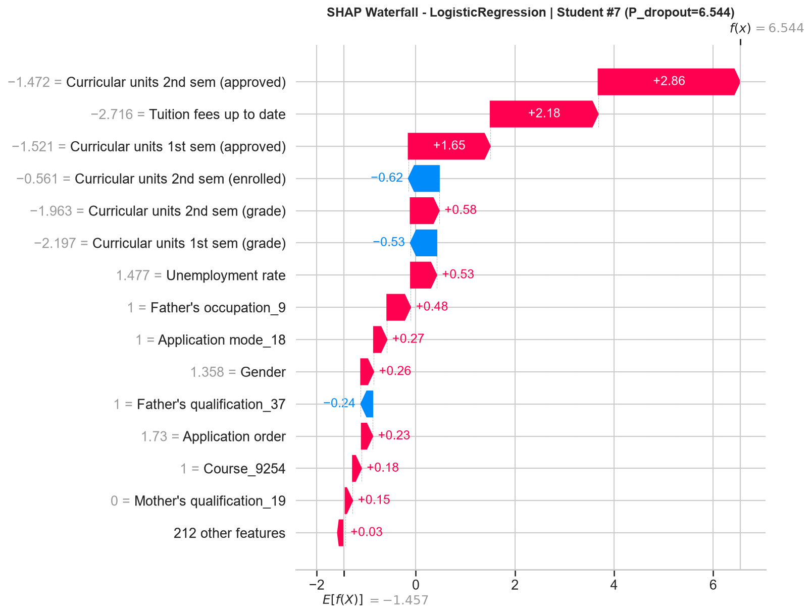
ONE STUDENT, ONE EXPLANATION
From Global Patterns to an Individual Advising Conversation
The local counterpart to the last two slides: one waterfall for the single highest-risk student.
■ Starting from the population baseline, three factors do almost all the work: few 2nd-sem units approved (+2.86), tuition fees not up to date (+2.18), and few 1st-sem units approved (+1.65).
■ These are the exact same three features that top the global SHAP and permutation-importance rankings — the model's reasoning for this one student is internally consistent with its reasoning overall.
■ This is the output an advisor would actually see: not just “high risk”, but which three facts to raise in a conversation and what a support plan should target first.
WHY THIS MATTERS FOR ADOPTION
A black-box score invites distrust from advisors and students alike. A per-student reason list is what turns a model into a tool people will actually use.
Fig. 10 — SHAP waterfall, Student #7, model risk score = 6.54 (log-odds scale).
STUDENT DROPOUT PREDICTION | Slim Jabou & Klajdi Barci
04 · EXPLAINABILITY
21 / 24

Slide 22
KEY TAKEAWAYS
What This Project Actually Shows
FINDING 1
FINDING 2
FINDING 3
Simple beats fancy, honestly measured
Risk is legible, not mysterious
74.8% recall leaves room to grow
A plain Logistic Regression, with no imbalance correction at all, statistically ties or beats Random Forest and AdaBoost under nested CV. Complexity bought nothing here.
Two-thirds of the model's decision power reduces to three facts: units completed each semester, and whether tuition is paid on time. Both are known before a crisis develops.
1 in 4 dropout cases is still missed at the default threshold. That threshold — not the model itself — is the cheapest next lever to pull.
RECOMMENDED INTERVENTION TRIGGERS, IN PRIORITY ORDER
1. Zero / near-zero units approved after semester 1
2. Tuition fees falling into arrears
3. Debtor status flagged at enrollment
4. No scholarship despite financial strain signals
STUDENT DROPOUT PREDICTION | Slim Jabou & Klajdi Barci
04 · EXPLAINABILITY
22 / 24

Slide 23
LIMITATIONS & FUTURE WORK
Where to Push Next
Known limitations
Natural next steps
■ Single institution, single country (Portugal) — thresholds and effect sizes may not transfer directly elsewhere.
■ 5 outer folds limit statistical power; the Wilcoxon test cannot confirm significance even where differences look real.
■ Reported results use the full-year feature set (1st + 2nd semester); a stricter, week-1-of-term early-warning score would rely on 1st-semester-only features and likely score somewhat lower.
■ SHAP local/global plots are computed on a fixed sample of students for computational efficiency, not the full 4,424.
■ Tune the decision threshold explicitly against an institution's real cost ratio of a missed dropout vs. a false alarm.
■ Add behavioural signals (LMS engagement, attendance) beyond registrar data to catch disengagement earlier.
■ Validate the early-intervention (1st-semester-only) configuration the framework already supports, for true week-1 scoring.
■ Re-run the KNN / Naive Bayes screen and gradient-boosted trees (e.g. XGBoost) alongside the current finalists as a final robustness check.
STUDENT DROPOUT PREDICTION | Slim Jabou & Klajdi Barci
04 · EXPLAINABILITY
23 / 24

Slide 24
THANK YOU
Questions & Discussion
Student Dropout Prediction — a leakage-safe, nested-CV benchmark with explainable, actionable outputs.
Slim Jabou
Klajdi Barci

