Slide 1
Parallel Programming with OpenMP
Parallel programming for the shared memory model
Assoc. Prof. Michelle Kuttel
mkuttel@cs.uct.ac.za
3 July 2012

Slide 2
Roadmap for this course
Introduction
OpenMP features
  creating teams of threads
  sharing work between threads
  coordinate access to shared data
  synchronize threads and enable them to perform some operations exclusively
OpenMP: Enhancing Performance

Slide 3
Terminology: Concurrency
Many complex systems and tasks can be broken down into a set of simpler activities.
e.g building a house
Activities do not always occur strictly sequentially: some can overlap and take place concurrently.
Notes:
include bricklaying, carpentry, plumbing, electrical installation and roofing.

Slide 4
The basic problem in concurrent programming:
Which activities can be done concurrently?

Slide 5
Why is Concurrent Programming so Hard?
Try preparing a seven-course banquet
  By yourself
  With one friend
  With twenty-seven friends …
Notes:
© 2003 Herlihy and Shavit
cook analogy works well for parallel computing

Slide 6
What is a concurrent program?
Sequential program: single thread of control
Concurrent program: multiple threads of control
  can perform multiple computations in parallel
  can control multiple simultaneous external activities
The word “concurrent” is used to describe processes that have the potential for parallel execution.

Slide 7
Concurrency vs parallelism
Concurrency
Logically simultaneous processing.
  Does not imply multiple processing elements (PEs).
  On a single PE, requires interleaved execution
Parallelism
Physically simultaneous processing.
  Involves multiple PEs and/or independent device operations.
A
B
C
Time

Slide 8
Concurrent execution
If the computer has multiple processors then instructions from a number of processes, equal to the number of physical processors, can be executed at the same time.
sometimes referred to as parallel or real concurrent execution.

Slide 9
pseudo-concurrent execution
Concurrent execution does not require multiple processors:
pseudo-concurrent execution
instructions from different processes are not executed at the same time, but are interleaved on a single processor.
Gives the illusion of parallel execution.
Notes:
e.g operating systems
switching between processes occurs voluntarily or in response to interrupts.
Interrupts signal external events such as the completion of an I/O operation or a clock tick to the processor.
processor switching does not affect the order of instructions executed by each process.

Slide 10
pseudo-concurrent execution
Even on a multicore computer, it is usual to have more active processes than processors.
In this case, the available processes are switched between processors.
Notes:
e.g operating systems
switching between processes occurs voluntarily or in response to interrupts.
Interrupts signal external events such as the completion of an I/O operation or a clock tick to the processor.
processor switching does not affect the order of instructions executed by each process.

Slide 11
Origin of term process
originates from operating systems.
  a unit of resource allocation both for CPU time and for memory.
  A process is represented by its code, data and the state of the machine registers.
  The data of the process is divided into global variables and local variables, organized as a stack.
Generally, each process in an operating system has its own address space and some special action must be taken to allow different processes to access shared data.

Slide 12
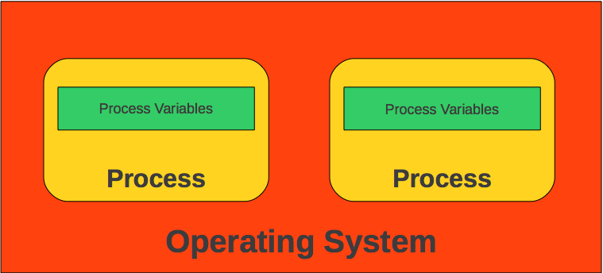
Process memory model
graphic: www.Intel-Software-Academic-Program.com

Slide 13
Origin of term thread
The traditional operating system process has a single thread of control – it has no internal concurrency.
With the advent of shared memory multiprocessors, operating system designers catered for the requirement that a process might require internal concurrency by providing lightweight processes or threads.
  “thread of control”
Modern operating systems permit an operating system process to have multiple threads of control.
In order for a process to support multiple (lightweight) threads of control, it has multiple stacks, one for each thread.

Slide 14
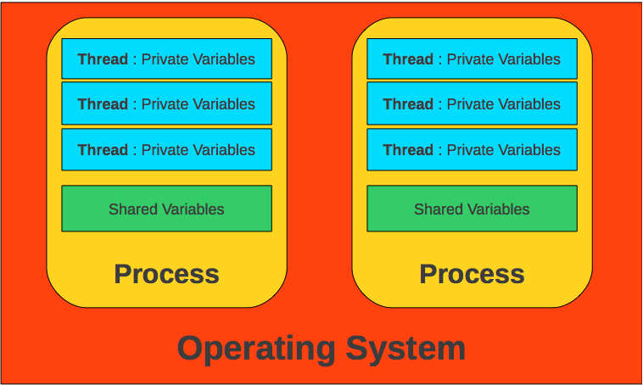
Thread memory model
graphic: www.Intel-Software-Academic-Program.com

Slide 15
Threads
Unlike processes, threads from the same process share memory (data and code).
They can communicate easily, but it's dangerous if you don't protect your variables correctly.

Slide 16
Correctness of concurrent programs
Concurrent programming is much more difficult than sequential programming because of the difficulty in ensuring that programs are correct.
Errors may have severe (financial and otherwise) implications.

Slide 17
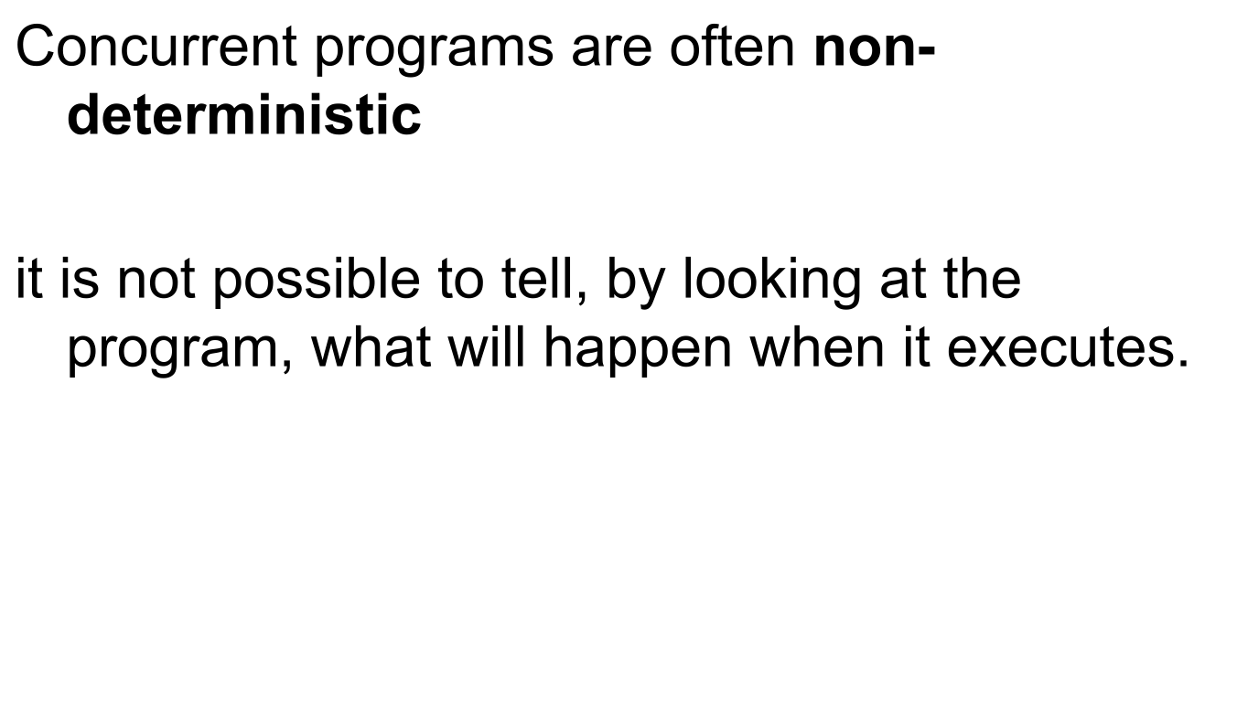
Non-determinism

Slide 18
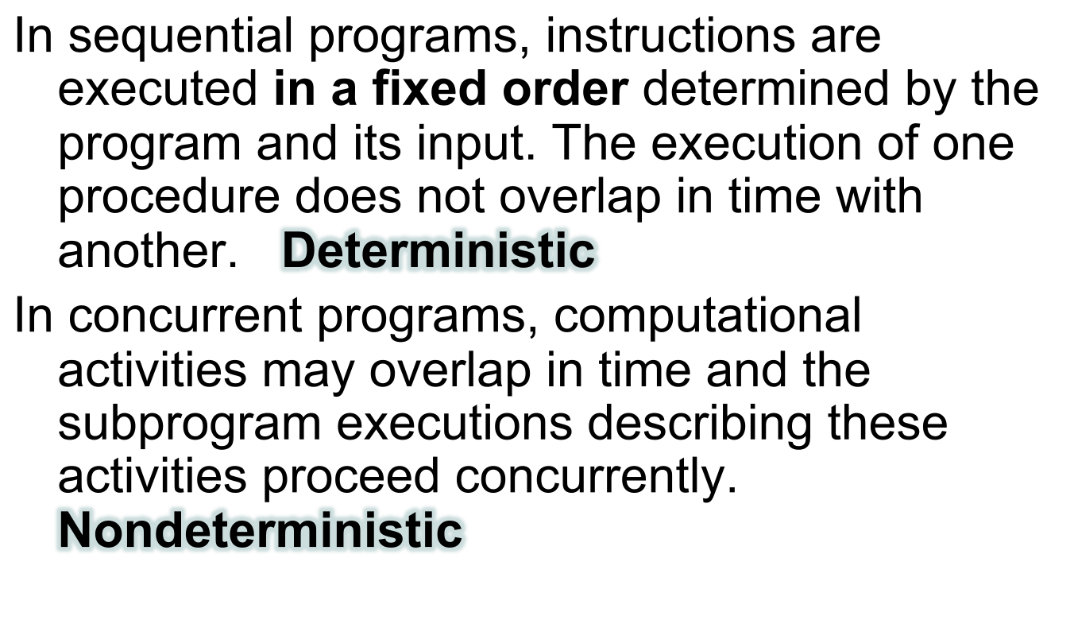
Concurrent execution
Notes:
What is the meaning of deterministic?
determinism |dɪˈtəːmɪnɪz(ə)m|noun Philosophythe doctrine that all events, including human action, are ultimately determined by causes external to the will. Some philosophers have taken determinism to imply that individual human beings have no free will and cannot be held morally responsible for their actions.

Slide 19
Fundamental Assumption
Processors execute independently: no control over order of execution between processors
Notes:
note - OK if no synchronization!

Slide 20
Simple example of a non-deterministic program
Main program:
x=0, y=0
a=0, b=0
Thread A:
x=1
a=y
What is the output?
Thread B:
y=1
b=x
Main program:
print a,b
Notes:
yesno
or
noyes

Slide 21
Simple example of a non-deterministic program
Main program:
x=0, y=0
a=0, b=0
Thread A:
x=1
a=y
Thread B:
y=1
b=x
Main program:
print a,b
Output: 0,0 OR 0,1 OR 1,0 OR 1,1
Notes:
yesno
or
noyes

Slide 22
Race Condition
A race condition is a bug in a program where the output and/or result of the process is unexpectedly and critically dependent on the relative sequence or timing of other events.
the events race each other to influence the output first.

Slide 23
Race condition: analogy
We often encounter race conditions in real life
Notes:
e.g. you arrange to meet your friend at Vida in Claremont at noon
Go to Cavendish square, but then realise that there ae 2 vdida’s in clarement, one at Palmyra junction
At 12h10 you go there, but he isn’t there. Few possibilities:
1.
friend is late
friend went to cavendish after you left
friend went to palmyraand now is en route to cavensid
unless you agree on a protocol, you could be shuttling backwards and forwards all day!: as you leave you friend may arrive.
The state of the system may change!

Slide 24
Thread safety
When can two statements execute in parallel?
On one processor:
    statement 1;
    statement 2;
On two processors:
  processor1: processor2:
    statement1; statement2;

Slide 25
Parallel execution
Possibility 1
  Processor1: Processor2:
    statement1;
    statement2;
Possibility 2
  Processor1: Processor2:
    statement2:
    statement1;

Slide 26
When can 2 statements execute in parallel?
Their order of execution must not matter!
In other words,
    statement1; statement2;
    must be equivalent to
    statement2; statement1;

Slide 27
Example
    a = 1;
    b = 2;
Statements can be executed in parallel.

Slide 28
Example
    a = 1;
    b = a;
Statements cannot be executed in parallel
Program modifications may make it possible.

Slide 29
Example
    a = f(x);
    b = a;
May not be wise to change the program (sequential execution would take longer).

Slide 30
Example
    b = a;
    a = 1;
Statements cannot be executed in parallel.

Slide 31
Example
    a = 1;
    a = 2;
Statements cannot be executed in parallel.

Slide 32
True (or Flow) dependence
For statements S1, S2
  S2 has a true dependence on S1
  iff
  S2 reads a value written by S1
  (the result of a computation by S1 ﬂows to S2: hence ﬂow dependence)
cannot remove a true dependence and execute the two statements in parallel

Slide 33
Anti-dependence
Statements S1, S2.
S2 has an anti-dependence on S1
iff
S2 writes a value read by S1.
(opposite of a ﬂow dependence, so called an anti dependence)

Slide 34
Anti dependences
S1 reads the location, then S2 writes it.
  can always (in principle) parallelize an anti dependence
    give each iteration a private copy of the location and initialise the copy belonging to S1 with the value S1 would have read from the location during a serial execution.
    adds memory and computation overhead, so must be worth it

Slide 35
Output Dependence
Statements S1, S2.
S2 has an output dependence on S1
iff
S2 writes a variable written by S1.

Slide 36
Output dependences
both S1 and S2 write the location.
  Because only writing occurs, this is called an output dependence.
  can always parallelize an output dependence
    by privatizing the memory location and in addition copying value back to the shared copy of the location at the end of the parallel section.

Slide 37
When can 2 statements execute in parallel?
S1 and S2 can execute in parallel
iff
there are no dependences between S1 and S2
  true dependences
  anti-dependences
  output dependences
Some dependences can be removed.

Slide 38

Costly concurrency errors (#1)
2003
a race condition in General Electric Energy's Unix-based energy management system aggravated the USA Northeast Blackout
  affected an estimated 55 million people

Slide 39
Costly concurrency errors (#1)
August 14, 2003,
a high-voltage power line in northern Ohio brushed against some overgrown trees and shut down
Normally, the problem would have tripped an alarm in the control room of FirstEnergy Corporation​, but the alarm system failed due to a race condition.
Over the next hour and a half, three other lines sagged into trees and switched off, forcing other power lines to shoulder an extra burden.
Overtaxed, they cut out, tripping a cascade of failures throughout southeastern Canada and eight northeastern states.
All told, 50 million people lost power for up to two days in the biggest blackout in North American history.
The event cost an estimated $6 billion
source: Scientific American

Slide 40

Costly concurrency errors (#2)
1985
Therac-25 Medical Accelerator*
a radiation therapy device that could deliver two different kinds of radiation therapy: either a low-power electron beam (beta particles) or X-rays.
*An investigation of the Therac-25 accidents, by Nancy Leveson and Clark Turner (1993).

Slide 41
Costly concurrency errors (#2)
1985
Therac-25 Medical Accelerator*
Unfortunately, the operating system was built by a programmer who had no formal training: it contained a subtle race condition which allowed a technician to accidentally fire the electron beam in high-power mode without the proper patient shielding.
In at least 6 incidents patients were accidentally administered lethal or near lethal doses of radiation - approximately 100 times the intended dose. At least five deaths are directly attributed to it, with others seriously injured.
*An investigation of the Therac-25 accidents, by Nancy Leveson and Clark Turner (1993).

Slide 42

Costly concurrency errors (#3)
2007
Mars Rover “Spirit” was nearly lost not long after landing due to a lack of memory management and proper co-ordination among processes
Notes:
Also, Microsofts BSoD usually race condition

Slide 43
Costly concurrency errors (#3)
2007
  a six-wheeled driven, four-wheeled steered vehicle designed by NASA to navigate the surface of Mars in order to gather videos, images, samples and other possible data about the planet.
  Problems with interaction between concurrent tasks
  caused periodic software resets reducing availability for
  exploration.
Notes:
Also, Microsofts BSoD usually race condition

Slide 44
3. Techniques
How do you write and run a parallel program?

Slide 45
Communication between processes
Processes must communicate in order to synchronize or exchange data
  if they don’t need to, then nothing to worry about!
Different means of communication result in different models for parallel programming:
  shared memory
  message passing

Slide 46
Parallel Programming
The goal of parallel programming technologies is to improve the “gain-to-pain” ratio
Parallel language must support 3 aspects of parallel programming:
  specifying parallel execution
  communicating between parallel threads
  expressing synchronization between threads
Notes:
in fact, all technologies!

Slide 47
Programming a Parallel Computer
can be achieved by:
  an entirely new language – e.g. Erlang
  a directives-based data-parallel language e.g. HPF (data parallelism), OpenMP (shared memory + data parallelism)
  an existing high-level language in combination with a library of external procedures for message passing (MPI)
  threads (shared memory – Pthreads, Java threads)
  a parallelizing compiler
  object-oriented parallelism (?)
Notes:
most current parallel languages provide exgtensions to existing languages - familar (ST - esperanto)

Slide 48
Parallel programming technologies
Technology converged around 3 programming environments:
OpenMP
simple language extension to C, C++ and Fortran to write parallel programs for shared memory computers
MPI
A message-passing library used on clusters and other distributed memory computers
Java
language features to support parallel programming on shared-memory computers and standard class libraries supporting distributed computing

Slide 49
Parallel programming has matured:
common machine architectures
standard programming models
Increasing portability between models and architectures
For HPC services, most users expected to use standard MPI or OpenMP, using either Fortran or C

Slide 50
Break

Slide 51
What is OpenMP?
Open specifications for Multi Processing
  multithreading interface specifically designed to support parallel programs
Explicit Parallelism
  programmer controls parallelization (not automatic)
Thread-Based Parallelism:
  multiple threads in the shared memory programming paradigm
  threads share an address space.

Slide 52
What is OpenMP?
  not appropriate for a distributed memory environment such as a cluster of workstations:
    OpenMP has no message passing capability.

Slide 53
When do we use OpenMP?
  recommended when goal is to achieve
  modest parallelism
  on a shared memory computer

Slide 54

Shared memory programming model
assumes programs will execute on one or more processors that shared some or all of available memory
multiple independent threads
  threads: runtime entity able to independently execute stream of instructions
  share some data
  may have private data
Notes:
Threads share the resources of the corresponding process
memory pages, registers
multiple threads on a sinlge processor are interleaved.

Slide 55

Hardware parallelism
Covert parallelism (CPU parallelism)
        Multicore + GPU’s
  Mostly hardware managed ( hidden on a microprocessor, “super-pipelined”, “superscalar”, “multiscalar” etc.)
  fine-grained
Overt parallelism (Memory parallelism)
    Shared Memory Multiprocessor Systems
    Message-Passing Multicomputer
    Distributed Shared Memory
  Software managed
  coarse-grained

Slide 56
Memory Parallelism
CPU
CPU
CPU
shared memory computer
serial
computer
memory
memory
CPU
distributed memory computer
CPU
CPU
CPU
memory
memory
memory
Notes:
SMP versus NUMA

Slide 57
We focus on:
The Shared Memory Multiprocessor
(SMP)
All memory is placed into a single (physical) address space.
Processors connected by some form of interconnection network
Single virtual address space across all of memory. Each processor can access all locations in memory.
cache
cache
cache
Bus
Bus
shared memory
from: Art of Multiprocessor Programming
Notes:
And we had expensive multiprocessor chips in the enterprise, that is, in server farms, high performance computing centers and so on. The
Shared memory multiprocessor (SMP) consists of multiple CPUs connected by a bus or interconnect network to a shared memory. Shared memory designs are broken down into two major categories – SMP and NUMA - depending on whether or not the access time to shared memory is uniform or non-uniform.

Slide 58
Shared Memory: Advantages
Shared memory is attractive because of the convenience of sharing data
  easiest to program:
    provides a familiar programming model
    allows parallel applications to be developed incrementally
    supports fine-grained communication in a cost-effective manner

Slide 59
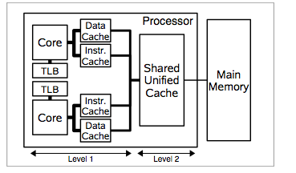
Shared memory machines: disadvantages
Cost is consistency and coherence requirements
Modern processors have an architectural cache hierarchy because of discrepancy between processor and memory speed: cache is not shared.
Figure from Using OpenMP, Chapman et al.
Uniprocessor cache handling system does not work for SMP’s:
memory consistency problem
An SMP that provides memory consistency transparently is cache coherent

Slide 60
OpenMP in context
Open MP competes with
- traditional “hand-threading” at one end
- more control
- MPI at the other end
- more scalable

Slide 61
So why OpenMP?
really easy to start parallel programming
  MPI/hand threading require more initial effort to think through
  though MPI can run on shared memory machines (passing “messages” through memory), it is much harder to program.

Slide 62
So why OpenMP?
very strong correctness checking versus the sequential program
supports incremental parallelism
  parallelizing an application a little at a time
  most other approaches require all-or-nothing

Slide 63
Why OpenMP?
OpenMP is the software standard for shared memory multiprocessors
The recent rise of multicore architectures makes OpenMP much more relevant
  as multicore goes mainstream, vital that software makes use of available technology

Slide 64
What is OpenMP?
not a new language: language extension to Fortran and C/C++
  a collection of compiler directives and supporting library functions

Slide 65
OpenMP language features
OpenMP allows the user to:
  create teams of threads
  share work between threads
  coordinate access to shared data
  synchronize threads and enable them to perform some operations exclusively.

Slide 66
OpenMP
API is independent of the underlying machine or operating system
  requires OpenMP compiler
    e.g. gcc, Intel compilers etc.
  standard include file in C/C++: omp.h

Slide 67
Diving in: First OpenMP program (in C)
#include <omp.h> //include OMP library
#include <stdio.h>
int main (int argc, char *argv[]) {
int nthreads, tid;
/* Fork a team of threads giving them their own copies of variables */
#pragma omp parallel private(nthreads, tid)
{
tid = omp_get_thread_num(); //get thread number
printf("Hello World from thread = %d\n", tid);
if (tid == 0) { //only master thread does this
nthreads = omp_get_num_threads();
printf("Number of threads = %d\n", nthreads);
}
} /* All threads join master thread and disband */
}
Notes:
experiment with placing of tid-0 section – if outside block, only one thread reported. If inside block, can be listed at any time. Use “barrier” to force other threads to complete before the number of threads is printed.

Slide 68
First program explained
OpenMP has three primary API components:
  Compiler Directives
    tell compiler which instructions to execute in parallel and how to distribute them between threads
  Runtime Library Routines
  Environment Variables
    e.g. OMP_NUM_THREADS
#include <omp.h>
#include <stdio.h>
int main (int argc, char *argv[]) {
int nthreads, tid;
#pragma omp parallel private(nthreads, tid)
{
tid = omp_get_thread_num();
printf("Hello World from thread = %d\n", tid);
if (tid == 0) {
nthreads = omp_get_num_threads();
printf("Number of threads = %d\n", nthreads);
}
}
}

Slide 69
Parallel languages: OpenMP
Basically, an OpenMP program is just a serial program with OpenMP directives placed at appropriate points.
A C/C++ directive takes the form:
  #pragma omp ...
  The omp keyword distinguishes the pragma as an OpenMP pragma, so that it is processed as such by OpenMP compilers and ignored by non- OpenMP compilers.
Notes:
In C and C++ all OpenMP implementations are required to deﬁne the preprocessor macro name _OPENMP to the value of the year and month of the approved OpenMP speciﬁcation in the form yyyymm. This macro may be used to selectively enable/disable the compilation of any OpenMP spe- ciﬁc piece of code.

Slide 70
Parallel languages: OpenMP
  OpenMP preserves sequential semantics:
  A serial compiler ignores the #pragma statements -> serial executable.
  An OpenMP-enabled compiler recognizes the pragmas -> parallel executable suitable
simplifies development, debugging and maintenance
Notes:
Show sequential version.
In C and C++ all OpenMP implementations are required to deﬁne the preprocessor macro name _OPENMP to the value of the year and month of the approved OpenMP speciﬁcation in the form yyyymm. This macro may be used to selectively enable/disable the compilation of any OpenMP spe- ciﬁc piece of code.

Slide 71
OpenMP features set
OpenMP is a much smaller API than MPI
not all that difficult to learn the entire set of features
possible to identify a short list of constructs that a programmer really should be familiar with.

Slide 72
OpenMP language features
OpenMP allows the user to:
  create teams of threads
    Parallel Construct
  share work between threads
  coordinate access to shared data
  synchronize threads and enable them to perform some operations exclusively.

Slide 73
Creating a team of threads: Parallel construct
The parallel construct is crucial in OpenMP:
a program without a parallel construct will be executed sequentially
Parts of a program not enclosed by a parallel construct will be executed serially.
Syntax of the parallel construct in C/C++
#pragma omp parallel [clause[[,] clause]. . . ]
structured block
Syntax of the parallel construct in FORTRAN
!$omp parallel [clause[[,] clause]. . . ]
structured block
!$omp end parallel

Slide 74
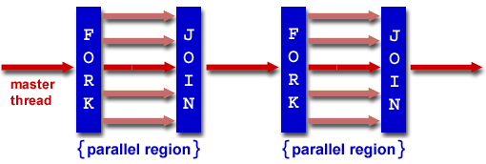
Runtime Execution Model
Fork-Join Model of parallel execution :
  programs begin as a single process: the initial thread. The initial thread executes sequentially until the first parallel region construct is encountered.

Slide 75
Runtime Execution Model
  FORK: the initial thread then creates a team of parallel threads. The statements in the program that are enclosed by the parallel region construct are then executed in parallel among the various team threads
  JOIN: When the team threads complete the statements in the parallel region construct, they synchronize (block) and terminate, leaving only the initial thread
Notes:
OpenMP sorts out the low-level details

Slide 76
Creating a team of threads: Parallel construct
The parallel construct is crucial in OpenMP:
a program without a parallel construct will be executed sequentially
Parts of a program not enclosed by a parallel construct will be executed serially.
Syntax of the parallel construct in C/C++
  clauses specify data access ( default, shared, private etc.)
#pragma omp parallel [clause[[,] clause]. . . ]
structured block
Syntax of the parallel construct in FORTRAN
!$omp parallel [clause[[,] clause]. . . ]
structured block
!$omp end parallel

Slide 77
Parallel Construct
parallel directive comes immediately before the block of code to be executed in parallel
parallel region must be a structured block of code
  a single entry point and a single exit point, with no branches into or out of any statement within the block
    can have stop and exit
a team of threads executes a copy of this block of code in parallel
  can query and control the number of threads in a parallel team.
  implicit barrier synchornization at end
Notes:
compare parallel for and a parallel region around a for

Slide 78
nested parallel regions
  you can nest parallel regions, in theory
  currently, all OpenMP implementations only support one level of parallelism and serialize the implementation of further nested levels.
  this is expected to change over time
    eventually, if another nested parallel directive encountered, each thread creates own team of threads (and becomes the master thread)
Notes:
what is barrier synchronization and what are the implications?
nesting creates multilevel parallel programs, but rarely used
waring: if a syntax error occurs, compiler will simply ignore directive – difficult error

Slide 79
Compiling and Linking OpenMP Programs
Once you have your OpenMP example program, you can compile and link it.
e.g:
  gcc -fopenmp omp_hello.c -o hello
Now you can run your program:
  ./hello

Slide 80
Environment variable example
  OMP_NUM_THREADS = 4
  ./hello1
Determines how many parallel threads
default number of threads is the number of cores
OpenMP allows users to specify how many threads will execute a parallel region with two different mechanisms:
  omp_ set_num_threads() runtime library procedure
  OMP_NUM_ THREADS environment variable
Order of printing may vary.... (big) issue of thread synchronization!
Notes:
Q:? What happens if you have more threads than there are cores?

Slide 81
OpenMP
  Runtime Library Routines
    small set
    typically used to modify execution parameters
      eg. control degree of parallelism exploited in different portions of program.

Slide 82
Basic OpenMP Functions
omp_get_num_procs
int procs = omp_get_num_procs()
omp_get_num_threads
int threads = omp getnumthreads()
int threads = omp_get_num_threads()
omp_get_max_threads
printf("Currently %d threads\n", omp_get_max_threads());
omp_get_thread_num
printf("Hello from thread id %d\n",omp_get_thread_num());
omp_set_num_threads
omp_set_num_threads(procs * atoi(argv[1]));

Slide 83
Number of threads in OpenMP Programs
Note that if the computer you are executing your OpenMPI program on has fewer CPUs or cores than the number of threads you have specified in OMP_NUM_THREADS,
the OpenMP runtime environment will still spawn as many threads, but the operating system will sequentialize them.

Slide 84
Sharing work amongst threads
If work sharing is not specified, all threads will do all the work redundantly
  work sharing directives allow programmer to say which thread does what
worksharing constructs used within parallel region construct
does not specify any parallelism
  partitions the iteration space across multiple threads.
Notes:
what is barrier synchronization and what are the implications?

Slide 85
OpenMP language features
OpenMP allows the user to:
  create teams of threads
  share work between threads
    Loop Construct
    Sections Construct
    Single Construct
    Workshare Construct (Fortran only)
  coordinate access to shared data
  synchronize threads and enable them to perform some operations exclusively.
C/C++ has three work-sharing constructs.
Fortran has four.
Notes:
work-sharing constructs are used to partition work across the multiple threads

Slide 86
OpenMP language features
OpenMP allows the user to:
  create teams of threads
  share work between threads
    Loop Construct
    Sections Construct
    Single Construct
    Workshare Construct (Fortran only)
  coordinate access to shared data
  synchronize threads and enable them to perform some operations exclusively.
Notes:
work-sharing constructs are used to partition work across the multiple threads

Slide 87
OpenMP loop-level parallelism
Focus on exploitation of parallelism within loops
e.g. To parallelize a for-loop, precede it by the directive:
  #pragma omp parallel for
  combined work sharing and parallel directive

Slide 88
Loop-level parallelism
#pragma omp parallel for [clause [clause ...]]
for (index = ﬁrst ; test_expr ; increment_expr) {
body of the loop
}
// C/C++ syntax for the parallel for directive.
The loop must immediately follow the omp directive

Slide 89
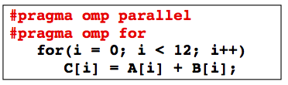
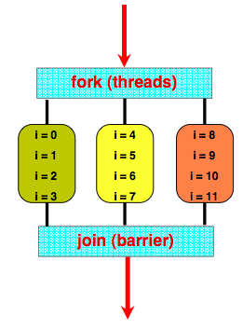
Work sharing in loops
Most obvious strategy is to assign a contiguous chunk of iterations to each thread
If programmer does not specify, assignment is implementation dependent
Also, a loop can only be shared if all iterations are independent

Slide 90
Loop nests
When one loop in a loop nest is marked by a parallel directive, the directive applies only to the loop that immediately follows the directive.
  The behavior of all of the other loops remains unchanged, regardless of whether the loop appears in the serial part of the program or is contained within an outer parallel loop:
    all iterations of loops not preceded by the parallel do are executed by each thread that reaches them.

Slide 91
Parallelizing simple loop: variables
in OpenMP the default rules state that :
  the loop index variable is private to each thread
  all other variable references are shared.

Slide 92
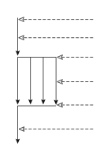
Parallelizing a simple loop
for (i=0; i<n;i++)
z[i] = a* x[i] +y;
Loop iterations are independent - no dependences: OK to go ahead
in C:
  parallel for directive
#pragma omp parallel for
{
for (i=0; i<n;i++)
z[i] = a* x[i] +y;
}
Notes:
EXAMPLE: omp_saxpy

Slide 93
Loop level parallelism: restrictions on loops
for (index = start ; index < end ; increment_expr)
it must be possible to determine the number of loop iterations before execution
  no while loops
  no variations of for loops where the start and end values change.
  increment must be the same each iteration
  all loop iterations must be done
    loop must be a block with single entry and single exit
    no break or goto
for( i = 0, i< n, i++)
if (x[i]>maxval) goto 100;
//not parallelizable

Slide 94
Loop level parallelism: restrictions on loops
for (i=0;i<N;i++) {
a[i] = a[i] * a[i];
if (fabs(a[i]) > machine_max) ||
fabs(a[i]) < machine_min)) {
printf(“%s”,i);
break;
}
}
Notes:
can’t parallelize this for loop, as it branches out of parallel region

Slide 95
Data race condition
Common error that programmer may not be aware of
  cause by loop data dependences
Need to pay careful attention to this during program development

Slide 96
Loop-carried dependence
A loop carried dependence is a dependence that is present only if the statements are part of the execution of a loop.
Otherwise, we call it a loop-independent dependence.
Loop-carried dependences prevent loop iteration parallelization.

Slide 97
Loop dependences
for (i=0; i<10;i++)
a(i) = a(i) + a(i – 1)
A simple loop with a data dependence.
whenever there is a dependence between two statements on some location, we cannot execute the statements in parallel.
  it would cause a data race.
  parallel program may not produce the same results as an equivalent serial program.

Slide 98
Loop dependences
for (i=1; i<4;i++)
a(i) = a(i) + a(i – 1)
A simple loop with a data dependence.
a
1 | 2 | 3 | 4
possible parallel execution
result
serial execution
a
6
10
1 | 2 | 3 | 4
3
a
1 | 2 | 3 | 4
3
5
9
Notes:
example - loop_depend_ser, loop_depend_par

Slide 99
Removing Loop dependences
The key characteristic of a loop that allows it to run correctly in parallel is that it must not contain any data dependences.
  Whenever one statement in a program reads or writes a memory location, and another statement reads or writes the same location, and at least one of the two statements writes the location, we say that there is a data dependence on that memory location between the two statements.

Slide 100
Loop dependences: Example
    for(i=0; i<100; i++) {
    a[i] = i;
    b[i] = 2*i;
    }
Iterations and statements can be executed in parallel.

Slide 101
Example
    for(i=0;i<100;i++) a[i] = i;
    for(i=0;i<100;i++) b[i] = 2*i;
Iterations and loops can be executed in parallel.

Slide 102
Example
    for(i=0; i<100; i++)
      a[i] = a[i] + 100;
There is a dependence … on itself!
Loop is still parallelizable.

Slide 103
Example
    for( i=0; i<100; i++ )
    a[i] = f(a[i-1]);
Dependence between a[i] and a[i-1].
Loop iterations are not parallelizable.

Slide 104
Level of loop-carried dependence
Is the nesting depth of the loop that carries the dependence.
Indicates which loops can be parallelized.

Slide 105
Nested loop dependences?
for (j=0;j<n;j++)
for (i=0;i<n;i++) {
c[i][j] =0;
for(k=0;k<n;k++)
c[i][j]=c[i][j]+a[i][k]*b[k][j];
}
computes product of 2 matrices C=AxB
we can safely parallelize the j loop
  each iteration of the j loop computes one column c[0:n-1, j] of the product and does not access elements of c that are outside that column.
  The dependence on c[i, j] in the serial k loop does not inhibit parallelization.

Slide 106
Example
    for(i=0; i<100; i++ )
    for(j=1; j<100; j++ )
    a[i][j] = f(a[i][j-1]);
Loop-independent dependence on i.
Loop-carried dependence on j.
Outer loop can be parallelized, inner loop cannot.

Slide 107
Example
    for( j=1; j<100; j++ )
    for( i=0; i<100; i++ )
    a[i][j] = f(a[i][j-1]);
Inner loop can be parallelized, outer loop cannot.
Less desirable situation (why?)
Loop interchange is sometimes possible.

Slide 108
Removing Loop Dependences
first detect them by analyzing how each variable is used within the loop:
  if the variable only read and never assigned within the loop body, there are no dependences involving it.
  a simple rule of thumb, a loop that meets all the following criteria has no dependences and can always be parallelized:
    All assignments are to arrays.
    Each element is assigned by at most one iteration.
    No iteration reads elements assigned by any other iteration.

Slide 109
Removing Loop Dependences
  consider the memory locations that make up the variable and that are assigned within the loop.
    For each such location, is there exactly one iteration that accesses the location? If so, there are no dependences involving the variable. If not, there is a dependence.

Slide 110
Loop dependences?
for( i = 2, i< n, i+=2)
a[i] = a[i] + a[i – 1]; //eg 1
for( i = 0, i< n/2, i++)
a[i] = a[i] + a[i + n/2]; //eg 2
for( i = 0, i< n/2+1, i++)
a[i] = a[i] + a[i + n/2]; //eg 3
for( i = 0, i< n, i++)
a[idx(i)] = a[idx(i)] + b[idx(i)]; //eg 4
Notes:
1: none - stride of 2
2: none
3: yes - first read is last written
4: don’t know what idx() does. However, if no elemnets of idx have smae value, no dependences

Slide 111
A loop-carried dependence caused by a conditional
x = 0 ;
for(i =0; i<n; i++)
if (switch_val(i))
x = new_val(i) ;
a[i] = x ;
One subtle special case of non-loop-carried dependences occurs when a location is assigned in only some rather than all iterations of a loop.
If x was assigned every loop, it would be parallelizable
  but now not
Notes:
If the assignment were performed in every iteration, there would be just a non-loop-carried dependence between the assignment and the use of x at line 20, which we could ignore. But because the assignment is performed only in some iterations, there is in fact a loop-carried dependence between line 10 in one iteration and line 20 in the next. In other words, because the assignment is controlled by a con- ditional, x is involved in both a non-loop-carried dependence between lines 10 and 20 (which we can ignore) and a loop-carried dependence between the same lines (which inhibits parallelization).

Slide 112
Loop Dependences
Once a dependence has been detected, the next step is to ﬁgure out what kind of dependence it is.
  There is a loop-carried dependence whenever two statements in different iterations access a memory location, and at least one of the statements writes the location.
  Based upon the dataﬂow through the memory location between the two statements, each dependence may be classiﬁed as an anti, output, or ﬂow dependence.

Slide 113
Removing Loop Dependences
remove anti dependences by providing each iteration with an initialized copy of the memory location, either through privatization or by introducing a new array variable.
Output dependences can be ignored unless the location is live-out from the loop.
We cannot always remove loop-carried ﬂow dependences.

Slide 114
loop-carried ﬂow dependences.
We cannot always remove loop-carried ﬂow dependences. However, we can:
  parallelize a reduction
  eliminate an induction variable
  skew a loop to make a dependence become non-loop-carried.
If we cannot remove a ﬂow dependence, we may instead be able to:
  parallelize another loop in the nest
  ﬁssion the loop into serial and parallel portions
  remove a dependence on a nonparallelizable portion of the loop by expanding a scalar into an array.

Slide 115
To remember
Statement order must not matter.
Statements must not have dependences.
Some dependences can be removed.
Some dependences may not be obvious.

Slide 116
How is loop divided amongst threads?
for loop iterations are not replicated
  each thread assigned a distinct set of iterations to execute.
  Since the iterations of the loop are assumed to be independent and can execute concurrently, OpenMP does not specify how the iterations are to be divided among the threads
    choice is left to the OpenMP compiler implementation.
  As the distribution of loop iterations across threads can signiﬁcantly affect performance, OpenMP supplies additional attributes that can be provided with the parallel for directive and used to specify how the iterations are to be distributed across threads.

Slide 117
Scheduling loops to balance load
The default schedule on most implementations allocates each thread executing a parallel loop about as many iterations as any other thread.
  however, often different iterations have different amounts of work.
#omp parallel for private(xkind)
for(i = 1; i< n; i++) {
xkind = f(i);
if (xkind< 10) smallwork(x[i]);
else bigwork(x[i]) ;
}

Slide 118
Scheduling loops to balance load
By changing the schedule of a load-unbalanced parallel loop, it is possible to reduce these synchronization delays and thereby speed up the program.
  A schedule is speciﬁed by a schedule clause on the parallel for directive.
  Can only schedule loops, not other work-sharing directives

Slide 119
Static and Dynamic Scheduling
a loop schedule can be:
  static
    the choice of which thread performs a particular iteration is purely a function of the iteration number and number of threads.
    Each thread performs only the iterations assigned to it at the beginning of the loop.
  dynamic:
    the assignment of iterations to threads can vary at runtime from one execution to another.
    Not all iterations are assigned to threads at the start of the loop.
      Instead, each thread requests more iterations after it has completed the work already assigned to it.

Slide 120
Static and Dynamic Scheduling
A dynamic schedule is more ﬂexible:
  if some threads happen to ﬁnish their iterations sooner, more iterations are assigned to them.
  However, the OpenMP runtime system must coordinate these assignments to guarantee that every iteration gets executed exactly once.
    Because of this coordination, requests for iterations incur some synchronization cost.
Static scheduling has lower overhead because it does not incur this scheduling cost, but it cannot compensate for load imbalances by shifting more iterations to less heavily loaded threads.

Slide 121
Static and Dynamic Scheduling
In both schemes, iterations are assigned to threads in contiguous ranges called chunks.
  The chunk size is the number of iterations a chunk contains.
schedule(type[, chunk])

Slide 122
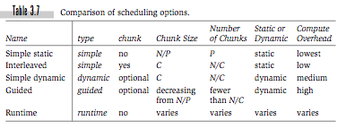
Scheduling options
schedule(type[, chunk])
* Table from: Parallel programming in OpenMP by Chandra, Dagum, Kohr, Maydan, Menom and McDonald

Slide 123
Scheduling types
schedule(static)
simple static
  each thread statically assigned one chunk of iterations.
  chunks equal or nearly equal in size, but the precise assignment of iterations to threads depends on the OpenMP implementation.
    if the number of iterations is not evenly divisible by the number of threads, the runtime system is free to divide the remaining iterations among threads as it wishes.

Slide 124
Scheduling types
schedule(static,chunk)
interleaved
  iterations are divided into chunks of size chunk until fewer than chunk remain.
  remaining iterations are divided into chunks determned by implementation.
  Chunks are statically assigned to processors in a round-robin fashion:
    the ﬁrst thread gets the ﬁrst chunk, the second thread gets the second chunk, and so on, until no more chunks remain.

Slide 125
Scheduling types
schedule(dynamic [, chunk])
simple dynamic
  iterations are divided into chunks of size chunk, similarly to an interleaved schedule.
  If chunk is not present, the size of all chunks is 1.
  At runtime, chunks are assigned to threads dynamically.

Slide 126
Scheduling types
schedule(guided [, chunk])
guided self-scheduling
  the ﬁrst chunk size implementation-dependent
  the size of each successive chunk decreases exponentially (a certain percentage of the preceding chunk size) down to a minimum size of.
  The value of the exponent depends on the implementation. If fewer than chunk iterations remain, how the rest are divided into chunks also depends on the implementation. If chunk is not speciﬁed, the minimum chunk size is 1. Chunks are assigned to threads dynamically.

Slide 127
Scheduling types
schedule(runtime)
runtime
  no chunk specified
  schedule type is chosen at runtime based on the value of the environment variable omp_schedule.
    should be set to a string that matches the parameters that may appear in parentheses in a schedule
      setenv OMP_SCHEDULE "dynamic,3"
    If OMP_SCHEDULE is not set, the choice of schedule depends on the implementation.

Slide 128
Scheduling- beware
the correctness of a program must not depend on the schedule chosen for its parallel loops.
  e.g. if one iteration writes a value that is read by another iteration that occurs later in a sequential execution:
    If the loop is ﬁrst parallelized using a schedule that assigns both iterations to the same thread, the program may get correct results at ﬁrst, but then mysteriously stop working if the schedule is changed while tuning performance.
    If the schedule is dynamic, the program may fail only intermittently, making debugging even more difﬁcult.
some kinds of schedules to be more expensive than others:
  a guided schedule is typically the most expensive of all because it uses the most complex function to compute the size of each chunk.

Slide 129
Scheduling- beware
some kinds of schedules are more expensive than others:
  a guided schedule is typically the most expensive of all because it uses the most complex function to compute the size of each chunk.
    main benefit is fewer chunks, which lowers synchronization costs
  dynamic schedules can balance the load better, at the cost of synchronization per chunk
worthwhile to experiment with different schedules and measure the results.

Slide 130
OpenMP language features
OpenMP allows the user to:
  create teams of threads
  share work between threads
  coordinate access to shared data
    declare shared and private variables
  synchronize threads and enable them to perform some operations exclusively.

Slide 131
OpenMP Memory model
by default, data is shared amongst, and visible to, all threads
additional clauses in the parallel directive enables threads to have private copies of some data and intialize that data
thread stores private data in a thread stack

Slide 132
OpenMP communication and data environment
clauses on parallel construct may be used to specify that a single variable is:
  shared
    variable shared between all threads
    communication can take place through these variables
  private
    each thread creates a private instance of the specified variable
    values are undefined on entry to loop, except for:
      loop control variable
      C++ objects invoke default constructor
  reduction

Slide 133
Data sharing: scoping
data scope clause consists of the keyword identifying the clause followed by a comma-separated list of variables within parentheses.
Any variable may be marked with a data scope clause, but there are restrictions:
  variable must be defined
  must refer to the whole object, not part of it
  a variable can appear in one clause only
  does not affect variables called in subroutines

Slide 134
Data sharing: scoping clauses
shared and private explicitly scope speciﬁc variables.
Unspecified variables are shared, except for:
  loop indices
shared attribute may result in data races – special care must be taken!
#pragma omp parallel for shared(a) private(i)
for (i=0; i<n; i++)
{
a[i] += i;
}

Slide 135
Data sharing: scoping clauses
Although shared variables make it convenient for threads to communicate, the choice of whether a variable is to be shared or private must be made carefully.
  Both the unintended sharing of variables between threads, or, conversely, the privatization of variables whose values need to be shared, are among the most common sources of errors in shared memory parallel programs.

Slide 136
Shared and private variables
private variables have advantages:
  reduce frequency of updates to shared memory (competition for resources)
  reduce likelihood of remote data accesses on ccNUMA platforms

Slide 137
Data sharing: scoping clauses
ﬁrstprivate and lastprivate perform initialization and ﬁnalization of privatized variables.
  At the start of a parallel loop, ﬁrstprivate initializes each thread copy of a private variable to the value of the master copy.
  At the end of a parallel loop, lastprivate writes back to the master copy the value contained in the private copy belonging to the thread that executed the sequentially last iteration of the loop.
  If the lastprivate clause is used on a sections construct, the object gets assigned the value that it has at the end of the lexically last sections construct.
Notes:
when parallelizing a loop we sometimes need access to the value that was in the master copy of the variable just before the loop, and we sometimes need to copy the last value written to a private variable back to the master copy at the end of the loop.

Slide 138
#pragma omp parallel for private(i) lastprivate(a)
for (i=0; i<n; i++)
{
a = i+1;
printf("Thread %d has a value of a = %d for i = %d\n",
omp_get_thread_num(),a,i);
} /*-- End of parallel for --*/
printf("Value of a after parallel for: a = %d\n",a);

Slide 139
Data sharing: scoping clauses
default changes the default rules used when variables are not explicitly scoped.
  default (shared | none)
    no default(private) clause in C, as C standard library facilities are implemented using macros that reference global variables.
    use default(none) for protection - all variables MUST be specified
reduction explicitly identiﬁes reduction variables.
#pragma omp parallel for default(none) shared(n,a) \
reduction(+:sum)
for (i=0; i<n; i++)
sum += a[i];
/*-- End of parallel reduction --*/
printf("Value of sum after parallel region: %d\n",sum);
Notes:
This clause gets the OpenMP
compiler to generate code that performs the summation in parallel. This is generally to
be preferred over a manual implementation.

Slide 140
Data sharing: Parallelizing Reduction Operations
In a reduction, we repeatedly apply a binary operator to a variable and some other value, and store the result back in the variable. e.g.
  find sum elements of array (+)
  reduction (redn_oper : var_list)

Slide 141
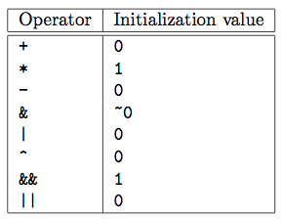
Reduction operations for C/C++
Notes:
note initial value
are must be exercised when parallelizing reductions that use subtraction (当�) or the C �&&� or 倒|� operators. Subtraction is in fact not a commutative-associative operator, so the code to update the reduction variable must be rewritten (typically replacing 当� by �+�) for the parallel reduction to produce the same result as the serial one. The C logical oper- ators �&&� and 倒|� short-circuit (do not evaluate) their right operand if the result can be determined just from the left operand. It is therefore not desirable to have side effects in the expression that updates the reduction variable because the expression may be evaluated more or fewer times in the parallel case than in the serial one.

Slide 142
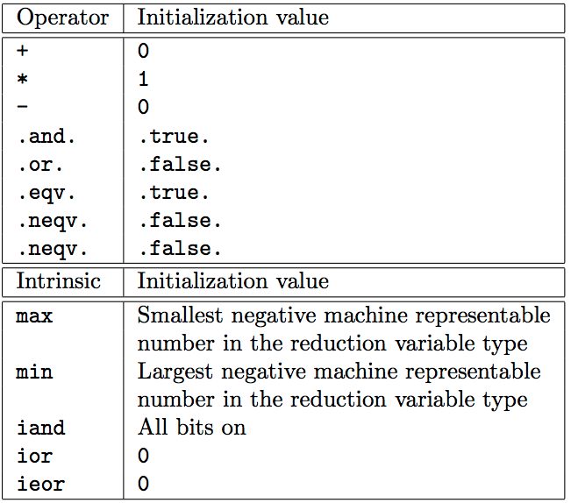
Reduction operations for Fortran

Slide 143
loop-level parallelism
Typical programs in science and engineering spend most of their time in loops, performing calculations on array elements
  e.g. ?
Parallel for loops can reduce time
  implemented incrementally
But need to choose loops carefully:
  parallel program must give same behaviour as sequential - correctness must be maintained
  execution time must be shorter!

Slide 144
OpenMP language features
OpenMP allows the user to:
  create teams of threads
  share work between threads
    Loop Construct
    Sections Construct
    Single Construct
    Workshare Construct (Fortran only)
  coordinate access to shared data
  synchronize threads and enable them to perform some operations exclusively.

Slide 145
Other worksharing constructs
loop level parallelism is considered fine-grained parallelism
  unit of work small relative to whole program
  simplest to expose
    incremental approach towards parallelizing an application, one loop at a time
  but limited scalability and performance.

Slide 146
Loop-level parallellism: limitations
Applications that spend substantial portions of their execution time in noniterative constructs are less amenable to this form of parallelization.
each parallel loop incurs the overhead for joining the threads at the end of the loop.
  each join is a synchronization point where all the threads must wait for the slowest one to arrive.
  negative impact on performance and scalability
Notes:
why? since the program can only run as fast as the slowest thread in each parallel loop.

Slide 147
Worksharing out of loops #1
#pragma omp sections [clause [clause] ...]
{
[#pragma omp section]
block
[#pragma omp section
block
...
...
]
}
The Sections Construct
distributes the execution of the different sections among the threads in the parallel team
  task queue
  Each section is executed once, and each thread executes zero or more sections.
can simply use
#pragma omp parallel sections [clause [clause] ...]
Notes:
A thread may execute more than one section if, for example, there are more sections than threads, or if a hread ﬁnishes one section before other threads reach the sections con- struct. It is generally not possible to determine whether one section will be executed before another (regardless of which came ﬁrst in the program痴 source), or whether two sections will be executed by the same thread.

Slide 148
Sections
In general, data parallel:
  to parallelize an application using sections, we must think of decomposing the problem in terms of the underlying data structures and mapping these to the parallel threads.
Approach requires a greater level of analysis and effort from the programmer, but can result in better application scalability and performance.
Coarse-grained parallelism, demonstrates greater scalability and performance but requires more effort to program.
Bottom line: Can be very effective, but a lot more work

Slide 149
Workingsharing out of loops #2
The Single Construct
#pragma omp single [clause [clause] ...]
block
specifies that only a single thread will execute a section
  implicit barrier at end (like all worksharing constructs)
OpenMP does not allow a work-sharing construct to be nested
Notes:
this thread will create an additional, brand-new team of threads, of which it will be the master, to execute the iterations of the doloop. The execution of this doloop will proceed in parallel with this newly created team, just like any other parallel region. After the parallel do loop is over, this new team will gather at the implicit barrier,
As of the date of this writing, however, all OpenMP implementations only support one level of parallelism and serialize the implementation of further nested levels. We expect this to change over time with additional experience.

Slide 150
Other worksharing constructs
A work-sharing construct does not launch new threads and does not have a barrier on entry.
  By default, threads wait at a barrier at the end of a work-sharing region until the last thread has completed its share of the work. However, the programmer can suppress this by using the nowait clause
#pragma omp for nowait
for (i=0; i<n; i++)
{
............
}

Slide 151
OpenMP language features
OpenMP allows the user to:
  create teams of threads
  share work between threads
  coordinate access to shared data
  synchronize threads and enable them to perform some operations exclusively.
    Barrier Construct
    Critical Construct
    Atomic Construct – atomic updates
    Locks
    Master Construct
    Flush

Slide 152
Synchronization
Although communication in an OpenMP program is implicit, it is usually necessary to coordinate the access to shared variables by multiple threads to ensure correct execution.

Slide 153
Mutual exclusion
cur_max = MINUS_INFINITY;
#pragma omp parallel for
for( i = 1;i< n;i++)
if (a[i] > cur_max)
cur_max = a[i];
possible for the program to yield incorrect results - a data race
  exercise - show this!

Slide 154
Mutual exclusion
mutual exclusion:
  control access to a shared variable by providing one thread with exclusive access
OpenMP synchronization constructs for mutual exclusion:
  critical sections
  atomic directive
  runtime library lock routines

Slide 155
Critical sections
only one critical section is allowed to execute at one time anywhere in the program.
  equivalent to a global lock in the program.
  illegal to branch into or jump out of a critical section
#pragma omp critical [(name)]
block
cur_max = MINUS_INFINITY;
#pragma omp parallel for
for( i = 1;i< n;i++)
#pragma omp critical
if (a[i] > cur_max)
cur_max = a[i];
code in example will now execute correctly, but it no longer exploits any parallelism.
  the execution is effectively serialized since there is no longer any overlap in the work performed in different iterations of the loop.

Slide 156
Critical sections
cur_max = MINUS_INFINITY;
#pragma omp parallel for
for( i = 1;i< n;i++)
if (a[i] > cur_max) {
#pragma omp critical
if (a[i] > cur_max)
cur_max = a[i];
}
most iterations of the loop only examine cur_max, but do not actually update it
  not always true!
why do we check curr_max twice?

Slide 157
Named critical sections
global synchronization can be overly restrictive
OpenMP allows critical sections to be named:
  a named critical section must synchronize with other critical sections of the same name but can execute concurrently with critical sections of a different name
  unnamed critical sections synchronize only with other unnamed critical sections.
#pragma omp critical (MAXLOCK)
block

Slide 158
Mutual exclusion synchronization
OpenMP synchronization constructs for mutual exclusion:
  critical sections
  atomic directive
    another way of expressing mutual exclusion and does not provide any additional functionality.
    comes with a set of restrictions that allow the directive to be implemented using the hardware synchronization primitives.
  runtime library lock routines
    OpenMP provides a set of lock routines within a runtime library
    another mechanism for mutual exclusion, but provide greater ﬂexibility

Slide 159
Event synchronization
constructs for ordering the execution between threads
  barriers
    each thread waits for all the other threads to arrive at the barrier.
  ordered sections
    we can identify a portion of code within each loop iteration that must be executed in the original, sequential order of the loop iterations.
      eg. for printing in order
  master directive
    identifies a block that must be executed by the master thread
#pragma omp barrier
#pragma omp ordered
#pragma omp master
Notes:
only one ordered section

Slide 160
Loop level parallelism: clauses overview
Scoping clauses (such as private or shared)
    most commonly used, control the sharing scope of one or more variables within the parallel loop.
schedule clause
    controls how iterations of the parallel loop are distributed across the team of parallel threads.
if clause
    controls whether the loop should be executed in parallel or serially like an ordinary loop, based on a user-deﬁned runtime test.
ordered clause
    speciﬁes that there is ordering (a kind of synchronization) between successive iterations of the loop, for cases when the iterations cannot be executed completely in parallel.
The copyin clause
    initializes certain kinds of private variables (called threadprivate variables) at the start of the parallel section.

Slide 161
Loop level parallelism: clauses overview
Multiple scoping and copyin clauses may appear on a parallel loop.
  generally, different instances of these clauses affect different variables that appear within the loop.
The if, ordered, and schedule clauses affect execution of the entire loop, so there may be at most one of each of these.

Slide 162
Parallel Overhead
We don’t get parallelism for free
the master thread has to start the slaves
iterations have to be divided among the threads
threads must synchronize at the end of workshare constructs (and other points).
threads must be stopped

Slide 163
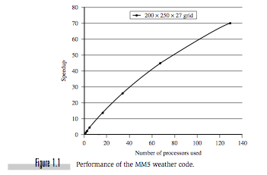
Parallel Speedup
compare lapsed time with best sequential algorithm with parallel algorithm
  Speedup for N processes =
time for 1 process
time for N processes
= T₁/T_{N}.
In the ideal situation, as N increases, so T_{N} should decrease by a factor of N.
Speedup is the factor by which the time can improve compared to a single processor
Figure from “Parallel Programming in OpenMP, by Chandra et al.

Slide 164
OpenMP performance
easy to create parallel programs with OpenMP
    but NOT easy to make them faster than the serial code!
OpenMP performance is influenced by:
  the way memory is accessed by individual threads
  the fraction of work that is sequential, or replicated
  the amount of time spent handling OpenMP constructs
  the load imbalance between synchronization points
  other synchronization overheads– critical regions etc.

Slide 165
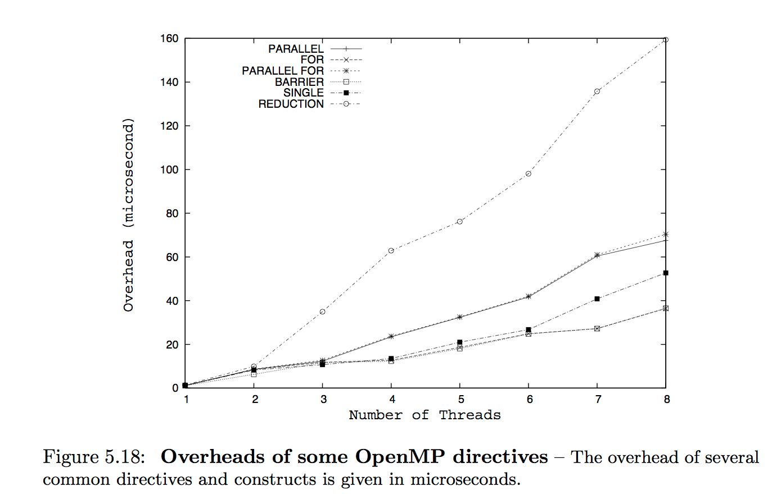
OpenMP microbenchmarks
The EPCC microbenchmarks help programmers estimate the relative cost of using different OpenMP constructs.
  provide an estimate of the overheads for each feature
Image from:
Using OpenMP - Portable Shared Memory Parallel Programming by Barbara Chapman, Gabriele Jost, Ruud van der Pas

Slide 166
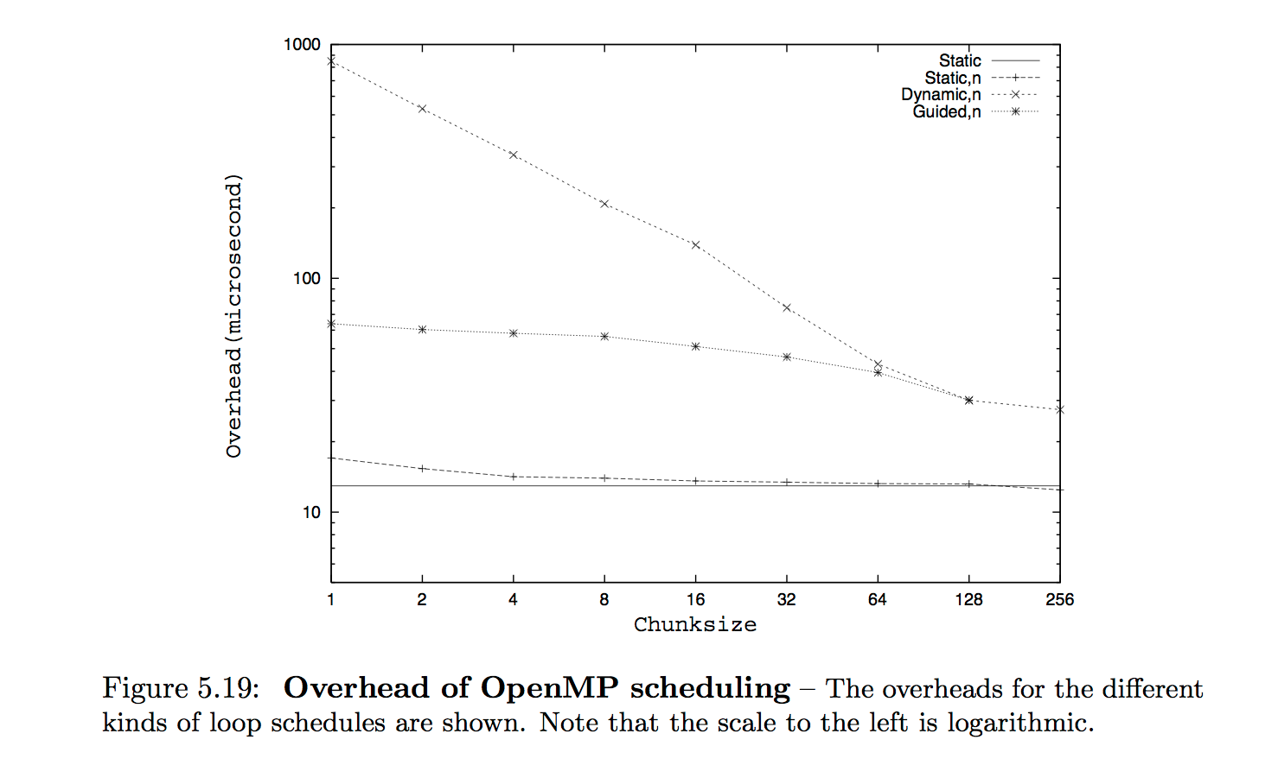
OpenMP microbenchmarks
Image from:
Using OpenMP - Portable Shared Memory Parallel Programming by Barbara Chapman, Gabriele Jost, Ruud van der Pas

Slide 167
OpenMP performance
AS with serial code, performance is often linked to cache issues
  NOTE – in C a 2D array is stored in rows, in FORTRAN in columns (“row-wise” versus “column-wise”)
    for good performance, it is critical that the arrays are accessed the way they are stored.

Slide 168
OpenMP performance
Example of good memory access – Array a is accessed rowwise
for (int i=0; i<n; i++)
for (int j=0; j<n; j++)
sum += a[i][j];
Example of bad memory access – Array a is accessed columnwise.
for (int j=0; j<n; j++)
for (int i=0; i<n; i++)
sum += a[i][j];

Slide 169
Coping with parallel overhead
to speed up a loop nest, it is generally best to parallelize the loop that is as close as possible to being outermost.
  because of parallel overhead incurred each time we reach a parallel loop
    outermost loop in the nest is reached only once each time control reaches the nest
    inner loops are reached once per iteration of the loop that encloses them.
Because of data dependences, the outermost loop in a nest may not be parallelizable
  can solve using loop interchange that swaps the positions of inner and outer loops
      but must respect data dependences

Slide 170
Reducing parallel overhead through loop interchange
for ( j = 2; j<n ;j++) // Not parallelizable - why?.
for (i = 1; i<n; i++) //Parallelizable.
a[i, j] = a[i, j] + a[i, j–1]
#omp parallel for
for (i = 1; i<n; i++) //Parallelizable.
for ( j = 2; j<n ;j++) // Not parallelizable
a[i, j] = a[i, j] + a[i, j–1]
Here we have reduced the total amount of parallel overhead
  but the transformed loop nest has worse utilization of the memory cache.
  transformations may involve a tradeoff - they improve one aspect of performance but hurt another aspect

Slide 171
Performance Issues
coverage
  Coverage is the percentage of a program that is parallel.
granularity
  how much work is in each parallel region.
load balancing
  how evenly balanced the work load is among the different processors.
  loop scheduling determines how iterations of a parallel loop are assigned to threads
    if load is balanced a loop runs faster than when the load is unbalanced
locality and synchronization
  cost to communicate information between different processors on the underlying system.
    synchronization overhead
    memory cache utilization
  need to understand machine architecture

Slide 172
Coping with parallel overhead
In many loops, the amount of work per iteration may be small, perhaps just a few instructions
  the parallel overhead for the loop may be orders of magnitude larger than the average time to execute one iteration of the loop.
  Due to the parallel overhead, the parallel version of the loop may run slower than the serial version when the trip-count is small.
  Solution: use if clause:
  can also be used for other functions, such as testing for data dependences at runtime
#pragma omp parallel for if (n>800)

Slide 173
Best practices
Optimize Barrier Use
  barriers are expensive operations
  the nowait clause eliminates the barrier that is implied on several constructs
  use where possible, while ensuring correctness
Avoid ordered construct
Avoid large critical regions

Slide 174
Best practices
Maximize parallel regions
#pragma omp parallel for
for (.....)
{
/*-- Work-sharing loop 1 --*/
}
#pragma omp parallel for
for (.....)
{
/*-- Work-sharing loop 2 --*/
}
.........
#pragma omp parallel for
for (.....)
{
/*-- Work-sharing loop N --*/
#pragma omp parallel
{
#pragma omp for /*-- Work-sharing loop 1 --*/
{ ...... }
#pragma omp for /*-- Work-sharing loop 2 --*/
{ ...... }
.........
#pragma omp for /*-- Work-sharing loop N --*/
{ ...... }
}
fewer implied barriers
potential for cache data reuse between loops.
downside is that can no longer adjust the number of threads on a per loop
basis, but this is often not a real limitation.

Slide 175
Best practices
Avoid parallel regions in inner loops
for (i=0; i<n; i++)
for (j=0; j<n; j++)
#pragma omp parallel for
for (k=0; k<n; k++)
{ .........}
#pragma omp parallel
for (i=0; i<n; i++)
for (j=0; j<n; j++)
#pragma omp for
for (k=0; k<n; k++)
{ .........}

Slide 176
Best practices
Address poor load balance
experiment with scheduling schemes

Slide 177
General OpenMP strategy
Programming with OpenMP:
  begin with parallelizable algorithm, SPMD model
Annotate the code with parallelization and synchronization directives (pragmas)
  Assumes you know what you are doing
  Code regions marked parallel are considered independent
  Programmer is responsibility for protection against races
Test and Debug

Slide 178
To think about: Multilevel programming
E.g. combination of MPI and OpenMP (or CPU threads and CUDA) within a single parallel-programming model.
  SMP clusters
advantage - optimization of parallel programs for hybrid architectures (e.g. SMP clusters)
disadvantage- applications tend to become extremely complex.

Slide 179
Some Useful OpenMP Resources
OpenMP specification - www.openmp.org
Parallel programming in OpenMP
by Rohit Chandra, Leonardo Dagum, Dave Kohr, Dror Maydan, Ramesh Menom, Jeff McDonald
Using OpenMP - Portable Shared Memory Parallel Programming
by Barbara Chapman, Gabriele Jost, Ruud van der Pas
NCSA
OmpSCR: OpenMP Source Code Repository: http://sourceforge.net/projects/ompscr/

