Slide 1
DES
Password decoding
A brute force approach
Johan Andrey Bosso
Paolo Innocenti
MICC, 20/03/2020

Slide 2
DES
Password decoding
MICC, 20/02/2020
Introduction
In this presentation:
we describe the decoding of DES-encrypted passwords by brute force approach.
we present 2 possible solutions, based on C++ and Java, implemented in both a sequential version and a parallel one.
we analyze the performed tests and the achieved results by considering the performance improvement obtained through the use of parallel programming techniques.

Slide 3
DES
Password decoding
MICC, 20/02/2020
DES decoding
Encryption algorithm based on 56 bits keys.
Uses the same key for coding and decoding.
Considered unsafe nowadays because of the few bits used for its keys.
Can be considered a research task based on the test of every key with every password.

Slide 4
DES
Password decoding
MICC, 20/02/2020
Implementations
Limited to 8 digits in the [0-9./] set for C++ and [0-9] set for Java.
Reasonable limitation because of the common use of dates for 8-digits passwords.
Two different approaches to handle the problem:
C++ version testes all the passwords with a key, before repeating the process with the following key.
Java version testes all the keys with a password, before moving to the following password.

Slide 5


DES
Password decoding
MICC, 20/02/2020
C++ & OpenMP
Password in GGMMYY o MMGGYY format, with sections separated by / or ., from custom dataset.
Outer For loop visits the key set.
Inner For loop visits the password set.
Parallelized using OpenMP in its 201511 version:
Parallelization run at compile time using the pragma directives on the two loops.
Environment variables to handle threads and chunking.
Particular focus put on how to chunk data.
Termination achieved using C++ exit() method.

Slide 6

DES
Password decoding
MICC, 20/02/2020
Java & Threads
Considers all password that can be generated with the [0-9] set.
Key space bits decreased the to allow easier testing.
Requires the definition of a custom password generator.
Parallelized by extending the Thread class:
each thread tests one password at a time on the entire key space
password generator shared among threads with synchronized generate() method
shared volatile boolean attribute to guarantee synchronized thread termination

Slide 7


DES
Password decoding
MICC, 20/02/2020
Hardware
C++ tests:
CPU Intel Core i7-7700HQ @ 2.80 GHz, with hyperthreading
16GB DDR4 RAM
OS Ubuntu 18.10
Java tests:
CPU Intel Core i5-6600K @ 3.6 GHz, without hyperthreading
16GB DDR4 RAM
OS Ubuntu 19.10

Slide 8
DES
Password decoding
MICC, 20/02/2020
Tests
C++
First test to analyze the relationship between key position in the keyset and performance
Fixed password
Influenced by position in the entire keyset for the sequential implementation
Influenced by position in the chunk and membership
Second test to analyze the impact of both dataset and keyset size
By changing the size of the sets.
By changing the position of password and key within their sets.
SpeedUp computed to evaluate the performance improvement.

Slide 9
DES
Password decoding
MICC, 20/02/2020
Tests
Java
First test to measure how the number of threads affected the execution time
by using 4,8 and 16 threads on a fixed password.
Second test to evaluate the impact of the amount of bits used to define the key space
by using a fixed password on a fixed number of threads.
and ranging the bits from 4 to 12
Third test to analyze how the position of the password in its domain affected the execution time
by using a fixed amount of bits and threads.
and using a password from the first quarter of the domain and one from the last quarter.
SpeedUp computed to evaluate the performance improvement.

Slide 10
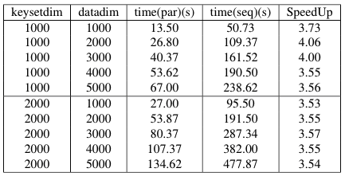
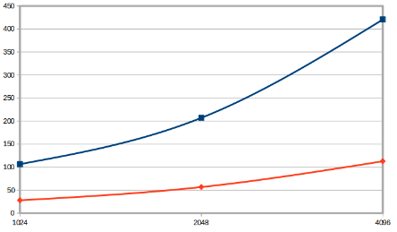
DES
Password decoding
MICC, 20/02/2020
Results
C++

Slide 11
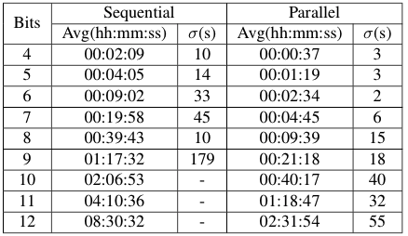
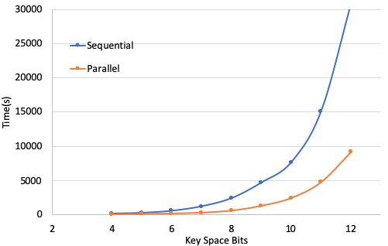
DES
Password decoding
MICC, 20/02/2020
Results
Java

Slide 12
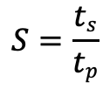
DES
Password decoding
MICC, 20/02/2020
Results
SpeedUp
$$S=\frac{ts}{tp}$$
Considering the speedup as , we achieved the following results:
3.6x average speedup for the C++ implementation.
3.3x average speedup for the Java implementation.

Slide 13
Thank you

