Slide 1
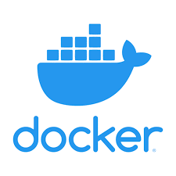
Docker: A short overview

Slide 2
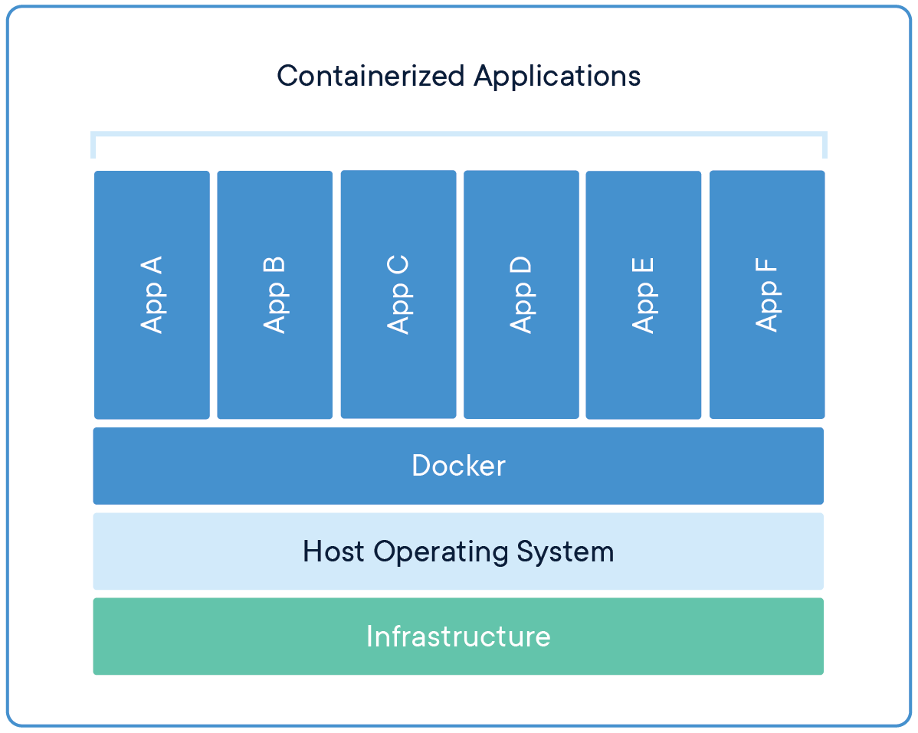
What is Docker?
Docker is an open platform for developing, shipping, and running applications.
Why should I use docker?
Solves the ”but it runs on my machine” problem (most of the time…)
Lightweight solution to isolate your application from infrastructure
Evolved as standard to deploy and manage applications
How to start with
Download Docker desktop https://docs.docker.com/desktop/
On Windows docker runs on WSL
Source: https://www.docker.com/blog/top-questions-for-getting-started-with-docker/

Slide 3
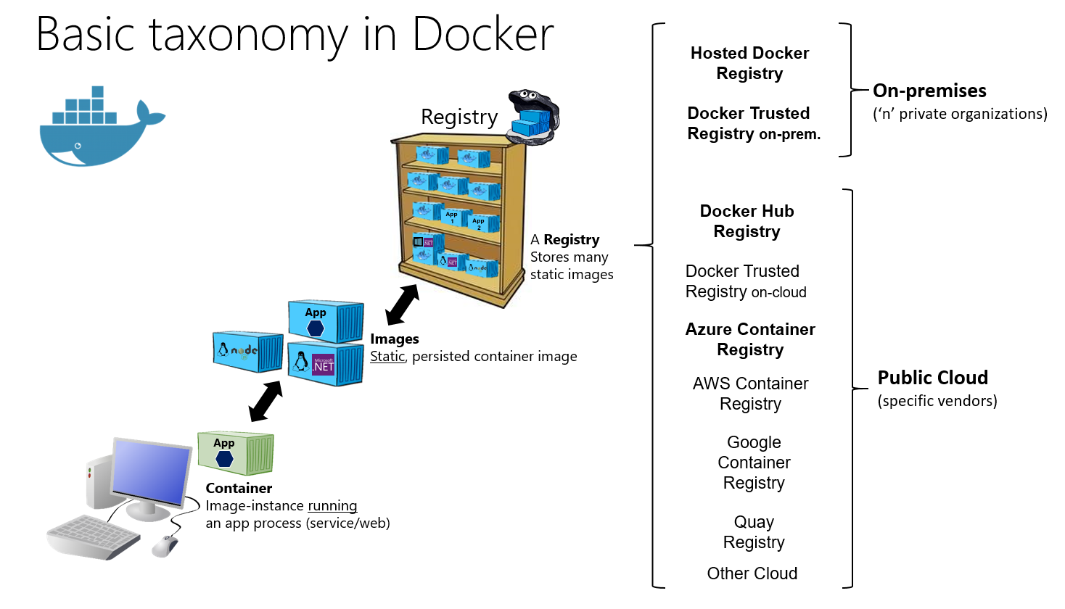
Images, containers, and registries
Container Applications run in containers
Images Specify what you run in a container
Registry Store images and make them available
Basic work steps
Develop app
Use Dockerfile to specify image
Build image
(Publish image in registry)
Run container given image
Source: https://learn.microsoft.com/en-us/dotnet/architecture/microservices/container-docker-introduction/docker-containers-images-registries

Slide 4
Running containers
docker run ubuntu
docker ps
docker run -it ubuntu → create a file
Second terminal: docker stop …
docker ps -a
docker start …
docker exec -it bash → file content
docker kill …
docker container prune
docker ps -a
docker run –-name test -it ubuntu → no file ☹ → exit
docker kill test
docker container prune

Slide 5
Persisting data
Volumes
Bind mount
Folders on your machine managed by docker
docker volume create mydata
docker volume ls
docker run --name test -it -v mydata:/data ubuntu
Create file, stop, container, prune
docker run --name test -it -v mydata:/data ubuntu → File still exists ☺
docker volume rm mydata
docker container rm test
Bind a local folder to the container
Bind the local folder with absolute path:
Mac/linux: docker run --name test -it -v “$PWD/mydata:/data” ubuntu
Windows docker run --name test -it -v %cd%/mydata:/data” ubuntu
On host: create a file in mydata
Check that it exists inside the container ☺
Exit, docker container rm test → Files still in local folder ☺

Slide 6
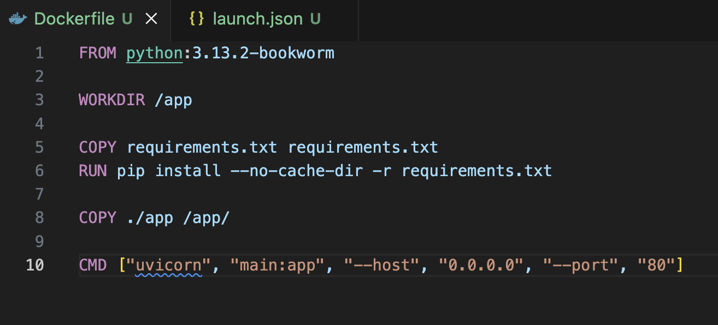
Dockerfile: Specify your image
Dockerfile Specifies the instructions to build your image
See code example: ADD LINK
Build the image docker build -t myapp .
List your images docker image ls
Run the image exposing the port docker run -d –p 8000:80 myapp
Check that the page is running http://localhost:8000

Slide 7
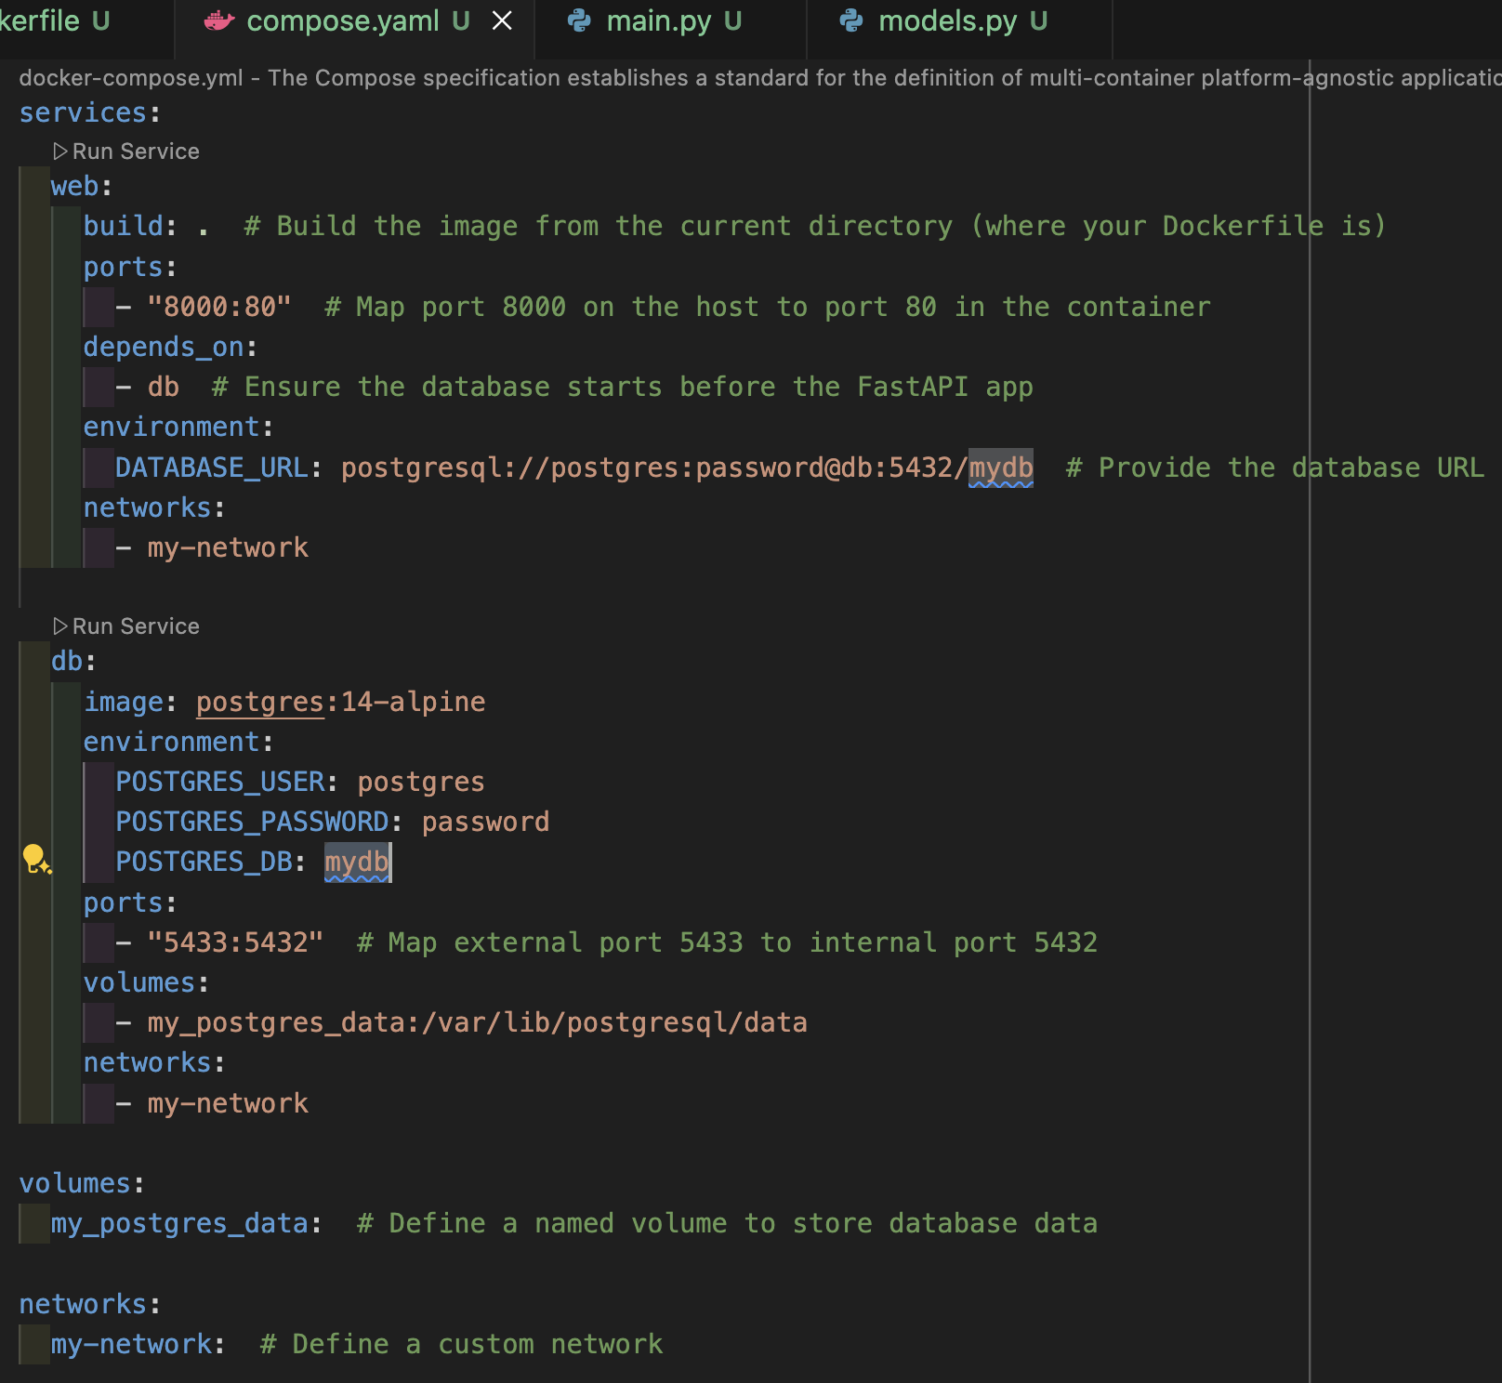
Combining Containers: Docker Compose

Slide 8
Resources
Advent of docker: https://adventofdocker.com/

