Slide 1

How to improve your Data Analysis Processes in your Web Application / ERP using RClass
Juan Antonio Breña Moral
Bren@juanantonio.info

Slide 2

Index.
Introduction
R, GNU Stat Engine
R_PHP, the project of Steve Chen
Rclass 1.0
Applications of Rclass 1.0
Alternatives
Slide <number>

Slide 3
Introduction.
This document has been created to explain the advantages to add a Data Analysis Module to improve Reporting activities in the Processes of any Company using R & PHP Web Technology and Rclass as a glue.
The idea is improve Reporting features of the ERP using a new module installed in the Intranet’s company.
Slide <number>

Slide 4
R, GNU Stat Engine. (I)
R is a free software environment for statistical computing and graphics. It is a GNU project which is similar to the S language and environment which was developed at Bell Laboratories (formerly AT&T, now Lucent Technologies) by John Chambers and colleagues. R can be considered as a different implementation of S. There are some important differences, but much code written for S runs unaltered under R.
R provides a wide variety of statistical (linear and nonlinear modelling, classical statistical tests, time-series analysis, classification, clustering, ...) and graphical techniques, and is highly extensible.
Slide <number>

Slide 5
R, GNU Stat Engine. (II)
One of R's strengths is the ease with which well-designed publication-quality plots can be produced, including mathematical symbols and formulae where needed.
R is an integrated suite of software facilities for data manipulation, calculation and graphical display.
Slide <number>

Slide 6
R_PHP, the project of Steve Chen
Rclass 1.0 has been developed using the R_PHP script, created by Steve Chen. R_PHP is hosted in: http://steve-chen.net/R_PHP/
R_PHP_Online is a PHP CGI web interface to run R program online, including graphic output.
Rclass 1.0 is basically a OOP version of R_PHP designed by Steve Chen.
Slide <number>

Slide 7
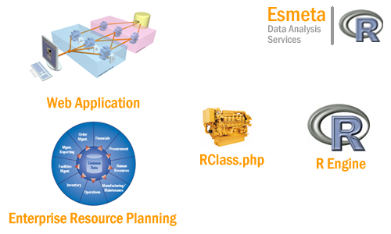
Rclass 1.0
Rclass 1.0 is a tool to integrate R Stat Engine with a Web Application.
Slide <number>

Slide 8
Applications of Rclass 1.0
Marketing / Sales:
  Sales budget Control
  Sales Prediction
  Campaigns Control
Slide <number>

Slide 9
Alternatives
There is others alternatives to integrate a Web Application / ERP with R.
Rserve
Rsoap
R.NET.Web
Rweb
Rpad
Slide <number>

Slide 10
Slide <number>

