Slide 1
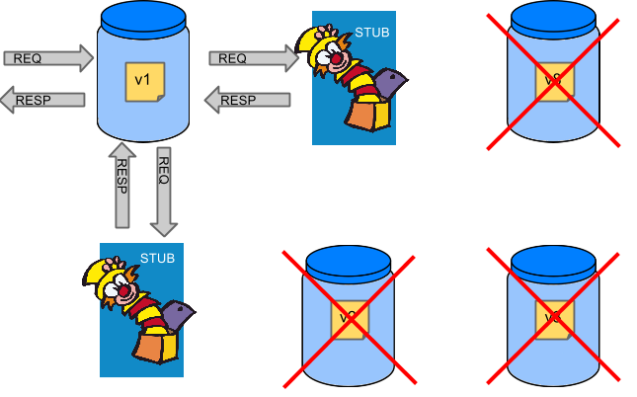
Spring Cloud Contract
Juan Antonio Brena Moral

Slide 2
Agenda
Pyramid of Testing
The Pipeline
The solution
Advantages
Demo
Links of interest

Slide 3
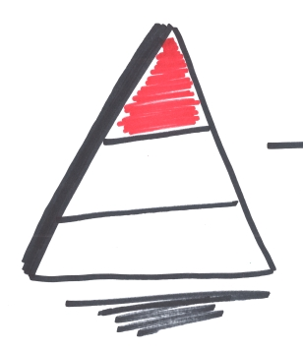
Pyramid of Testing
Integration Test

Slide 4
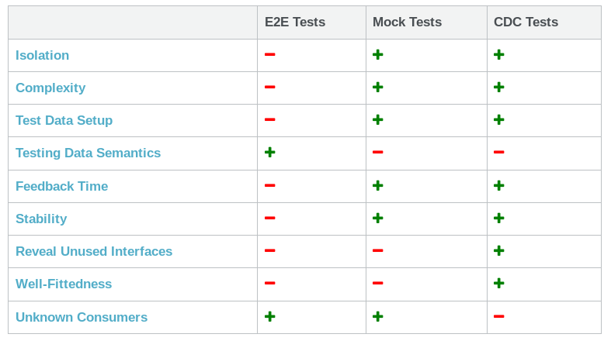
Pyramid of Testing

Slide 5
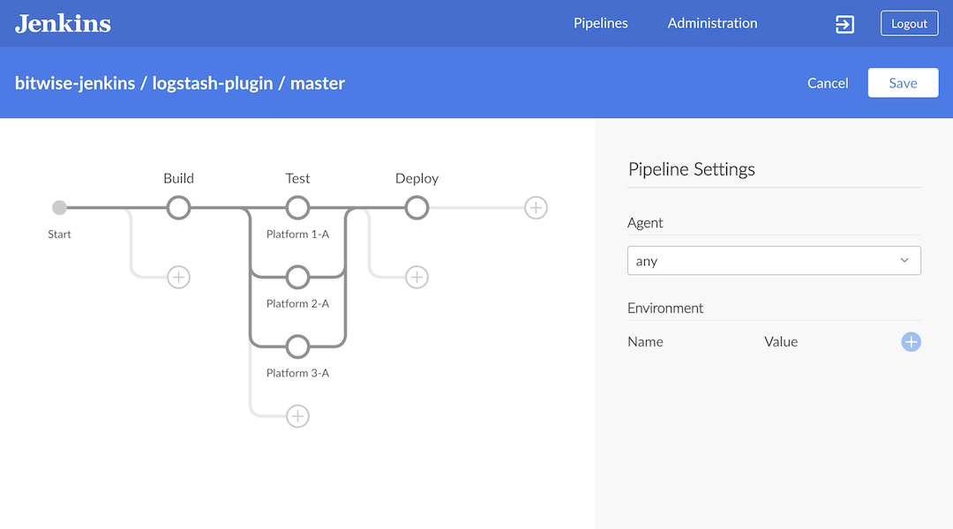
The pipeline

Slide 6
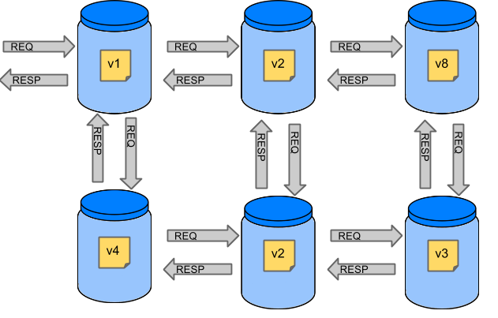
The Pipeline

Slide 7
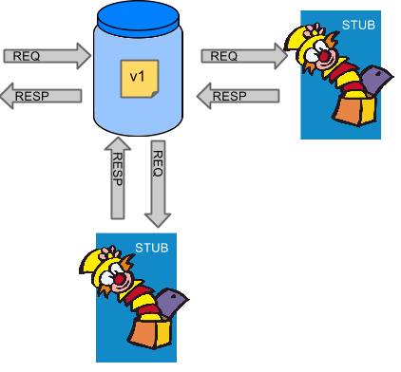
The Pipeline

Slide 8
The solution
Spring Cloud Contract
  You always need confidence when pushing new features into a new application or service in a distributed system. To that end, this project provides support for Consumer-driven Contracts and service schemas in Spring applications, covering a range of options for writing tests, publishing them as assets, and asserting that a contract is kept by producers and consumers — for both HTTP and message-based interactions.

Slide 9
Advantages
TDD Approach
  Contract first
Not follow a Waterfall approach in any environment
Social Skills
Better knowledge about your dependencies
More complete tests

Slide 10
Links of Interest
https://www.thoughtworks.com/radar/techniques/consumer-driven-contract-testing
https://martinfowler.com/articles/consumerDrivenContracts.html
https://martinfowler.com/articles/microservice-testing/
https://reflectoring.io/7-reasons-for-consumer-driven-contracts/
http://www.servicedesignpatterns.com/WebServiceEvolution/ConsumerDrivenContracts

Slide 11
Links of Interest
http://cloud.spring.io/spring-cloud-static/spring-cloud-contract/2.0.0.M5/single/spring-cloud-contract.html
https://cloud.spring.io/spring-cloud-contract/
https://github.com/spring-cloud/spring-cloud-contract

