Slide 1
Optimizing Inventory through ABC/XYZ Analysis and Demand Forecasting
Julian Sneve
Colorado State University Global
Dr. Orenthio Goodwin
November 2, 2025

Slide 2
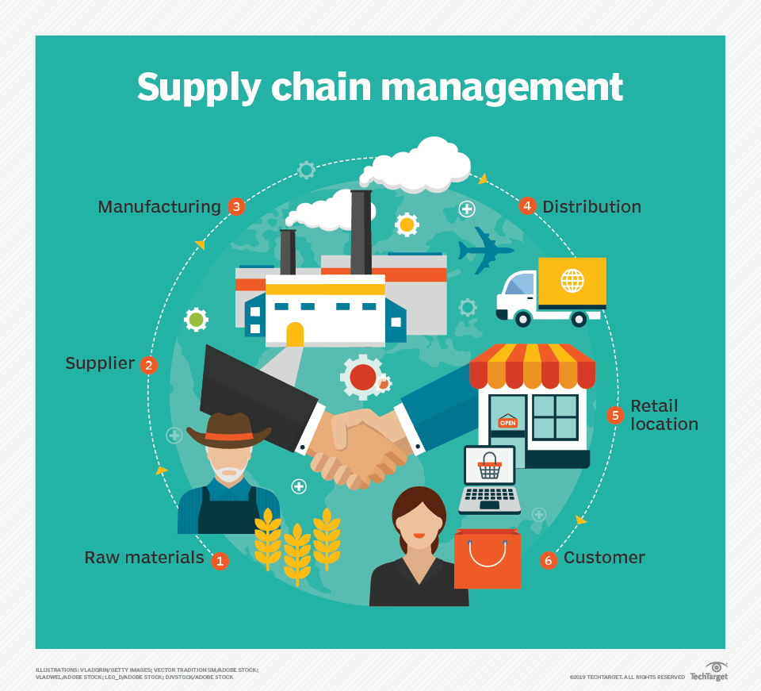
Background & Objectives
Modern supply chains face challenges balancing inventory levels and demand variability.
Excess stock increases carrying costs, while shortages impact service levels.
Objective:
  Analyze the benefits of integrating ABC/XYZ inventory classification with seasonality analysis to optimize inventory performance.

Slide 3

Dataset Overview
Source: DataCo Smart Supply Chain dataset
  180,519 records
  36 variables
Key variables:
  product_id
  quantity
  profit

Slide 4
Research Questions and Hypotheses
Which products drive the most profit?
  H₀ : There is no significant difference in average profit across products.
  H₁ : There is a significant difference in average profit for at least one product.
Which products have the most demand variability?
  H₀ : There is no significant difference in demand variability across products.
  H₁ : There is a significant difference in demand variability for at least one product.
Does seasonality affect the stability of product demand across XYZ categories?
  H₀ : Seasonality has no significant effect on the variability of product demand across XYZ categories.
  H₁ : Seasonality has a significant effect on the variability of product demand across XYZ categories.

Slide 5
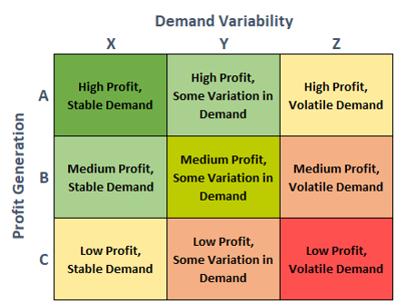
Methodology Overview
Tools:
  Microsoft Excel
  SAS Studio
ABC: ranked by cumulative profit (Pareto 80/20 principle).
XYZ: based on coefficient of variation of demand (X = stable, Z = volatile).
ABC/XYZ combination used to determine inventory

Slide 6
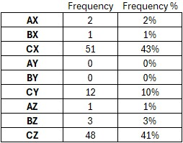
ABC/XYZ Analysis Results
AX items represent ~15% of SKUs but generate ~70% of total revenue.
BY and CZ items display higher demand uncertainty and lower profitability.
Insights: segment-driven replenishment and prioritization strategies improve efficiency.

Slide 7
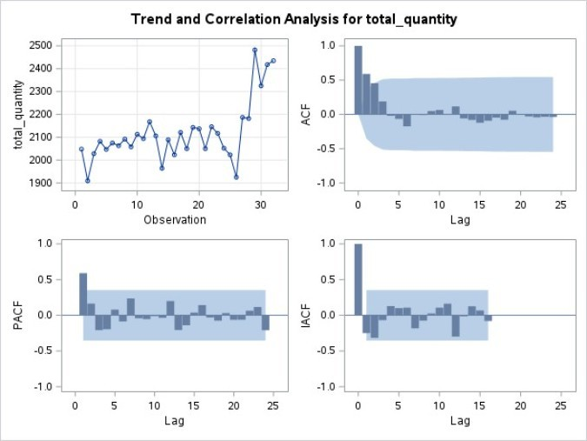
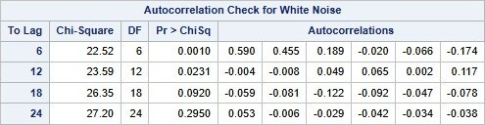
X-Category Seasonality Results
Power BI dashboard integrates ABC/XYZ segmentation and forecast results.
Interactive filters by segment, category, and time horizon.
KPIs: Inventory Turnover, Forecast Accuracy, Service Level, Profitability.
Enables proactive decision-making for supply chain managers.

Slide 8
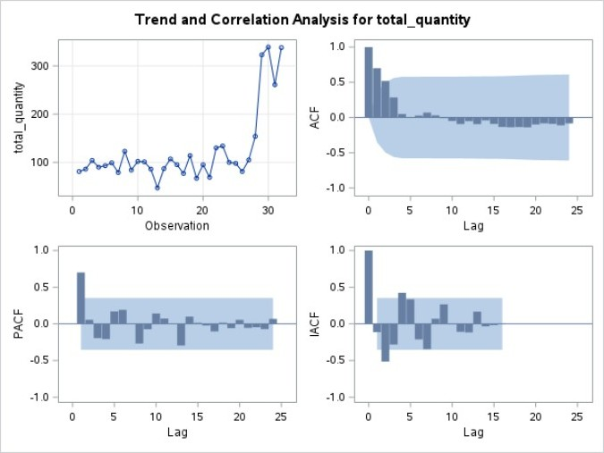
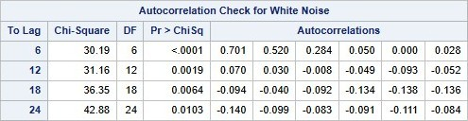
Y-Category Seasonality Results
Power BI dashboard integrates ABC/XYZ segmentation and forecast results.
Interactive filters by segment, category, and time horizon.
KPIs: Inventory Turnover, Forecast Accuracy, Service Level, Profitability.
Enables proactive decision-making for supply chain managers.

Slide 9
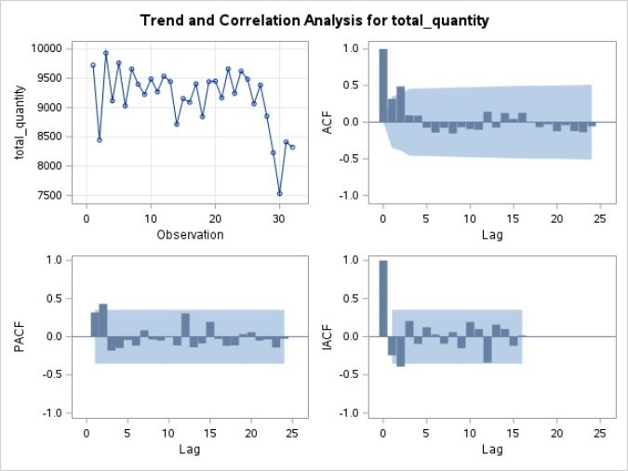

Z-Category Seasonality Results
Power BI dashboard integrates ABC/XYZ segmentation and forecast results.
Interactive filters by segment, category, and time horizon.
KPIs: Inventory Turnover, Forecast Accuracy, Service Level, Profitability.
Enables proactive decision-making for supply chain managers.

Slide 10
Conclusions & Recommendations
ABC/XYZ Classification is a Flexible Framework
  Integrating ABC/XYZ classification with predictive analytics offers a useful and flexible framework for better inventory management.
"Super-Pareto" Profit Distribution
  ABC analysis revealed a highly concentrated "super-Pareto" effect, where a few products drive the majority of revenue, emphasizing the strategic focus needed for these high-value items.
Seasonality is Not a Key Determinant
  A seasonality assessment found that while some autocorrelation existed in X and Y products, it was not a statistically significant determinant of demand variability across the XYZ categories, particularly for high-volatility Z products.
Tailored Forecasting Approaches
  Using time-series models (like ARIMA) for stable X and Y categories, while high-variability Z items require simpler, stochastic approaches with robust safety stock.

Slide 11
References
ASCM. (2023). Supply chain analytics. Association for Supply Chain Management. https://www.ascm.org/topics/supply-chain-analytics/
Constante, F., Silva, F., & Pereira, A. (2019). DataCo smart supply chain for big data analysis. Mendeley Data. https://data.mendeley.com/datasets/8gx2fvg2k6/5
Falatouri, T., Darbanian, F., Brandtner, P., & Udokwu, C. (2022). Predictive analytics for demand forecasting – a comparison of SARIMA and LSTM in retail SCM. Procedia Computer Science, 200(2022), 993-1003. https://creativecommons.org/licenses/by-nc-nd/4.0
Natsypayeva, E., Ivashina, M., Efremova, N., Chistyakova, S., & Melnichenko, V. (2020). Optimization of the assortment of retailers based on the use of ABC and XYZ analysis. Quality – Access to Success 21(179), 157-160.
Thieuleux, E. (2025). ABC XYZ analysis in inventory management: a complete guide with Excel example. AbcSupplyChain. https://abcsupplychain.com/abc-xyz-analysis/

