Slide 1
Job Completion
is where we record job completion from job order.

Slide 2
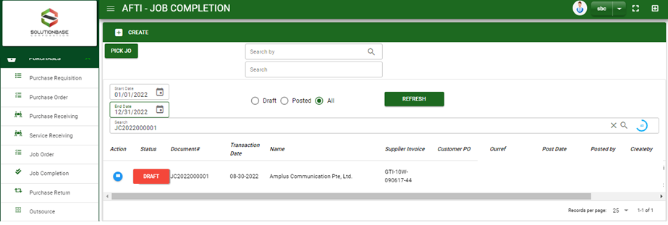

Purchase / Job Completion- Module
Main Window
When you click the Job Completion module under Purchases, Job Completion transactions list will display based on filtered date and status in the job completion main window.
Job Completion – Main Window

Slide 3
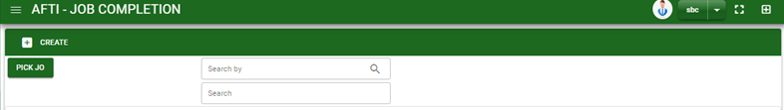
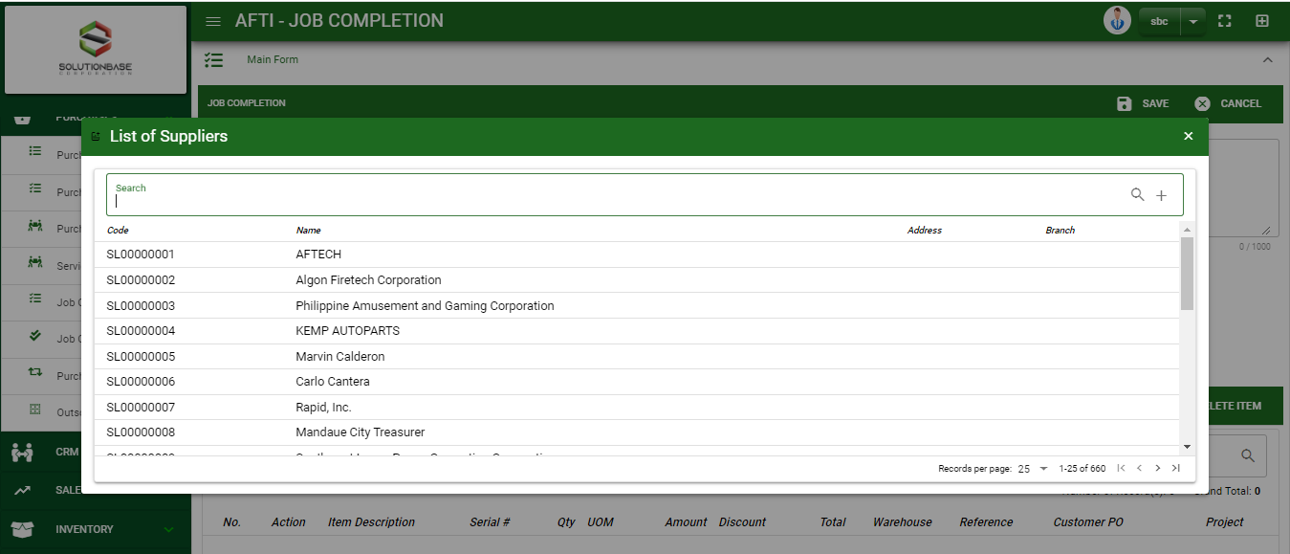
Purchase / Job Completion- Module
How To Create Job Completion Transaction?
1
CREATE USING CREATE BUTTON
1. In Job Completion – Main Window, you will notice a create button in the upper left of the window. Click the create button and you will be redirect in job completion – main form.
2. After you click the create button a dialog box will pop out with list of supplier. Search and select a supplier.
3. After you select a supplier, you will be redirected in job completion– main form where you will encode the other necessary information of the transaction and record the items’ to be receive from the supplier
How to search supplier?
Type the supplier name in the search bar.
And it will automatically sort out.
Then click the selected supplier.

Slide 4
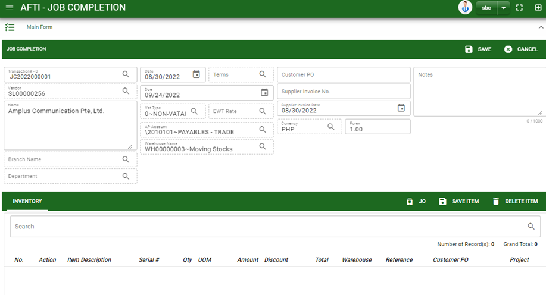



Purchase / Job Completion- Module
How To Create Job Completion Transaction?
4.1. Fill in other necessary information.
4.2. If done in header, click save button.
5. After saving the header, you may now add the job completion.
Job Order: Click Job Order button to select JO that has been completed.
4.1
Stock

Slide 5
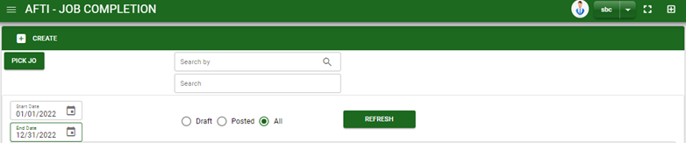


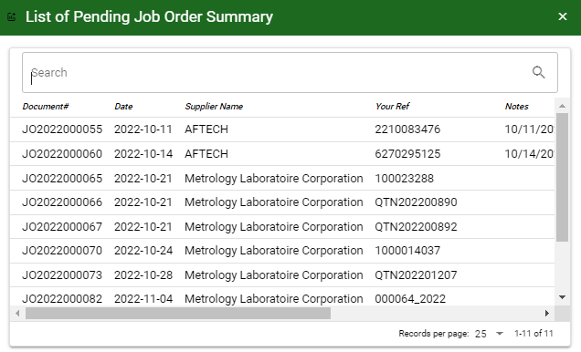
Purchase / Job Completion- Module
How To Create Job Completion Transaction?
CREATE USING PICK JO BUTTON
1. In Job Completion– Main Window, you will notice a Pick JO button in the upper left of the window. Click the button and a confirmation message will pop out. Click OK to proceed.
2. After you proceed to pick JO, search and select the job order transaction you want to create a job completion.
3. After you select the JO transaction, you will be redirect in job completion – main form where details from selected JO transaction are copied from header to details of items.
2
How to search Job Order transaction?
Type the transaction number in the search bar.
And it will automatically sort out.
Then click the selected JO transaction.

Slide 6
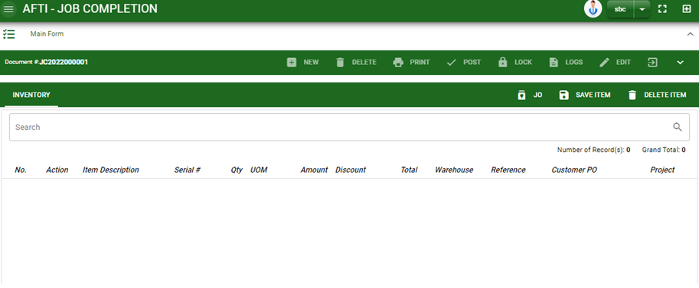

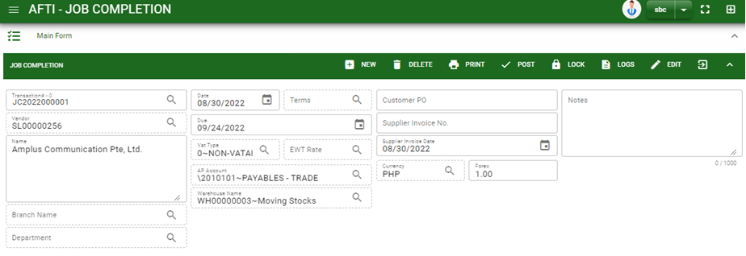
Purchase / Job Completion- Module
How To Create Job Completion Transaction?
If done, finalize the transaction by click the arrow button to maximize the main form header.
In header, click post button.
9

Slide 7
Purchase / Job Completion- Module
How To Edit Job Completion Transaction?
1.1. In the job completion – main window, search the job completion transaction you wish to edit its information in the search bar. Or,
1.2. In job completion – main form, click the lookup button and select the transaction you wish to edit its information by typing its transaction number in the search bar.
2. After you select the JC transaction, if you wish to edit the header of the transaction click edit button.
3. If you are done editing the job completion header, click save button in the upper side of the header.
1.1.
Job Completion – Main Window
HEADER
2.
1.2.
How to search RR transaction?
Type the transaction number in the search bar.
Click ‘enter’ in the keyboard to search.
Click to select the transaction you want to edit
Job Completion – Main Form

Slide 8
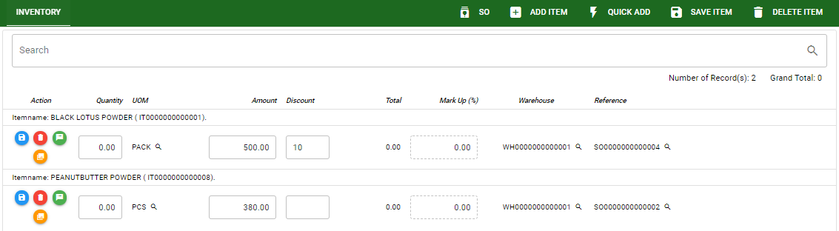
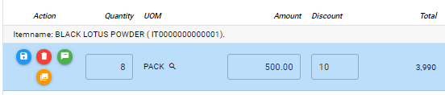
Purchase / Job Completion- Module
How To Edit Job Completion Transaction?
4. If you want to edit the items in job completion stock, edit right away the details you want to change and you will notice that after you change the details, the item you edited will be highlighted into blue.
5. If you’re done editing, click save item button to save the changes you made in the items.
6. To delete all items in the stock, click delete item button.
7. To delete a specific item on the table, click the delete icon next to the item to delete it.
STOCK
5
6
7
4

Slide 9
Purchase / Job Completion- Module
How To Delete Job Completion Transaction?
1.1.
1.1. In the job completion – main window, search the transaction you want to delete.
1.2. In job completion - main form, click the lookup button and select the transaction you want to delete.
2. If done, click delete button.
Job Completion – Main Windows
HEADER
2.
1.2.
How to search Jc transaction?
Type the transaction number in the search bar.
Click ‘enter’ in the keyboard to search.
Click to select the transaction you want to edit
Job Completion – Main Form

Slide 10
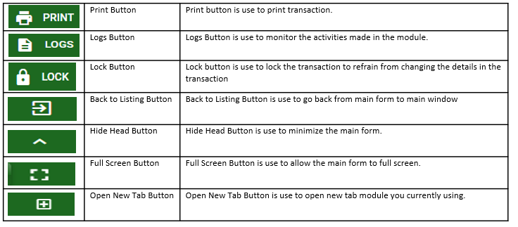
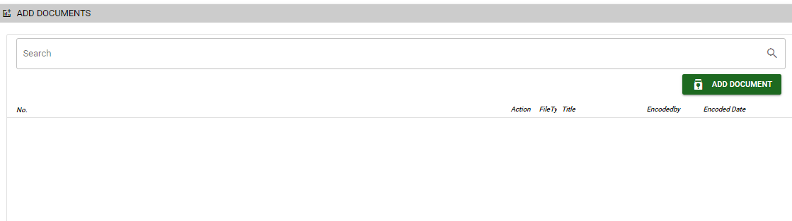
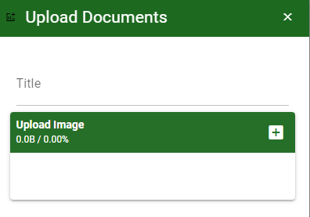
Purchase / Job Completion- Module
Other Information
Other Buttons
When you click the arrow up icon parallel in the main form on the upper right, and the job completion – main form will be minimize and the other tab will be visible.
Attachment tab
1. Click the arrow icon parallel to attachment tab
2. Click add document button
3. Once you click the add document button, a dialog box of upload documents will pop out.
4. To upload files, follow ‘how to upload document”
Shipping tab
Click the arrow icon parallel to Shipping/ billing address
You may view or edit the Shipping and Billing Address for the JC transaction.
2
How to upload document?
Type the title of the document.
Click add button to add the document you want to upload.
Then click upload button.
If you want to add more document, click add document button and repeat steps 1 to #3

