Slide 1
Service Invoice
Service Invoice is where service invoice are recorded.

Slide 2
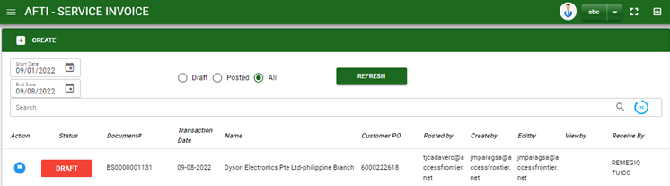

Sales/ Service Invoice - Module
Main Window
When you click the Service Invoice module under Sales, Service Invoice transactions list will display based on filtered date and status in the sales invoice main window.
Service Invoice – Main Window

Slide 3
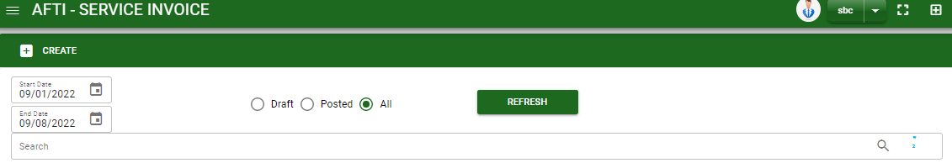
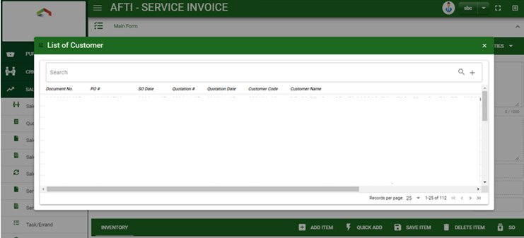
Sales/ Service Invoice - Module
How To Create Service Invoice Transaction?
1
1. In Service Invoice – Main Window, you will notice a create button in the upper left of the window. Click the create button and you will be redirect in sales invoice – main form.
2. After you click the create button a dialog box will pop out with list of pending Service SO’s. Search and select a customer or Service SO transaction number.
How to search Service SO transaction?
Type the document no. of SO transaction in the search bar.
And it will automatically sort out.
Then click the selected SO transaction.

Slide 4
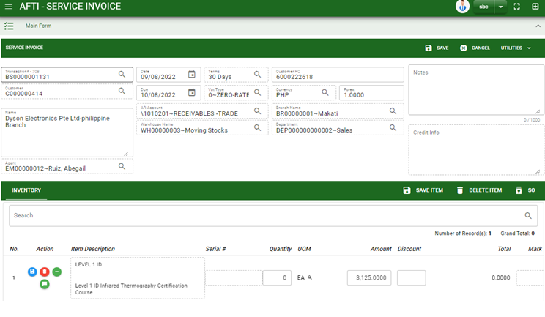
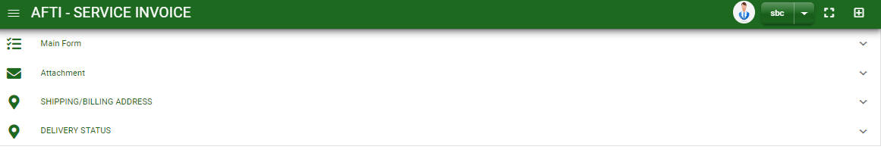
Sales/ Service Invoice - Module
How To Create Service Invoice Transaction?
3
3. After you select the Service SO transaction, click save button to display the details from selected Service SO transaction.
4. Once saved, check the details in main form.
5. Details from main form, instruction and shipping/ billing address will be copied from the selected Service SO transaction.

Slide 5
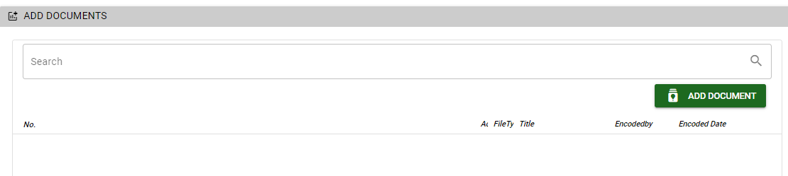
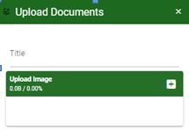
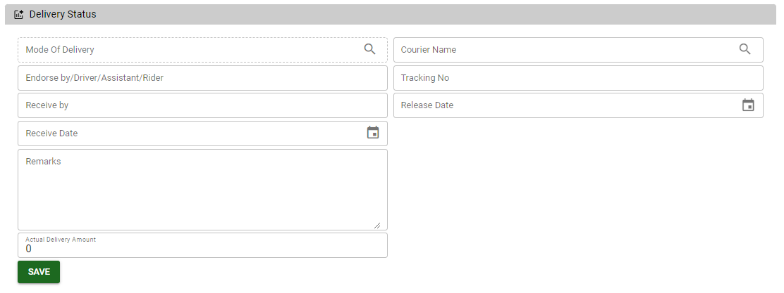
Sales/ Service Invoice - Module
How To Create Service Invoice Transaction?
6. If you want to upload file attachment, click the attachment and upload the file.
How to upload document?
Type the title of the document.
Click add button to add the chosen document to upload
Then click upload button.
If you want to add more document, click add document button and repeat steps #1 to 3.
1
2.
7. To add details in delivery, scroll down and click the delivery status tab. Encode the necessary details and click save once done.
8. To finalized the transaction, go to main form and click post button
7

Slide 6
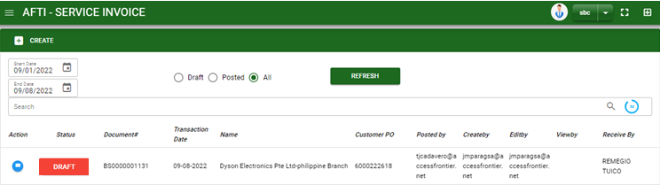
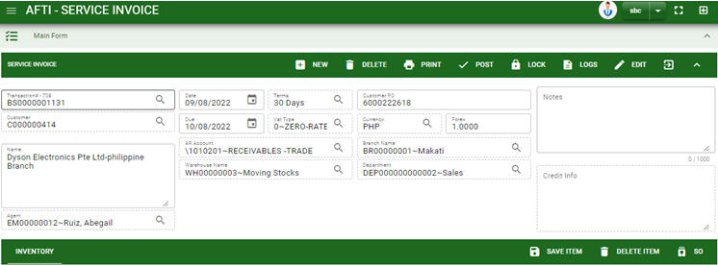
Sales/ Service Invoice - Module
How To Delete Service Invoice Transaction?
1.1. In the service invoice – main window, search the transaction you want to delete.
1.2. In service invoice – main form, click the lookup button and select the transaction you want to delete.
2. If done, click delete button.
1.1.
Service Invoice – Main Window
HEADER
2.
1.2.
How to search BS transaction?
Type the transaction number in the search bar.
Click ‘enter’ in the keyboard to search.
Click to select the transaction you want to delete
Service Invoice – Main Form

Slide 7
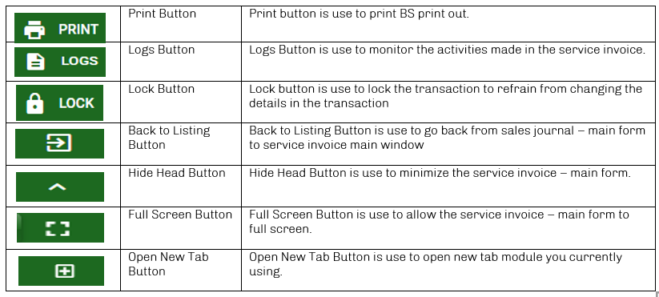
Sales/ Service Invoice - Module
Other Buttons

