Slide 1
Service Sales Order
Service Sales Order is where service order of customers is recorded from quotation.

Slide 2
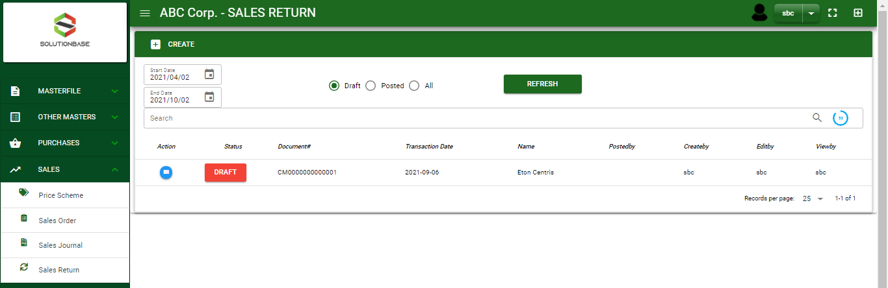

Sales/ Service Sales Order - Module
Main Window
When you click the Service Sales Order module under Sales, Service Sales Order transactions list will display based on filtered date and status in the sales order main window.
Service Sales order – Main Window

Slide 3
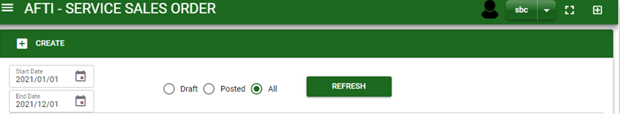
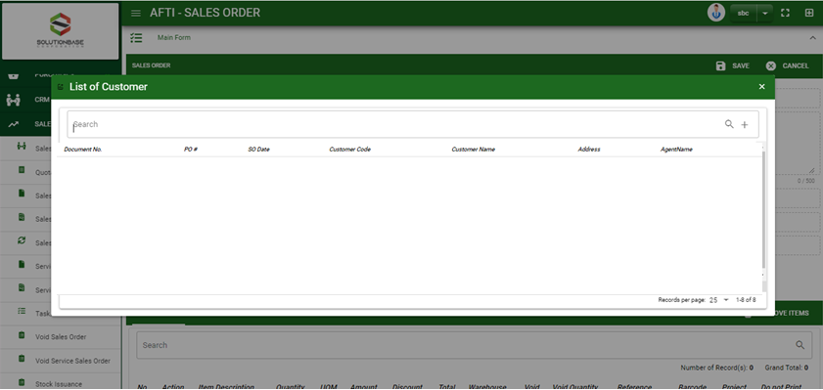
Sales/ Service Sales Order - Module
How To Create Service Sales order Transaction?
1
1. In Service Sales Order – Main Window, you will notice a create button in the upper left of the window. Click the create button and you will be redirect in service sales order – main form.
2. After you click the create button a dialog box will pop out with list of pending customer service quotations. Search and select a customer or the quotation transaction.
2
How to search quotation transaction?
Type the transaction number of quotation in the search bar.
And it will automatically sort out.
Then click the selected transaction in quotation

Slide 4
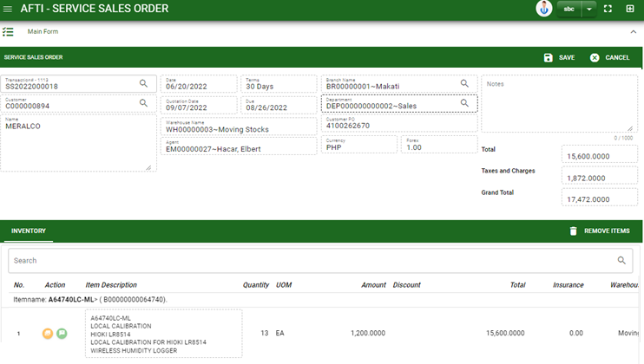
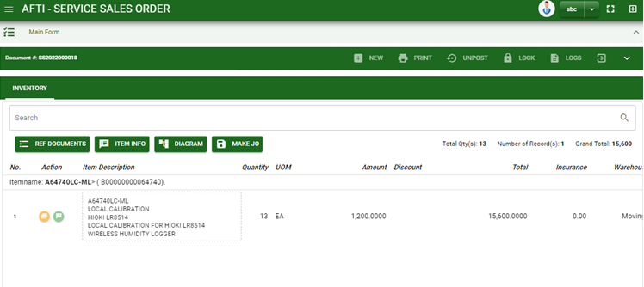
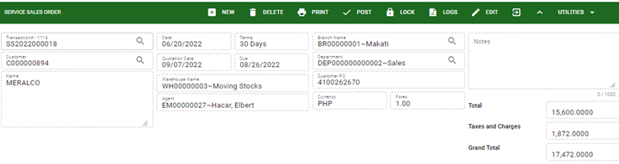
Sales/ Service Sales Order - Module
How To Create Service Sales order Transaction?
3. After you select the quotation, you will be redirect in service sales order – main form where you all information from quotation will be copied.
4. Check the transaction.
5. To finalize the transaction, click post button located in the header.
Service Sales order – Main Form
5

Slide 5
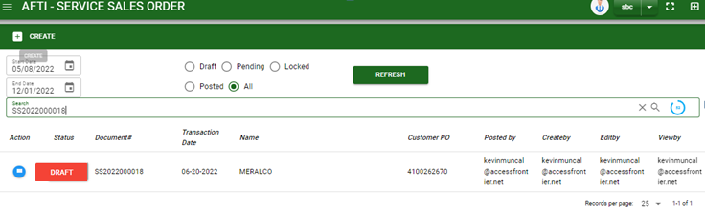
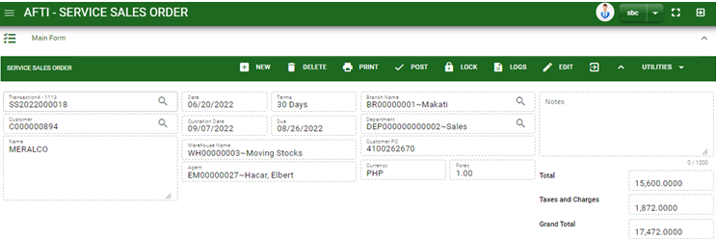

Sales/ Service Sales Order - Module
How To Delete Service Sales Order Transaction?
1.1.
1.1 In the service sales order – main window, search the transaction you want to delete.
1.2. In service sales order – main form, click the lookup button and select the transaction you want to delete.
2. If done, click delete button.
Service Sales Order – Main Window
HEADER
How to search Service SO transaction?
Type the transaction number in the search bar.
Click ‘enter’ in the keyboard to search.
Click to select the transaction you want to delete.
Service Sales Order – Main Form

Slide 6
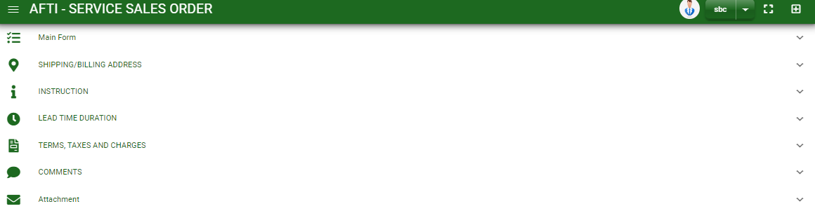
Sales/ Service Sales Order - Module
Other Information
When you click the arrow icon parallel in the main form on the upper right, the service sales order – main form will be minimize and the other tab will be visible.
Shipping/ billing Address tab
Instruction tab
Lead Time Duration
Terms, Taxes and Changes
Comments Tab
1. Click the arrow icon parallel to the tab you want to view
2. After you click the arrow, details copied from QTN will display

Slide 7
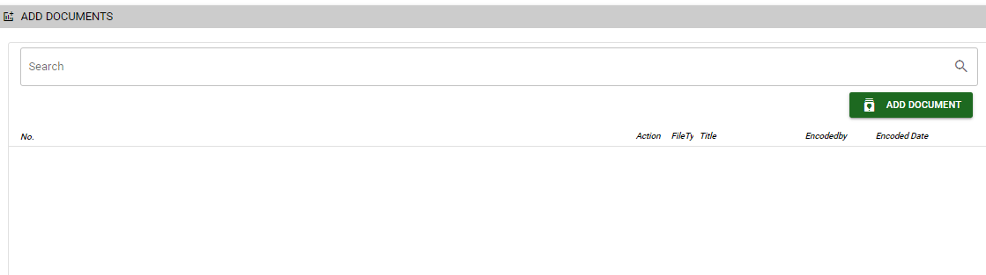
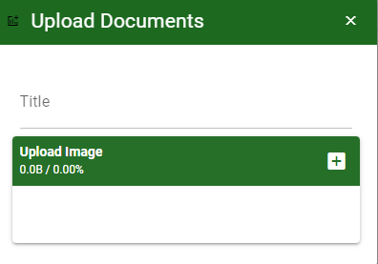
Sales/ Service Sales Order - Module
Attachment tab
1. Click the arrow icon parallel to attachment tab
2. Click add document button
3. Once you click the add document button, a dialog box of upload documents will pop out.
4. To upload files, follow ‘how to upload document”
2
How to upload document?
Type the title of the document.
Click add button to add the document you want to upload
Then click upload button.
If you want to add more document, click add document button and repeat steps 1 to #3

Slide 8
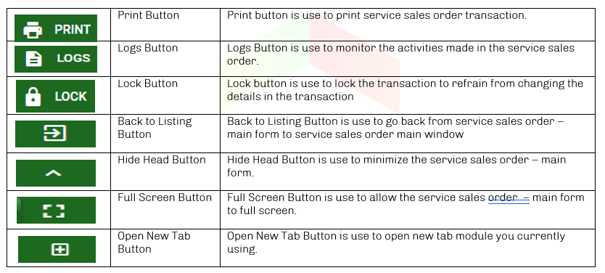
Sales/ Service Sales Order - Module
Other Buttons

