Slide 1
Accounts Receivable Setup
A module where outstanding Accounts Receivable is setup per Customer given the cut off date when starting to use the system.

Slide 2
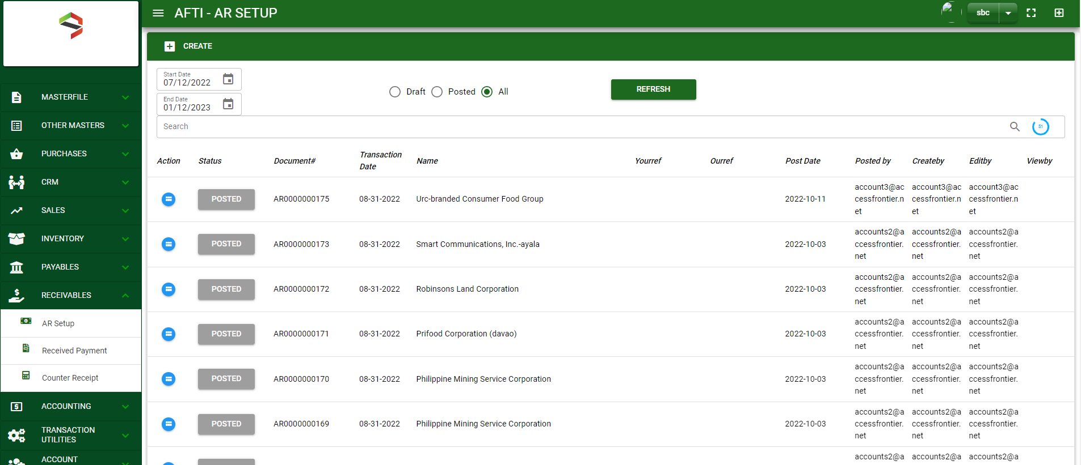

Accounting / Accounts Receivable Setup - Module
Main Window
When you click the Accounts Receivable Setup module under Receivables, Accounts Receivable Setup transactions list will display based on filtered date and status in the Accounts Receivable Setup - main window.
Accounts Receivable Setup– Main Window
2

Slide 3
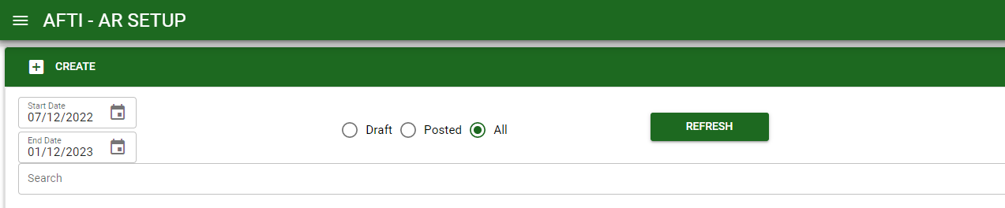
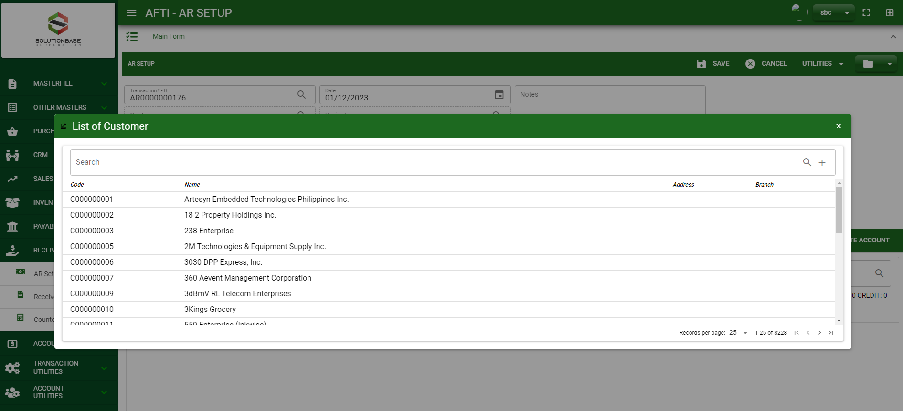
Accounting / Accounts Receivable Setup - Module
How To Create Accounts Receivable Setup Transaction?
1
1. In Accounts Receivable Setup – Main Window, you will notice a create button in the upper left of the window. Click the create button and you will be redirect Accounts Receivable Setup – main form.
2. After you click the create button a dialog box will pop out with list of customers. Search and select a customer.
3. After you select a customer, you will be redirect in Accounts Receivable Setup – main form where you will encode the other necessary information of the transaction and record the journal entry
2
How to search customer?
Type the customer name in the search bar.
And it will automatically sort out.
Then click the selected customer.
3

Slide 4
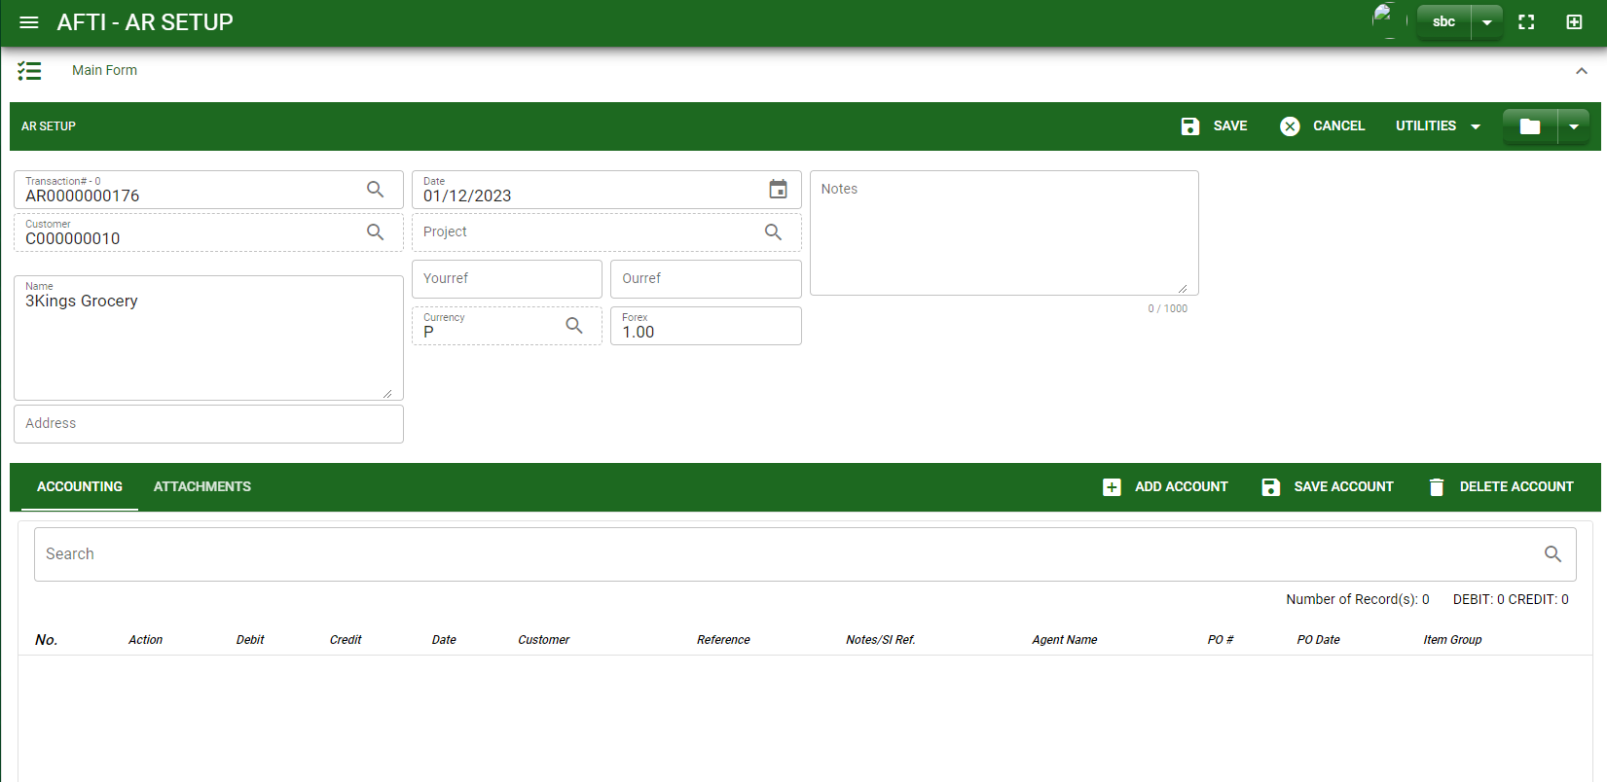
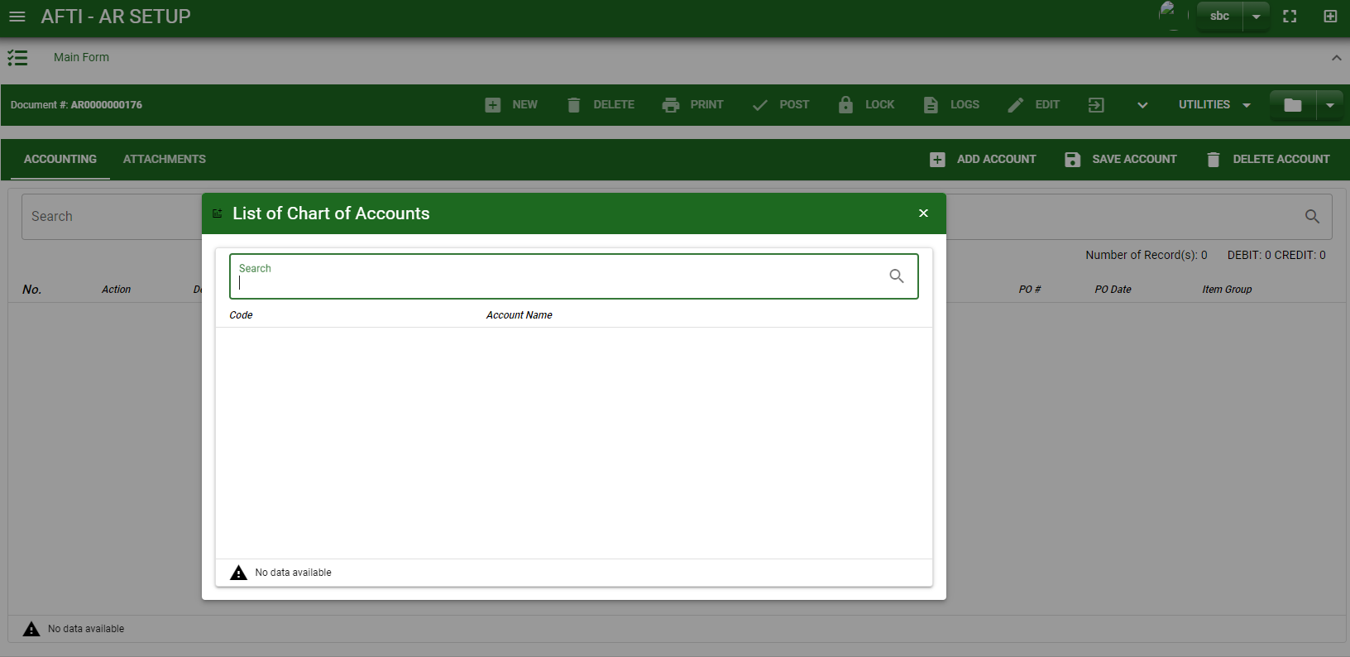
Accounting / Accounts Receivable Setup - Module
How To Create Accounts Receivable Setup Transaction?
4.4
4.1 After you select the customer, some details such as address, date are automatically plotted in their respective field.
4.2 In header, current date is also plotted automatically but if you wish to change the date – click the date picker and select its respective date.
4.3 In header, add the necessary information if necessary and fill out required fields.
4.4 If done in header, click save button.
Header
4.1 to 4.3
Detail
6
5. After saving the header, you may now add accounts by clicking add new account, search an account to add.
How to search an account?
Type the account name in the search bar.
And it will automatically sort out.
Then click the selected account.
4

Slide 5
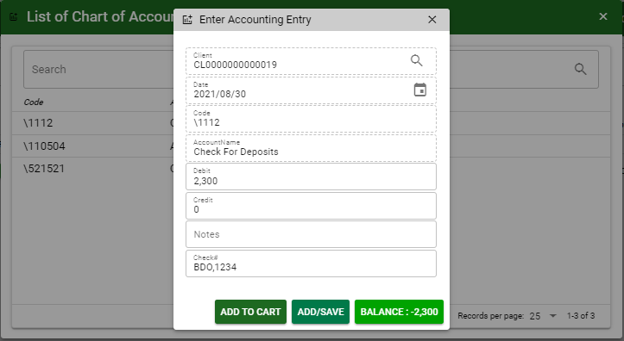
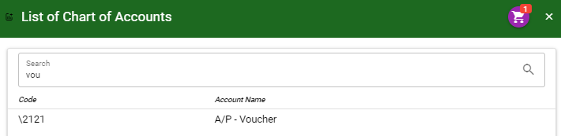
Accounting / Accounts Receivable Setup - Module
How To Create Accounts Receivable Setup Transaction?
6. After you select an account, a dialog box will prompt. Enter the details of the account.
7. Enter the details of the account. For the amount, enter the amount either in debit or credit field. But if you want to copy of amount in the balance, click the balance to autofill the credit field.
8. You may also add notes if necessary.
7
7
8
9.1
9.2
7
9.1 To save the account, if you want to add more other account, click add to cart button and select more accounts again. OR,
9.2 OR If you want to plot the selected account already in Accounts Receivable setup– detail, you may click add/ save button.
How to plot the selected accounts in the Accounts Receivable Setup – detail
Click the cart icon.
And a dialog box with list of selected accounts will pop out.
Then click the accept button.
5

Slide 6
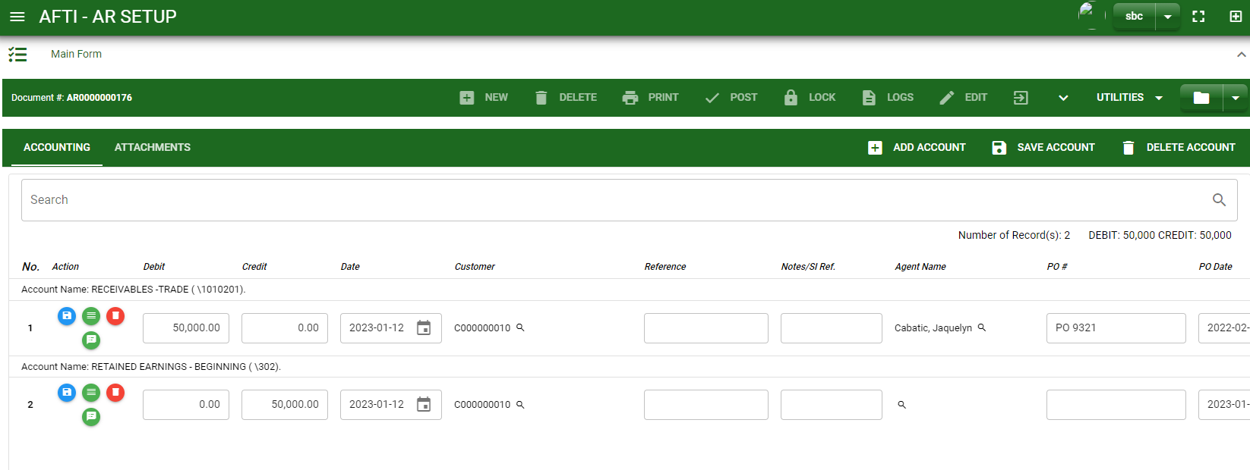
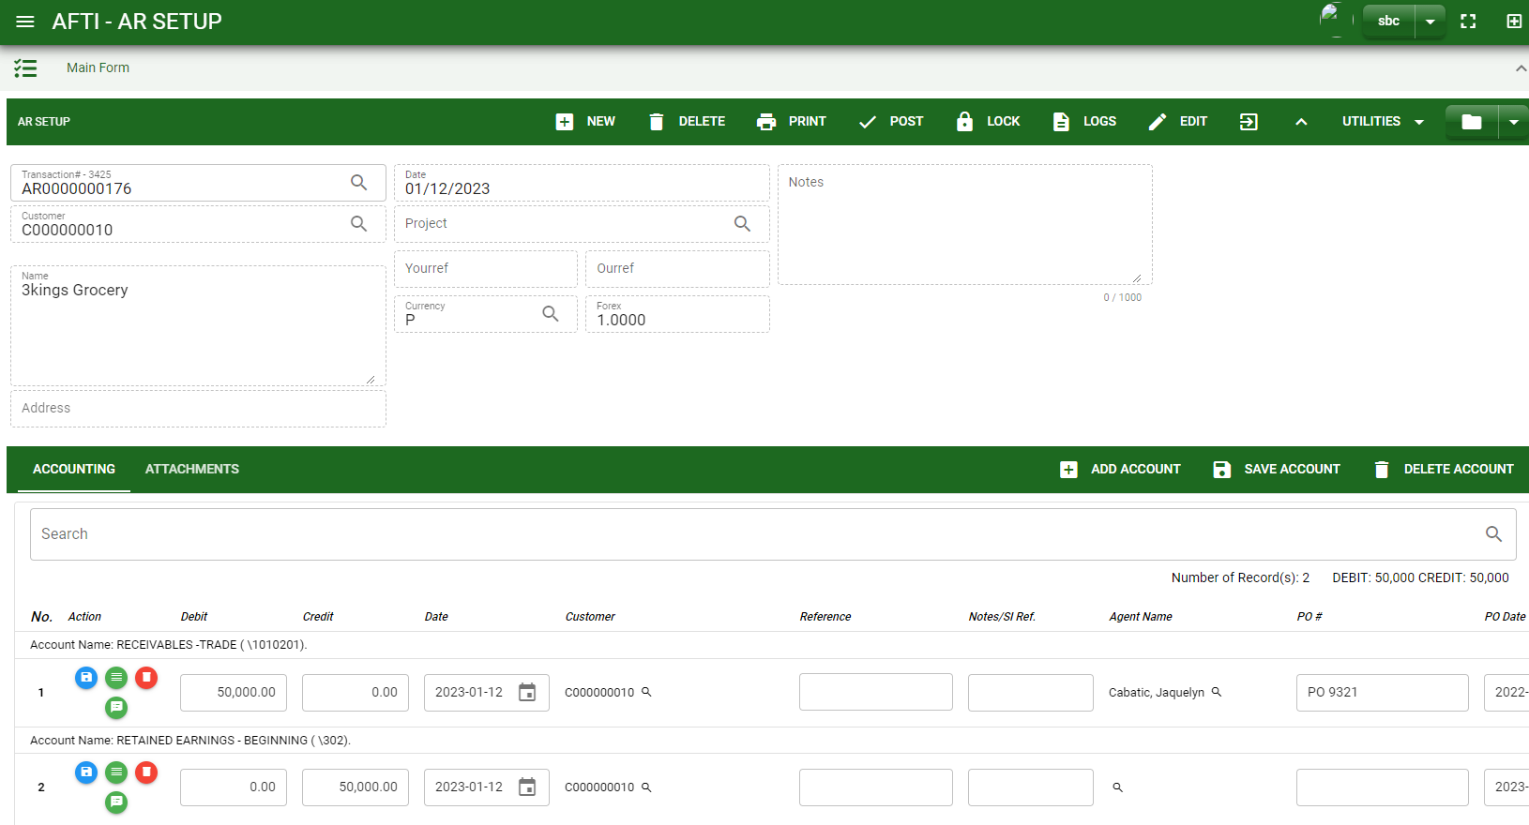
Accounting / Accounts Receivable Setup - Module
How To Create Accounts Receivable Setup Transaction?
10
10. If done click the arrow to enable the buttons in the header.
11. To finalize, click post button.
11
6

Slide 7
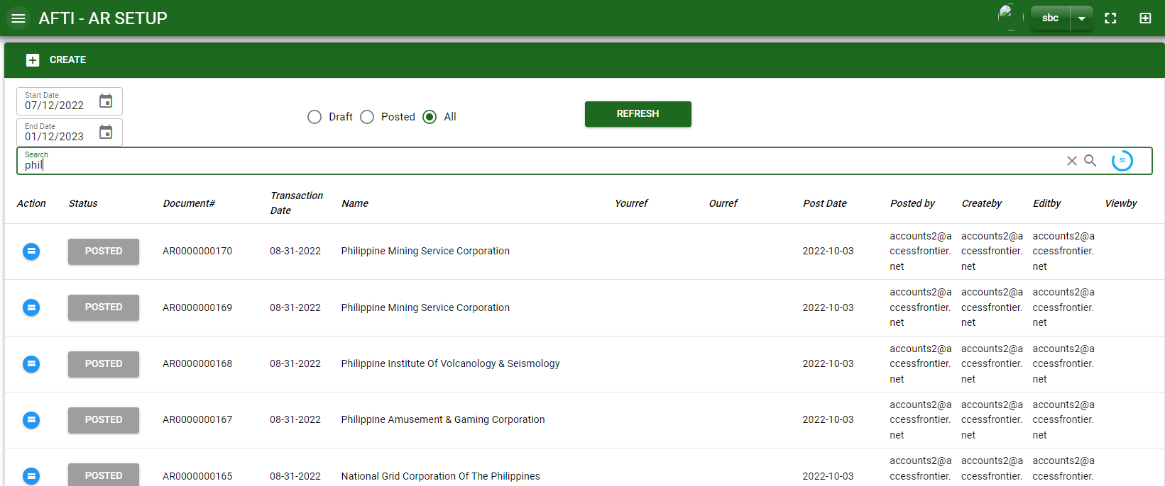

Accounting / Accounts Receivable Setup - Module
How To Edit Accounts Receivable Setup Transactions
1.1.
1.1 In the Accounts Receivable Setup – main window, search the journal entry you wish to edit its information in the search bar. Or,
1.2 In Accounts Receivable Setup – main form, click the lookup button and select the transaction you wish to edit its information by typing its transaction number in the search bar.
Accounts Receivable Setup– Main Window
HEADER
1.2.
2.
2. After you select the AR transaction, if you wish to edit the header of the transaction click edit button.
3. If you are done editing the AR header, click save button in the upper side of the header.
How to search transaction?
Type the transaction number in the search bar.
Click ‘enter’ in the keyboard to search.
Click to select the transaction you want to edit
7
Accounts Receivable Setup– Main Form

Slide 8
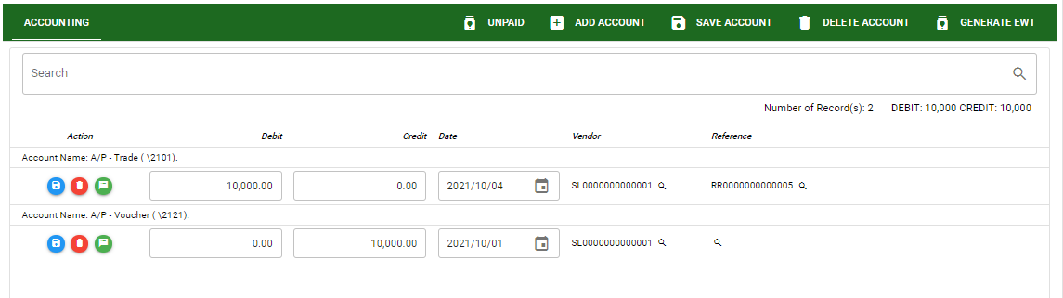
Accounting / Accounts Receivable Setup - Module
How To Edit Accounts Receivable Setup Transactions
DETAIL
4. If you want to edit the entry in the detail, edit right away the details you want to change and you will notice that after you change the details, the account you edited will be highlighted into blue.
5. If you’re done editing, click save account button to save the changes you made in the entry.
6. To delete all accounts in the entry, click delete account button.
7. To delete a specific line on the table, click the delete icon next to the account to delete it.
5
6
4
7
8

Slide 9
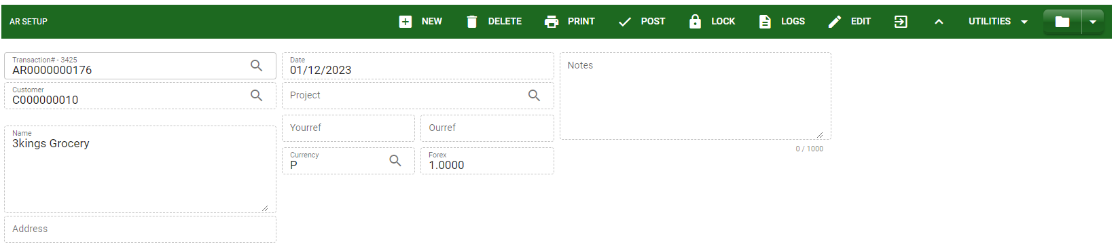
Accounting / Accounts Receivable Setup - Module
How To Delete Accounts Receivable Setup Transactions
1.1.
1. In the Accounts Receivable Setup – main window, search the journal entry you wish to edit its information in the search bar. Or,
1.2 In Accounts Receivable Setup – main form, click the lookup button and select the transaction you wish to edit its information by typing its transaction number in the search bar.
Accounts Receivable Setup– Main Window
HEADER
2. If done, click delete button.
2.
1.2.
How to search transaction?
Type the transaction number in the search bar.
Click ‘enter’ in the keyboard to search.
Click to select the transaction you want to edit
Accounts Receivable Setup– Main Form
9

Slide 10
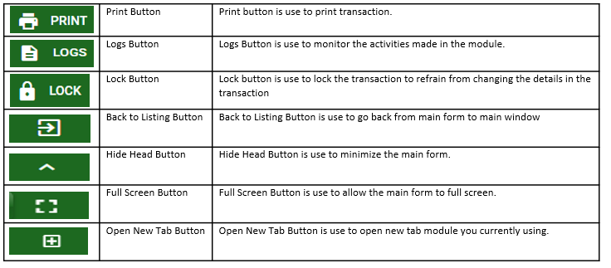
Accounting / Accounts Receivable Setup - Module
Other Buttons
10

