Slide 1
Bank Reconciliation
Bank Reconciliation is where we reconcile the book and bank book.

Slide 2

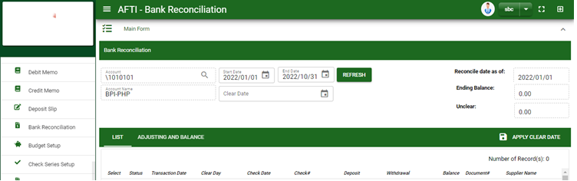

Accounting /Bank Reconciliation- Module
Main Window
When you click the Bank Reconciliation module under Accounting, Bank Recon main form will display
Bank Reconciliation – Main Window
2

Slide 3
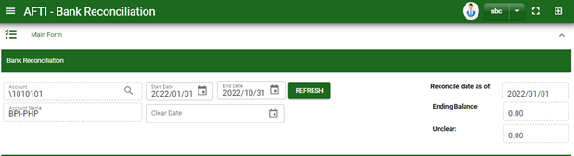
Accounting /Bank Reconciliation- Module
How To Clear Transactions?
1. In Bank Recon – Main Form, select bank to reconcile by clicking the account lookup button.
2. Select the start and end date of the transactions to reconcile. Note that start date will be the reconcile date as of.
3. Select clear date by click the date picker in clear date field
4. Click refresh button to generate transactions within the selected start and end date
5. After you click the refresh button, transactions will display in list tab.
1
2
4
3
3

Slide 4
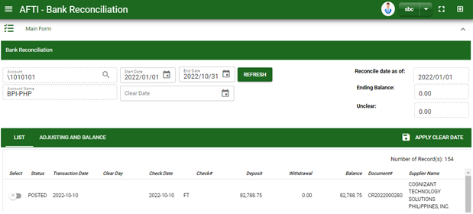
Accounting /Bank Reconciliation- Module
How To Clear Transactions?
6. Select transaction you want to clear, click apply clear date button
7. After you clear all the transactions, transactions selected will be tagged its clear date in clear day column.
8. After clearing the transactions, click adjusting and balance tab
8
6
6
4

Slide 5
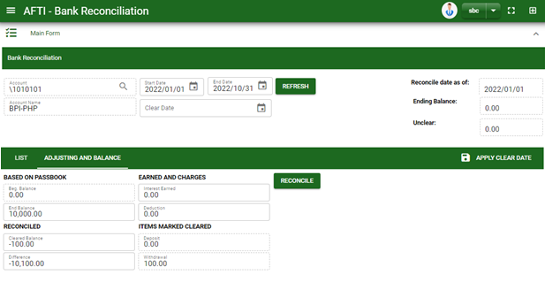
Accounting /Bank Reconciliation- Module
How To Clear Transactions?
9. When you are already in adjusting and balance tab, click refresh button.
10. Fill in the necessary fields. See descriptions and instructions to follow.
11. If done, click reconcile button
Based On Passbook: Input the beginning and ending balance based on your passbook.
In your first Bank Reconciliation;
Enter your beginning balance in your passbook based on your start date, and
Ending balance in your passbook based on your end date.
On your Second Bank Reconciliation;
Beginning balance will be automatically your ending balance from your first transaction in Bank reconciliation, and
Enter your ending balance in your passbook.
Earnings and Charges: Enter the amount of interest earned and deductions based on your bank statement.
Items Marked Cleared: In Deposit and Withdrawal fields, amount will be automatically the sum of cleared transactions of deposit and withdrawals.
Reconciled: In cleared balance field, amount is the sum of the beginning balance, deposit and interest earned less deductions and withdrawal. In difference field, amount will be the difference of ending balance and cleared balance.
10
11

Slide 6
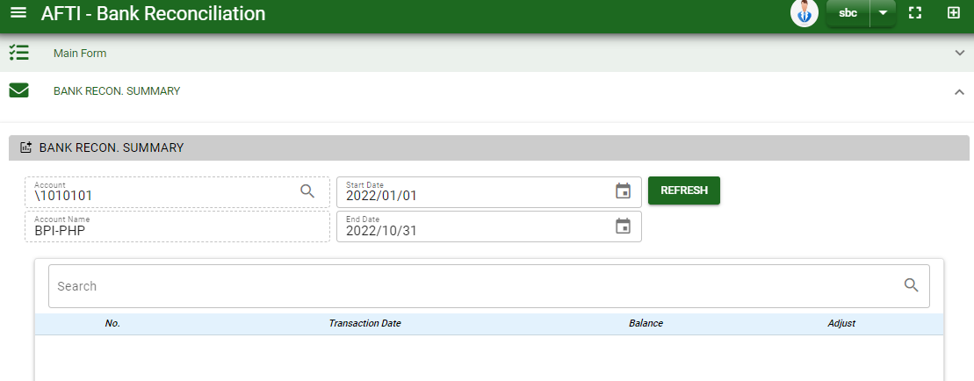
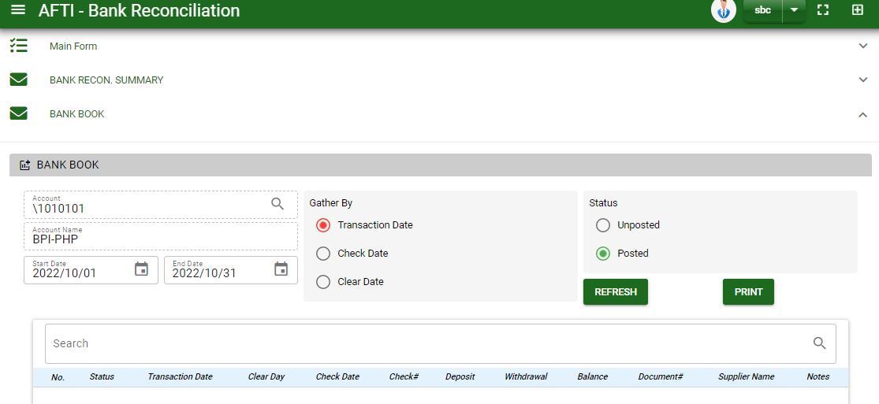
Accounting /Bank Reconciliation- Module
How To Clear Transactions?
12
12. To view the bank summary, scroll down and click the arrow to minimize the bank recon- main form and view the bank summary.
13. Select the start and end date you want to view
14. Click refresh button to display the bank recon summary
13
14
16. To view the bank book, scroll down and click the arrow to minimize the bank recon summary and view the bank book.
17. Provide the filter you want to view
18. Click refresh button to display the bank book based on selected filter
17
18

