Slide 1
Branch Ledger
This module contains list of branches.

Slide 2
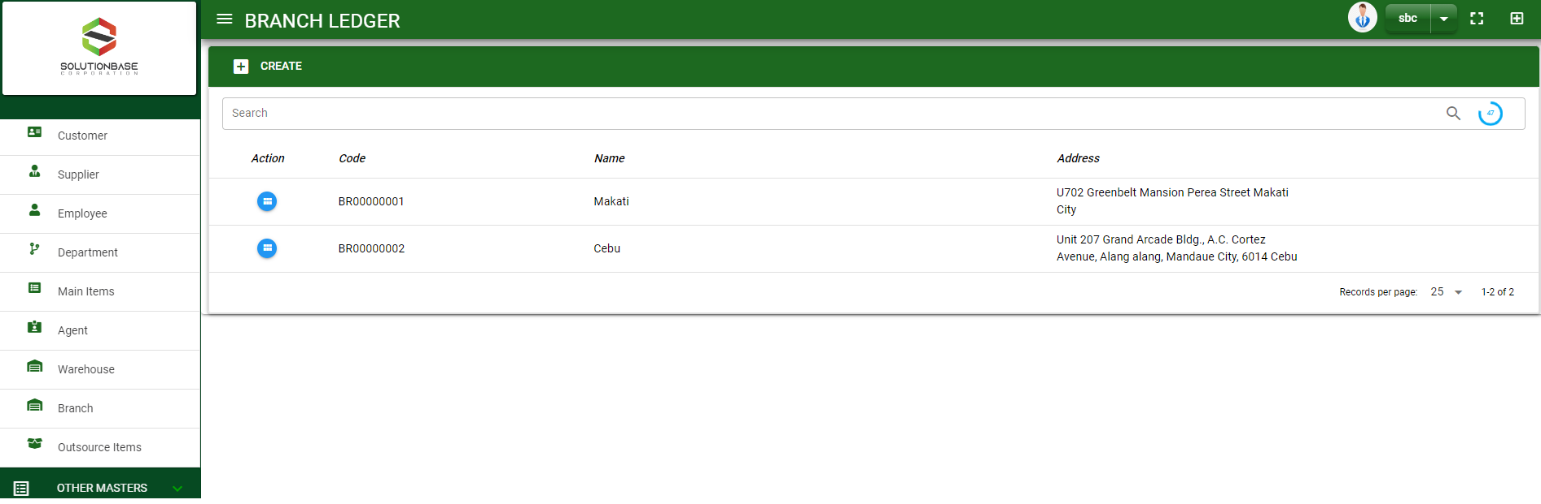

Masterfile / Branch Ledger - Module
Main Window
When you click the Branch module under Masterfile, branch list will display in the branch ledger main window.
Branch Ledger – Main Window
2

Slide 3
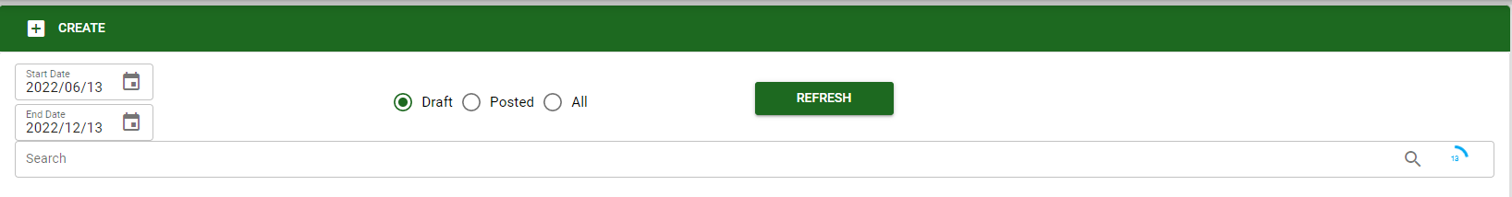
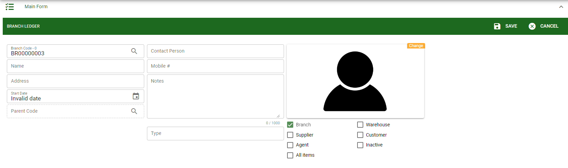
Masterfile / Branch Ledger - Module
1
How To Create New Branch?
1. In Branch Ledger – Main Window, you will notice a create button in the upper left of the window. Click the create button and you will be redirect in branch ledger – main form.
2. After you click the create button in the branch ledger – main window, you will be redirected in branch ledger – main form where you will encode the branch other information.
3. In the photo, fill in all the necessary details in the provided field.
4. If done, click save button.
4
3
Branch Ledger – Main Form
3

Slide 4
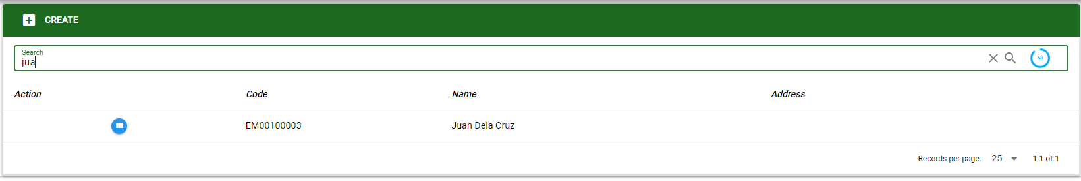
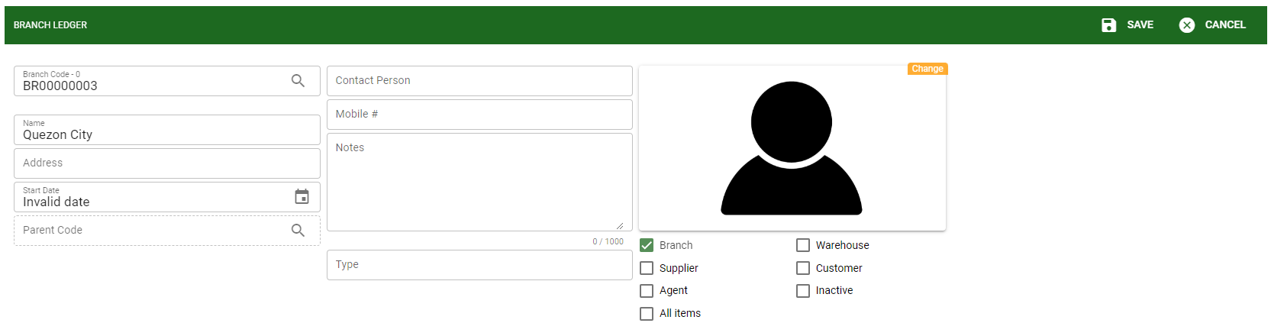

Masterfile / Branch Ledger - Module
How To Edit Branch Details?
1.1 In the branch ledger – main window, search the branch you wish to edit its information in the search bar. Or,
1.2 In branch ledger – main form, click the lookup button and select the branch you wish to edit its information by typing its branch name in the search bar.
1.1.
Branch Ledger – Main Window
2
1.2.
2. After you select the branch, click edit button in the upper right side of branch ledger – main form.
How to search branch?
Type the branch name in the search bar.
Click ‘enter’ in the keyboard to search.
Click the button before the branch code to select the branch.
Branch Ledger – Main Form
4

Slide 5
Masterfile / Branch Ledger - Module
How To Edit Branch Details?
4
3
3. Edit the information you want to edit.
4. If done, click save button.
Branch Ledger – Main Form
5

Slide 6
Masterfile / Branch Ledger - Module
How To Delete a Branch?
1.1.
1.1 In the branch ledger – main window, search the customer you want to delete.
1.2 In branch ledger – main form, click the lookup button and select the customer you want to delete.
Branch Ledger – Main Window
3
3. Click delete button.
1.2.
Branch Ledger – Main Form
6

Slide 7
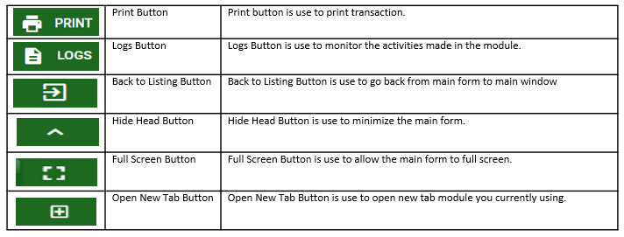
Masterfile / Branch Ledger - Module
Other Buttons
7

