Slide 1
Received Payment
Received Payment it is module where we record collection we received.

Slide 2
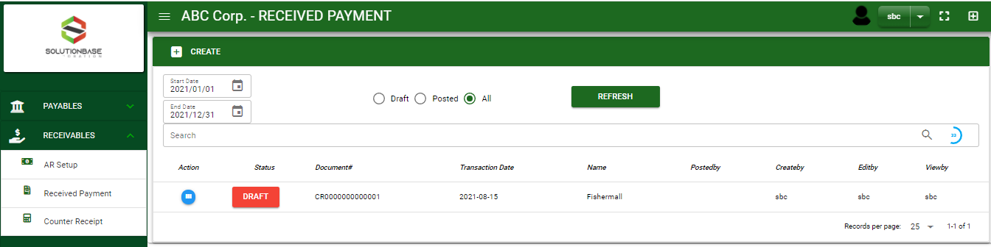

Receivables / Received Payment - Module
Main Window
When you click the Received Payment module under Receivables, Received Payment transactions list will display based on filtered date and status in the received payment - main window.
Received Payment – Main Window

Slide 3
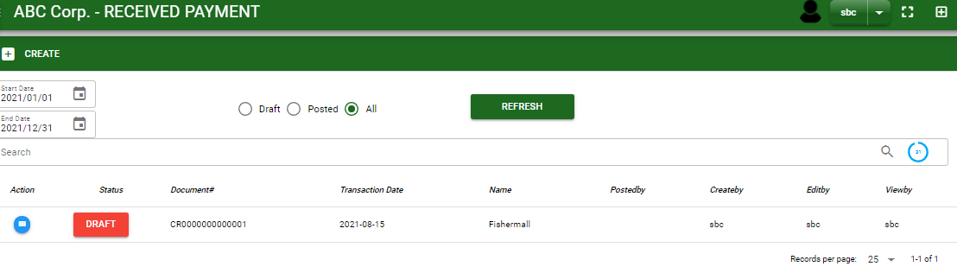
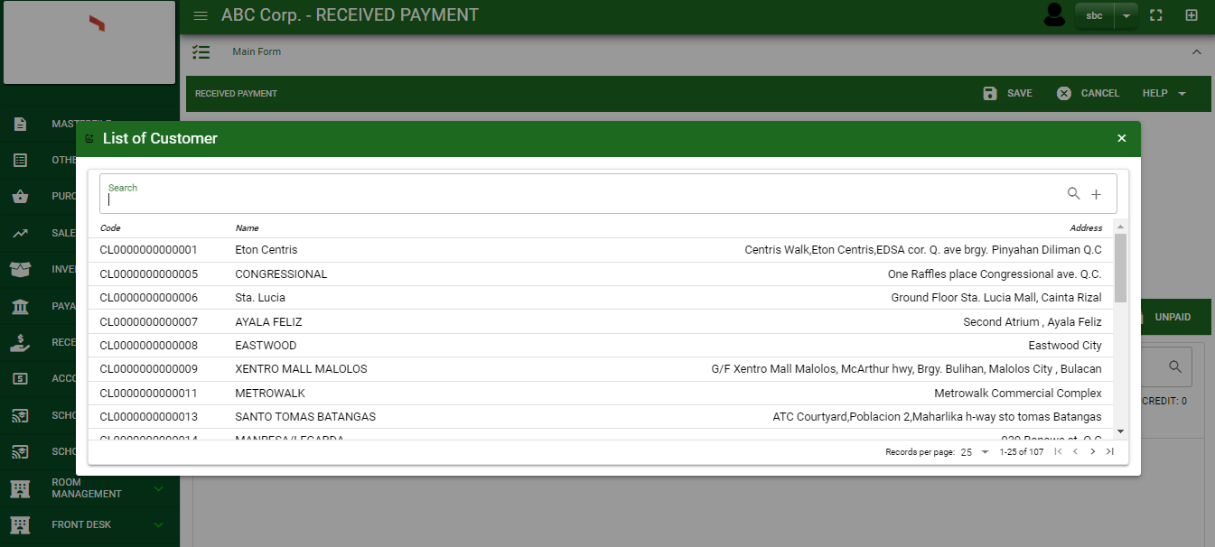
Receivables / Received Payment - Module
How To Create Received Payment Transaction?
1. In Received Payment – Main Window, you will notice a create button in the upper left of the window. Click the create button and you will be redirect in received payment – main form.
2. After you click the create button a dialog box will pop out with list of customer. Search and select a customer.
1
3. After you select a customer, you will be redirect in received payment – main form where you will encode the other necessary information of the transaction and record the received payment transaction
2
How to search customer?
Type the customer name in the search bar.
And it will automatically sort out.
Then click the selected customer.

Slide 4
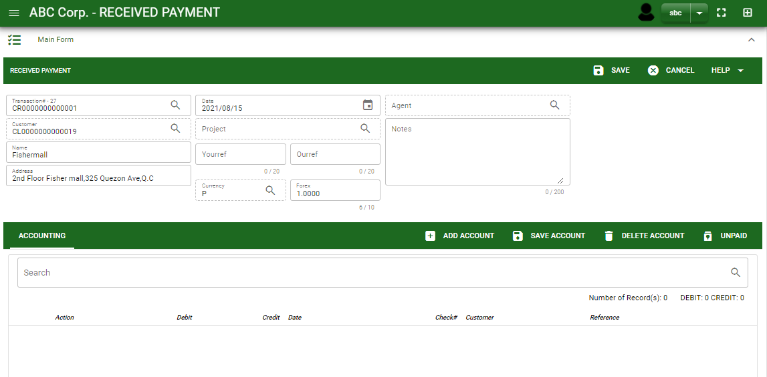
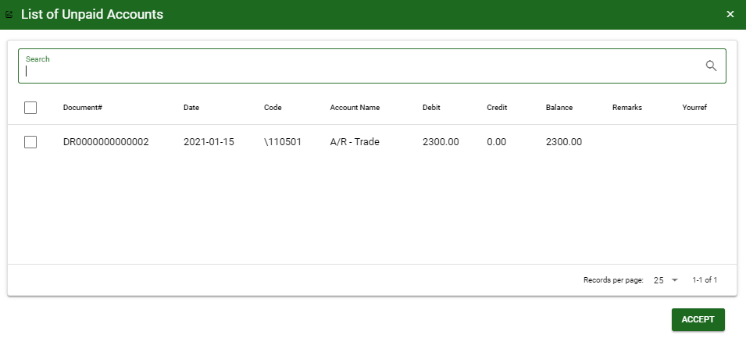
Receivables / Received Payment - Module
How To Create Received Payment Transaction?
4.4
Header
4.1 After you select the customer, some details such as address, date are automatically plotted in their respective field.
4.2 In header, current date is also plotted automatically but if you wish to change the date – click the date picker and select its respective received date.
4.3 In header, add the necessary information if necessary.
4.4 If done in header, click save button.
5.1. After saving the header, you may now select the receivable account that you will record. If the A/R is from sales journal transaction, click unpaid button to view all the A/R account to the customer and select it by ticking the check box.
4.1 to 4.3
5.1
Detail
5.1.
5.2.

Slide 5
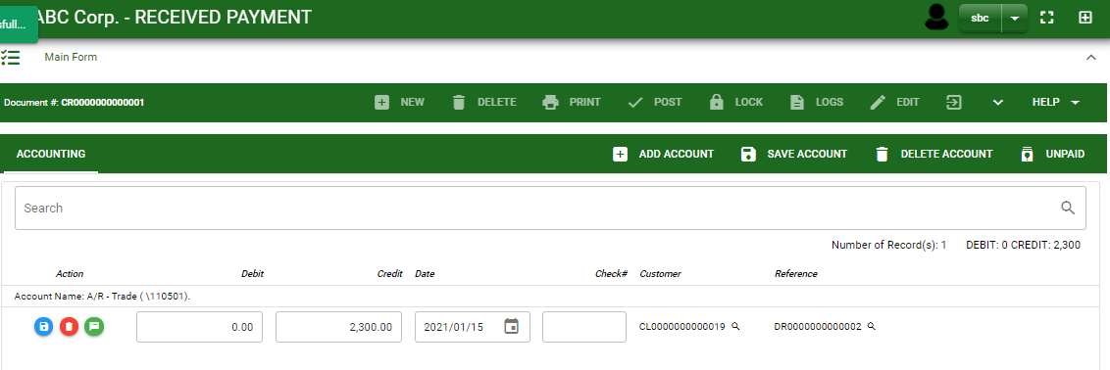
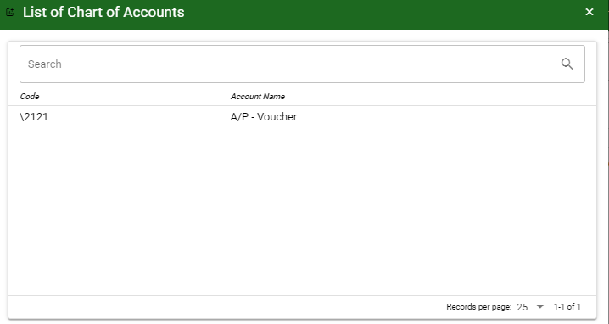
Receivables / Received Payment - Module
How To Create Received Payment Transaction?
6. After you select the unpaid account, you will be redirect in received payment – main window and the selected unpaid accounts will be displayed in received payment – detail.
7. If you want to add other receivable account that is not in the unpaid list, click add account and search the account you wish to add.
8. After you select an account, a dialog box will prompt. Enter the details of the account.
7
How to search an account?
Type the account name in the search bar.
And it will automatically sort out.
Then click the selected account.

Slide 6
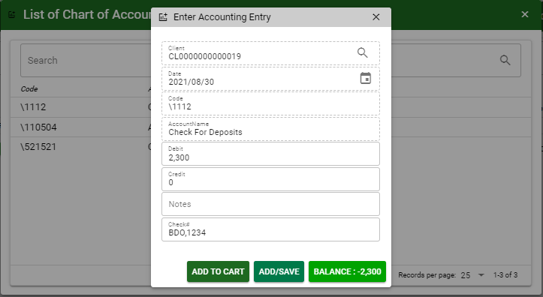
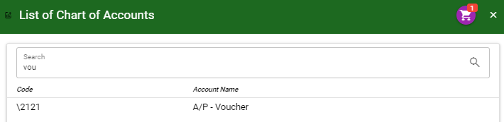
Receivables / Received Payment - Module
How To Create Received Payment Transaction?
9. Enter the details of the account. For the amount, enter the amount either in debit or credit field. But if you want to copy of amount in the balance, click the balance to autofill the credit field.
10. You may also add notes if necessary.
11. If the account is in Check, enter the check date and check number.
11.1 To save the account, if you want to add more other account, click add to cart button and select more accounts again.
11.2. OR If you want to plot the selected account already in received payment– detail, you may click add/ save button.
11
9
10
11
11.1
11.2
9
11.1
How to plot the selected accounts in the received payment – detail
Click the cart icon.
And a dialog box with list of selected accounts will pop out.
Then click the accept button.

Slide 7
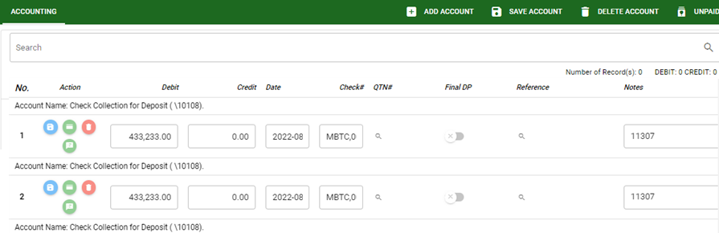
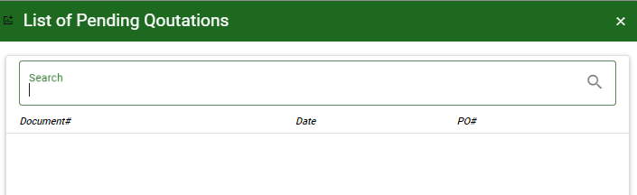

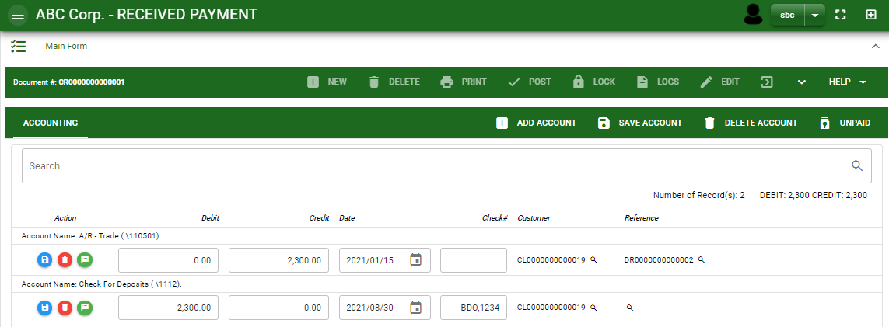
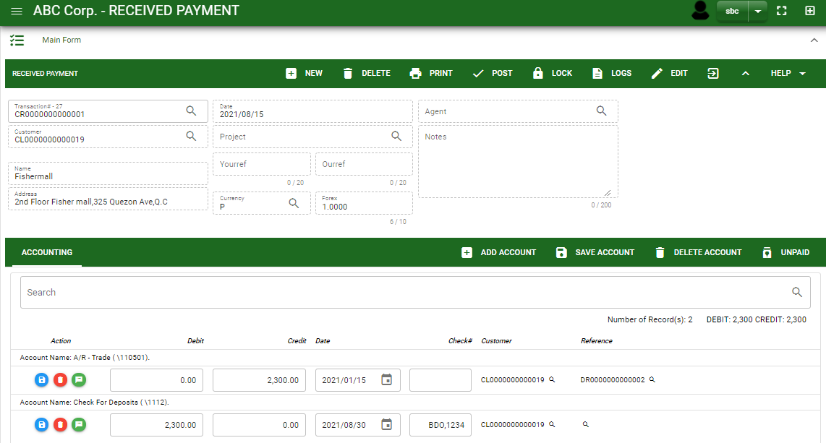
Receivables / Received Payment - Module
How To Create Received Payment Transaction?
12. For advance payment, click QTN# and select its related quotation transaction.
13. If the final downpayment is already collected and quotation transaction is no longer needed in qtn# lookup, tagged it as a final dp. This will allow the system to remove the QTN transaction in the list in the lookup.
14. If done click the arrow to enable the buttons in the header.
15. To finalize, click post button.
12
14
15

Slide 8
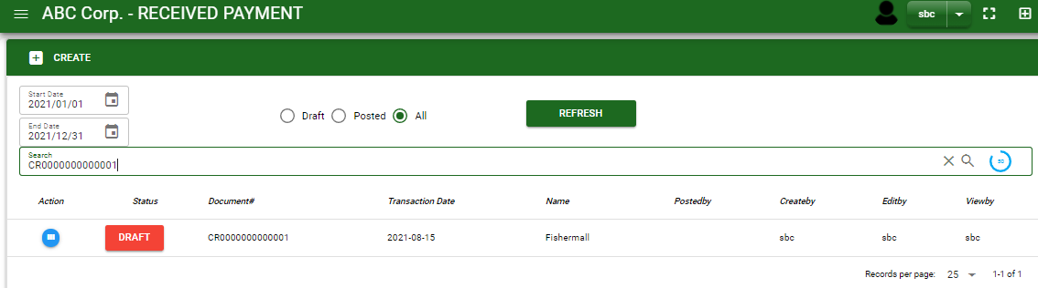
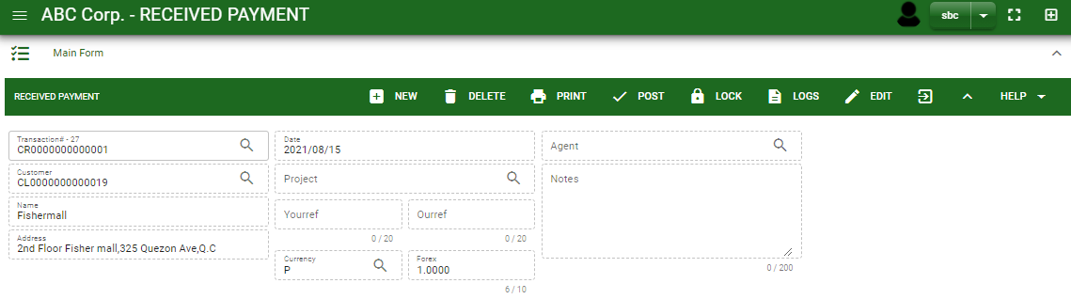
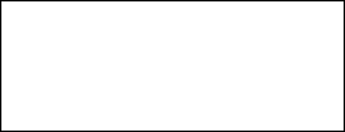
Receivables / Received Payment - Module
How To Edit Received Payment Transaction?
1.1 In the received payment – main window, search the received payment transaction you wish to edit its information in the search bar. Or,
1.2 In received payment – main form, click the lookup button and select the transaction you wish to edit its information by typing the transaction number in the search bar.
2. After you select the CR transaction, if you wish to edit the header of the transaction click edit button.
3. If you are done editing the CR header, click save button in the upper side of the header.
1.1.
Received Payment – Main Window
HEADER
2.
1.2.
How to search CR transaction?
Type the transaction number in the search bar.
Click ‘enter’ in the keyboard to search.
Click to select the transaction you want to edit
Received Payment – Main Form

Slide 9
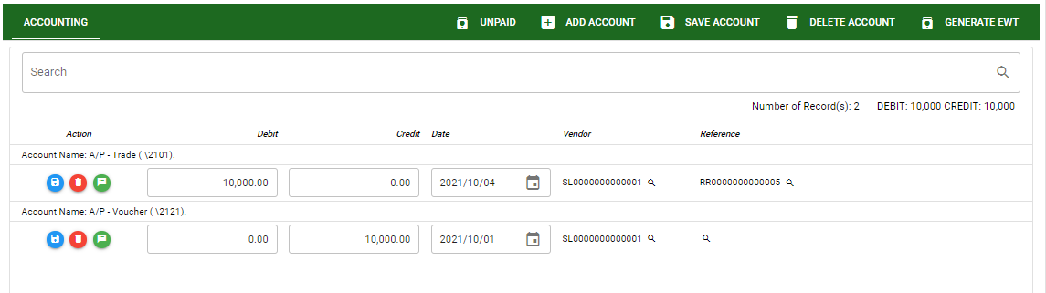
Receivables / Received Payment - Module
How To Edit Received Payment Transaction?
4. If you want to edit the entry in the detail, edit right away the details you want to change and you will notice that after you change the details, the account you edited will be highlighted into blue.
5. If you’re done editing, click save account button to save the changes you made in the entry.
6. To delete all accounts in the entry, click delete account button.
7. To delete a specific line on the table, click the delete icon next to the account to delete it.
DETAIL
5
6
4
7

Slide 10
Receivables / Received Payment - Module
How To Delete Received Payment Transaction?
1.1.
1.1. In the received payment – main window, search the received payment transaction you wish to edit its information in the search bar. Or,
1.2. In received payment – main form, click the lookup button and select the transaction you wish to edit its information by typing its transaction number in the search bar.
2. If done, click delete button.
Received Payment – Main Window
HEADER
2.
1.2.
How to search CR transaction?
Type the transaction number in the search bar.
Click ‘enter’ in the keyboard to search.
Click to select the transaction you want to edit
Received Payment – Main Form

Slide 11
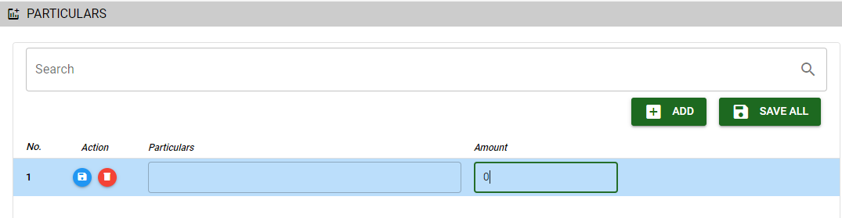

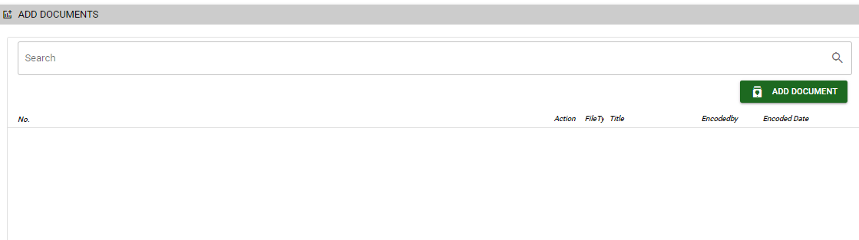
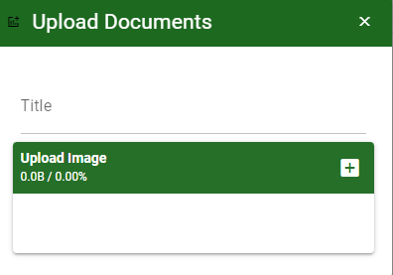
Receivables / Received Payment - Module
Other Information
Particular Tab
When you click the arrow up icon parallel in the main form on the upper right, and the received payment – main form will be minimize and the other information will be displayed as shown in the photo.
Click the arrow parallel to what information you want to open and provide the necessary filter to generate the data you want to display.
Particular tab
Click maximize arrow to view the Particular tab
Provide the necessary details in their fields
2.1. Click Add button to add new row
2.2. Type particular and amount if there’s any
2.3. If done, click save all button
Click save button once done
Attachment tab
1. Click maximize arrow to view the attachment tab
2. Click add document button
3. Once you click the add document button, a dialog box of upload documents will pop out.
4. To upload files, follow ‘how to upload document”
2.1
Attachment Tab
2
How to upload document?
Type the title of the document.
Click add button to add the chosen document to upload
Then click upload button.
If you want to add more document, click add document button and repeat steps 1 to #3

Slide 12
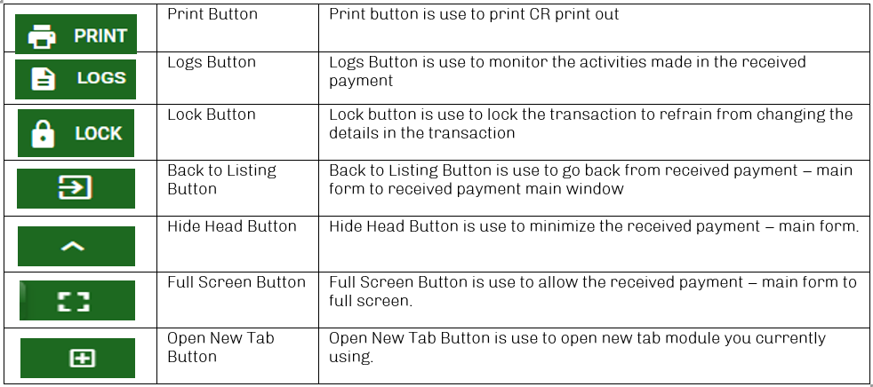
Receivables / Received Payment - Module
Other Buttons

