Slide 1
Customer Ledger
Customer Ledger is a list of customers of the company.
It is where all transactions in inventory, receivables and payments made by the customer are all display.

Slide 2
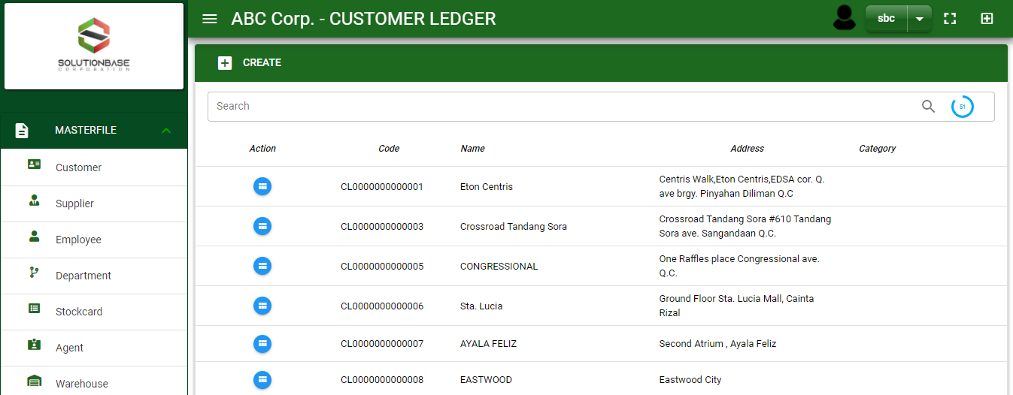

Masterfile / Customer Ledger - Module
Main Window
When you click the Customer module under Masterfile, customer list will display in the customer ledger main window.
Customer Ledger – Main Window
2

Slide 3
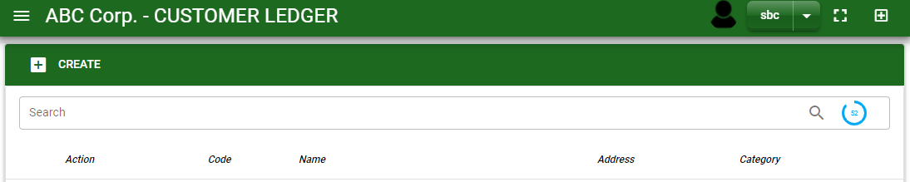
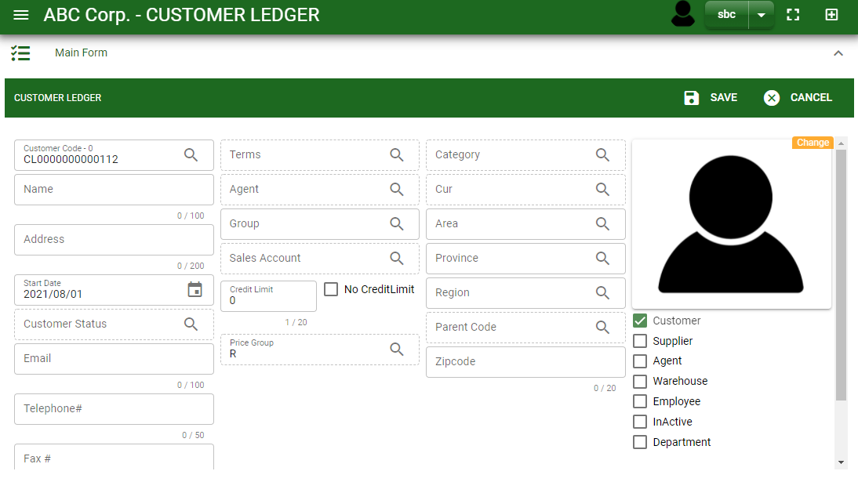
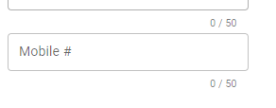
Masterfile / Customer Ledger - Module
How To Create New Customer?
1
In Customer Ledger – Main Window, you will notice a create button in the upper left of the window. Click the create button and you will be redirect in customer ledger – main form.
After you click the create button in the customer ledger – main window, you will be redirected in customer ledger – main form where you will encode the customer other information.
In the photo, fill in all the necessary details in the provided field.
If done, click save button.
4
3
Customer Ledger – Main Window
3

Slide 4
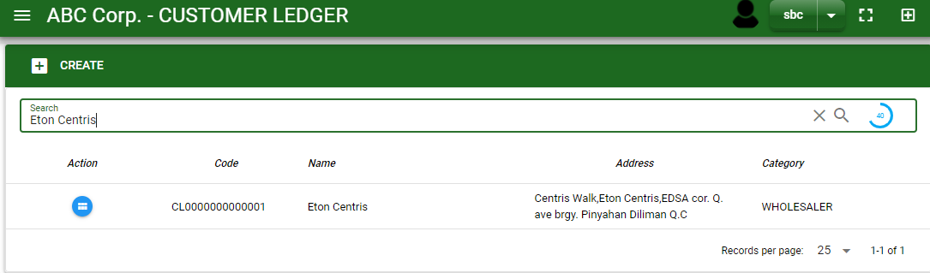
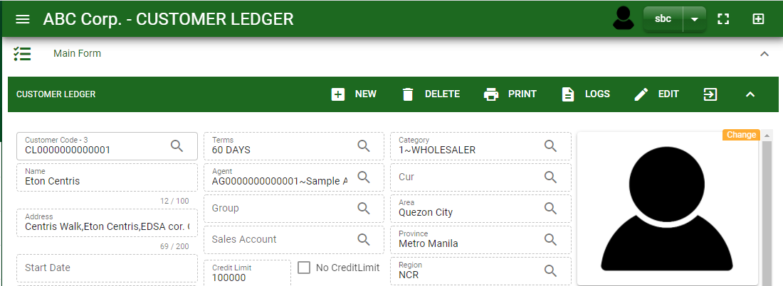
Masterfile / Customer Ledger - Module
How To Edit Customer Details?
1.1 In the customer ledger – main window, search the customer you wish to edit its information in the search bar. Or,
1.2 In customer ledger – main form, click the lookup button and select the customer you wish to edit its information by typing its customer name in the search bar.
1.1.
Customer Ledger – Main Window
2. After you select the customer, click edit button in the upper right side of customer ledger – main form.
2.
1.2.
How to search customer?
Type the customer name in the search bar.
Click ‘enter’ in the keyboard to search.
Click the button before the customer code to select the customer.
Customer Ledger – Main Form
4

Slide 5
Masterfile / Customer Ledger - Module
How To Edit Customer Details?
3. Edit the information you want to edit.
4. If done, click save button.
4
5

Slide 6

Masterfile / Customer ledger - Module
How To Delete a Customer Ledger?
1.1 In the customer ledger – main window, search the customer you want to delete.
1.2 In customer ledger – main form, click the lookup button and select the customer you want to delete.
1.1.
Customer Ledger – Main Window
2. Click delete button.
2.
1.2.
How to search customer?
Type the customer name or customer code.
Click ‘enter’ in the keyboard to search.
Click the button before the customer code to select the customer.
Customer Ledger – Main form
6

Slide 7
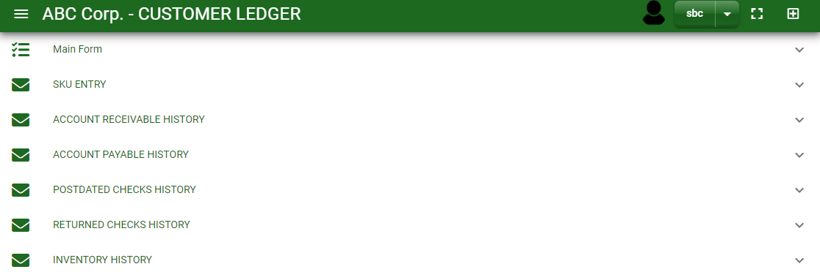
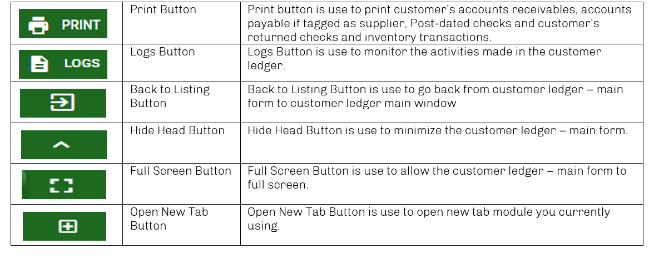
Masterfile / Customer Ledger - Module
Other Information
When you click the arrow parallel to the main form on the upper right, the customer ledger – main form will minimize and the other information will be displayed as shown in the photo below.
Click the arrow parallel to what information you want to open and provide the necessary filter to generate the data you want to display.
Customer Ledger – Main form
Other Buttons
7

Slide 8
END

