Slide 1
Cash/Check Voucher
is where payment whether it is in cash or in check is recorded. It is where we also disburse the APV document we made in Accounts Payable Voucher.

Slide 2
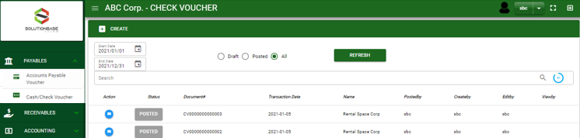

Payables / Cash/Check Voucher- Module
Main Window
When you click the Cash/ Check Voucher module under Payables, Cash/ Check Voucher transactions list will display based on filtered date and status in the Cash/ Check Voucher - main window.
Cash/Check Voucher – Main Window
2

Slide 3
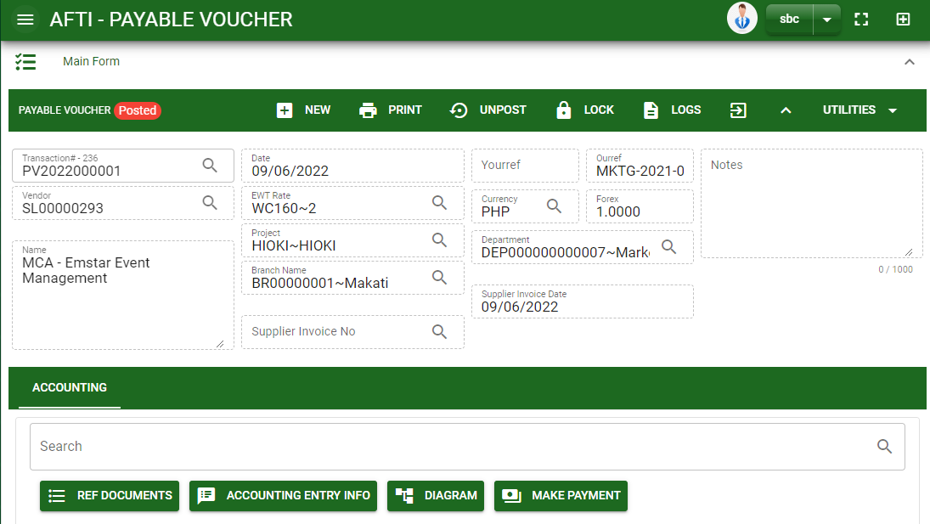
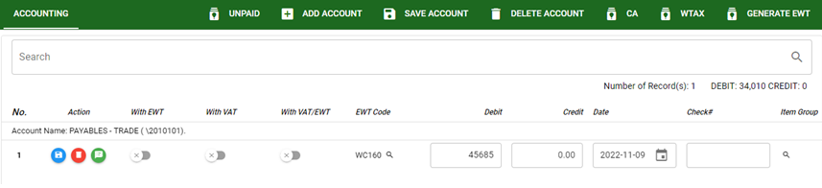
Payables / Cash/Check Voucher- Module
How To Create Cash/Check Voucher Transaction?
CREATE CV FROM APV MODULE
1. Once the APV transaction is posted, a button of make payment will appear in APV – main form.
2. Click the make button to automatically create a CV document
3. You will be redirected in CV – main form with details from APV transaction where you make a payment.
4. To add account, click add account button
5. If done, click save account button.
6. To finalize, click post button in the upper part of the CV – main form
2
4
5
3

Slide 4
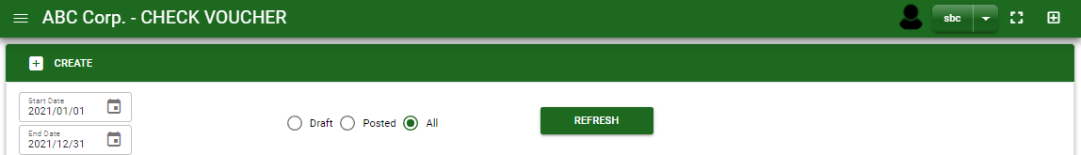
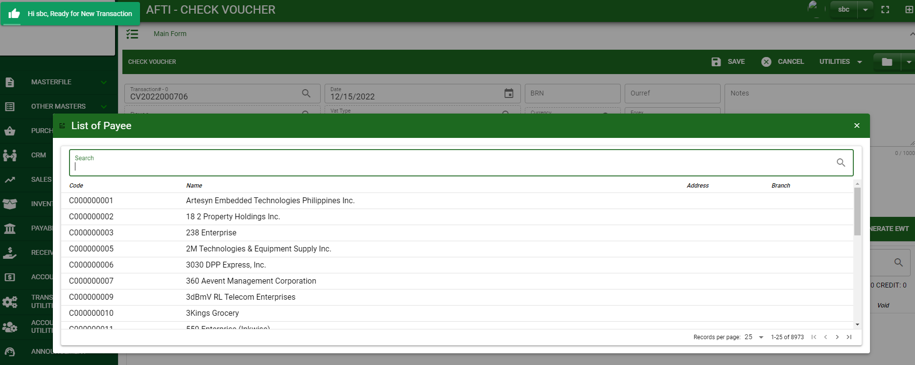
Payables / Cash/Check Voucher- Module
How To Create Cash/Check Voucher Transaction?
CREATE CV THRU CREATE BUTTON
1
1. In Cash/Check Voucher – Main Window, you will notice a create button in the upper left of the window. Click the create button and you will be redirect in cash/check voucher – main form.
2. After you click the create button a dialog box will pop out with list of payees. Search and select a payee.
3. After you select a payee, you will be redirect in cash/check voucher – main form where you will encode the other necessary information of the transaction and record the CV transaction
3
2
How to search supplier?
Type the supplier name in the search bar.
And it will automatically sort out.
Then click the selected supplier.
4

Slide 5
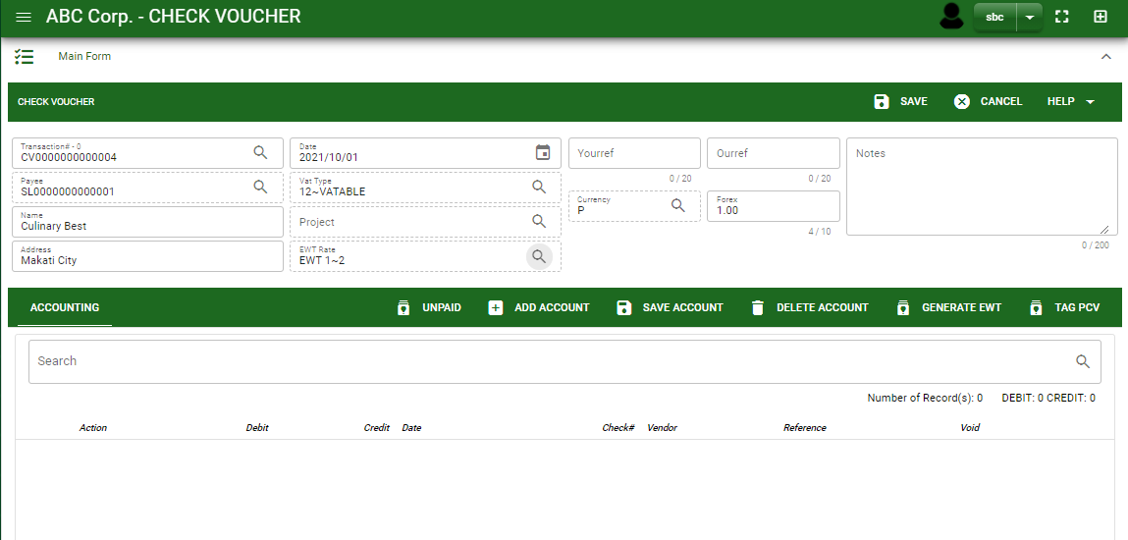
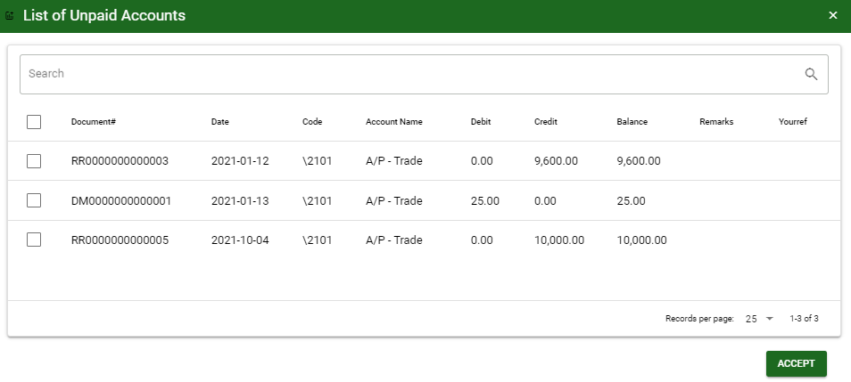
Payables / Cash/Check Voucher- Module
How To Create Cash/Check Voucher Transaction?
4.4
4.1 After you select the supplier, some details such as address, terms are automatically plotted in their respective field. If you wish to change the EWT rate if there’s any, click the lookup button and select its respective EWT rate.
4.2 In header, current date is also plotted automatically but if you wish to change the date – click the date picker and select its respective disbursement date.
4.3 In header, add the necessary information if necessary.
5.1 After saving the header, you may now select the payable or expense account that you will record. If the payment is from APV or receiving report transaction, click unpaid button to view all the unpaid payables of the supplier and select it by ticking the check box.
Header
4.1 to 4.3
5.1
Detail
5.1.
5.2.
5

Slide 6
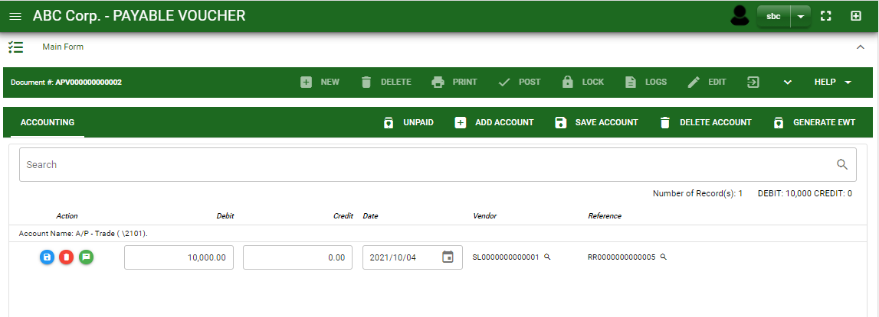

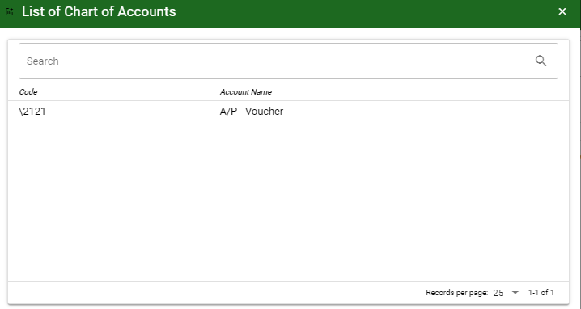
Payables / Cash/Check Voucher- Module
How To Create Cash/Check Voucher Transaction?
6. After you select the unpaid account, you will be redirect in cash/check voucher – main window and the selected unpaid accounts will be displayed in cash/check voucher – detail.
7. If you want to add other payable and expense account that is not in the unpaid list, click add account and search the account you wish to add.
8. After you select an account, a dialog box will prompt. Enter the details of the account.
7
How to search an account?
Type the account name in the search bar.
And it will automatically sort out.
Then click the selected account.
6

Slide 7
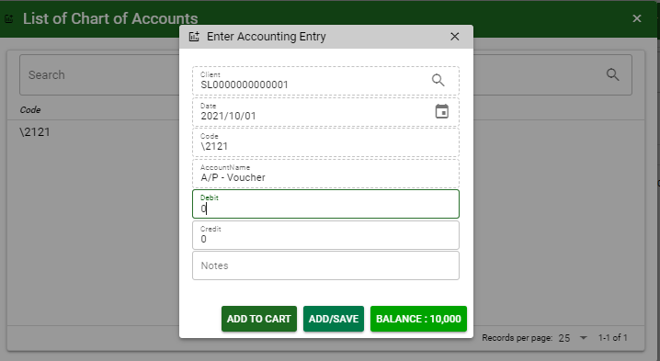
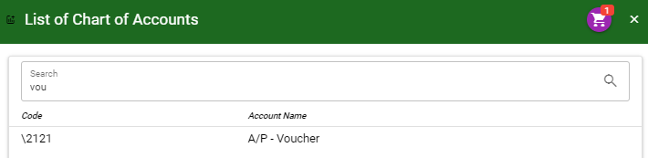
Payables / Cash/Check Voucher- Module
How To Create Cash/Check Voucher Transaction?
9. Enter the details of the account. For the amount, enter the amount either in debit or credit field. But if you want to copy of amount in the balance, click the balance to autofill the credit field.
10. You may also add notes if necessary.
11.1 If you want to add more other account, click add to cart button and select more accounts again. OR
11.2 OR If you want to plot the selected account already in accounts payable voucher – detail, you may click add/ save button.
9
10
11.1
11.2
9
11.1
How to plot the selected accounts in the accounts payable voucher – detail
Click the cart icon.
And a dialog box with list of selected accounts will pop out.
Then click the accept button.
7

Slide 8
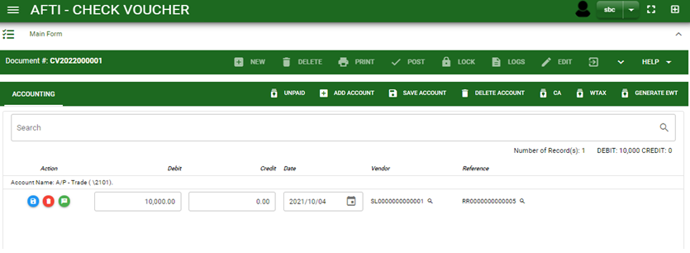
Payables / Cash/Check Voucher- Module
How To Create Cash/Check Voucher Transaction?
CA Button
13. If the transaction is related to cash advance, click the CA button to select the CA account
WTAX Button
14. If the transaction is related to withholding tax – payable, click the WTAX button to select the related withholding tax payable needed for the transaction entry
13
14
8

Slide 9
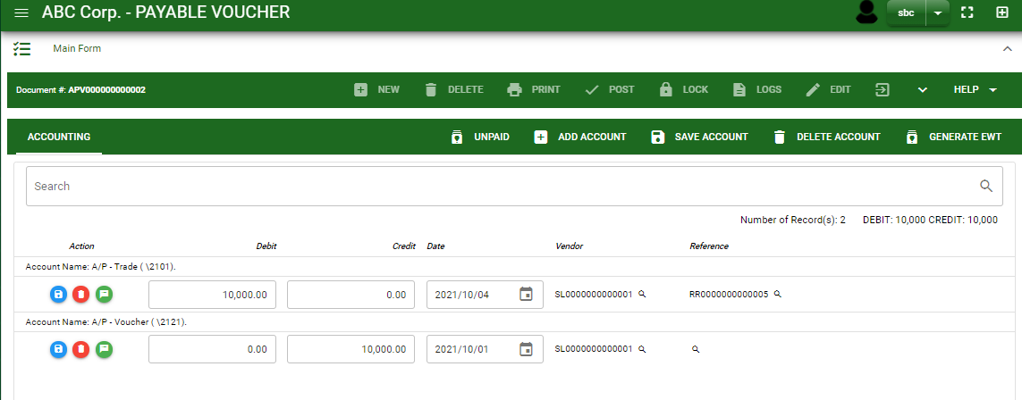
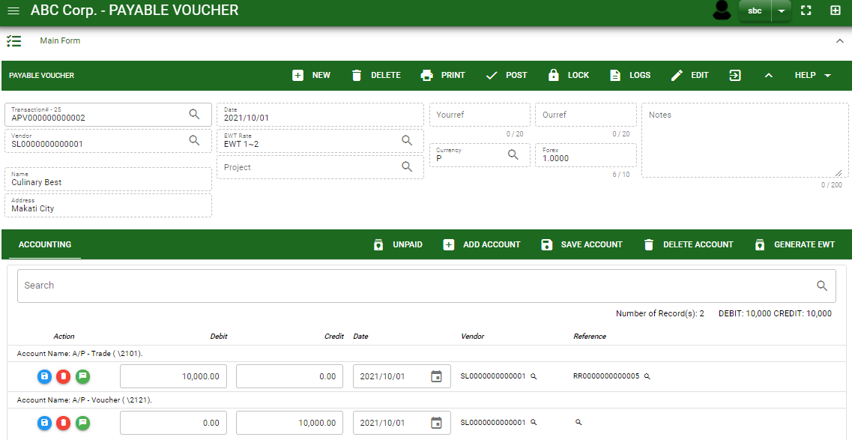
Payables / Cash/Check Voucher- Module
How To Create Cash/Check Voucher Transaction?
15
15. If done click the arrow to enable the buttons in the header.
16. To finalize, click post button.
16
9

Slide 10
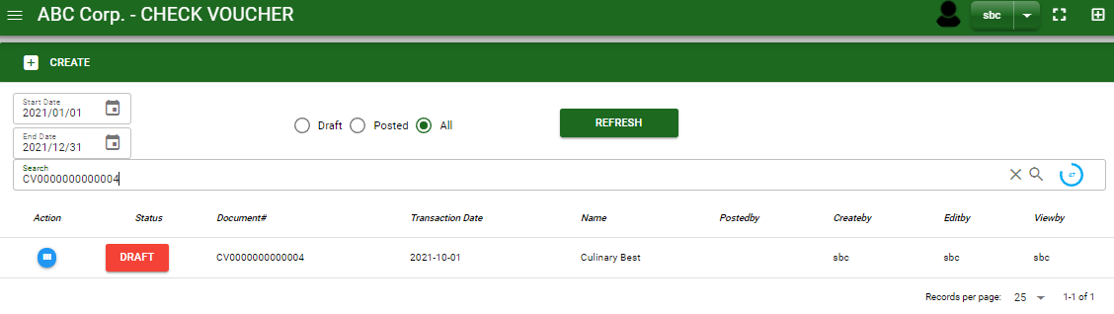
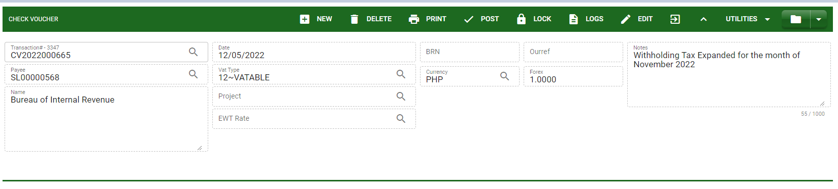

Payables / Cash/Check Voucher- Module
How To Edit CV Transaction?
1.1 In the cash/check voucher – main window, search the transaction you wish to edit its information in the search bar. Or,
1.2 In cash/check voucher – main form, click the lookup button and select the transaction you wish to edit its information by typing the transaction number in the search bar.
1.1.
Cash/Check Voucher – Main Window
HEADER
2.
1.2.
How to search CV transaction?
Type the transaction number in the search bar.
Click ‘enter’ in the keyboard to search.
Click to select the transaction you want to edit
2. After you select the CV transaction, if you wish to edit the header of the transaction click edit button.
3. If you are done editing the CV header, click save button in the upper side of the header.
Cash/Check Voucher– Main Form
10

Slide 11
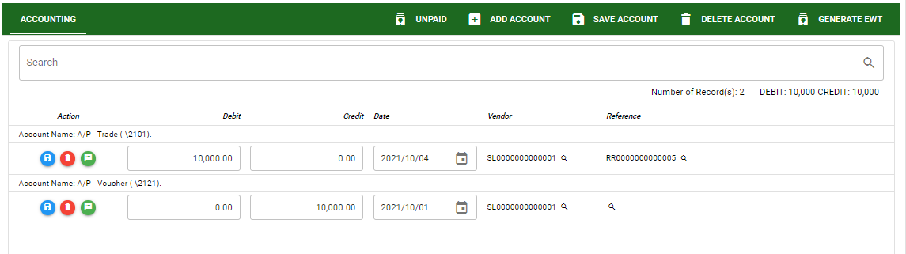
Payables / Cash/Check Voucher- Module
How To Edit CV Transaction?
DETAIL
4. If you want to edit the entry in the detail, edit right away the details you want to change and you will notice that after you change the details, the account you edited will be highlighted into blue.
5. If you’re done editing, click save account button to save the changes you made in the entry.
6. To delete all accounts in the entry, click delete account button.
7. To delete a specific line on the table, click the delete icon next to the account to delete it.
5
6
4
7
11

Slide 12
Payables / Cash/Check Voucher- Module
How To Delete CV Transaction?
1.1 In the cash/check voucher – main window, search the payable voucher transaction you wish to edit its information in the search bar. Or,
1.2 In cash/check voucher – main form, click the lookup button and select the transaction you wish to edit its information by typing the transaction number in the search bar
Cash/Check Voucher – Main Window
2. If done, click delete button.
HEADER
2.
1.2.
Cash/Check Voucher – Main form
12

Slide 13
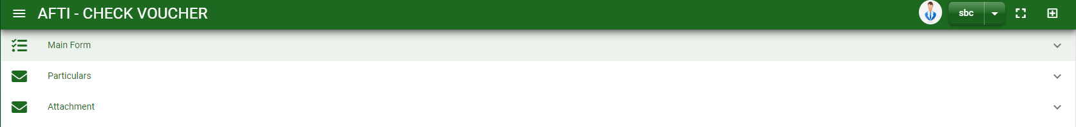
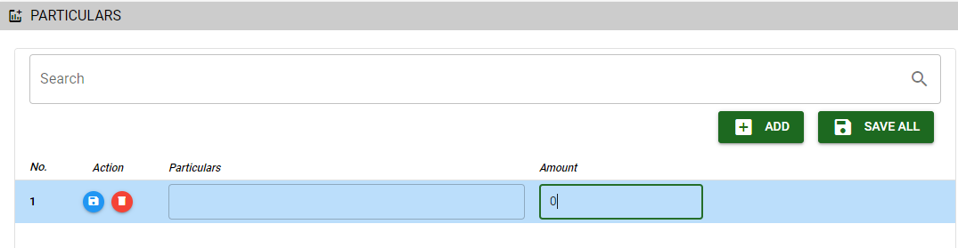

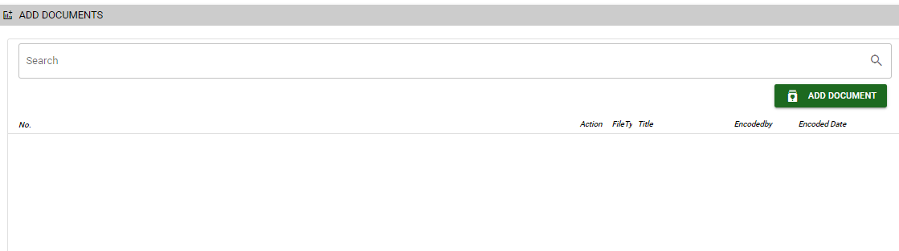
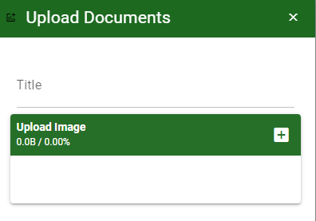
Payables / Cash/Check Voucher- Module
Other Information
When you click the arrow up icon parallel in the main form on the upper right, and the cash/check voucher – main form will be minimize and the other information will be displayed as shown in the photo.
Click the arrow parallel to what information you want to open and provide the necessary filter to generate the data you want to display.
Particular tab
Click maximize arrow to view the Particular tab
Provide the necessary details in their fields
2.1. Click Add button to add new row
2.2. Type particular and amount if there’s any
2.3. If done, click save all button
Click save button once done
Attachment tab
1. Click maximize arrow to view the attachment tab
2. Click add document button
3. Once you click the add document button, a dialog box of upload documents will pop out.
4. To upload files, follow ‘how to upload document”
2.1
2
How to upload document?
Type the title of the document.
Click add button to add the chosen document to upload
Then click upload button.
If you want to add more document, click add document button and repeat steps 1 to #3
13

Slide 14
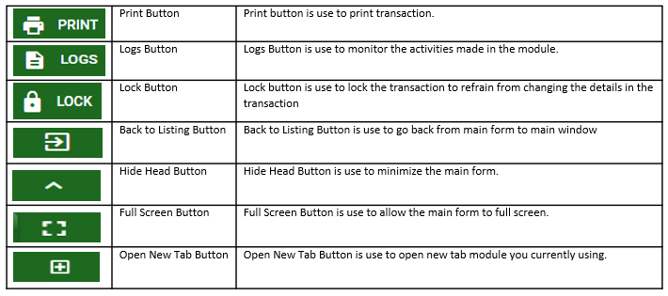
Payables / Cash/Check Voucher- Module
Other Buttons
14

