Slide 1
Department Ledger
This module contains list of departments.

Slide 2
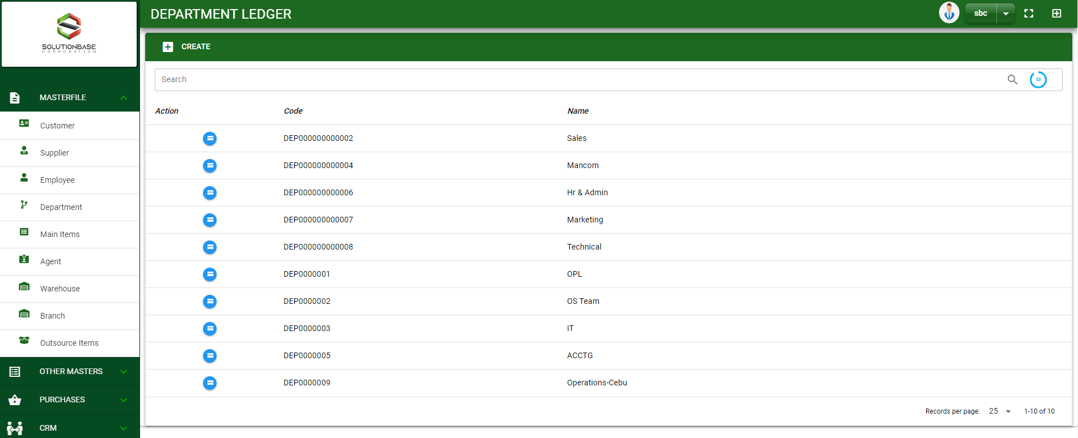

Masterfile / Department Ledger - Module
Main Window
When you click the Department module under Masterfile, department list will display in the department ledger main window.
Department Ledger – Main Window
2

Slide 3
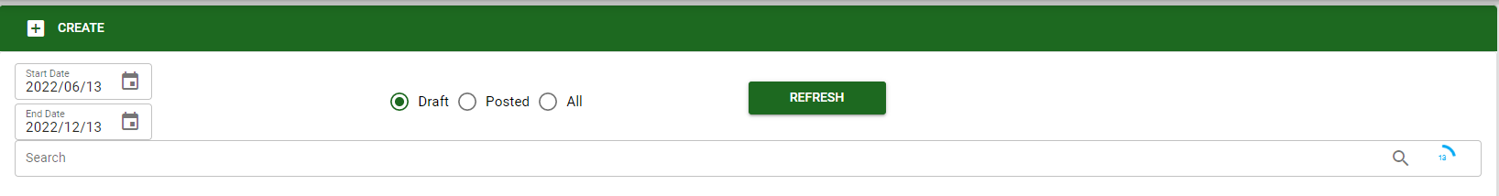
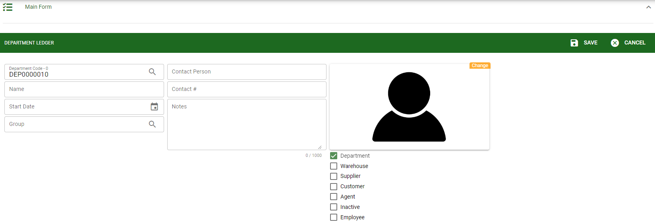
Masterfile / Department Ledger - Module
1
How To Create New Department?
1. In Department Ledger – Main Window, you will notice a create button in the upper left of the window. Click the create button and you will be redirect in department ledger – main form.
2. After you click the create button in the department ledger – main window, you will be redirected in department ledger – main form where you will encode the department other information.
3. In the photo, fill in all the necessary details in the provided field.
4. If done, click save button.
4
3
Department Ledger – Main Form
3

Slide 4
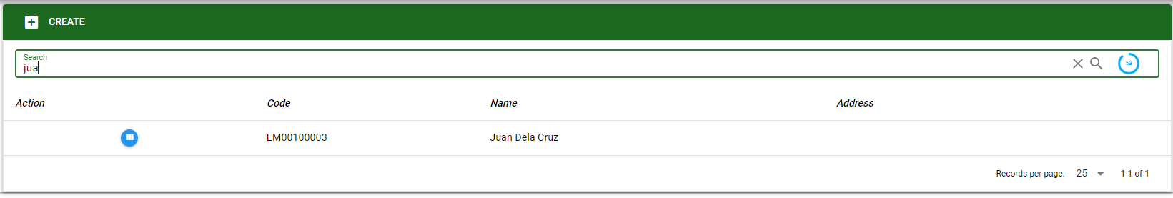
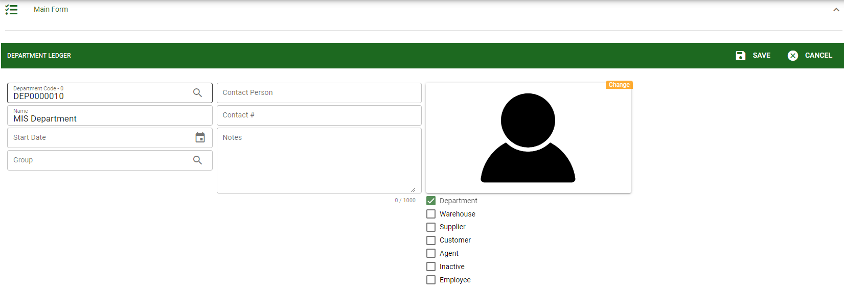

Masterfile / Department Ledger - Module
How To Edit Department Details?
1.1 In the department ledger – main window, search the department you wish to edit its information in the search bar. Or,
1.2 In department ledger – main form, click the lookup button and select the department you wish to edit its information by typing its department name in the search bar.
1.1.
Department Ledger – Main Window
2
2. After you select the department, click edit button in the upper right side of department ledger – main form.
1.2.
How to search department?
Type the department name in the search bar.
Click ‘enter’ in the keyboard to search.
Click the button before the department code to select the department.
Department Ledger – Main Form
4

Slide 5
Masterfile / Department Ledger - Module
How To Edit Department Details?
4
3
3. Edit the information you want to edit.
4. If done, click save button.
Department Ledger – Main Form
5

Slide 6
Masterfile / Department Ledger - Module
How To Delete a Department?
1.1.
1.1 In the department ledger – main window, search the customer you want to delete.
1.2 In department ledger – main form, click the lookup button and select the customer you want to delete.
Department Ledger – Main Window
3
3. Click delete button.
1.2.
Department Ledger – Main Form
6

Slide 7
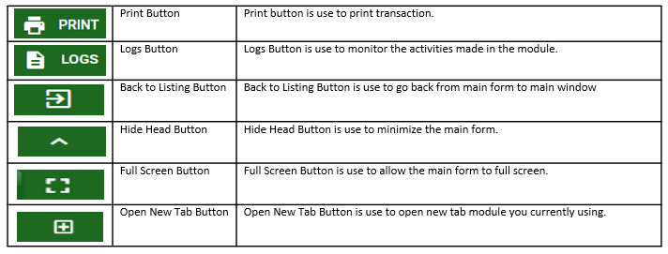
Masterfile / Department Ledger - Module
Other Buttons
7

