Slide 1
Purchase Return
Purchase Return is where item returned that has been previously purchased from the supplier are recorded.

Slide 2
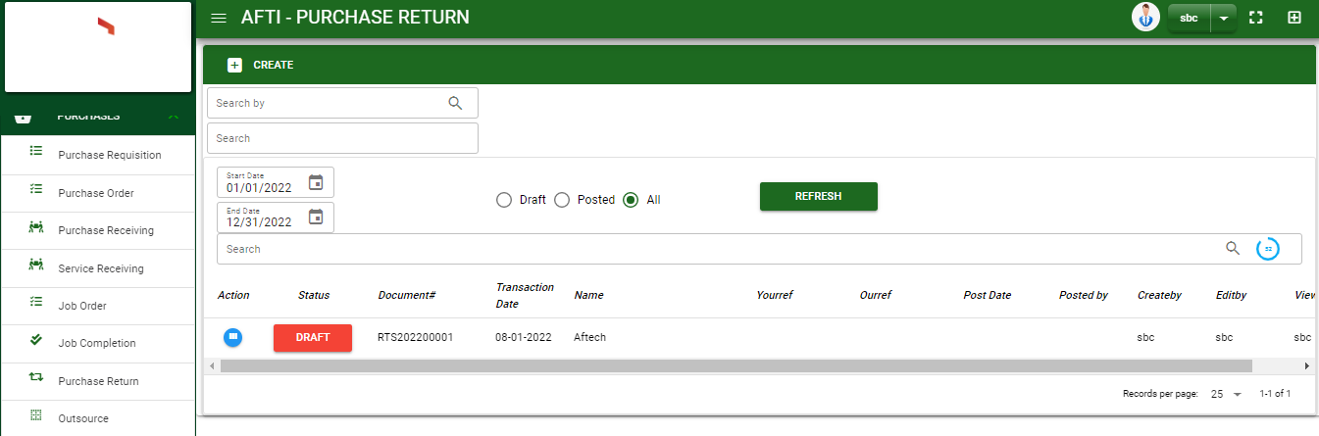

Purchase / Purchase Return - Module
Main Window
When you click the Purchase Return module under Purchases, Purchase Return transactions list will display based on filtered date and status in the purchases return main window.
Purchase Return – Main Window

Slide 3
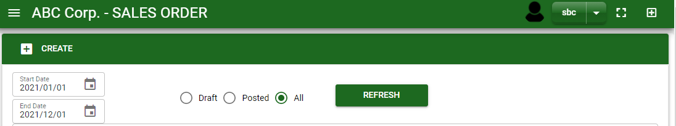
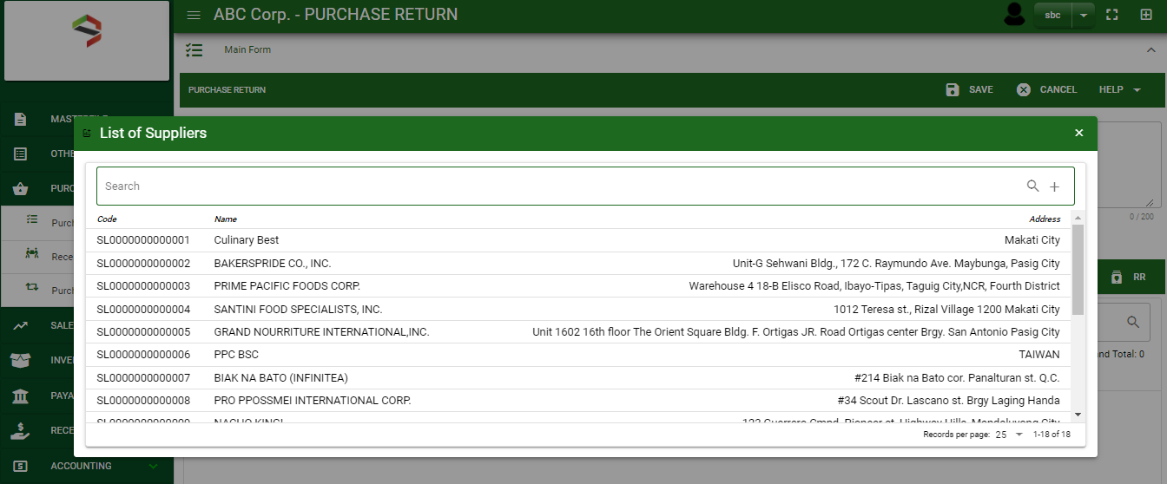
Purchase / Purchase Return - Module
How To Create Purchase Return Transaction?
1
1. In Purchase Return – Main Window, you will notice a create button in the upper left of the window. Click the create button and you will be redirect in purchase return – main form.
2. After you click the create button a dialog box will pop out with list of supplier. Search and select a supplier.
3. After you select a supplier, you will be redirected in purchase return – main form where you will encode the other necessary information of the transaction and record the items’ returned to the supplier
2
How to search supplier?
Type the supplier name in the search bar.
And it will automatically sort out.
Then click the selected supplier.

Slide 4
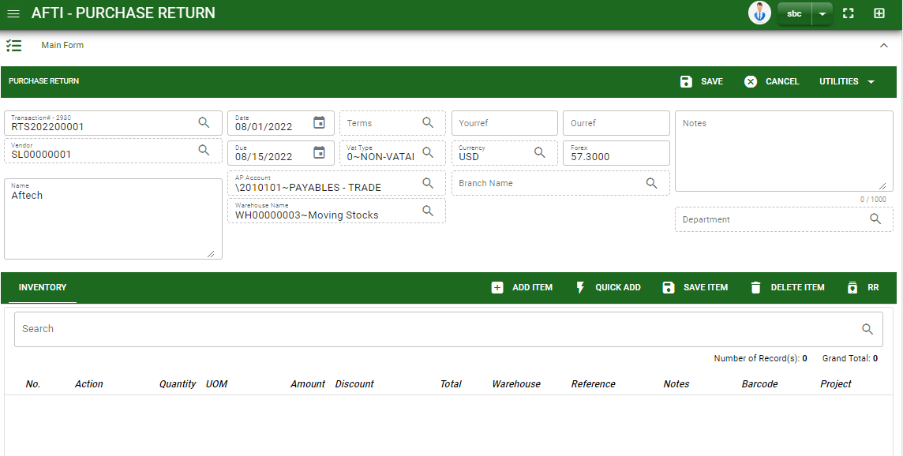
Purchase / Purchase Return - Module
How To Create Purchase Return Transaction?
4.1. Fill in other necessary information.
4.2. If done in header, click save button.
5. After saving the header, you may now select the returned items to supplier.
Add item: If returned items don’t have any reference, manually add the item by clicking the add item button.
Quick Add: If you know the item code, you may click this button to manually add an item
RR: If returned items are from Purchase Receiving, click RR button to select transaction from purchase receiving module.
Header
4.2
4.1
Stock
5

Slide 5
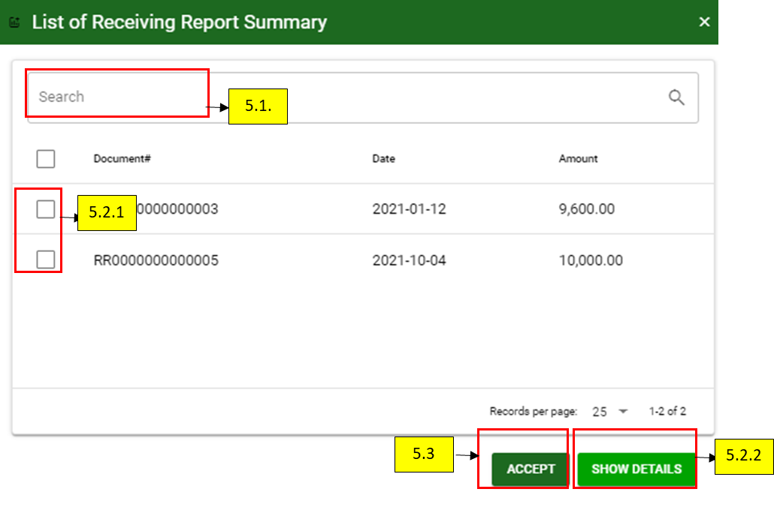
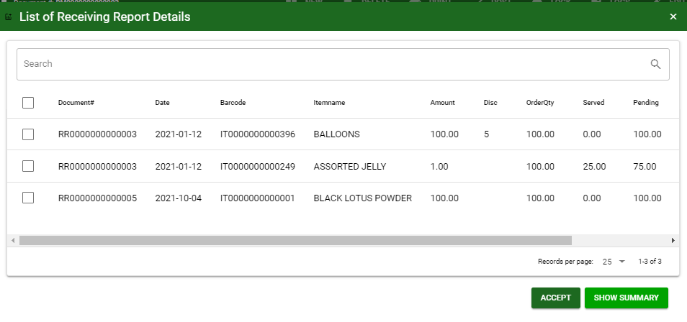
Purchase / Purchase Return - Module
How To Create Purchase Return Transaction?
5.1. After saving the header, you may now select the returned items to supplier from Receiving Report and select the items returned by clicking RR button
5.2.1. After you click the RR button, a dialog box of all receiving report transactions to the supplier will be displayed. Search the document number and select the received items, returned to supplier by ticking the check box. You may select multiple receiving report transactions in one purchase return transaction.
5.2.2. Click show details button, to itemize the receiving report transaction.
5.3. If done, click accept button.
5.2.1

Slide 6
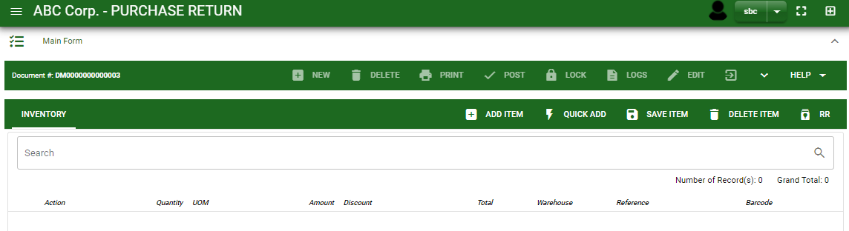
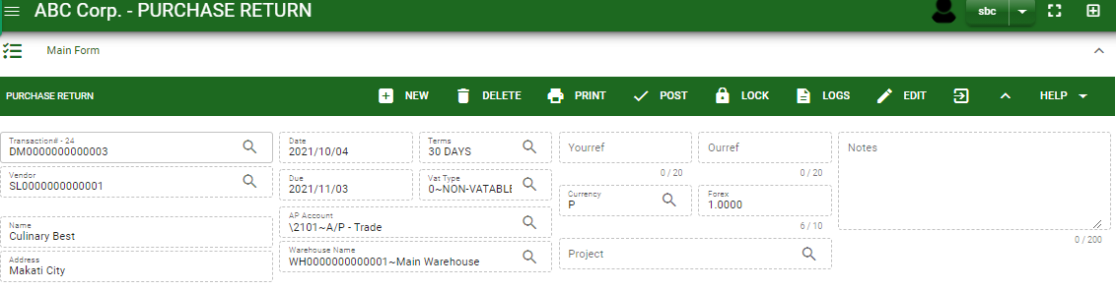
Purchase / Purchase Return - Module
How To Create Purchase Return Transaction?
6. If done, finalize the transaction by click the arrow button to maximize the main form header.
7 In header, click post button.
6.
7.

Slide 7
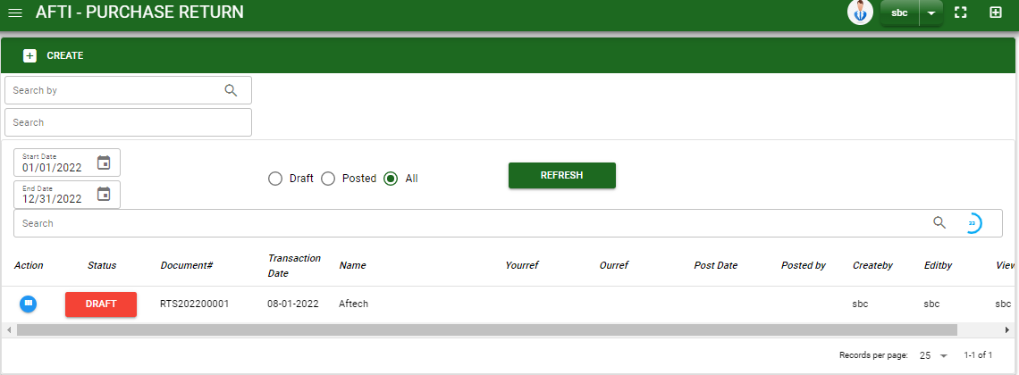
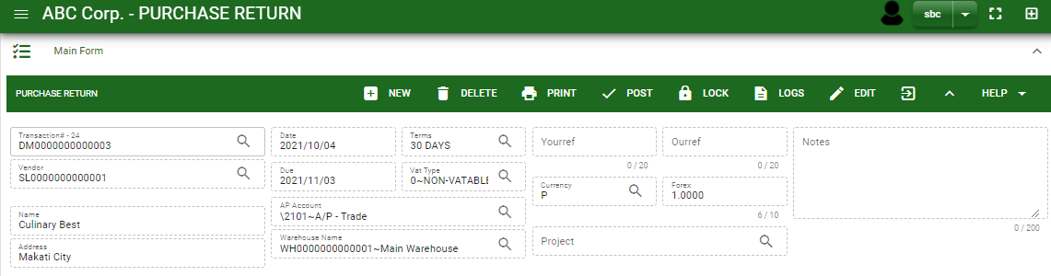
Purchase / Purchase Return - Module
How To Edit Purchase Return Transaction?
1.1. In the purchase return – main window, search the purchase return transaction you wish to edit its information in the search bar. Or,
1.2 In purchase return – main form, click the lookup button and select the transaction you wish to edit its information by typing its transaction number in the search bar.
2. After you select the purchase return transaction, if you wish to edit the header of the transaction click edit button.
3. If you are done editing the purchase return header, click save button in the upper side of the header.
1.1.
Purchase Return – Main Window
HEADER
2.
1.2.
How to search PR transaction?
Type the transaction number in the search bar.
Click ‘enter’ in the keyboard to search.
Click to select the transaction you want to edit
Purchase Return – Main Form

Slide 8
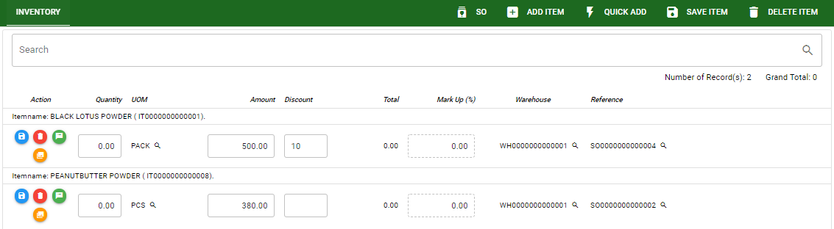
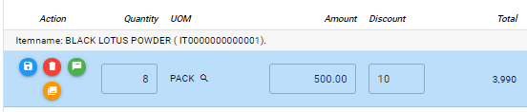
Purchase / Purchase Return - Module
How To Edit Purchase Return Transaction?
4. If you want to edit the items in purchase return stock, edit right away the details you want to change and you will notice that after you change the details, the item you edited will be highlighted into blue.
5. If you’re done editing, click save item button to save the changes you made in the items.
6. To delete all items in the stock, click delete item button.
7. To delete a specific item on the table, click the delete icon next to the item to delete it.
STOCK
5
6
7
4

Slide 9
Purchase / Purchase Return - Module
How To Delete Purchase Return Transaction?
1.1.
1.1. In the purchase return – main window, search the transaction you want to delete.
1.2. In purchase return – main form, click the lookup button and select the transaction you want to delete.
2. If done, click delete button.
Purchase Return – Main Window
HEADER
2.
1.2.
How to search PR transaction?
Type the transaction number in the search bar.
Click ‘enter’ in the keyboard to search.
Click to select the transaction you want to edit
Purchase Return – Main Form

Slide 10
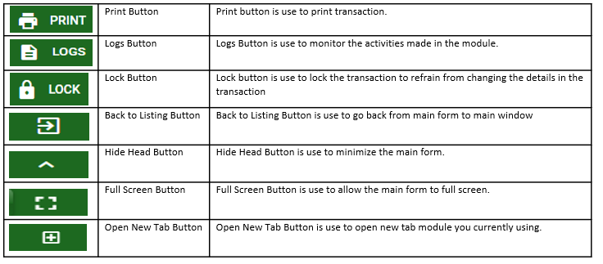
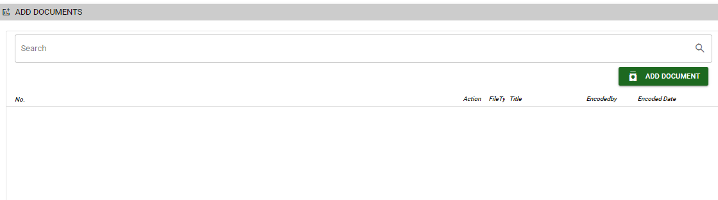
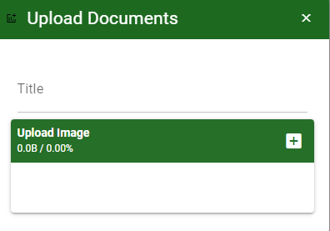
Purchase / Purchase Return- Module
Other Information
Other Buttons
When you click the arrow up icon parallel in the main form on the upper right, and the purchase return– main form will be minimize and the other tab will be visible.
Attachment tab
1. Click the arrow icon parallel to attachment tab
2. Click add document button
3. Once you click the add document button, a dialog box of upload documents will pop out.
4. To upload files, follow ‘how to upload document”
Shipping tab
Click the arrow icon parallel to Shipping/ billing address
You may view or edit the Shipping and Billing Address for the return transaction.
2
How to upload document?
Type the title of the document.
Click add button to add the document you want to upload.
Then click upload button.
If you want to add more document, click add document button and repeat steps 1 to #3

