Slide 1
Deposit Slip
A module where we record deposit of cash and/or check we received.

Slide 2
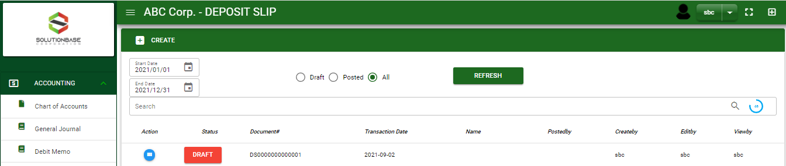

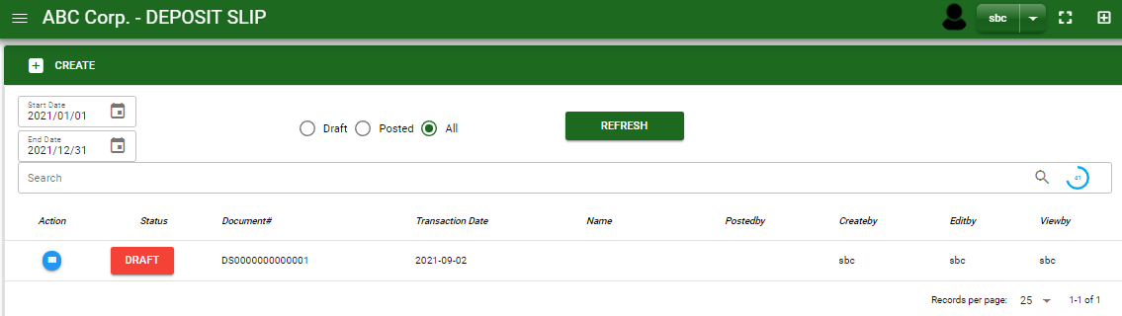

Accounting / Deposit Slip - Module
Main Window
When you click the Deposit Slip module under Accounting, Deposit Slip transactions list will display based on filtered date and status in the deposit slip - main window.
Deposit Slip – Main Window
How To Create Deposit Slip Transaction?
1
1. In Deposit Slip – Main Window, you will notice a create button in the upper left of the window. Click the create button.
3. After you click the create button, you will be redirect in deposit slip – main form where you will encode the other necessary information of the transaction and record the deposit slip transaction
2

Slide 3
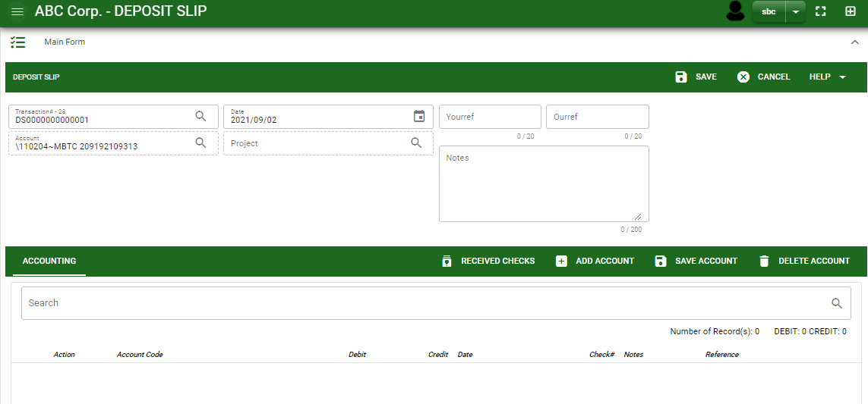
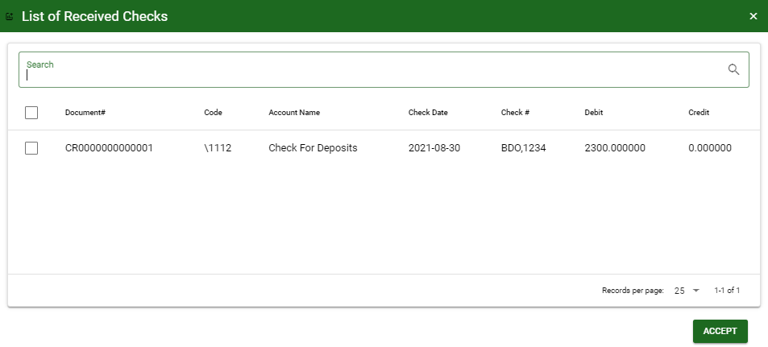
Accounting / Deposit Slip - Module
How To Create Deposit Slip Transaction?
4.4
Header
4.1 In header, cash in bank account has automatically filled out. Click the lookup button and select the corresponding Cash in Bank account.
4.2 Current date is also plotted automatically but if you wish to change the date – click the date picker and select its respective received date.
4.3 In header, add the necessary information if necessary.
4.4 If done in header, click save button.
4.1 to 4.3
5.1
Detail
5.1 After saving the header, you my now select the cash and/or check account that you will record.
5.2 Click accept, if done.
5.1.
5.2.
3

Slide 4
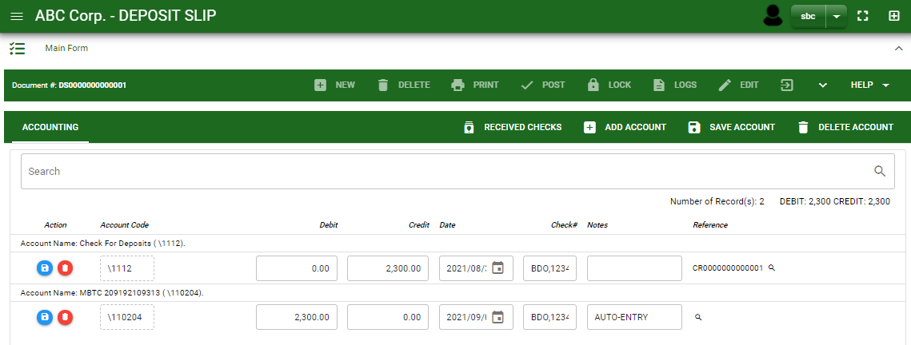
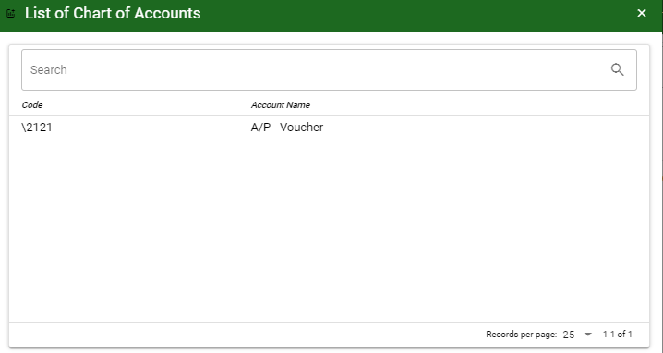
Accounting / Deposit Slip - Module
How To Create Deposit Slip Transaction?
6. After you select the cash and/or check account, you will be redirect in deposit slip – main window and the selected accounts will be displayed in deposit slip – detail.
7. If you want to add other account, click add account and search the account you wish to add.
8. After you select an account, a dialog box will prompt. Enter the details of the account.
7
How to search an account?
Type the account name in the search bar.
And it will automatically sort out.
Then click the selected account.
4

Slide 5
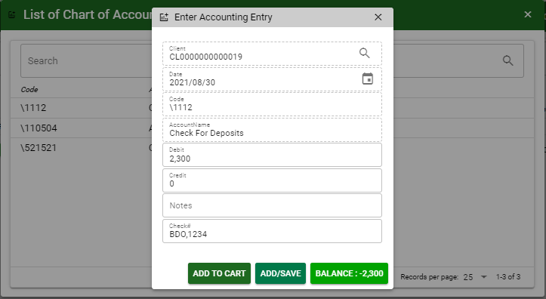
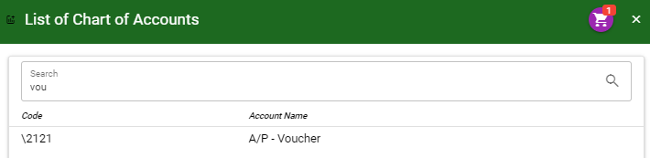
Accounting / Deposit Slip - Module
How To Create Deposit Slip Transaction?
9. Enter the details of the account. For the amount, enter the amount either in debit or credit field. But if you want to copy the amount in the balance, click the balance to autofill the credit field.
10. You may also add notes if necessary.
11. If the account is in Check, enter the check date and check number.
11
9
10
11
11.1 To save the account, if you want to add more other account, click add to cart button and select more accounts again. OR,
11.1
11.2
9
11.2 If you want to plot the selected account already in deposit slip– detail, you may click add/ save button.
11.1
How to plot the selected accounts in the deposit – detail
Click the cart icon.
And a dialog box with list of selected accounts will pop out.
Then click the accept button.
5

Slide 6
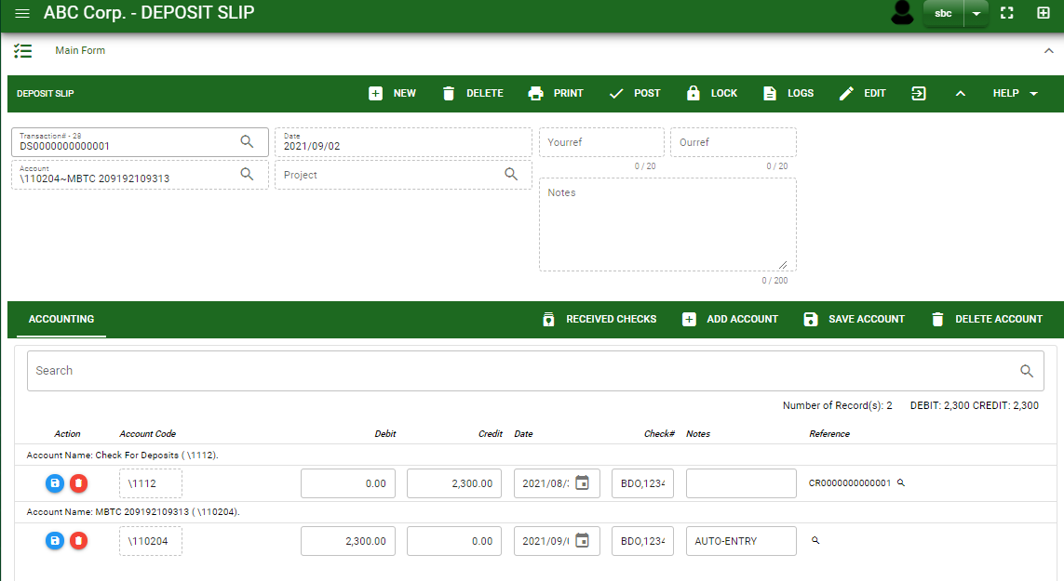
Accounting / Deposit Slip - Module
How To Create Deposit Slip Transaction?
12
12. If done click the arrow to enable the buttons in the header.
13 To finalize, click post button.
13
6

Slide 7
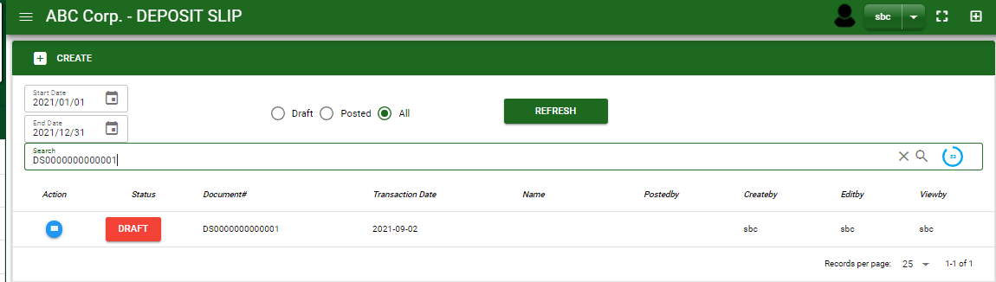
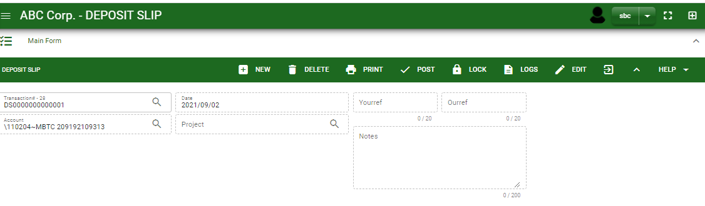

Accounting / Deposit Slip - Module
How To Edit Deposit Slip Transaction?
1.1 In the deposit slip – main window, search the deposit slip transaction you wish to edit its information in the search bar. Or,
1.2 In deposit slip – main form, click the lookup button and select the transaction you wish to edit its information by typing the transaction number in the search bar.
1.1.
Deposit Slip – Main Window
HEADER
2. After you select the DS transaction, if you wish to edit the header of the transaction click edit button.
3. If you are done editing the DP header, click save button in the upper side of the header.
2.
1.2.
How to search DS transaction?
Type the transaction number in the search bar.
Click ‘enter’ in the keyboard to search.
Click to select the transaction you want to edit
Deposit Slip – Main Form
7

Slide 8
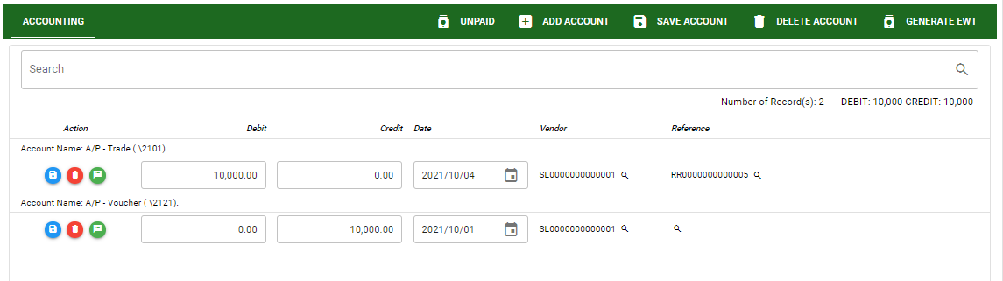
Accounting / Deposit Slip - Module
How To Edit Deposit Slip Transaction?
4. If you want to edit the entry in the detail, edit right away the details you want to change and you will notice that after you change the details, the account you edited will be highlighted into blue.
5. If you’re done editing, click save account button to save the changes you made in the entry.
6. To delete all accounts in the entry, click delete account button.
7. To delete a specific line on the table, click the delete icon next to the account to delete it.
DETAIL
5
6
4
7
8

Slide 9
Accounting / Deposit Slip - Module
How To Delete Deposit Slip Transaction?
1.1 In the deposit slip – main window, search the deposit slip transaction you wish to edit its information in the search bar. Or,
Deposit Slip – Main Window
1.2 In deposit slip – main form, click the lookup button and select the transaction you wish to edit its information by typing its transaction number in the search bar.
HEADER
2.
1.2.
How to search DP transaction?
Type the transaction number in the search bar.
Click ‘enter’ in the keyboard to search.
Click to select the transaction you want to edit
2. If done, click delete button.
Deposit Slip – Main form
9

Slide 10
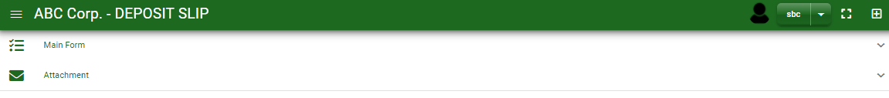
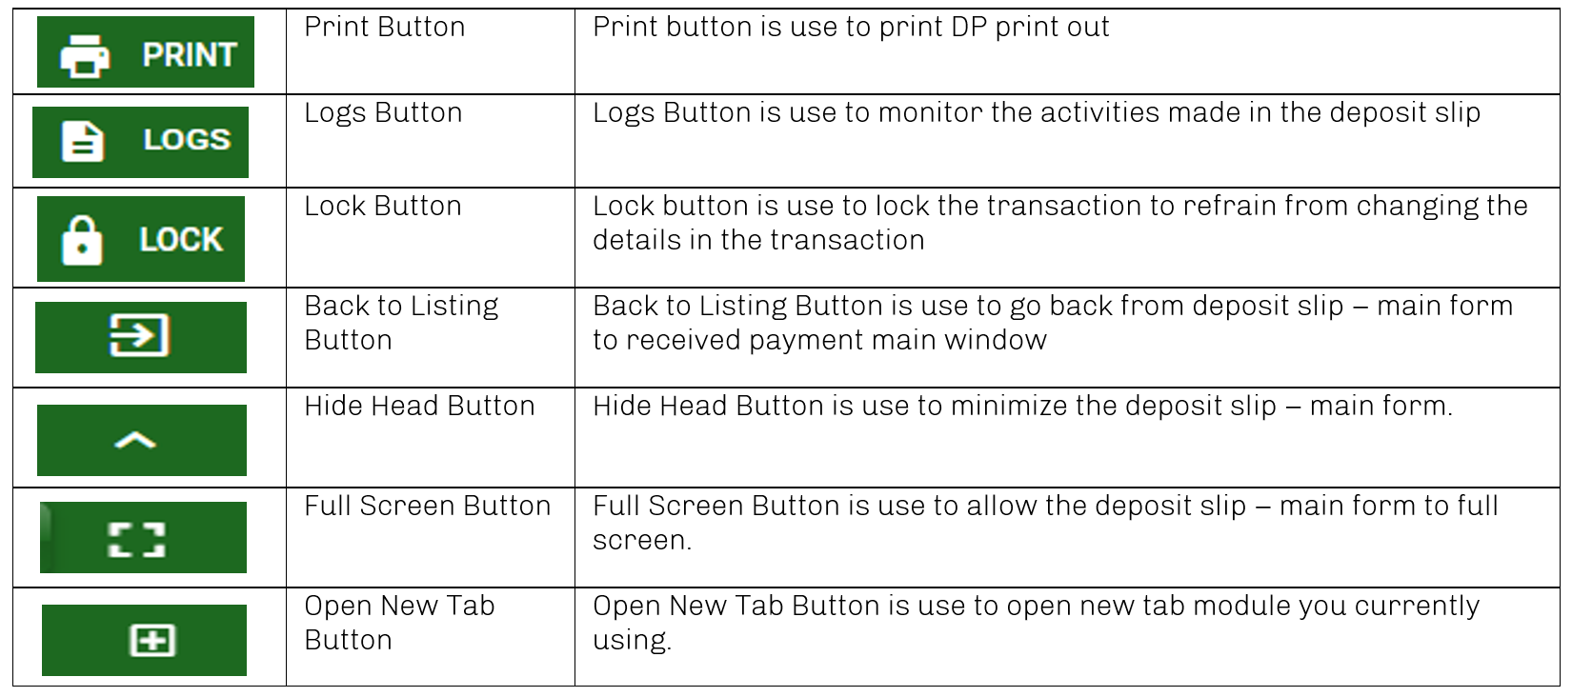
Accounting / Deposit Slip - Module
Other Information
When you click the arrow up icon parallel in the main form on the upper right, and the deposit slip – main form will be minimize and the other information will be displayed as shown in the photo below.
Click the arrow parallel to what information you want to open and provide the necessary filter to generate the data you want to display.
If you want to upload file attachment in image form, click the attachment and upload the file.
Other Buttons
10

