Slide 1
Employee Ledger
Is a list of employees of the company.
It is where all information of employee are recorded and transaction history can be viewed.

Slide 2
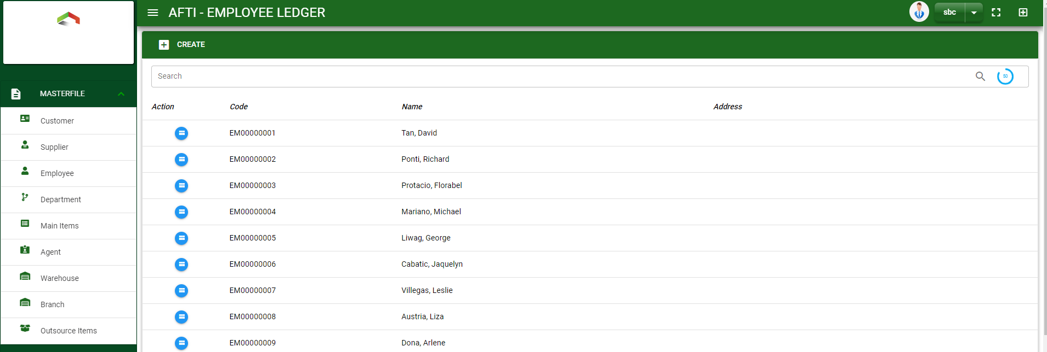

Masterfile / Employee Ledger - Module
Main Window
When you click the Employee module under Masterfile, employee list will display in the employee ledger main window.
Employee Ledger – Main Window
2

Slide 3
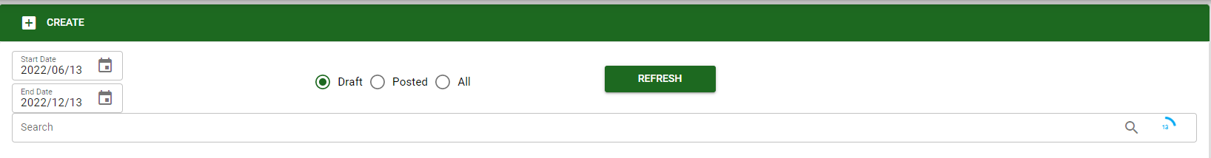
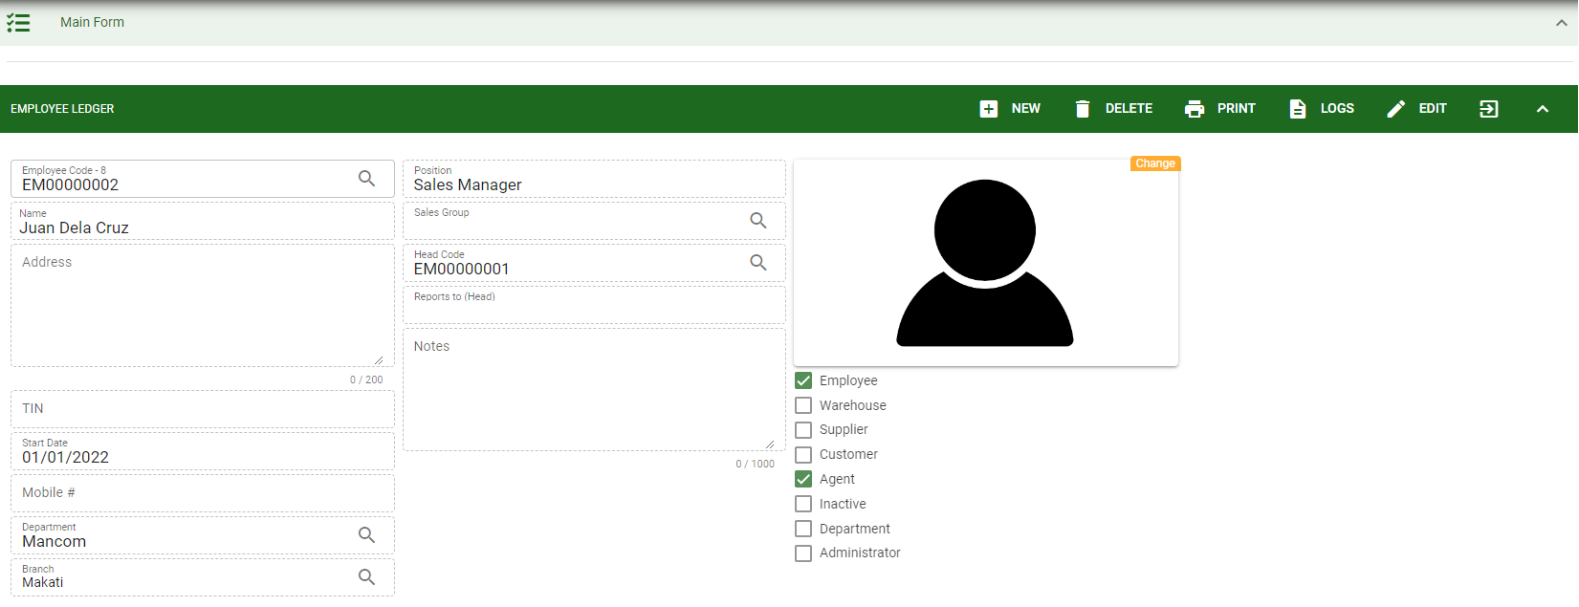
Masterfile / Employee Ledger - Module
1
How To Create New Employee?
1. In Employee Ledger – Main Window, you will notice a create button in the upper left of the window. Click the create button and you will be redirect in employee ledger – main form.
2. After you click the create button in the employee ledger – main window, you will be redirected in employee ledger – main form where you will encode the employee other information.
3. In the photo, fill in all the necessary details in the provided field.
4. If done, click save button.
4
3
Employee Ledger – Main Form
3

Slide 4
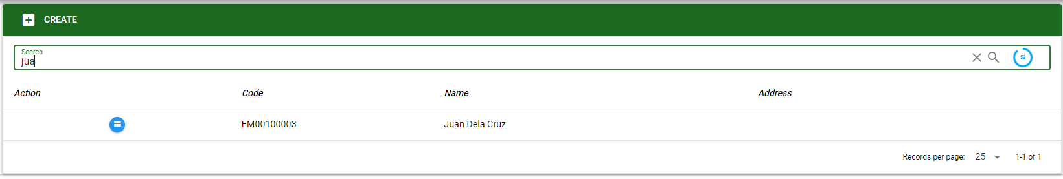
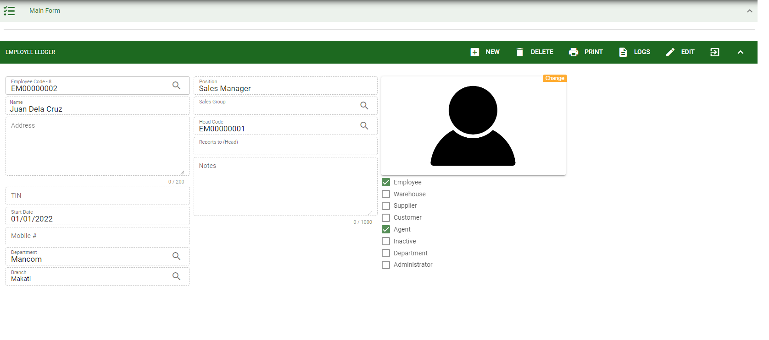

Masterfile / Employee Ledger - Module
How To Edit Employee Details?
1.1 In the employee ledger – main window, search the employee you wish to edit its information in the search bar. Or,
1.2 In employee ledger – main form, click the lookup button and select the employee you wish to edit its information by typing its employee name in the search bar.
1.1.
Employee Ledger – Main Window
2
2. After you select the employee, click edit button in the upper right side of employee ledger – main form.
1.2.
How to search employee?
Type the employee name in the search bar.
Click ‘enter’ in the keyboard to search.
Click the button before the employee code to select the employee.
Employee Ledger – Main Form
4

Slide 5
Masterfile / Employee Ledger - Module
How To Edit Employee Details?
4
3
3. Edit the information you want to edit.
4. If done, click save button.
Employee Ledger – Main Form
5

Slide 6
Masterfile / Employee Ledger - Module
How To Delete a Employee Ledger?
1.1 In the employee ledger – main window, search the customer you want to delete.
1.2 In employee ledger – main form, click the lookup button and select the customer you want to delete.
1.1.
Employee Ledger – Main Window
3
3. Click delete button.
1.2.
Employee Ledger – Main Form
6

Slide 7
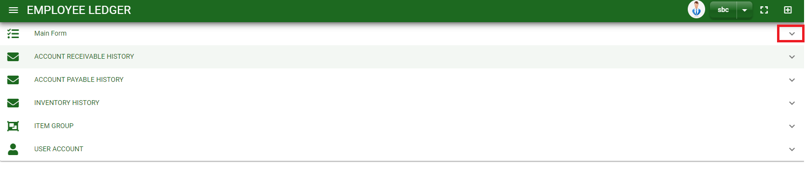
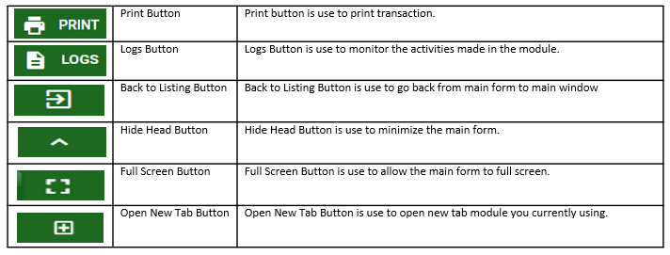
Masterfile / Employee Ledger - Module
Other Information
When you click the arrow parallel to the main form on the upper right, the employee ledger – main form will minimize and the other information will be displayed as shown in the photo below.
Click the arrow parallel to what information you want to open and provide the necessary filter to generate the data you want to display.
Employee Ledger – Main form
Other Buttons
7

